Slide 1
Signal Processing of Remote Photoplethysmography(Rppg)
Rosa Maleki

Slide 2
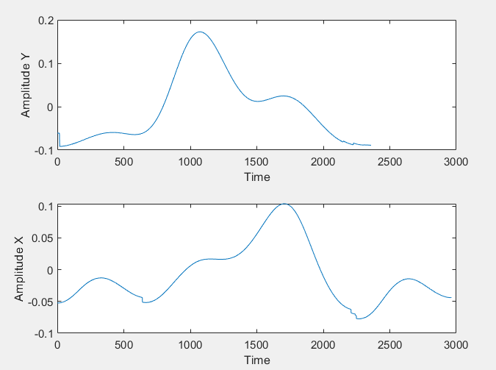
Rppg signal
A sample of a average pulse of rPPG signals

Slide 3
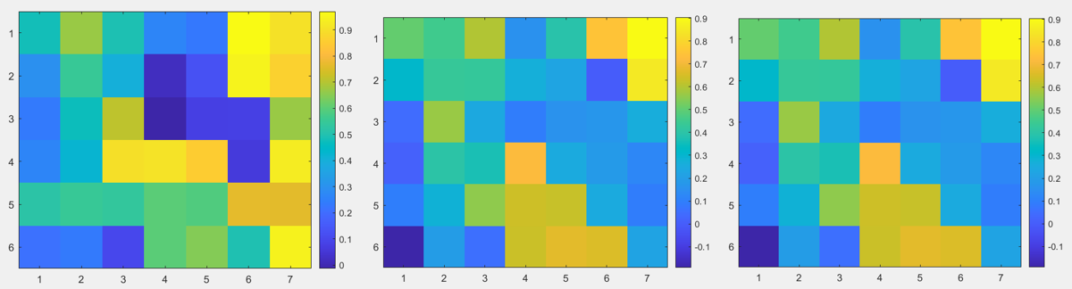
Validating 4d data using correlation
Sample of the results in 3 channels

Slide 4
How to get the average pulse of a signal
For each person:
Resizing the 4D database: from (320,510,3,19999) to (32,51,3,19999)
Filtering the data in all 3 channels
For signal of each location in green channel dividing the pulses using picks (minimums)
Aligning the picks of the pulses.
Average the pulses to get a mask for each location
Averaging the masks to get a total mask for each person
Validating each location using local mask and total mask

Slide 5
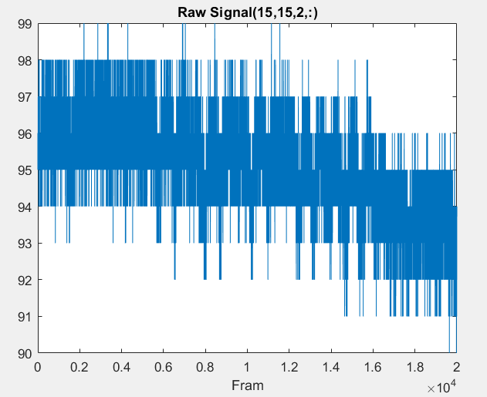
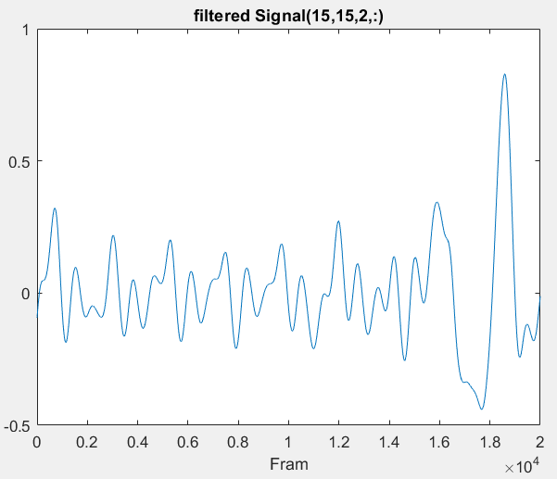
Raw signal vs filtered signal
From our 4D database (320,510,3,19999) get the green channel of signal in the location (15,15) as a sample.
Resizing the 4D database: from (320,510,3,19999) to (32,51,3,19999)
Filtering the data in all 3 channels get the green channel of signal in the location (15,15) as a sample.

Slide 6
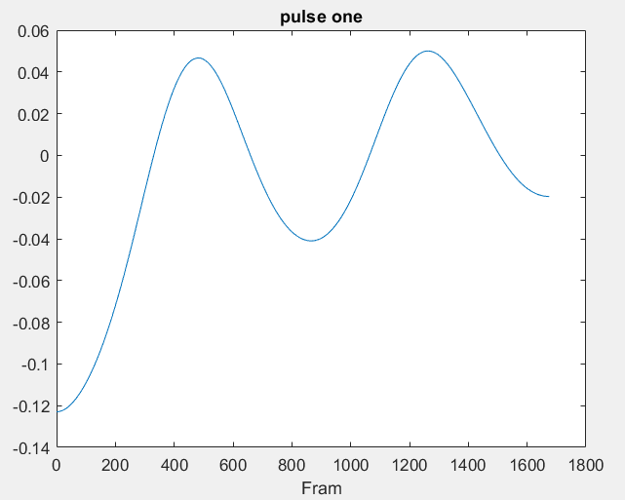
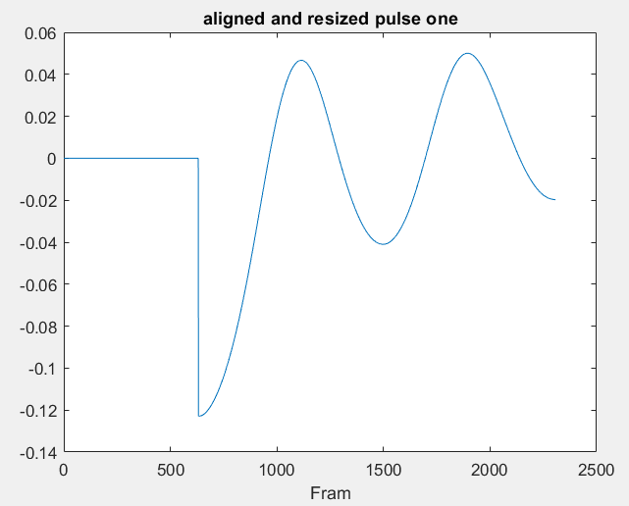
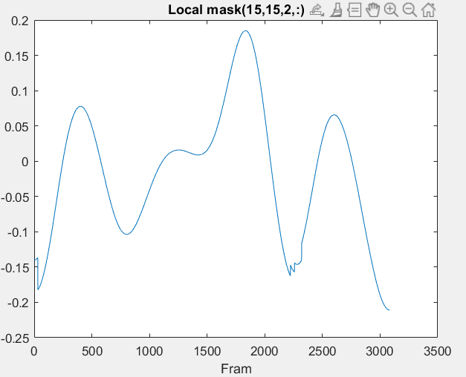
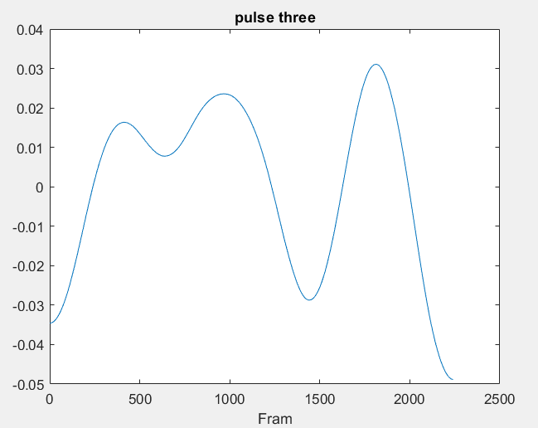
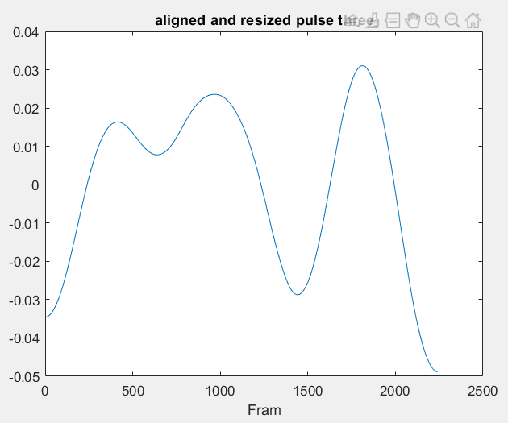
Local Mask
For signal of each location in green channel dividing the pulses using picks (minimums)
Aligning the picks of the pulses and make them the same size.
Average the pulses to get a mask for each location.

Slide 7
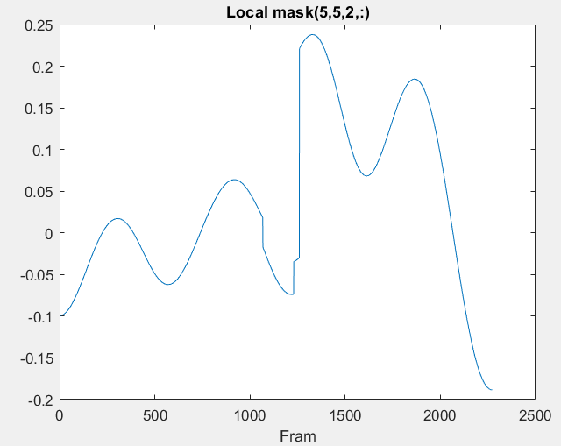
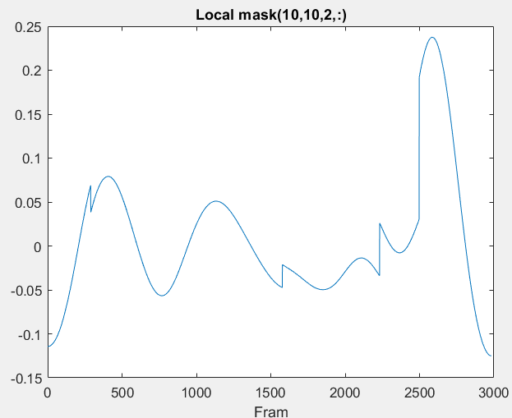
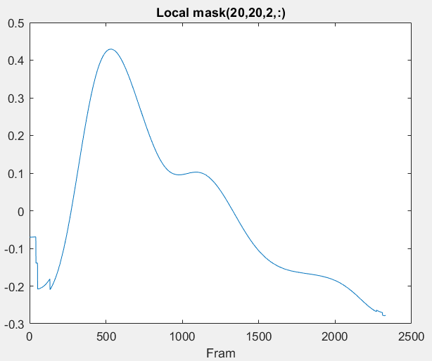
Average masks based on the location

Slide 8
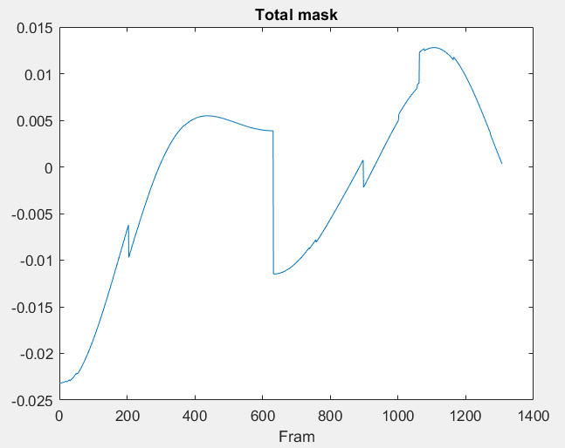
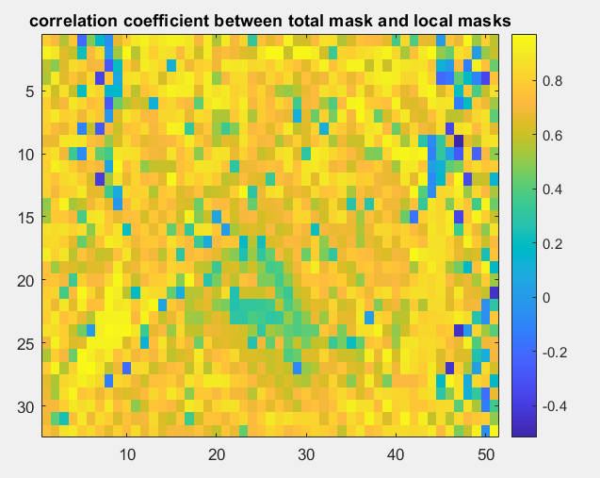
Average masks

Slide 9
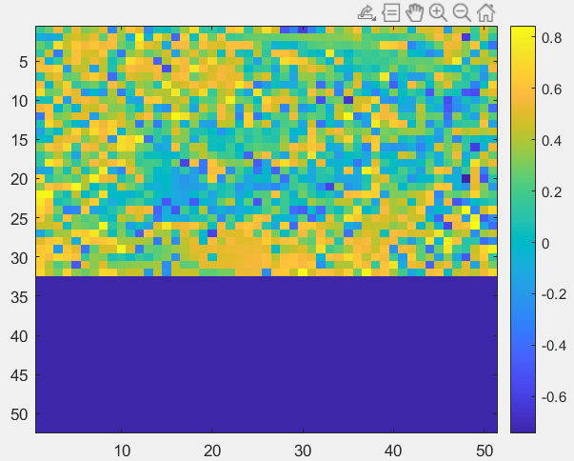
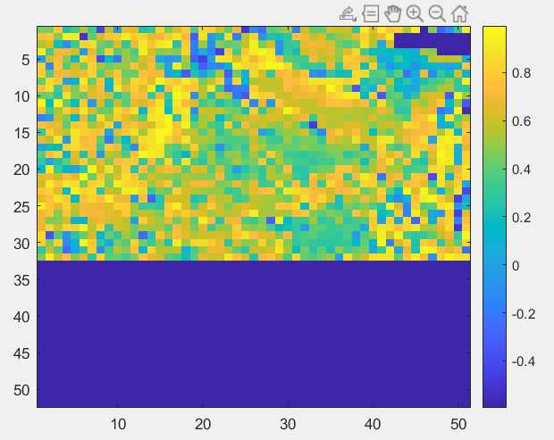
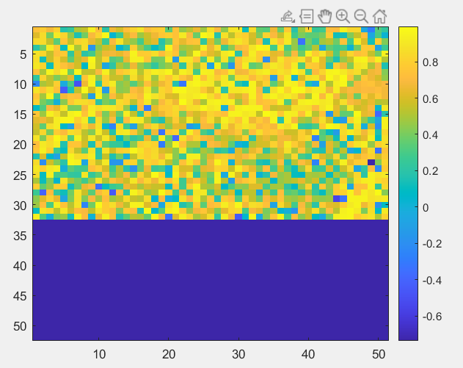
correlation
Applying the same method to the signals extracted from other people and see the result as below
Only considering 31 times 51

