Slide 1
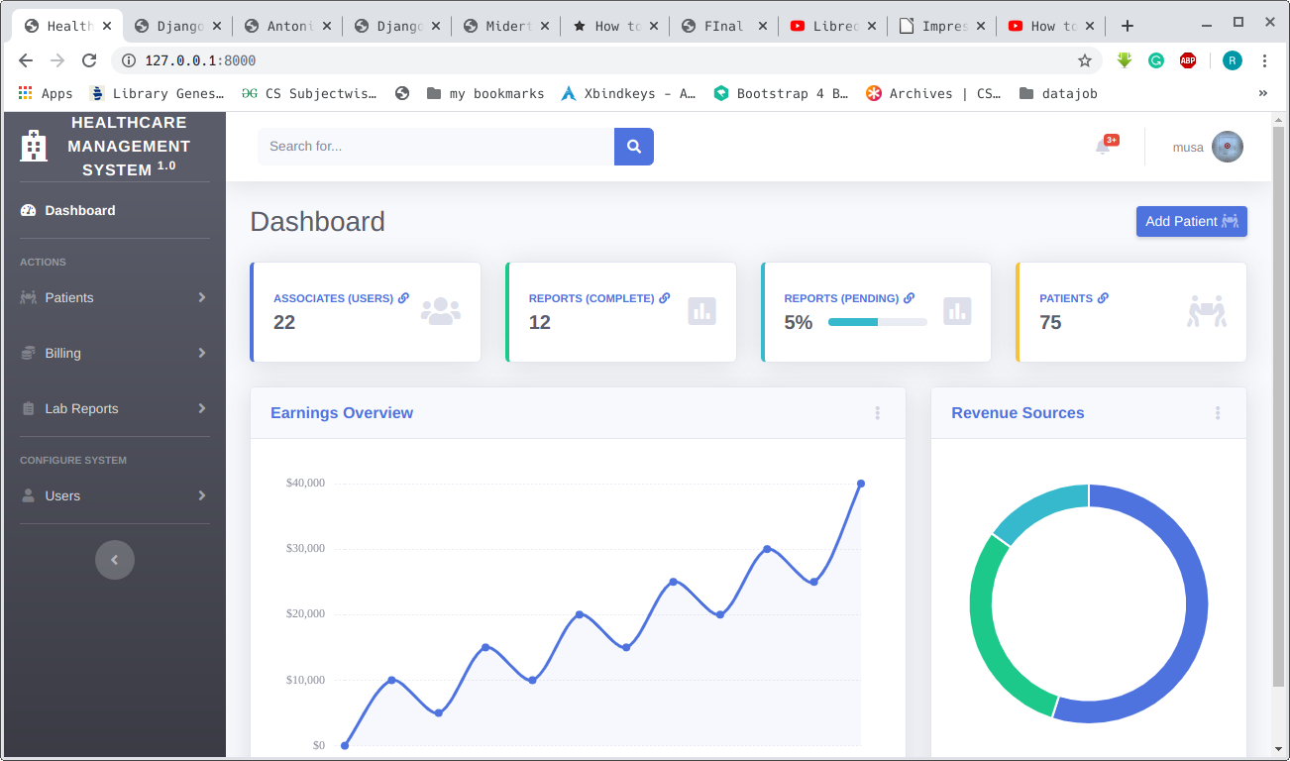
Healthcare management system

Slide 2
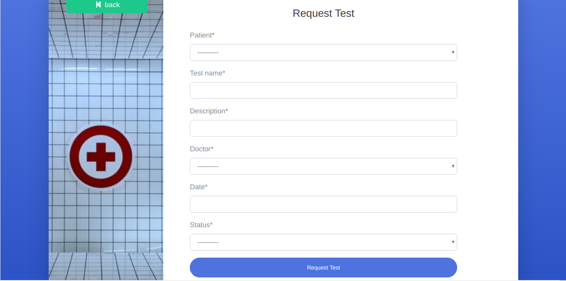
Request lab test

Slide 3
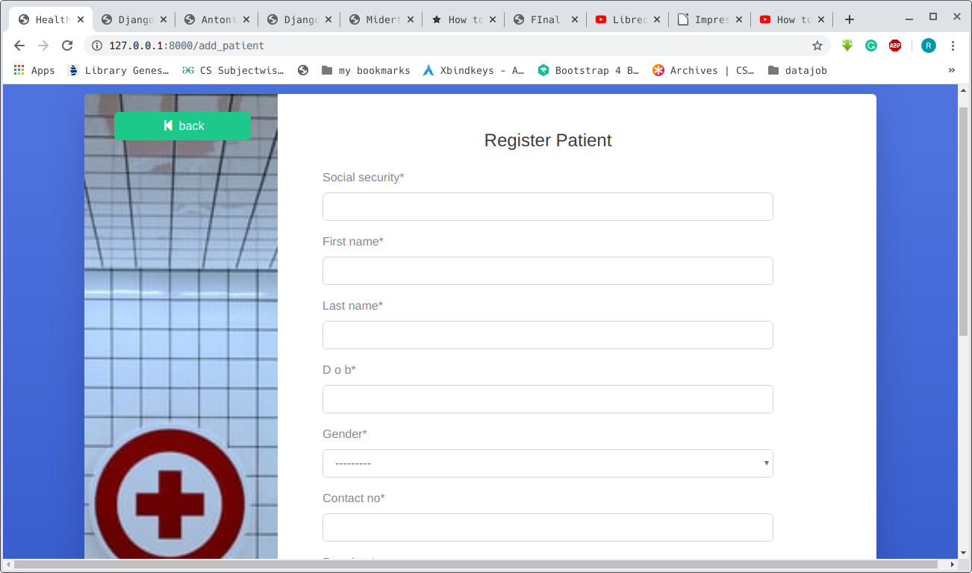
Register Patient

Slide 4
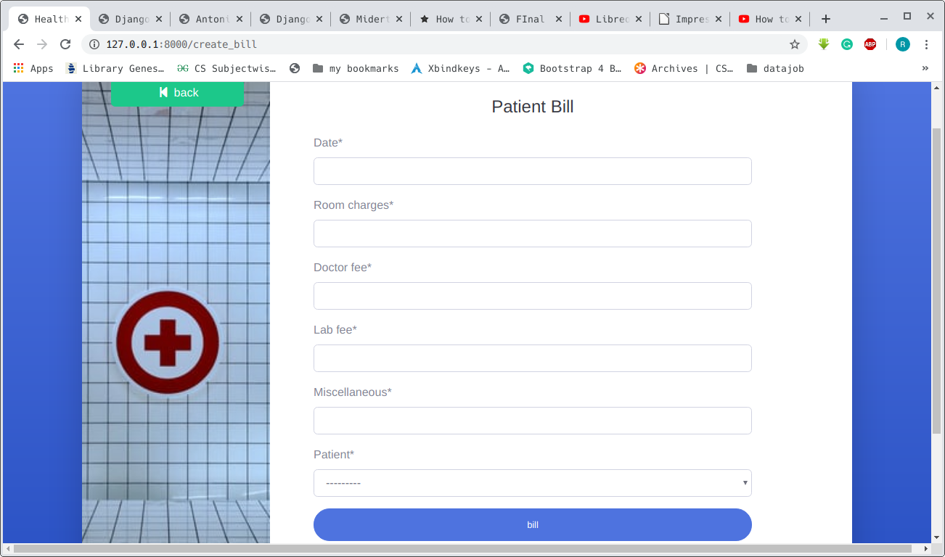
Create Bill

Slide 5

Add new user to the system

