Slide 1
2020-1 Computer Network
First Homework

Slide 2
Multiplexing based multi-access chat program
Implementation guide
Multiplexing chat server with multiple access to clients
Clients can see each other's chat
Select timeout value = sec 5, usec 5000
Message buffer maximum 100
Client based on TCP multiprocess with I/O routine split
When input the client exit character, use the half-close technique to exit

Slide 3
Experiment scenario and submission method
Experimental scenario – (as shown in the next slide)
Access 3 clients to server (multiple access servers)
Message by one client should be visible to other clients (name + chat content)
When running the client, the name should be passed as an argument along with IP and Port.
When exit a client, server print a message that client be disconnected
Client process should be terminated normally, so that it does not fall into the blocking state.
Run the new client to check the chat function again
Submission deadline : Until June 4, 11:59pm
Submission form
File name format
Student ID_Name_client.c, Student ID_Name_server.c (ex: 12121432_고화랑_client.c)
Submit the client and server code together in a compressed file

Slide 4
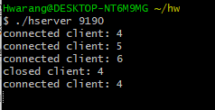
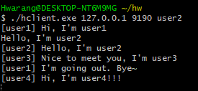
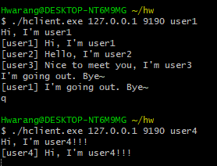
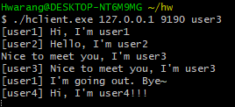
Example
Run server ./server_file <Port>
Run client : ./client_file <IP> <Port> <user name>
1-1. Run server
1-1. Run client2
1-2. After client connection
Check the output of socket
file descriptor
2. Chat
Message by one client
should be visible to
other clients
3-2. Closed client1
4-1. New client4 connected
4-2. Chat new client 4
1-1. Run client1
1-1. Run client3
2. Chat
Message by one client
should be visible to
other clients
2. Chat
Message by one client
should be visible to
other clients
4-2. Chat new client 4
3-1. Closed client1
4-1. Run new client4
4-2. Chat new client 4

