Slide 1
Tennis, the quiet, respectful sport.
Did you know that it gets so quiet at a tennis match that you can actually read the minds of other spectators?!!

Slide 2
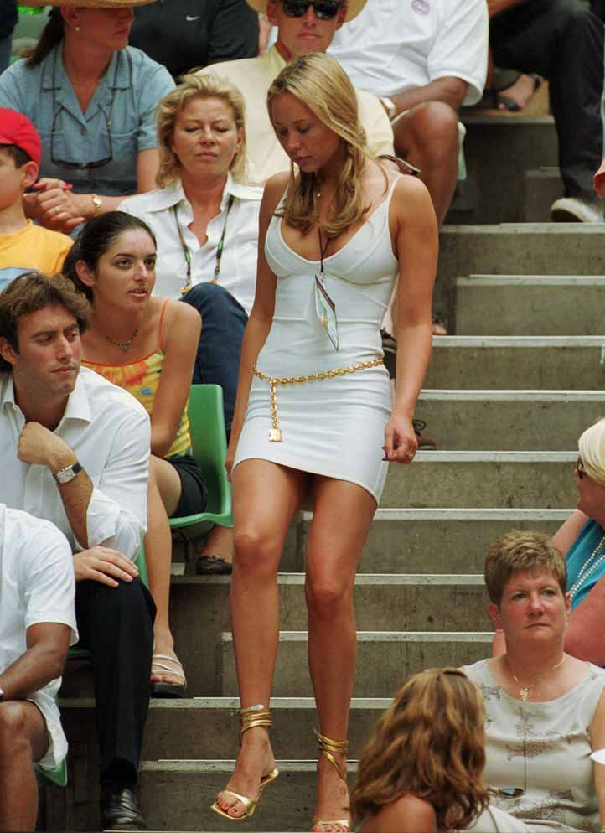
You are so dead, buddy.
I wonder if the wife knows I am having a good old perv. Nah, she won’t notice.
I used to look like that.
If I was to turn for a women then that would be why
BITCH!
I love the tennis!
That reminds me, I forgot my undies too!
Mind Readings

Slide 3
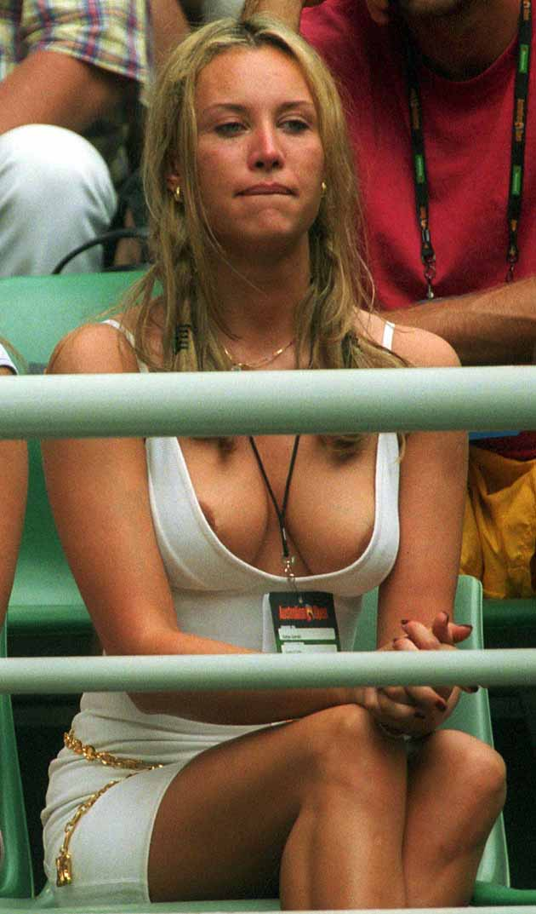
I’ve got this weird feeling that people are staring at me…

