Slide 1
Leave Form System
Rose Anne Brillo
Capstone Project 2025

Slide 2

Introduction & Purpose
Manual leave tracking causes confusion & scheduling conflicts.
Digitizing the system improves clarity, record-keeping, and efficiency.
Current state: paper forms, text, verbal notices.
Desired state: central, digital, trackable system.

Slide 3


Challenges in Leave Management
Informal Leave Requests
Leave requests are handled via handwritten notes, texts, and verbal messages, creating confusion and lack of clarity.
Staff Dissatisfaction
Frequent forgetfulness and miscommunication lead to staff frustration and dissatisfaction with the leave management process.
Scheduling Conflicts
Poor record-keeping causes scheduling conflicts, especially during busy seasons or periods of high staff turnover.
Impacts on Efficiency
These issues lower staff morale and reduce the operational efficiency of the restaurant.
Notes:
Image source: Microsoft 365 content library The restaurant’s informal leave request process relies on handwritten notes, texts, and verbal messages. This leads to frequent staff dissatisfaction and forgotten requests. Poor record-keeping also results in scheduling conflicts, especially during busy seasons or high turnover, ultimately affecting staff morale and operational efficiency.

Slide 4

Desired State for the Industry
Online Leave Requests
Staff can easily submit leave requests through a digital platform, making the process fast and convenient.
Efficient Review and Approval
Managers can quickly review, approve, or decline leave requests using a centralized online system, improving efficiency.
Automatic Record-Keeping
The system automatically keeps records of leave history, ensuring easy access and supporting effective shift planning.
Notes:
Image source: Microsoft 365 content library A streamlined, digital Leave Form System allows staff to submit leave requests online, simplifying the process. Managers or admins can efficiently review, approve, or decline requests through a centralized platform. Automatic record-keeping ensures easy retrieval of leave history, supporting effective shift planning and reducing scheduling conflicts across the organization.

Slide 5
Industry Background
Hospitality industry – Food & Beverage sector.
Challenges: high turnover, shift complexity, limited HR systems.
Trend: digital tools for efficiency, but complex/pricey for small biz.

Slide 6
Stakeholders
Employees – Submit & track leave, see balances.
Admins – Approve/decline requests, manage records & entitlements.
Both expect easy use, mobile access, accuracy, and reports.

Slide 7
Product Overview
Goal: Simple digital leave management system for restaurants.
Features: Submit, approve, track leave, generate reports.
Responsive web app (React.js + Node.js + MySQL).

Slide 8
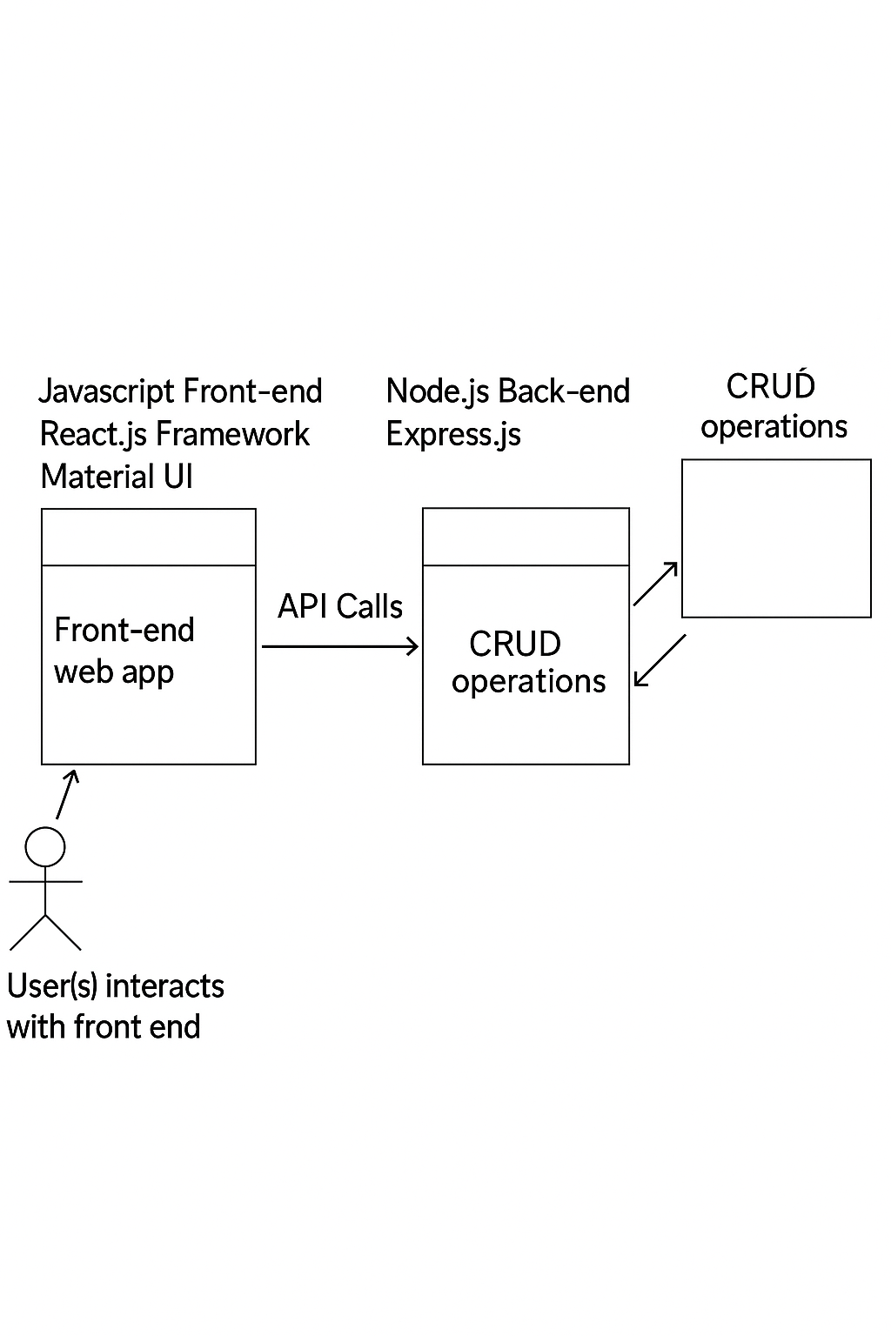
System Architecture

Slide 9
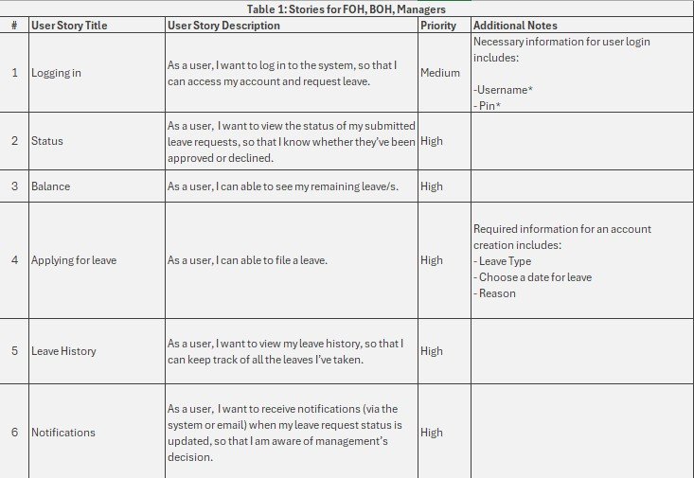
User Stories

Slide 10
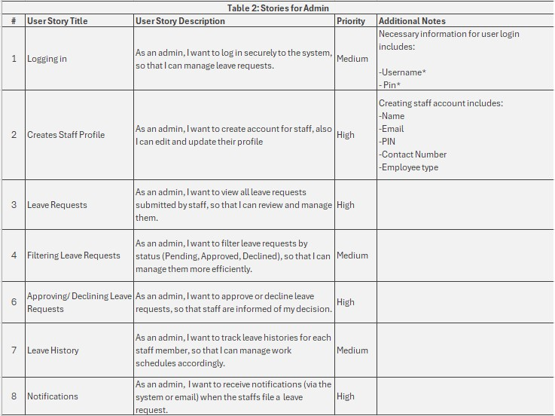
USER STORIES

Slide 11
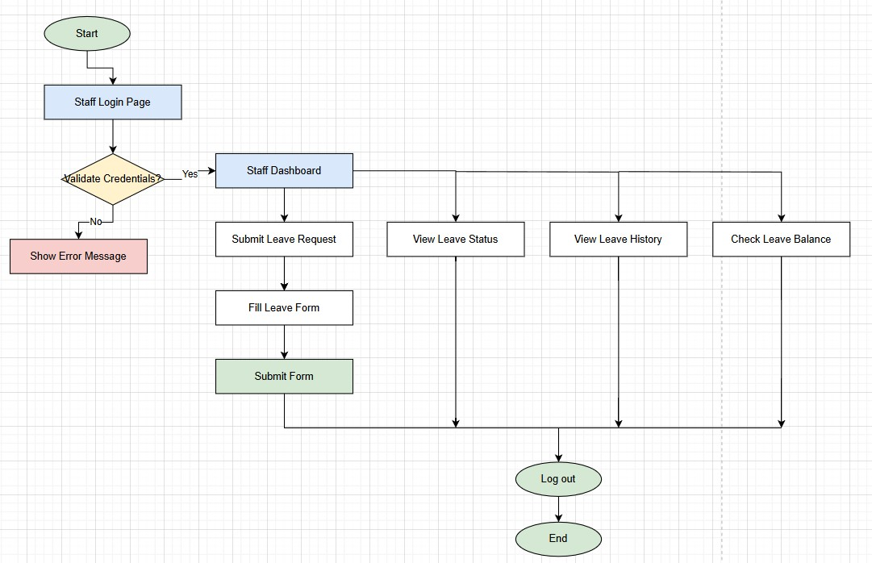
USER FLOW

Slide 12
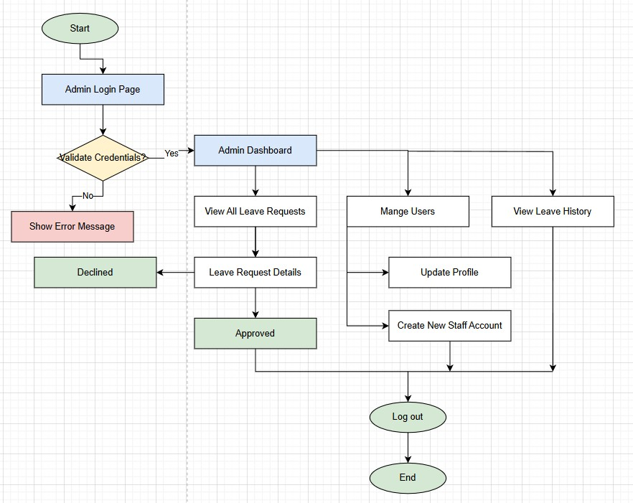
USER FLOW

Slide 13
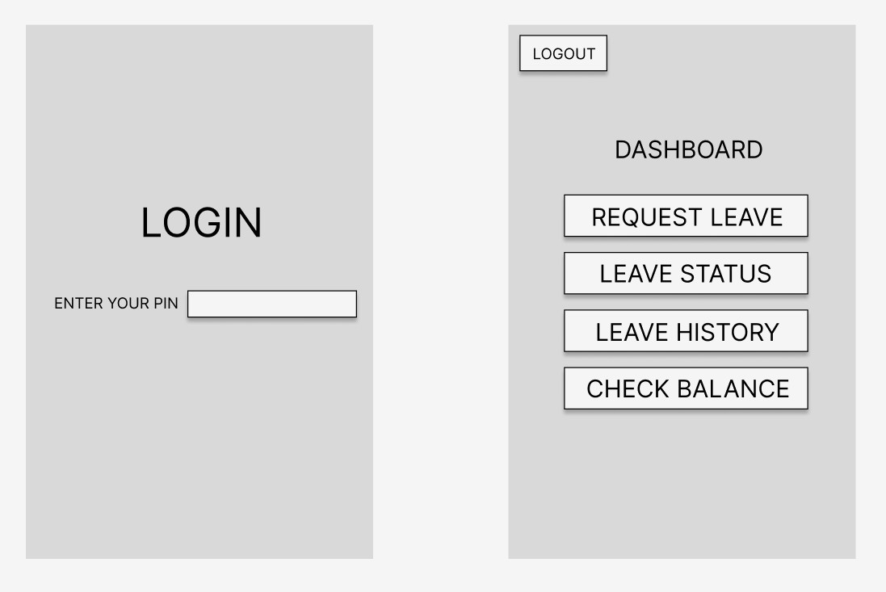
FIGMA DESIGN - staff

Slide 14
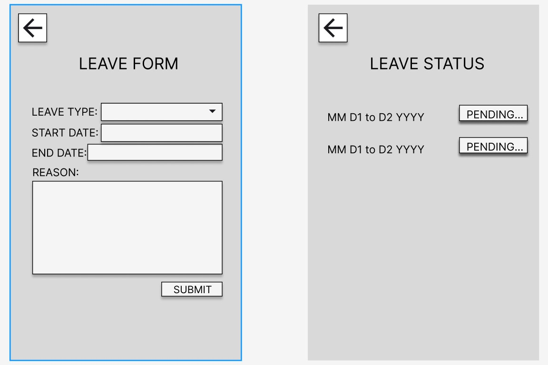
FIGMA DESIGN - staff

Slide 15
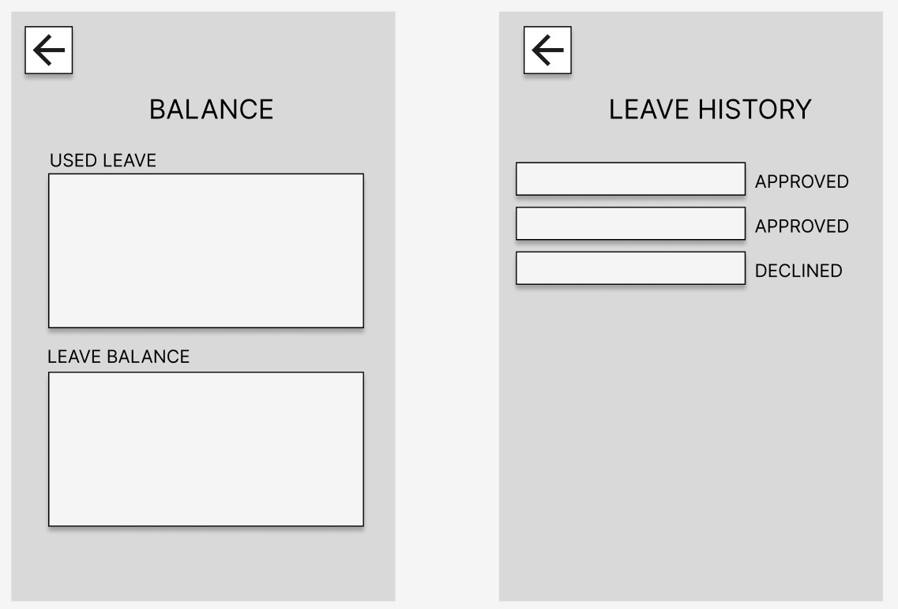
Figma design- staff

Slide 16
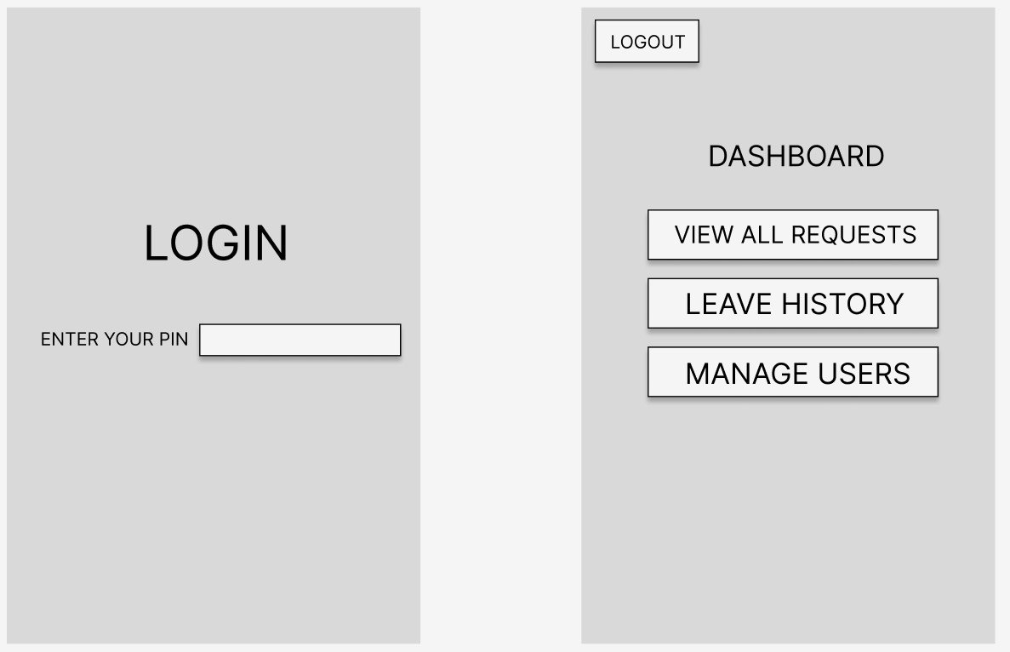
FIGMA DESIGN - ADMIN

Slide 17
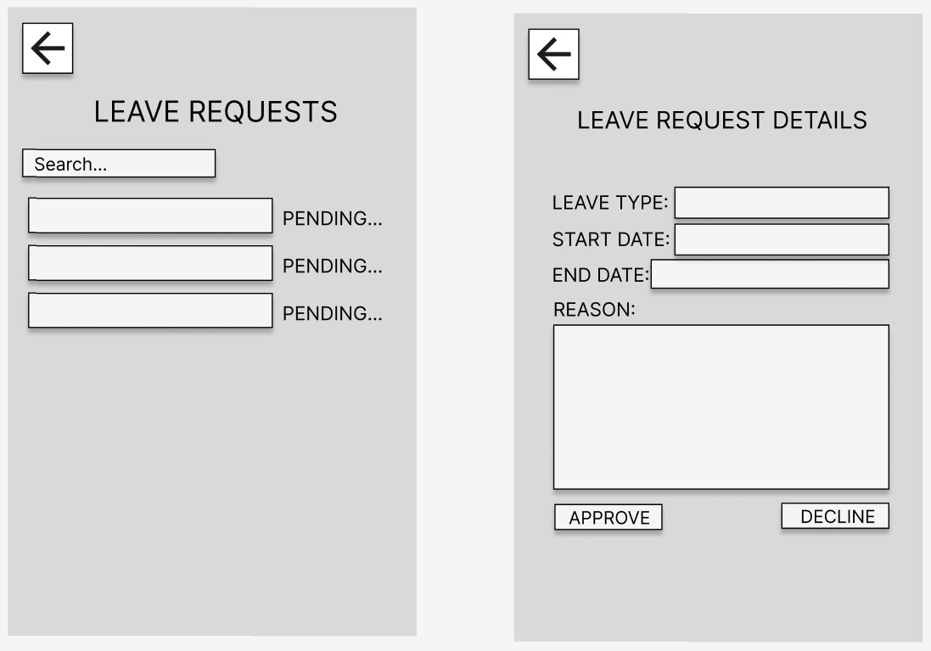
FIGMA DESIGN - ADMIN

Slide 18
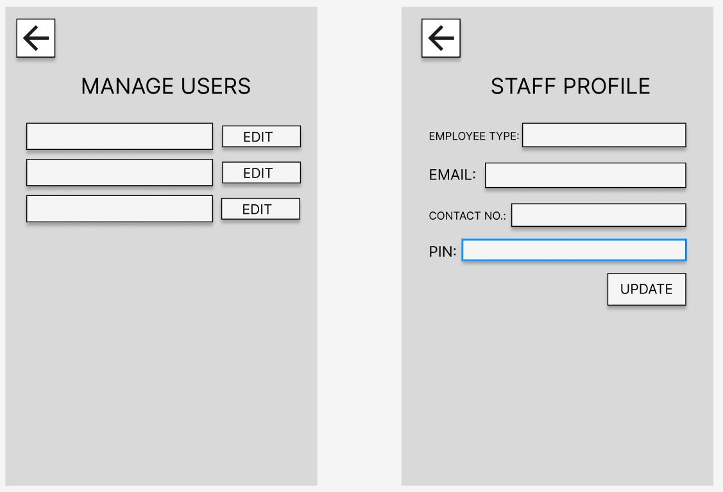
FIGMA DESIGN - ADMIN

Slide 19
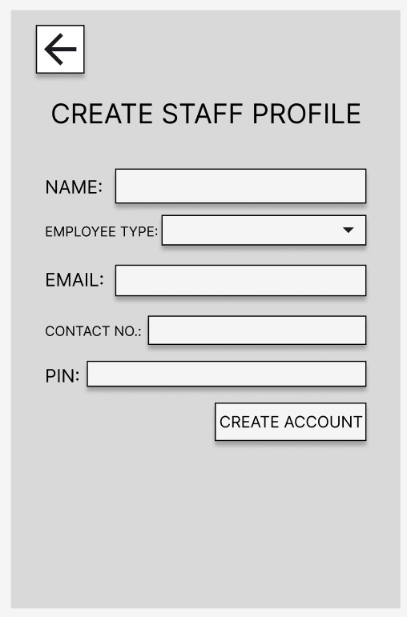
FIGMA DESIGN - ADMIN

Slide 20

Out of Scope Features
Payroll integration, multi-level approval workflows.
Automated scheduling, push/SMS notifications.
Mobile app development, recruitment or benefits modules.

Slide 21


Non-Functional Requirements
Secure login, encrypted data, session timeout.
Responsive UX with <2s load time.
MTBF > 30 days, role-based access control.

Slide 22
Testing Strategy
Manual + automated testing performed.
Edge cases logged and debugged using console logs.
Focus on CRUD reliability and user workflow.

Slide 23
Deployment & Implementation
Deployed on a secure, responsive server environment.
Connected React front-end and Express back-end.
Tested DB connections, ensured cross-device usability.

Slide 24
End-to-End Results
System met all goals for simplicity, transparency, and access.
Test users gave positive feedback on ease of use.
Manual process successfully replaced with digital flow.

Slide 25
References & Tools
GitHub: github.com/roseeyyyy/Capstone2025
Tech: React.js, Node.js, Express.js, MySQL, Axios, Bootstrap.
Tools: Figma, Trello, VS Code.

Slide 26

DEMo

