Slide 1
Risk Factors in COVID-19
Rose Glavin

Slide 2
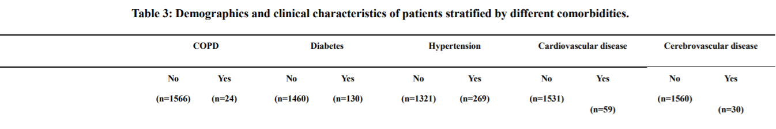
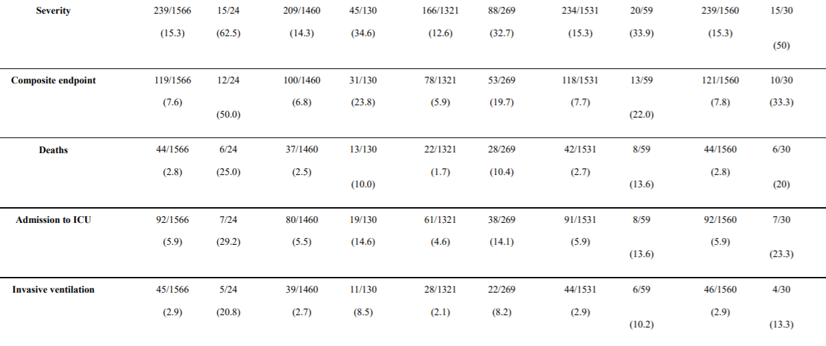

Slide 3
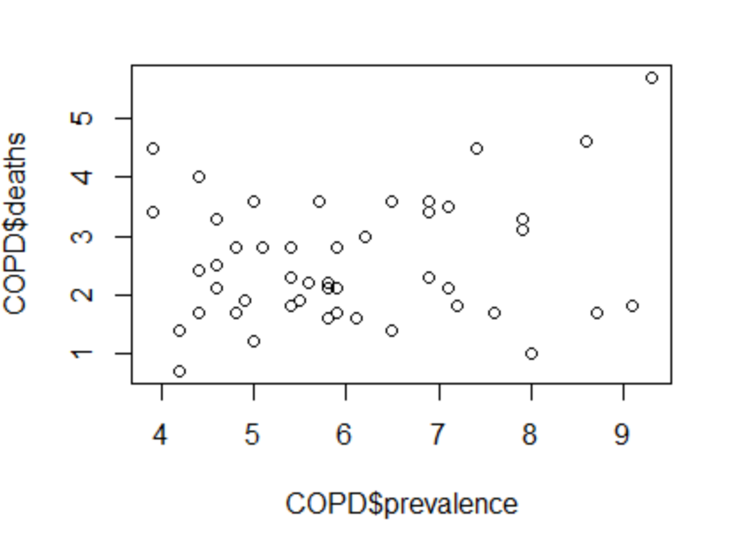

Slide 4
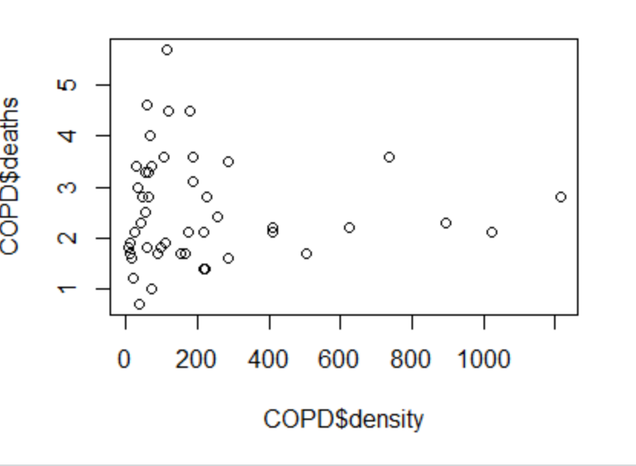

Slide 5
LR Model
Prevalence of COPD
Population Density
Deaths - assume it is more reliable than number of cases
Number of days since shelter in place order

Slide 6
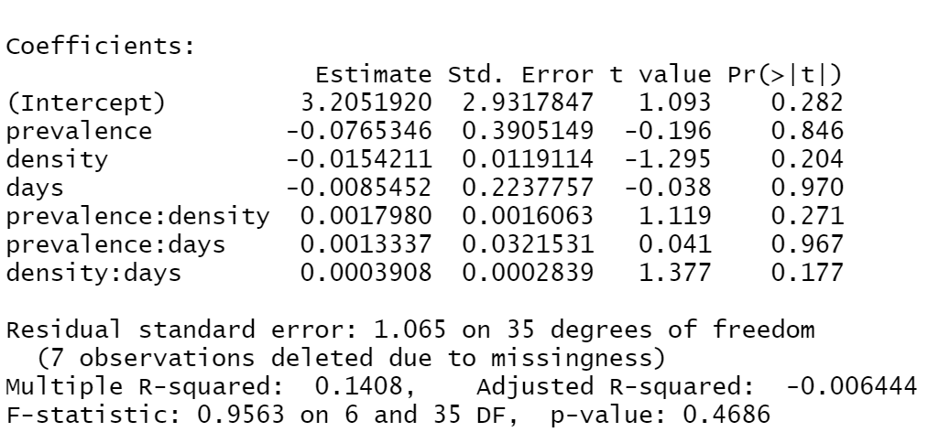

Slide 7
Life Expectancy and Mortality Rates in the United States, 1959-2017 JAMA. 2019;322(20):1996-2016. doi:10.1001/jama.2019.16932
Conclusions and Relevance US life expectancy increased for most of the past 60 years, but the rate of increase slowed over time and life expectancy decreased after 2014. A major contributor has been an increase in mortality from specific causes (eg, drug overdoses, suicides, organ system diseases) among young and middle-aged adults of all racial groups, with an onset as early as the 1990s and with the largest relative increases occurring in the Ohio Valley and New England. The implications for public health and the economy are substantial, making it vital to understand the underlying causes.

Slide 8
Early Studies – Risk Factors
Source | COPD | HT | DIABETES | CV
China - Hospitalized | 1.5% | 16.9 | 8% | 3.7%
China - Deaths | 9% | 50% | 25% | 18%
China - Prevalence | 5.87% | 23.2% | 10.9% | 20%
US – Deaths | 9.2% | 1.57% | 10% | 9%
New York - Deaths | 8.3% | 55.4% | 37.3% | 12.4%
US – Prevalence | 5.6% | 45% | 10.5% | 6.7%

Slide 9
ISSUES
Prevalence of disease in entire population compared to hospitalized/ ICU /deaths
Berkson’s paradox in action?
Variance in prevalence between population
COPD California : 4%
COPD Tennessee Alabama : 9%
Validity of data – garbage in, garbage out
Need multiple corroborating sources
We need to look at causes rather than correlation
Need to be aware of confirmation bias and epistemological issues
No fever, no test ?

Slide 10
AN Approach
Graphical Representation showing our understanding of cause and effect
Use the colliders in the graph to assert a sphere of influence
Define the d-separations which correspond to conditional independence
Test the theory against data
Identify latent variables, common causes
Refine and loop through adding data to get a correct fully supported graph

Slide 11
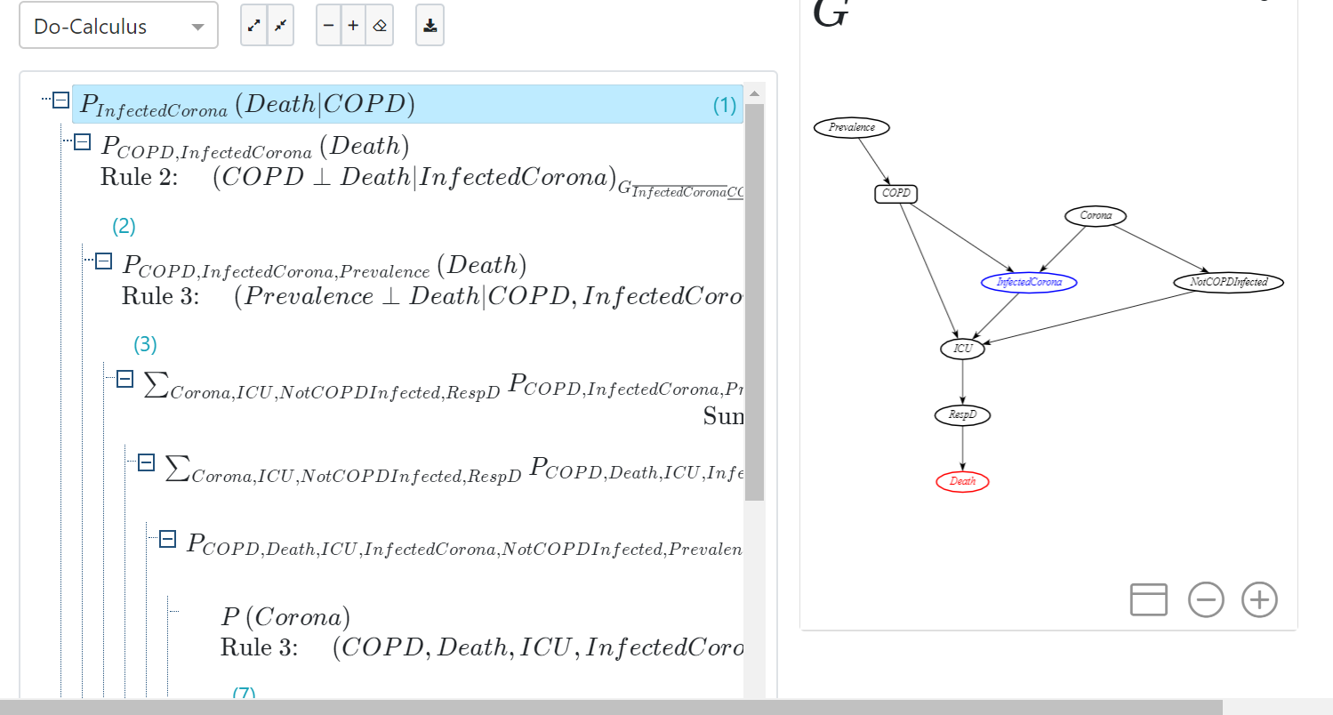

Slide 12
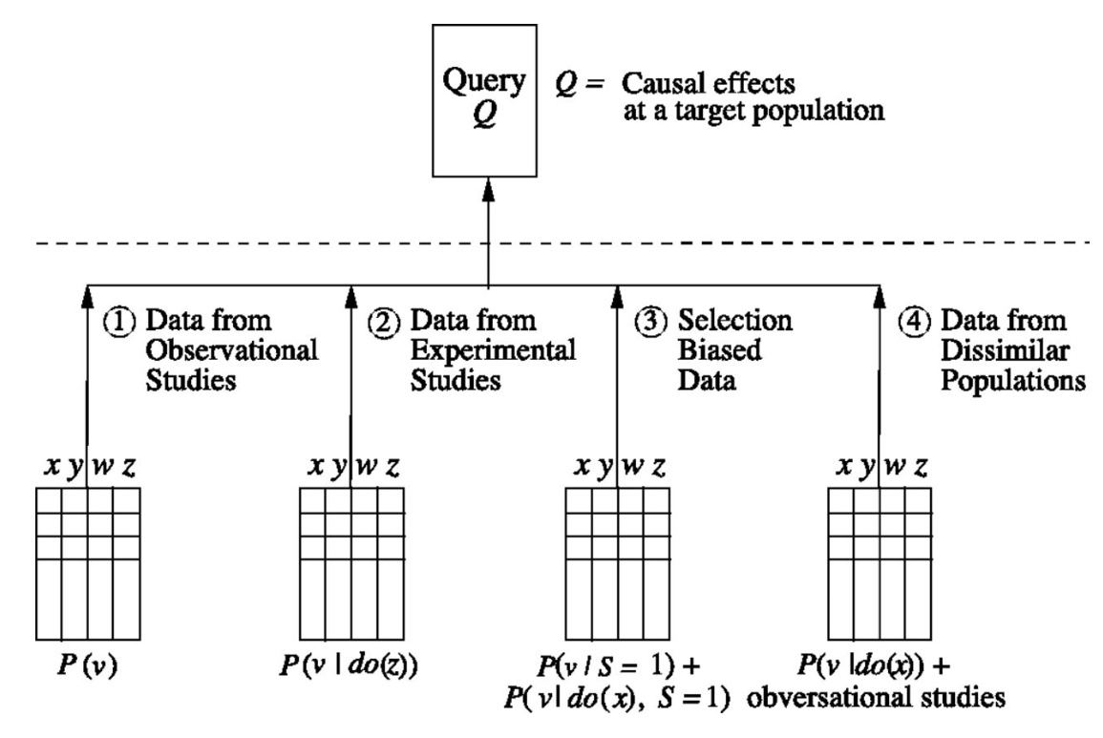

Slide 13
Tasks
Define Graph
Gather data
MIMIC 111 with co-morbidity,
Observational data from tables in studies using Tabula ( Guan, Xie, Grasseli)
Research data - Mine papers using INDRA , BEL statements to build KG
Build annotation pipeline
Build knowledge graphs , apply domain knowledge , refine
Combine data sources to test assumptions
Discover latent factors, refine data semantics, and causal knowledge through conditional independence

