Slide 1
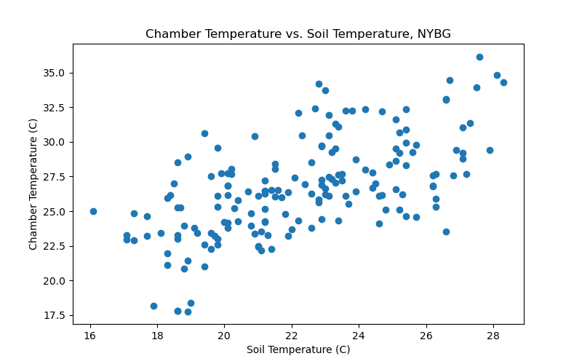
Relationship between Chamber Temperature and Soil Temperature across All Sites at NYBG

Slide 2
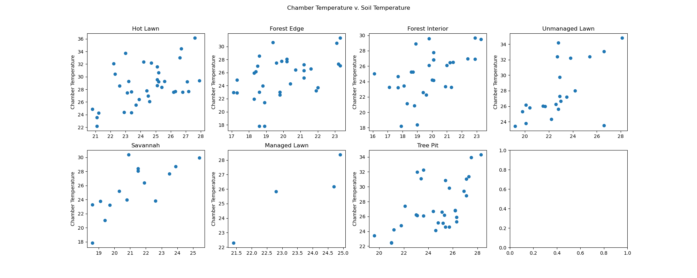
Relationship between Chamber Temperature and Soil Temperature by land type at NYBG

Slide 3
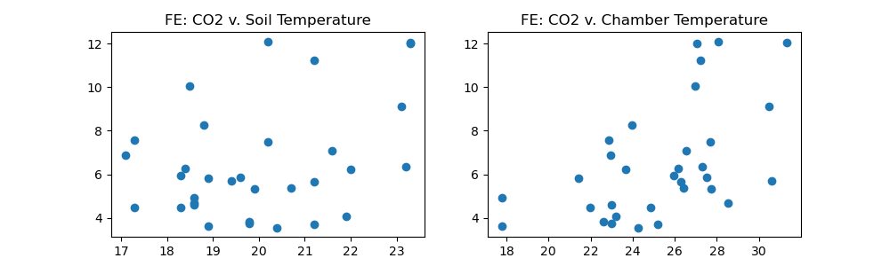
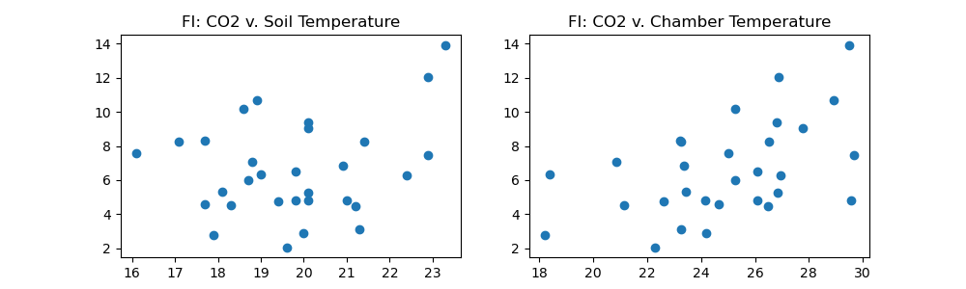
Side-by-side comparisons of CO2 flux vs. Soil Temperature (left) and CO2 flux vs. Chamber Temperature (right)
by Land Type at NYBG
Forest Edge
Forest Interior

Slide 4
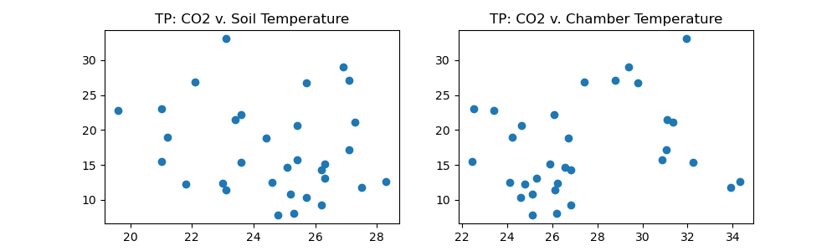
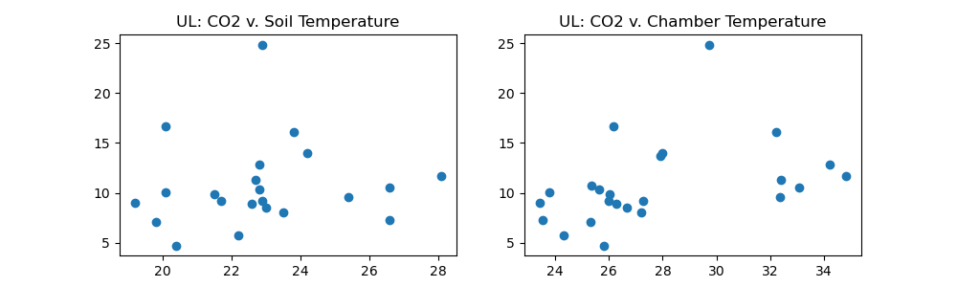
Tree Pit
Unmanaged Lawn

Slide 5
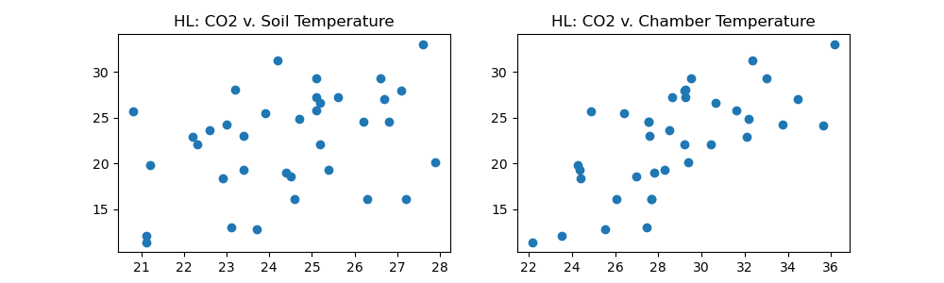
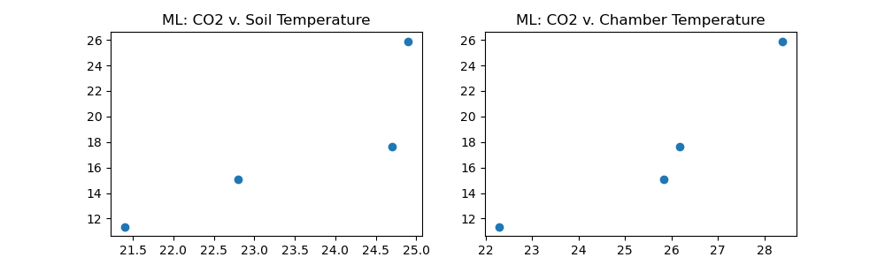
Hot Lawn
Managed Lawn

Slide 6
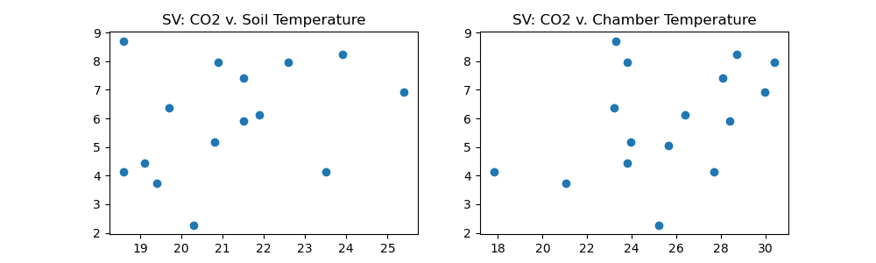
Savannah

