Slide 1
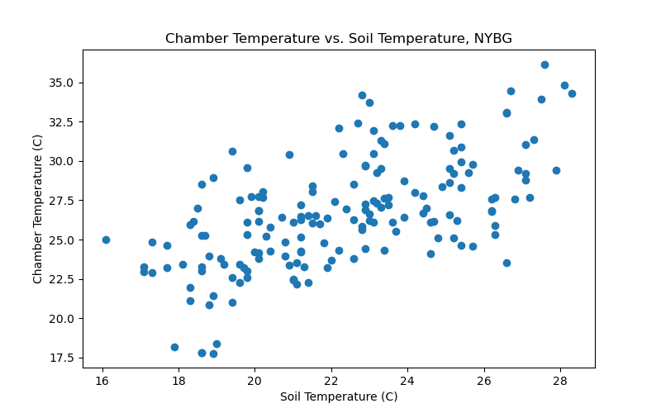
Relationship between Chamber Temperature and Soil Temperature across All Sites at NYBG

Slide 2
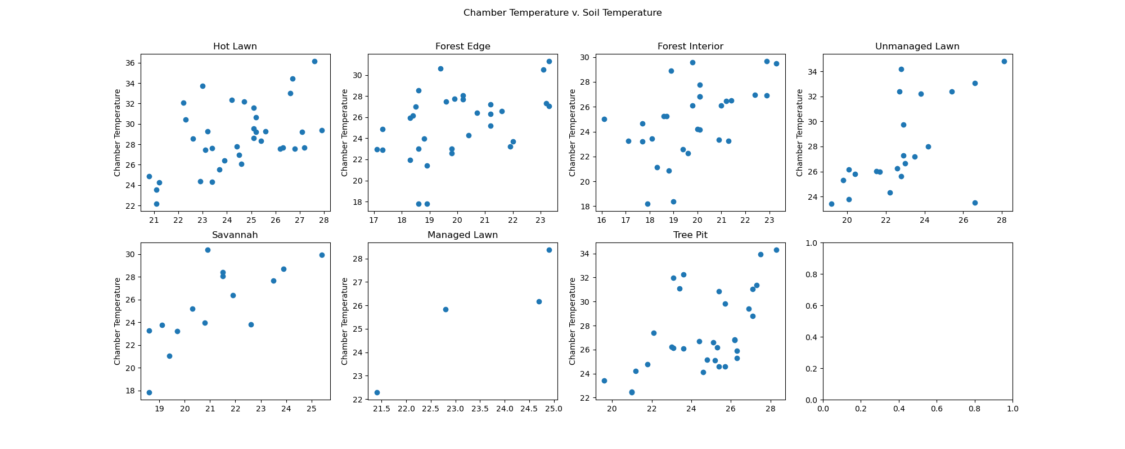
Relationship between Chamber Temperature and Soil Temperature by land type at NYBG

Slide 3
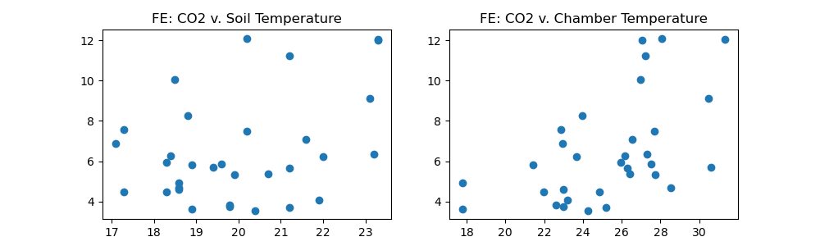
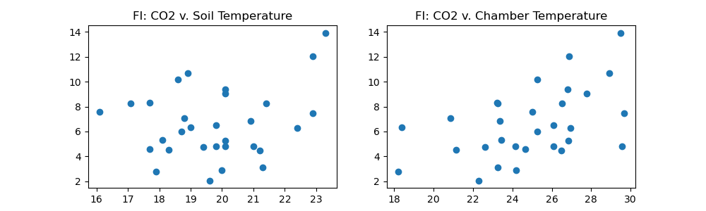
Side-by-side comparisons of CO2 flux vs. Soil Temperature (left) and CO2 flux vs. Chamber Temperature (right)
by Land Type at NYBG
Forest Edge
Forest Interior

Slide 4
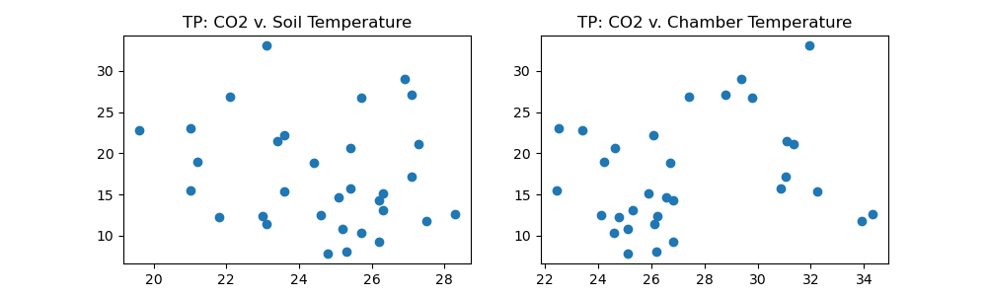
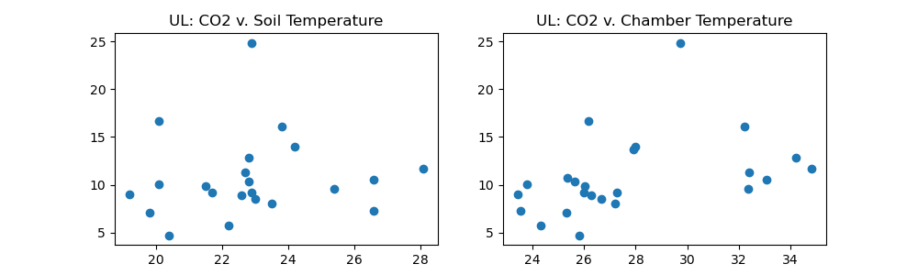
Tree Pit
Unmanaged Lawn

Slide 5
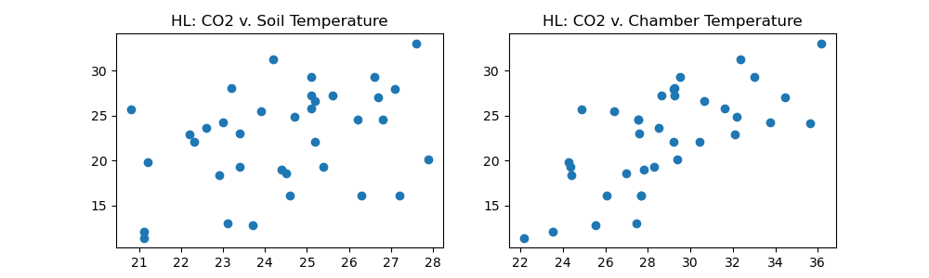
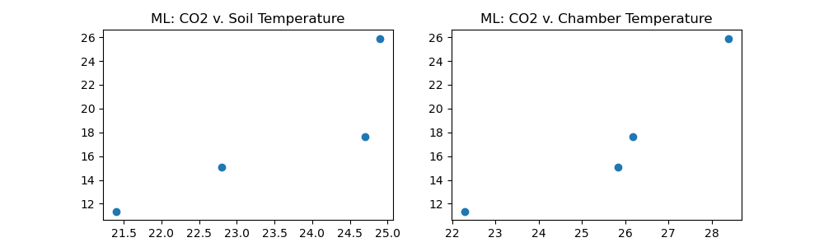
Hot Lawn
Managed Lawn

Slide 6
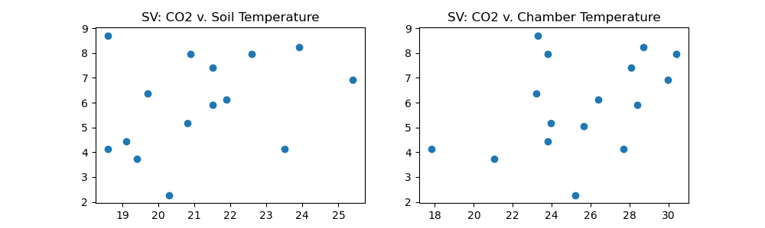
Savannah

Slide 7
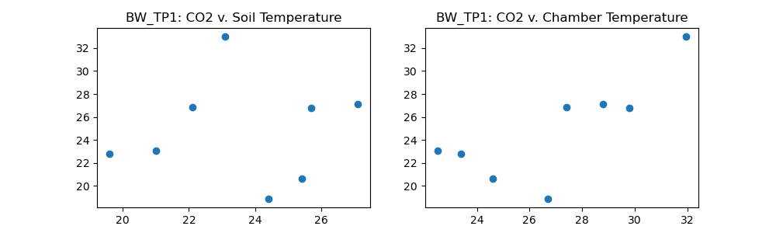
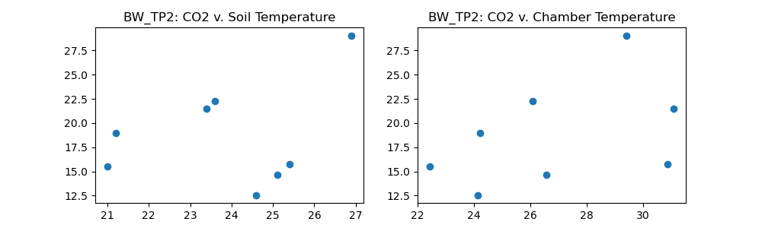
Side-by-side comparisons of CO2 flux vs. Soil Temperature (left) and CO2 flux vs. Chamber Temperature (right)
by Collar at NYBG
Tree Pit 1
Tree Pit 2

Slide 8
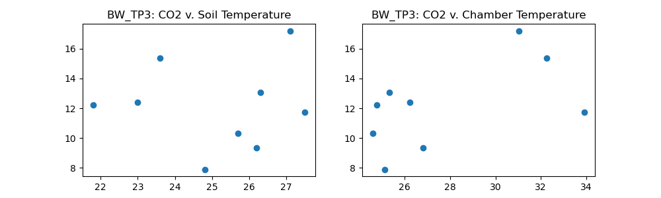
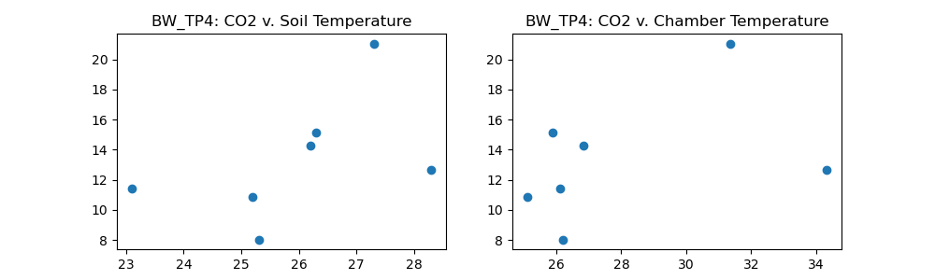
Tree Pit 3
Tree Pit 4

Slide 9
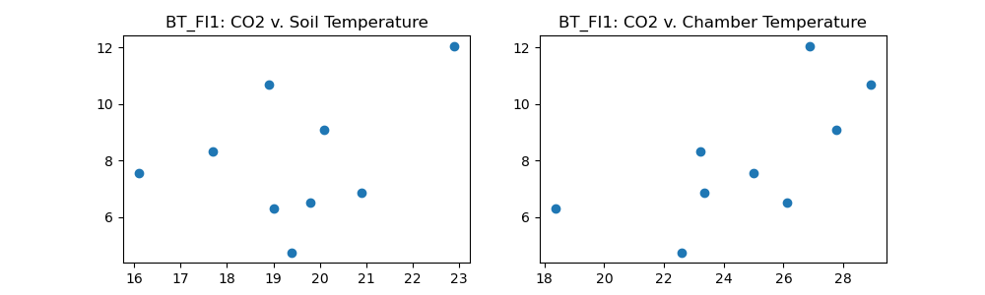
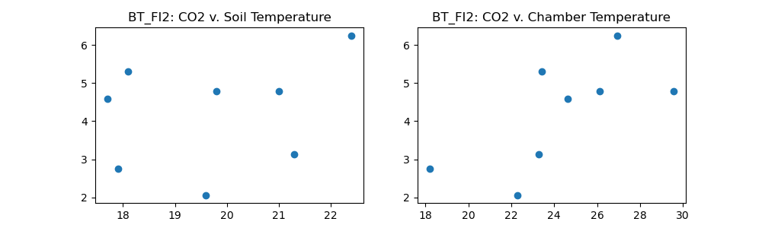
Forest Interior 1
Forest Interior 2

Slide 10
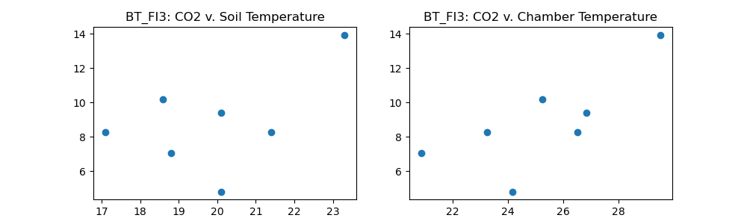
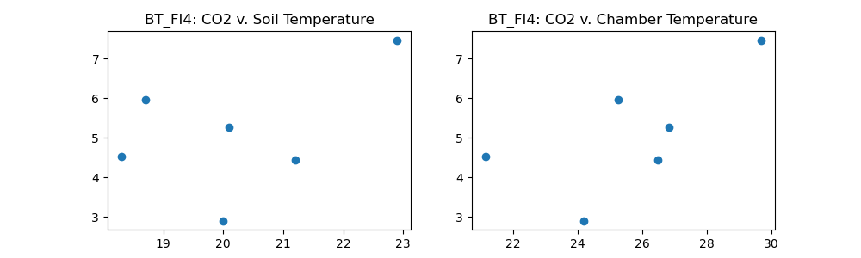
Forest Interior 3
Forest Interior 4

Slide 11
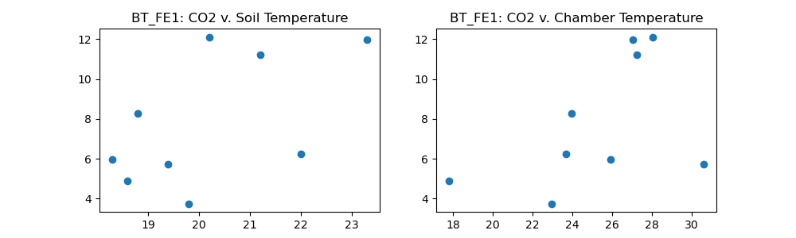
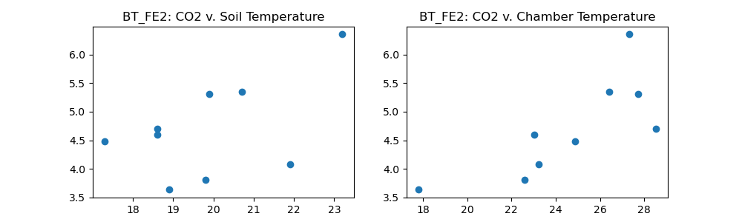
Forest Edge 1
Forest Edge 2

Slide 12
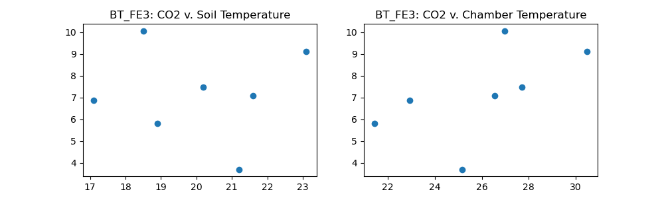
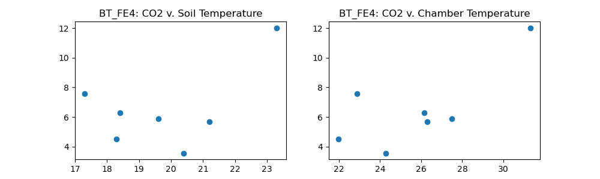
Forest Edge 3
Forest Edge 4

Slide 13
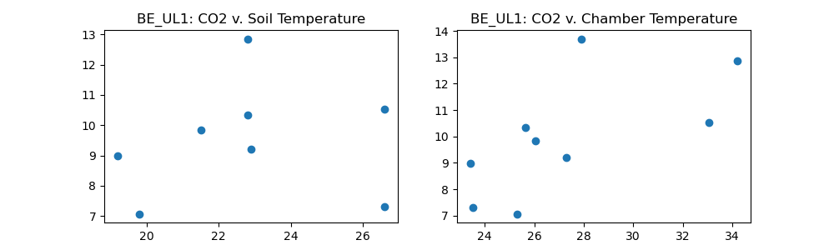
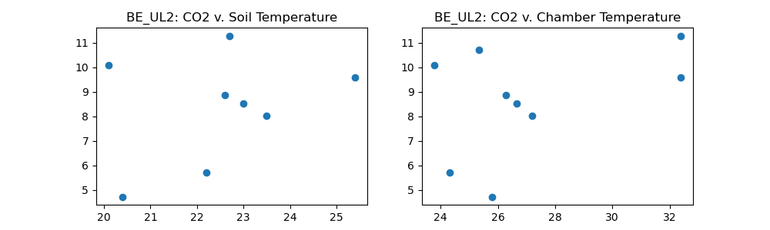
Unmanaged Lawn 1
Unmanaged Lawn 2

Slide 14
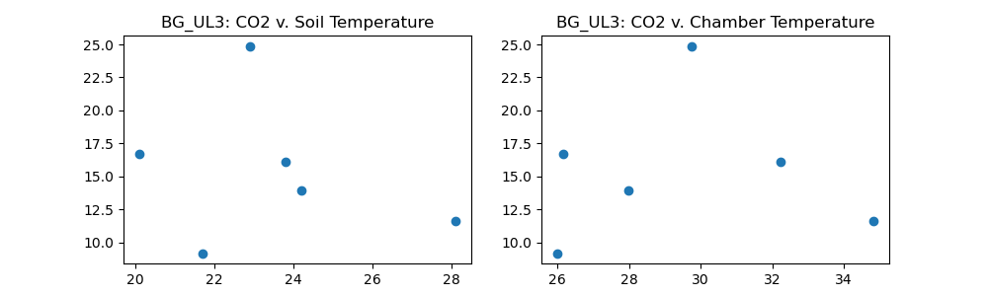

Unmanaged Lawn 3
Managed Lawn 1
(only ML collar)

Slide 15
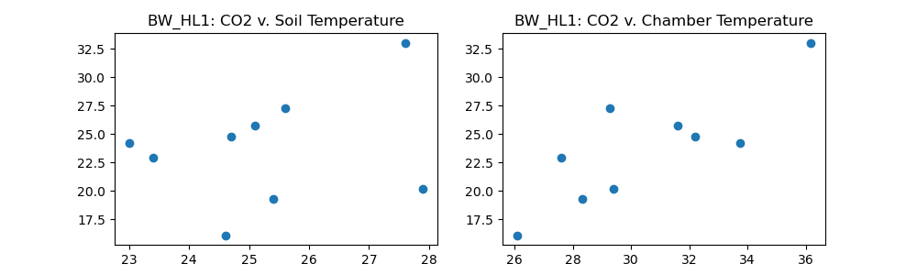
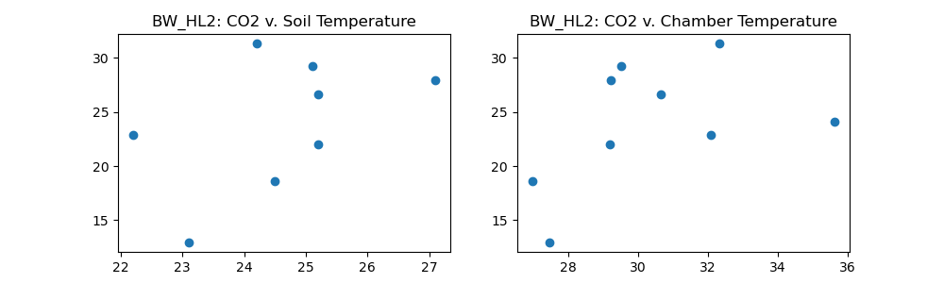
Hot Lawn 1
Hot Lawn 2

Slide 16
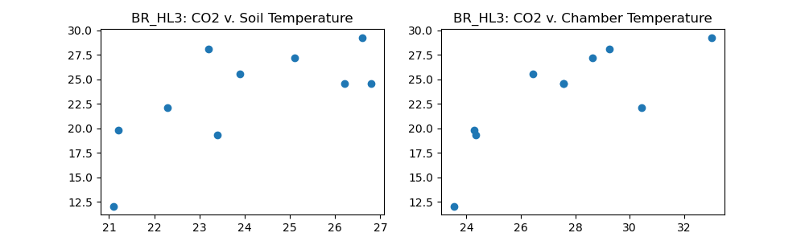
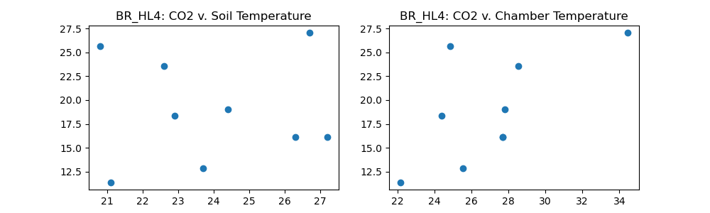
Hot Lawn 3
Hot Lawn 4

Slide 17
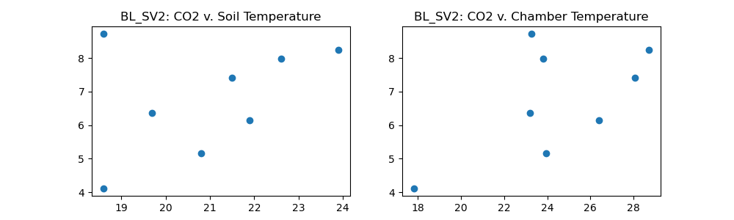
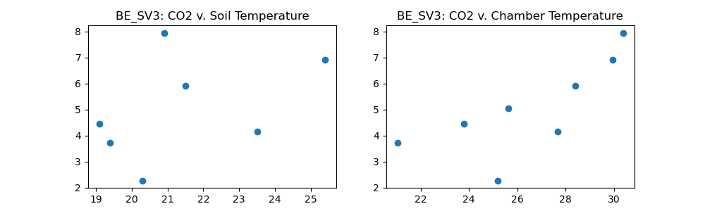
Savannah 2
(this site was always extremely wet and muddy)
Savannah 3

