Slide 1
Soil fluxes
June 16, 2022

Slide 2
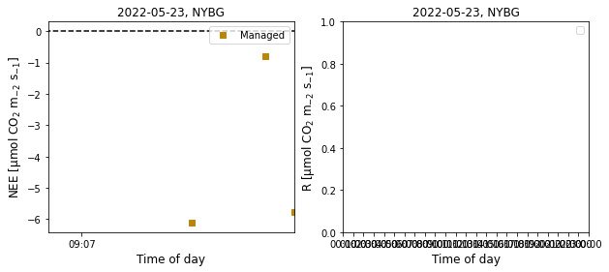
2022 May 23, NYBG

Slide 3
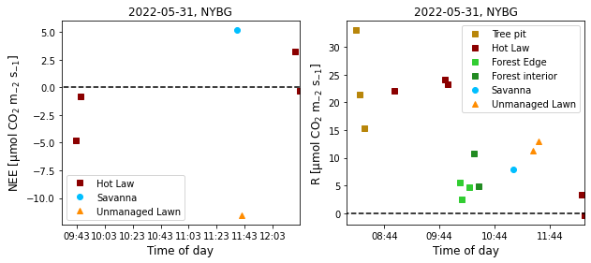
2022 May 31, NYBG

Slide 4
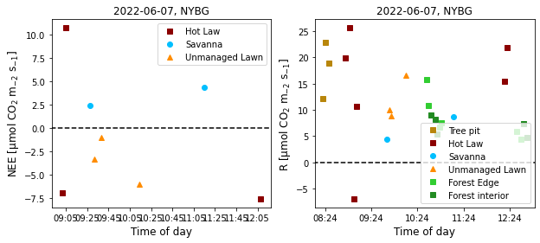
2022 June 7, NYBG

Slide 5
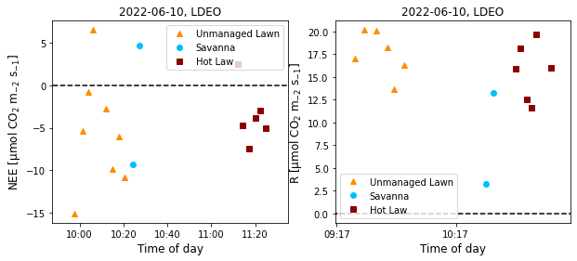
2022 June 10, LDEO (3 days before cutting)
LH_SV2_R
LH_SV1_R
LH_SV1_R
LH_SV2_R

Slide 6
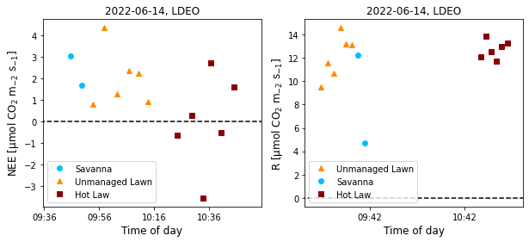
2022 June 14, LDEO (day 1 after cutting)
LH_SV1_R
LH_SV2_R

Slide 7
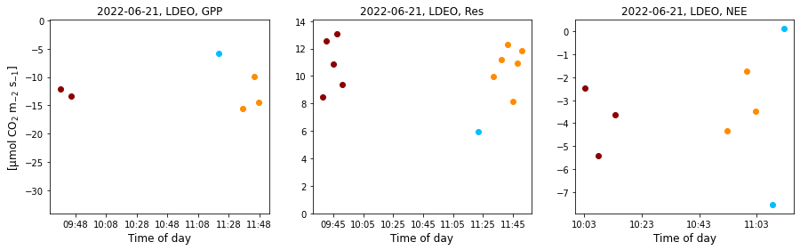
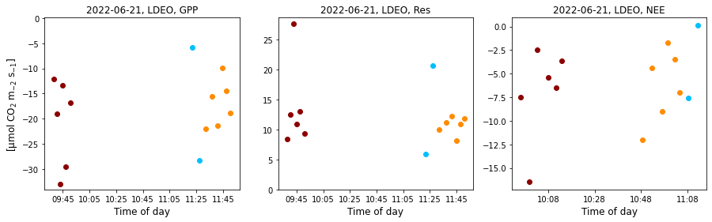
Jun 21 LDEO
Lin and exp agree

Slide 8
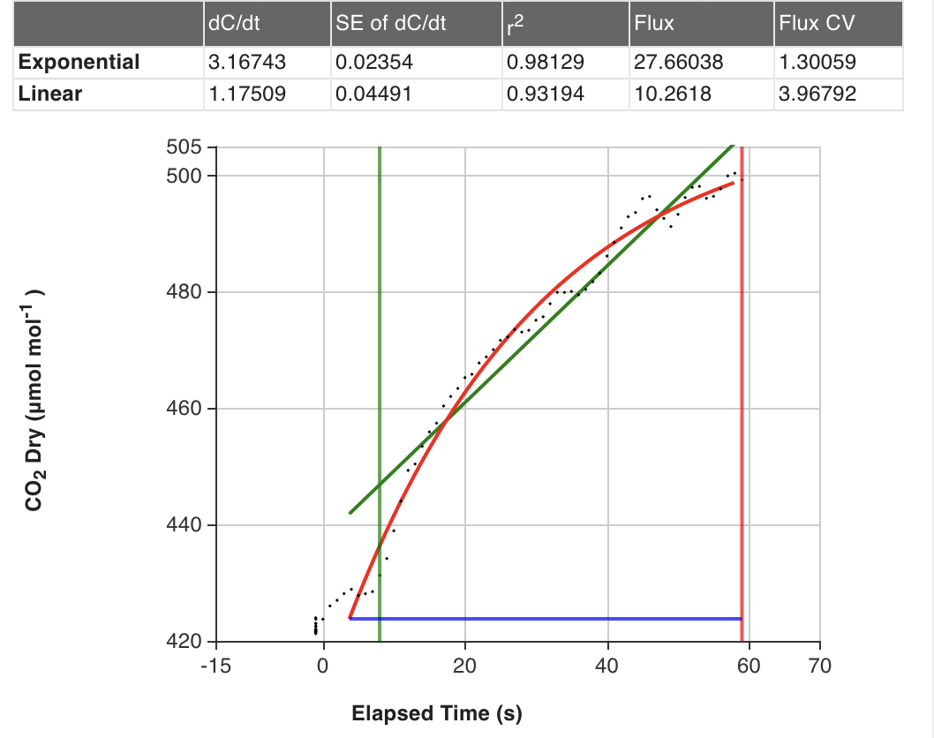
Exponential fits better mathematically, but not physically

Slide 9
LDEO!

Slide 10
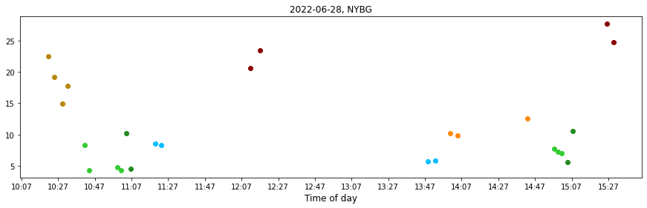
Li-cor7810 respiration at NYBG

Slide 11
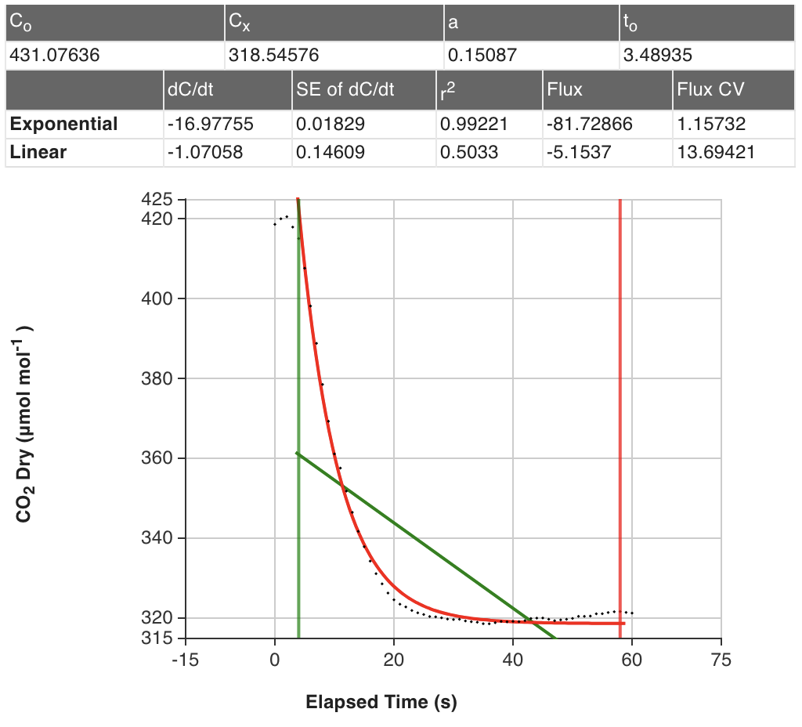
That’s why we don’t trust the exponential

Slide 12
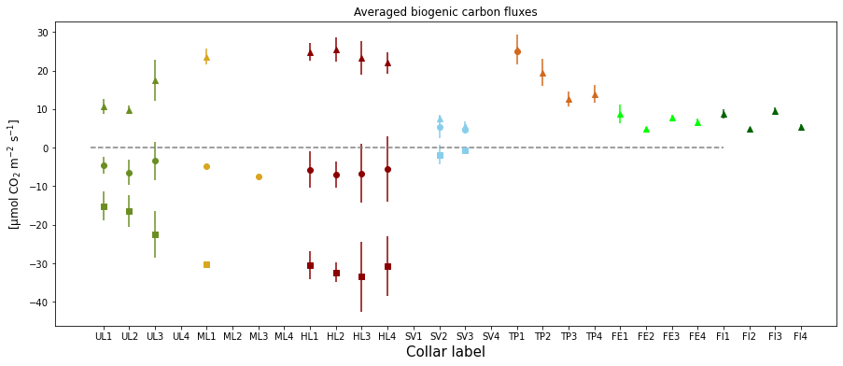
Averaged GPP, NEE, and Res

Slide 13
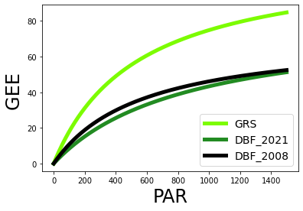
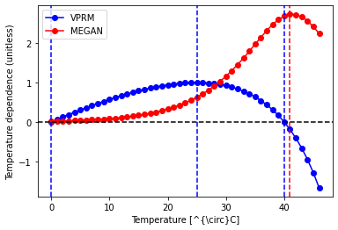
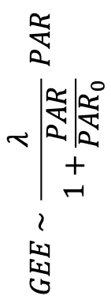
VPRM light and air temperature response curves for grassland
light
air temp
$$GEE \sim \frac{λ}{1+\frac{PAR}{{PAR}_{0}}} PAR$$

Slide 14
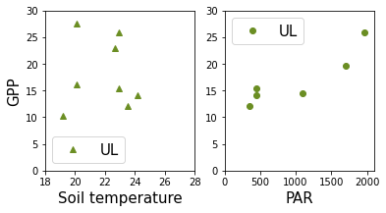
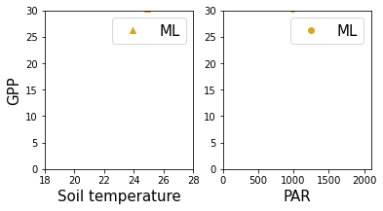
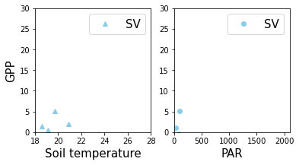
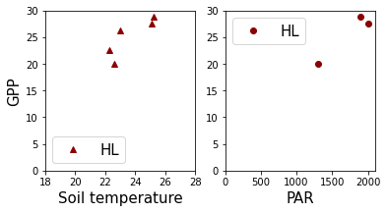
GPP light and soil temperature response curve (for lawns only)

Slide 15
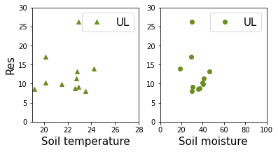
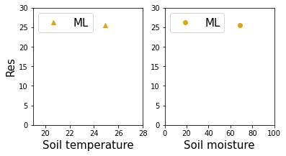
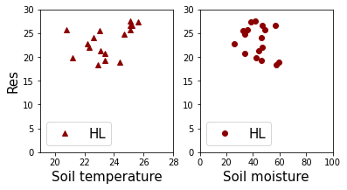
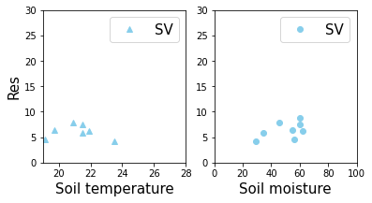
R temperature response curve (for lawns)

Slide 16
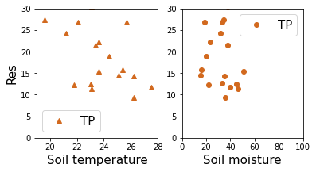
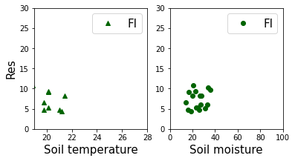
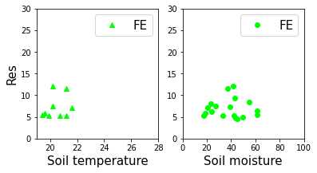
R temperature response curve (for forests)

Slide 17
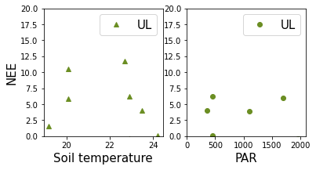
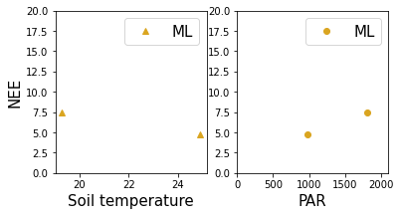
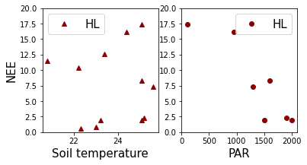
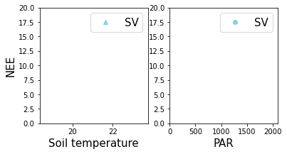
NEE temperature and light response curve (for lawns only)

Slide 18
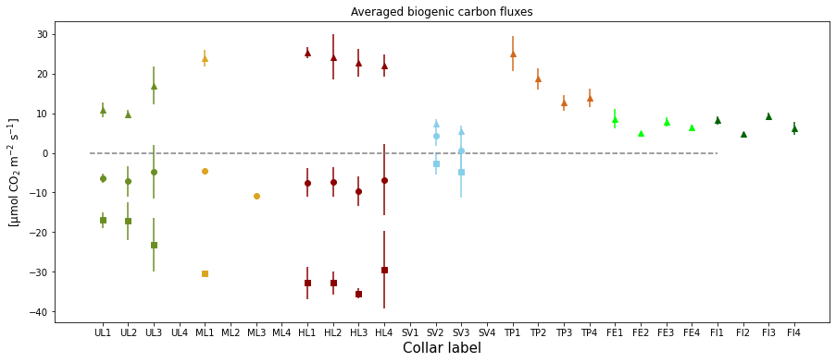
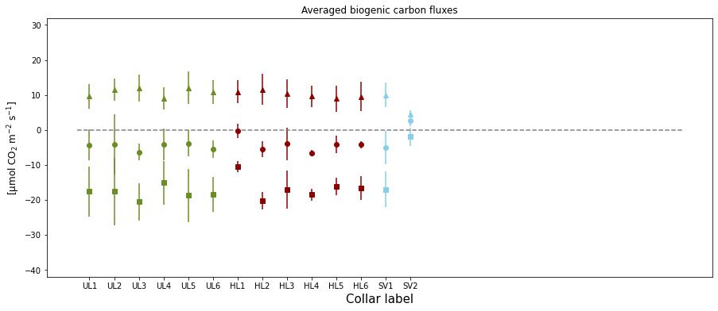
Averaged GPP, NEE, and Res
NYBG
LDEO

Slide 19
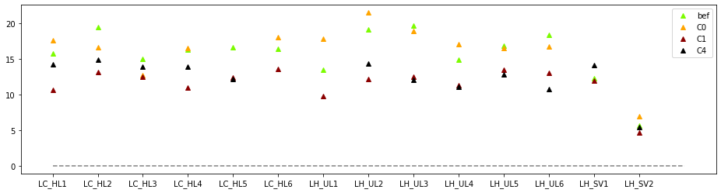
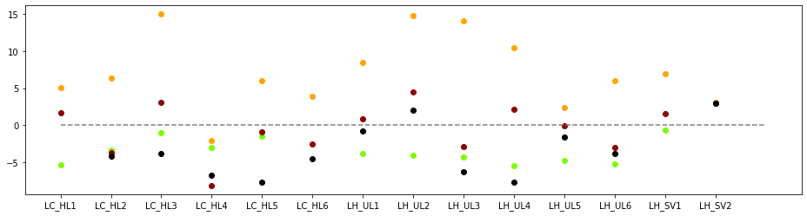
Cutting at LDEO
R
NEE

Slide 20
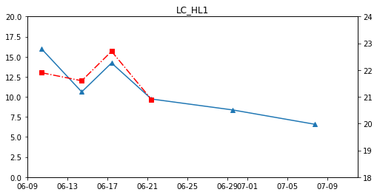
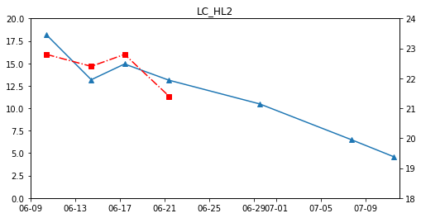
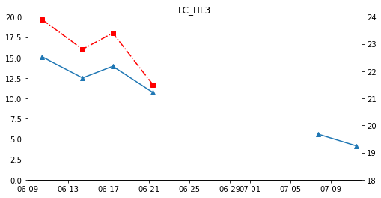
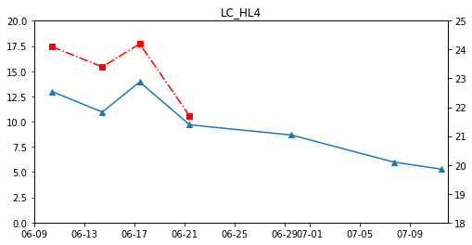
Time series of R – lawns near road (“hot lawn”)

Slide 21
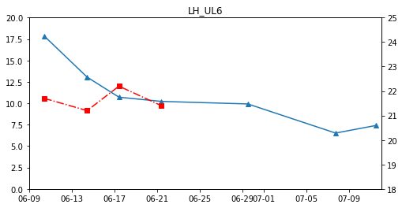
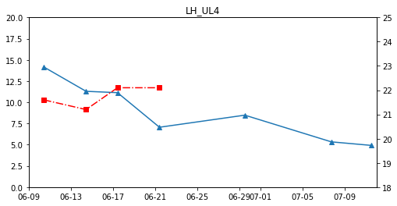
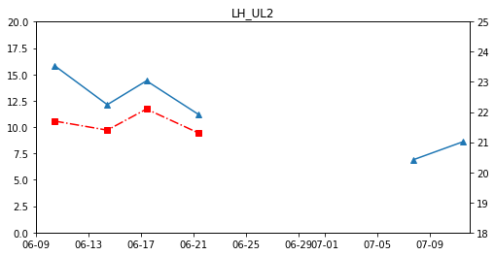
Time series of R – unmanaged lawns

Slide 22
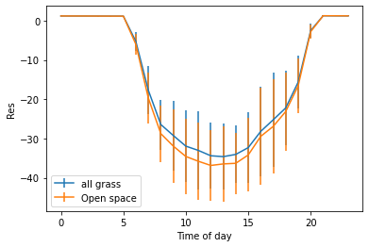
VPRM – open space and grassland

Slide 23
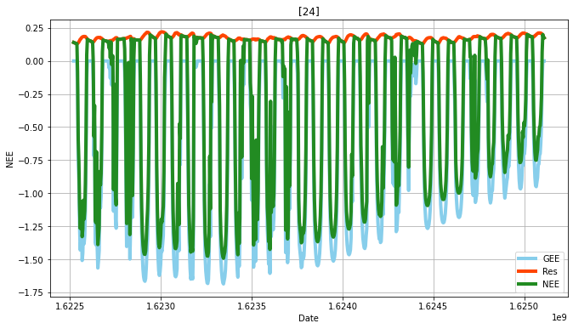
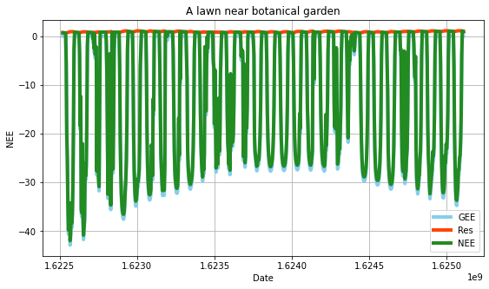
VPRM @ NYBG - June

Slide 24
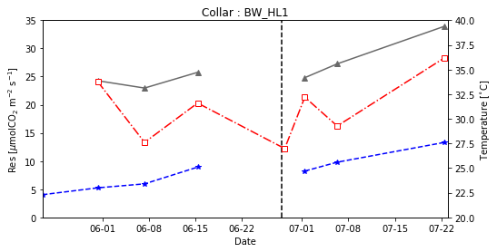
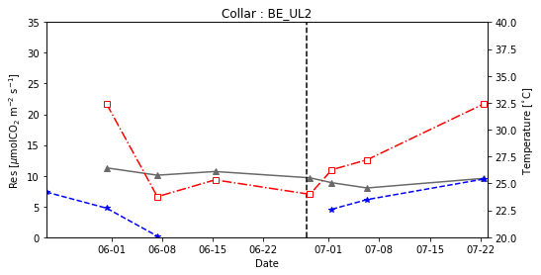
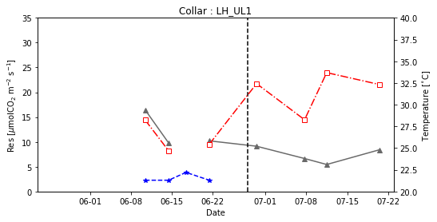
R and temperature
NYBG
Seasonality
Selection of temperature products
Short-term variation : Tair?
Long-term variation: Tsoil?
NYBG
LDEO
water stress?

Slide 25
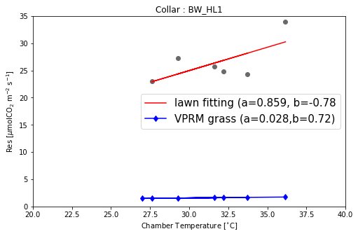
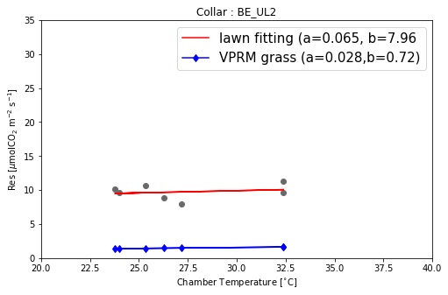
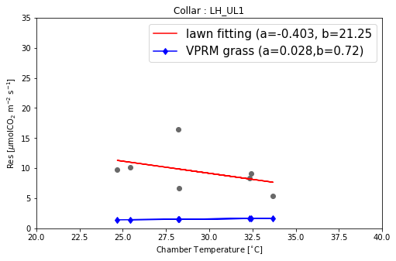
Air temperature response curves for ”hot lawns”
NYBG
NYBG
LDEO

Slide 26
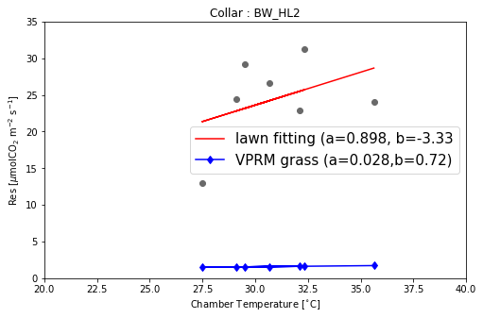


Air temperature response curves for ”hot lawns”

Slide 27
Air temperature response curves for ”unmanaged lawns”
water stress?
BW_HL1 [40.3 32.3 34. 35.7 nan 34. 38.6 44.3]
BW_HL2 [39.7 26. 44.3 47.1 nan 59.1 56.8 58.5]
BR_HL3 [52.8 47.1 42.5 42. nan 46.5 41.4 55.1]
BR_HL4 [46. 48.8 48.8 46.5 nan 57.4 59.5 55.9]
BE_UL2 [44.3 40.8 39.7 nan nan 37.4 30. 32.9]
BG_UL3 [37.4 nan 28.9 30. nan 27.7 18.6 19.2]

Slide 28


Slide 29

Soil temperature (℃)

Slide 30



Seasonality

Slide 31

Seasonality

Slide 32

Seasonality

Slide 33


Slide 34

Lawn respiration at NYBG — each collar
Notes:
Does the data tell seasonality?
Perhaps not because
each data point might not be representative of the weather conditions of the season (e.g. 0531)
Management disturb natural seasonality (soil moisture for hot lawns)

Slide 35

Lawn respiration at NYBG — averages

Slide 36

Air temperature and respiration

Slide 37

The main driver for hot lawns is air temperature

Slide 38
How ISA affects the respiration

Slide 39

Management differences between HL and UL

Slide 40
Why big gap in GEE between HL12 and HL34

Slide 41
Vegetated land vs developed land
practical nor ecologically relevant generally

Slide 42




