Slide 1
STAT Deep Learning - Midterm
Vegetable Image Classification

Slide 2
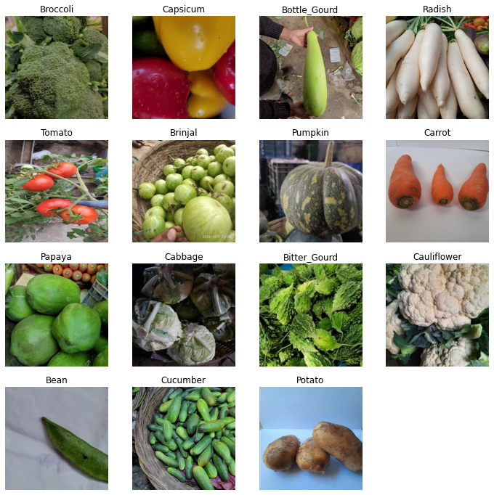
Vegetable dataset
15 types of common vegetables that are found throughout the world.
Bean, bitter gourd, bottle gourd, brinjal, broccoli, cabbage, capsicum, carrot, cauliflower, cucumber, papaya, potato, pumpkin, radish and tomato.
21,000 images
15 classes
Each class contains 1400 images of size 224×224
.jpg format.
Split 70% training, 15% validation, 15% test.
Sourced from Kaggle: https://www.kaggle.com/datasets/misrakahmed/vegetable-image-dataset
Notes:
M Israk Ahmed
Image preprocessing conducted to improve information through filtering.

Slide 3
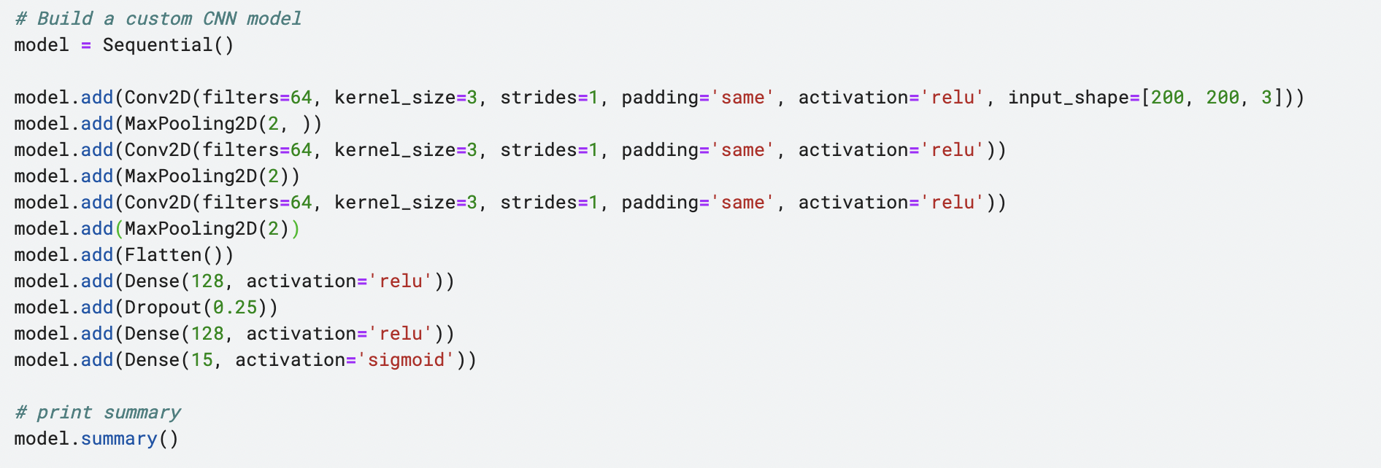
BUILDING CUSTOM CNN WITH MODIFICA
Notes:
M Israk Ahmed -
Image preprocessing conducted to improve information through filtering.

Slide 4
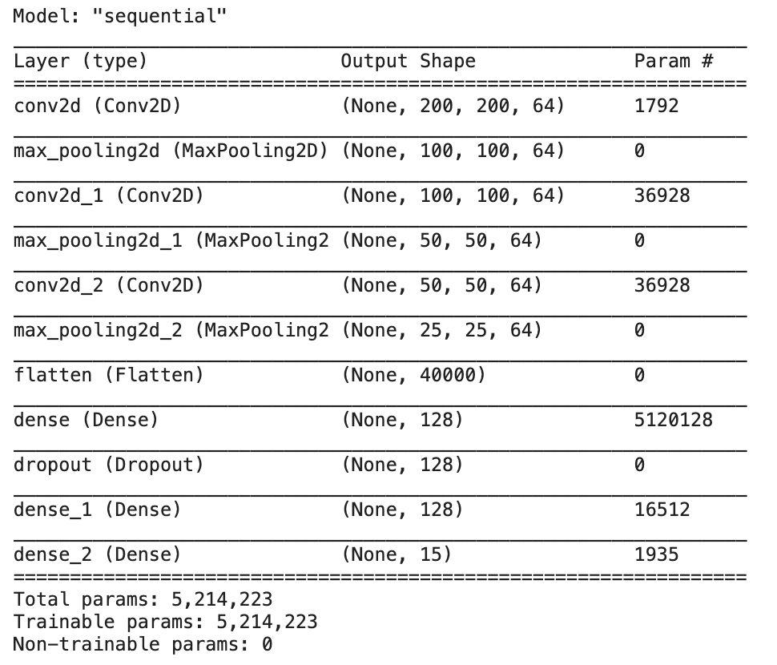
Vegetable image classification using cnn
Convolutionary Layer #1 - 64 filters, 3x3 size, ReLU activation
Max Pooling Layer #1 - Pool size = 2
Convolutionary Layer #2 - 64 filters, 3x3 size, ReLU activation
Max Pooling Layer #2 - Pool size = 2
Convolutionary Layer #3 - 64 filters, 3x3 size, ReLU activation
Max Pooling Layer #2 - Pool size = 2
Flatten Layer
Dense Layer #1 and #2 - 128 neurons, ReLU activation
Dropout Layer – 0.25 dropout rate
Output Layer – 15 neurons, sigmoid activation
Notes:
Added 3rd Convolutional layer, changed all conv layers to 64 filters, kernel size 3, stride 1, padding = same
Added 3rd max pooling layer
Changed softmax activation in output layer to sigmoid activation
11m total params down to 5.2m

Slide 5
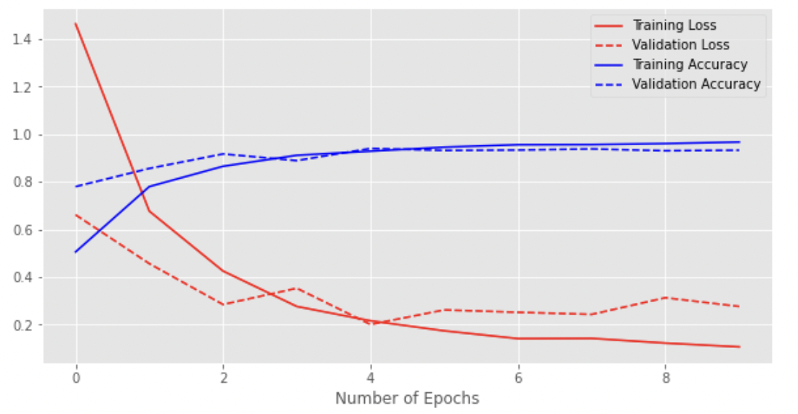
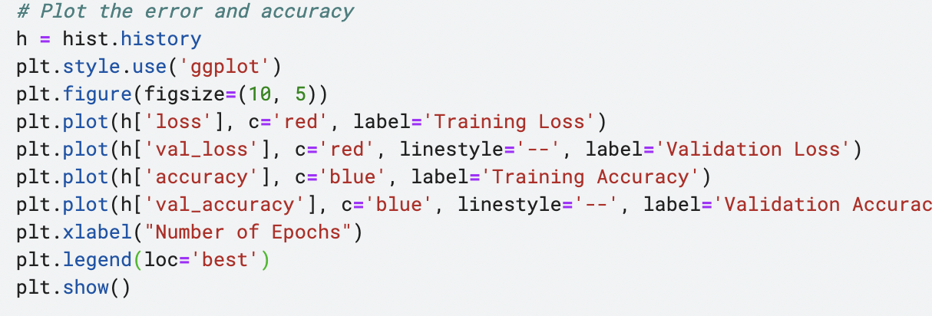
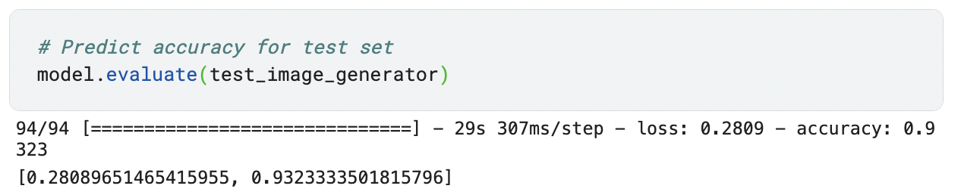
Training and validation loss and accuracy
Notes:
Model trains for 10 epochs before early stopping.
Test set = 93.28% accuracy v Ahmed’s accuracy of 95.47%

Slide 6
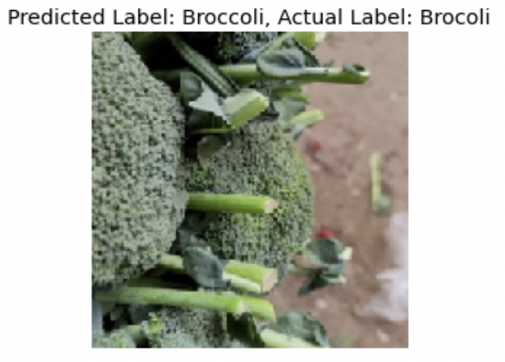
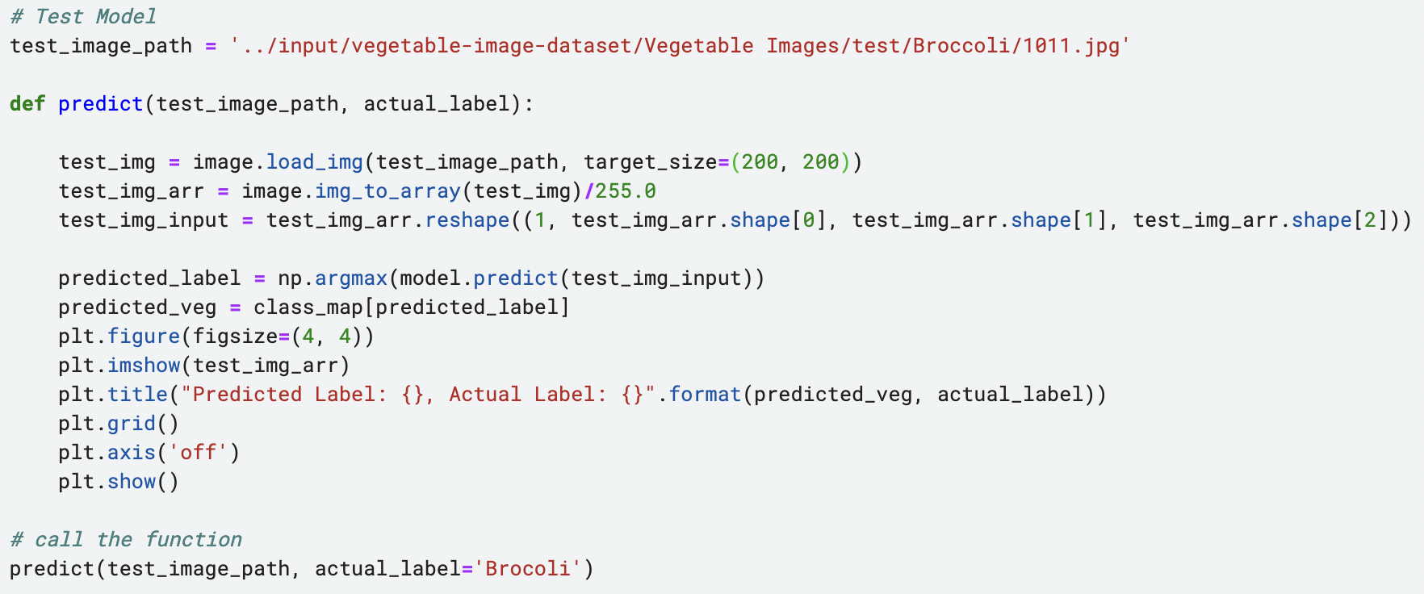
Testing the model
Notes:
Then we test for the model’s predictions by taking the path of an image of a broccoli from the dataset. We load and preprocess the image and use the model to make a prediction. The function prints the predicted label and actual label and we can see that the model has worked in this instance.

Slide 7
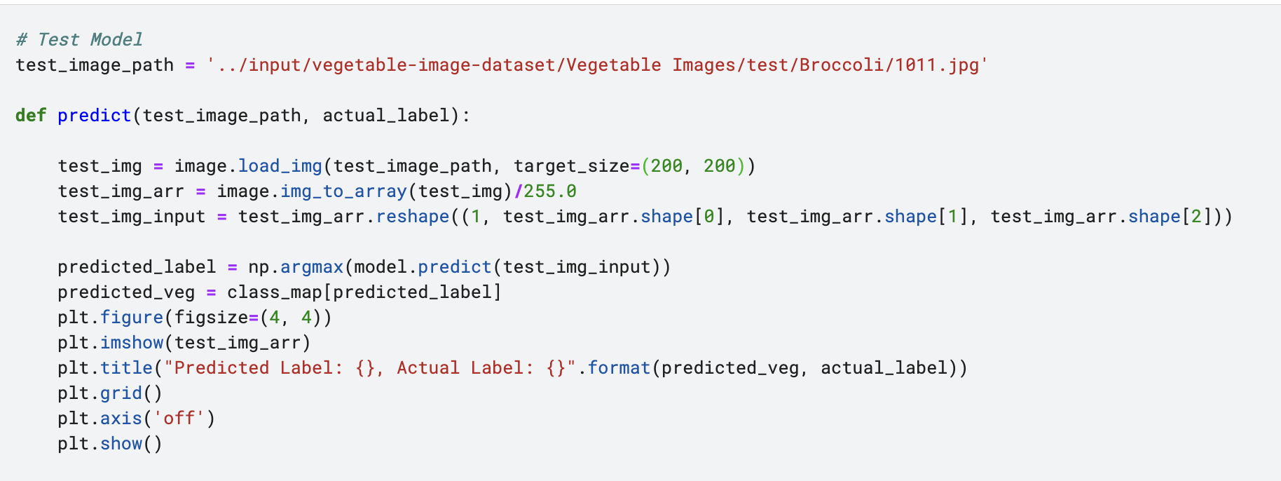
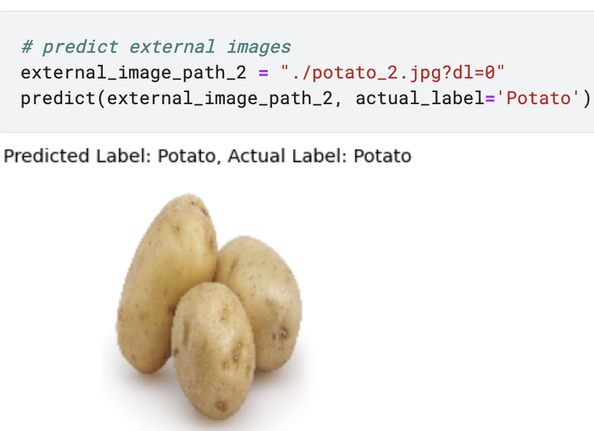
Testing the model on external image
Notes:
Then we test for the model’s predictions on an external image of a potato and even with lower test accuracy, the model is able to correctly predict the external image of a potato is a potato. The model works in this instance.

