Slide 1
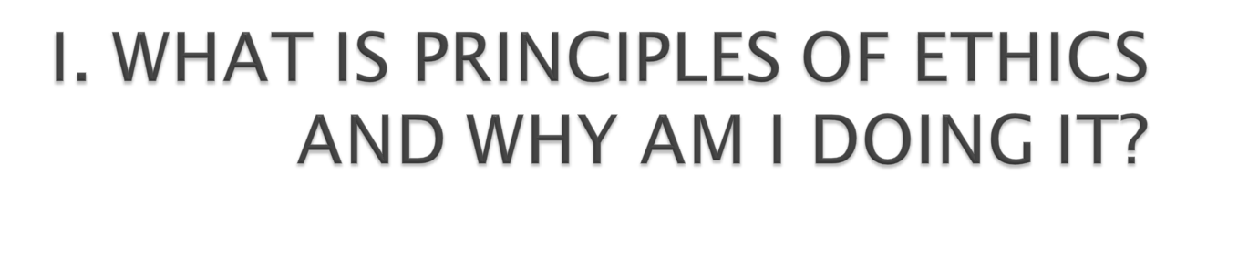
What is Ethics?

Slide 2

Nature of Ethics
Material object
Formal object
Types of goodness
Spontaneous moral knowledge
Moral experience and ethical reflection
From moral experience to ethics: understanding the rationality contained in moral experience

Slide 3

“Ethics is the area of Philosophy which studies the moral life of man; that is, his human life as a person, considered from the point of view of its goodness or badness” (Debeljuh, p. 25)
“Ethics may be defined as the science of the moral rectitude of human acts in accordance with the first principles of natural reason
“ (Mimbi, p. 25)

Slide 4

Divide yourselves into groups of 3-4 people
Analyse the two definitions
Identify:
  The main points for each definition separately
  The points the 2 definitions have in common

Slide 5

Main Points Debeljuh | Main Points Mimbi | Points in common

Slide 6
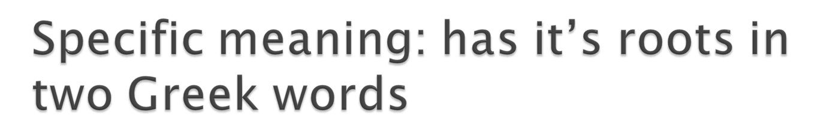
Ethos: (accent on e) = custom: principles and customs which governed a community and guided the life of the city.
Ethos: (hat on e) = character (usual way of being).

Slide 7
Latin term: “mors” = custom.
Morality: knowledge of customs.

Slide 8

Differentiate between ethics and moral knowledge

Slide 9

Develop body of knowledge (discover truth!) to help us:
  Understand morality (ethical value) of free human acts
  How these acts bring us closer to /farther from happiness (our goal in life!)
  Discover guidelines (norms / reference points) so we can choose free acts that bring us closer to real / true happiness

Slide 10

Knowledge of universal moral principles
Apply
(virtue of prudence)
Real life situations

Slide 11

Think and write your own definition of Ethics in your notes
Share / compare your definition with the people seated close to you
Rewrite your definition of Ethics in your notes with any new ideas you may have gained by sharing your knowledge

Slide 12

If we can get the Glossary to work on the ELP, write up your definition of Ethics there for all to share and learn from each other!

Slide 13

Material Object in any science:
  It is the WHAT you study
  The matter / thing / direct object you actually study
  Material Object of Medicine / Finance?
Formal Object of any science:
  It is the ANGLE / PERSPECTIVE from which you study the material object
  Formal Object of Medicine / Finance?

Slide 14

WHAT do we study?
HUMAN ACTS
human acts acts of man
(free / voluntary) (involuntary)
intellect / will body functions, etc
YES!!!
NO!!!

Slide 15

ANGLE / perspective
Specific free human act
It’s morality /moral or ethical value

Slide 16

You come late to class because you didn’t get out of bed on time. When the lecturer asks why you are late, you say that you got stuck in the jam and this delayed you.
Material Object:
  Particular type of act:
  Which one:
Formal Object:
  Chosen act:
  It’s moral value:

Slide 17

Write your own definition of morality in your notes
Share it with a few people around you and discuss the concept briefly
Rewrite your definition of morality with any new insights you may have gained from your sharing with others

Slide 18

We need to know that there are different types of goodness in our real world
Natural goodness: the goodness that an act or that any real thing possesses by the very fact that it exists!
Technical goodness: the effectiveness or goodness of the technique and skill used in carrying out the act
Moral goodness: goodness of the act based on the fact that it leads the person closer to their true, objective, real, final goal

Slide 19
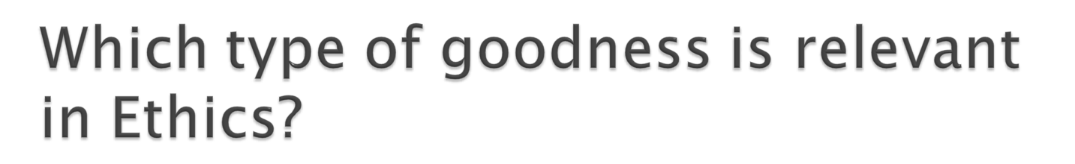
Relevant type of goodness:
Why?

Slide 20

Read the article in groups of 4 and do the following together:
Identify one free act in the story:
What is the material object of the act?
What is the formal object of the act?
What is the moral value of the act?

Slide 21
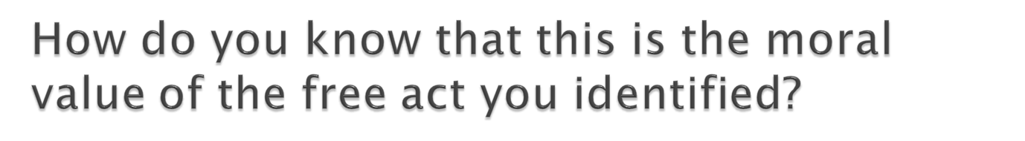
Write your own personal explanation answer to the question in your notes:

Slide 22
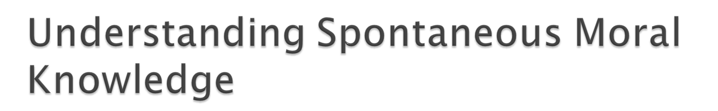
Tell a client there are no rooms available in the hotel when there are plenty of rooms?
Wash the car when asked by your Dad?
Take a cocktail laced with ecstasy?
Force your girlfriend to have an abortion?
Copy homework from a friend instead of doing it yourself?
Loan some bus fare to a friend who has none?

Slide 23
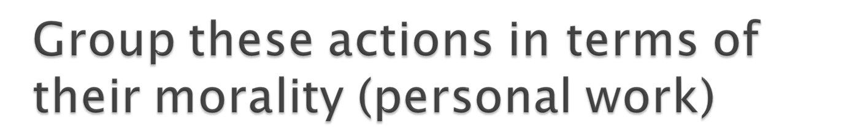
Morally Good Actions
Morally Bad Actions

Slide 24

Do we have a natural, personal knowledge or awareness of acts that are good and acts that are bad?
Where does this spontaneous moral knowledge we have come from?

Slide 25

1. Ever cheated by your boy / girl friend?
  How did you feel about it?
  Would you do it to someone else?
  why / why not?
2. Ever listen to / watch indecent music / video tape?
  Are you aware of the effect it had on you?
  Did you get hooked and continue doing this?
  Did you reject it and avoid this since then?
  Why / why not?
3. Identify one or two things you have learned from your Mum or Dad
  Do you imitate him / her?
  Why / why not?

Slide 26
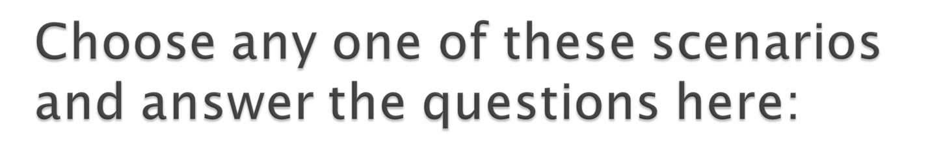

Slide 27
Do the personal experiences we have of good and evil influence our understanding of what is right or wrong?
How do our personal experiences of good and evil affect the way we act ourselves?
Do we have any other ways of knowing what is right and wrong?

Slide 28

We have identified that we have spontaneous moral knowledge (my personal knowledge of what is good / bad)
  And asked how we acquire this knowledge
We have looked at our personal moral experience (good/bad things we have experienced)
  And tried to understand how it influences the way we act
We have started ethical reflection!

Slide 29
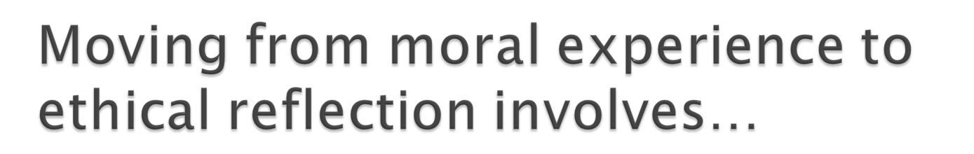
Understanding the rationality contained in moral experience
Reflecting on the nature of a free human act
Systematic thinking about the goodness / badness of free human acts!
Identifying guiding moral principles
Applying first moral principles to evaluate the goodness / badness of our acts

Slide 30
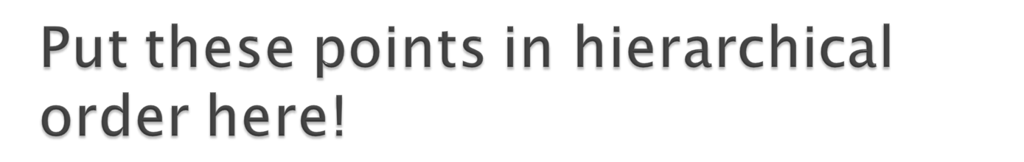
1.
2.
3.
4.
5.

Slide 31

composed-synthesis
1. intellectual 2. experimental/
base practical base
(knowledge of (real/possible free acts)
first moral principles)
3. judgement on the morality of a specific free act

Slide 32

The study of the moral goodness or badness of specific, free human actions, from the perspective of the First Moral Principles!

Slide 33

Identify one example of each type of goodness in the text.
Identify an example of spontaneous moral knowledge in any action of any character.
What kind of moral experience could have produced this moral knowledge in that character (imagine to understand!)?

Slide 34

Is the spontaneous moral knowledge shown by this character about what is morally good or bad in the act you have chosen actually true / correct in your opinion?
How can you know with certainty if this character’s spontaneous moral knowledge about the chosen act is true / correct?

Slide 35

1. Be able to define the various concepts we have introduced and discussed with precision!
2. Be able to apply these theoretical concepts to real human acts (practice using articles from the newpapers!).
3. Think about how these concepts and their application can help you to understand your own actions better in ethical terms (practice trying to use the concepts to understand your acts better!).
4. As you apply these newly acquired concepts to your own actions, can you change, develop, improve your free acts?

Slide 36

Debeljuh, P., Ethics: Learning to Live, pp. 23-36.
Mimbi, P., The Sources of Effective Leadership, pp. 25-34; pp. 41-43; pp. 53-54.

Slide 37

Your notes for Philosophical Anthropology

