Slide 1

APA Formatting and Style Guide
Purdue OWL staff
Brought to you in cooperation with the Purdue Online Writing Lab
Notes:
Welcome to “APA Formatting and Style Guide”. This Power Point Presentation is designed to introduce your students to the basics of APA Formatting and Style Guide. You might want to supplement the presentation with more detailed information posted on Purdue OWL http://owl.english.purdue.edu/owl/resource/560/01/

Slide 2

What is APA Style?
The American Psychological Association (APA) citation style is the most commonly used format for manuscripts in the social sciences.
APA regulates:
  Stylistics
  In-text citations
  References
Notes:
Publication Manual of the American Psychological Association, 6th ed., contains detailed guidelines to formatting a paper in the APA style. APA style is most commonly used for formatting papers in the Social Sciences—business, economics, psychology, sociology, nursing, etc. Updates to APA are posted on the APA website www.apastyle.org. You may also reference the Purdue OWL: http://owl.english.purdue.edu/.
APA format provides writers with a format for cross-referencing their sources--from their parenthetical references to their reference page. This cross-referencing system allows readers to locate the publication information of source material. This is of great value for researchers who may want to locate your sources for their own research projects. The proper use of APA style also shows the credibility of writers; such writers show accountability to their source material. Most importantly, use of APA style can protect writers from plagiarism--the purposeful or accidental use of source material by other writers without giving appropriate credit.

Slide 3
Point of View &Voice
  Personal pronouns where appropriate
    ✓: “We conducted an experiment…”
    ✗: “The authors conducted an experiment….”
  Active voice rather than passive voice
    ✓: “We asked participants questions.”
    ✗: “The participants have been asked questions by the researchers.”
Notes:
APA format is not limited by the rules of citing the sources- in-text citations and entries in the list of References. It also regulates the stylistics of conveying research.
This slide introduces the basics of APA stylistics related to the point of view and voice in an APA paper, which encourages a writer to use personal pronouns and the active voice. The explanations are provided with examples.
This slide can be supplemented by the relevant section from OWL http://owl.english.purdue.edu/owl/resource/560/15/

Slide 4
Language
Language in an APA paper should be:
Clear: be specific in descriptions and explanations
Concise: condense information when you can
Plain: use simple, descriptive adjectives and minimize figurative language
Notes:
This slide explains the APA requirements to language of an APA paper.
Clarity and conciseness are the major concern when reporting research in APA . It is not easy to balance clarity (which requires providing clarification) and conciseness (which requires packing information). To achieve clarity, a writer should avoid vague wording and be specific in descriptions and explanations. To achieve conciseness, a writer should condense information. Because APA format is widely used in science-related papers, the language of APA format is plain and simple. A writer should avoid using metaphors and minimize the use of figurative language, which is typical for creative writing.
This slide can be supplemented by the relevant sections from OWL
http://owl.english.purdue.edu/owl/resource/560/15/
http://owl.english.purdue.edu/owl/resource/560/14/
and “Conciseness in academic writing” handout http://owl.english.purdue.edu/owl/resource/572/01/

Slide 5
Types of APA Papers
The Literature Review:
  Summarizes scientific literature on a particular research topic
  Includes:
    a title page,
    introduction, and
    a list of references
Notes:
This slide introduces two most commonly used genres in APA format: the literature review and the experimental report (also known as the research article).
The literature review paper, which is the summary of what the scientific literature in the discipline field says about the topic of research, is the genre students likely encounter in their academic studies. The paper includes the title page, introduction and a list of references.
The experimental report or research article provides an account of conducted research. This genre includes the title page, abstract, introduction (which is the review of the published studies on the research topic with the purpose to find the niche for the reported study), method, results, discussion, references, appendices (optional). The experiential report often contains tables and figures. See the slides describing APA format of tables and figures.
This slide can be supplemented by the relevant section from OWL http://owl.english.purdue.edu/owl/resource/560/13/

Slide 6
Types of APA Papers
The Experimental Report:
  Describes your experimental research
  Includes:
    a title page,
    abstract,
    introduction,
    methods, results, and discussion sections,
    a list of references,
    appendices,
    tables, and
    figures
Notes:
This slide introduces two most commonly used genres in APA format: the literature review and the experimental report (also known as the research article).
The literature review paper, which is the summary of what the scientific literature in the discipline field says about the topic of research, is the genre students likely encounter in their academic studies. The paper includes the title page, introduction and a list of references.
The experimental report or research article provides an account of conducted research. This genre includes the title page, abstract, introduction (which is the review of the published studies on the research topic with the purpose to find the niche for the reported study), method, results, discussion, references, appendices (optional). The experiential report often contains tables and figures. See the slides describing APA format of tables and figures.
This slide can be supplemented by the relevant section from OWL http://owl.english.purdue.edu/owl/resource/560/13/

Slide 7
Types of APA Papers
If your paper fits neither category:
  Follow the general format
  Consult the instructor
  Consult the APA Publication Manual
Notes:
The general format, which is introduced in the following six slides, regulates formatting papers of any genre students may encounter in their academic studies. For students, consulting the instructor about the specific requirement is the safest policy. For authors of manuscripts prepared for submission to scientific journal, consulting Publication Manual is a must.
This slide can be supplemented by the “Other papers” section from OWL http://owl.english.purdue.edu/owl/resource/560/13/

Slide 8
General APA Format
Your essay should:
  be typed,
  double-spaced,
  have 1” margins,
  use 10-12pt. Standard font (ex. Times New Roman), and
  be printed on standard-sized paper (8.5”x 11”)
[Note: If you are writing a manuscript draft, APA suggests using two spaces between sentences to aid readability (see pp.87-88 in the APA manual).]
Notes:
This slide presents the general format of an APA formatted paper: An essay should be typed and double-spaced on the standard-sized paper (8.5”x11”) with 1” margins on all sides. Times New Roman or similar font in 10-12 pt. size should be used. The document should include a page header indicating a short title of the essay and a page number in the upper right-hand of every page (including the title page).

Slide 9
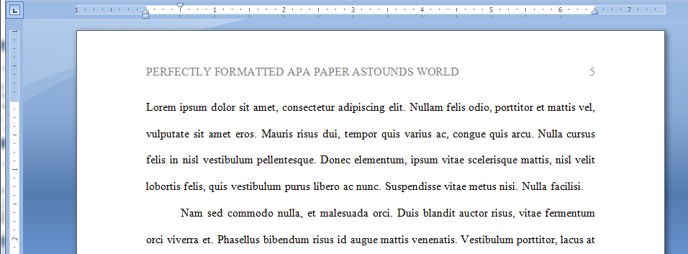
General APA Format
Every page of your essay should:
  Include a page header (Title, all caps) in the upper left-hand corner and
  the page number in the upper right
Notes:
This slide presents the general format of an APA formatted paper: An essay should be typed and double-spaced on the standard-sized paper (8.5”x11”) with 1” margins on all sides. Times New Roman or similar font in 10-12 pt. size should be used. The document should include a page header indicating a short title of the essay and a page number in the upper right-hand of every page (including the title page).

Slide 10
General APA Format
Your essay should
include four major
sections:
References
Main Body
Abstract
Title page
Notes:
This slide introduces four required part of an APA paper: a title page, abstract, main body (essay itself), and a list of References. An abstract page and list of references are titled as Abstract and Reference, respectively.
It is important to remind students that each page should have a page header with a short title and page number.
This slide can be supplemented by the “General Format” section from OWL http://owl.english.purdue.edu/owl/resource/560/01/

Slide 11

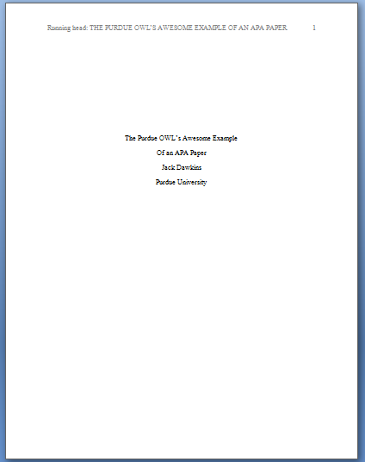

Title Page
Page header:
(use Insert Page Header)
title flush left + page number flush right.
Title:
(in the upper half of the page, centered)
name (no title or degree) + affiliation (university, etc.)

Slide 12

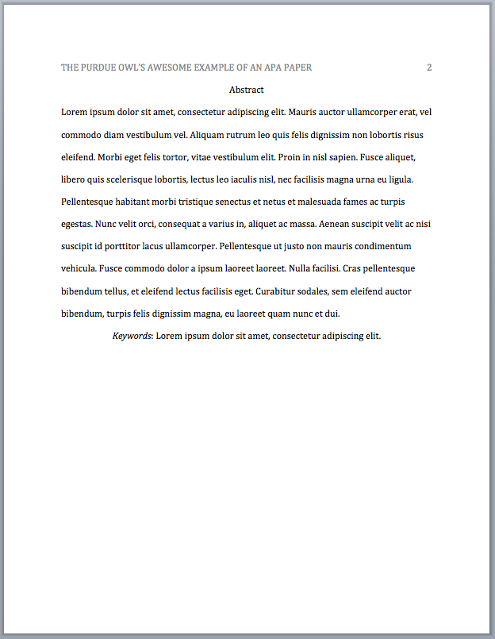

Abstract Page
Page header: do NOT include “Running head:”
Abstract: centered, at the top of the page
Write a 150- to 250- word summary of your paper in an accurate, concise, and specific manner.
Notes:
This slide provides a visual example of an abstract page, which consists of a page header, a heading—Abstract, and a brief summary of the paper accurately presenting its contents.
Type the heading –Abstract– centered at the top of the page. Below, type the paragraph of the paper summary (between 150 and 250 words) in block format—without indentation.
The abstract should contain the research topic, research questions, participants, methods, results, data analysis, and conclusions. It may also include possible implications of your research and future work you see connected with your finding, and may include keywords.

Slide 13
Main Body (Text)
Number the first text page as page number 3
Type and center the title of the paper at the top of the page
Type the text double-spaced with all sections following each other without a break
Identify the sources you use in the paper in parenthetical, in-text citations
Format tables and figures
Notes:
This slide provides the basic reminders about formatting the text:
Make sure that the first text page is page number 3 (page#1 is a title page, page #2 is an abstract page).
Start with typing the essay title centered, at the top of the page.
Type the text double-space with all sections following each other without a break. Do not use white space between paragraphs.
Create parenthetical in-text citations to identify the sources used in the paper.
Format tables and figures.
The following slides introduce APA formatting of references, in-text citations, and tables and figures.

Slide 14
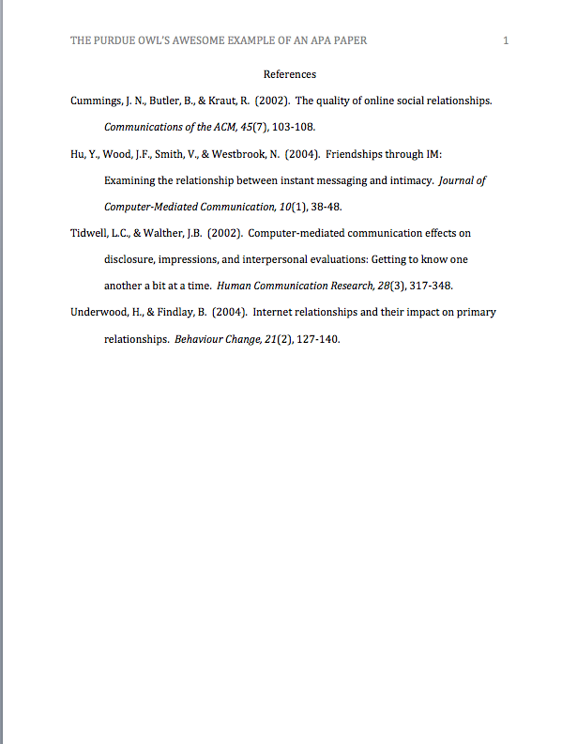
Reference Page
Center the title (References) at the top of the page. Do not bold it.
Double-space reference entries
Flush left the first line of the entry and indent subsequent lines
Order entries alphabetically by the surname of the first author of each work
Notes:
This slide explains the format and purpose of a references page.
The facilitator may stress that each source referenced within the paper should also appear on the reference page, which appears at the end of the paper.
To create a references page,
center the heading—References—at the top of the page;
double-space reference entries;
flush left the first line of the entry and indent subsequent lines. To use “hanging” feature of “Indent and Space” tab, go to “Paragraph” →”Indentation” →choose “Hanging” in the ”Special” box.
Order entries alphabetically by the author’s surnames. If a source is anonymous, use its title as an author’s surname.
Note: Unlike MLA, APA is only interested in what they call “recoverable data”—that is, data which other people can find. For example, personal communications such as letters, memos, emails, interviews, and telephone conversations should not be included in the reference list since they are not recoverable by other researchers.
For specific information about entries in the reference list, go to http://owl.english.purdue.edu/owl/resource/560/05

Slide 15
References: Basics
Invert authors’ names (last name first followed by initials)
  EX:“Smith, J.Q.”
Capitalize only the first letter of the first word of a title and subtitle, the first word after a colon or a dash in the title, and proper nouns. Do not capitalize the first letter of the second word in a hyphenated compound word.
  EX: The perfectly formatted paper: How the Purdue OWL saved my essay.
Notes:
This slide provides basic rules related to creating references entries.

Slide 16
References: Basics
Capitalize all major words in journal titles
Italicize titles of longer works such as books and journals
Do not italicize, underline, or put quotes around the titles of shorter works such as journal articles or essays in edited collections
Notes:
This slide provides basic rules related to creating references entries.

Slide 17
Making the Reference List
APA is a complex system of citation. When compiling the reference list, the strategy below might be useful:
Identify the type of source:
  Is it a book? A journal article? A webpage?
Find a sample citation for this type of source
  Check a textbook or the OWL APA Guide: http://owl.english.purdue.edu/owl/resource/560/01/
“Mirror” the sample
Make sure that the entries are listed in alphabetical order and that the subsequent lines are indented (Recall References: Basics)
Notes:
APA is a complex system of citation, which is time-consuming to learn and difficult to keep in mind. To help students handle the requirements of APA format, this slide introduces a strategy of surviving APA.
The facilitator should stress the importance of correct identification of a type of source: e.g., Is it an article from a newspaper or from a scholarly journal? Hard copy or electronic version?
When the source type is identified correctly, it’s fairly easy to find a sample of a similar reference in the APA chapter of a composition book or in an on-line APA resource. The APA guide on the OWL website is particularly easy to browse since its links are organized by types of sources—scroll down to the box of links http://owl.english.purdue.edu/owl/resource/560/01/
After a sample is found, all it takes is to mirror it precisely and arrange entries in the alphabetical order.
Note: Many electronic library databases, e.g. Proquest, have citation feature. The useful strategy is to save and import into a references list citation entries (make sure you choose APA format) while doing literature search. You can always delete later reference entries of the sources you’re not going to use in the paper.

Slide 18
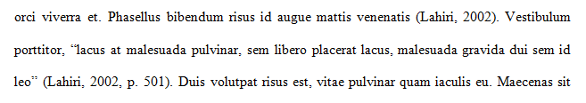
In-text Citation: Basics
In-text citations help readers locate the cited source in the References section of the paper.
Whenever you use a source, provide in parenthesis:
  the author’s name and the date of publication
  for quotations and close paraphrases, provide the author’s name, date of publication, and a page number
Notes:
This slide explains the basics of in-text citations.
In-text citations help establish credibility of the writer, show respect to someone else’s intellectual property (and consequently, avoid plagiarism). More practically, in-text citations help readers locate the cited source in the references page. Thus, keep the in-text citation brief and make sure that the information provided in the body of the paper should be just enough so that a reader could easily cross-reference the citation with its matching entry on the reference page; i.e., the body of the paper and the in-text citation together contains the author’s name and the year of publication. To avoid plagiarism, also provide a page number (in p.3 / pp.3-5 format) for close paraphrases and quotations.

Slide 19
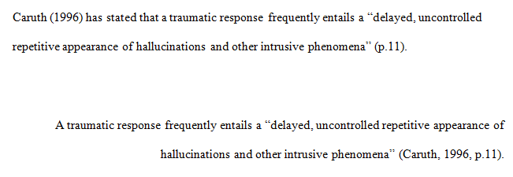
In-Text Citation:
Quotations
When quoting:
Introduce the quotation with a signal phrase
Include the author’s name, year of publication, and page number
Keep the citation brief—do not repeat the information
Notes:
This slide provides explanation and examples of in-text citations with quotations.

Slide 20
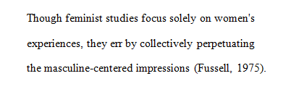
In-Text Citation:
Summary or Paraphrase
Provide the author’s last name and the year of
publication in parenthesis after a summary or a paraphrase.
Notes:
APA format is not limited by the rules of citing the sources- in-text citations and entries in the list of References. It also regulates the stylistics of conveying research.
This slide introduces the basics of APA stylistics related to the point of view and voice in an APA paper, which encourages a writer to use personal pronouns and the active voice. The explanations are provided with examples.
This slide can be supplemented by the relevant section from OWL http://owl.english.purdue.edu/owl/resource/560/15/

Slide 21
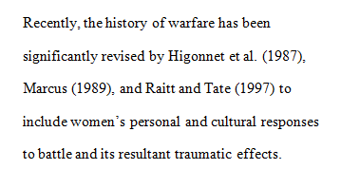
In-Text Citation:
Summary or Paraphrase
Include the author’s name in the signal phrase, followed by the year of publication in parenthesis.
Notes:
The following three slides provide instructions and examples of in-text citations with summary/ paraphrase.
The facilitator should emphasize the importance of developing the skills of critical reading (which enables finding main claims in the text), summarizing, and paraphrasing. When paraphrasing or summarizing, the major concern should be fair and accurate representation of the ideas in the source.
This slide can be supplemented by the “Quoting, Paraphrasing, and Summarizing” section from OWL
http://owl.english.purdue.edu/owl/resource/563/01/
and sections on APA in-text citations:
http://owl.english.purdue.edu/owl/resource/560/01/
http://owl.english.purdue.edu/owl/resource/560/02

Slide 22
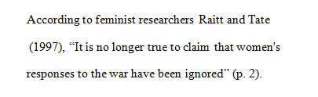
In-Text Citation:
Summary or Paraphrase
When including the quotation in a summary/paraphrase, also provide a page number in parenthesis after the quotation:
Notes:
This slide continues explaining formatting in-text citations with summary/ paraphrase.

Slide 23
In-Text Citation:
Signal Words
Introduce quotations with signal phrases, e.g.:
According to Xavier (2008), “….” (p. 3).
Xavier (2008) argued that “……” (p. 3).
Use such signal verbs such as:
acknowledged, contended, maintained,
responded, reported, argued, concluded, etc.
Use the past tense or the present perfect tense of verbs in signal phrases when they discuss past events.
Notes:
Acquiring a rich repertoire of signal words and phrases is the key to success in representing others’ ideas in academic writing. This slide provides a few examples of those and reminds that APA requires to use the past or present perfect tense of verbs in signal phrases.
The facilitator might want to point to the chapter in the composition book that introduces and practices signal words.

Slide 24
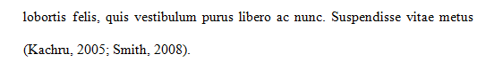
In-Text Citation:
Two or More Works
When the parenthetical citation includes two or
more works, order them in the same way they appear in the reference list—the author’s name, the year of publication—separated by a semi-colon.
Notes:
This slide explains and exemplifies the specific cases of in-text citations. It might be supplemented with “Author/Authors” section from OWL http://owl.english.purdue.edu/owl/resource/560/03/

Slide 25
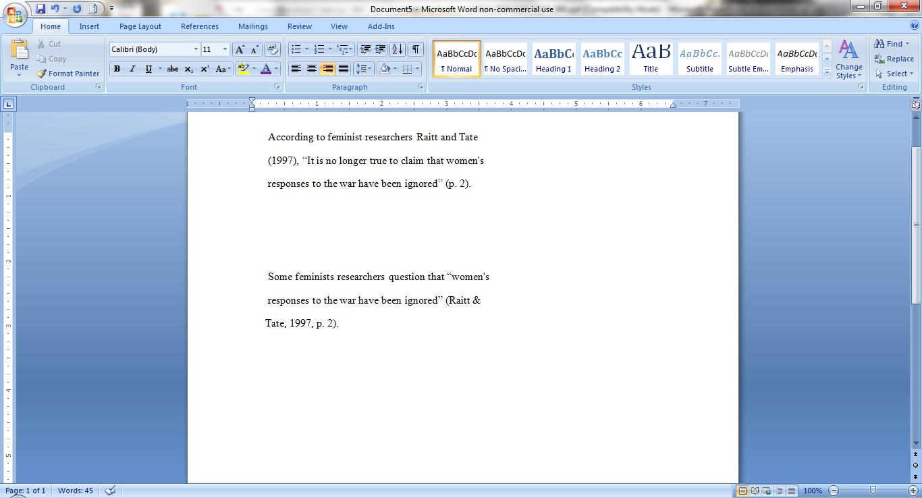
In-Text Citation:
Works with Two Authors
When citing a work with two authors, use
In the signal phrase, use “and” in between the authors’ names
In parenthesis, use “&” between names
Notes:
This slide explains and exemplifies the specific cases of in-text citations. It might be supplemented with “Author/Authors” section from OWL http://owl.english.purdue.edu/owl/resource/560/03/

Slide 26
In-Text Citation:
Works with 3-5 Authors
When citing a work with three to five authors, identify all authors in the signal phrase or in parenthesis.
(Harklau, Siegal, & Losey, 1999)
In subsequent citations, only use the first author's last name followed by "et al." in the signal phrase or in parentheses.
(Harklau et al., 1993)
Notes:
This slide explains and exemplifies the specific cases of in-text citations. It might be supplemented with “Author/Authors” section from OWL http://owl.english.purdue.edu/owl/resource/560/03/

Slide 27
In-Text Citation:
Works with 6+ Authors
When citing a work with six and more authors, identify the first author’s name followed by “et al.”
Smith et al. (2006) maintained that….
(Smith et al., 2006)
Notes:
This slide explains and exemplifies the specific cases of in-text citations. It might be supplemented with “Author/Authors” section from OWL http://owl.english.purdue.edu/owl/resource/560/03/

Slide 28
In-Text Citation:
Unknown Author
When citing a work of unknown author:
use the source’s full title in the signal phrase
cite the first word of the title followed by the year of publication in parenthesis.
According to “Indiana Joins Federal Accountability System” (2008)
OR
(“Indiana,” 2008)
Titles:
Articles and Chapters = “ ”
Books and Reports = italicize
Notes:
This slide explains and exemplifies the specific cases of in-text citations. It might be supplemented with “Author/Authors” section from OWL http://owl.english.purdue.edu/owl/resource/560/03/

Slide 29
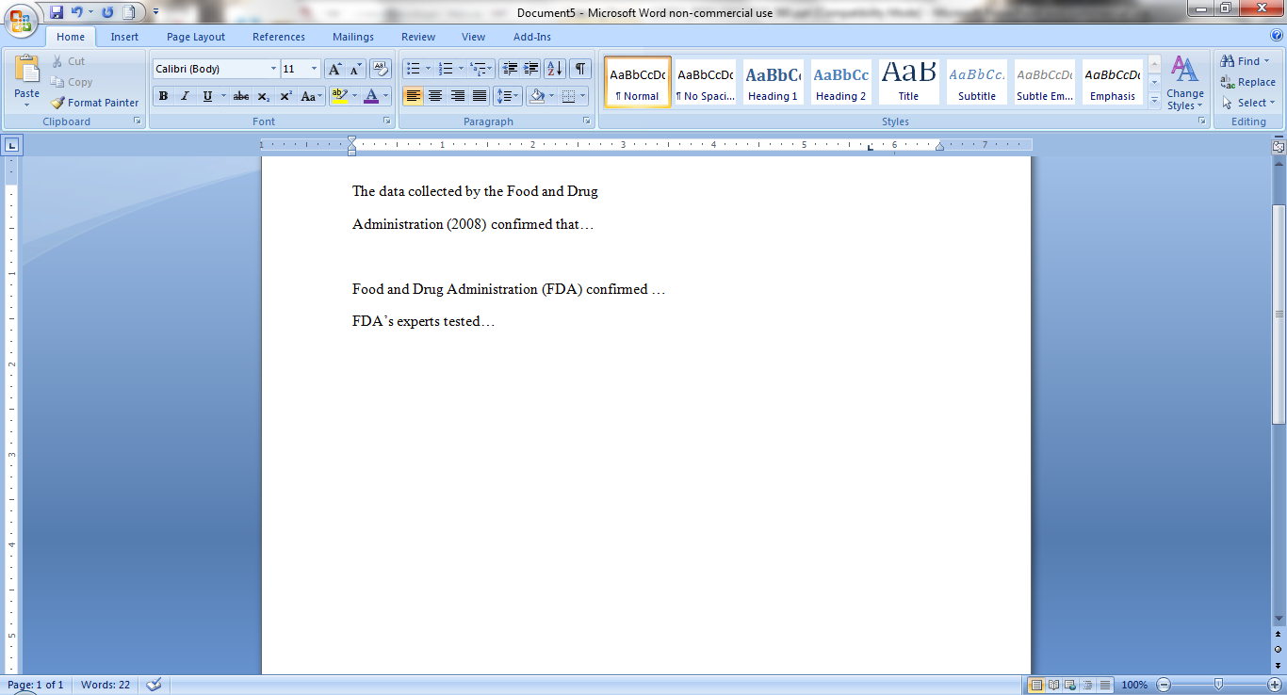
In-Text Citation:
Organization
When citing an organization:
mention the organization the first time you cite the source in the signal phrase or the parenthetical citation.
If the organization has a well-known abbreviation, include the abbreviation in brackets the first time the source is cited and then use only the abbreviation in later citations.
Notes:
This slide explains and exemplifies the specific cases of in-text citations. It might be supplemented with “Author/Authors” section from OWL http://owl.english.purdue.edu/owl/resource/560/03/

Slide 30
In-Text Citation:
Same Last Name/Author
When citing authors with the same last names, use first initials with the last names.
(B. Kachru, 2005; Y. Kachru, 2008)
When citing two or more works by the same author and published in the same year, use lower-case letters (a, b, c) after the year of publication to order the references.
Smith’s (1998a) study of adolescent immigrants…
Notes:
This slide explains and exemplifies the specific cases of in-text citations. It might be supplemented with “Author/Authors” section from OWL http://owl.english.purdue.edu/owl/resource/560/03/

Slide 31
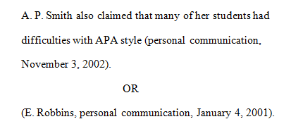
In-Text Citation:
Personal Communication
When citing interviews, letters, e-mails, etc., include the communicator’s name, the fact that it was personal communication, and the date of the communication.
Do not include personal communication in the reference list.
Notes:
This slide explains and exemplifies the specific cases of in-text citations. It might be supplemented with “Author/Authors” section from OWL http://owl.english.purdue.edu/owl/resource/560/03/

Slide 32
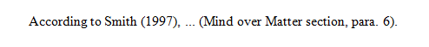
In-Text Citation:
Electronic Sources
When citing an electronic document, whenever possible, cite it in the author-date style. If electronic source lacks page numbers, locate and identify paragraph number/paragraph heading.
Notes:
This slide explains and exemplifies the specific cases of in-text citations. It might be supplemented with “Author/Authors” section from OWL http://owl.english.purdue.edu/owl/resource/560/03/

Slide 33
Headings
APA uses a system of five heading levels
APA Headings
Level | Format
1 | Centered, Boldfaced, Upper & Lowercase Headings
2 | Left-aligned, Boldface, Upper & Lowercase Headings
3 | Indented, boldface, lowercase heading with a period.
4 | Indented, boldface, italicized, lowercase heading with period.
5 | Indented, italicized, lowercase heading with a period.
Notes:
This slide explains a system of five heading levels in APA. It might be supplemented by the section “APA Headings” from OWL http://owl.english.purdue.edu/owl/resource/560/16/

Slide 34
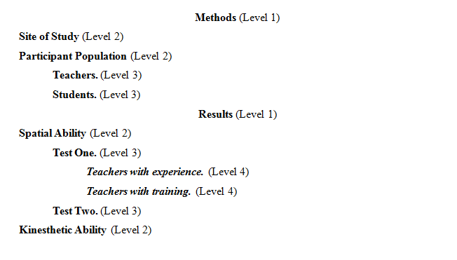
Headings
Here is an example of the five-level heading system:
Notes:
Thus, if the article has four sections, some of which have subsection and some of which don’t, use headings depending on the level of subordination. Section headings receive level one format. Subsections receive level two format. Subsections of subsections receive level three format. In APA Style, the Introduction section never gets a heading and headings are not indicated by letters or numbers. Levels of headings will depend upon the length and organization of your paper. Regardless, always begin with level one headings and proceed to level two, etc.

Slide 35
Tables
Label tables with an Arabic numeral and provide a title. The label and title appear on separate lines above the table, flush-left and single-spaced.
Cite a source in a note below the table.
Table 1
Internet users in Europe
Country | Regular Users
France | 9 ml
Note: The data are adapted from “The European Union and Russia” (2007). Retrieved from http://epp.eurostat.ec.europa.eu
Notes:
Tables are a common and often required feature of an APA format (consider, the research article, for example). This slide provides visual guidelines to formatting tables in APA.
The facilitator should point that a table format consists of four elements:
The table label—e.g., Table 1
The title in italics , both appearing on separate lines above the table, flush-left and single-spaced
The table
The Citation of the source below the table in the form of Note (see the example on the slide).

Slide 36
Figures
Label figures with an Arabic numeral and provide a title. The label and the title appear on the same line below the figure, flush-left .
You might provide an additional title centered above the figure.
Cite the source below the label and the title.
Figure 1. Internet users in Europe. Adapted from The European Union and Russia: Statistical comparison by Eurostat Statistical Books, 2007, Retrieved from http://epp.eurostat.ec.europa.eu
Notes:
Although figures in an APA paper are formatted in a manner which is similar to that of formatting tables, there a few differences.
In particular, the order is the following:
You might provide an additional title centered above the figure.
The figure
The label and title (in italics) on the same line below the figure, flush-left: Figure 1. Internet users in Europe
A Citation of the source below the table in the form of Note (see the example on the slide).

Slide 37
Additional Resources
The Purdue OWL: http://owl.english.purdue.edu
The Purdue Writing Lab @ HEAV 226
Composition textbooks
Publication Manual of the American Psychological Association, 6th ed.
APA’s website: http://www.apastyle.org
Notes:
There are many rules for following APA format, and the facilitator should stress that it is nearly impossible to memorize them all. Students’ best course of action is to utilize the official APA handbook or the APA section in an updated composition textbook as guides for properly using the documentation format. Since the American Psychological Association, a professional group of behavioral and social science professors and instructors, periodically updates the guide, students should be certain that they are using the most current information possible.
There are other resources for finding current information on APA documentation style. The APA web site offers some limited information about recent format changes, especially regarding the documentation of World Wide Web and electronic sources. The Purdue University Writing Lab has a page on APA formatting and documentation style at its web site: http://owl.english.purdue.edu/owl/resource/560/01/ For quick questions on APA format, students can also call the Writing Lab Grammar Hotline at 494-3723.

Slide 38
The End
APA Formatting and Style Guide
Brought to you in cooperation with the Purdue Online Writing Lab
Notes:
Writer and Designer: Jennifer Liethen Kunka
Contributors: Muriel Harris, Karen Bishop, Bryan Kopp, Matthew Mooney, David Neyhart, and Andrew Kunka
Revising Author: Ghada M. Gherwash and Joshua M. Paiz, 2014 Elizabeth Angeli, 2011; Elena Lawrick, 2008; Arielle McKee, 2014
Developed with resources courtesy of the Purdue University Writing Lab
Grant funding courtesy of the Multimedia Instructional Development Center at Purdue University
© Copyright Purdue University, 2000, 2006, 2007, 2008

