Slide 1
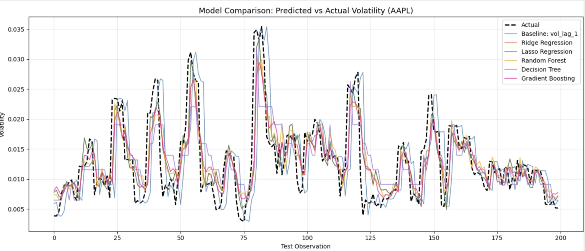
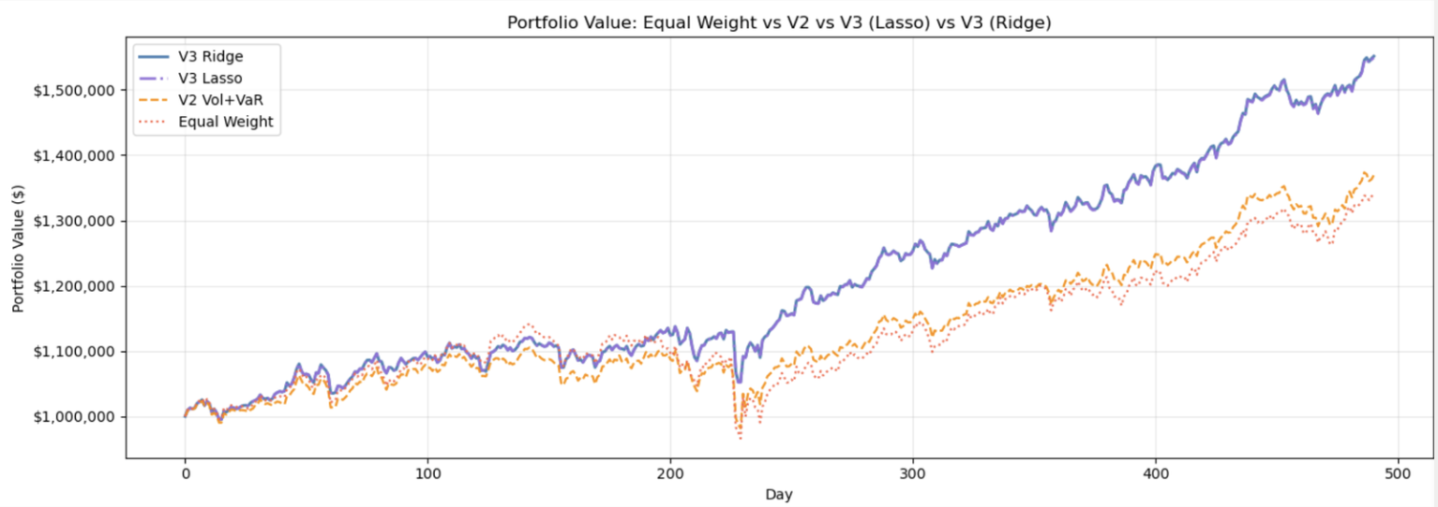
Machine Learning for Short-Term Volatility Prediction
Jules Dao & Rose Nguyen · DATA 300: Statistical and Machine Learning · Prof. Lulu Wang
Dickinson College · Group 3 · Spring 2026
ABSTRACT
PREDICTED VS ACTUAL VOLATILITY (AAPL)
Metric | Equal Weight | V2 Vol+VaR | V3 Lasso | V3 Ridge ★
Total Return | 34.17% | 36.94% | 54.94% | 55.17%
Ann. Volatility | 12.90% | 11.63% | 11.14% | 11.14%
Sharpe Ratio | 1.24 | 1.45 | 2.08 | 2.08
Max Drawdown | −15.38% | −11.19% | −7.49% | −7.48%
Calmar Ratio | 2.22 | 3.30 | 7.34 | 7.37
Win Rate | 56.33% | 55.31% | 59.18% | 59.39%
This project investigates supervised machine learning for predicting short-term equity volatility across S&P 500 constituents. Five models are benchmarked against a naive baseline on 2015–2026 daily data. Lasso Regression achieves the best generalization (Test R² ≈ 0.756). Predictions drive a volatility-parity portfolio delivering 55.17% total return, Sharpe of 2.08, and max drawdown of −7.48% — versus 34.17%, 1.24, and −15.38% for equal-weight.
PURPOSE & GOALS
Research Question:
Which ML model best predicts next-day equity volatility, and does better accuracy translate into superior risk-adjusted returns?
Goals:
KEY FINDINGS
Compare 5 regression models systematically.
Engineer domain-informed features.
Validate via portfolio backtesting.
Lasso/Ridge achieve R² ≈ 0.756 — all ML models substantially outperform naive baseline (R² = 0.453).
Better vol prediction directly improves risk management: Sharpe 2.08 vs 1.24, drawdown −7.48% vs −15.38%.
Marginal RMSE difference (Lasso vs Ridge) does not affect portfolio outcomes at average-case level.
V3 strategies confirm that momentum filtering and regime detection add real economic value.
DATA
MODEL COMPARISON
Daily OHLCV data for S&P 500 constituents spanning January 2015 to April 2026.
1,381,187 stock-day observations across hundreds of tickers.
Table 1. Final Test-Set Evaluation
Table 2. Spike-Day RMSE Analysis
Model | Test RMSE | Test MAE | Test R²
★ Lasso | 0.006533 | 0.003749 | 0.756
Ridge | 0.006536 | 0.003749 | 0.756
Rand. For. | 0.006539 | 0.003784 | 0.755
Grad. Bst | 0.006581 | 0.003795 | 0.752
Dec. Tree | 0.007710 | 0.004647 | 0.660
Baseline | 0.009779 | 0.005418 | 0.453
Model | Overall RMSE | Asymmetric RMSE | Spike RMSE
Ridge Regression | 0.006536 | 0.008349 | 0.015017
Lasso Regression | 0.006533 | 0.008349 | 0.015029
Random Forest | 0.006539 | 0.008392 | 0.015219
Gradient Boosting | 0.006581 | 0.008492 | 0.015508
Decision Tree | 0.007710 | 0.009658 | 0.016975
Baseline: vol_lag_1 | 0.009779 | 0.012033 | 0.020990
METHODS
CHALLENGES
Data Split:
Data leakage debugging in rolling-window feature construction.
Computational scale: 1.38M rows required careful pipeline design.
Right-skewed target with extreme outliers (max = 1.93).
SVM and neural net dropped due to time constraints.
Train: Jan 2015 – Feb 2024
Test: Feb 2024 – Apr 2026
Chronological split — no shuffling
Lasso is the best model with lowest CV RMSE Mean and Std. However, on extreme volatility days, Ridge marginally outperforms Lasso (Spike RMSE 0.015017 vs 0.015029), suggesting L2 shrinkage extrapolates to tail events slightly better.
→ Model choice depends on objective: average accuracy → Lasso | tail-risk sensitivity → Ridge
Models:
SPIKE-DAY ANALYSIS (TOP 5% VOLATILITY DAYS)
Lasso Regression ★
PORTFOLIO BACKTESTING RESULTS
Ridge Regression
FUTURE DIRECTIONS
Gradient Boosting
GARCH / LSTM benchmarks for formal comparison.
Walk-forward backtesting with periodic retraining.
Stress-test on 2008, COVID, 2022 crisis periods.
Options-implied volatility as forward-looking feature.
Random Forest
Decision Tree
Evaluation:
Metric | Equal Wt. | V2 Vol+VaR | V3 Lasso | V3 Ridge ★
Total Return | 34.17% | 36.94% | 54.94% | 55.17%
Ann. Volatility | 12.90% | 11.63% | 11.14% | 11.14%
Sharpe Ratio | 1.24 | 1.45 | 2.08 | 2.08
Max Drawdown | −15.38% | −11.19% | −7.49% | −7.48%
Calmar Ratio | 2.22 | 3.30 | 7.34 | 7.37
Win Rate | 56.33% | 55.31% | 59.18% | 59.39%
5-fold time-series CV · RMSE · MAE · R²
FEATURE ENGINEERING
REFERENCES
Feature | Correlation
ewma_vol | +0.888
vol_10 | +0.828
vol_lag_1 | +0.827
vol_lag_2 | +0.742
r_pos_5 | +0.662
r_neg_5 | −0.756
return_lag_1 | −0.047
return_lag_2 | −0.062
return_10 | −0.174
Asness, Frazzini & Pedersen (2012). Risk Parity.
Bollerslev (1986). J. Econometrics — GARCH.
Ghysels, Santa-Clara & Valkanov (2004). MIDAS.
Nelson (1991). Econometrica — EGARCH.
Yang (2023). ICFTBA Proceedings.
Salt Financial (n.d.). Volatility Forecasting Guide.
Yang (2023) ICFTBA · Ghysels et al. (2004) · Bollerslev (1986) GARCH · Nelson (1991) EGARCH · Asness et al. (2012) Risk Parity · Salt Financial n.d.

