Slide 1

CUSTOMER RETENTION STRATEGY · BUSINESS ANALYTICS CASE STUDY
Who won't come back,
and where retention
spend actually pays off
A churn-prediction and value-based targeting analysis of
232,079 shoppers across five months of a cosmetics store
Rose Nguyen

Slide 2
PART I
Business Context
Executive summary
Business problem
Project approach

Slide 3
EXECUTIVE SUMMARY
PART I · BUSINESS CONTEXT
Most first-time shoppers never return, and 98% of the revenue at risk sits in just two segments
77%
0.82
$572k
$0.05
of October shoppers do not return within 60 days
ROC-AUC churn model, beating a recency-only rule (0.74)
total 60-day revenue at risk - 70% in one segment
spend per $1 defended under value-first targeting, vs $99 churn-first
Recommendation: shift retention budget from the highest-churn segment to the highest revenue-at-risk segment, and act on early week-one behaviour before customers are gone.
Rose Nguyen · Customer Retention Strategy
2

Slide 4
BUSINESS PROBLEM
PART I · BUSINESS CONTEXT
On a browse-heavy store, value comes from repeat visits - yet three in four shoppers vanish
A cosmetics store where low-ticket, impulse purchases mean revenue depends on customers coming back, not on any single order.
Situation
77% of October-active users never return in the next 60 days. Retention, not acquisition, is the binding constraint.
Complication
Who will not return? Which early behaviors predict that? And where should retention budget be spent?
Question
Rose Nguyen · Customer Retention Strategy
3

Slide 5
PROJECT APPROACH
PART I · BUSINESS CONTEXT
A leakage-free model built and validated to withstand scrutiny
Data
Leakage-free label
232k users · 5 months of view / cart / purchase events; October behaviour, Nov–Dec outcomes
Features from October only; churn measured from a disjoint future window - recency can't leak the target
Two models
Validation
Interpretable logistic regression benchmarked against gradient boosting for the predictive ceiling
5-fold cross-validation (±0.001), naive baselines, permutation importance, calibration check
Rose Nguyen · Customer Retention Strategy
4

Slide 6
PART II
Business Diagnostics
Understanding customer behaviour
Funnel analysis
Retention analysis

Slide 7
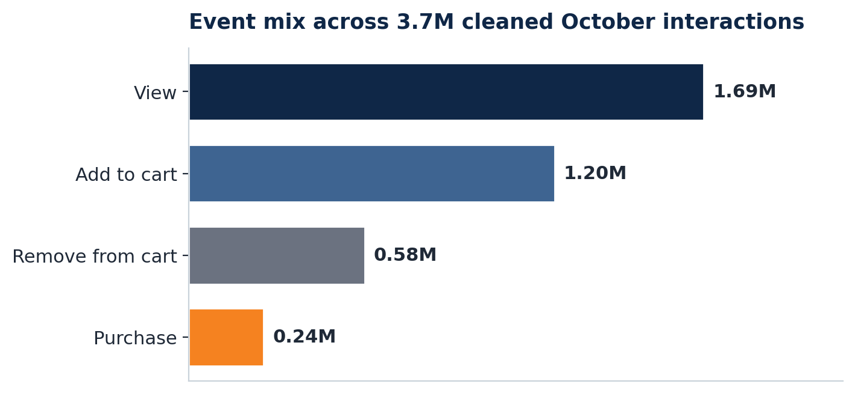
UNDERSTANDING CUSTOMER BEHAVIOUR
PART II · BUSINESS DIAGNOSTICS
A high-volume, low-ticket, browse-heavy store
3.7M
Cleaned interactions from 232,079 shoppers
$4.11
Median item price - impulse-priced
25,755
Buyers; median buyer spend $32
1 session
For the median user - mostly one-and-done
Rose Nguyen · Customer Retention Strategy
5

Slide 8
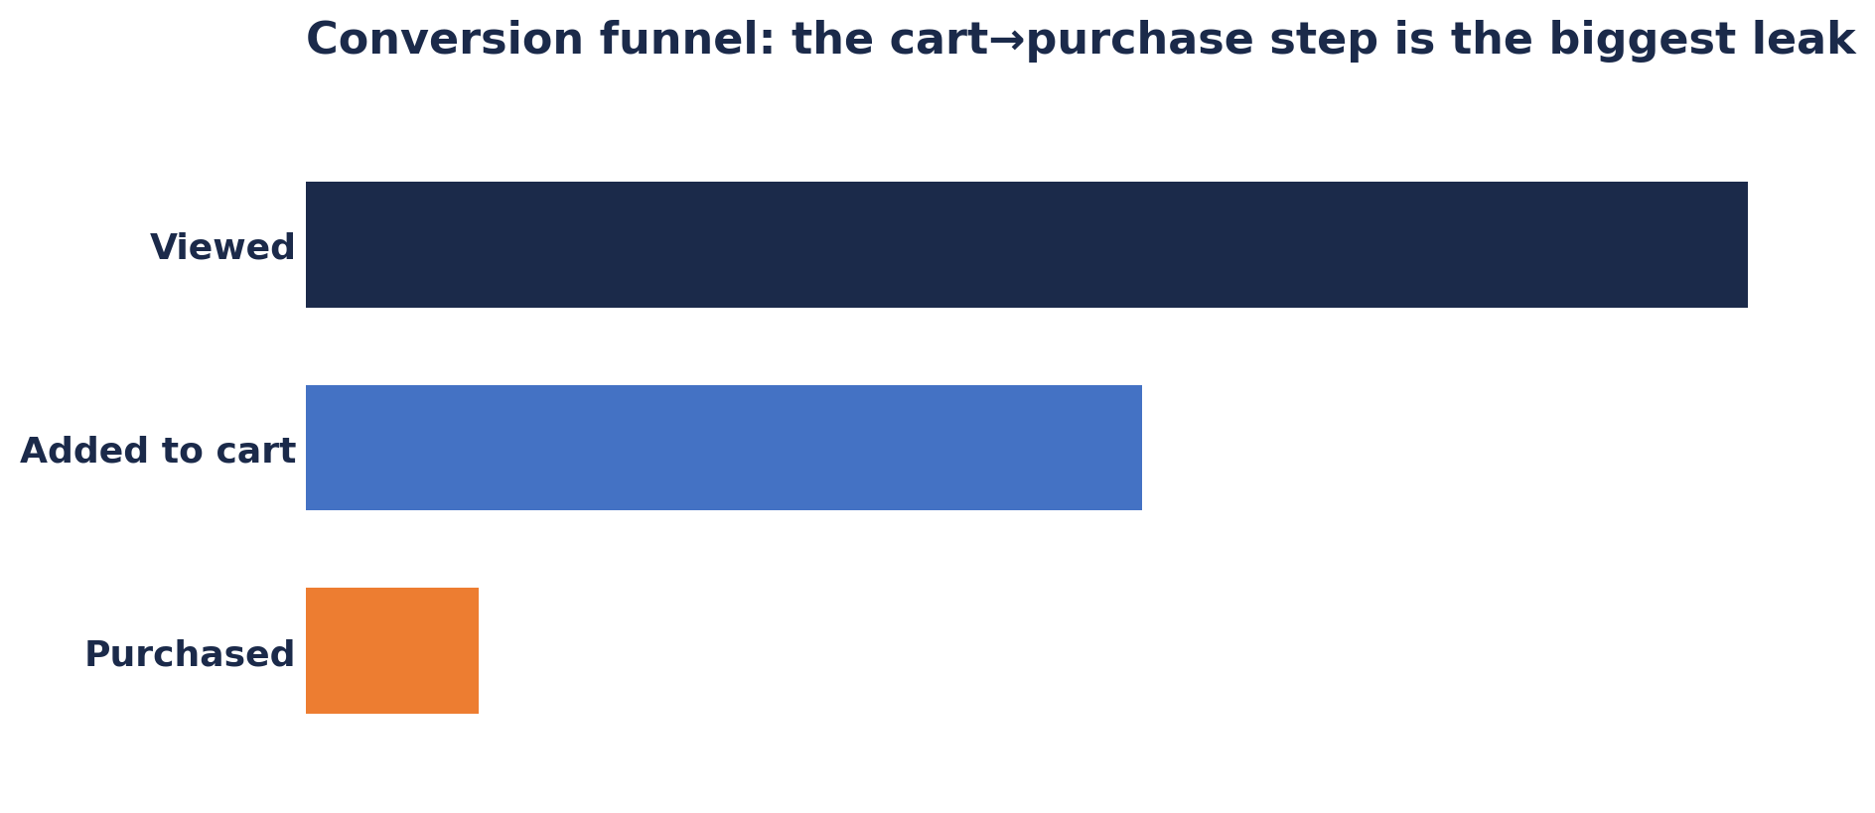
FUNNEL ANALYSIS
PART II · BUSINESS DIAGNOSTICS
58% of viewers add to cart - but only 1 in 5 carts convert
Where the leak is
The steep drop from intent to purchased is the biggest single leak in
the funnel: a large share of shoppers add products to the cart but never complete a purchase.
A cart-stage recovery mechanism has the largest surface area to lift returns and revenue.
100%
58%
12%
Rose Nguyen · Customer Retention Strategy
6

Slide 9
RETENTION ANALYSIS
PART II · BUSINESS DIAGNOSTICS
Most users never form a habit - retention collapses right after the first visit
1
Week 0
Early
session for the median user, most shoppers appear once and leave
is where the cohort curve falls off a cliff, few return the next week
depth (multiple sessions, more active days) is the strongest protective signal
Churn must be predicted from week-1 behaviour. By the time inactivity is visible, the customer is already gone, which is also why a naive 30-day-inactivity label leaks.
Rose Nguyen · Customer Retention Strategy
7

Slide 10
PART III
Predictive Analytics
Predicting customer churn
What drives customer churn?

Slide 11
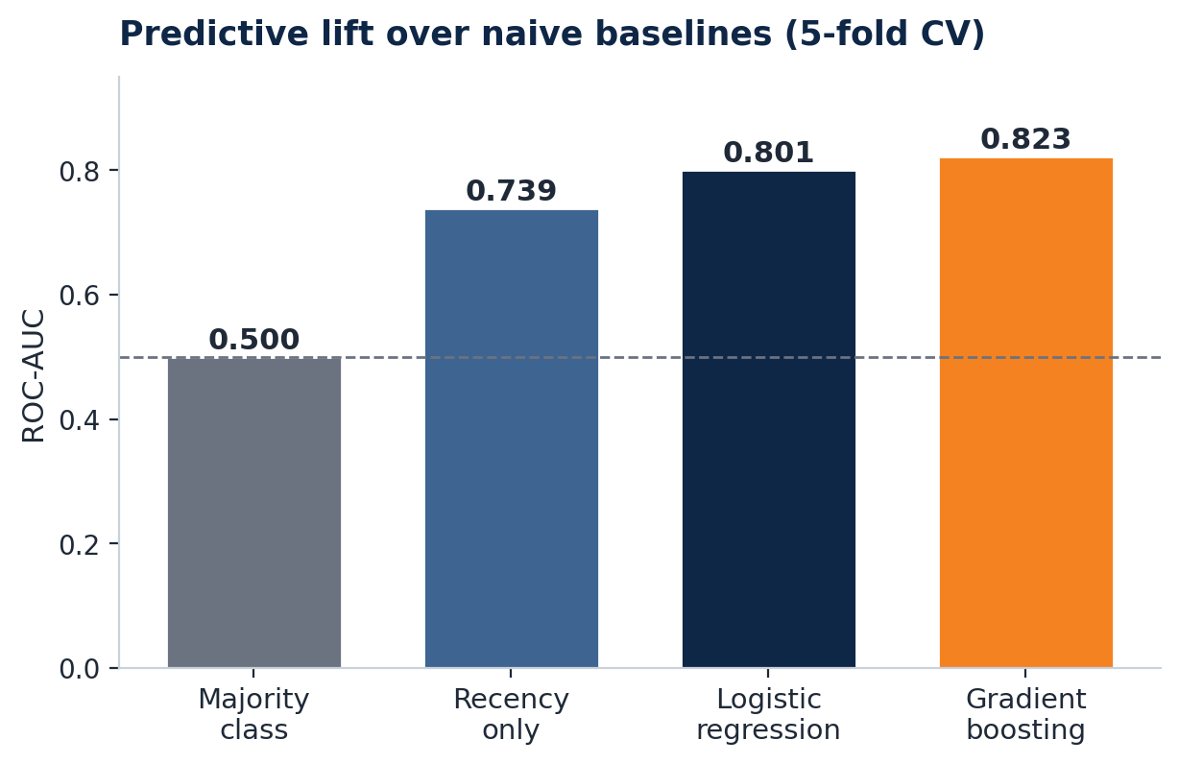
PREDICTING CUSTOMER CHURN
PART III · PREDICTIVE ANALYTICS
The behavioral model predicts non-return at ROC-AUC 0.82, clearly beating recency alone
What it means
Recency alone delivers strong predictive performance (ROC-AUC = 0.74). Adding customer behavior features further improves performance to 0.80-0.82. Because non-return accounts for 77% of customers, ROC-AUC and the improvement over the 0.50 baseline provide a more reliable measure of model performance than PR-AUC.
Rose Nguyen · Customer Retention Strategy
8

Slide 12
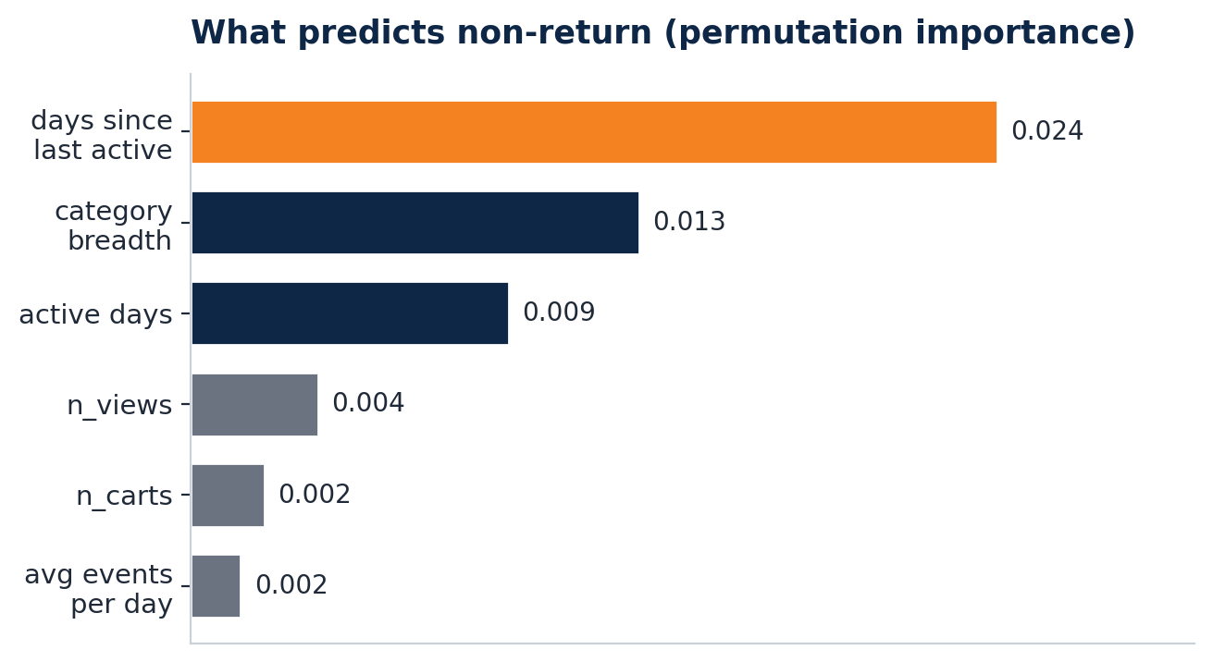
WHAT DRIVES CUSTOMER CHURN?
PART III · PREDICTIVE ANALYTICS
Three early signals separate returners from churners
What it means
Recency within October is the top risk signal, category breadth and active days are are associated with lower non-return risk, and both models agree, above their error bars. Shoppers who explore broadly and return across days are far likelier to stay.
Rose Nguyen · Customer Retention Strategy
9

Slide 13
PART IV
Business Strategy
Where is revenue actually at risk?
Value-based targeting strategy
Financial impact

Slide 14
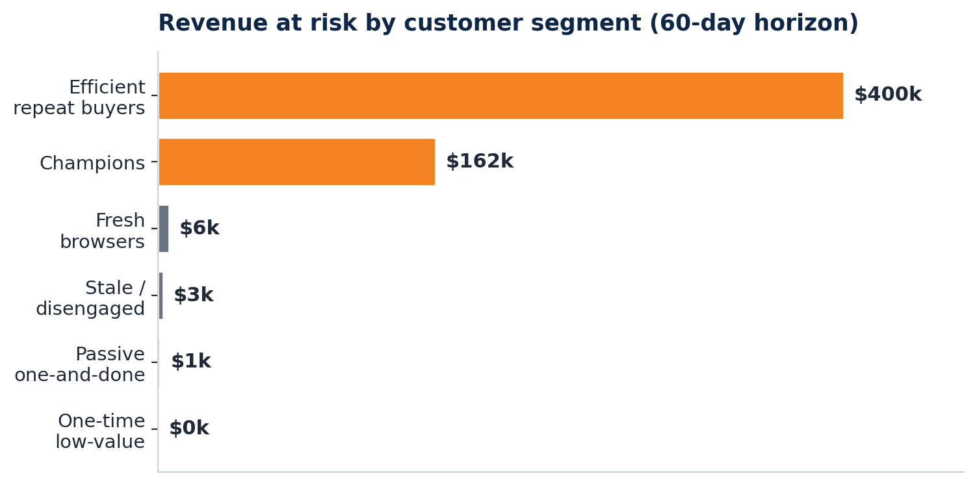
WHERE IS REVENUE ACTUALLY AT RISK?
PART IV · BUSINESS STRATEGY
Churn rate misleads: 98% of the $572k at risk sits in just two segments
$400k
sits with Efficient repeat buyers - more than the other five segments combined. Champions add $162k. The 91%-churn stale segment carries just $3k.
Rose Nguyen · Customer Retention Strategy
10

Slide 15
VALUE-BASED TARGETING STRATEGY
PART IV · BUSINESS STRATEGY
Contact a user only when churn probability × incremental uplift × value exceeds contact cost
The model produces well-calibrated probabilities (Brier Score = 0.129), making its predictions reliable for business decisions. Customers are contacted only when their expected value exceeds the intervention cost (break-even: $22.50). This ensures marketing resources are focused on high-value, at-risk customers while avoiding unnecessary outreach to low-value segments.
3.4%
$81 vs $2.56
37% / 22%
Of users selected - a focused, fundable campaign
Average Oct spend of targeted vs non-targeted
Of repeat buyers and champions targeted, 0% of stale
Rose Nguyen · Customer Retention Strategy
11

Slide 16
FINANCIAL IMPACT
PART IV · BUSINESS STRATEGY
Value-first targeting defends $1 of revenue for 5 cents; churn-first pays $99
Churn-first (naive)
Value-first (recommended)
Contact the whole 91%-churn stale segment
Contact only users with positive expected value
Users contacted
111,339
Users contacted
~7,960
Campaign spend / cycle
$301k
Campaign spend / cycle
$21k
Revenue at risk addressed
$3k
Revenue at risk addressed
$400k segment
Campaign cost per $1 of at-risk revenue addressed
$98.8
Campaign cost per $1 of at-risk revenue addressed
$0.05
Expected profit ≈ $21k per 60-day cycle at full user base under illustrative economics ($2.70/contact, 12% uplift). A fixed 15% budget rule tests negative (−$29k) at the same scale: only 3.4% of users clear the break-even, so the quota forces ~8,000 additional contacts below it, each destroying about $1.87, so the EV>0 rule is retained. Dollar inputs are assumptions to tune against real campaign costs.
Rose Nguyen · Customer Retention Strategy
12

Slide 17
PART V
Implementation
Strategic recommendations
Implementation roadmap
Validation plan
Limitations & next steps

Slide 18
STRATEGIC RECOMMENDATIONS
PART V · IMPLEMENTATION
Three levers, sequenced by return on effort
01
02
03
48-hour cart-abandonment nudge
Early-activation onboarding
High-value win-back program
Recover the largest funnel leak while intent is warm.
Build week-1 depth for shallow, single-session users.
Protect the ~$400k at-risk repeat-buyer segment first.
Metric: cart→purchase, 60-day return
Metric: sessions/user, week-1→2 retention
Metric: churn in high-value tier
Rose Nguyen · Customer Retention Strategy
13

Slide 19
IMPLEMENTATION ROADMAP
PART V · IMPLEMENTATION
From model to money in three phases
PHASE 1
PHASE 2
PHASE 3
Prove
Scale
Institutionalise
Weeks 1–4
Months 2–3
Months 4–6
Deploy churn risk score to CRM
Launch cart-nudge A/B on the $400k segment
Baseline dashboards: return rate, cart→purchase
Read out A/B; roll out winning nudge
Launch early-activation onboarding flow
Wire EV>0 value-first targeting into campaigns
Monthly model retrain + drift monitoring
Quasi-experimental causal read (propensity-score matching / difference-in-differences)
Extend label windows; upgrade spend to CLV
KPI: A/B live · risk score in CRM
KPI: +3pp 60-day return; +5pp cart→purchase
KPI: stable AUC ≥0.80; +$20k / cycle profit
Gate to scale: A/B shows ≥3pp lift in 60-day return at 95% confidence, with flat opt-out and revenue guardrails.
Rose Nguyen · Customer Retention Strategy
14

Slide 20
VALIDATION PLAN
PART V · IMPLEMENTATION
Prove it before scaling: a powered, guardrailed A/B test
Note: the dataset is observational - this is a validated experimental design, not a completed A/B test.
Hypothesis
A 48-hour cart-abandonment nudge lifts the 60-day return rate
Design
Users randomised 50/50; two-proportion z-test on return rate with a 95% CI
Power
Sized for a 3pp lift at 80% power from the 22.9% baseline return rate
Guardrails
Notification opt-out and revenue/user; fixed sample size - no peeking
Rose Nguyen · Customer Retention Strategy
15

Slide 21
LIMITATIONS & NEXT STEPS
PART V · IMPLEMENTATION
What this analysis is - and is not
Next steps
Run the cart-nudge A/B test on the priority segment
Deploy calibrated risk scores for live targeting
Extend the cohort view across all five months
Validate causal lift with matching / difference-in-differences
Limitations
“Churn” means non-return, not subscription cancellation
No demographics or marketing channel - product/UX levers only
Nov-Dec label overlaps Black Friday, so churn is a lower bound
Dollar targeting inputs are illustrative assumptions
Rose Nguyen · Customer Retention Strategy
16

Slide 22
FINAL TAKEAWAY
Predict non-return early, then spend where revenue is at risk, not where churn is highest.
Rose Nguyen · Customer Retention Strategy

