Slide 1

All About Standards
PAL Leader: Rose Nichols
Notes:
Introduce myself

Slide 2


Today’s Session
Introduction to Protocols
Introduction to Web Standards
Why bother with standards?
Using the W3C Validator
Activity - Basic XHTML coding & validation

Slide 3
Protocols
A protocol is a set of rules and procedures that allow controlled communication
You will have come across many protocols already
HTTP, FTP, TCP/IP, SMTP
Can you name any others and how they’re used?

Slide 4
Standards
Standards are important
Standards are a level to which coding languages need to conform
Who sets the standards?
Can you name any standards?
Why should we bother with standards?

Slide 5
Why bother with standards?
Cross-browser compatibility
Accessibility
Readability
Appearance
Professionalism
Site Maintenance

Slide 6
W3C Validator
http://validator.w3.org/
Try validating some well-known sites, such as:
  Google, Amazon
  eBay, UWE
Then some less well-known sites!
See if you can find any trending patterns

Slide 7
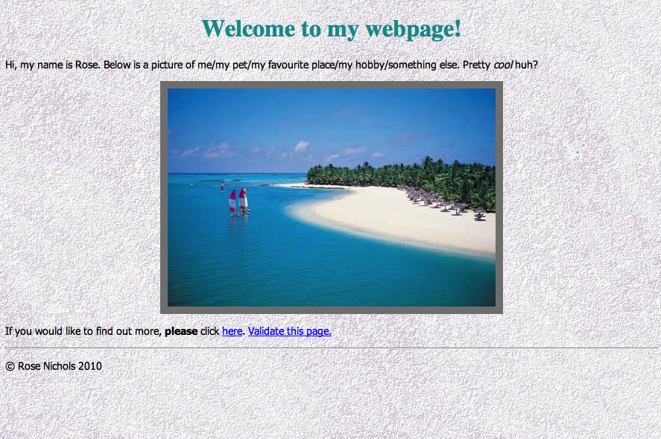
Activity

Slide 8
Please get in touch rose2.nichols@live.uwe.ac.uk

