Slide 1
HTML vs. XHTML
+ Assignment Preview

Slide 2
Today’s Session...
What is XHTML?
XHTML vs. HTML
Differences in syntax
Which should you use?
Transitional vs. Strict
Frames, Tables, Divs & Spans
Introduction to CSS
Assignment preview

Slide 3
What is XHTML?
Extensible Hypertext Markup Language
Almost identical to HTML 4.01
Intended to replace HTML
“a stricter and cleaner version of HTML”
Became a W3C Recommendation January, 2000.
Different syntax

Slide 4
Differences in Syntax
<P>Hello<br>Welcome to XHTML
<B><i>Here you will learn</i></B>
<font color=“red”>how you write XHTML</font>
<center>compared to HTML 4.01</center>
<img src=“image.jpg”>
<a href=http://www.google.co.uk>Google</a>

Slide 5
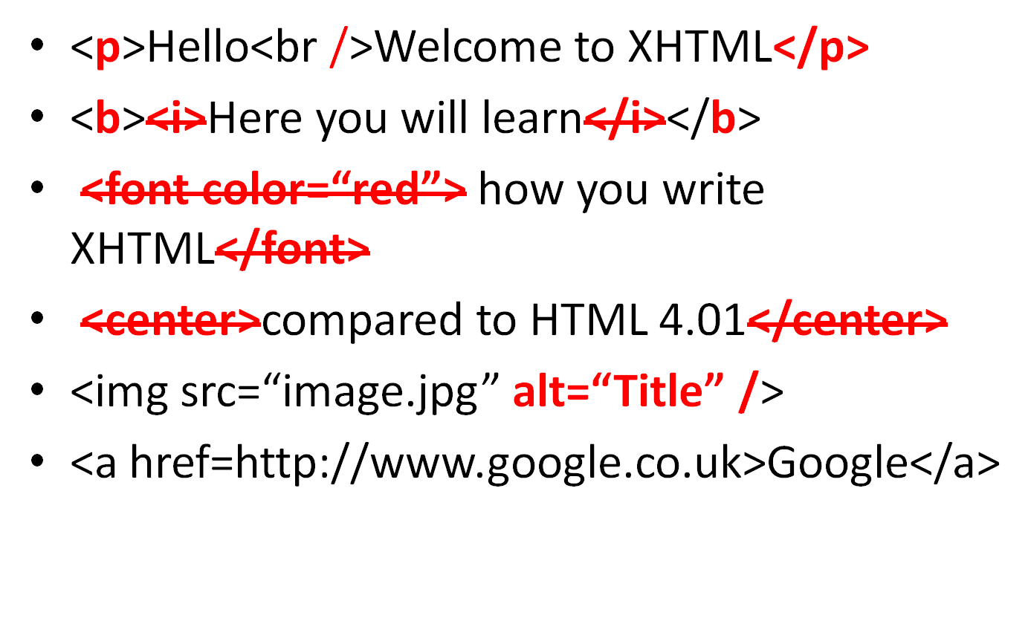
Differences in Syntax

Slide 6
Differences in Syntax
To change the font colour...
To change the text position...
Use CSS
(we will come back to this later)

Slide 7
Which Should You Use?
XHTML!!!
More modern
More cross-browser compatible
Preferred professionally
Allows greater flexibility
Gets you more used to writing CSS
Can get you more marks on certain assignments (!)

Slide 8
Transitional vs. Strict
Always aim for strict code
To developers, transitional tends to show a lack of knowledge or dedication to coding
XHTML & HTML were created to be standard by default
Strict ensures maximum browser compatibility
In strict: <font>, <center>, <iframe>, <strike>, <u> are not valid

Slide 9
Frames, Tables, Divs & Spans
Do NOT use frames!
Use tables for tabular data ONLY!
Use divs to form your page layout
Use spans for formatting small amounts of content

Slide 10
Introduction to CSS
Not required for Assignment
Cascading Style Sheets
Used to describe the presentation (look & formatting) of a webpage
Evolved from HTML attributes e.g. <img border... & <body bgcolor...
External, Internal & Inline
  What’s the difference?
  Find out how to import a stylesheet
  How do you set a background colour using CSS?

Slide 11
Introduction to CSS
What’s the difference?
  External = separate .css file imported into XHTML page
  Internal = defined in page <head>
  Inline = defined in <body> in element
Find out how to import a stylesheet
  <link rel="stylesheet" type="text/css" href="style.css" />
How do you set a background colour using CSS?
  Body { background: #CC0000; }

Slide 12
Re: Differences in Syntax
Change font colour using CSS:
.red { color: #FF0000; }
Use this in your XHTML:
<p class=“red”>Text here</p>
Change text position using CSS:.center {text-align: center;}Use this in your XHTML:<p class=“center”>Text here</p>

Slide 13
Assignment Preview
Thursday 3rd December 2009, 2pm (!!!)
A report of 1000 words
A blog linked to the module exercises
A “Charity” website
37.5% of total module marks
< 40% = fail, 40%-50% = Third, 50%-60% = 2.2, 60%-70%=2.1, 70%+ = First

Slide 14
Assignment Preview
This assessment provides an opportunity to:
  experiment with blogging technology
  identify key learning points within the early stages of this module and adopt a reflective approach to learning
  search the Web and collect a set of useful links to web resources
  demonstrate mastery of the exercises set in the module exercises

Slide 15
Next Week...
Opportunity to do some XHTML coding
JavaScript
CSS
Introduction to forms
Assignment help
+ WHATEVER YOU WANT!!

