Slide 1

Machine Learning Methods for Satellite Image Analysis: Neural Networks and Support Vector Machines
Macarena Ortiz & Juan Pinales
November 18, 2015
Lunchbytes

Slide 2
Outline
The Problem of Pattern Recognition
The Machine Learning Approach
Neural Networks
  Background
  Training a feedforward neural network by backpropagation
    Application: Using a neural network to classify algal blooms in a satellite image
What are Support Vector Machines?
  Background and easy explanation of what they are and what they can do. Some math illustrated for the masochists.
  Use SVMs on a satellite image using a one-class learning method and achieve a binary classification image to detect algal blooms.
Toolboxes and Modules for Machine Learning

Slide 3
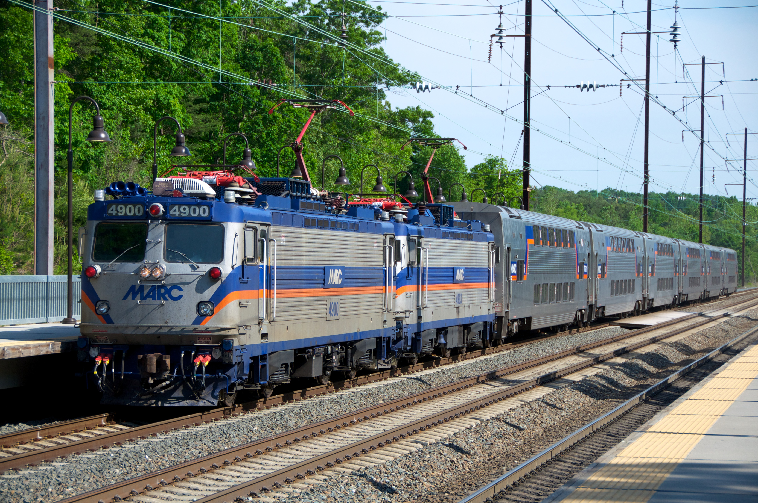
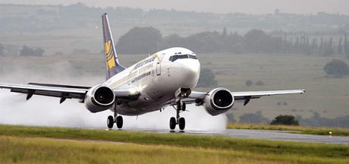
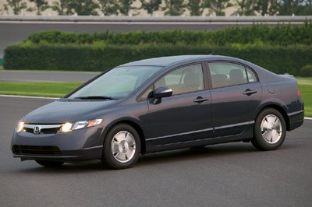
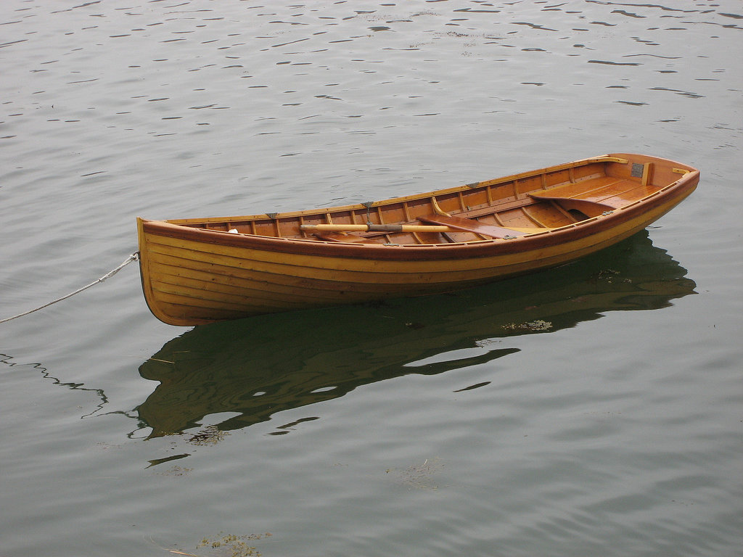

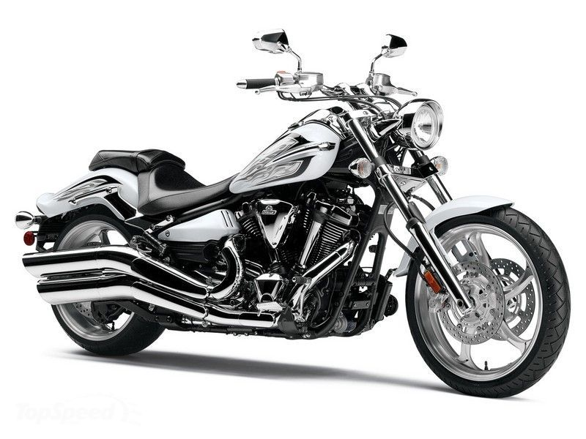
The Problem of Pattern Recognition
Problem: Develop an image processing algorithm that can identify vehicles in a image dataset.
Central question: How do we define a vehicle?
Form
  Does it have wheels?
    Quantity?
    Size?
Function
  Transportation of people?
  Transportation of goods?
  Movement through land, air, or sea?

Slide 4
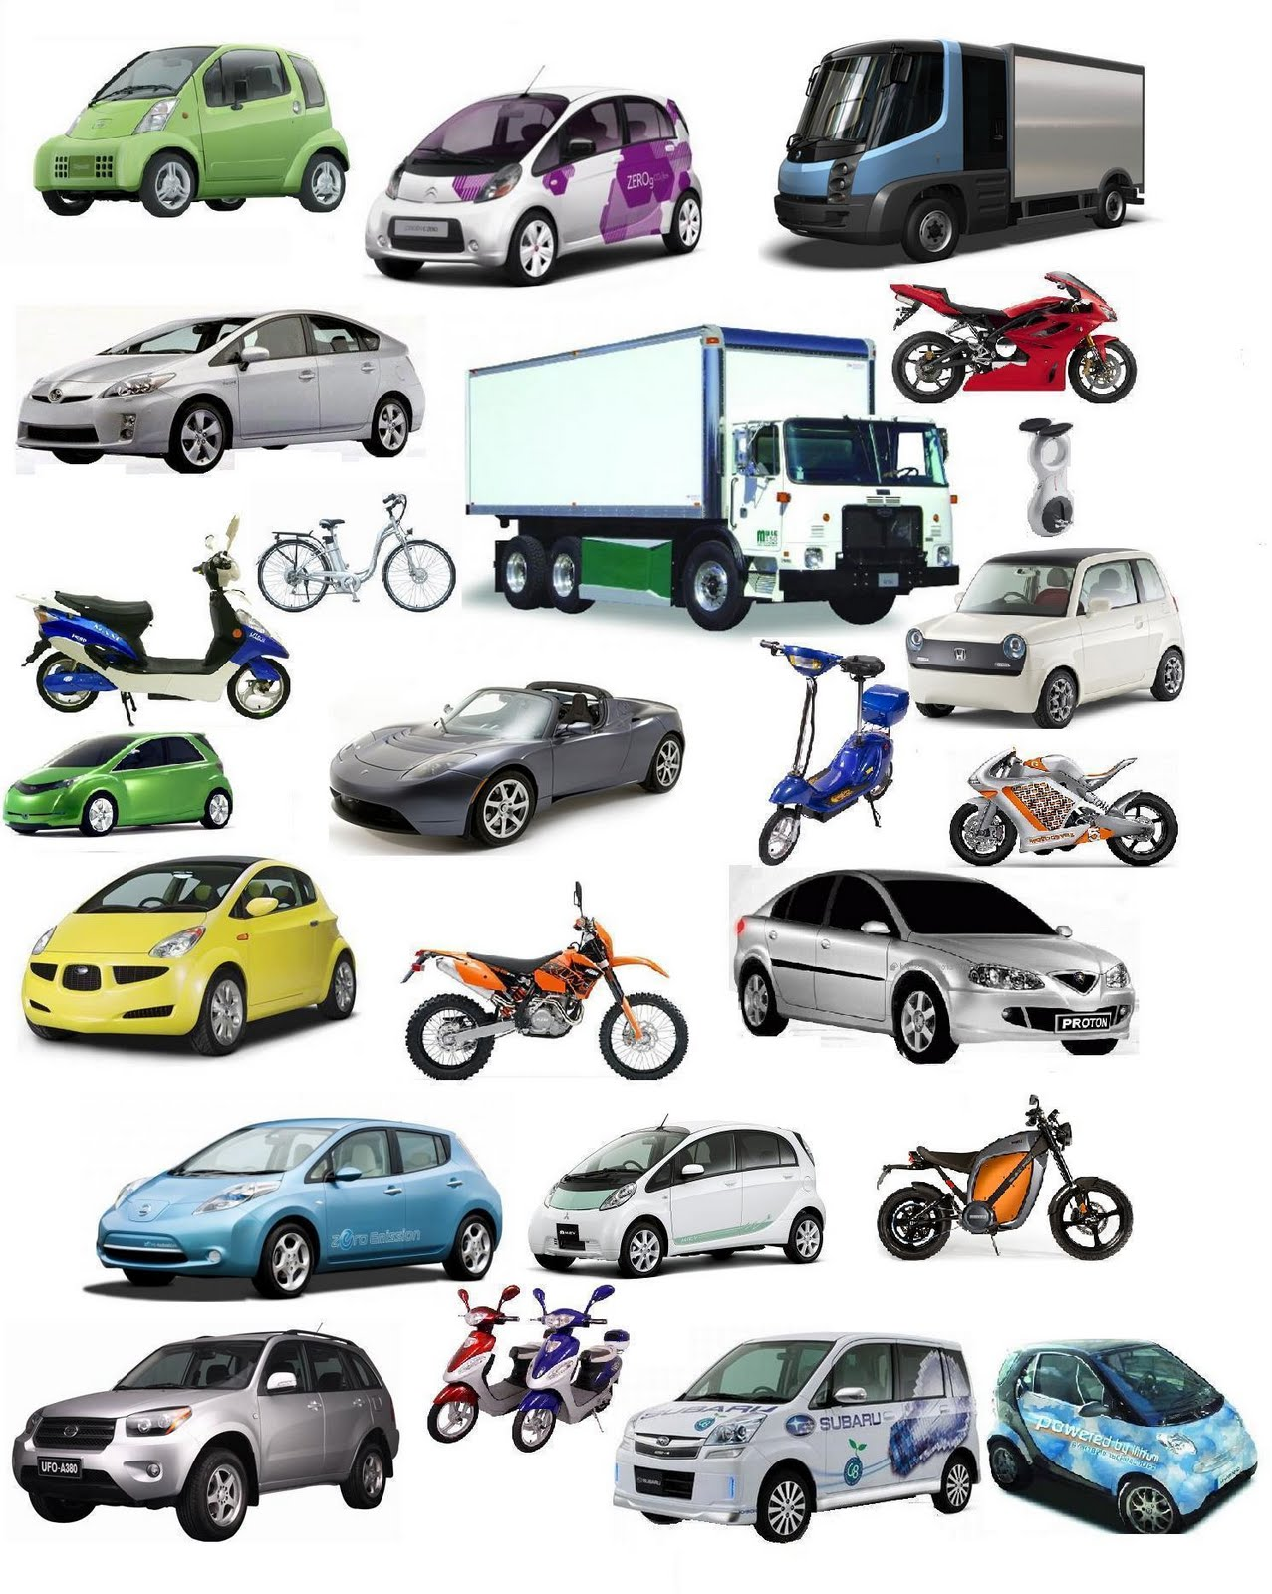
The Problem of Pattern Recognition
Even if we restricted our problem to the detection of one type vehicle (land vehicles), our problem would still have too many variables.
No single rubric/template would fit all these.
  Different pixel intensities.
  Different shapes/morphologies.
  Different illuminations.
  New vehicle models.
intentblog.com

Slide 5
The Machine Learning Approach
Instead of manually writing programs for specific tasks, the machine learning approach does the following:
  Collect many examples of the output we want given an input, i.e., a dataset that has the right answers.
  A machine learning algorithm produces a program that takes these examples and it’s trained to recognize certain inputs and to produce the requisite outputs.
  A well-trained program should recognize the cases it was trained with as well as new cases.
  If the data changes, the program can change by training it with different data.

Slide 6
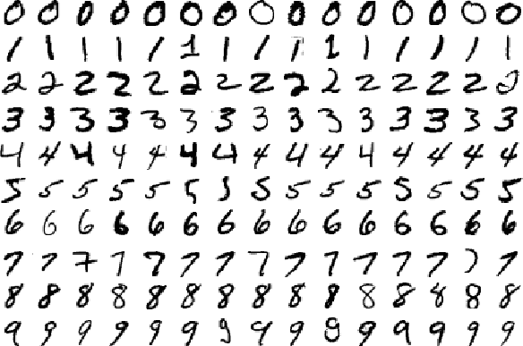
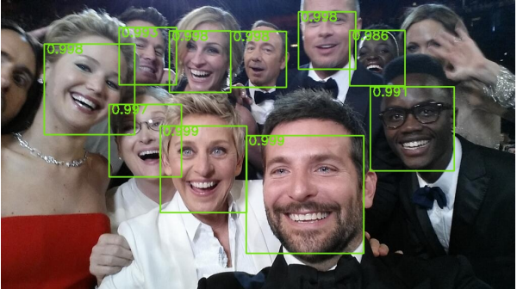

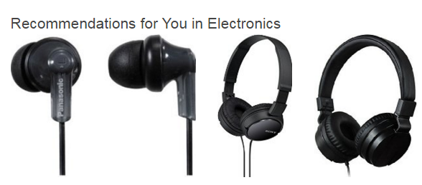
The Machine Learning Approach
Common application of machine learning for pattern recognition include
  Handwritten text recognition
  Face recognition
  Credit card fraud detection
  Online shopping recommendations
  Scientific Analysis
    Classification
    Regression
    Time Series Prediction
nikhilbuduma.com
www.technologyreview.com
amazon.com
mmmsimpsons.tumblr.com

Slide 7
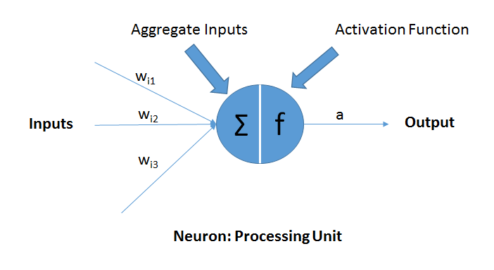
Artificial Neural Networks
Parallel-distributed algorithms composed of simple processing units (“neurons”), which are capable of learning from data.
  Inspired by the central nervous system, particularly the brain of mammals.
  Maps a given set of inputs into expected outputs.
    In classification, for example, they are concerned with the transformation of data from feature space to class space.
  Can approximate non-linear functions.
dni-institute.in
Notes:
Modifying inputs with sets of weights, doing a computation, and relating the network’s output to a desired output.

Slide 8
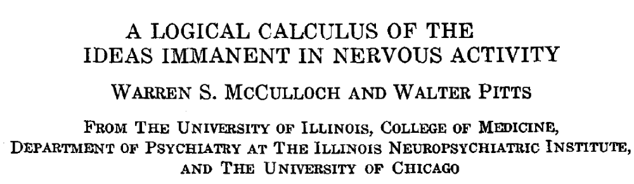
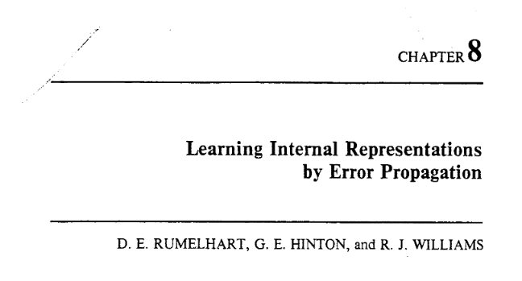
Background
McCulloch and Pitts (1943)
  Proposed treating the “all or none” nature of neurons in terms of propositional logic, i.e., neurons as binary threshold units
Rosenblatt (1958)
  This is the beginning of the perceptron.
  Processors capable of recognizing patterns in linearly separable data by adjusting weights on various interconnections based on feedback
Rumelhart, Hinton, and Williams (1986)
  Proposed a formula for propagating back the gradient of a neuron calculation from a unit to its inputs.
  Formed the basis for backpropagation.
In Parallel Distributed Processing:
Explorations in the Microstructure of Cognition (Vol. 1)
Notes:
multiple layers of adaptive, non-linear hidden units

Slide 9
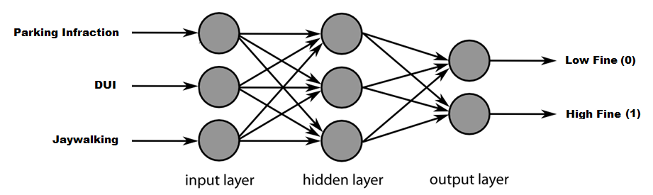
Neural Network Architecture
Feedforward Neural Network
  Most common type of neural network.
  Often called a multi-layer perceptron (MLP).
  Information flows in one direction from the input layer to the output layer.
  The output passed by each layer is a nonlinear function of the previous one.
http://technobium.com/
Notes:
multiple layers of adaptive, non-linear hidden units

Slide 10
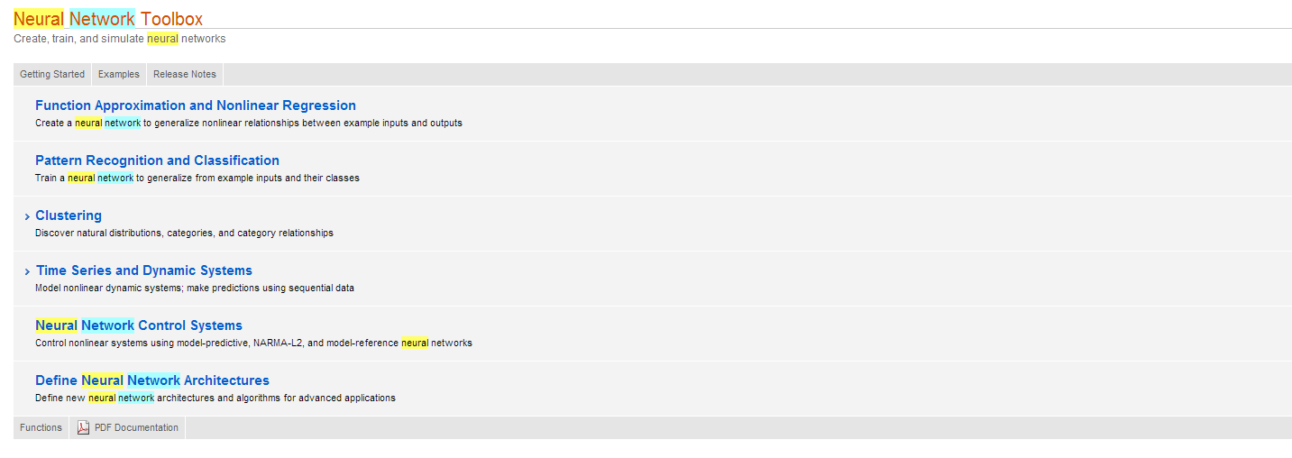
Artificial Neural Networks
MATLAB Neural Network Toolbox

Slide 11
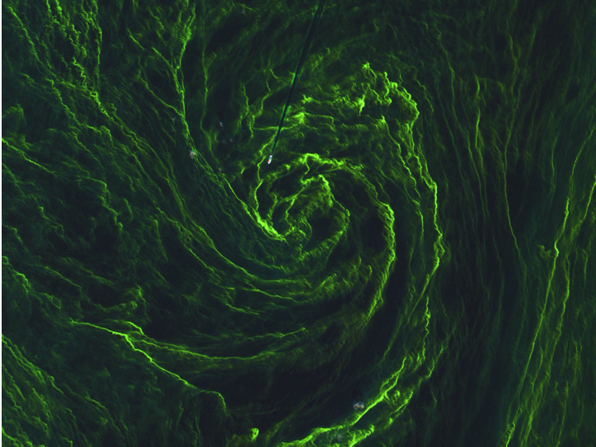
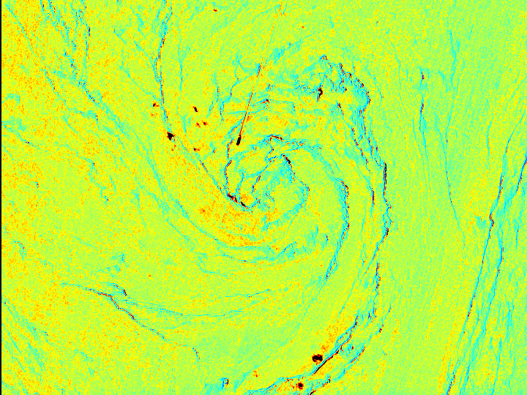
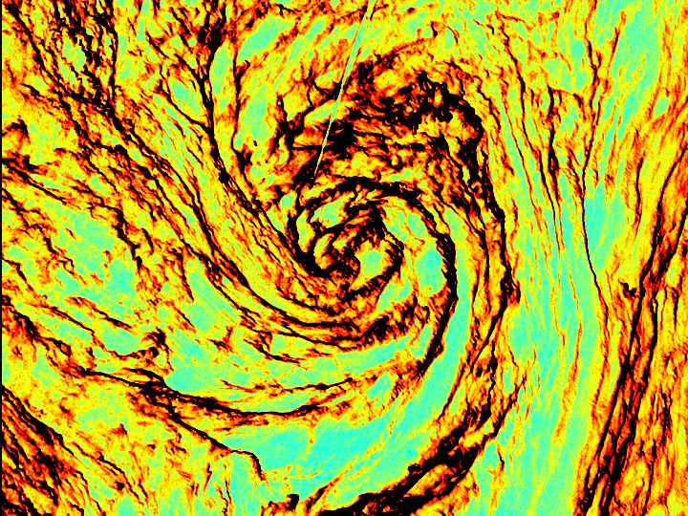
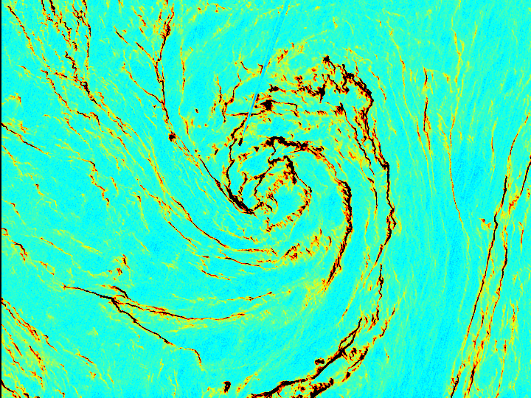
Neural Network Application: Classifying Algal Blooms in Satellite Images
Blue
Green
Red
Training
Data
Testing
ESA’s Sentinel-2A (Multispectral Imager)
Notes:
Sentinel-2A captured this detailed image of an algal bloom in the middle of the Baltic Sea on 7 August 2015. The image, which has a spatial resolution of 10 m, reveals the bloom in exquisite detail as well as a ship heading into the ‘eye of this algal storm’. The ship’s wake can be seen as a straight dark line where the bloom has been disturbed by the ship’s propellers.

Slide 12
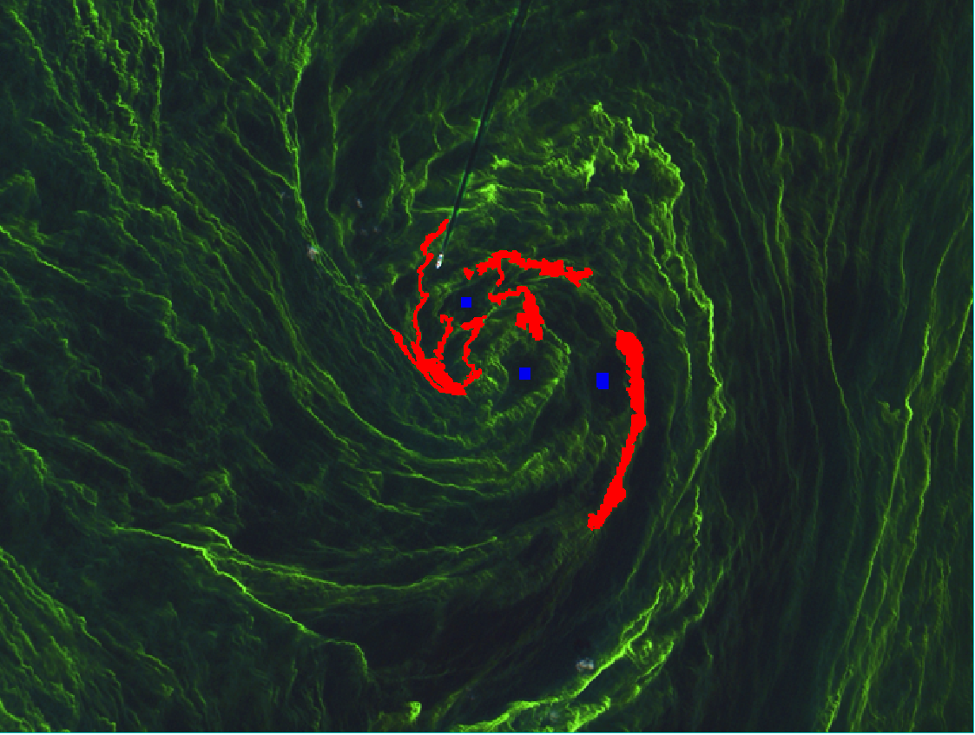
Neural Network Training: Target Data
Sentinel-2A (Multispectral Imager)
Data

Slide 13
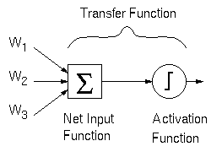
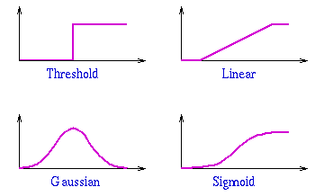
Neural Network Training
Vectorized Image Data (x)
Hidden Layer
Bias
Input Layer
Output Layer
1
27, 28, 26, …
Red band
2
47, 50, 49, …
Green band
Algae
3
t = 1, 0, 0 …
http://staff.itee.uq.edu.au/
Types of Activation Function
Blue band
…
40, 38, 37, …
10
Each neuron has an associated transfer function.
  Sum of the weighted inputs is added to a bias term, and passed to an activation function.

Slide 14
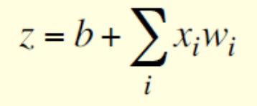
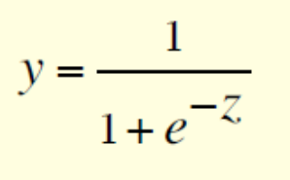
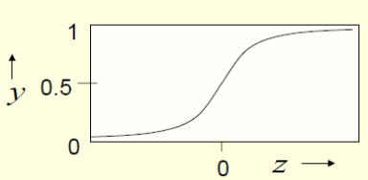
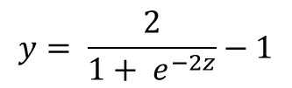
Neural Network Training
Vectorized Image Data (x)
Hidden Layer
Each neuron has an associated transfer function.
  Sum of the weighted inputs is added to a bias term, and passed to an activation function.
  Neurons using sigmoid functions.
Bias
Input Layer
Output Layer
A
1
27, 28, 26, …
Red band
B
2
47, 50, 49, …
Green band
Algae
C
t = 1, 0, 0 …
3
Net Input
Activation Functions
40, 38, 37, …
Blue band
…
D
10
Log Sigmoid
$$y= \frac{2}{1+ e^{−2z}}−1$$
Hinton,2014
Tan Sigmoid

Slide 15



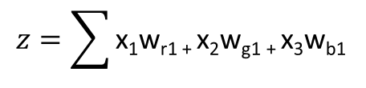
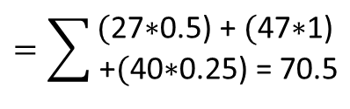







Neural Network Training
Vectorized Image Data (x)
Hidden Layer
Bias
$$Hidden Layer Calculation$$
Input Layer
Output Layer
Net Input
1
w_{r1}
$x\text{1}$ = 27, 28, …
Red band
Activation Function
2
$$h= \frac{2}{1+ e^{−2z}}−1$$
w_{g1}
$x\text{2}$ = 47, 50, …
Green band
w_{b1}
Algae
$b$=0
$\text{w}\text{r}\text{1}$=0.5
$\text{w}\text{g}\text{1}$=1
$\text{w}\text{b}\text{1}$=0.25
3
t = 1, 0, 0 …
$$z=\sum{\text{x}\text{1}\text{w}\text{r}\text{1 + }\text{x}\text{2}\text{w}\text{g}\text{1 + }\text{x}\text{3}\text{w}\text{b}\text{1 }}$$
$x\text{3}$ = 40, 38, …
Blue band
…
$$=\sum{\begin{aligned}\text{(}\text{27∗0.5)}\text{ +} \text{(}\text{4}\text{7∗}\text{1}\text{)} \\ \text{+}\text{(}\text{4}\text{0}\text{∗}\text{0.25) = }\text{70.5}\end{aligned}}$$
10
$$h= \frac{2}{1+ e^{−2(70.5)}}−1=1$$

Slide 16

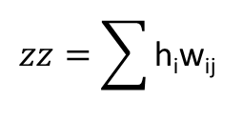
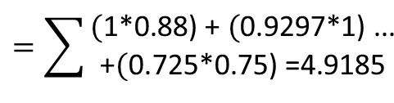

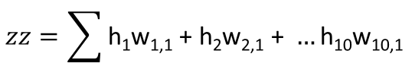
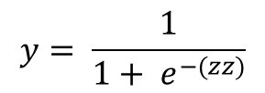



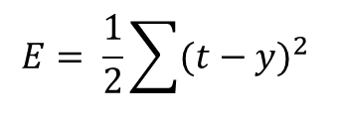
Neural Network Training
Vectorized Image Data (x)
Hidden Layer
Bias
$$Output Layer Calculation$$
Input Layer
Output Layer
Net Input
Activation Function
1
$$zz=\sum{\text{h}\text{i}\text{w}\text{ij} }$$
$$y= \frac{1}{1+ e^{−(zz)}}$$
w_{r1}
w_{1,1}
$x\text{1}$ = 27, 28, …
Red band
2
w_{2,1}
$\text{w}\text{1}\text{,1}$=0.88
$\text{w}\text{2,1}$=$\text{1}$
w_{10,1}= $\text{0.75}$
w_{g1}
1
Algae (1)
$$zz=\sum{\text{h}\text{1}\text{w}\text{1,1}\text{ +} \text{h}\text{2}\text{w}\text{2,1} \text{+ }…\text{h}\text{10}\text{w}\text{10,}\text{1} }$$
$x\text{2}$ = 47, 50, …
Green band
w_{b1}
w_{3,1}
t = 1, 0, 0 …
3
$$=\sum{\begin{aligned}\text{(}\text{1∗0.88)}\text{ +} \text{(}\text{0.}\text{9}\text{297}\text{∗1}\text{)}\text{ ...} \\ \text{+}\text{(}\text{0.725∗0.75) =}\text{4.9185}\end{aligned}}$$
$x\text{3}$ = 40, 38, …
Blue band
w_{10,1}
…
$$y= \frac{1}{1+ e^{−(4.9185)}}=0.99$$
10
$$E= \frac{1}{2}\sum{{(t−y)}^{2} }$$
Error Function

Slide 17

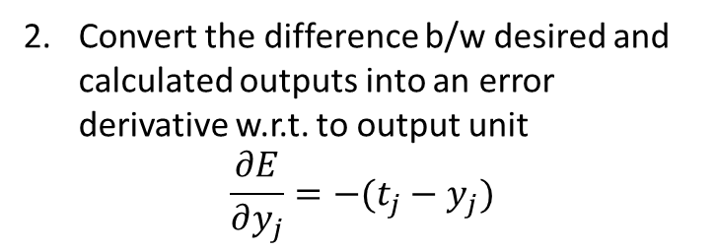

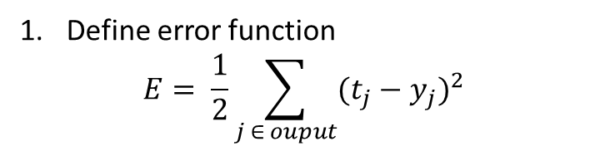
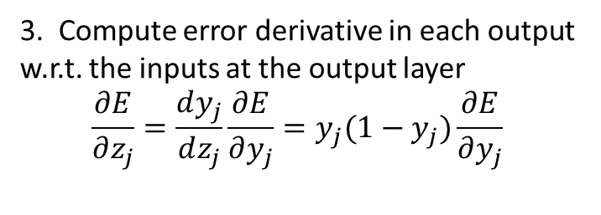





Neural Network Training: Backpropagation
Hidden Layer
Bias
$$Backpropagation$$
Define error function
$$E= \frac{1}{2}\sum_{j ∈ ouput}{{(t_{j}−y_{j})}^{2}}$$
Input Layer
Output Layer
$$y_{i}$$
Total net input received at output layer
$$\frac{∂E}{∂z_{j}}$$
Convert the difference b/w desired and calculated outputs into an error derivative w.r.t. to output unit
$$\frac{∂E}{∂y_{j}}=−(t_{j}−y_{j})$$
$$z_{j}$$
$$\frac{∂E}{∂y_{j}}$$
$$y_{j}$$
t = t₁, t₂, … t_{j}
3. Compute error derivative in each output w.r.t. the inputs at the output layer
$$\frac{∂E}{∂z_{j}}=\frac{dy_{j}}{dz_{j}}\frac{∂E}{∂y_{j}}=y_{j}(1−y_{j})\frac{∂E}{∂y_{j}}$$
Layer i
Layer j
$$Based on (Hinton, 2014)$$

Slide 18

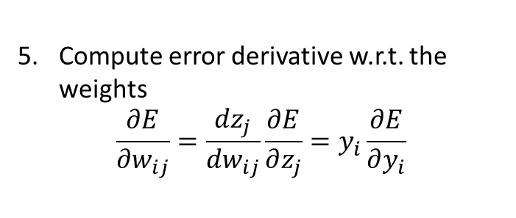
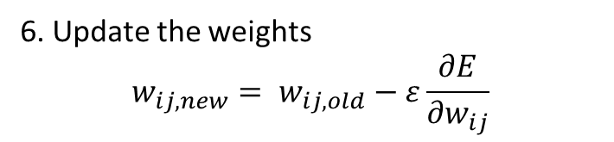
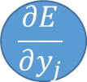


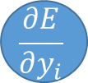
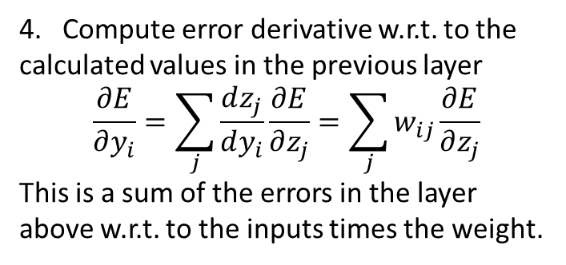
Neural Network Training: Backpropagation
Input Layer
Hidden Layer
Output Layer
Bias
$$Backpropagation$$
Total net input received at output layer
4. Compute error derivative w.r.t. to the calculated values in the previous layer
$$\frac{∂E}{∂y_{i}}=\sum_{j}{\frac{dz_{j}}{dy_{i}}\frac{∂E}{∂z_{j}}}=\sum_{j}{w_{ij}\frac{∂E}{∂z_{j}}}$$
This is a sum of the errors in the layer above w.r.t. to the inputs times the weight.
$$\frac{∂E}{∂y_{i}}$$
$$y_{i}$$
$$\frac{∂E}{∂z_{j}}$$
$$w_{ij}$$
$$z_{j}$$
$$\frac{∂E}{∂y_{j}}$$
$$y_{j}$$
Compute error derivative w.r.t. the weights
$$\frac{∂E}{∂w_{ij}}=\frac{dz_{j}}{dw_{ij}}\frac{∂E}{∂z_{j}}=y_{i}\frac{∂E}{∂y_{i}}$$
6. Update the weights
$$w_{ij, new}= w_{ij, old}−ε\frac{∂E}{∂w_{ij}}$$
Layer i
Layer j
$ε$ = learning rate
Compute error derivatives for all the hidden units efficiently at the same time

Slide 19
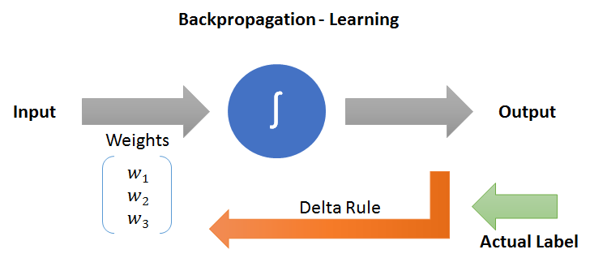
Backpropagation Illustrated
dni-institute.in
The error propagates backwards layer by layer from the output units.
By changing the (adaptive) weights iteratively, the neural network is able to learn.

Slide 20
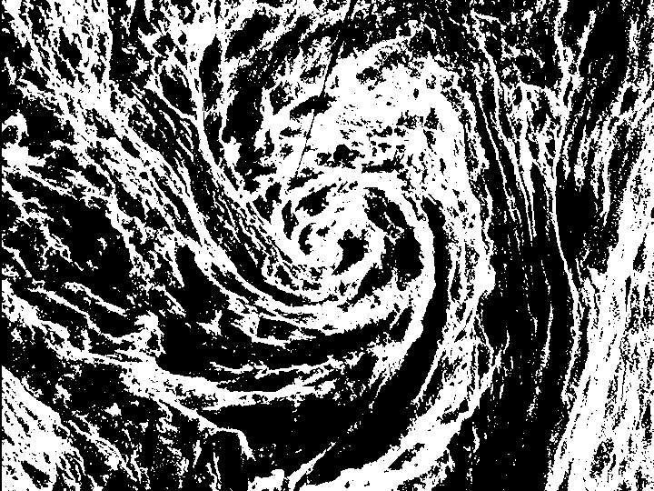
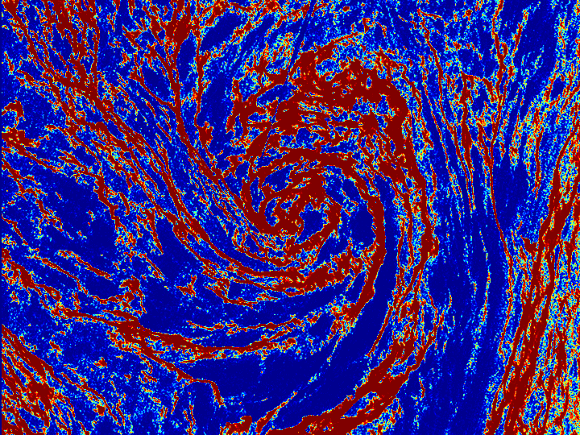
Neural Network Classification

Slide 21
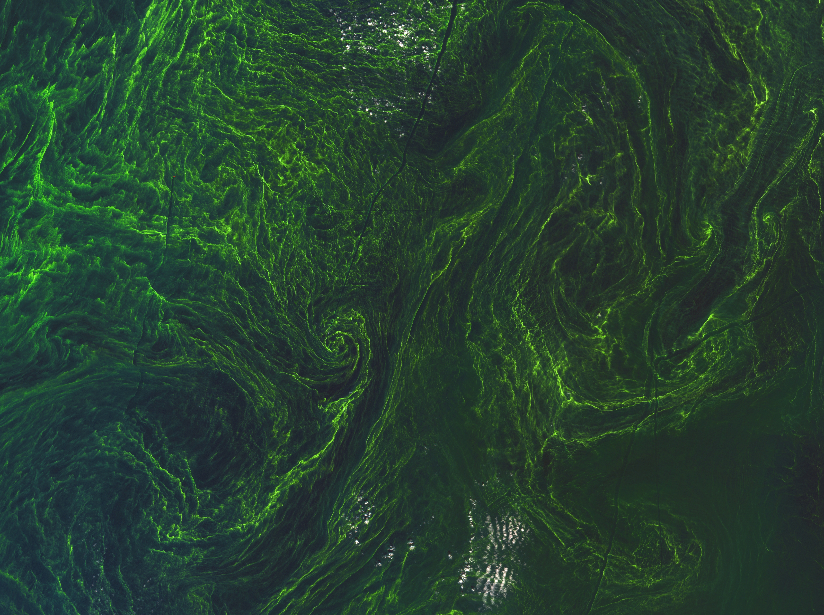
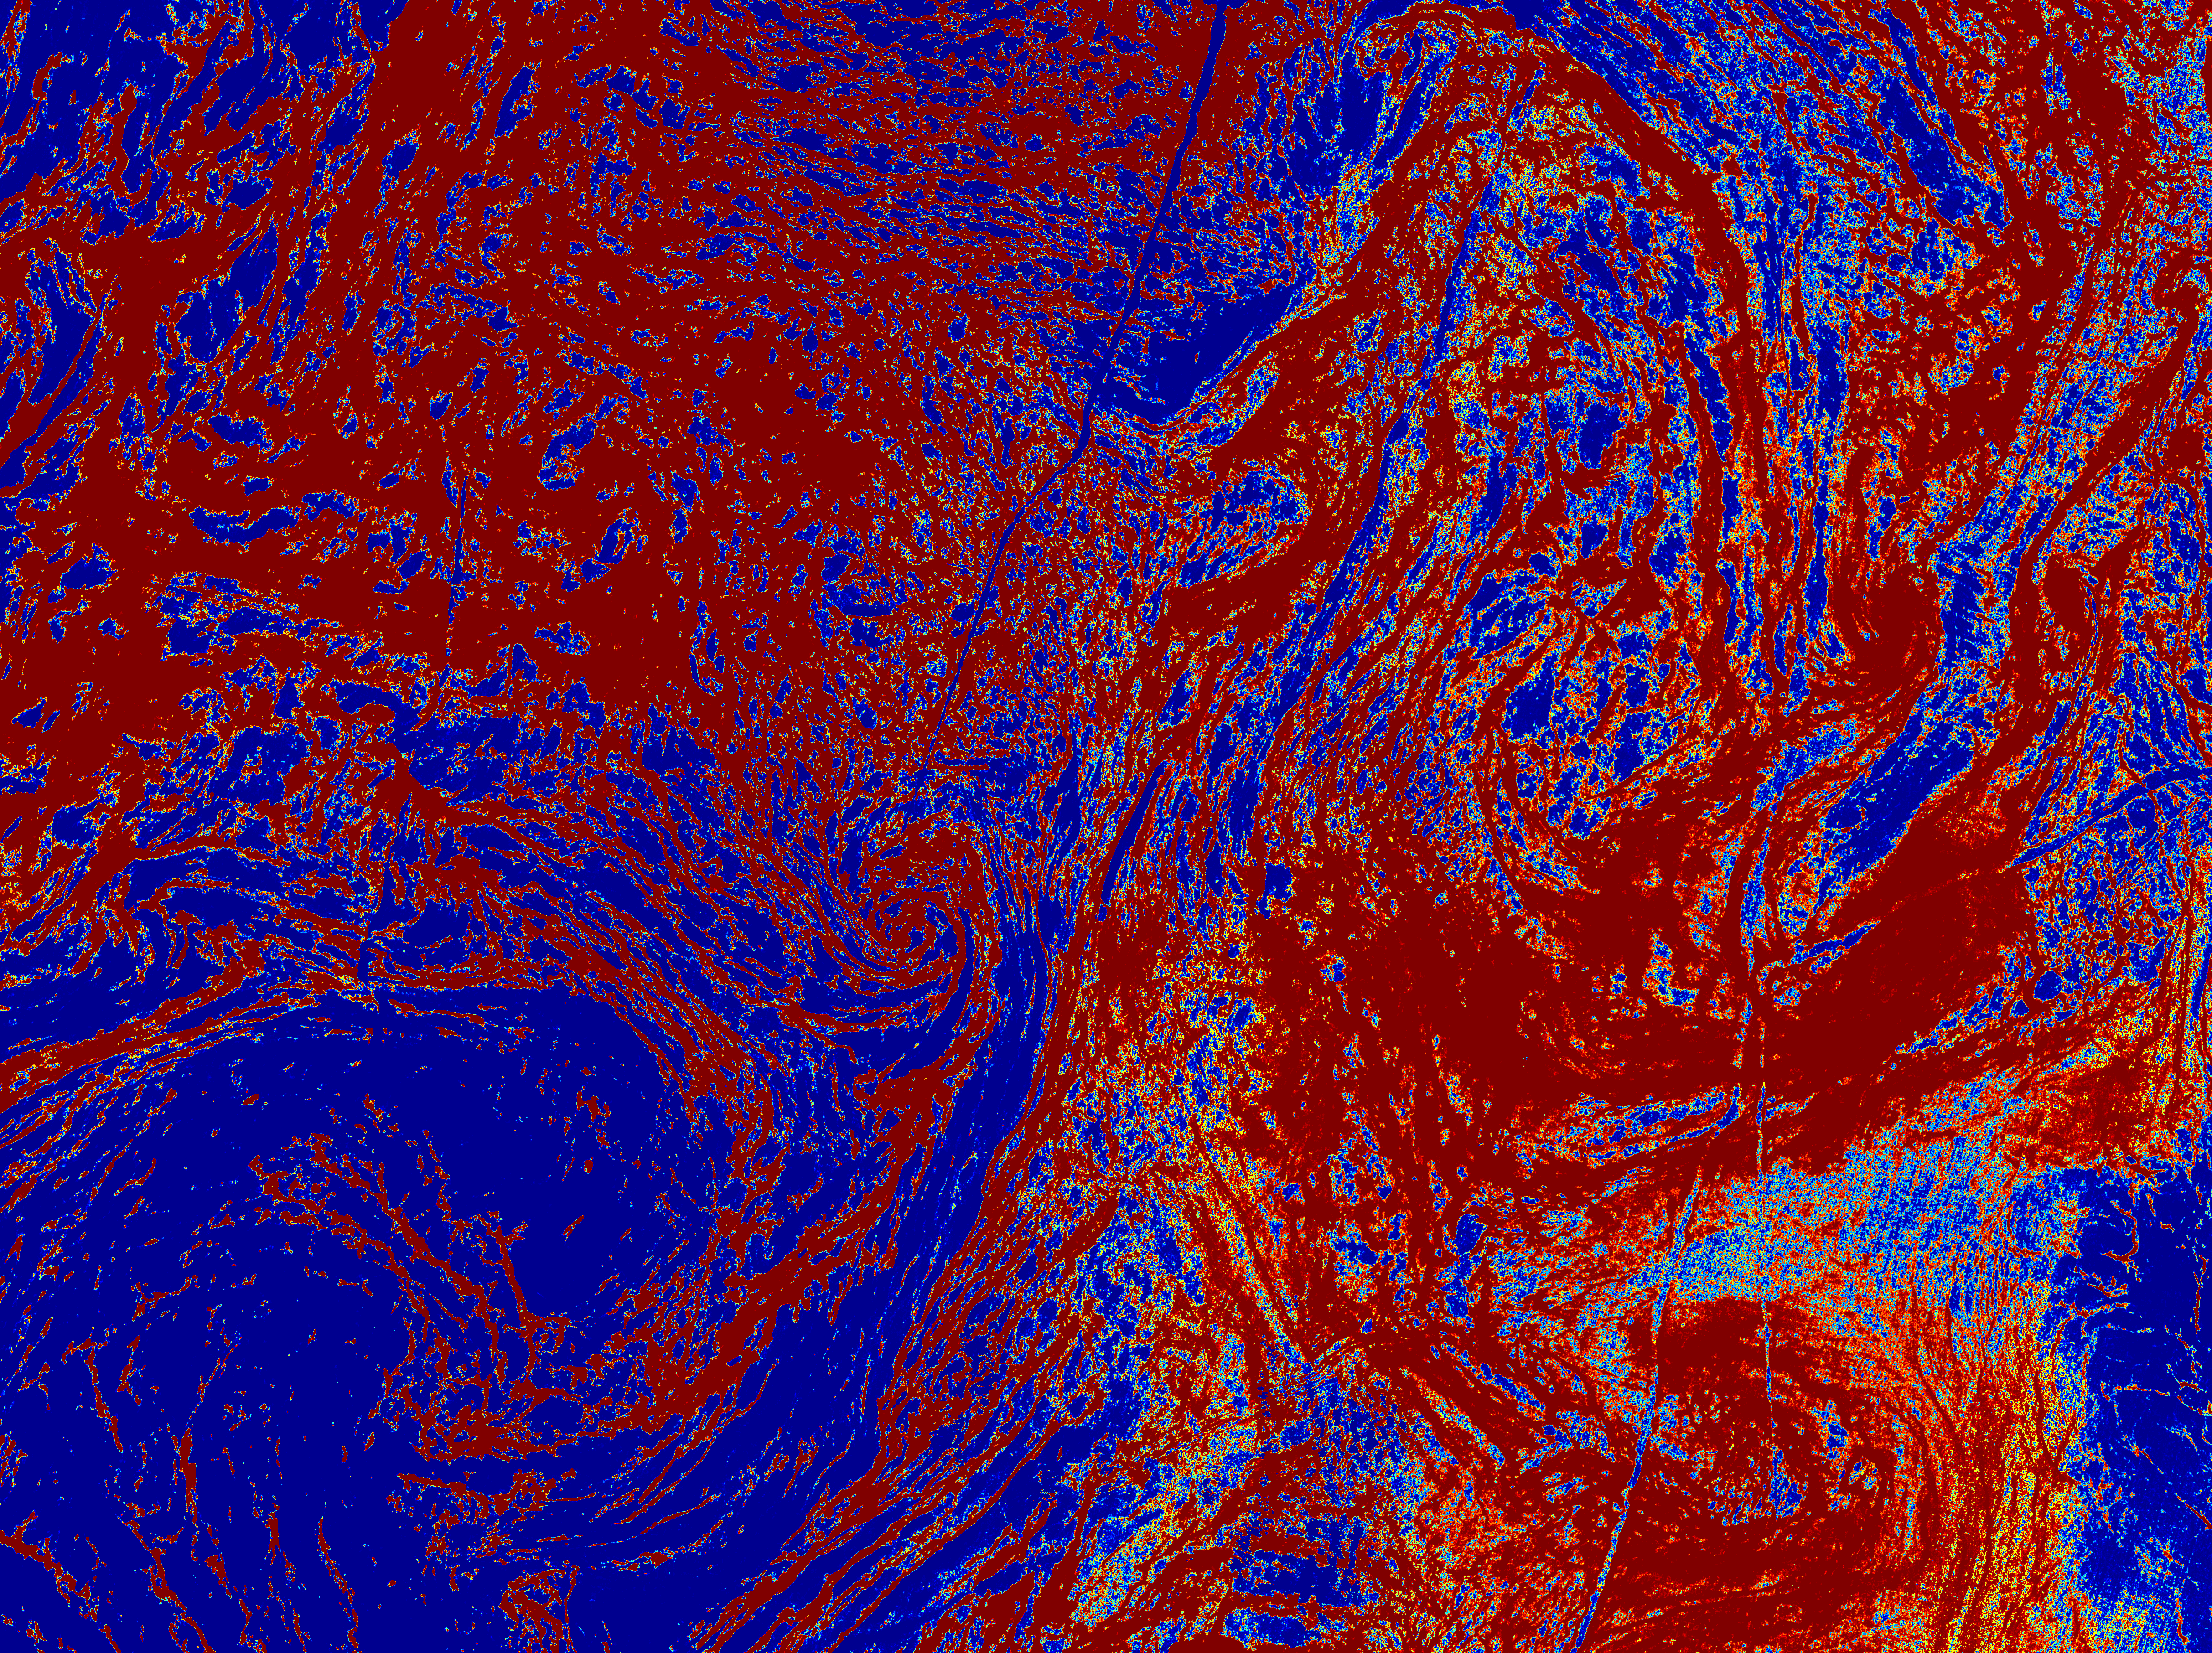
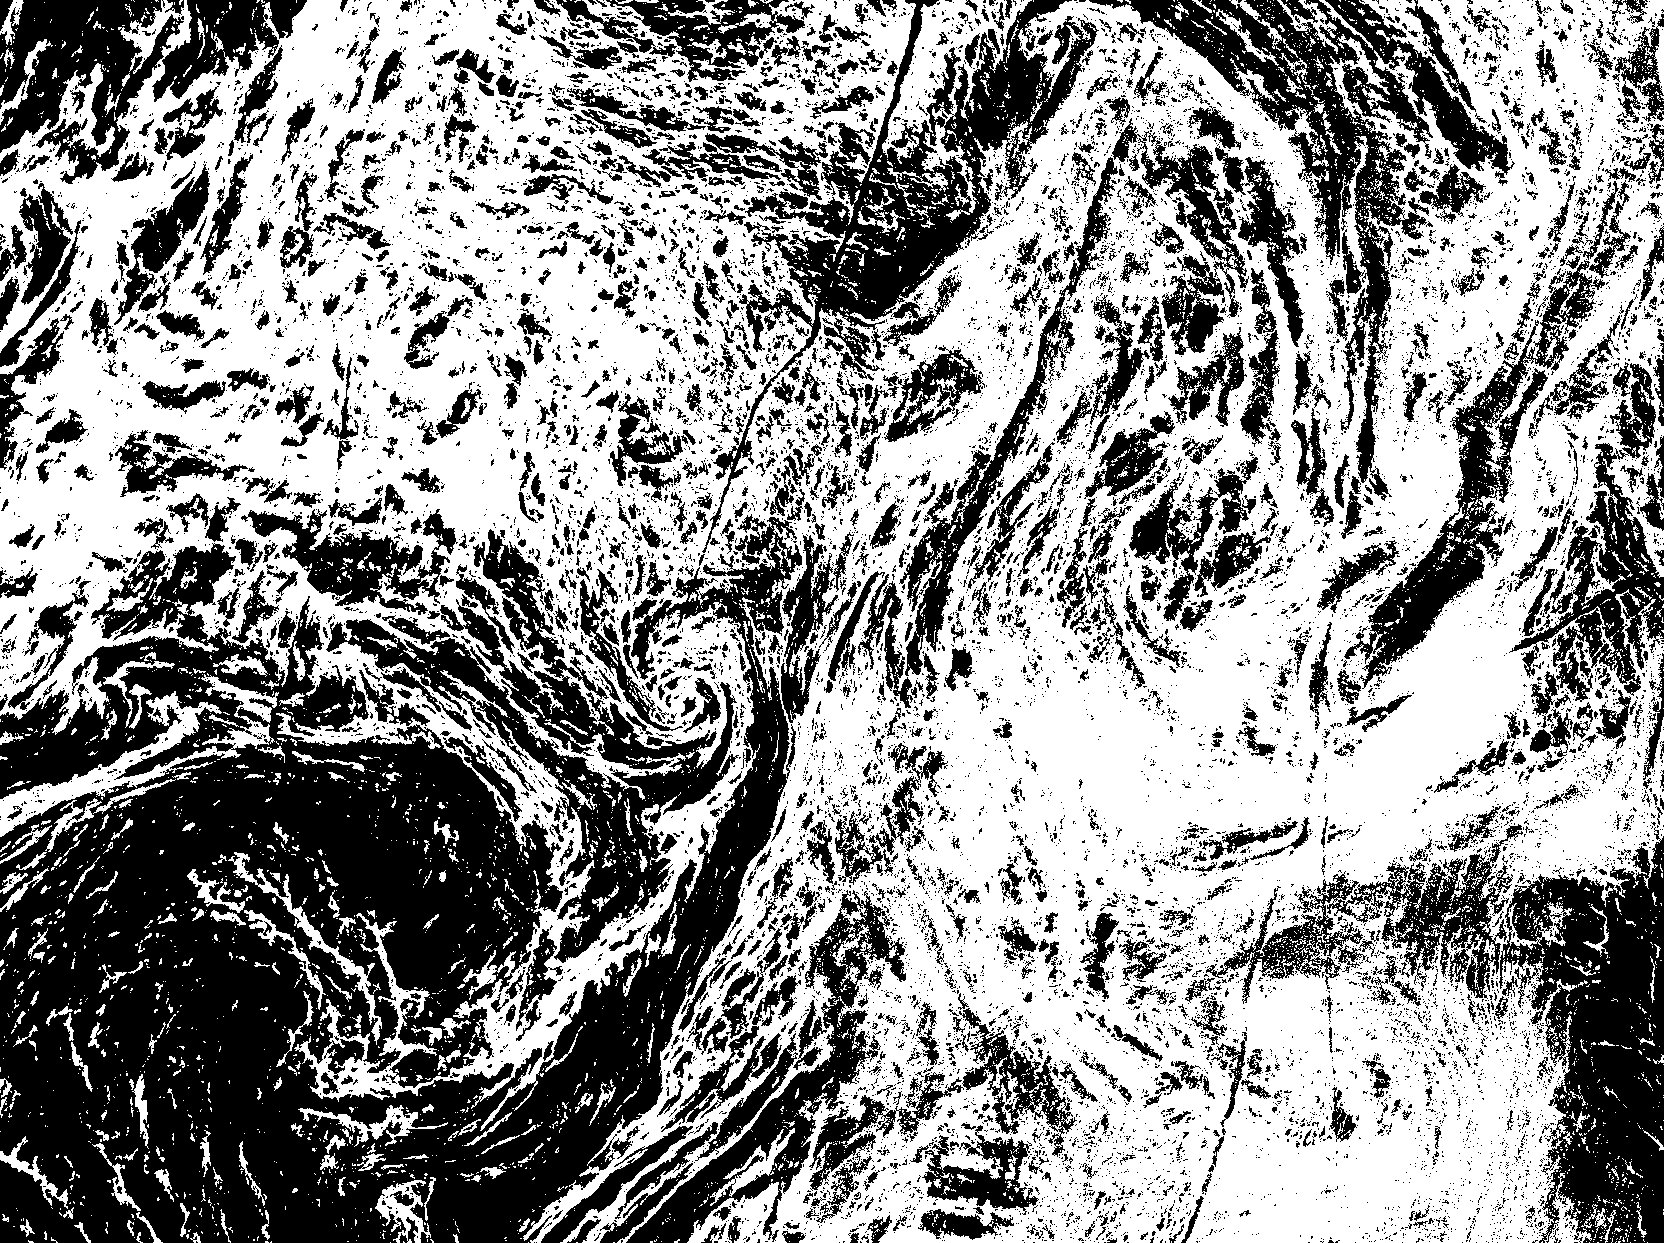
Neural Network Classification
Training
Testing

Slide 22
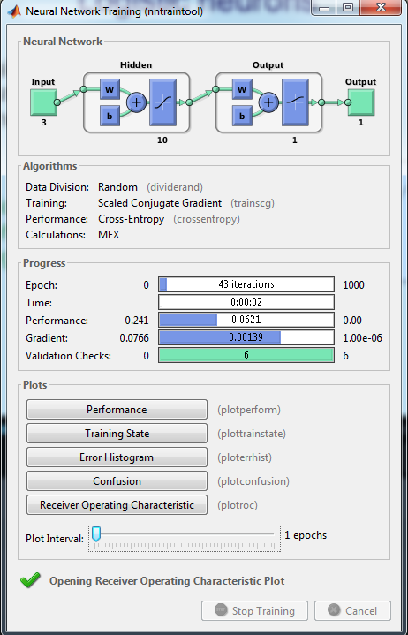
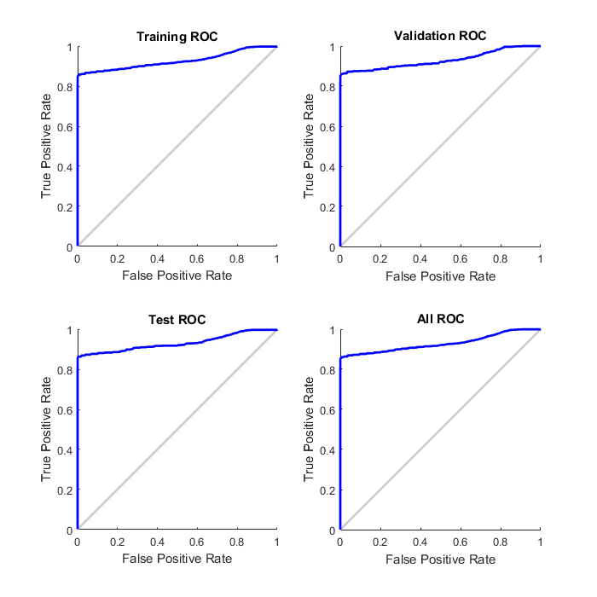
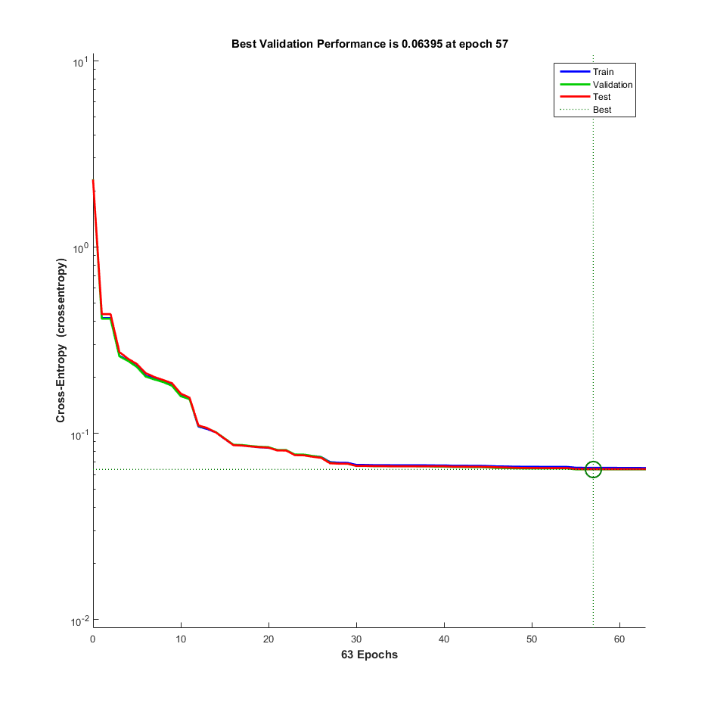
MATLAB NN Toolbox GUI
Validation Performance
ROC Curves

Slide 23
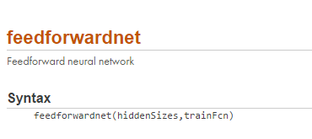





MATLAB Neural Network Toolbox
Inputs
Outputs
N_{hiddenlayers} = 10

Slide 24
Conclusion
Artificial neural networks are analytical tools capable of
  Learning relationships within the datasets and recognize hidden, periodic patterns through continued exposure to repeat examples of those patterns (the right answers).
  Generalizing conclusions about similar but previously unseen data.
  Synergistically incorporate data from different sources whose feature space is complex and has different statistical distributions.
  Difficulties
    Determining the appropriate architecture.
    Generalization may not be achieved if the training data is inadequate.
    Computational cost.
    Susceptible to local minima.

Slide 25



Artificial Neural Networks Toolboxes/Modules
http://leenissen.dk/fann/wp/
http://scikit-learn.org/stable/
http://pybrain.org/

