Slide 1
AI ASSISTED PRODUCTS
Third-Party Services Dashboard
Connecting cloud services through official MCP servers
Franco Busso - Rangio Nachlieli - Ivan Zirlinger - Hadar Lavinsky

Slide 2
What This Project Does
Services
→
Official MCP servers
→
Claude Code
→
dataExports/
→
Local dashboard
Claude Code talks to each service through its vendor's own official MCP server, downloads test data into local files, and the dashboard reads only from those files - never live from the services.
Third-Party Services Dashboard
2

Slide 3
The Services and Their Official MCP Servers
Service | Official MCP server | Extra service owner
Gmail | Google's Gmail MCP, via Claude's Gmail connector | Shared setup
GitHub | github/github-mcp-server (remote) | Shared setup
Notion | Notion MCP (mcp.notion.com) | Shared setup
Google Calendar | Google's Calendar MCP, via Claude's connector | Franco Busso
Todoist | Doist's official Todoist MCP | Ivan Zirlinger
Linear | Linear's official MCP (suggested) | Rangio Nachlieli
ClickUp | ClickUp's official MCP (suggested) | Hadar Lavinsky
Third-Party Services Dashboard
3

Slide 4
What Each Team Member Did
FB
RN
IZ
HL
Franco Busso
Rangio Nachlieli
Ivan Zirlinger
Hadar Lavinsky
Test accounts, MCP setup, downloaded all data, localStorageFormats.md, download skill
Built the local dashboard website from dataExports/
This presentation and the screenshot walkthrough of every service
Demo video and the final root README
Extra service: Google Calendar
Extra service: Linear
Extra service: Todoist
Extra service: ClickUp
Third-Party Services Dashboard
4

Slide 5
Test Accounts and Test Data
Why test accounts?
The test data story: Pairly
This repository is public.
- Every login uses a throwaway test account, never a personal one.
- No real passwords, API keys, tokens, or personal data are ever written to a file.
- Secrets live only in environment variables or Claude Code's credential store.
A fictional startup whose app matches university students into study groups. Every service (Gmail, GitHub, Notion, Calendar, Todoist...) is filled with the same story, so a cross-service search for a name like "Maya Chen" or a place like "Westbrook" returns matching results everywhere.
Deep teal
#0F766E
Warm coral
#F97362
Pairly's own brand colors - used here too.
Third-Party Services Dashboard
5

Slide 6
Local Storage Formats and the Download Skill
Pending content
[ PLACEHOLDER - fill in once Franco finishes these files ]
- Summary of docs/localStorageFormats.md: the folder layout under dataExports/<service>/ and the file format used for each service's downloaded data.
- What the download skill in .claude/skills/ does and how it is invoked.
Third-Party Services Dashboard
6

Slide 7
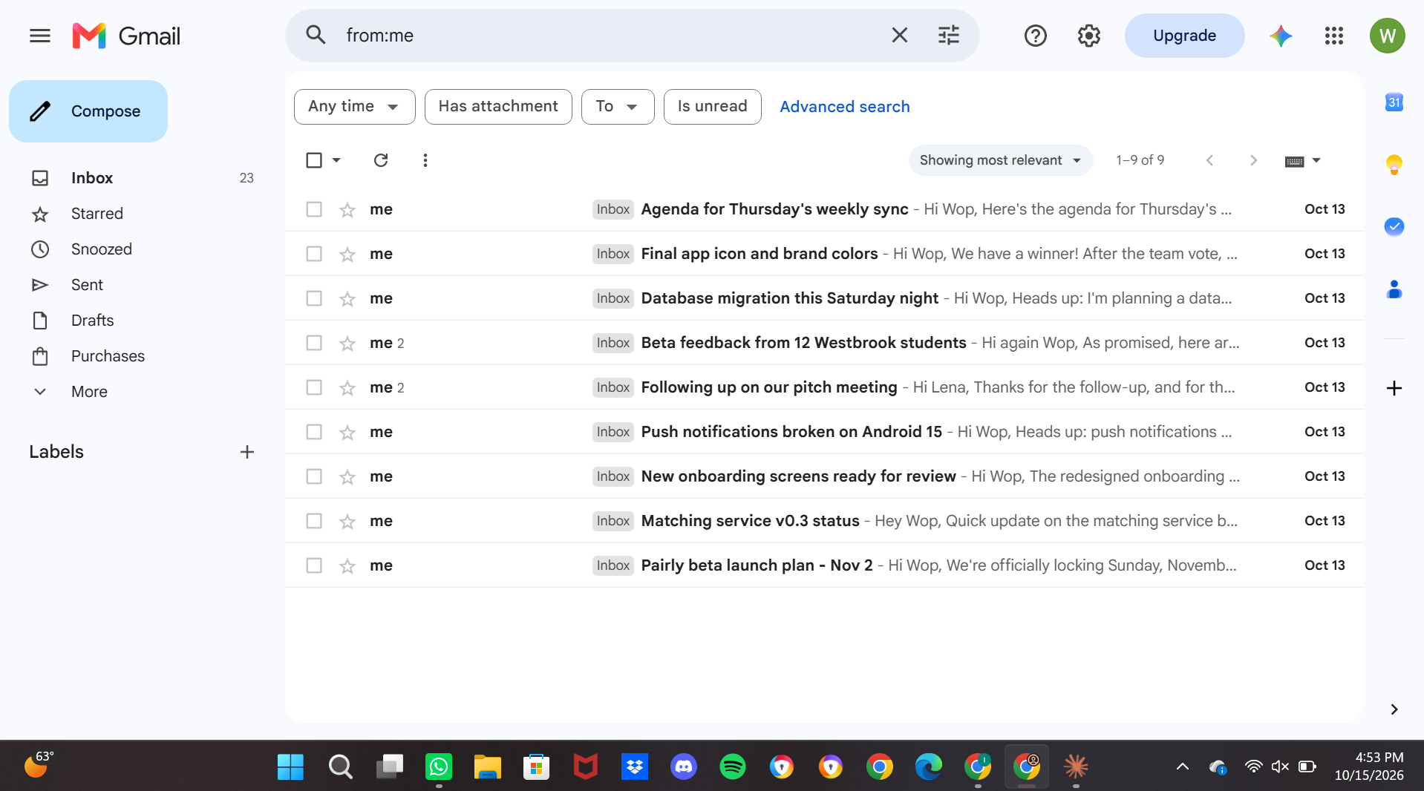
Gmail
[ screenshot placeholder ]
Original - service website (test profile)
Local dashboard (same content)
Third-Party Services Dashboard
7

Slide 8
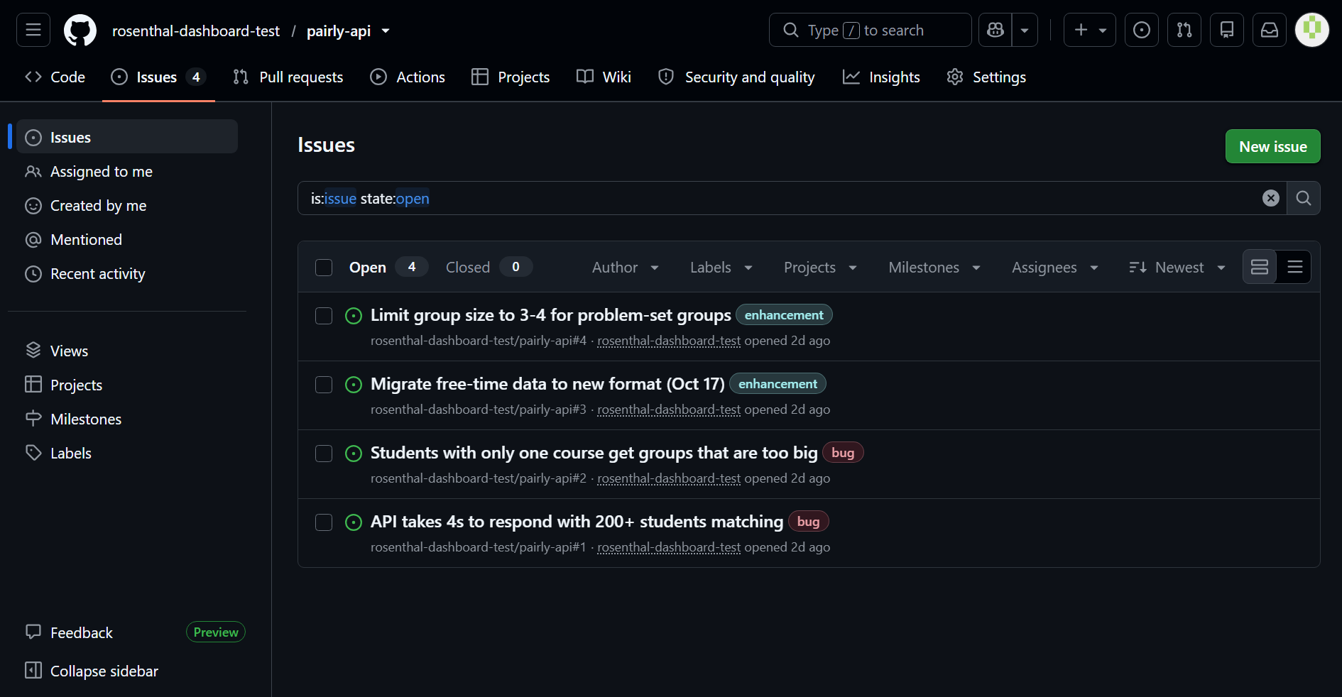
GitHub
[ screenshot placeholder ]
Original - service website (test profile)
Local dashboard (same content)
Third-Party Services Dashboard
8

Slide 9
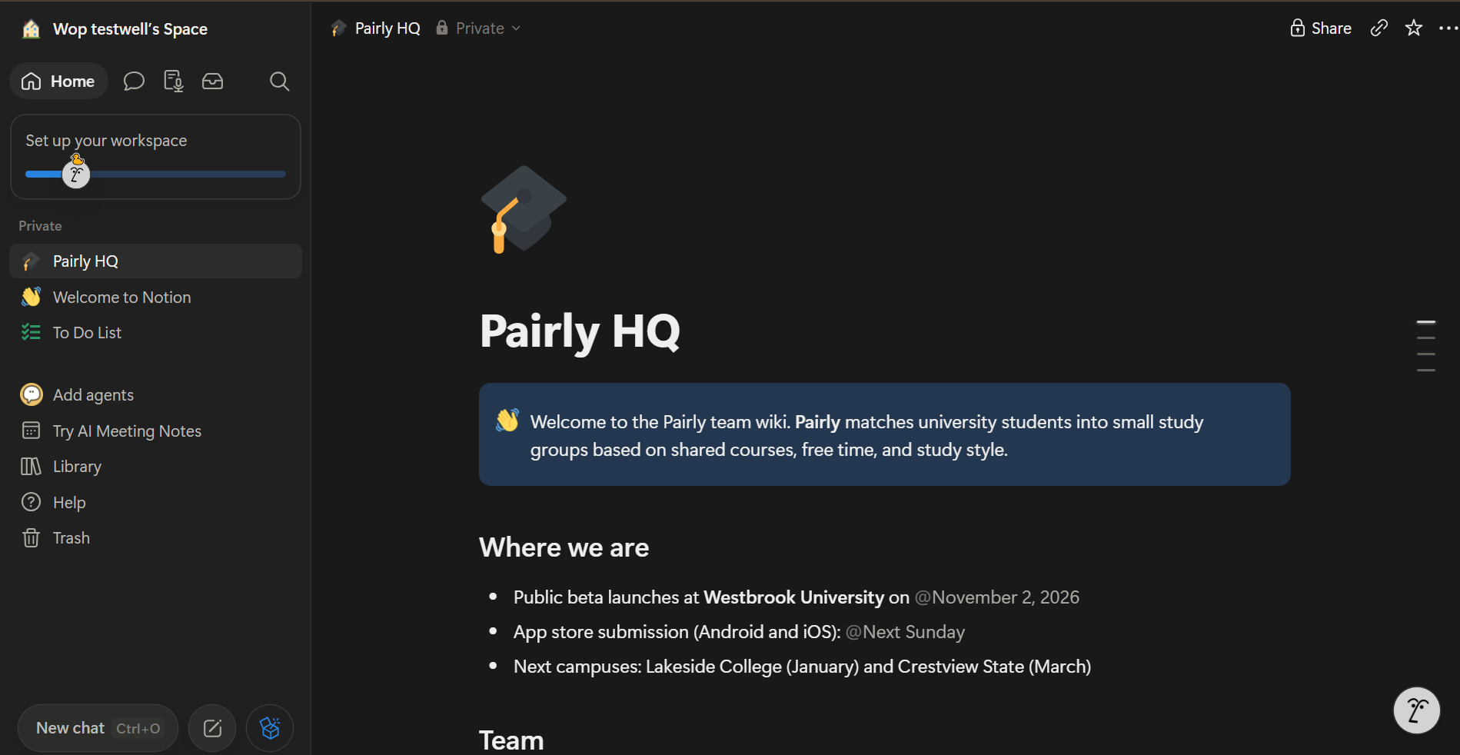
Notion
[ screenshot placeholder ]
Original - service website (test profile)
Local dashboard (same content)
Third-Party Services Dashboard
9

Slide 10
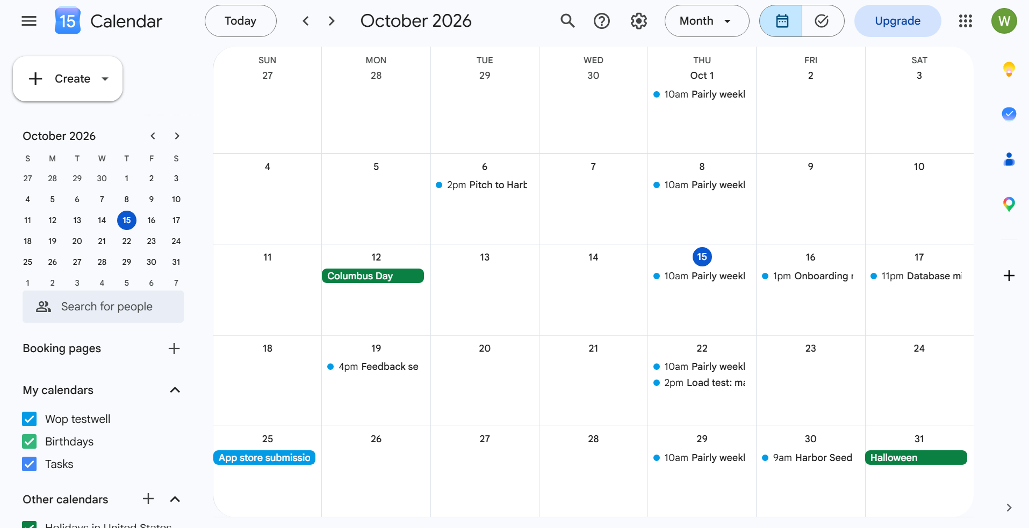
Google Calendar
[ screenshot placeholder ]
Original - service website (test profile)
Local dashboard (same content)
Third-Party Services Dashboard
10

Slide 11
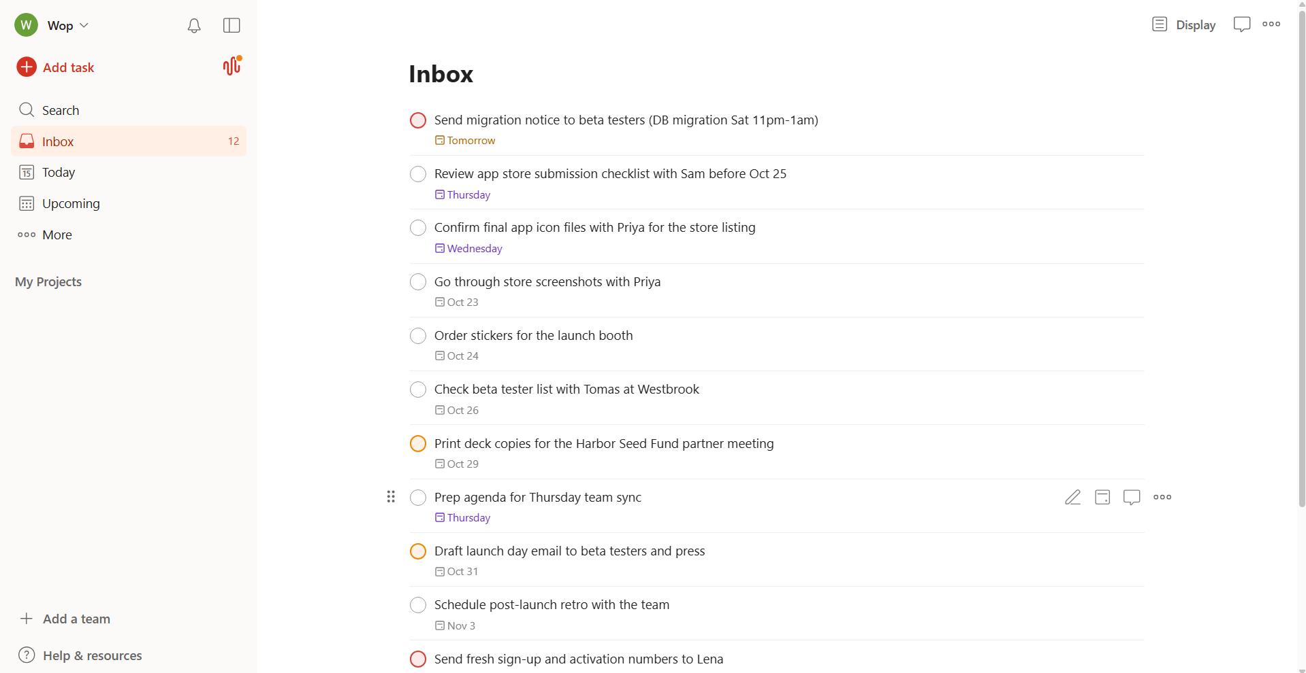
Todoist
[ screenshot placeholder ]
Original - service website (test profile)
Local dashboard (same content)
Third-Party Services Dashboard
11

Slide 12
Linear
[ screenshot placeholder ]
[ screenshot placeholder ]
Original - service website (test profile)
Local dashboard (same content)
Third-Party Services Dashboard
12

Slide 13
ClickUp
[ screenshot placeholder ]
[ screenshot placeholder ]
Original - service website (test profile)
Local dashboard (same content)
Third-Party Services Dashboard
13

Slide 14
Cross-Service Search in the Dashboard
[ screenshot placeholder: dashboard cross-service search ]
Third-Party Services Dashboard
14

Slide 15
Security: Keeping Secrets Out of a Public Repo
1
2
3
4
Test accounts only
No secrets in files
Env vars and OAuth
.mcp.json has no secrets
Every login (Google, GitHub, Todoist...) uses a throwaway test account, never a personal one.
Passwords, API keys, tokens, and OAuth secrets are never written into any file or chat.
GITHUB_PAT lives in a local environment variable; other servers use OAuth held by Claude Code.
It only references ${GITHUB_PAT}; real values stay on each machine, outside git.
Third-Party Services Dashboard
15

