Slide 1
CLAUDE CODE + THIRD-PARTY SERVICES
Atlas Data Dashboard
One local search across GitHub, Notion, Linear, Asana and Todoist.
Yoni Pomerantz · Rafi Cornick · Zachary Sicklick
GitHub
Notion
Linear
Asana
Todoist

Slide 2
THE PROJECT
One dashboard for five cloud services
We used Claude Code and each vendor's official MCP server to download test data, saved it on our own computers in a documented format, and built a local website that searches all of it at once.
01
02
03
Connect
Download and store
Search
Claude Code reaches each service through the vendor's official MCP server.
Data lands in dataExports/, one folder per service, with metadata and a written format spec.
A local website reads those files and searches one service or all of them together.

Slide 3
THE TEAM
Three students, five services
Student | Service | Contribution
Yoni Pomerantz | GitHub, Notion, Linear | Test data, MCP setup and downloads for GitHub, Notion and Linear; localStorageFormats.md; the download skill; the dashboard; the GitHub repo
Rafi Cornick | Asana | Asana test account and data, Asana MCP app setup, extended the skill and format doc for Asana, Asana export
Zachary Sicklick | Todoist | Todoist test account and data, extended the skill and format doc for Todoist, Todoist export, this presentation
GitHub and Notion are required for every group; each student owns one extra service (Linear, Asana, Todoist).

Slide 4
TEST DATA
Project Atlas: a fictional logistics launch
Northwind Logistics is opening a delivery hub in Lisbon. Every service holds tasks, repos, pages and issues for the same made-up project, so one search returns connected results.
10
10
10
12
12
GitHub repos
Notion pages
Linear issues
Asana tasks
Todoist tasks
Linear's export also includes its 4 default onboarding issues (14 files in total).
The cast: Joe Smith (project lead), Maria Lopez (finance), Priya Natarajan (engineering), Daniel Okafor (sales). All fictional.

Slide 5
HOW IT WORKS
How the data moves
Step 1
Step 2
Step 3
Step 4
Step 5
Cloud services
Official MCP servers
Claude Code + skill
dataExports/
Local dashboard
GitHub, Notion, Linear, Asana, Todoist
Vendor-hosted, set up in .mcp.json
The skill in .claude/ repeats the download
One folder per service, on our computers
Searches one service or all at once
Nothing is fetched live by the website. It only reads the files Claude Code already saved.

Slide 6
LOCAL STORAGE
One folder per service, metadata included
Service | Fields kept for each item (one JSON file per item, named by its ID)
GitHub | Repo name, description, README text, visibility, URL, created, updated, pushed
Notion | Page ID, title, icon, full page text, workspace, last edited, URL
Linear | Issue key, title, description, status, priority, estimate, due date, timestamps
Asana | Task ID, name, notes, priority, completed, due date, created, modified
Todoist | Task ID, content, description, priority, labels, due date, added, completed
dataExports/
asana/
github/
linear/
notion/
todoist/
Every format is written down in localStorageFormats.md, and validate.py checks the files against it.

Slide 7
REPEATABILITY
One skill, the same format every time
Step 1
Step 2
Step 3
Document the format
Save it as a skill
Start fresh, repeat
Claude Code explains how it stores each service. We reviewed it and kept the result in localStorageFormats.md.
The project skill .claude/skills/download-test-data tells Claude Code which folder, file names and fields to use.
After /clear, a new conversation runs the skill and produces the same layout, skipping unchanged items.
Tested in a fresh conversation: after /clear, the skill found 1 new GitHub repo, downloaded it, skipped the 33 unchanged items, and every file passed validation.

Slide 8
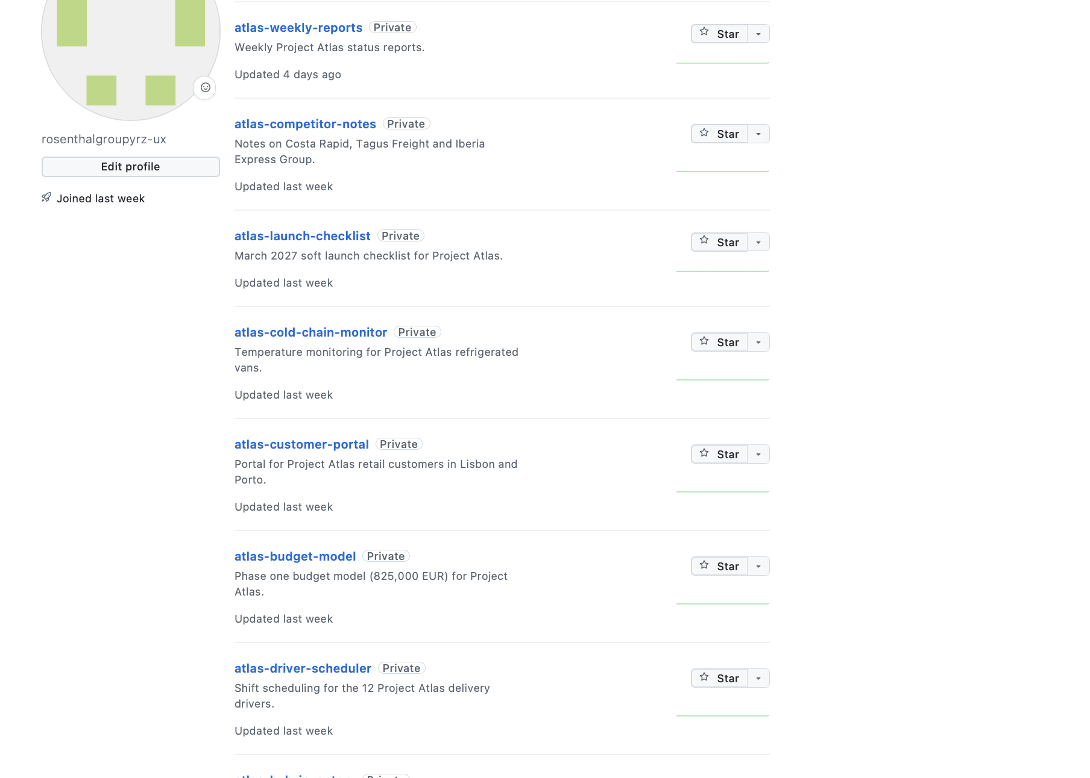
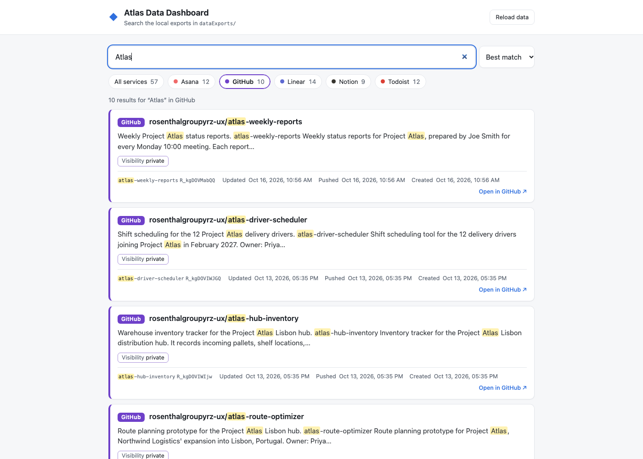
GitHub
10 repos
Ten private atlas-* repositories in the test account. The dashboard shows each repo's name, description, visibility and its updated, pushed and created times.
Original test content in GitHub
Same content in the dashboard

Slide 9
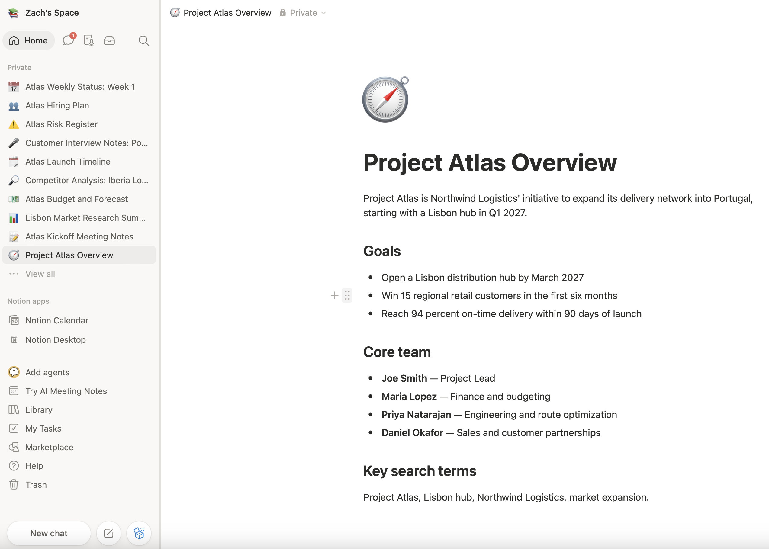
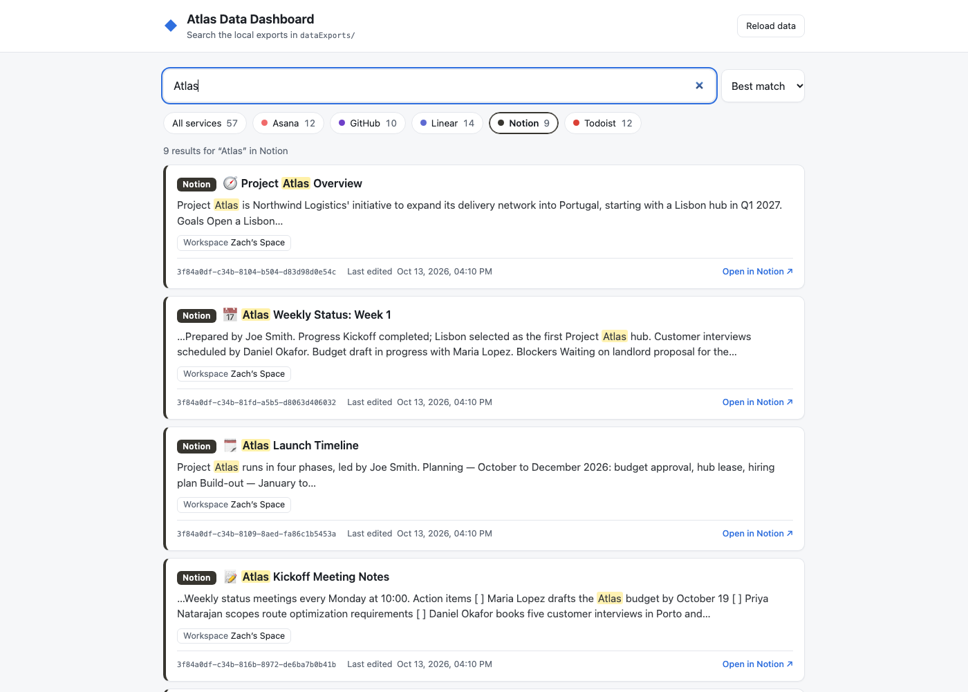
Notion
10 pages
Project Atlas pages such as the overview, budget, risk register and kickoff notes. The dashboard shows title, icon, a text excerpt, workspace and last-edited time.
Original test content in Notion
Same content in the dashboard

Slide 10
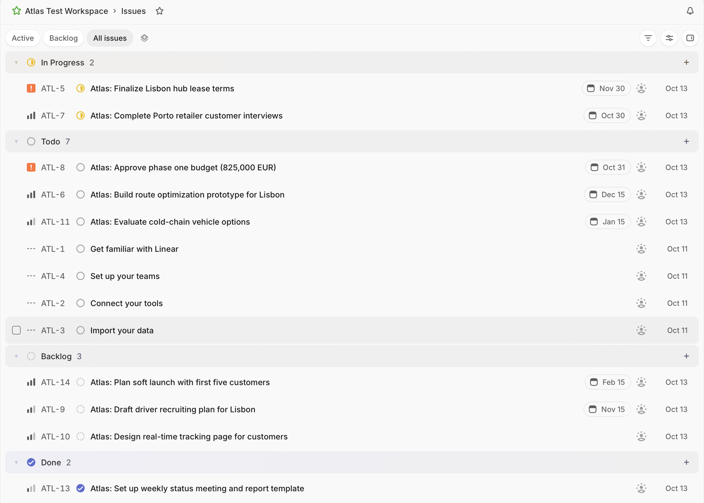
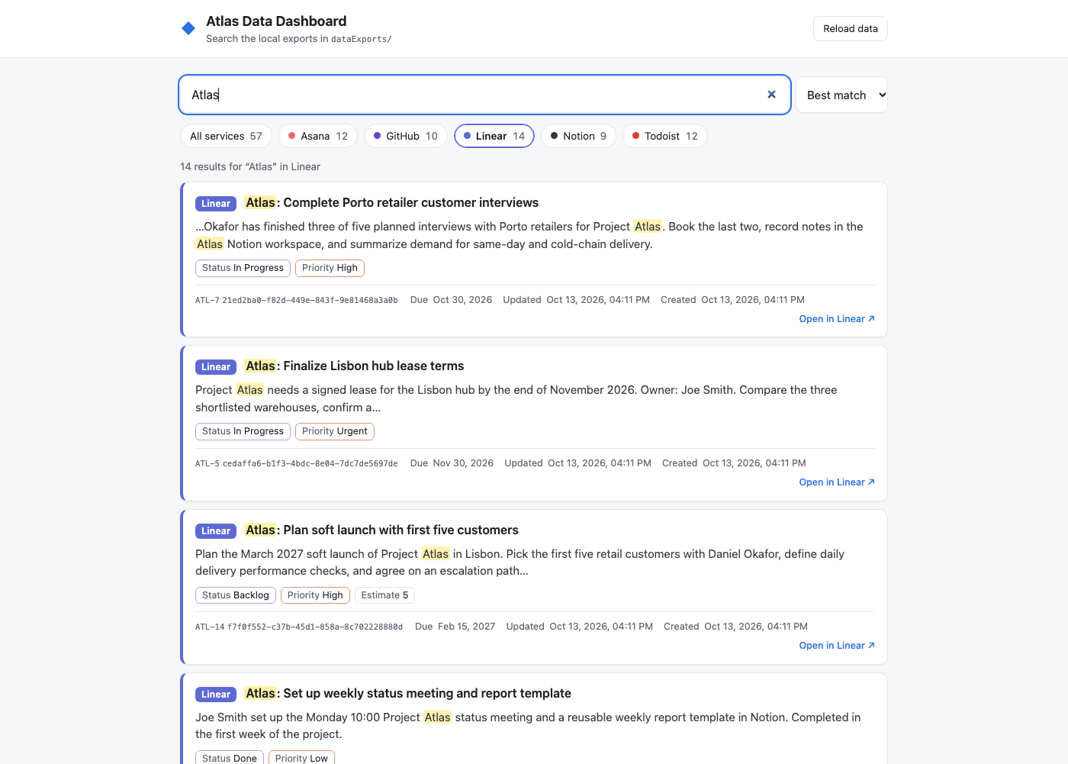
Linear
10 issues
Atlas issues ATL-5 to ATL-14 (plus Linear's 4 default issues). The dashboard shows status, priority, estimate, due date and timestamps.
Original test content in Linear
Same content in the dashboard

Slide 11
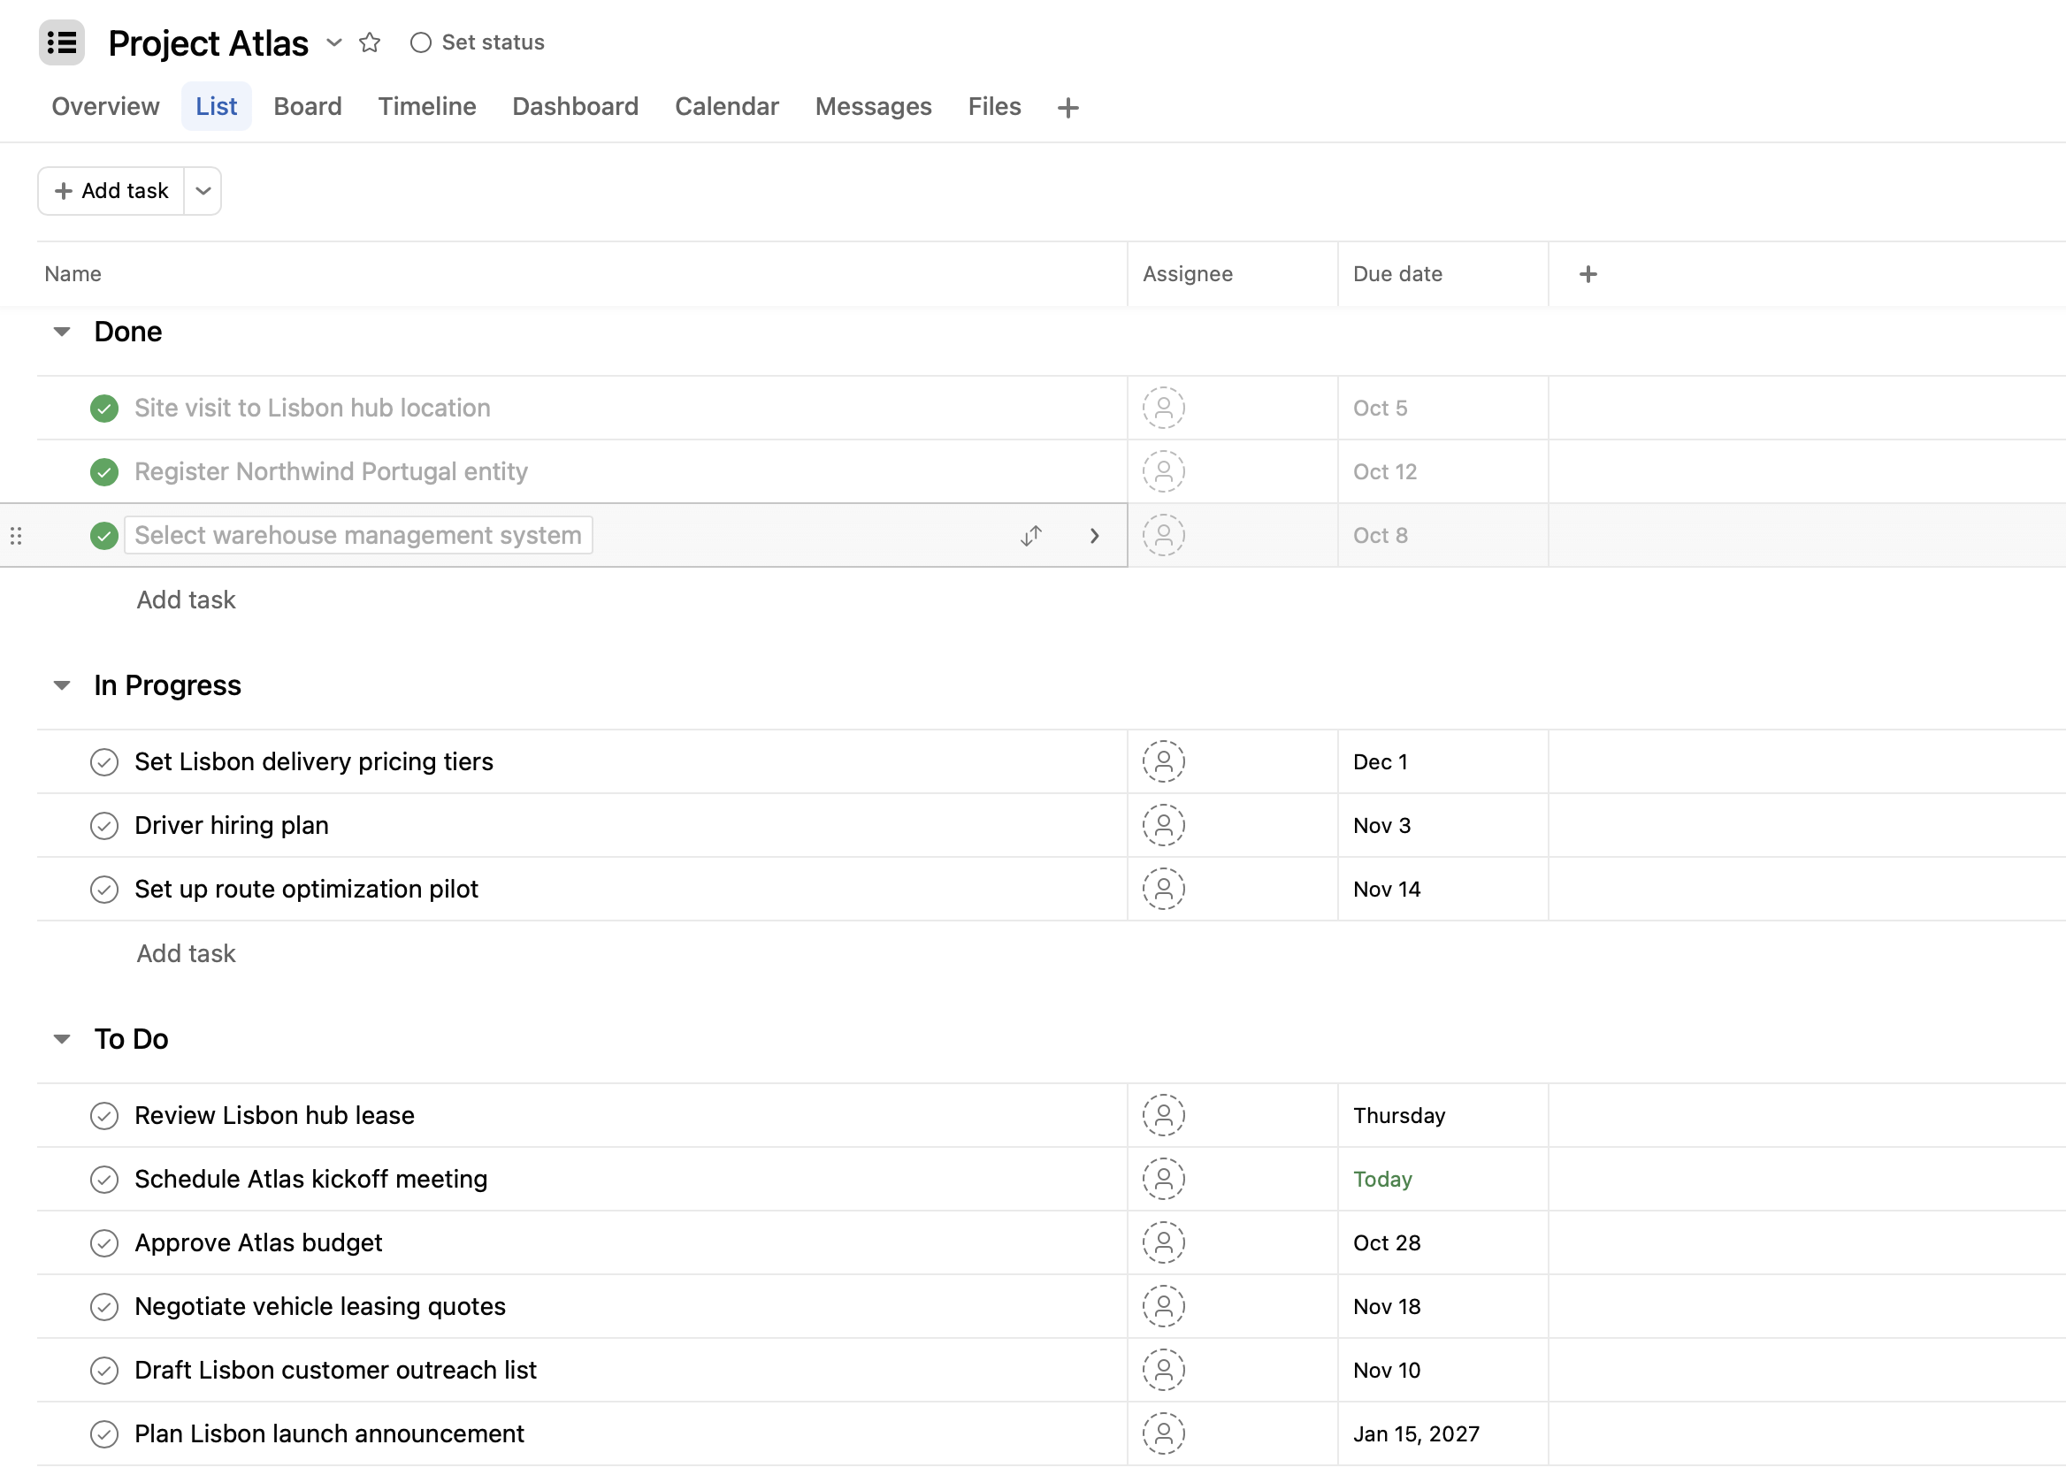
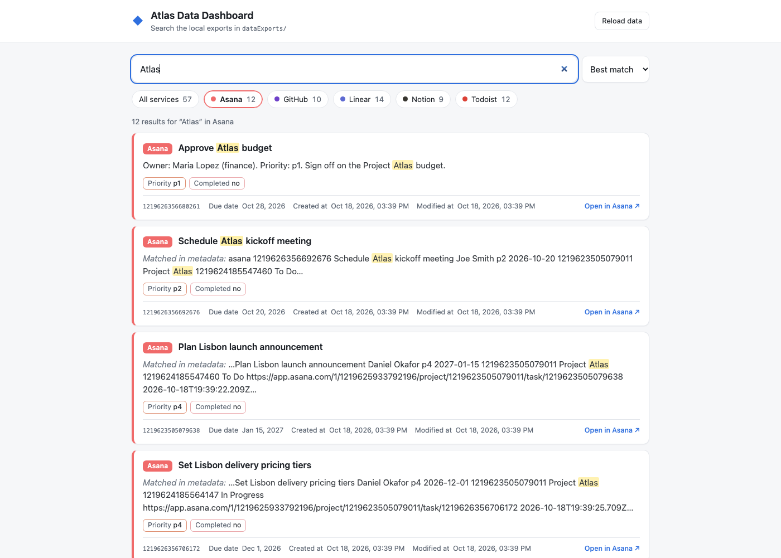
Asana
12 tasks
The Project Atlas task list across To Do, In Progress and Done. The dashboard shows name, owner, priority, completed flag, due date and timestamps.
Original test content in Asana
Same content in the dashboard

Slide 12
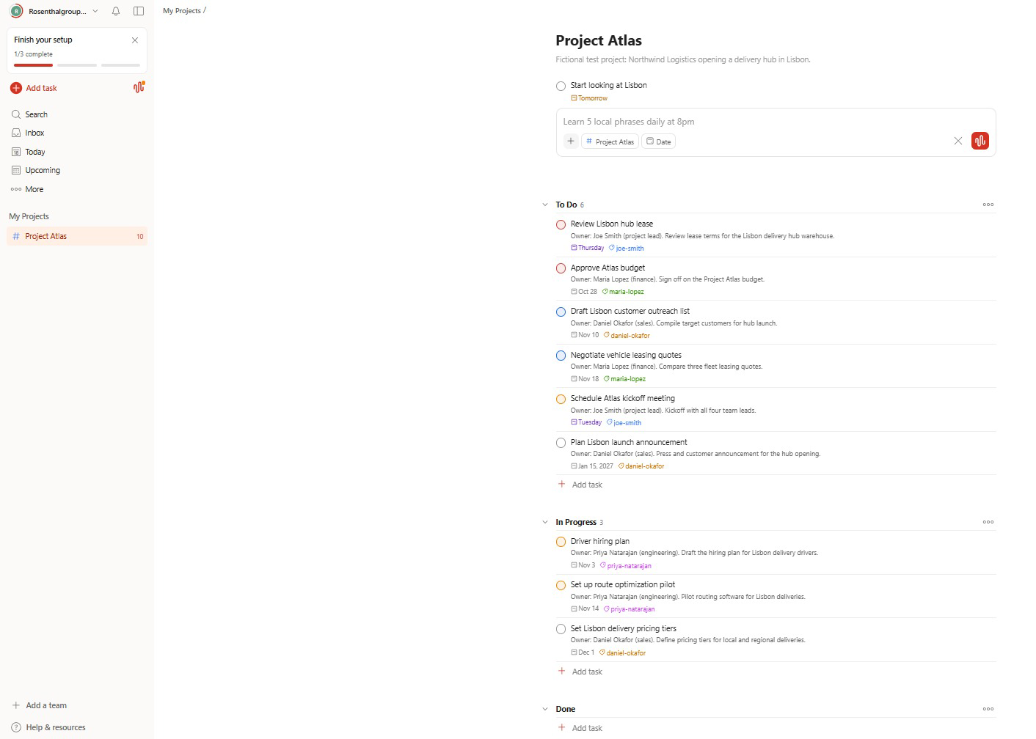
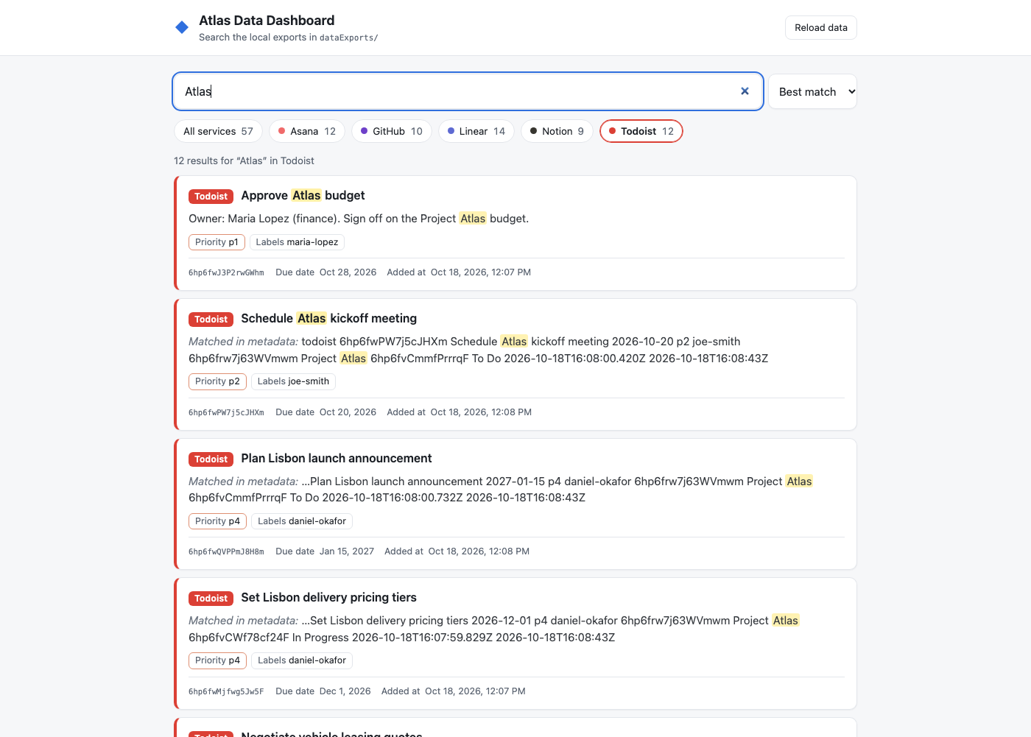
Todoist
12 tasks
The Project Atlas project with owners as labels. The dashboard shows priority, labels, due date, and added and completed times.
Original test content in Todoist
Same content in the dashboard

Slide 13
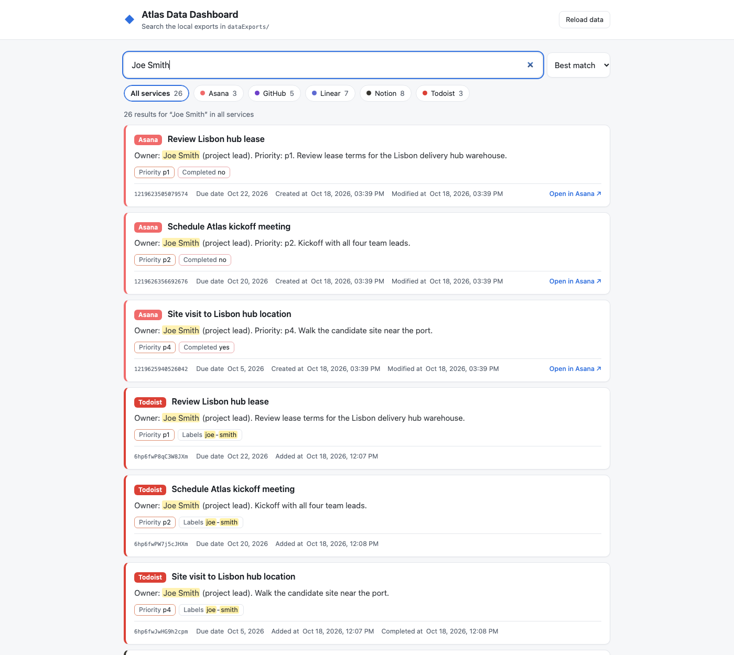
CROSS-SERVICE SEARCH
Searching “Joe Smith” everywhere
One query returns 26 matches, and every result is tagged with the service it came from.
Service | Matches
Notion | 8
Linear | 7
GitHub | 5
Asana | 3
Todoist | 3

Slide 14
THE DASHBOARD
What the website does
Search everything
Filter by service
Clear source labels
One query runs across all services and returns the matches together.
Service chips show how many matches each source has.
Each result has a colored service badge.
Highlighted matches
Handles bad data
Open the original
Search terms are highlighted, and metadata-only matches are labeled.
Empty folders and malformed JSON files are skipped with a warning.
Links jump back to the item in its service.

Slide 15
GROUND RULES
Safe by design
Test accounts only
Official MCP servers
No personal, school or work accounts. All content is fictional Project Atlas data.
Only vendor-hosted servers, never community connectors.
No secrets in the repo
One public repository
Tokens and OAuth secrets stay in the macOS Keychain or local settings, never in a file.
Code, data and docs live in one public GitHub repo, so only test data goes in.

Slide 16
DELIVERABLES
Everything lives in one GitHub repo
Item | What it holds
dataExports/ | Downloaded data, one sub-folder per service
.claude/skills/ | The download skill that repeats the export in the same format
.mcp.json | MCP server configuration (no secrets)
localStorageFormats.md | The storage format for each service
webapp/ + README.md | The dashboard code and how to run it
docs/ | Screenshots, this presentation and the demo video
github.com/rosenthalgroupyrz-ux/third-party-services-dashboard

