Slide 1
Recurrent NN (sequential data in life)
https://www.youtube.com/watch?v=cdLUzrjnlr4
Siraj’s example code (not us Tensorflow but only numpy) that train NN to add two binary numbers. The RNN takes in two bits and produce one bit output .
Learning representations by back-propagating errors: Geff Hinton, 1986 Nature:
We describe a new learning procedure, back-propagation, for networks of neurone-like units. The procedure repeatedly adjusts the weights of the connections in the network so as to minimize a measure of the difference between the actual output vector of the net and the desired output vector. As a result of the weight adjustments, internal ‘hidden’ units which are not part of the input or output come to represent important features of the task domain, and the regularities in the task are captured by the interactions of these units. The ability to create useful new features distinguishes back-propagation from earlier, simpler methods such as the perceptron-convergence procedure.
How to choose the number of hidden layers and nodes in a feedforward neural network?

Slide 2
An epoch is one complete presentation of the data set to be learned to a learning machine. Learning machines like feedforward neural nets that use iterative algorithms often need many epochs during their learning phase.
An epoch describes the number of times the algorithm sees the entire data set. So, each time the algorithm has seen all samples in the dataset, an epoch has completed.
You have a training data which you shuffle and pick mini-batches from it. When you adjust your weights and biases using one mini-batch, you have completed one iteration. Once you run out of your mini-batches, you have completed an epoch. Then you shuffle your training data again, pick your mini-batches again, and iterate through all of them again. That would be your second epoch. https://stackoverflow.com/questions/4752626/epoch-vs-iteration-when-training-neural-networks
Announcing SyntaxNet: The World’s Most Accurate Parser Goes Open Source
http://alexminnaar.com/deep-learning-basics-neural-networks-backpropagation-and-stochastic-gradient-descent.html
Very good backprop tutorial

Slide 3
LSTM -- How does it work?
https://datascience.stackexchange.com/questions/19614/need-help-understanding-lstms-backpropagation-and-carousel-of-error
https://stats.stackexchange.com/questions/185639/how-does-lstm-prevent-the-vanishing-gradient-problem
How LSTM alleviates vanishing gradient? Puzzled question.
http://arunmallya.github.io/writeups/nn/lstm/index.html#/5
LSTM step by step tutorial.
http://www.cs.toronto.edu/~rgrosse/csc321/lec10.pdf
A good explanation slide of how LSTM uses memory cells to prevent vanishing gradient. See #14.
Two strategies for dealing with exploding/vanishing gradients:
1 Minimize the long-distance dependencies
2 Keep the network’s transformation close to the identity function

Slide 4
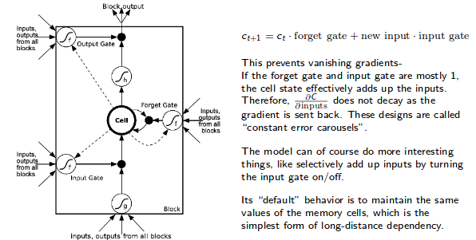
LSTM
The reason it could solve the vanishing gradient is that LSTM does not
directly propagate input to output through hidden states as conventional RNN does :
future hidden layer = (w (w (w (w * previous hidden layer))))
Rather, LSTM passes hidden layers through gates (sigmoid function inside) that determine if the signals in hidden layers are transmitted or not.
Cell states represent long term memory behavior
Hidden states represent working memory behavior
Sirja’s figure is much better to understand.

Slide 5
http://www.cs.toronto.edu/~rgrosse/csc321/lec10.pdf
Exploding and vanishing gradients
Dealing with exploding/vanishing gradients
Long-term Short-Term Memory (LSTM)
Easy to preserve parts of the hidden state over time, which simplifies the form of the dependencies between distant time steps.
Reverse the input or output sequence
Therefore at least some predictions only require short-range dependencies. The network can learn to predict these first, before learning the harder ones.
Clip the gradients so that their norm is smaller than some maximum value
This throws away information, but at least the weight updates are better behaved

Slide 6
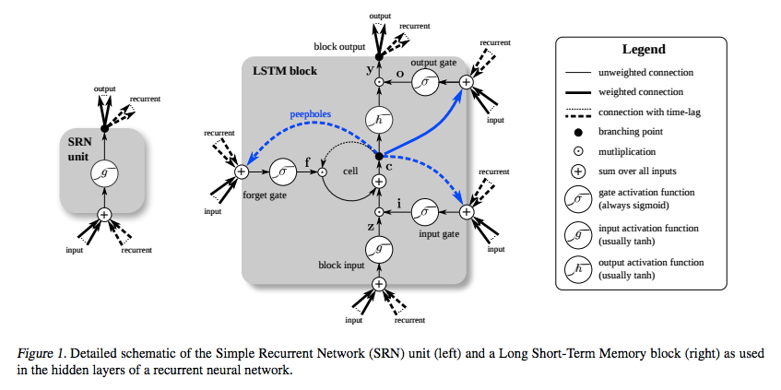
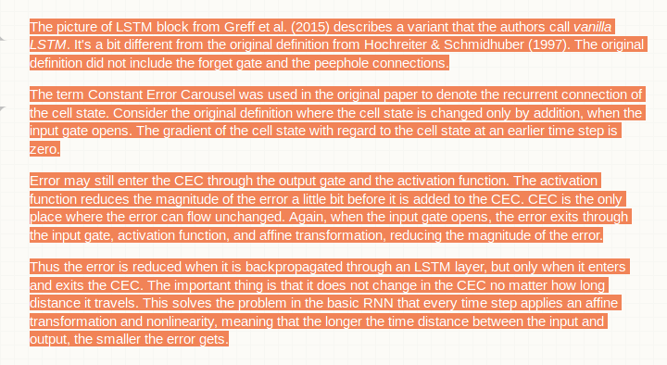
https://stats.stackexchange.com/questions/185639/how-does-lstm-prevent-the-vanishing-gradient-problem

Slide 7
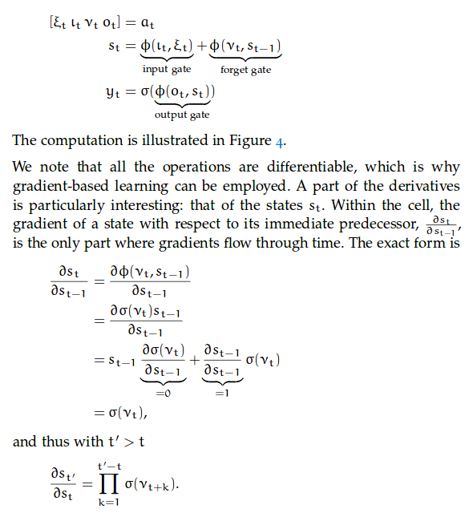
https://d-nb.info/1082034037/34
[2] Bayer, Justin Simon. Learning Sequence Representations. Diss. München, Technische Universität München, Diss., 2015, 2015.
This dissertation has a nice derivation showing how LSTM cell helps vanishing gradient problem. See at page 14.
The key is that the ‘forget’ gate is placed at every cell right along the long chain of ‘recurrent connection’
Constant Error Carousel (CEC) is the term.
Even though product of sigmoid will decrease (just like deep NN), there is no exponential drop due to the large products of weights. The product of sigmoids are more well behaving than products of weights.

Slide 8
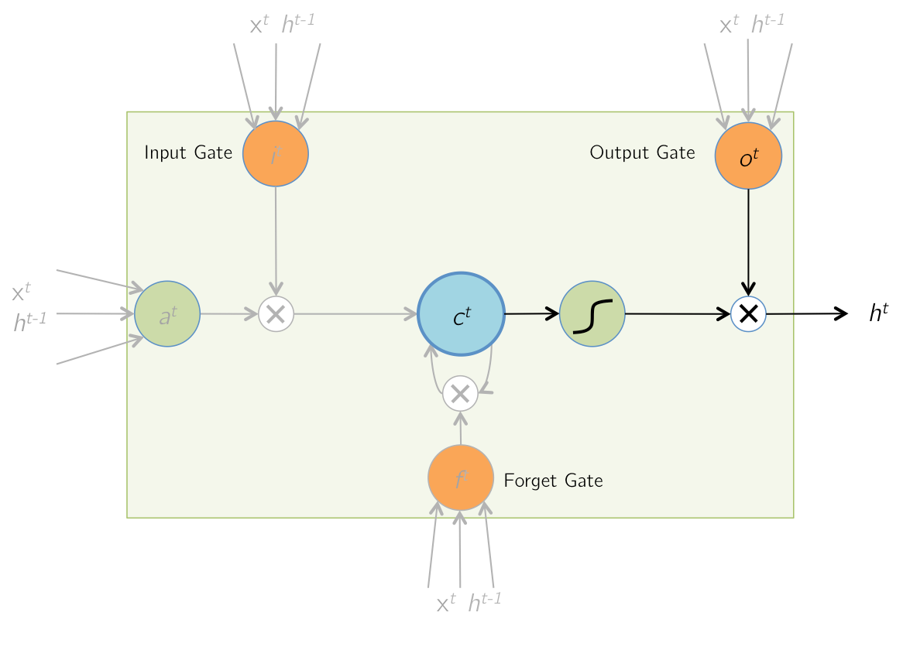
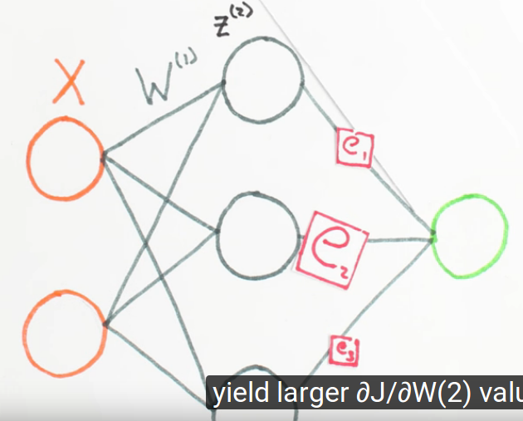
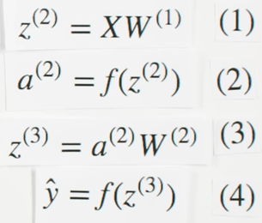
http://arunmallya.github.io/writeups/nn/lstm/index.html#/5
Slides showing animations of process
https://www.youtube.com/watch?v=GlcnxUlrtek
Neural Networks Demystified [Part 3: Gradient Descent]
Stochastic gradient descent : if we use data one at a time, sometimes it won’t matter our cost function is convex.
X is input (3x2, here 3 is size of data)
W1 is input weight (2x3; 2 input size, 3 hidden layer size)
Z2 is activity of layer 2 (3x3; 3 inputs, 3 cell values)
A2 is activity of layer 2 after activation function
W2 is 2nd layer weight (3x1; 3 cells, 1 output)
Y is output

Slide 9
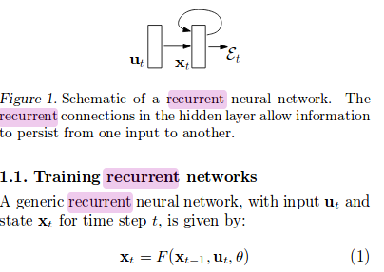
https://learningtensorflow.com/lesson3/
Study this of tensorflow take image input
https://www.youtube.com/watch?v=oPTwwQNRs7k
Tutorial of variable
ff
https://stats.stackexchange.com/questions/185639/how-does-lstm-prevent-the-vanishing-gradient-problem
Two references are excellent
1] On the difficulty of training recurrent neural networks
2] L E A R N I N G S E Q U E N C E R E P R E S E N T A T I O N S
Justin Baye’s disseration on RNN learning methods

Slide 10

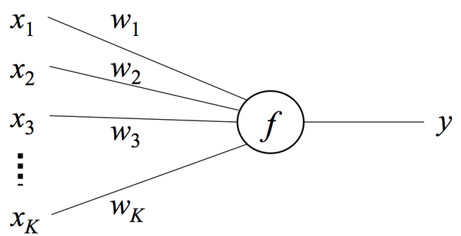

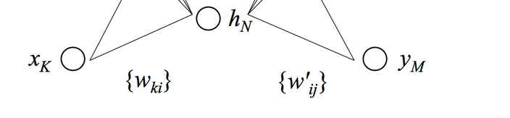



http://alexminnaar.com/deep-learning-basics-neural-networks-backpropagation-and-stochastic-gradient-descent.html
Deep learning basic; easy to follow math
Now let's turn our attention to the gradient of the objective function with respect to the input-to-hidden weights wki. As we shall see, this gradient has already been partially computed when we computed the previous gradient.
https://github.com/jldbc/numpy_neural_net/blob/master/three_layer_network.py
numpy_neural_net/three_layer_network.py

Slide 11


Delta of weights from hidden to output depends on
The delta of function from output to Error (, and
Gradient of output to w*x (ui) (function of Sigmoid or Relu) , and
Gradient of w*x to w, which is just x.
Requires dE/dh
Delta of Weights close to input are dependent on weights close to output.
In 3 layer design,
Delta of weights from input to the hidden layer depends on
Gradient of Error to hidden (value to value), and
Gradient of hidden to the output of w*x (ui) (value to value) , and
Gradient of w*x to w (value to parameter), which is just x.

Slide 12
Backprop example of simple NN
https://github.com/jldbc/numpy_neural_net/blob/master/three_layer_network.py
def backprop(X,y,model,z1,a1,z2,output,reg_lambda):
delta3 = output
delta3[range(X.shape[0]), y] -= 1 #yhat - y
dW2 = (a1.T).dot(delta3)
db2 = np.sum(delta3, axis=0, keepdims=True)
#delta2 = delta3.dot(model['W2'].T) * (1 - np.power(a1, 2)) #if tanh
delta2 = delta3.dot(model['W2'].T) * relu_derivative(a1) #if ReLU
dW1 = np.dot(X.T, delta2)
db1 = np.sum(delta2, axis=0)
# Add regularization terms
dW2 += reg_lambda * model['W2']
dW1 += reg_lambda * model['W1']
return dW1, dW2, db1, db2
a1 = relu(z1)
dW1 is the gradient from input to the hidden; relies on dE/dh (x → *w1 + b1 → z1 → Relu → a1 → *w2 + b2→ z2 → ?? → out )
DW2 = dE/dw2 = dE/z2 dz2/da1 = (y^-y)* a1 = (a1.T).dot(delta3) === this is because a1 is multiplied by W2 and then go through Error creating function (what I am not sure what that is)
dW1 = dE/dW1 = dE/da1 da1/dW1 = dE/dz2 dz2/da1 da1/dW1 = (y^-y) * w2 * ( x * derivative_relu ) = x * ( (y^- y) * w2 * derivative__relu )

Slide 13
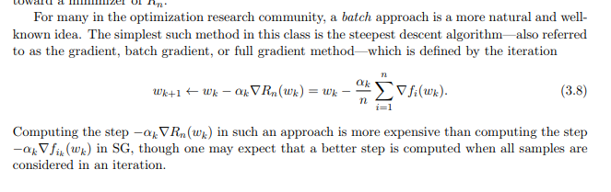
How does mini-batch backprop work?
One solution we found is the average of all
Overview: http://ruder.io/optimizing-gradient-descent/index.html
Korean translation : https://brunch.co.kr/@chris-song/50
The guy blogging
https://machinelearningmastery.com/gentle-introduction-mini-batch-gradient-descent-configure-batch-size/
One of the further reading lists ---> Optimization Methods for Large-Scale Machine Learning L´eon Bottou∗ Frank E. Curtis† Jorge Nocedal‡ February 12, 2018 https://arxiv.org/pdf/1606.04838.pdf

Slide 14
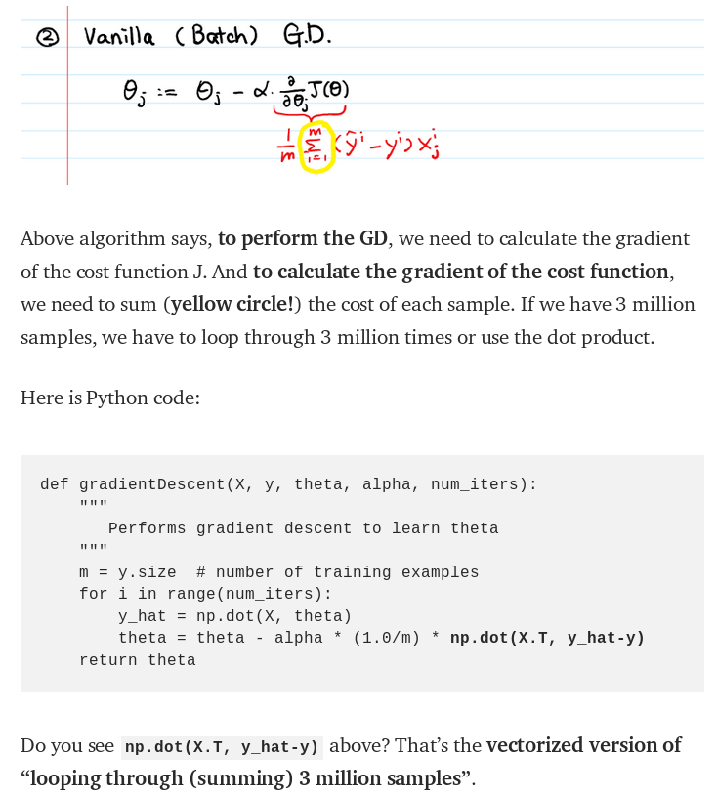

I searched
‘batch gradient’ and found this article explained it well.
https://towardsdatascience.com/difference-between-batch-gradient-descent-and-stochastic-gradient-descent-1187f1291aa1
Batch gradient: 1000 샘플을 사용
해서 theta를 update; new theta and
same 1000 sample 을 사용해서
theta를 다시 update; repeat!!!!

Slide 15
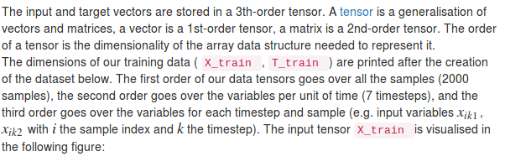
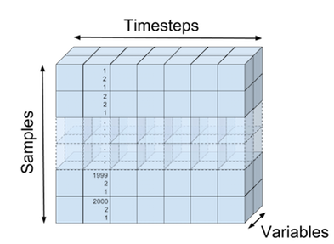
Why Newton-Raphson method is not used in NN?
1. second derivatives are expensive
2. lots of saddle point (read)
Identifying and attacking the saddle point problem in
high-dimensional non-convex optimization
http://peterroelants.github.io/posts/rnn_implementation_part01/
http://peterroelants.github.io/posts/rnn_implementation_part02/
Google: cost function for recurrent neural network
How to implement a recurrent neural network Part 2
Logistic classification
Logistic classification is used to output the probability that the output at current time step k is 1. This function together with its cost and gradient is implemented in the LogisticClassifier class below.

Slide 16
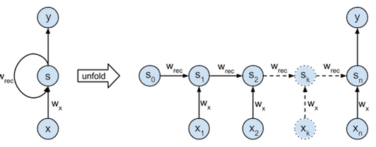
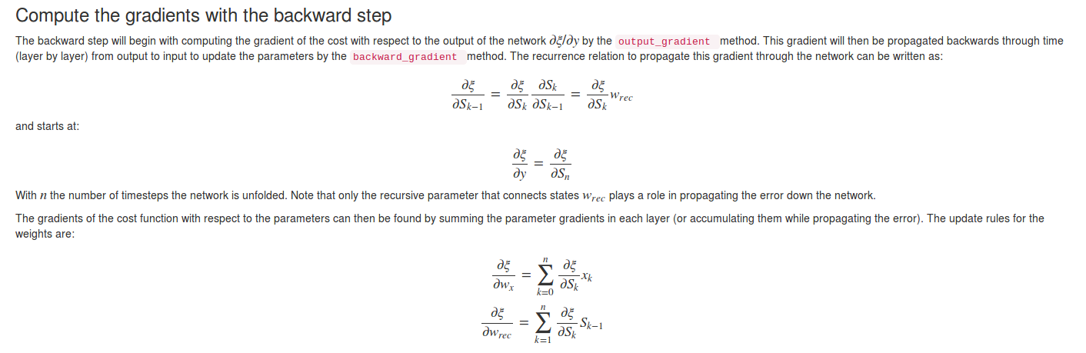
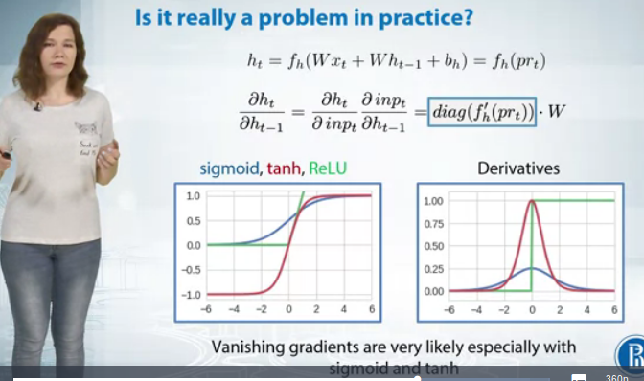
http://peterroelants.github.io/posts/rnn_implementation_part01/
https://www.coursera.org/learn/intro-to-deep-learning/lecture/gaBQJ/the-training-of-rnns-is-not-that-easy
Going from right term back to the left, recursively calculate using the following relationship ( see the first part of the layer_1_delta in siraj’s code)

Slide 17
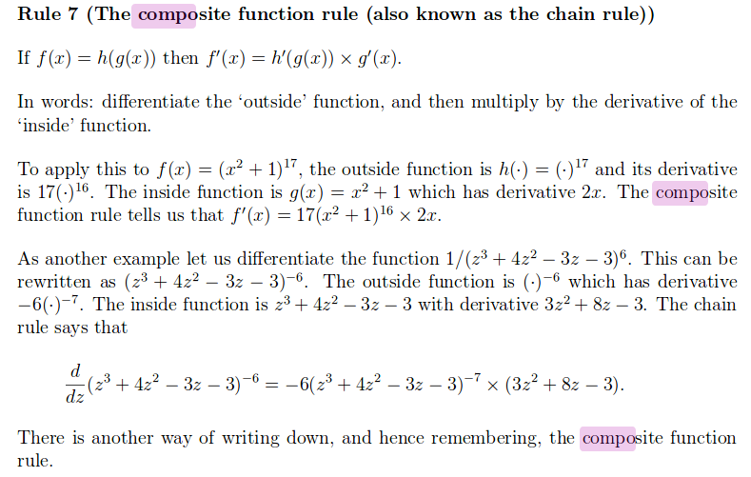
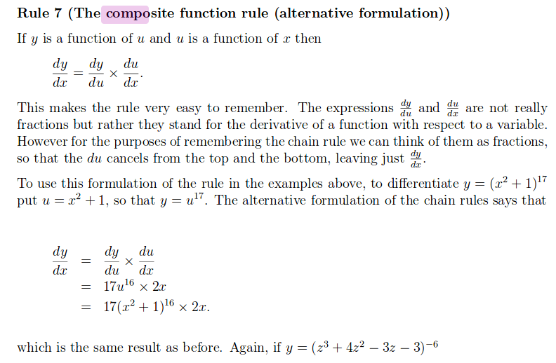
https://sydney.edu.au/stuserv/documents/maths_learning_centre/compositefunctionrule.pdf

Slide 18
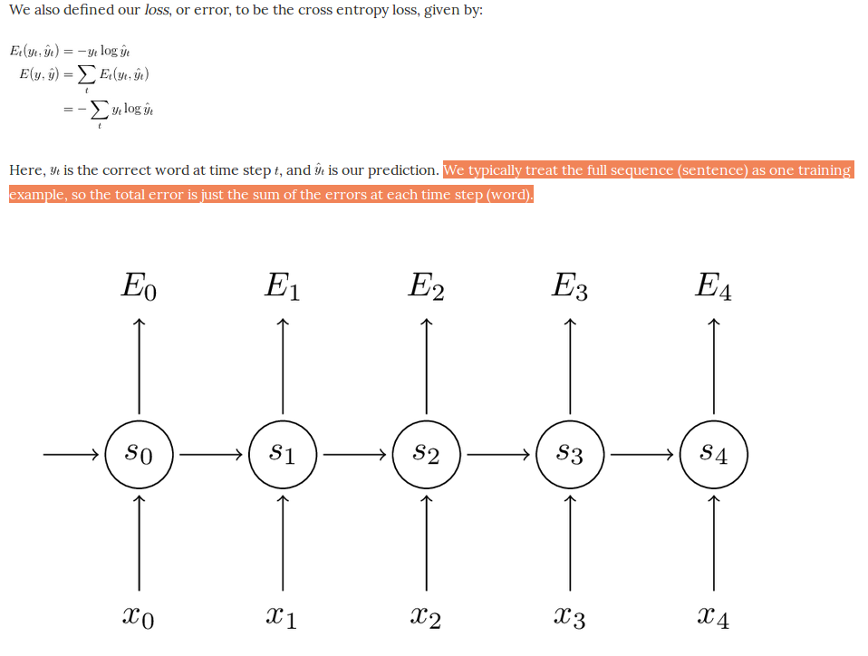
http://www.wildml.com/2015/10/recurrent-neural-networks-tutorial-part-3-backpropagation-through-time-and-vanishing-gradients/

Slide 19
Google: Tensorflow binary addition
https://gist.github.com/odo/58961375195d6dd3496571f6dc3c333a
Deep Learning for Answer Sentence Selection
https://arxiv.org/pdf/1412.1632.pdf
Selecting Best Answers from Question-Answers Pairs
https://cs224d.stanford.edu/reports/Anonymous1.pdf
Deep text-pair classification with Quora’s 2017 question dataset
https://explosion.ai/blog/quora-deep-text-pair-classification

Slide 20
Things to read and three papers revolutionized DL;
Why the “unsupervised learning” though?
https://www.quantstart.com/articles/Deep-Learning-with-Theano-Part-1-Logistic-Regression
Deep Learning with Theano - Part 1: Logistic Regression ... www.quantstart.com Over the last ten years the subject of deep learning has been one of the most discussed fields in machine learning and artificial intelligence.
https://www.nature.com/articles/nature14539
32.
Hinton, G. E., Osindero, S. & Teh, Y.-W. A fast learning algorithm for deep belief nets. Neural Comp. 18, 1527–1554 (2006). This paper introduced a novel and effective way of training very deep neural networks by pre-training one hidden layer at a time using the unsupervised learning procedure for restricted Boltzmann machines.
33.
Bengio, Y., Lamblin, P., Popovici, D. & Larochelle, H. Greedy layer-wise training of deep networks. In Proc. Advances in Neural Information Processing Systems 19 153–160 (2006). This report demonstrated that the unsupervised pre-training method introduced in ref. 32 significantly improves performance on test data and generalizes the method to other unsupervised representation-learning techniques, such as auto-encoders.
https://www.youtube.com/watch?v=Oq38pINmddk
unsupervised pre-training method

Slide 21
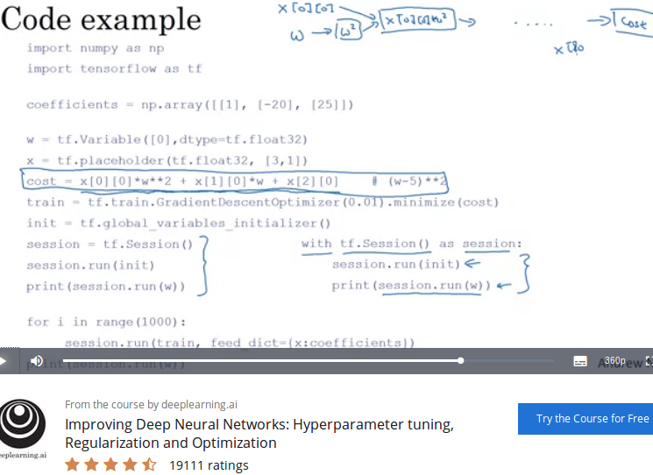
https://www.coursera.org/learn/deep-neural-network/lecture/zcZlH/tensorflow?

Slide 22
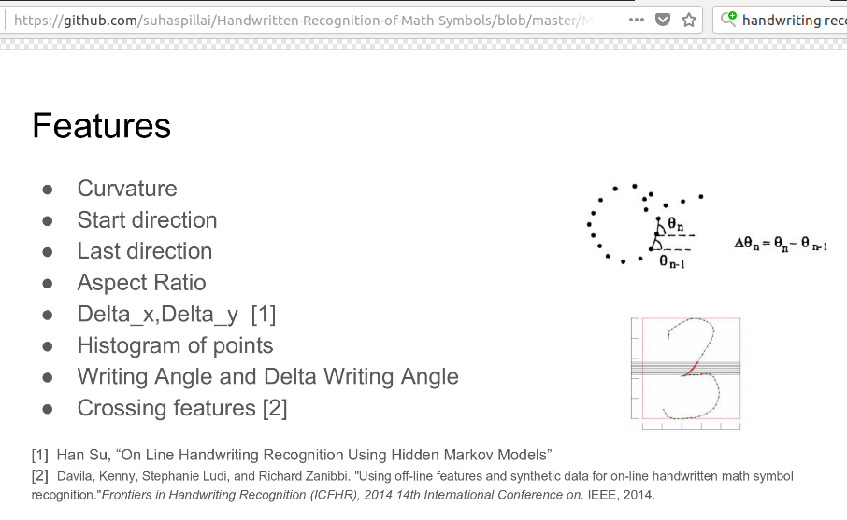
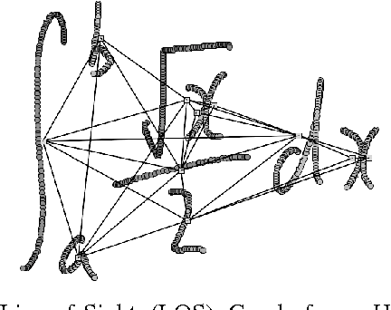
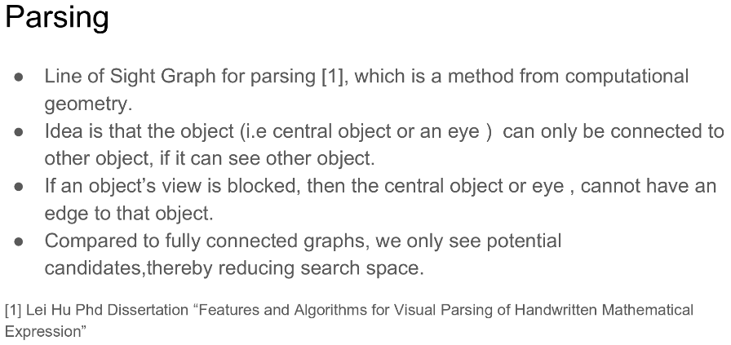
https://github.com/suhaspillai/Handwritten-Recognition-of-Math-Symbols/blob/master/Math_Symbol_Recognition.pdf
Figure 1: Line-of-Sight (LOS) Graph for a Handwritten Expression. Small square nodes represent bounding box centers for eleven handwritten strokes. Edges represent mutually ‘visible’ strokes. Two strokes share an edge if an unobstructed line can be drawn from one stroke’s bounding box center to a point on the convex hull for the other stroke (see Algorithm 1)

Slide 23
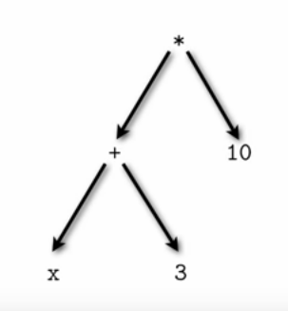

Parsing

