Slide 1
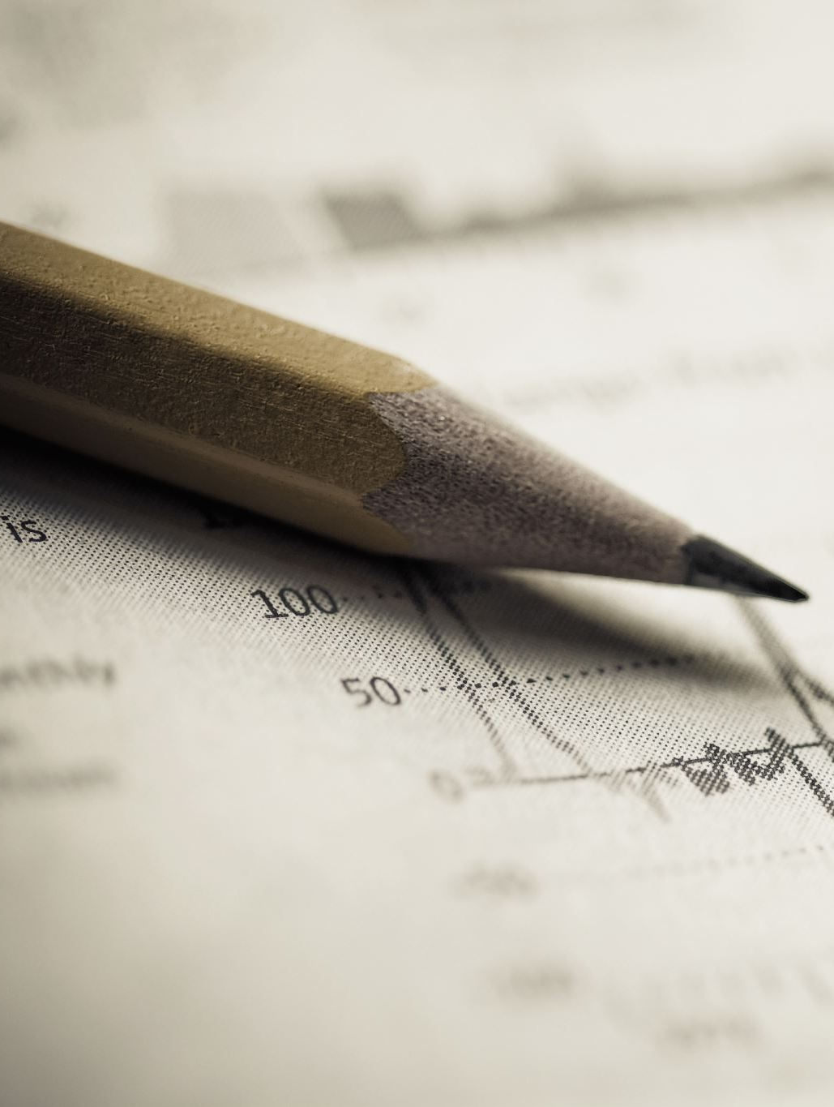
Stock News Parser & Analysis Project
Rozy Patel (100952561)
VinayPasam (100950765)
Anitha Babu(100944475)
Arjun Aji (100944831)
Nihal Mansuri: 100956112

Slide 2
Workflow Summary
Stage 1
Scrape PR Newswire (last 7-14 days)
Stage 2
Extract stock symbols from articles
Stage 3
Focus on tech stocks: AAPL, NVDA, MSFT, AMZN
Stage 4
Fetch stock history using Yahoo Finance
Stage 5
Generate reports and graphs

Slide 3
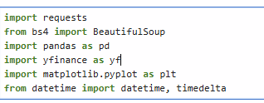
Library

Slide 4
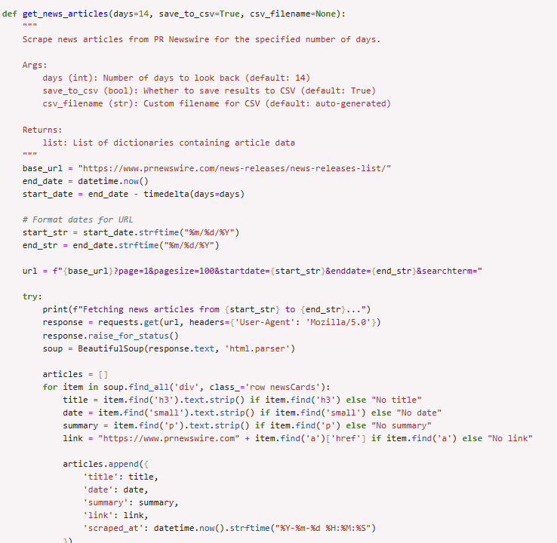
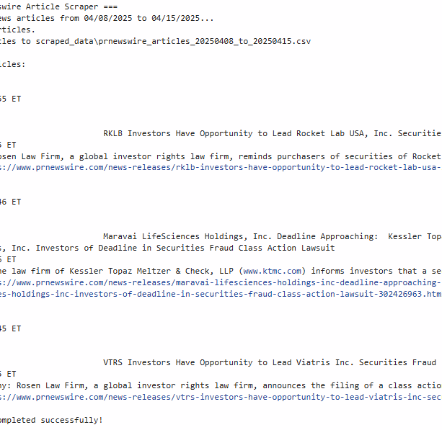
News Scraper

Slide 5
News Scraper
Scraped 98 articles between April 8–15, 2025
Example title: 'RKLB Investors Opportunity...'
Symbols Found: NASDAQ:RKLB
Saved to: scraped_data/prnewswire_articles_20250408_to_20250415.csv

Slide 6
Symbol Extraction Matrix
Symbol | Count
WHY:ROSEN | 2
CHING:KESSL | 2
NASDAQ:SSNC | 1
MAAKT:GOVER | 1

Slide 7
Focused Symbol Tracking (Tech Giants)
Company | Mentions
AAPL | 2
NVDA | 1
MSFT | 2
AMZN | 1

Slide 8
Historical Data Collection
30-day data from Mar 17 – Apr 15, 2025
Symbols: AAPL, NVDA, MSFT
Metrics: Close Price, Volume, Daily % Change, 5-Day MA

Slide 9
Stock Report Matrix
Symbol | Start Price | End Price | Change % | 30D High | 30D Low | Avg Volume | Latest Volume
NASDAQ:AAPL | $214.00 | $202.14 | -5.54% | $225.62 | $169.21 | 75,986,237 | 50,304,417
NASDAQ:NVDA | $119.53 | $112.20 | -6.13% | $122.89 | $86.62 | 320,033,641 | 211,050,923
NYSE:MSFT | $388.70 | $385.73 | -0.76% | $396.36 | $344.79 | 26,938,069 | 17,074,637

Slide 10
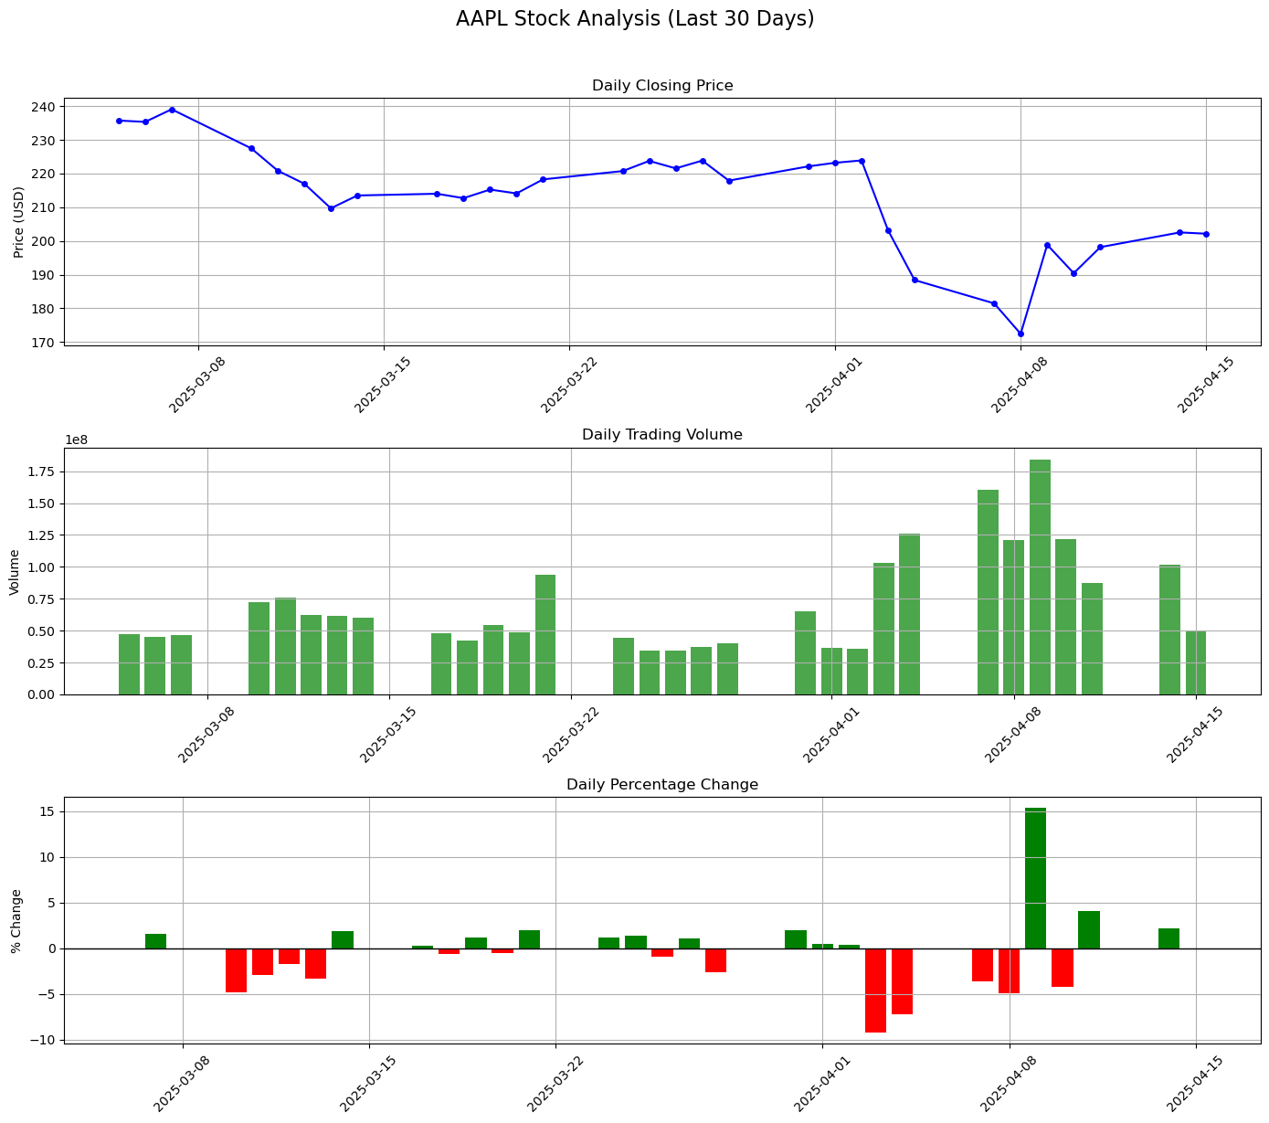
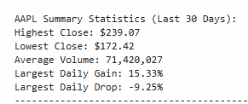
Visual Insights APPL
Moderate volatility with strong recovery signs
Volume stable, with slight rise during late dips
AAPL shows resilience — suitable for balanced-risk investors

Slide 11
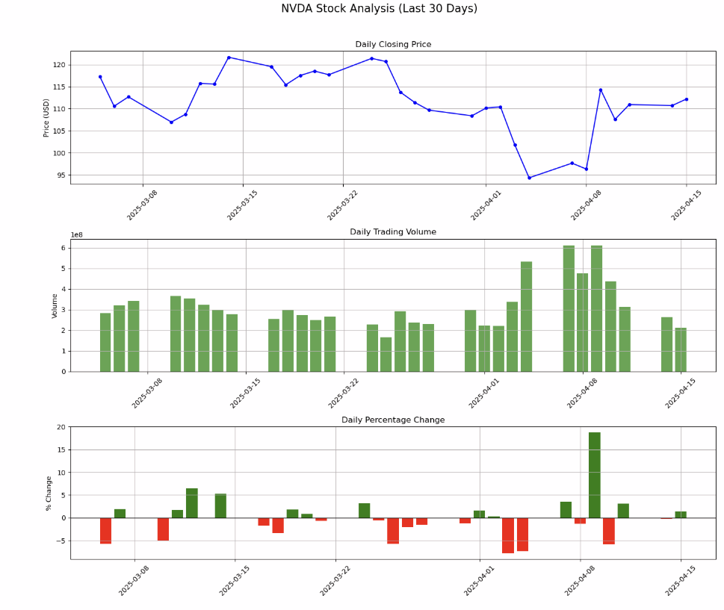
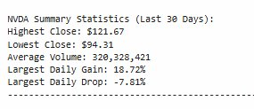
Visual Insights NVDA
Highly volatile, with sharp price shifts
Very high volume reflects active trading interest
Best for opportunistic short-term trades, not long-term holds

Slide 12
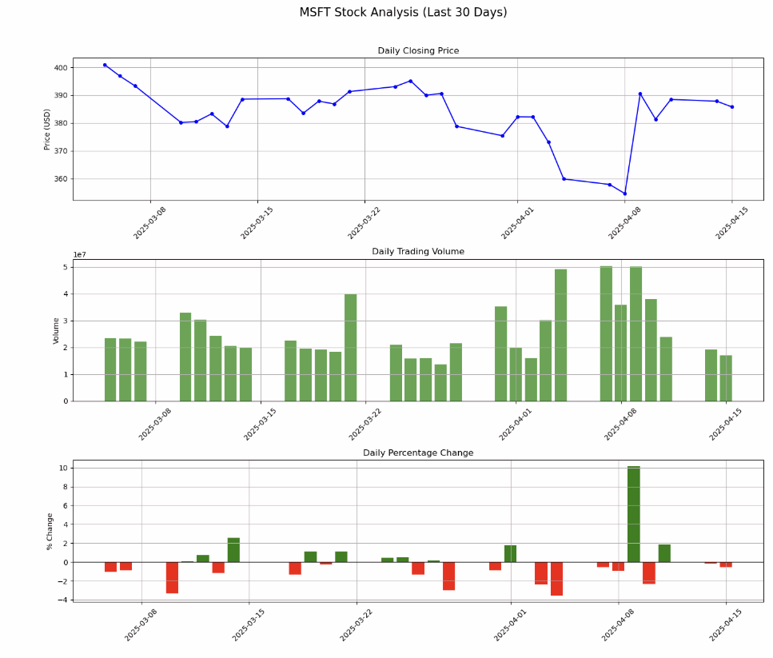
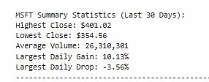
Visual Insights MSFT
Stable trend with low volatility
Moderate trading volume shows consistent investor confidence
Ideal for long-term, low-risk investors

Slide 13
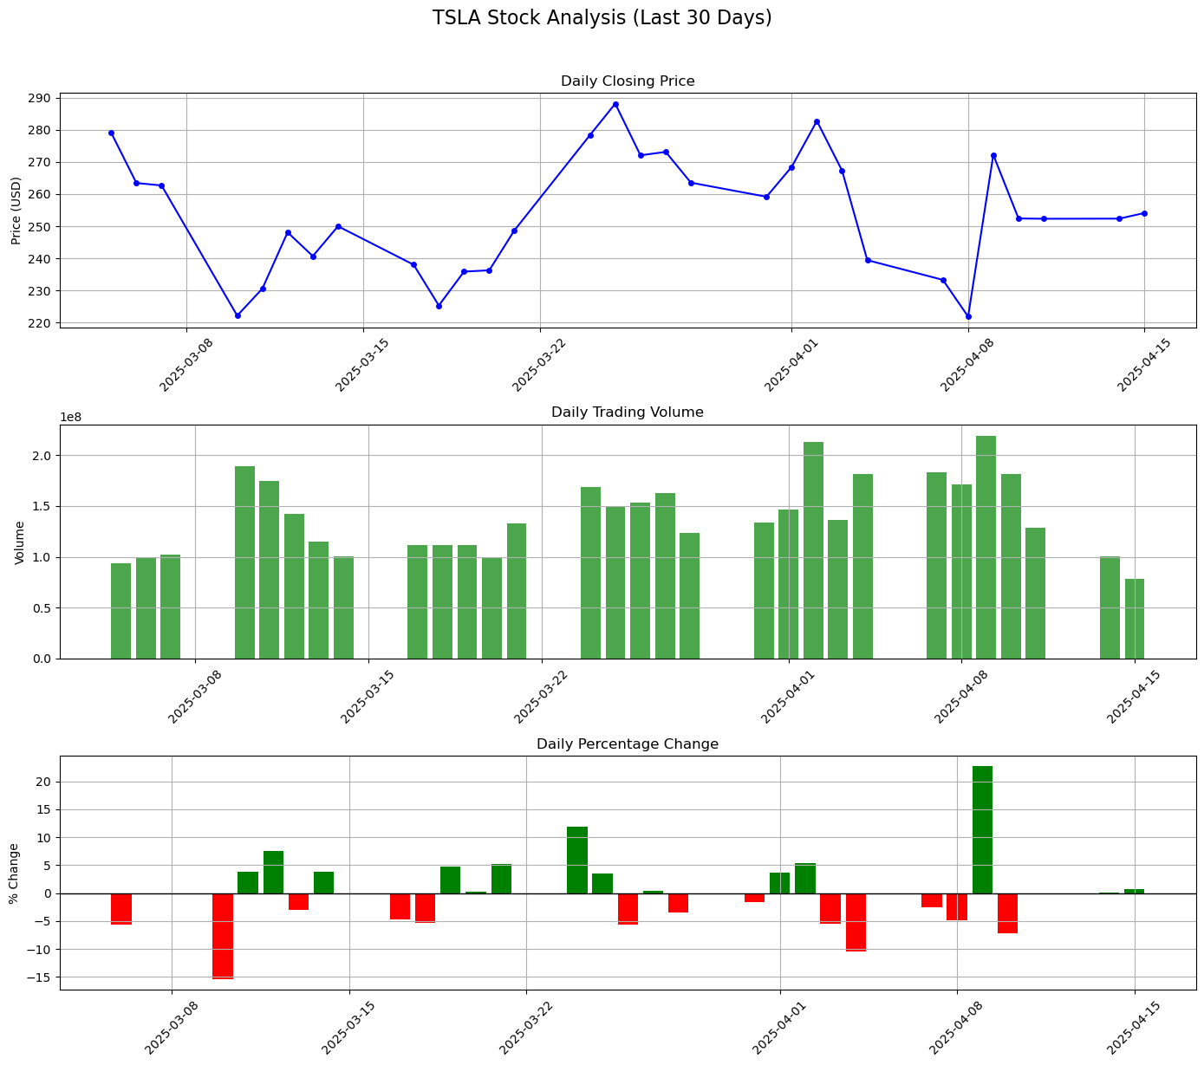
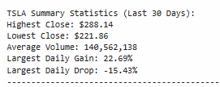
Visual Insights​ TSLA ​
High trading volume shows strong market interest
Best for high-risk, short-term traders

Slide 14
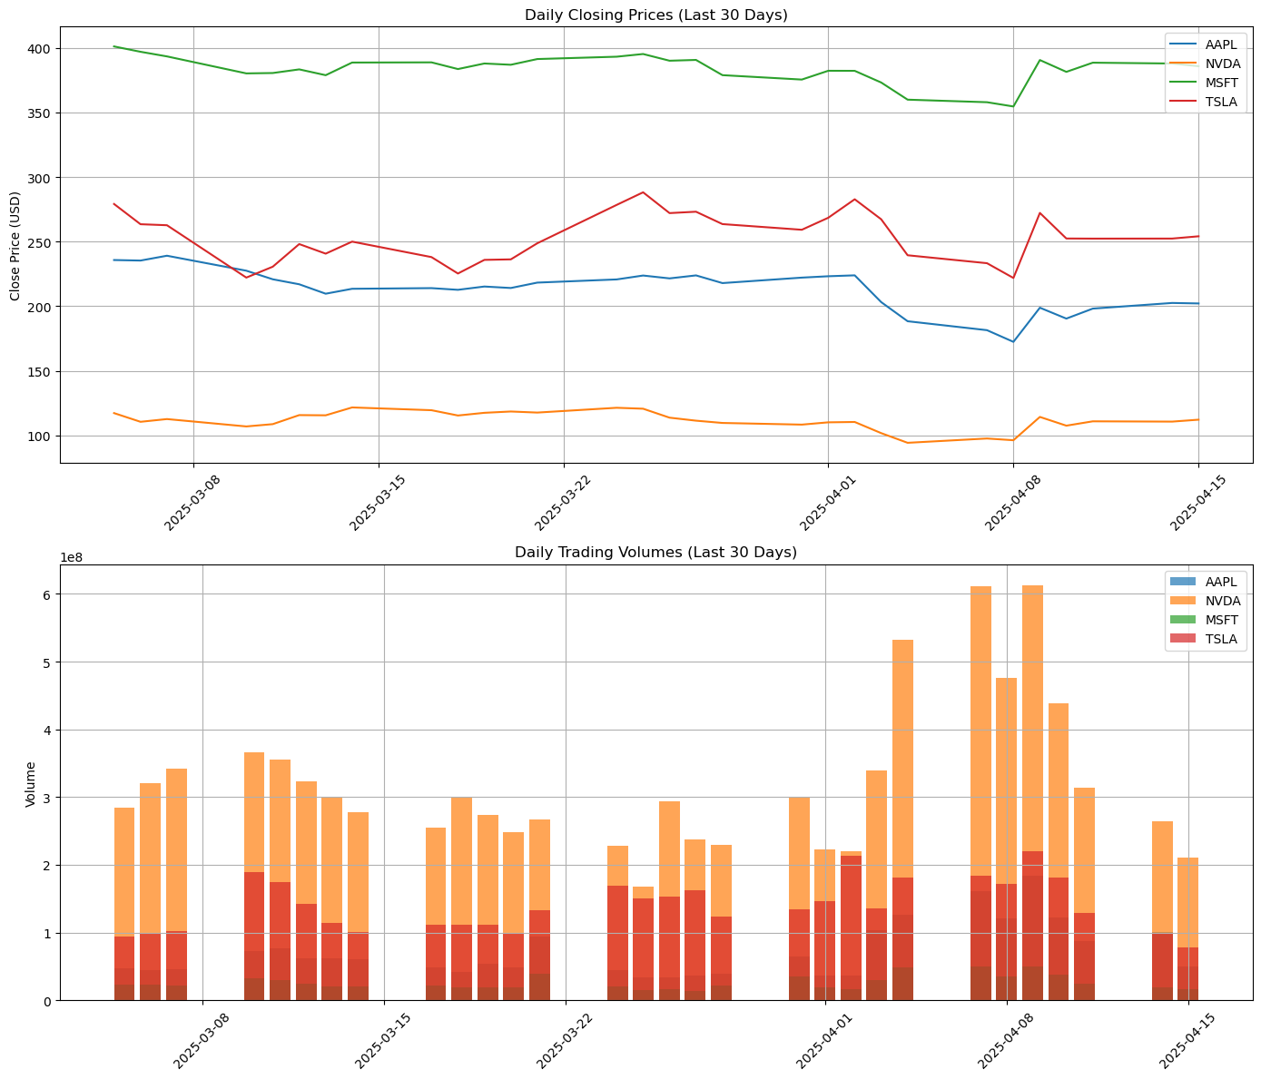
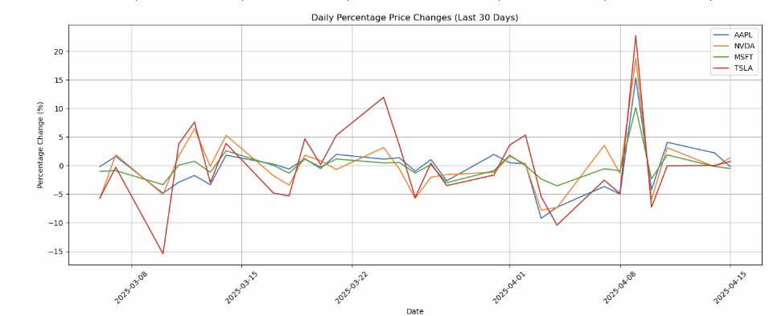
Daily closing price and daily trading volume for the stocks

Slide 15
Insight: Daily Closing Price & Trading Volume (Last 30 Days)
NVDA and TSLA exhibited the most volatility in daily percentage price changes, with TSLA reaching a peak gain of ~22% and a sharp dip around -15%.
AAPL and MSFT remained relatively stable, with narrower fluctuation ranges and steadier performance.
In terms of volume, TSLA consistently had the highest trading activity, indicating strong investor interest or speculative trading.
NVDA's volume spiked sharply during the first week of April, aligning with a rapid price rebound—possibly due to impactful news or investor sentiment.
MSFT and AAPL show high stability and liquidity, suitable for conservative investors seeking less risk.

Slide 16
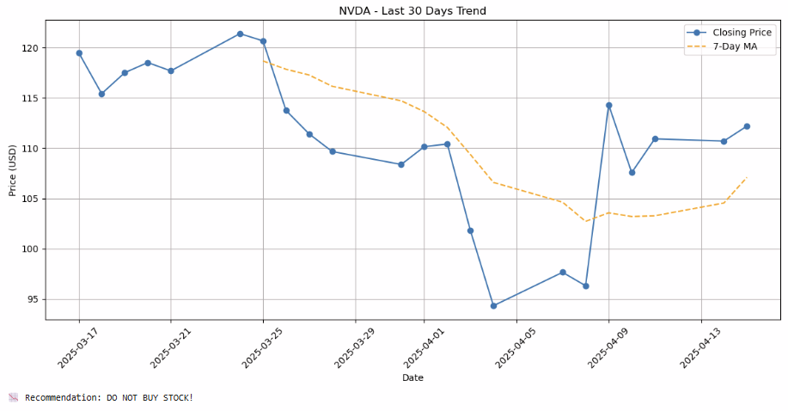
NVDA 30-Day Trend Visualization
NVDA showed a consistent downward trend starting late March.
The 7-day moving average stayed below the price line most of the time, signaling weak momentum.
Despite occasional rebounds, the trend remains volatile and bearish.
Recommendation: DO NOT BUY STOCK! (Wait for a more stable upward pattern before entering.)

Slide 17
Recommendation
•NVDA has shown a downward + inconsistent trend.
• Large early April drop followed by partial recovery
• 7-day moving average still trending downward
• Volume is high but trend is volatile
• Final Verdict: WAIT BEFORE BUYING STOCK!

Slide 18
To Sum Up
Among the four tech stocks analyzed NVDA, AAPL, MSFT, and TSLA and all demonstrated varying levels of volatility, trading volume, and price trends over the past 30 days.
MSFT showed the most stable performance, with low volatility and consistent volume, making it ideal for long-term investors.
TSLA and NVDA exhibited high volatility with sharp gains and drops, reflecting strong market activity and speculative behavior — best suited for short-term trading.
AAPL remained moderately volatile but demonstrated strong recovery and investor confidence, making it a balanced option for medium-risk investors.
Recommendation Summary:
MSFT – Buy/Hold (Stable growth)
AAPL – ️ Buy cautiously (Resilient but slightly volatile)
NVDA – Wait (Inconsistent trend)
TSLA – Avoid or trade short-term only (High risk)

Slide 19
Conclusion & Future Enhancements
End-to-end automation achieved
Effective combination of NLP + Finance APIs
Regex + keyword filtering for stock symbols
Future: Real-time tracking, other industries, sentiment analysis

Slide 20
This analysis helps investors align their choices with their risk appetite and strategy, backed by data-driven insights and visual trends.
Thank You

