Slide 1

LAI-CNNs for Question Answering
August 3, 2018
Royal Sequeira
David R. Cheriton School of Computer Science
University of Waterloo

Slide 2
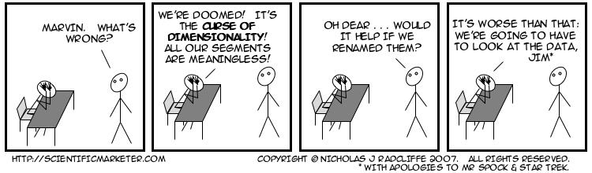
Ante 2013: Feature Engineering
Handpicked features
Domain knowledge
Curse of dimensionality!

Slide 3
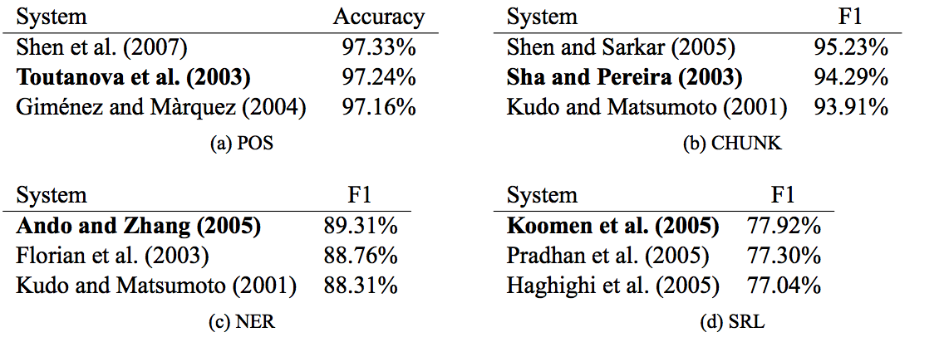
Ante 2013: SOTA

Slide 4
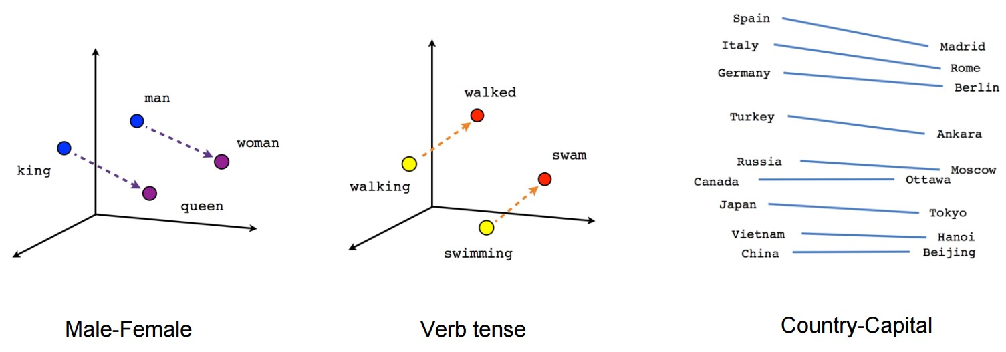
Circa 2013: Enters Deep Learning
“A word is known by the company it keeps”

Slide 5
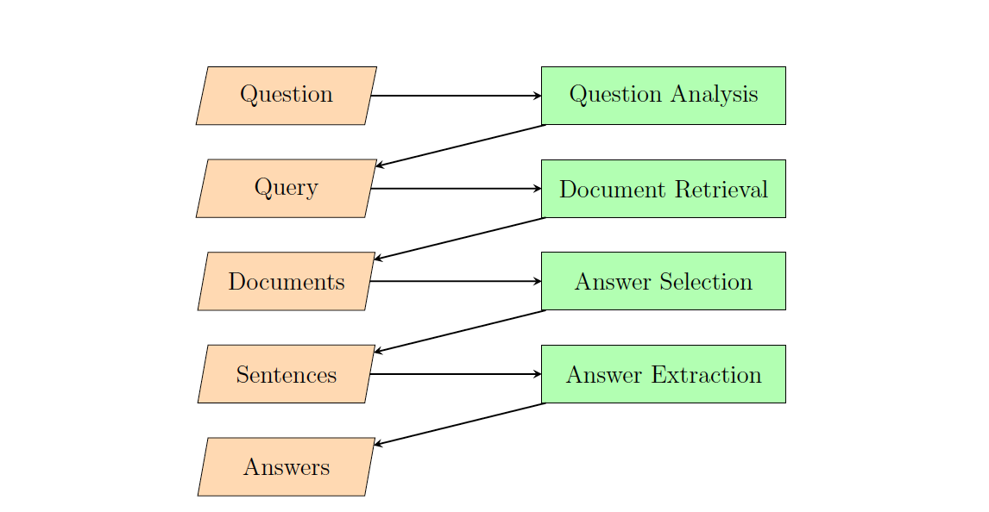
Task: Factoid QA

Slide 6
Task
Answer selection
Given a pair of question and answers, recognize the relevant answers
A ranking problem
Q: question
A: {a_{1,} a_{2,} …, a_{m} } answers
Rank A such that most relevant answers appear at the top of the ranked list
Notes:
Researchers started focusing on the most important component of the pipeline

Slide 7
Evaluation Metrics
Mean Average Precision
Quantifies the quality of a ranked list
[1, 0, 0, 1, 1, 1]
[1/1, 0, 0, 2/4, 3/5, 4/6]
AP: 0.6917
Mean Reciprocal Rank
How well the first relevant answer is placed
[0, 0, 0, 1, 1, 1]
[0, 0, 0, 1/4, .., ..]
MRR: 0.25

Slide 8
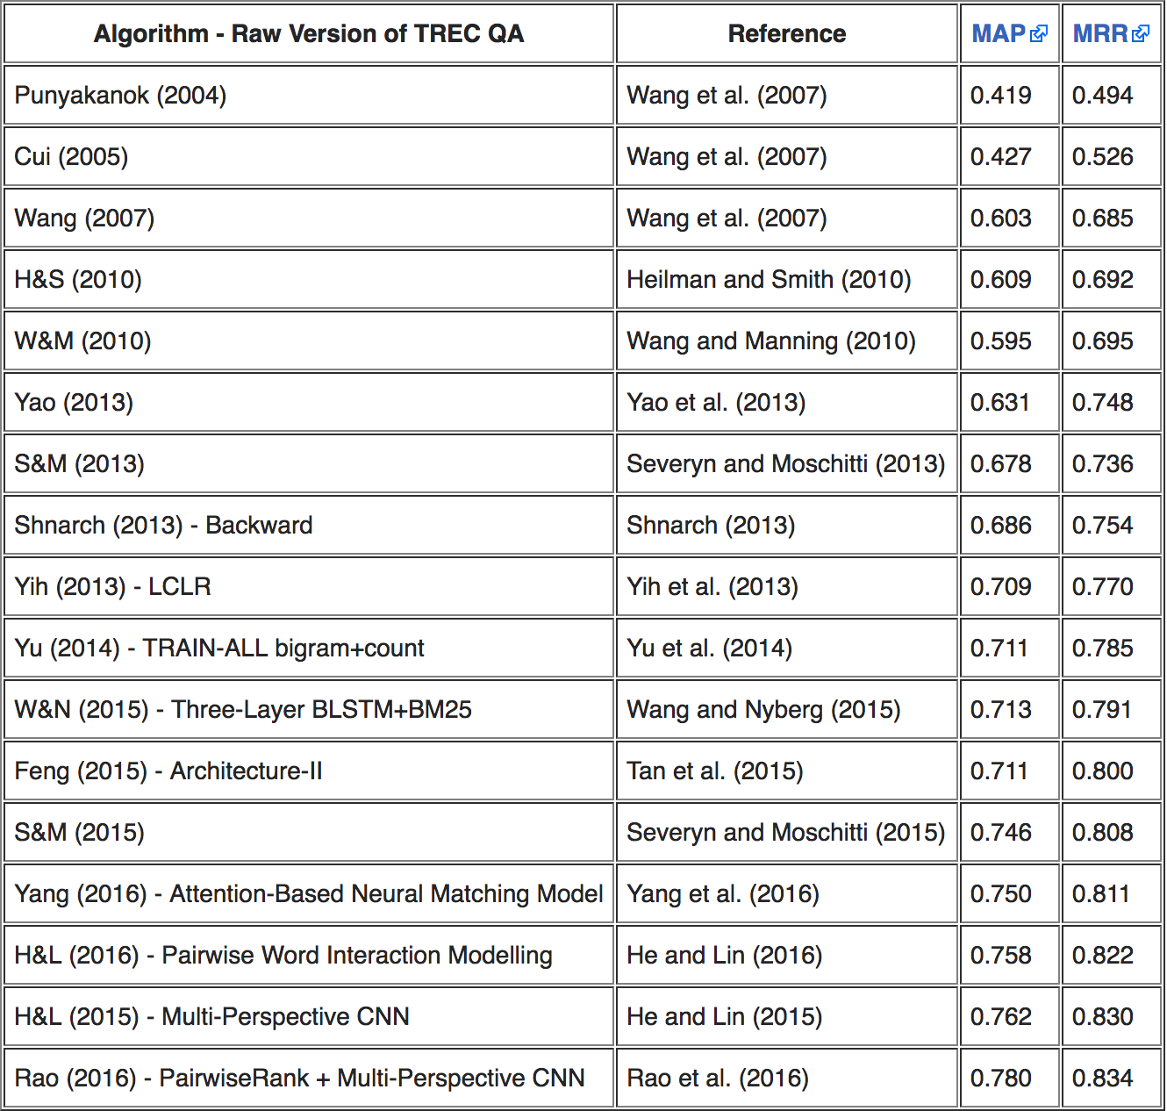
TrecQA: State of the Art

Slide 9
TrecQA: State of the Art

Slide 10
SM Model
features
features

Slide 11
TrecQA: State of the Art

Slide 12
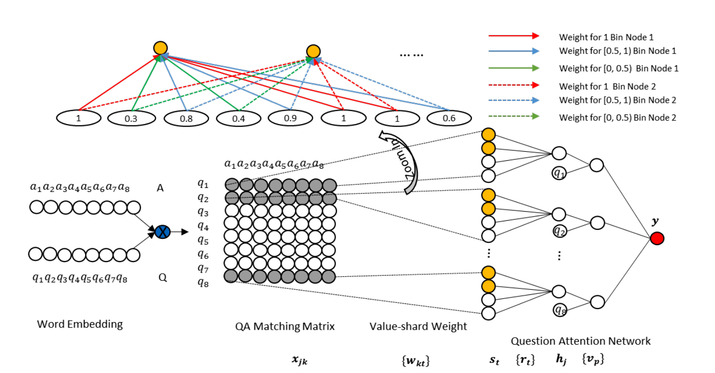
TrecQA: State of the Art

Slide 13
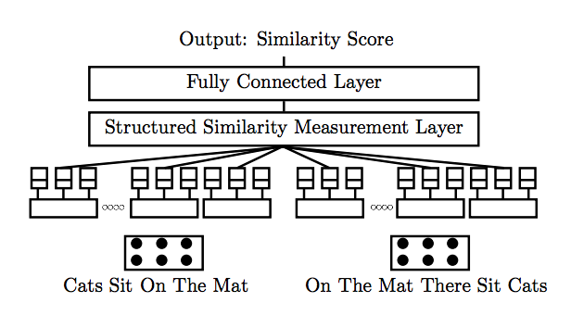
TrecQA: State of the Art

Slide 14
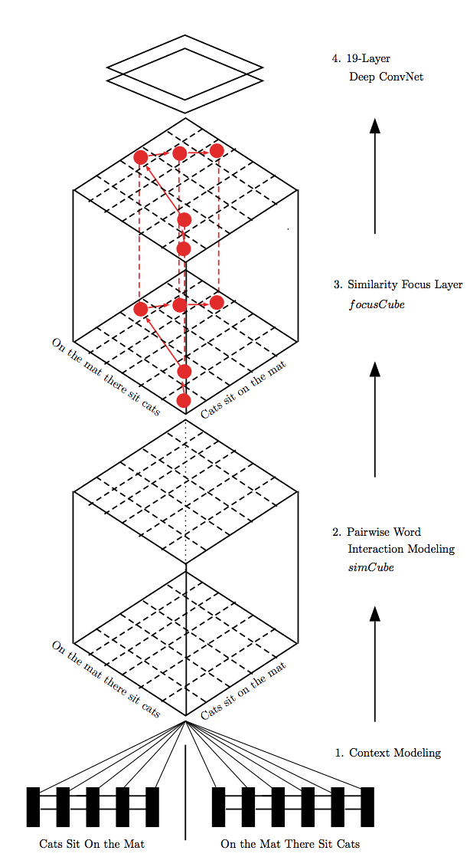
TrecQA: State of the Art

Slide 15
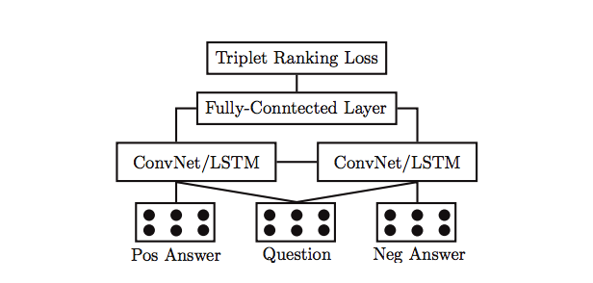
TrecQA: State of the Art

Slide 16
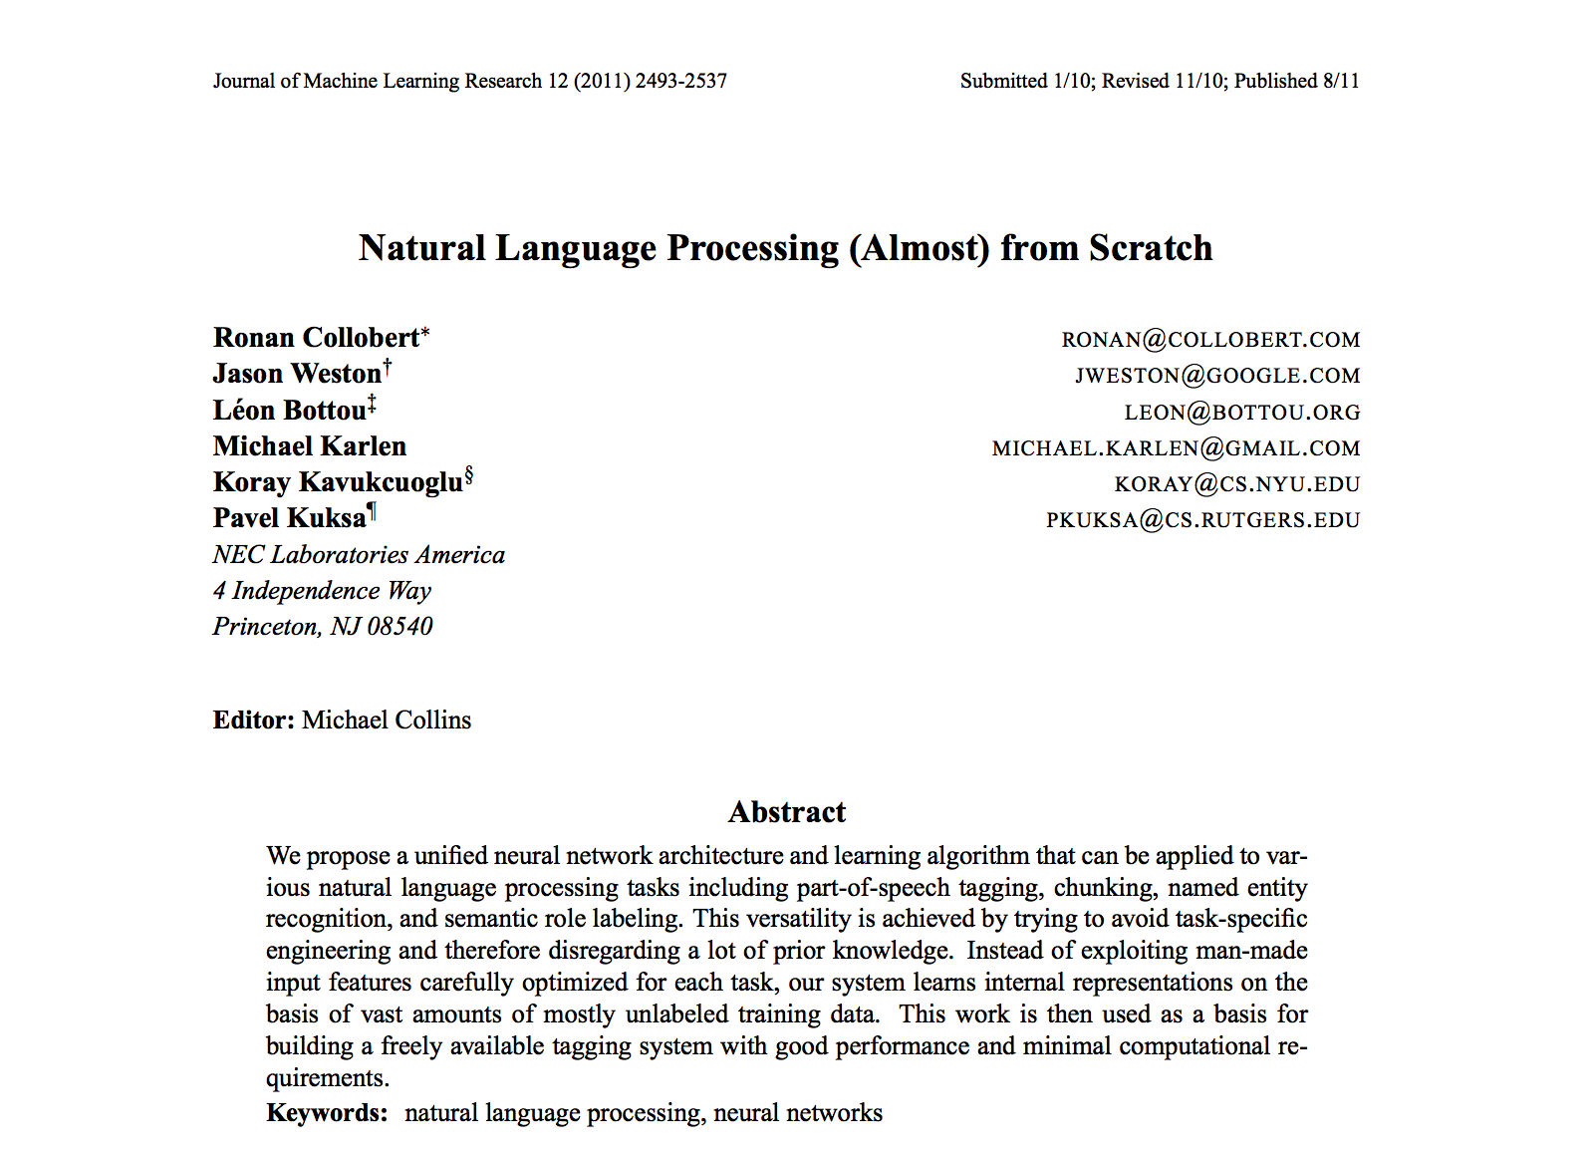
NLP from Scratch?!

Slide 17
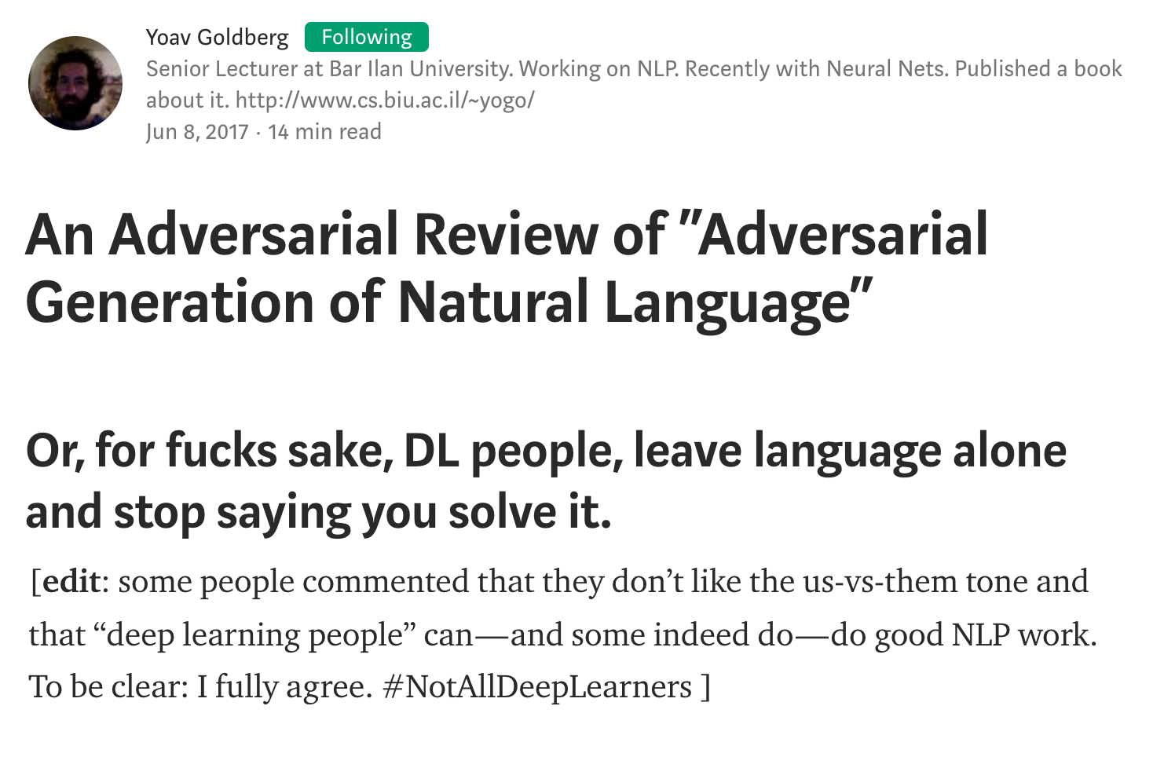

Slide 18
LAI-CNNs
POS tagger
Named Entity Recognizer
Dependency Parser

Slide 19
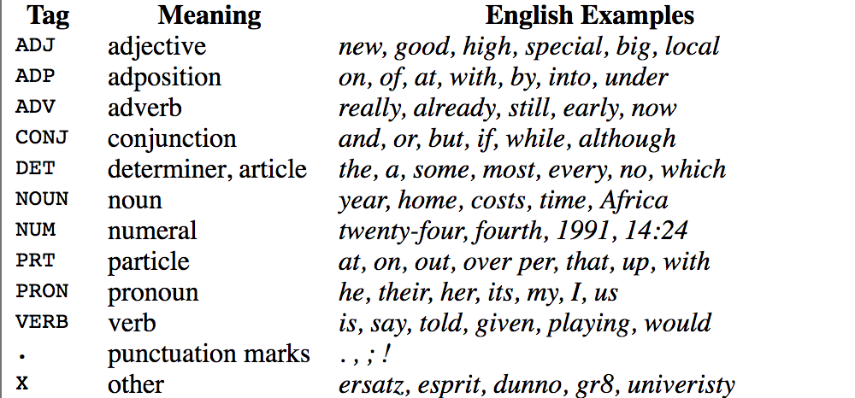
Part-of-Speech
DET a
NOUN dog
VERB runs

Slide 20
Parts-of-Speech
Captures ADJ-NOUN like relations
Q: What is the longest river in the world ?
ADJ NOUN
One-hot vector representation
ADJ [0, 1, 0, 0, 0, 0, 0, 0, 0, 0, 0, 0, 0, 0]
NOUN [0, 0, 0, 0, 0, 0, 0, 1, 0, 0, 0, 0, 0, 0]

Slide 21
Named Entity Recognizer
Germany’s representative to the European Union’s veterinary committee Werner Zwingman said on Wednesday consumers should …
Helps recognize entities like person, location, organization etc.
Q: When was Albert Einstein born ?

Slide 22
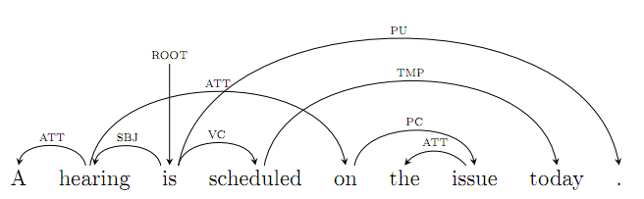
Dependency Information
ROOT
DET
SUBJ
DET a
NN dog
VERB runs

Slide 23
LAI-CNNs

Slide 24
Evaluation: TrecQA
 | MAP | MRR
SM Model | 0.768 [0.766, 0.769] | 0.821 [0.811, 0.827]
SOTA | 0.782 | 0.837
Linguistic Features
POS | 0.774 [0.768, 0.778] | 0.832 [0.816, 0.848]
NER | 0.776 [0.768, 0.786] | 0.837 [0.832, 0.840]
Headword + Dep | 0.777 [0.775, 0.781] | 0.837 [0.825, 0.848]
Cumulative features
POS + NER | 0.779 [0.777, 0.785] | 0.846 [0.840, 0.853]
POS + NER + Headword + Dep | 0.781 [0.776, 0.793] | 0.843 [0.831, 0.854]
Result format: avg [min, max]

Slide 25
Evaluation: WikiQA
 | MAP | MRR
SM Model | 0.688 [0.682, 0.692] | 0.709 [0.706, 0.711]
SOTA | 0.743 | 0.755
Linguistic Features
POS | 0.701 [0.695, 0.704] | 0.721 [0.715, 0.725]
NER | 0.696 [0.688, 0.704] | 0.716 [0.706, 0.726]
Headword + Dep | 0.696 [0.689, 0.707] | 0.712 [0.702, 0.723]
Cumulative features
POS + NER | 0.700 [0.696, 0.705] | 0.718 [0.712, 0.723]
POS + NER + Headword + Dep | 0.704 [0.698, 0.711] | 0.720 [0.710, 0.731]
Result format: avg [min, max]

Slide 26
Conclusions
We propose LAI-CNNs for QA, a hybrid between feature engineering and DL techniques
We used the following simple features: POS, NER, Dependency
We achieve STOA just by adding one of the linguistic features
A better balance between sophisticate NNs and feature engineering

Slide 27
Questions?

