Slide 1
DDA
Contest Tracker · Power BI Portfolio Project
DDA Contest Performance &
Student Intelligence Dashboard
Analyzing Contest Performance, Rankings & Programming Skills using Power BI
ROZ RAJAK
Power BI | SQL | Excel

Slide 2



INTRODUCTION
Project Overview
The DDA Contest Tracker is a Power BI analytics project built to understand how students perform across coding and competitive contests. It brings together contest records, academic details, student master data, and leaderboard results into a single connected model — turning scattered spreadsheets into a clear, interactive picture of participation, accuracy, and skill.
4 Source Tables
Contest, students, academics & leaderboard data
Star-Schema Model
Connected via contest_id & student_id
From raw contest logs to performance intelligence
Four source tables are modeled into a star schema, then explored through two dashboards covering executive-level contest metrics and individual student performance analytics.
2 Interactive Dashboards
Executive overview & performance intelligence
DDA Contest Performance & Student Intelligence Dashboard
2

Slide 3







GOALS
Project Objective
Track Participation
Analyze Performance
Evaluate Skill Areas
Compare Branches
Monitor student participation across every contest type and cycle.
Study scores, accuracy, and overall contest rankings.
Assess MCQ accuracy and programming performance separately.
Benchmark participation and performance across branches & colleges.
Classify Performers
Track Individuals
Enable Mentoring
Identify high, medium, and low performing student segments.
Follow individual student performance over time.
Support data-driven mentoring and training decisions.
DDA Contest Performance & Student Intelligence Dashboard
3

Slide 4




THE CHALLENGE
Problem Statement
Contest and leaderboard data naturally grows across many disconnected sources. Reviewed manually, it becomes very difficult to extract consistent, timely insight.
Data scattered across multiple tables
Hard to track individual performance
Manual ranking & accuracy analysis
Contest, student, and leaderboard records live separately.
No unified view of a single student’s journey over time.
Calculating accuracy and rank trends by hand is slow and error-prone.
Difficult branch/college comparison
Hard to spot high/low performers
Power BI as the Solution
No easy way to benchmark participation across branches.
Consistent performers are difficult to identify without a dashboard.
One connected model, interactive dashboards, instant insight.
DDA Contest Performance & Student Intelligence Dashboard
4

Slide 5




DATA SOURCES
Dataset Overview
DIMENSION
DIMENSION
DIMENSION
FACT TABLE
dim_contest
dim_student_year
dim_students
fact_leaderboard
Holds contest-level information — what each contest is, its type, and when it ran.
Holds academic / student-year information tied to each student.
Master record of student identity — name, branch, and college.
Contest-level student performance & leaderboard metrics — the analytical core.
COLUMNS
COLUMNS
COLUMNS
COLUMNS
contest_date · contest_name · contest_id · contest_type
branch · course_duration · current_year · email · passout_year · student_id
branch · college · email · name · passout_year · student_id · total_students
accuracy · MCQ_correct / total · programming_point · rank · total_points ·
performance_type ...
DDA Contest Performance & Student Intelligence Dashboard
5

Slide 6
DATA MODEL
Star-Schema Design
The model follows a classic star schema — three dimension tables surround a single fact table, connected by shared key columns.
dim_contest
dim_students
dim_student_year
key: contest_id
key: student_id
key: student_id
fact_leaderboard
Central fact table — contest performance & rankings
Relationships: dim_contest → fact_leaderboard (contest_id) dim_students → fact_leaderboard (student_id) dim_student_year → fact_leaderboard (student_id)
DDA Contest Performance & Student Intelligence Dashboard
6

Slide 7
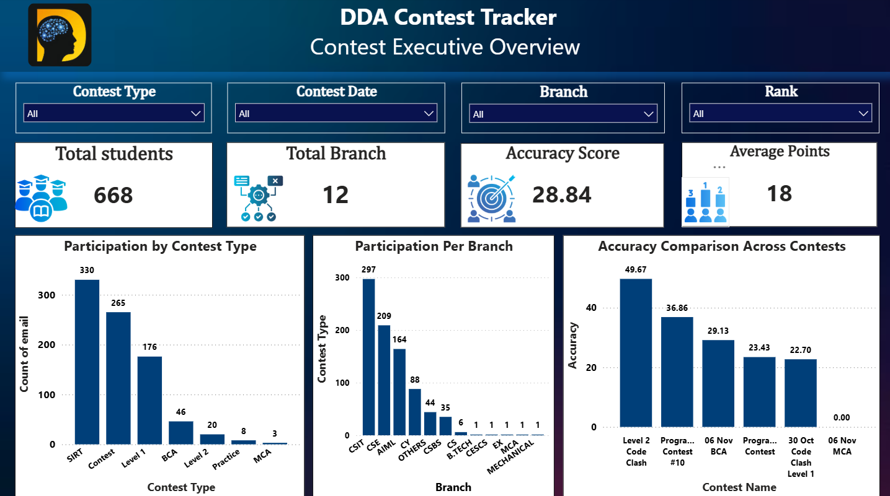
DASHBOARD 01
Contest Performance — Executive Overview
WHAT IT ANALYZES
A top-level view of contest activity — total students, branch coverage, average accuracy, and average points — filterable by contest type, date, branch, and rank.
668
Total Students
12
Branches Covered
28.84
Accuracy Score
Also visualizes participation by contest type, participation per branch, and accuracy comparison across contests.
DDA Contest Performance & Student Intelligence Dashboard
7

Slide 8
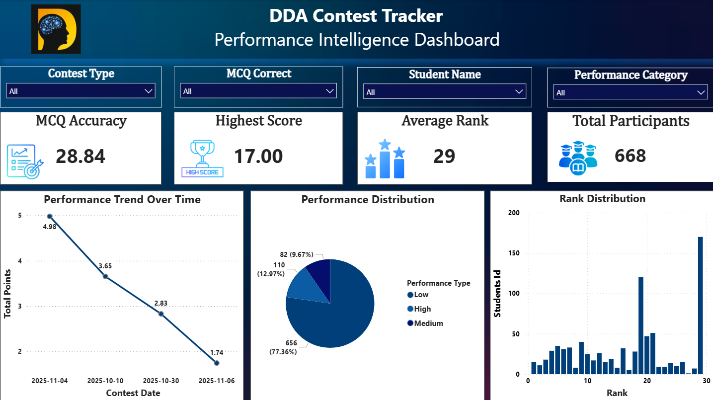
DASHBOARD 02
Student Performance & Competitive Analytics
WHAT IT ANALYZES
A deeper, student-level view — MCQ accuracy, highest score, average rank, performance trend over time, performance-tier distribution, and rank distribution — filterable by contest type, MCQ correct, student name, and performance category.
17.00
Highest Score
29
Average Rank
668
Total Participants
DDA Contest Performance & Student Intelligence Dashboard
8

Slide 9


FINDINGS
Key Insights
Overall Performance
Accuracy
Programming vs. MCQ
Average total points trended downward across the four tracked contest dates — 4.98 → 3.65 → 2.83 → 1.74 — pointing to a gap worth investigating.
Overall accuracy score sits at 28.84, with the highest single score recorded at 17.00 — showing clear room for improvement in precision.
The dashboard separately tracks MCQ correctness and programming points, allowing skill-specific coaching rather than one blanket score.
Branch Participation
Contest Trends
Performance Tiers
CSIT, CSE, and AIML lead participation volume, while several branches show minimal engagement — highlighting an outreach gap.
Accuracy varies widely by contest, from 49.67 on Level 2 Code Clash down to 0.00 on 06 Nov MCA, showing inconsistent difficulty or engagement.
Students are grouped into Low, Medium, and High performance categories, with the large majority currently concentrated in a single tier — a key mentoring signal.
DDA Contest Performance & Student Intelligence Dashboard
9

Slide 10




NEXT STEPS
Recommendations
Targeted Mentoring
Programming Skill Development
Direct mentoring toward students identified in the low-performance tier.
Run focused practice sessions to lift programming_point and programming_solved scores.
Accuracy Improvement
Continuous Performance Tracking
Address the accuracy gap through timed practice and review of MCQ patterns.
Keep monitoring performance trends across every new contest cycle.
Branch-Level Interventions
Recognize Top Performers
Design branch-specific engagement plans where participation is lowest.
Publicly celebrate high performers to sustain motivation and healthy competition.
DDA Contest Performance & Student Intelligence Dashboard
10

Slide 11







TOOLKIT
Tools & Skills
Power BI
SQL / MySQL
Advanced Excel
DAX
Data Modeling
Data Visualization
Data Cleaning
KPI Development
Business Intelligence
Analytical Thinking
Dashboard Design
DDA Contest Performance & Student Intelligence Dashboard
11

Slide 12

END TO END
Project Impact & Analytics Workflow
Raw Data
Data Cleaning
Data Modeling
DAX & KPIs
Power BI Dashboard
Insights
Data-Driven Decisions
Who this helps
Students
Mentors
Training Teams
Management
See where they stand and what to improve next.
Spot who needs support before it becomes a pattern.
Design contests around real skill gaps.
Track program-wide outcomes at a glance.
DDA Contest Performance & Student Intelligence Dashboard
12

Slide 13

WRAP UP
Conclusion
The DDA Contest Tracker demonstrates a complete analytics workflow — from four raw source tables, through a clean star-schema model, to two interactive Power BI dashboards. It converts contest and leaderboard data into clear signals about participation, accuracy, and programming performance at both the individual and branch level.
Turning student performance data into meaningful insights for better learning outcomes.
The result is a reusable foundation that mentors and training teams can act on immediately — and a portfolio piece that shows the full data analyst workflow end to end.
DDA Contest Performance & Student Intelligence Dashboard
13

Slide 14



Thank You
DDA Contest Performance & Student Intelligence Dashboard
[rosesolanki29@gmail.com]
linkedin.com/in/roz-rajak
github.com/rosesolanki29
ROZ RAJAK

