Slide 1



DATA ANALYST PORTFOLIO PROJECT
Sales & Business Analytics
Dashboard
Power BI | Data Analysis | Business Intelligence
“Transforming sales data into actionable business insights.”
Power BI
Data Analytics
Business Intelligence

Slide 2







INTRODUCTION
Project Overview
This project uses historical sales and order data to build a centralized Power BI dashboard that consolidates revenue, cost, profitability, and volume metrics into a single, interactive view. Rather than reviewing scattered spreadsheet totals, stakeholders can explore performance across products, regions, and sales channels in real time.
HOW POWER BI ADDS VALUE
Raw Sales Data
Data Preparation
Power BI Analysis
Revenue
Profit
Cost
Units Sold
Business Insights
Product Performance
Regional Performance
Sales Channel Performance
Order Trends
Decisions
SALES & BUSINESS ANALYTICS DASHBOARD
02 / 12

Slide 3

GOALS
Project Objectives
Monitor Sales & Profitability
Analyze Regional Performance
Identify Item Type Performance
Track overall revenue, cost and profit performance in one view.
Compare revenue and profit across countries and regions.
Surface high- and low-performing item types by profit.
Compare Channels & Priorities
Track Trends Over Time
Support Decisions
Evaluate sales channels and order priority contribution.
Observe how cost, revenue and profit move year over year.
Enable faster, data-driven business decision making.
SALES & BUSINESS ANALYTICS DASHBOARD
03 / 12

Slide 4

THE CHALLENGE
Problem Statement
Without a centralized view, raw sales data makes it difficult to:
THE SOLUTION
Quickly identify the most profitable item types
Power BI Dashboard
Compare performance across regions and countries
Understand each sales channel's contribution
Centralized KPIs
Track revenue and profit trends over time
Interactive Analysis
Identify areas that need business attention
Make decisions from scattered spreadsheet data
Faster Decision Making
SALES & BUSINESS ANALYTICS DASHBOARD
04 / 12

Slide 5


THE DATA
Dataset Overview
Business Dimensions
Dates
Identifiers
Country, Region, Item Type, Rep Name, Sales Channel, Order Priority
Order Date, Ship Date
Order ID
Financial Metrics
Sales Volume
Total Cost, Total Revenue, Total Profit, Unit Cost, Unit Price
Units Sold
Geography + Products + Sales Channels + Time + Financial Performance

Slide 6
BEHIND THE DASHBOARD
Data Modeling & Preparation
Sales Dataset
DATA PREPARATION ACTIVITIES
Checked for missing values
Data Cleaning & Transformation
Removed duplicate records where applicable
Power BI Data Model
Corrected and standardized data types
Formatted Order Date and Ship Date fields
Measures / KPIs (DAX)
Validated numeric financial fields
Interactive Dashboard
Created calculated measures and KPIs
Built on a single flat sales table using Power BI's native modeling and DAX measures — no external ETL pipeline or multi-table schema was required for this analysis.
SALES & BUSINESS ANALYTICS DASHBOARD
06 / 12

Slide 7


THE SOLUTION
Dashboard Overview
The Power BI dashboard brings KPI summaries, trend analysis, and comparative breakdowns together on a single screen, with a Year slicer that lets users filter every visual interactively.
KPI Summary Cards
Profit by Item Type
Revenue, Profit, Cost & Order Trend
Order ID count, Total Cost, Total Profit and Total Revenue at a glance.
Ranked bar chart of total profit across all item types.
Combo line chart comparing four metrics across item types.
Cost Trend by Year
Profit by Sales Channel
Year Filter
Line chart tracking total cost from 2010 through 2017, with forecast.
Pie chart splitting total profit between Offline and Online.
Interactive slicer (2010–2017) to filter the full dashboard.
SALES & BUSINESS ANALYTICS DASHBOARD
07 / 12

Slide 8
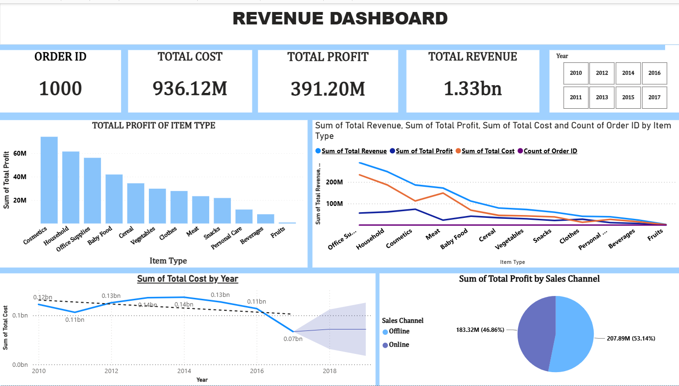
INTERACTIVE POWER BI DASHBOARD
KPI Summary
Item Type Profit Ranking
Revenue / Profit / Cost Trend
Cost Trend by Year
Profit by Sales Channel
Filters: Year Slicer (2010–2017)

Slide 9


WHAT THE DATA SHOWS
Key Insights
1.33bn
391.20M
936.12M
1,000
Total Revenue
Total Profit
Total Cost
Orders Analyzed
Cosmetics leads profitability
Office Supplies drives the top line
Cosmetics generates the highest total profit of any item type, followed by Household and Office Supplies — these three categories anchor overall profitability.
Office Supplies records the highest combined revenue, cost and order count among item types, making it the largest contributor to overall business volume.
Offline channel leads, but Online is close
Total cost dropped sharply after 2016
Offline sales contribute 53.14% of total profit (207.89M) versus 46.86% (183.32M) from Online — a fairly balanced channel mix worth monitoring.
Total cost fell from roughly 0.11bn in 2016 to about 0.07bn in 2017, the steepest year-over-year decline in the trend, with a widening forecast range beyond it.
Fruits, Beverages & Personal Care lag
These item types sit at the bottom of the profit ranking, indicating limited contribution compared to top performers like Cosmetics and Household.

Slide 10


TURNING INSIGHT INTO ACTION
Business Recommendations
Double down on top performers
Prioritize marketing and inventory investment in Cosmetics, Household and Office Supplies given their proven profit contribution.
Investigate low-profit categories
Review pricing, cost structure and demand for Fruits, Beverages and Personal Care to identify improvement opportunities.
Refine sales channel strategy
With Offline at 53% and Online at 47% of profit, evaluate whether targeted investment can grow the Online channel's share.
Monitor cost and margin closely
Track the cost trend that dropped sharply after 2016 to confirm it reflects efficiency gains rather than a data or volume issue.
Establish regular Power BI reporting
Use the dashboard as a recurring reporting cadence so performance shifts are caught early and decisions stay data-driven.
SALES & BUSINESS ANALYTICS DASHBOARD
10 / 12

Slide 11


TOOLKIT
Tools & Skills
Power BI
DAX
Data Analysis
Dashboard Development
Measures
Trend Analysis
Data Visualization
Calculated Metrics
Sales Analysis
KPI Development
Business KPIs
Profitability Analysis
Interactive Filters / Slicers
Business Insights
SALES & BUSINESS ANALYTICS DASHBOARD
11 / 12

Slide 12
CONCLUSION
Sales Data, Transformed Into Insight
This project demonstrates how Power BI can transform raw sales data into a centralized analytical solution — turning scattered numbers into a clear, explorable story for the business.
Improved visibility into overall sales performance
Better understanding of revenue and profitability drivers
Easier comparison across products, regions and channels
Interactive, self-serve business analysis
Stronger support for data-driven decisions
“The dashboard transforms raw sales data into clear, actionable business insights.”
Thank You

