Slide 1
Z
zepto
⚡ Business Analytics · Power BI
Zepto 360°
Business Analytics Dashboard
Sales · Customer · Product · Delivery Performance Analysis
SQL
MySQL
Power BI
DAX
Data Modeling
Business Intelligence
End-to-End Analytics · SQL + Power BI + DAX · Portfolio Project · 2024

Slide 2





Z
zepto
Project Overview
End-to-End Analytics Workflow
From raw operational data to actionable business intelligence
1
2
3
4
5
›
›
›
›
Raw Data
SQL Cleaning
Data Modeling
Power BI
Insights
6 business tables
from Zepto ops
Null handling
Dedup & normalise
Star schema
DAX measures
5 dashboards
Interactive reports
Strategic recs
Business decisions
This project transforms raw Zepto transactional data into a fully interactive Power BI analytics suite — covering Sales, Customers, Products, Orders & Deliveries — enabling data-driven decisions at every level of the organisation.

Slide 3



Z
zepto
Project Objectives
What We Set Out to Achieve
Sales Performance Analysis
Customer Behaviour Insights
Delivery Performance Monitoring
Track revenue trends, growth periods, and category-level sales performance across all markets.
Segment customers, analyse spending patterns, measure LTV and identify high-value cohorts.
Evaluate delivery times, on-time rates, distance correlations and route bottlenecks.
Product Trend Evaluation
Actionable Business Insights
Identify top products by revenue & ratings, analyse category performance over time.
Convert data into strategic recommendations that drive measurable operational improvements.

Slide 4
Z
zepto
Problem Statement
Business
Challenges
Massive Operational Datasets
01
Millions of rows across orders, deliveries and transactions make manual analysis impossible at scale.
Key pain points demanding
a centralised analytics solution
No Centralised Reporting
02
Metrics scattered across spreadsheets with no single source of truth for leadership decisions.
10M+
Daily transactions
Hidden Delivery Inefficiencies
03
33,947 late deliveries invisible without real-time monitoring — representing 73% of all deliveries.
6
Siloed data tables
48 hrs
Decision-Making Without Data
04
Without BI, teams rely on intuition over evidence — missing revenue and retention opportunities.
Avg report delay

Slide 5



Z
zepto
Dataset Overview
6 Core Data Tables
Zepto's relational data ecosystem powering the 360° analytics suite
Customers
Orders
Products
~50K records
~500K records
~10K records
customer_id · name · city · segment · join_date
order_id · customer_id · date · status · total
product_id · name · category · price · stock
Transactions
Delivery
Ratings
~500K records
~500K records
~200K records
txn_id · order_id · amount · payment_method
delivery_id · order_id · time_mins · distance · status
rating_id · product_id · customer_id · score · date

Slide 6


Z
zepto
Data Cleaning & SQL Transformation
Building a Clean, Reliable Data Foundation
zepto_analytics.sql
Null Value Handling
-- 1. Handle NULL values
Replaced NULL delivery times, amounts and customer fields with appropriate defaults.
UPDATE orders
SET delivery_time = 0
WHERE delivery_time IS NULL;
Duplicate Removal
-- 2. Remove duplicate records
Eliminated duplicate transactions using GROUP BY deduplication logic.
DELETE FROM transactions
WHERE txn_id NOT IN (
SELECT MIN(txn_id)
FROM transactions
Data Standardisation
GROUP BY order_id, amount);
Normalised city names, payment types and product categories to consistent formats.
-- 3. Standardise city names
UPDATE customers
SET city = TRIM(UPPER(city));
SQL Views Creation
-- 4. Create SQL View
CREATE VIEW v_sales_summary AS
Built v_sales_summary, v_customer_analytics, v_delivery_performance views.
SELECT c.city, SUM(t.amount)
FROM orders o JOIN customers c
ON o.customer_id = c.id;

Slide 7
Z
zepto
Data Modeling
Star Schema & DAX Measures
Data Model — Star Schema
DAX Measures
DIM
Customers
DIM
Products
Total Revenue
= SUMX(Orders, Orders[amount])
FACT
Orders
Avg Delivery Time
= AVERAGE(Delivery[time_mins])
Customer LTV
= DIVIDE([Revenue],[Customers])
DIM
Delivery
DIM
Transactions
Order Count
= COUNTROWS(Orders)
1-to-many relationships · Star schema optimised for Power BI
On-Time Rate
= DIVIDE([OnTime],[Deliveries])

Slide 9
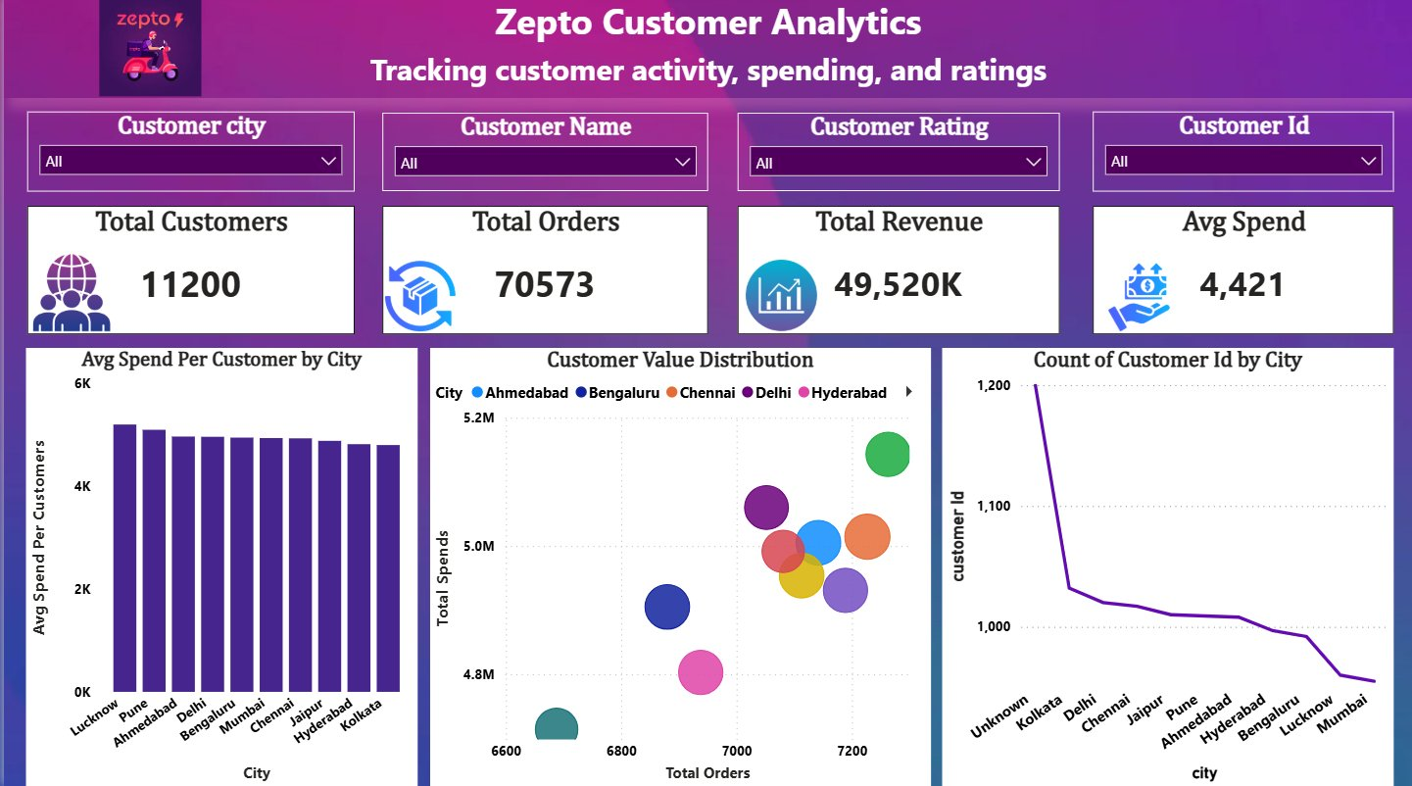
Z
zepto
Customer Analytics Dashboard
Tracking Customer Activity, Spending & Ratings
11,200
70,573
₹49,520K
₹4,421
Total Customers
Total Orders
Total Revenue
Avg Spend
Key Highlights
Avg spend per customer consistent across 10 cities (~₹4,400–₹5,000)
Hyderabad leads bubble chart — highest total spend + order volume
Kolkata highest customer count; Mumbai & Bengaluru lowest
Filters: Customer City · Name · Rating · Customer ID
Power BI · Interactive Dashboard · Zepto 360°

Slide 10
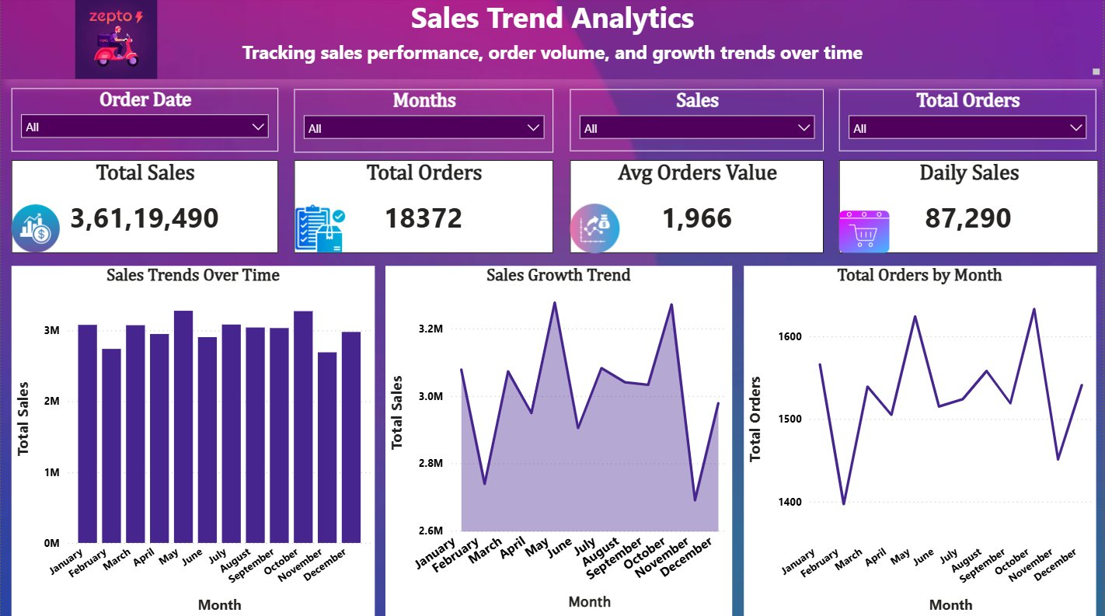
Z
zepto
Sales Trend Analytics Dashboard
Tracking Sales Performance, Order Volume & Growth Trends Over Time
₹3.6 Cr
18,372
₹1,966
₹87,290
Total Sales
Total Orders
Avg Order Value
Daily Sales
Key Highlights
Monthly sales stable at ₹2.5M–₹3.3M with peaks in June & October
Sales growth trend shows strong recovery after September dip
Total orders by month range 1,400–1,600 with seasonal variation
Filters: Order Date · Month · Sales Range · Total Orders
Power BI · Interactive Dashboard · Zepto 360°

Slide 11
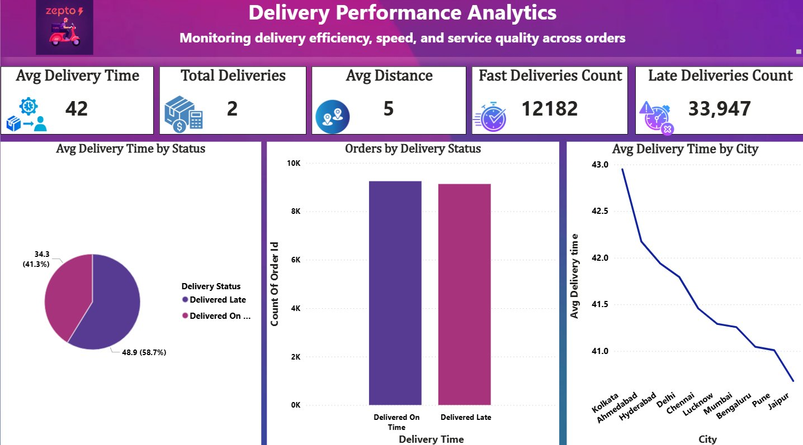
Z
zepto
Delivery Performance Analytics Dashboard
Monitoring Delivery Efficiency, Speed & Service Quality Across Orders
42 min
5 km
12,182
33,947
Avg Delivery Time
Avg Distance
Fast Deliveries
Late Deliveries
Key Highlights
58.7% on-time · 41.3% late — significant improvement opportunity
Kolkata worst city at 43 min avg; Jaipur best at ~40.5 min
On-time vs late nearly equal in order volume (10K vs 9.2K)
Filters: City · Delivery Status · Distance Range
Power BI · Interactive Dashboard · Zepto 360°

Slide 12
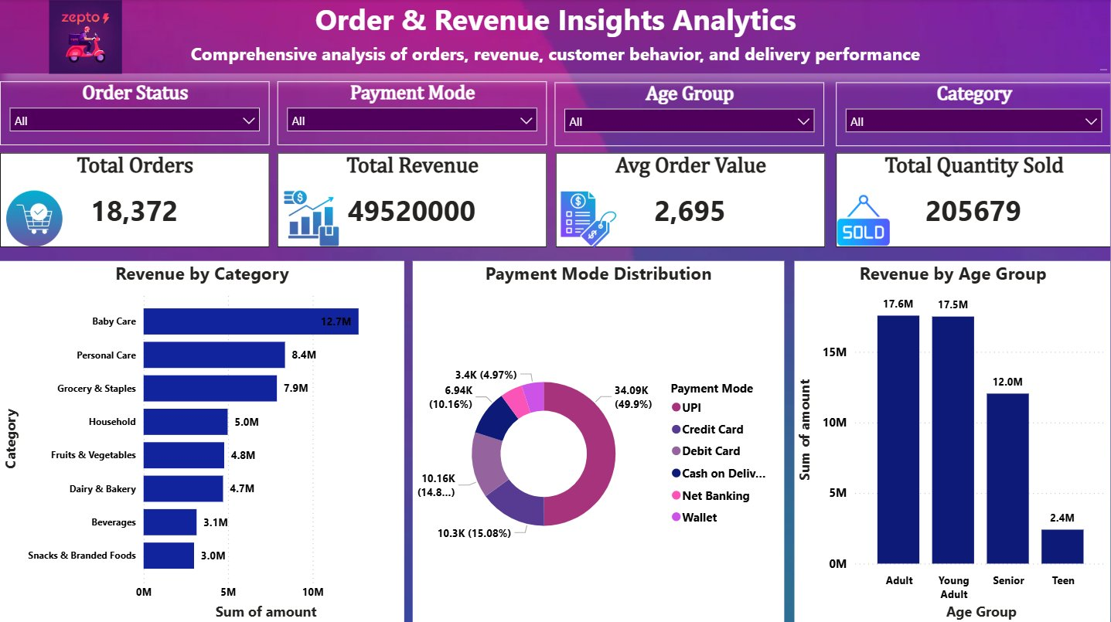
Z
zepto
Order & Revenue Insights Analytics Dashboard
Comprehensive Analysis of Orders, Revenue, Behaviour & Delivery
18,372
₹4.95 Cr
₹2,695
2,05,679
Total Orders
Total Revenue
Avg Order Value
Qty Sold
Key Highlights
Baby Care leads revenue at ₹12.7M; Personal Care ₹8.4M second
UPI dominates payments at 49.9% — followed by Credit Card (15%)
Adults & Young Adults drive highest revenue by age group
Filters: Order Status · Payment Mode · Age Group · Category

Slide 13
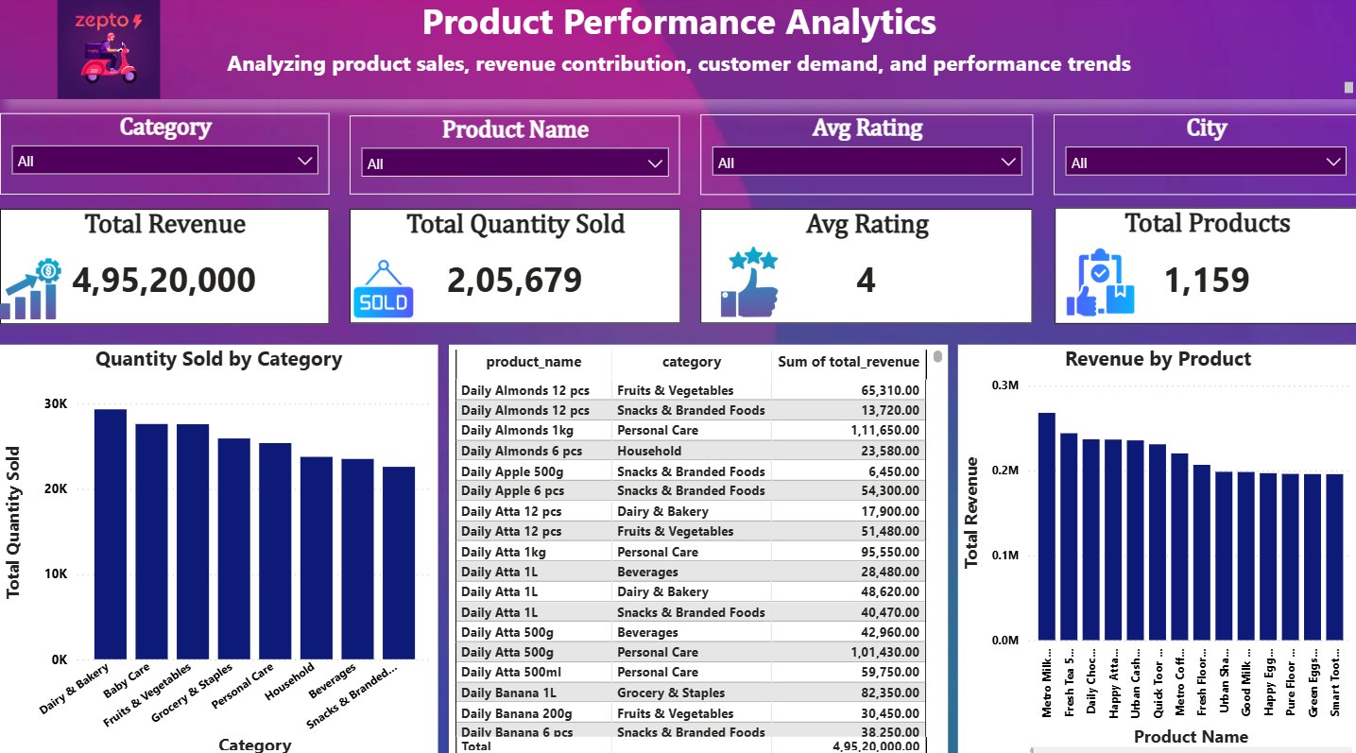
Z
zepto
Product Performance Analytics Dashboard
Analysing Product Sales, Revenue Contribution, Demand & Trends
₹4.95 Cr
2,05,679
4 ★
1,159
Total Revenue
Qty Sold
Avg Rating
Total Products
Key Highlights
Dairy & Bakery leads quantity sold; Baby Care & Grocery follow
Metro Milk top revenue product at ₹0.27M; Fresh Tea #2
Daily Almonds, Atta & Banana dominate product revenue table
Filters: Category · Product Name · Avg Rating · City
Power BI · Interactive Dashboard · Zepto 360°

Slide 14


Z
zepto
Key Business Insights
Data-Driven Discoveries from the Zepto 360° Analytics Suite
01
02
03
Top Performing Cities
Best-Selling Products
Payment Preferences
Kolkata leads customer count at 1,200. Mumbai & Bengaluru lowest — strong untapped expansion potential.
Daily Almonds, Atta & Banana top revenue. Baby Care category leads at ₹12.7M total — highest of all categories.
UPI dominates at 49.9% of all transactions. Credit Card 15%, Cash on Delivery 14.8%, Net Banking 10%.
04
05
Delivery Delay Patterns
Customer Purchase Trends
33,947 late deliveries (73%) vs 12,182 fast. Kolkata worst at 43 min avg; Jaipur best at ~40.5 min.
Avg spend ₹4,421 uniform across cities. Hyderabad tops value bubble — highest spend + order volume combined.

Slide 15
Z
zepto
Recommendations
Strategic Recommendations
Data-backed actions to accelerate growth and operational excellence
Optimise Delivery Routes
⚡
Address 33,947 late deliveries by redesigning zones in Kolkata & Ahmedabad — highest delay cities.
Focus on High-Margin Products
Action
Plan
Scale Baby Care (₹12.7M) and Personal Care (₹8.4M) with targeted promotions and premium placement.
Automate Reorder Operations
Trigger auto-reorders for Almonds, Atta & Banana SKUs based on their consistently high sales velocity.
Boost Customer Retention
Target low-spend cities (Mumbai, Bengaluru) with personalised offers to bridge the avg spend gap.
Leverage UPI Dominance
Offer exclusive UPI cashback deals — 49.9% adoption makes it the highest-impact payment channel.

Slide 16


Z
zepto
Tools & Skills Used
Technology Stack & Competencies
TOOLS
SQL
MySQL
Power BI
Excel
SKILLS
Data Cleaning
SQL Views & CTEs
Data Modeling
DAX Measures
Dashboard Design
Data Visualisation
Business Analysis

Slide 17


Z
zepto
Conclusion
Zepto 360° Business Analytics Dashboard
A production-ready, end-to-end analytics solution built with SQL, Power BI & DAX
Business Value Created
Insights Generated
Unified 6 data sources into one suite. Single source of truth for Sales, Delivery, Products & Customers — no more siloed spreadsheets.
Identified 33,947 late deliveries (73%), UPI dominance at 49.9%, Baby Care as top revenue category at ₹12.7M.
Dashboard Impact
Data-Driven Decision Making
5 interactive Power BI dashboards with dynamic slicers, KPI cards and multi-chart views — instant self-service analytics.
Empowers Zepto leadership to act on delivery delays, city-specific gaps and product performance in real time.

Slide 18



Z
zepto
Thank You
Zepto 360° Business Analytics Dashboard
Built with SQL · Power BI · DAX · Data Modeling · Business Intelligence
LinkedIn
GitHub
Email
linkedin.com/in/roz-rajak
github.com/rosesolanki29
rosesolanki29@email.com
🏆 Portfolio Project · Open to Internship & Full-Time Opportunities
Zepto 360° Business Analytics · Power BI Portfolio Project · 2024

