Slide 1
HTML5 Notes
Quick Start

Slide 2
Languages for Web Developers
HTML: defines the content of web pages
CSS: specifies the layout of web pages
JavaScript: programs the behavior of web pages
JQuery: a JavaScript library that makes it easier to program for different web browsers
JQueryMobile: a jQuery library that makes it easier to program for mobile platforms

Slide 3
HTML Files
Every web page is actually a HTML file.
Each HTML file is just a plain-text file, but with a .html file extension instead of .txt, and is made up of many HTML tags as well as the content for a web page.
HyperText Markup Language

Slide 4
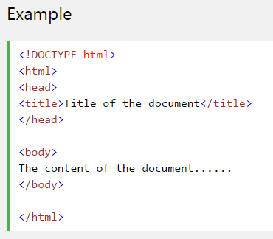
HTML Format
The <!DOCTYPE> declaration must be the very first thing in your HTML document, before the <html> tag.
Lets the browser knows what type of document to expect.
Remember to specify the html attribute

Slide 5
HTML: Common Tags
http://www.danfergusdesign.com/classfiles/generalReference/html5reference.php
<!-- comment -->
<p>: paragraph
<h1> -- <h6>: header styles
<br />: line break
<ul>: unordered list
<li>: list item
<a> : anchor
<img> :image
<input />
<button>
<div>: block style divider
<span>: inline style divider
HTML tags are not case sensitive: <P> means the same as <p> but W3C recommends lowercase
HTML elements are written with a start tag, an end tag, with the content in between:
<tagname>content</tagname>
The HTML element is everything from the start tag to the end tag:
<p>My first HTML paragraph.</p>
Some HTML elements do not have an end tag.

Slide 6
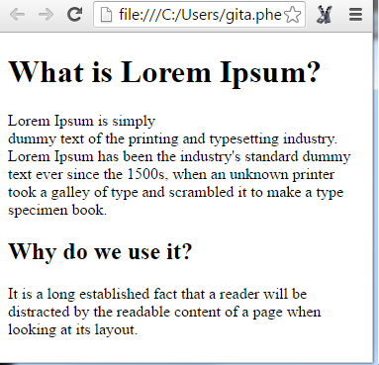
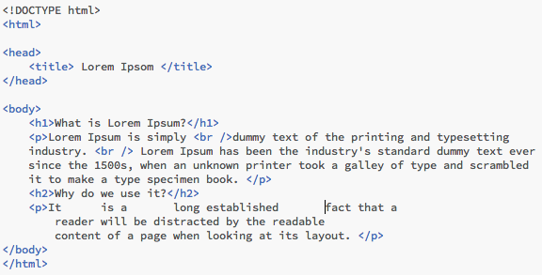
HTML Common Tags: Formatting Basics
<!-- comment -->
<p>: paragraph
<h1> -- <h6>: header styles
<br />: line break
<ul>: unordered list
<li>: list item
<a> : anchor
<img> :image
<input />
<button>
<div>: block style divider
<span>: inline style divider
Website with sample text: www.lipsum.com

Slide 7
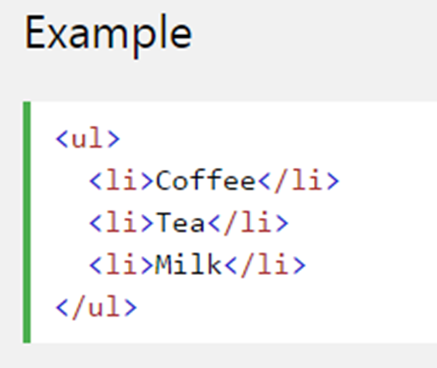
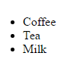
HTML Common Tags: Creating Lists
<!-- comment -->
<p>: paragraph
<h1> -- <h6>: header styles
<br />: line break
<ul>: unordered list
<li>: list item
<a> : anchor
<img> :image
<input />
<button>
<div>: block style divider
<span>: inline style divider

Slide 8
HTML Common Tags: hypertext links and images
<!-- comment -->
<p>: paragraph
<h1> -- <h6>: header styles
<br />: line break
<ul>: unordered list
<li>: list item
<a> : anchor
<img> :image
<input />
<button>
<div>: block style divider
<span>: inline style divider
Use the HTML <a> to create a hyperlink
Use the HTML <img> to insert an image. We will store our images in the img folder

Slide 9
HTML Attributes
http://www.w3schools.com/tags/ref_attributes.asp
Attributes provide additional information about an element
Attributes are always specified in the start tag
Attributes come in name/value pairs like: name="value
href | Specifies the URL of the page the link goes to <a href=“http://www.gcsu.edu”> Georgia College </a>
src height width | Specifies the URL of the media file. <img src=“img/smiley.gif” height=“50px” width=“50px” />
id | Specifies a unique id for an element <p id=“introduction”>

Slide 10
HTML Common Tags
HTML Common Tags: hypertext links and images
<!-- comment -->
<p>: paragraph
<h1> -- <h6>: header styles
<br />: line break
<ul>: unordered list
<li>: list item
<a> : anchor
<img> :image
<input />
<button>
<div>: block style divider
<span>: inline style divider
Use the HTML <a> along with href attribute to define the link address
<a href=“http://www.gcsu.edu”> Georgia College </a>
Use the HTML <img> element (inside <a>) to use an image as a link
<a href=“http://www.cnn.com/"> <img src="smiley.gif" ></a>
Bookmark a location in your page using the id attribute and then use the HTML<a> along with href to link to the book mark.
Use the HTML id attribute (id="value") to define bookmarks in a page
Use the HTML href attribute (href="#value") to link to the bookmark
Remember to include # before value!

Slide 11
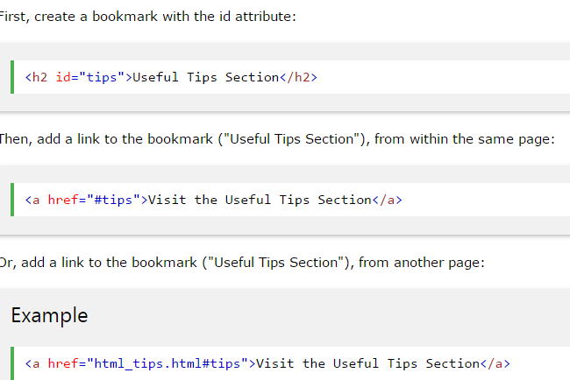
HTML Bookmarks

Slide 12
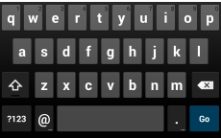
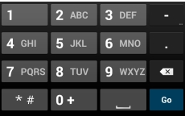
Form Virtual Keyboards: Text inputs with different keyboards
<label for=“name”>Name</label>
<input type=“text” id=“name” />
<label for=“email”> Email</label>
<input type=“email” id=“email” />
<label for=“phone”>Phone</label>
<input type=“tel” id=“phone” />
<label for=“count”>Count</label>
<input type=“number” id=“count” />
Common Tags
<!-- comment -->
<p>: paragraph
<h1> -- <h6>: header styles
<br />: line break
<ul>: unordered list
<li>: list item
<a> : anchor
<img> :image
<input />
<button>: button
<div>: block style divider
<span>: inline style divider
The type of input specified determines the virtual keyboard that appears. Types include: color, date, datetime, search, url + more.
The for attribute in label is used to bind the label with input element. It is not required.

Slide 13
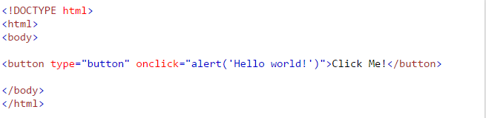
HTML Clickable Button
http://www.w3schools.com/tags/tag_button.asp
Common Tags
<!-- comment -->
<p>: paragraph
<h1> -- <h6>: header styles
<br />: line break
<ul>: unordered list
<li>: list item
<a> : anchor
<img> :image
<input />
<button>: button
<div>: block style divider
<span>: inline style divider
The <button> tag defines a clickable button.
Note: The onclick attribute specifies the JavaScript code that will execute when the button is clicked.
In most of our examples, we call a user defined JavaScript function when the button is pressed:
<button id=“btnOne” onclick=“display(id)” > Click Me! </button>
In this example, when the button is clicked, the id of this tag is passed as an argument to the user defined display function

Slide 14
HTML Block and Inline Elements
Block-level Elements
A block-level element always starts on a new line and takes up the full width available (stretches out to the left and right as far as it can). Examples of block-level elements:
<div>
<h1> - <h6>
<p>
Inline Elements
An inline element does not start on a new line and only takes up as much width as necessary. Examples of inline elements:
<span>
<a>
<img>

Slide 15
HTML Block and Inline Elements
Common Tags
<!-- comment -->
<p>: paragraph
<h1> -- <h6
<br />: line break
<ul>: unordered list
<li>: list item
<a> : anchor
<img> :image
<input />
<button>: button
<div>: block style divider
<span>: inline style divider
<div> and <span> elements are often used as a container for other HTML elements.
They have no required attributes, but style and class are common.
The <div> element can be used to style blocks of content: <div style="background-color:black; color:white; padding:20px;"> <h2>London</h2> <p>London is the capital city of England. It is the most populous city in the United Kingdom, with a metropolitan area of over 13 million inhabitants.</p> </div>
The <span> element can be used to style parts of the text: Example: <h1> My <span style="color:red">Important</span> Heading</h1>

Slide 16
Specifying Styles Using id and class attributes
Elements can have both id and class attributes
id : short for fragment identifier.
Must be unique - use an id name only once in any html document
Duplicate id tags will cause errors
Commonly, used to identify a specific element in JavaScript
class
Can be used multiple times in the same HTML document
Commonly, used to apply styling to a specific element in CSS
class | Specifies one or more class names for an element (refers to a class in a style sheet) <p class=“highlight”>

Slide 17
HTML5 Features supported by current mobile browsers
Application Cache: Offline package installation
Web storage: Persistent and session storage
Geolocation:
Multimedia: Video and Audio Players
Viewport definitions: Meta tag support
Canvas API: 2D Drawing API
Motion Sensors: Accelerometer, Gyroscope, Magnetometer
Form Virtual Keyboards: Text inputs with different keyboards
File API: Opening local files through input type
FileSystem API: Virtual File System for persistent state
HTML Media Capture: Taking pictures, record video and audio from an input file type
XMLHttpRequest 2.0: AJAX 2.0: upload files, progress
Web SQL storage: Persistent SQLite storage (inactive API, not on firefox)
IndexedDB: Agnostic database system (replacement for WebSQL, not on android browser)
http://mobilehtml5.org

