Slide 1

Developed by: Acsinia Ioana
https://github.com/roseyoanna/jewelryShop
https://jewelry-shop-fawn.vercel.app/
Course: Front-End Development by:
Year: 2026

Slide 2
Project Overview
About the Project
Luxury Jewels is a modern e-commerce web application
designed to showcase and sell unique jewelry pieces
through an elegant and intuitive interface.
The application focuses on providing users with a smooth
shopping experience by allowing them to browse
products, search by category, manage a Wishlist and
purchase items through a dynamic shopping cart.
Main Objectives:
Develop a responsive online jewelry store.
Create an intuitive user interface.
Simulate the shopping experience of a real e-commerce website.
Practice modern front-end development technologies.

Slide 3
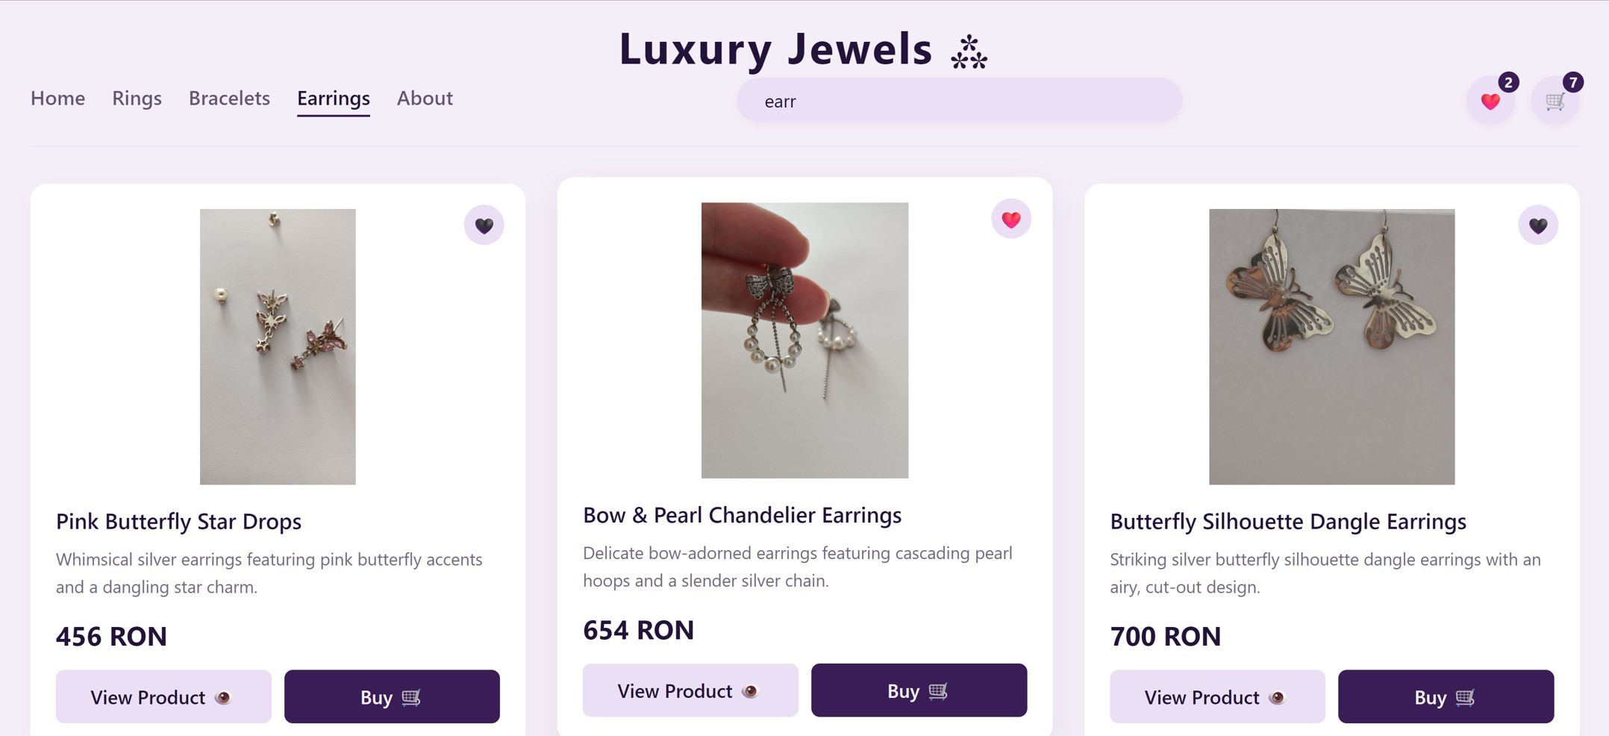

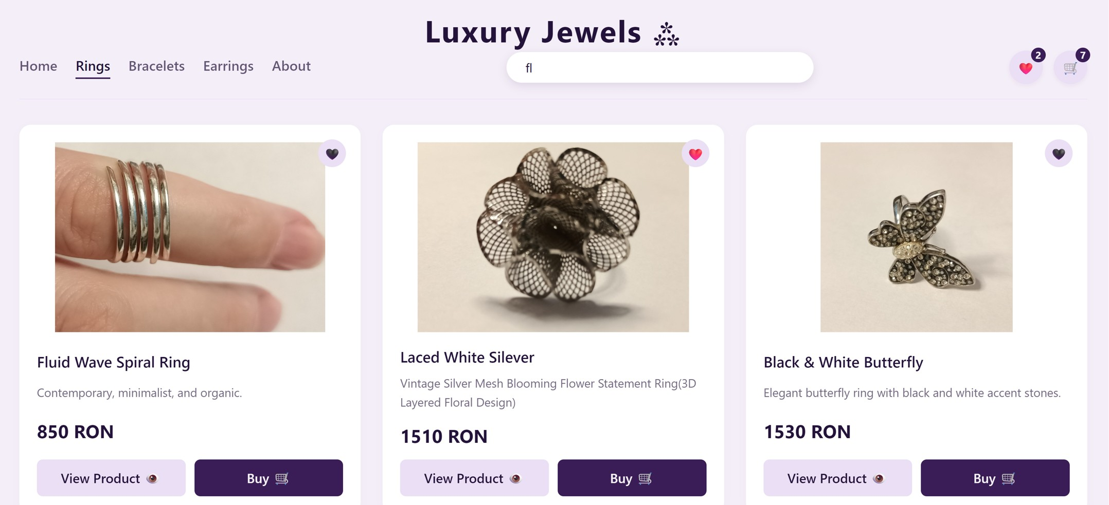

Slide 4
MAIN FUNCTIONALITIES
Implemented Features:
Navigation menu
Product categories
Search functionality
Product details page
Wishlist system
Shopping cart
Quantity management
Automatic total calculation
Responsive interface
Modern UI/UX design
Shopping cart indicator
Easy navigation back to the product list
Large product image gallery

Slide 5
CART AND OTHER FEATURES
The application enhances the user experience with interactive features.
The shopping cart allows users to manage their selected products.
Includes:
The cart updates dynamically.
Add & Remove products to Wishlist & to CART
Favorite products counter
Cart counter
"Added to Cart" notification popup
Instant interface updates
Total amount displayed in real time
Increase & decrease quantity
Order summary
These features provide immediate visual feedback and improve usability.

Slide 6
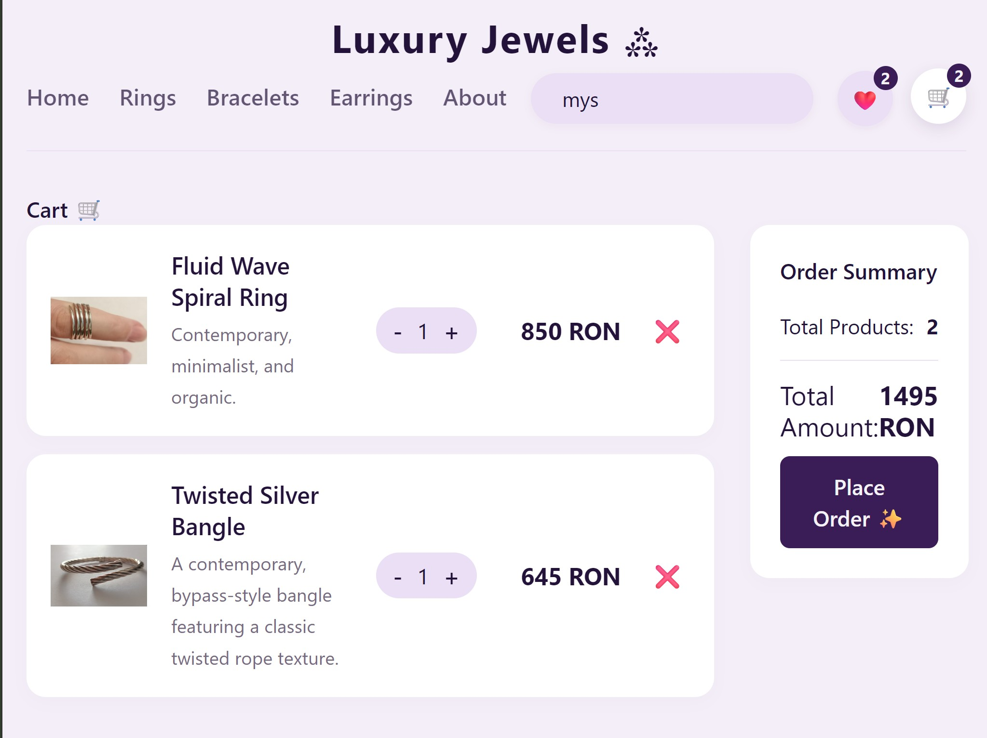
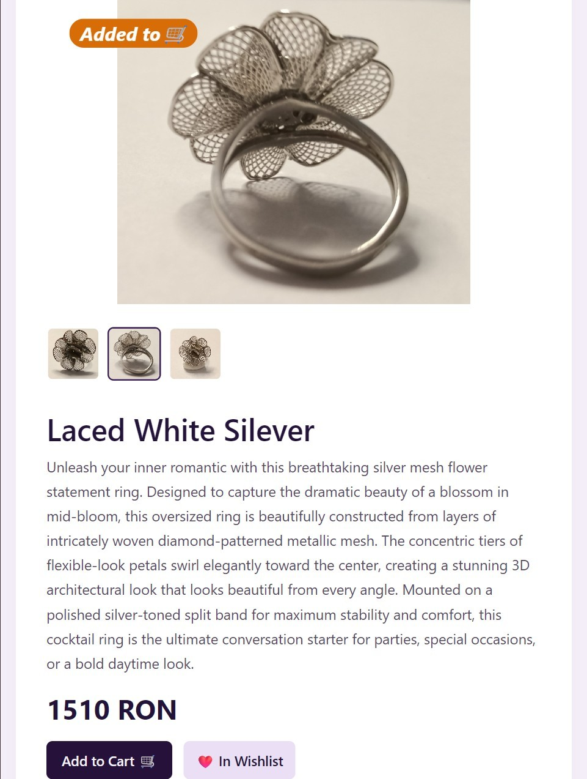
Each product has a dedicated page that presents complete information. This page helps users make informed purchasing decisions. The cart updates dynamically as users interact with it.

Slide 7
Technologies Used:
React.js
JavaScript (ES6+)
HTML5
CSS3
Context API / React State Management
Local Storage (for Cart & Wishlist persistence)
Development Tools
Visual Studio Code
Git & GitHub
npm

Slide 8
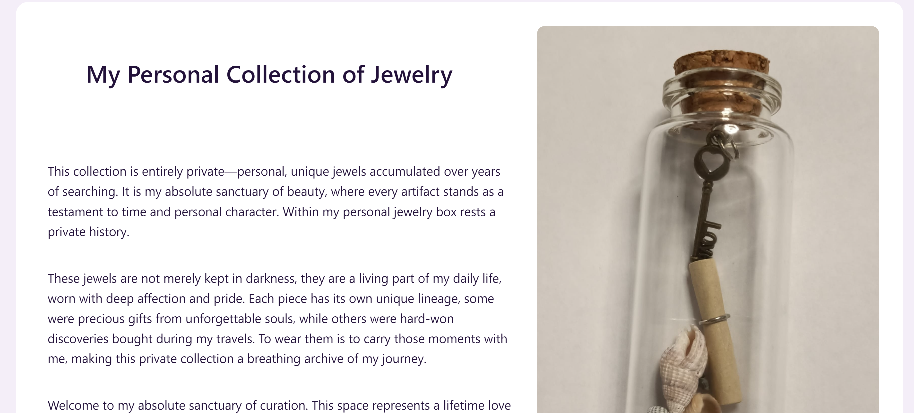
The About section introduces the concept behind Luxury Jewels.
It presents the collection as a personal and unique selection of jewelry pieces, emphasizing craftsmanship, elegance, and sentimental value.
This section creates a stronger emotional connection between users and the products.

Slide 9
Conclusion
Luxury Jewels demonstrates the development of a complete front-end e-commerce application using modern web technologies.
The project combines functionality with an elegant user interface to create an engaging online shopping experience.

Slide 10
Future Improvements
User authentication
Backend integration
Database support
Payment gateway integration
Order history
Product filtering and sorting
Admin dashboard
Product reviews and ratings

Slide 11
Questions ?
Thank You !

