Slide 1
IBM University Engagement Project Submission
“Exploring the Power of Agentic AI with IBM Granite and LangFlow”

Slide 2

Project Title – Smart Recipe Preparation Agent
Domain of Project – Food Technology (FoodTech)
Student Name | Recent Passport Photo | Email ID | Mobile number [WhatsApp]
Roshna Geekuri |  | rosh07995@gmail.com | 9000867674

Slide 3
Problem Statement -
Problem Statement : Recipe Preparation Agent
The Challenge
Many people struggle to decide what to cook using the limited ingredients available at home. Existing recipe sources often require ingredients that users may not have, leading to food waste, extra expenses, and time-consuming meal planning. Users also need guidance on ingredient substitutions, cooking methods, and dietary preferences. Without an intelligent assistant, preparing meals efficiently becomes difficult. The challenge is to develop an AI-powered Recipe Preparation Agent that can recommend suitable recipes, provide cooking instructions, and offer personalized dietary guidance using only the ingredients available to the user.
The Objective
Recipe Recommendation • Recommend suitable recipes using only the ingredients available with the user.
RAG-Based Retrieval • Retrieve the most relevant recipes from a recipe knowledge base using a Retrieval-Augmented Generation (RAG) approach.
AI-Powered Recipe Generation • Generate personalized recipes and step-by-step cooking instructions using IBM Granite 4h Small.
Ingredient Substitution • Suggest alternative ingredients when required ingredients are unavailable.
Cooking Assistance • Provide useful cooking tips and preparation guidance for better meal outcomes.
Dietary Guidance • Offer dietary recommendations based on user preferences and nutritional requirements.
Food Waste Reduction • Maximize the use of available groceries and minimize food wastage.
User-Friendly Experience • Deliver a smart and interactive cooking assistant using IBM watsonx.ai, LangFlow, Streamlit, and Python.

Slide 4
Technology Used
Development Framework • LangFlow
AI Platform • IBM watsonx.ai
Foundation Model • IBM Granite 4h Small
Frontend Interface • Streamlit
Programming Language • Python
Knowledge Base • recipes.csv
RAG Implementation • CSV-based Recipe Retrieval and Context Augmentation
Version Control • GitHub
I used LangFlow + IBM watsonx.ai + Granite Models

Slide 5
Proposed Solution -
Ingredient Collection
• The user enters available ingredients through a simple and interactive Streamlit-based interface.
Recipe Knowledge Base
• A structured recipe repository (recipes.csv) is used as the knowledge base containing recipe names, ingredients, and cooking information.
Intelligent Recipe Retrieval
• The system analyzes the user-provided ingredients and retrieves the most relevant recipes from the knowledge base using a Retrieval-Augmented Generation (RAG) approach.
IBM Granite-Powered Processing
• Retrieved recipe information is provided as context to IBM Granite 4h Small through IBM watsonx.ai for intelligent recipe generation.
Personalized Recipe Generation
• IBM Granite generates detailed recipe recommendations tailored to the ingredients available with the user.
Smart Cooking Assistance
• The system provides step-by-step cooking instructions to help users prepare meals efficiently and accurately.
Ingredient Substitution Support
• Alternative ingredient suggestions are generated whenever specific ingredients are unavailable.
Dietary Guidance
• Personalized cooking tips and dietary recommendations are provided based on user-selected preferences.
Sustainable Cooking Experience
• The solution minimizes food waste, reduces meal planning effort, and promotes smarter and more sustainable cooking practices.

Slide 6
Langflow component Used -
1) Chat Input
Provides an interface where users enter available ingredients for recipe generation.
2) Prompt Template
Formats the user ingredients into a structured prompt for recipe generation.
3) IBM watsonx.ai Component
Connects LangFlow with IBM watsonx.ai and IBM Granite foundation models.
4) IBM Granite 4h Small
Generates recipe recommendations, cooking instructions, substitutions, cooking tips, and dietary guidance.
5) Chat Output
Displays the AI-generated recipe response.
6) Streamlit Interface
Provides a user-friendly frontend for ingredient input and recipe display.

Slide 7
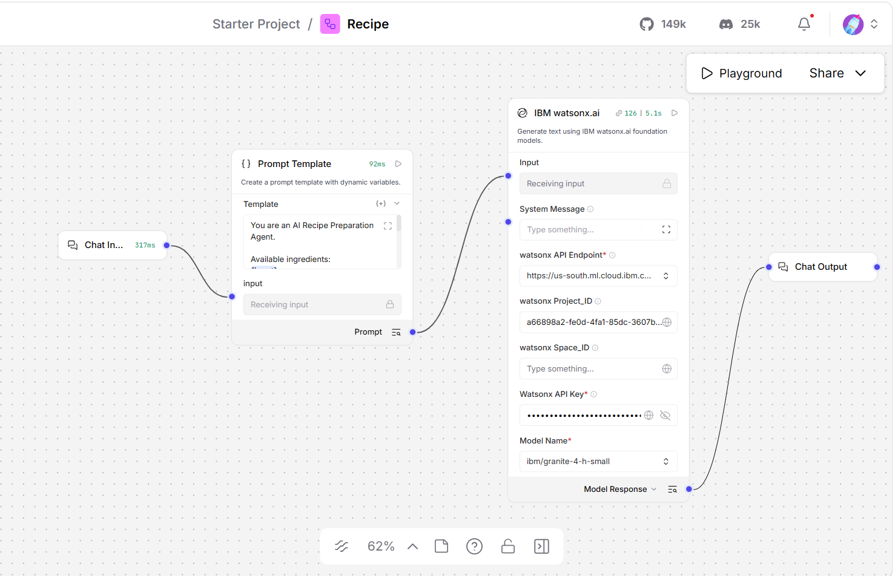
Langflow workflow -

Slide 8
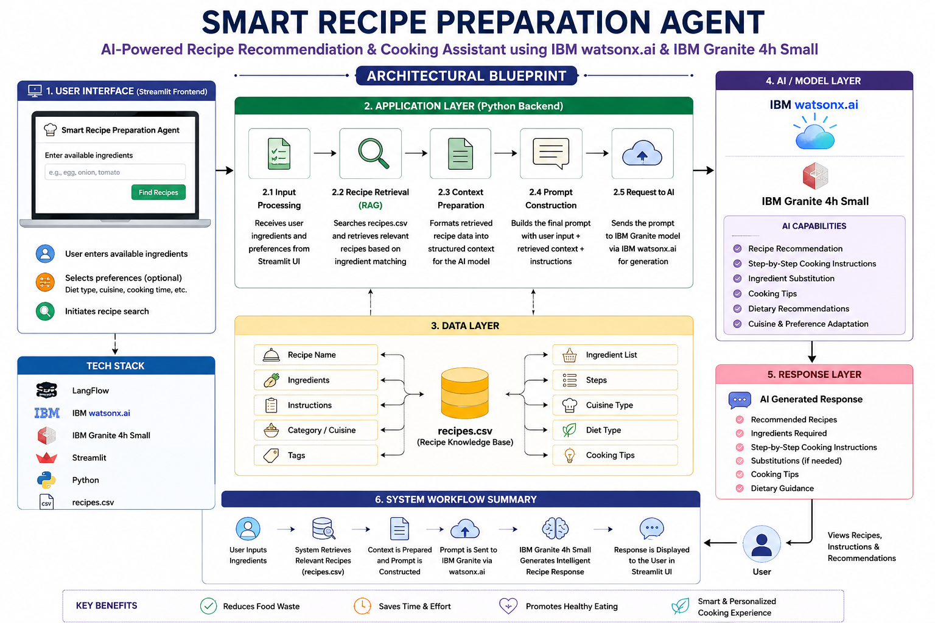
Architecture blueprint

Slide 9

Role of Agentic AI in the solution
Role of Agentic AI in Smart Recipe Agent
The Smart Recipe Preparation Agent leverages Agentic AI to function as an intelligent and context-aware cooking assistant that helps users prepare meals using only the ingredients available at home. The system begins by understanding user-provided ingredients and dietary preferences through a simple and interactive interface. It then performs intelligent recipe retrieval from the recipe knowledge base (recipes.csv) by identifying recipes that closely match the available ingredients. This retrieval process ensures that the generated recommendations remain relevant, practical, and aligned with the user’s available resources.
The Agentic AI framework enables the system to perform multiple intelligent tasks, including ingredient analysis, recipe retrieval, context preparation, decision-making, response generation, and recommendation delivery. This autonomous workflow allows the solution to provide accurate, useful, and personalized cooking assistance without requiring users to manually search through numerous recipes. The system dynamically adapts its recommendations based on ingredient availability and user preferences, ensuring a better user experience and higher recommendation quality.
By combining recipe retrieval, AI-driven reasoning, and generative capabilities, the Smart Recipe Preparation Agent significantly reduces food waste, minimizes meal-planning effort, saves time, and improves cooking convenience. The solution demonstrates the practical application of Agentic AI, RAG, IBM watsonx.ai, and IBM Granite Foundation Models in solving real-world problems while promoting smarter, more efficient, and sustainable cooking practices for everyday users.

Slide 10
Technology Used
Langflow platform -For designing and managing the AI workflow and integrating IBM Granite models.
IBM Granite 4h Small – Used for recipe generation, cooking instructions, ingredient substitutions, and dietary recommendations.
IBM Cloud – It provides the infrastructure to build, deploy, and scale the Recipe Agent efficiently. IBM Cloud enables a reliable, secure, and scalable environment for deploying the Recipe Agent.
RAG (Retrieval-Augmented Generation) – Retrieves relevant recipes from the recipes.csv knowledge base and provides context for intelligent recipe generation.
IBM Watsonx.ai - For model deployment, embeddings, and AI governance
Python – Used for recipe retrieval logic, ingredient matching, and application development.

Slide 11
Novelty and Uniqueness
• RAG-Based Recipe Intelligence Retrieves relevant recipes from a recipe knowledge base and combines them with AI-generated responses for more accurate and context-aware recommendations.
• IBM Granite-Powered Personalization Utilizes IBM Granite 4h Small to provide personalized cooking instructions, ingredient substitutions, and dietary recommendations.
• Food Waste Reduction Approach Promotes sustainable cooking by maximizing the utilization of available pantry ingredients and minimizing ingredient wastage.
• Smart Cooking Assistance Acts as an intelligent cooking companion by providing step-by-step guidance, preparation tips, and adaptive recommendations.
• Simple Yet Practical Architecture Combines Streamlit, Python, RAG, LangFlow, IBM watsonx.ai, and IBM Granite into a lightweight and deployable real-world solution.
• User-Centric Experience Delivers quick, personalized, and easy-to-follow recipe recommendations without requiring extensive cooking knowledge.
• Real-World Impact Addresses everyday cooking challenges by saving time, simplifying meal preparation, improving decision-making, and encouraging sustainable food consumption.

Slide 12
Git Hub Link
Here’s my working GitHub link - https://github.com/rosh-624/Smart-Recipe-Preparation-Agent
·
·
·

Slide 13
Future Scope
More Recipe Variety
• Expand the recipe database to include a wider range of regional, national, and international dishes.
Better Personalized Recommendations
• Recommend recipes based on user preferences such as vegetarian, vegan, high-protein, or low-calorie diets.
Smart Nutrition Insights
• Provide nutritional information and calorie estimates for each generated recipe.
Improved Recipe Search
• Implement advanced RAG techniques to retrieve more accurate and relevant recipes from larger knowledge bases.
Multi-Language Support
• Support multiple languages to make the application accessible to a broader audience.
Mobile Application
• Develop a mobile-friendly version of the solution for easier access and improved user experience.
Enhanced Ingredient Suggestions
• Provide smarter ingredient substitution recommendations based on availability and dietary restrictions.
Sustainable Cooking Assistance
• Further reduce food waste by recommending recipes that maximize the use of available ingredients.
·
·
·

Slide 14
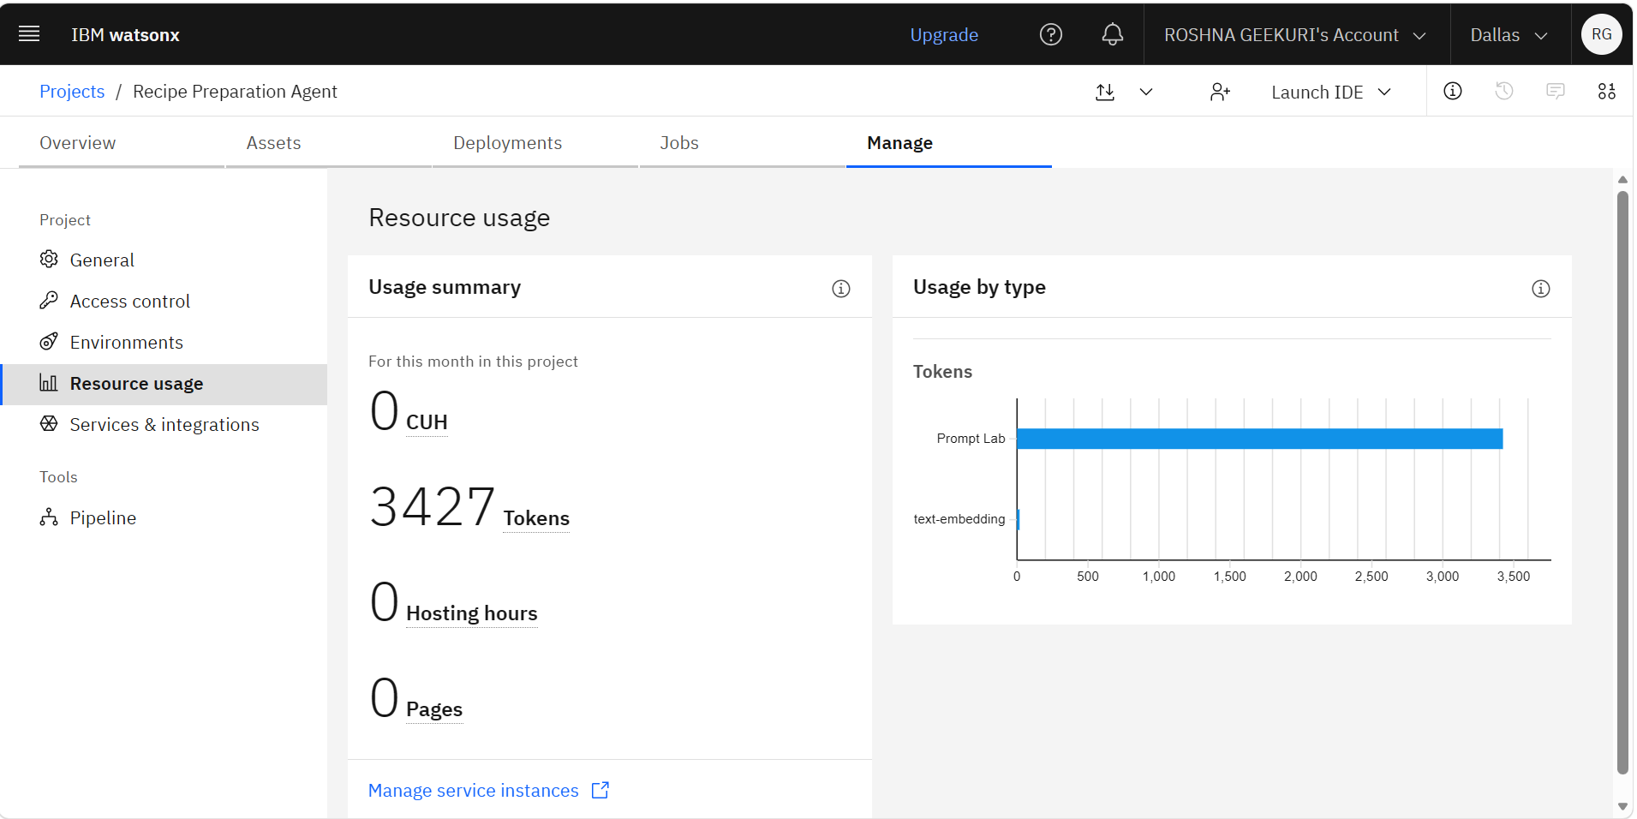

Slide 15


