Slide 1

MUSICAL TIME MACHINE
SCRUM MASTER
ROSHNA SHIRIN M
MES24MCA-2046
Department of Computer Applications
MES College of Engineering, Kuttippuram
21/08/2025

Slide 2
PRODUCT OWNER RESHMI K ASSISTANT PROFESSOR DEPARTMENT OF COMPUTER APPLICATIONS MES COLLEGE OF ENGINEERING, KUTTIPPURAM

Slide 3
TABLE OF CONTENTS
Introduction
Objective
Existing System
Proposed System
Motivation
Functionalities
Module Description
Developing Environment
Product Backlog
User Story
Project Plans
Sprint Backlog
Data Flow Diagrams
ER Diagram

Slide 4
MUSICAL TIME MACHINE
A personalized playlist generator that recreates nostalgic music experiences.
Allows users to input a specific date to fetch top charting songs from that period.
Integrates Spotify Web API for playlist creation and playback.
Bridges music, memory, and technology to enhance user experience.

Slide 5
OBJECTIVES
Provide users with the ability to revisit memories through music.
Retrieve historical top songs from sources like Billboard charts.
Automatically create and save playlists in users’ Spotify accounts.
Offer a user-friendly interface for easy interaction.
Ensure secure authentication using OAuth 2.0.

Slide 6
EXISTING SYSTEM
Streaming platforms (Spotify, YouTube, Apple Music) provide music discovery.
No direct option to revisit songs from a specific date.
Users manually search old songs, which is time-consuming.
Lack of personalized nostalgic music tools.

Slide 7
PROPOSED SYSTEM
Accept a date input from the user.
Fetch the top-ranking songs of that date via chart data.
Use Spotify API to generate a personalized playlist.
Playlist automatically saved to user’s account.
Runs on both Windows and Linux, with Flask (web) / Tkinter (desktop) frontends.

Slide 8
MOTIVATIONS
Music strongly evokes memories and emotions.
Lack of features in streaming apps to travel back in time musically.
Create a fun, engaging way to connect with personal history.
Encourage users to rediscover and share nostalgic music.

Slide 9
FUNCTIONALITIES
User enters a date as input.
System fetches top songs from Billboard or chart sources.
Spotify API integration for playlist creation.
Playlist automatically saved to user’s Spotify library.
Secure OAuth 2.0 authentication.
User-friendly interface for playback and navigation.

Slide 10
MODULE DESCRIPTION
User Interface Module – Date input & playlist access.
Data Fetching Module – Retrieves top songs for given date.
API Integration Module – Communicates with Spotify API.
Authentication Module – Manages secure OAuth login.
Playlist Creation Module – Compiles songs into Spotify playlist.
Storage/Output Module – Saves playlist to user’s account.

Slide 11
DEVELOPING ENVIRONMENT
Operating System: Windows / Linux
Frontend: Flask (Web) or Tkinter (Desktop)
Backend: Python
APIs: Spotify Web API, Chart Data API
Libraries: Spotipy, Requests, Datetime
Authentication: OAuth 2.0
IDE: VS Code / PyCharm

Slide 12
PRODUCT BACKLOG
ID | NAME | PRIORITY <high/medium/low> | ESTIMATE (Hours) | STATUS <Planned/In progress/Completed>
1 | Spotify login via OAuth | High | 5 | Completed
2 | Date input feature | High | 5 | In Progress
3 | Fetch chart data module | High | 20 | In progress
4 | Playlist creation feature | High | 10 | planned
5 | Save playlist to Spotify account | High | 10 | planned

Slide 13
PRODUCT BACKLOG
ID | NAME | PRIORITY <high/medium/low> | ESTIMATE (Hours) | STATUS <Planned/In progress/Completed>
6 | User-friendly GUI/Web interface | Medium | 15 | planned
7 | Optional: Genre filter | Low | 8 | planned
8 | Optional: Mood-based playlist | Low | 8 | planned

Slide 14
USER STORY
User Story ID | As a type of User | I want to <Perform some task> | So that i can <Achieve Some Goal>
1 | USER | Login with spotify | Access my Spotify account securely
2 | USER | Enter a specific date | Retrieve top songs from that time
3 | USER | Fetch chart data | Get accurate historical music information
4 | USER | Generate a playlist of top songs | Relive nostalgic music moments
5 | USER | Save the playlist to my spotify account | Listen to it anytime on Spotify
6 | USER | Use a simple interface | Easily navigate and play playlists
7 | USER | Apply filters like genre or mood (optional) | Customize playlists based on my preference

Slide 15
PROJECT PLAN
User StoryID | Task Name | Start Date | End Date | Days | Status
1 | Sprint 1 | 7/08/2025 | 8/08/2025 | 6 | Completed
2 |  | 15/08/2025 | 18/08/2025 |  | Completed
3 |  | 20/08/2022 | 22/08/2022 |  | In progress
3 | Sprint 2 | 22/08/2025 | 24/08/2025 | 11 | In progress
7 |  | 1/09/2025 | 5/09/2025 |  | planned
8 |  | 8/09/2025 | 10/09/2025 |  | planned
6 | Sprint 3 | 14/09/2025 | 17/09/2025 | 12 | planned
4 |  | 19/09/2025 | 22/09/2025 |  | planned
5 |  | 25/09/2025 | 28/09/2025 |  | planned

Slide 16
SPRINT BACKLOG
Backlog tem | Status And Completion Date | Original Estimation in Hours | Day 1 hrs | Day 2 hrs | Day 3 hrs | Day 4 hrs | Day 5 hrs | Day 6 hrs | Day 7 hrs | Day 8 hrs | Day 9 hrs | Day 10 hrs
SPRINT1
Setup environment | 7/8/2025 | 2 | 1 | 1 | 0 | 0 | 0 | 0 | 0 | 0 | 0 | 0
API authentication | 15/8/25 | 4 | 1 | 1 | 1 | 1 | 0 | 0 | 0 | 0 | 0 | 0

Slide 17
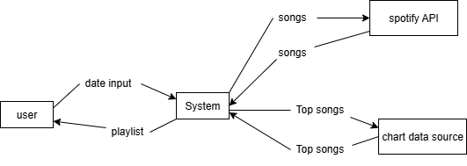
DATA FLOW DIAGRAM
LEVEL 0

Slide 18
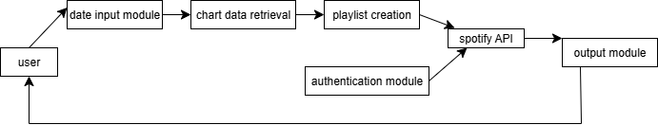
DATA FLOW DIAGRAM
LEVEL 1

Slide 19
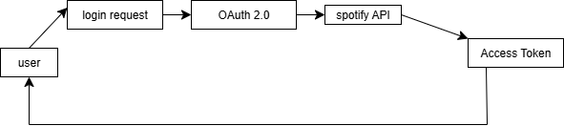
DATA FLOW DIAGRAM
Level 1.1

Slide 20

DATA FLOW DIAGRAM
Level 1.2

Slide 21
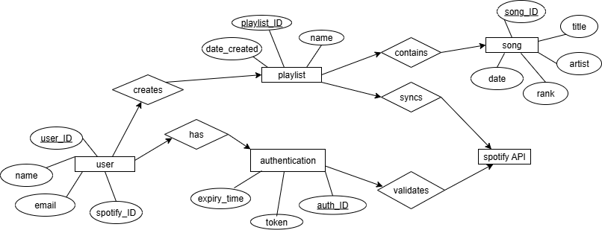
ER DIAGRAM

Slide 22
THANK YOU

