Slide 1

MUSICAL TIME MACHINE
SCRUM MASTER
ROSHNA SHIRIN M
MES24MCA-2046
Department of Computer Applications
MES College of Engineering, Kuttippuram
21/08/2025

Slide 2
PRODUCT OWNER RESHMI K ASSISTANT PROFESSOR DEPARTMENT OF COMPUTER APPLICATIONS MES COLLEGE OF ENGINEERING, KUTTIPPURAM

Slide 3
TABLE OF CONTENTS
Introduction
Objective
Existing System
Proposed System
Motivation
Functionalities
Module Description
Developing Environment
Product Backlog
User Story
Project Plans
Sprint Backlog
Work Flow Diagram

Slide 4
MUSICAL TIME MACHINE
Musical Time Machine is a Flask-based web application integrated with Spotify API.
Allows users to log in with their Spotify account using OAuth 2.0.
Generates personalized playlists based on:
Time Travel (Billboard Hot 100 by date)
Mood (Happy, Sad, Chill, Party)
Language (English, Hindi, Tamil, Malayalam, etc.)
Genre (Pop, Rock, Jazz, EDM, etc.)
Recently Played history

Slide 5
MUSICAL TIME MACHINE
Uses Spotipy (Python client for Spotify Web API) for playlist creation.
Scrapes Billboard Hot 100 for historical top English songs.
Adds support for regional languages using Spotify’s search and market-based queries.
Provides a simple and interactive web dashboard (HTML + CSS + Flask templates).
API integration
Web development with Flask
Data scraping
Multi-user authentication

Slide 6
OBJECTIVES
To develop a web-based playlist generator using Flask and Spotify API.
To implement secure user authentication with Spotify OAuth (multi-user support).
To provide multiple ways for users to create playlists:
Based on Billboard charts (time travel feature).
By mood, language, and genre preferences.
From recently played songs.
To integrate web scraping (Billboard Hot 100) for historical data.
To practice and demonstrate concepts of API integration, data handling, and web development.
To create a user-friendly dashboard for playlist generation.

Slide 7
EXISTING SYSTEM
Users rely on Spotify app or website for listening to music and creating playlists.
Spotify provides curated playlists (e.g., Daily Mix, Release Radar, Mood/Genre playlists).
Recently Played section is available but not automatically converted into playlists.
No option to time travel to past music charts (e.g., Billboard Hot 100 by date).
Limited support for multi-language playlist creation in one place.
Users need to manually search and add songs to playlists.

Slide 8
PROPOSED SYSTEM
A Flask-based web application integrated with Spotify API.
Provides multi-user login using Spotify OAuth 2.0.
Allows users to generate playlists automatically based on:
Billboard Hot 100 (Time Travel)
Mood preferences
Language choices
Music genres
Recently played songs
Uses web scraping (Billboard) and Spotify search for fetching songs.
Eliminates the need for manual playlist creation.
Offers a simple, user-friendly dashboard for easy playlist generation.

Slide 9
MOTIVATIONS
Music is an essential part of daily life and people often look for personalized playlists
Manually creating playlists is time-consuming and repetitive
Existing platforms like Spotify lack a direct feature to explore past charts such as Billboard Hot 100
Regional and language-based playlist creation is limited in the current system
Need for a simple web-based tool that automatically generates playlists based on user preferences
Opportunity to learn and apply concepts of Flask, API integration, and web scraping in a real-world scenario

Slide 10
FUNCTIONALITIES
User Authentication
Secure login using Spotify OAuth 2.0 for multiple users
Time Travel Playlist
Generates playlists from Billboard Hot 100 based on a selected date (year, month, day)
Mood-based Playlist
Creates playlists depending on the user’s mood such as happy, sad, chill, or party
Language-based Playlist
Allows users to create playlists in preferred languages like English, Hindi, Tamil, Malayalam

Slide 11
FUNCTIONALITIES
Genre-based Playlist
Generates playlists by selecting genres such as Pop, Rock, Jazz, Classical, EDM, Hip-Hop
Recently Played Playlist
Converts a users recently played tracks into a new playlist
Dashboard Interface
User-friendly web dashboard for selecting features and generating playlists
Logout Feature
Secure logout option with session clearing and Spotify account sign-out

Slide 12
MODULE DESCRIPTION
User Authentication Module
Handles Spotify login using OAuth 2.0 and manages user sessions
Dashboard Module
Provides a central interface where users can choose playlist generation options
Time Travel Module
Scrapes Billboard Hot 100 for a given date and creates a playlist with top songs from that period
Mood-based Module
Generates playlists by mapping moods (happy, sad, chill, party) to suitable tracks

Slide 13
MODULE DESCRIPTION
Language-based Module
Creates playlists based on the user’s selected language by searching Spotify content
Genre-based Module
Allows users to pick a genre (Pop, Rock, Jazz, Classical, EDM, Hip-Hop) and generates playlists
Recently Played Module
Fetches the users recently played songs and compiles them into a playlist
Logout Module
Clears user session data and provides an option to log out from both the app and Spotify

Slide 14
DEVELOPING ENVIRONMENT
Operating System: Windows 10 / Linux (development and testing)
Programming Language: Python 3.x
Framework: Flask (web framework)
Front End: HTML, CSS, Jinja2 templates
Back End: Flask with Spotipy (Spotify API integration)
Database: Not required (session-based storage only)
Web Scraping: BeautifulSoup (for Billboard charts)
APIs: Spotify Web API (via Spotipy)
IDE / Editor: Visual Studio Code
Package Manager: pip (Python package installer)
Version Control: Git and GitHub

Slide 15
PRODUCT BACKLOG
6
Recently Played Playlist
Medium
15
planned
ID | NAME | PRIORITY <high/medium/low> | ESTIMATE (Hours) | STATUS <Planned/In progress/Completed>
1 | User Authentication | High | 5 | Completed
2 | Dashboard | High | 5 | In Progress
3 | Mood-based Playlist | High | 4 | In progress
4 | Language-based Playlist | High | 6 | planned
5 | Genre-based Playlist | High | 3 | planned
6 | Recently Played Playlist | High | 2 | planned

Slide 16
PRODUCT BACKLOG
ID | NAME | PRIORITY <high/medium/low> | ESTIMATE (Hours) | STATUS <Planned/In progress/Completed>
7 | Playlist Management | High | 3 | planned
8 | Error Handling | High | 7 | planned
9 | UI/UX Enhancements | Medium | 4 | planned
10 | Documentation & Reports | Medium | 6 | planned
11 | Future Enhancements (Optional) | low | 4 | planned

Slide 17
USER STORY
User Story ID | As a type of User | I want to <Perform some task> | So that i can <Achieve Some Goal>
1 | USER | Log in with spotify | Access my playlists securely
2 | USER | Log out | Protect my account
3 | USER | See a dashboard | choose how to create a playlist
4 | USER | Select a date | Get songs from that time period
5 | USER | Pick a mood | Listen to music that matches my feeling
6 | USER | Choose a language | Hear songs in my preferred language
7 | USER | Select a genre | Explore music I like

Slide 18
USER STORY
User Story ID | As a type of User | I want to <Perform some task> | So that i can <Achieve Some Goal>
8 | USER | User recently played | Save recent songs as a playlist
9 | USER | Save playlists automatically | Access them later on spotify
10 | USER | Get alerts when no songs are found | Try another option quickly
11 | USER | Open playlist link | Play it directly on spotify

Slide 19
PROJECT PLAN
User StoryID | Task Name | Start Date | End Date | Days | Status
1 | Sprint 1 | 7/08/2025 | 8/08/2025 | 6 | Completed
2 |  | 15/08/2025 | 18/08/2025 |  | Completed
3 |  | 20/08/2022 | 22/08/2022 |  | In progress
3 | Sprint 2 | 22/08/2025 | 24/08/2025 | 14 | Completed
11 |  | 25/08/2025 | 26/08/2025 |  | Completed
8 |  | 27/08/2025 | 28/08/2025 |  | Completed
10 |  | 29/08/2025 | 30/08/2025 |  | Completed
7 |  | 1/09/2025 | 5/09/2025 |  | Completed

Slide 20
PROJECT PLAN
User StoryID | Task Name | Start Date | End Date | Days | Status
6 | Sprint 3 | 14/09/2025 | 15/09/2025 | 12 | planned
9 |  | 16/09/2025 | 17/09/2025 |  | planned
4 |  | 19/09/2025 | 22/09/2025 |  | planned
5 |  | 25/09/2025 | 28/09/2025 |  | planned

Slide 21
SPRINT BACKLOG
Backlog tem | Status And Completion Date | Original Estimation in Hours | Day 1 hrs | Day 2 hrs | Day 3 hrs | Day 4 hrs | Day 5 hrs | Day 6 hrs | Day 7 hrs | Day 8 hrs | Day 9 hrs | Day 10 hrs
SPRINT1
User authentication | 7/8/2025 | 2 | 1 | 1 | 0 | 0 | 0 | 0 | 0 | 0 | 0 | 0
dashboard | 15/8/25 | 4 | 1 | 1 | 1 | 1 | 0 | 0 | 0 | 0 | 0 | 0

Slide 22
SPRINT BACKLOG
Backlog tem | Status And Completion Date | Original Estimation in Hours | Day 1 hrs | Day 2 hrs | Day 3 hrs | Day 4 hrs | Day 5 hrs | Day 6 hrs | Day 7 hrs | Day 8 hrs | Day 9 hrs | Day 10 hrs
SPRINT2
Mood based playlist | 24/8/25 | 2 | 1 | 1 | 0 | 0 | 0 | 0 | 0 | 0 | 0 | 0
Playlist management | 26/8/25 | 2 | 1 | 1 | 0 | 0 | 0 | 0 | 0 | 0 | 0 | 0
Documents and reports | 28/8/25 | 2 | 1 | 1 | 0 | 0 | 0 | 0 | 0 | 0 | 0 | 0
Error handling | 30/8/25 | 2 | 1 | 1 | 0 | 0 | 0 | 0 | 0 | 0 | 0 | 0
More features | 5/9/25 | 5 | 1 | 1 | 1 | 1 | 1 | 0 | 0 | 0 | 0 | 0

Slide 23
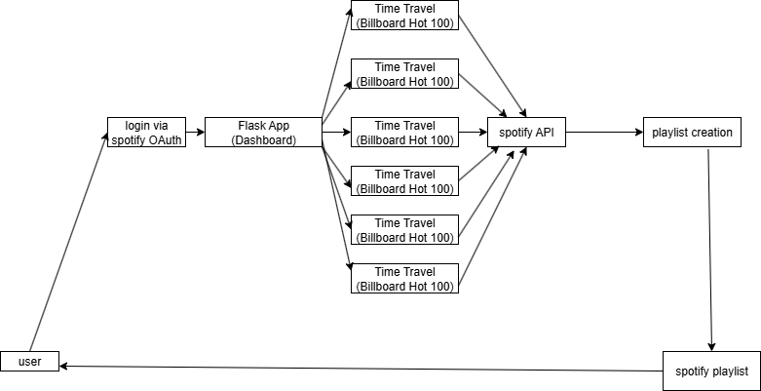
WORK FLOW DIAGRAM

Slide 24
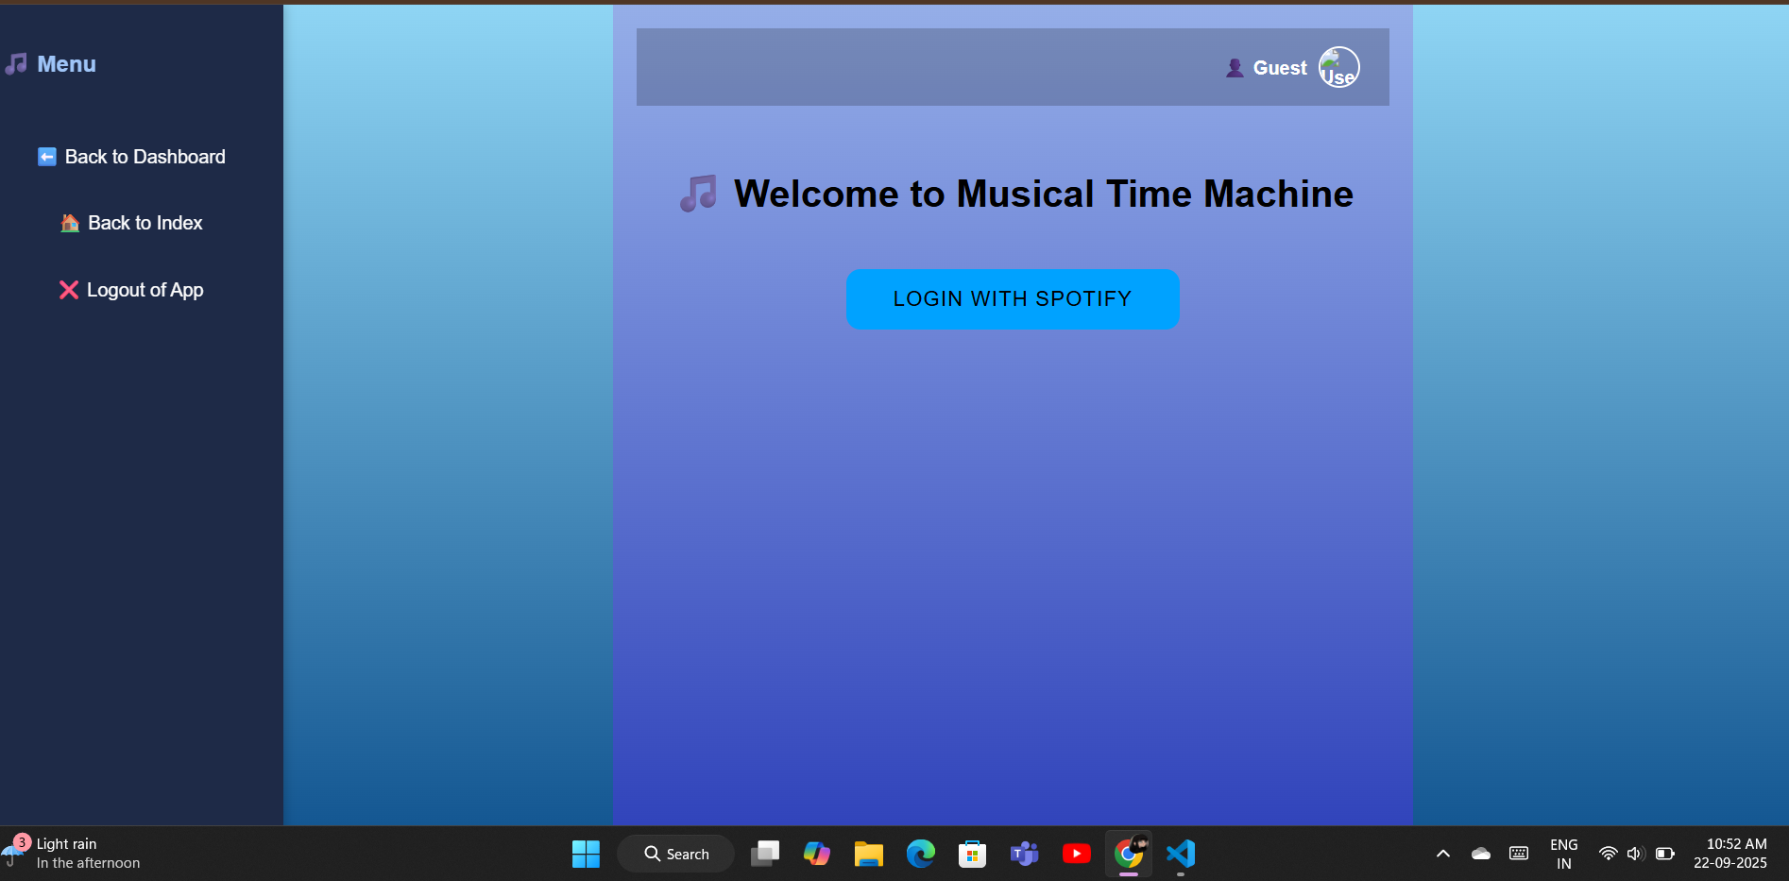
interface

Slide 25
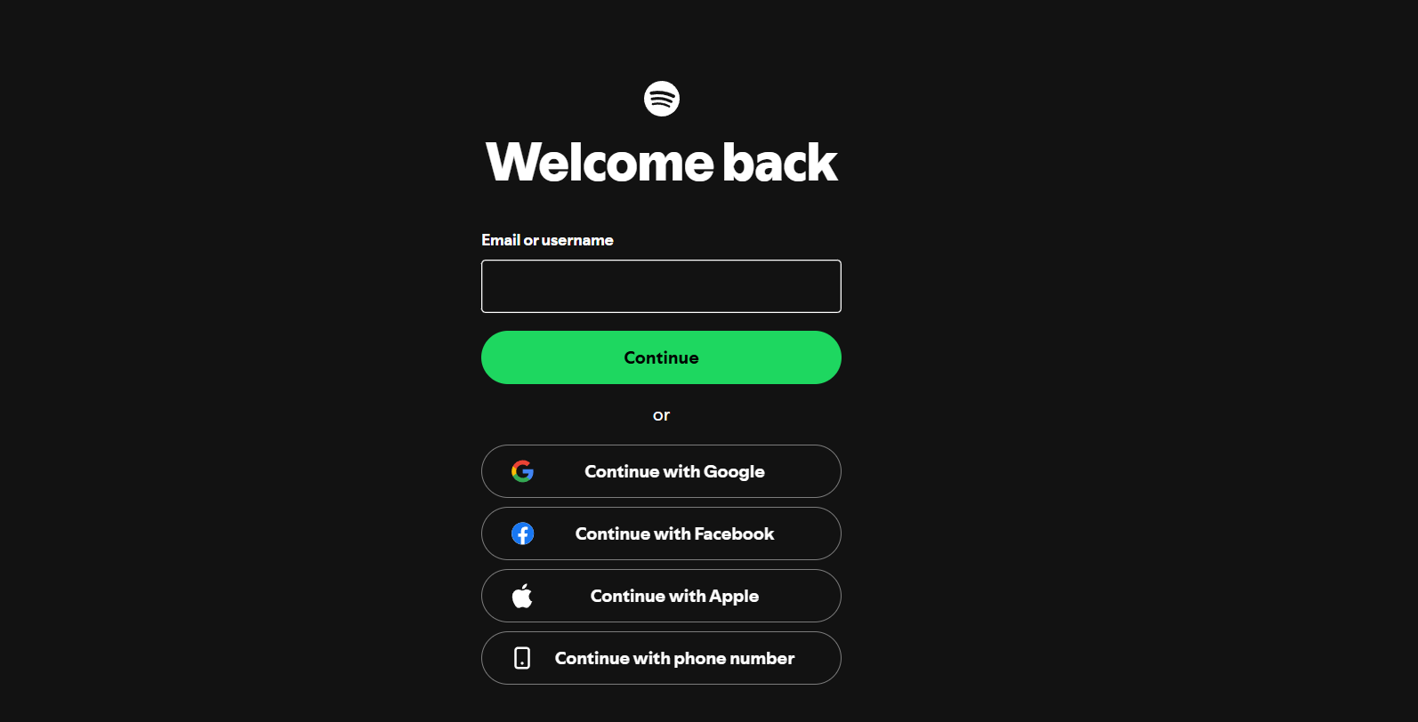
interface

Slide 26
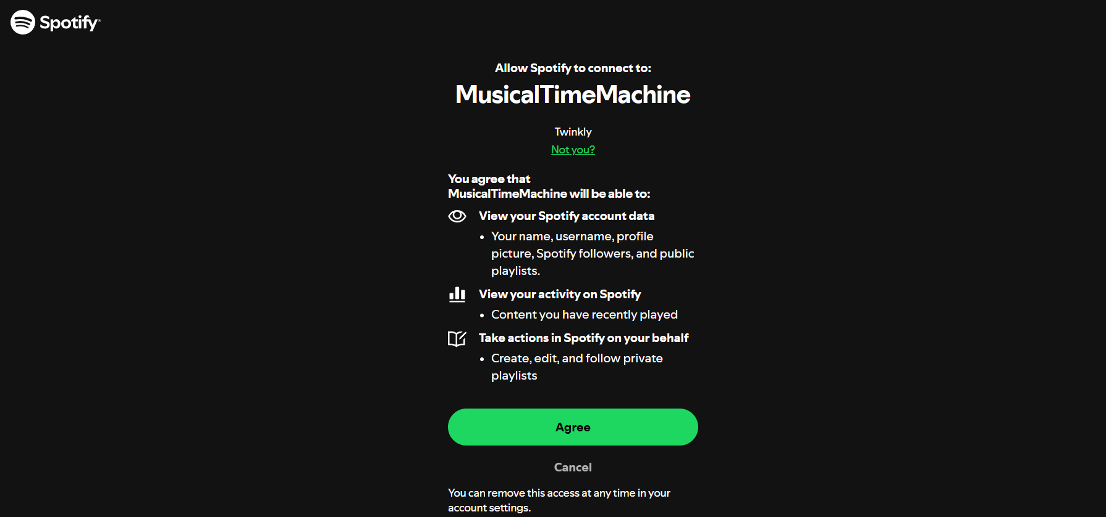
interface

Slide 27
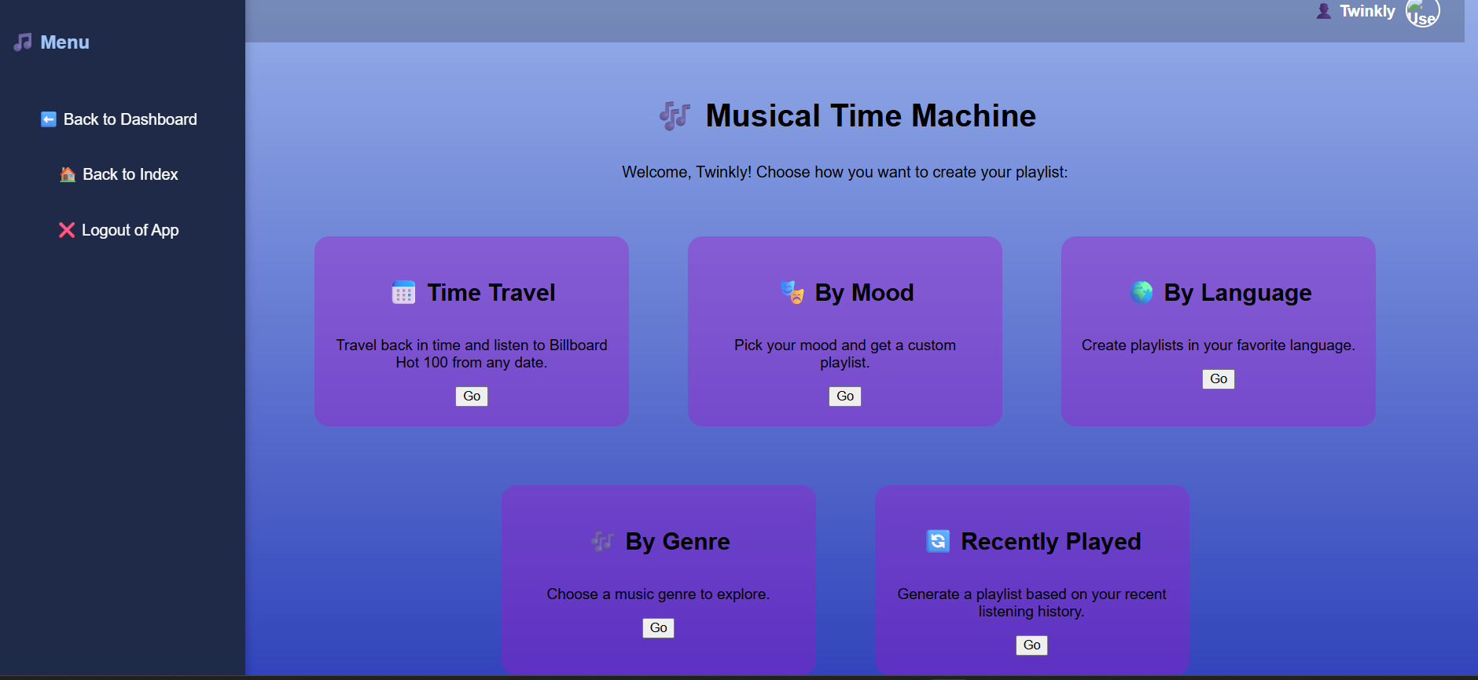
interface

Slide 28
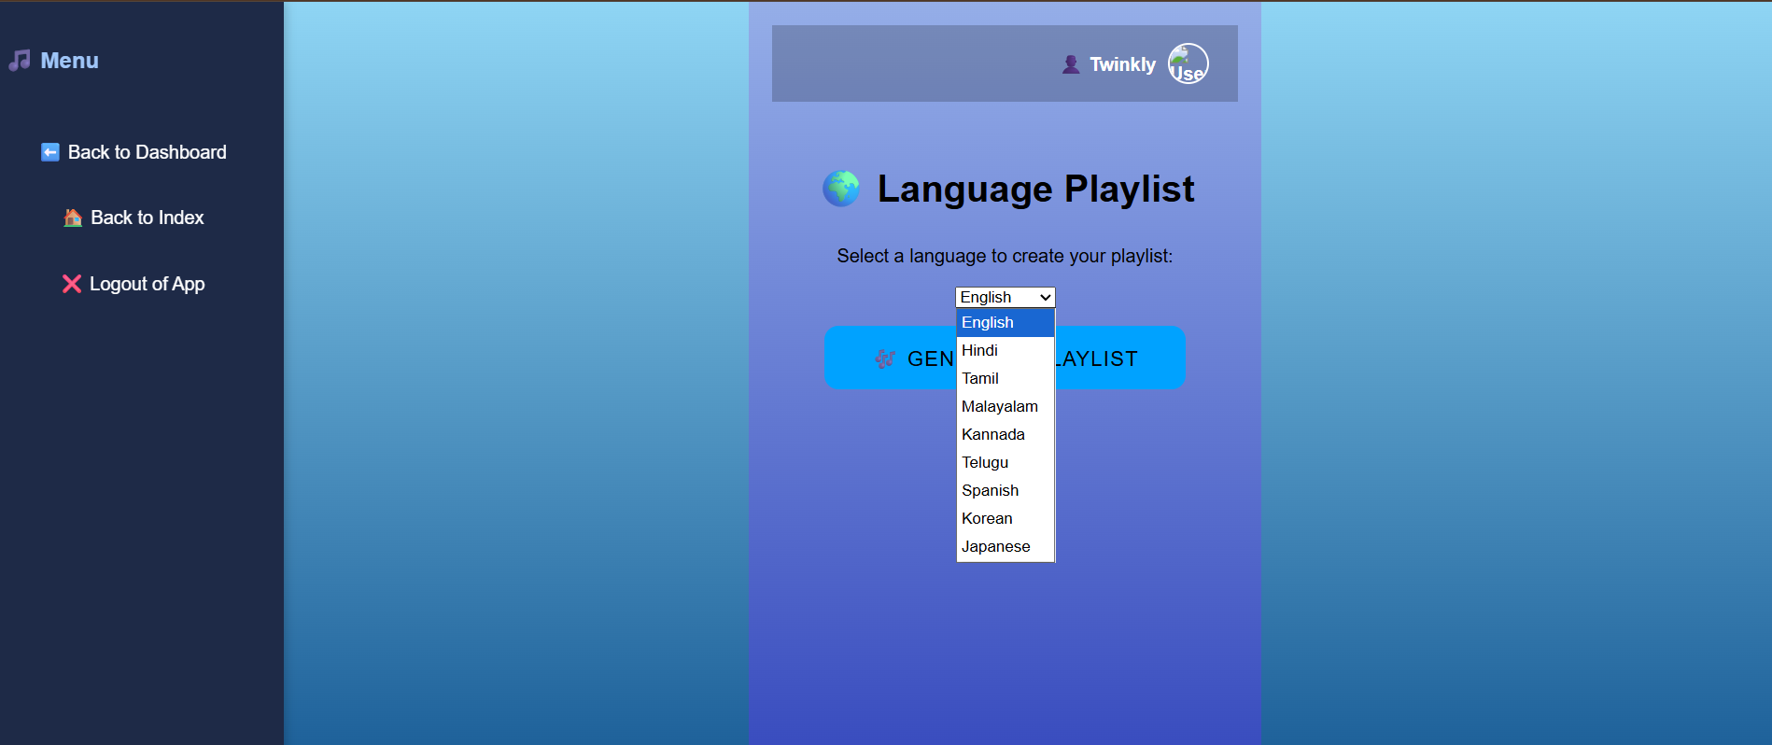
interface

Slide 29
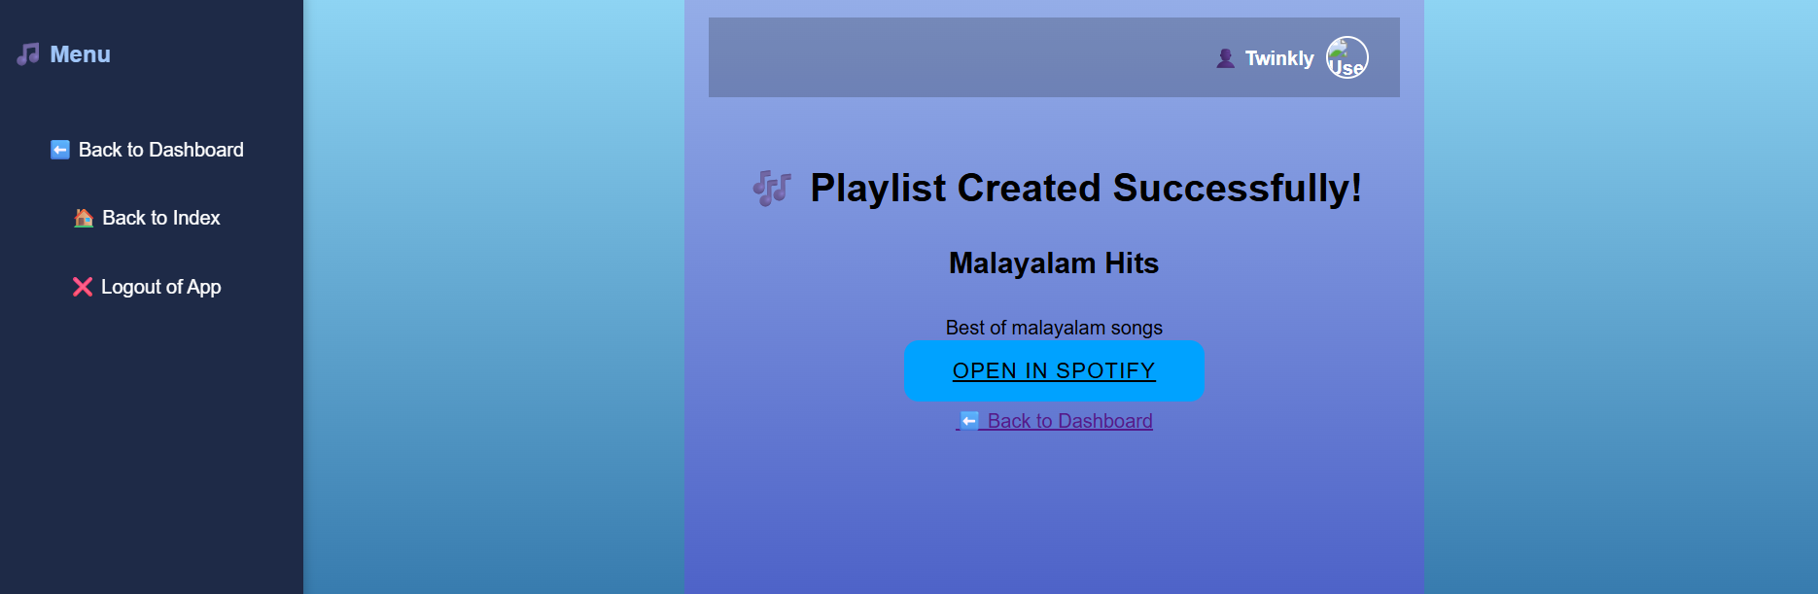
interface

Slide 30
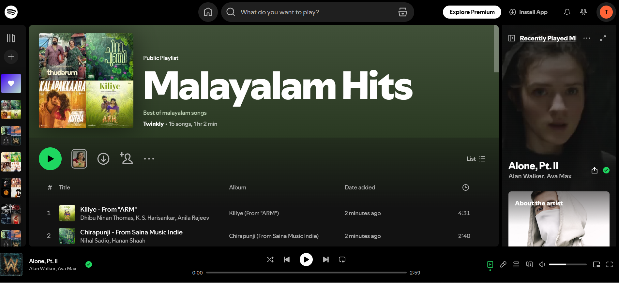
interface

Slide 31
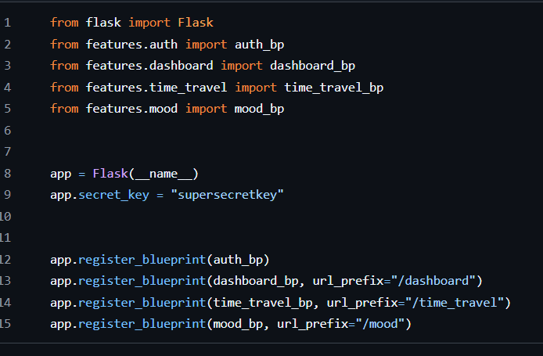
App.py

Slide 32
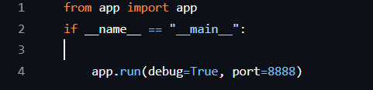
Main.py

Slide 33
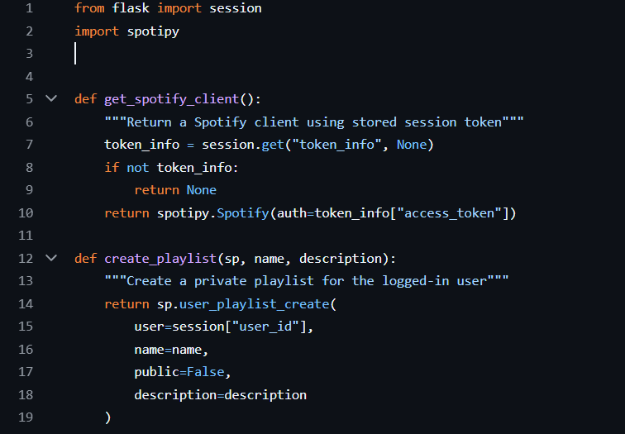
Utils.py

Slide 34
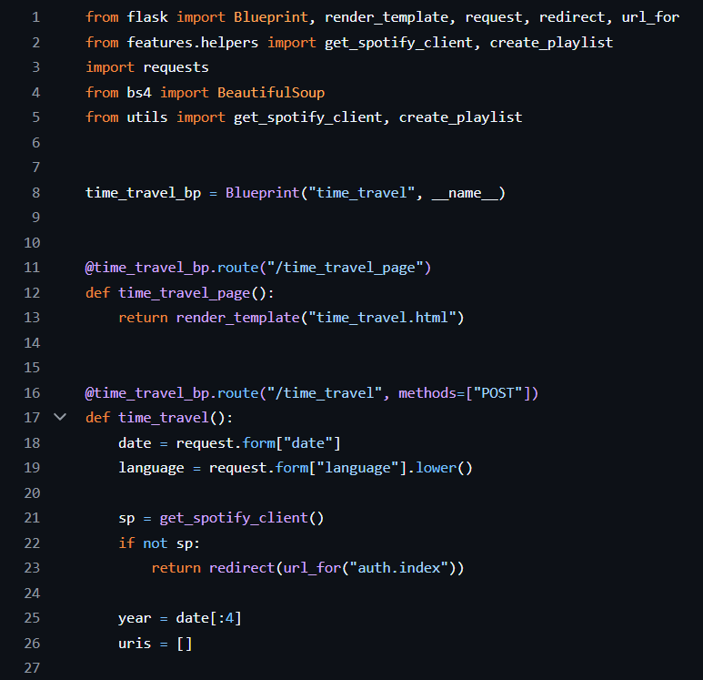
Time_travel.py

Slide 35
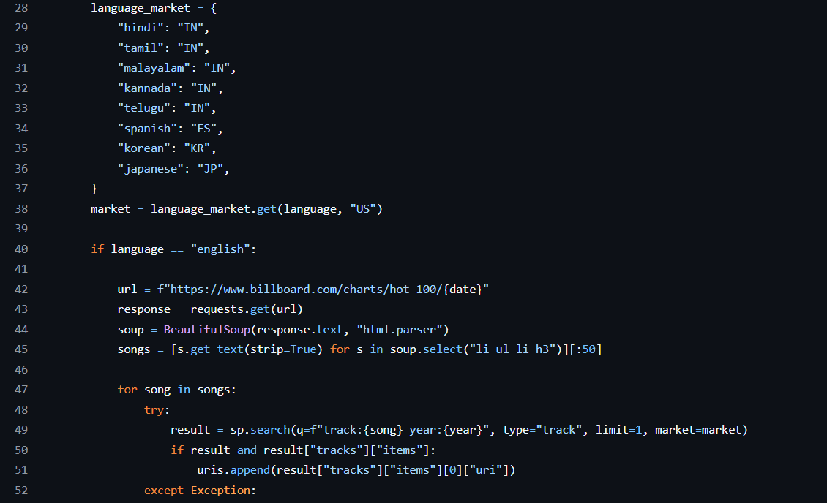
Time_travel.py

Slide 36
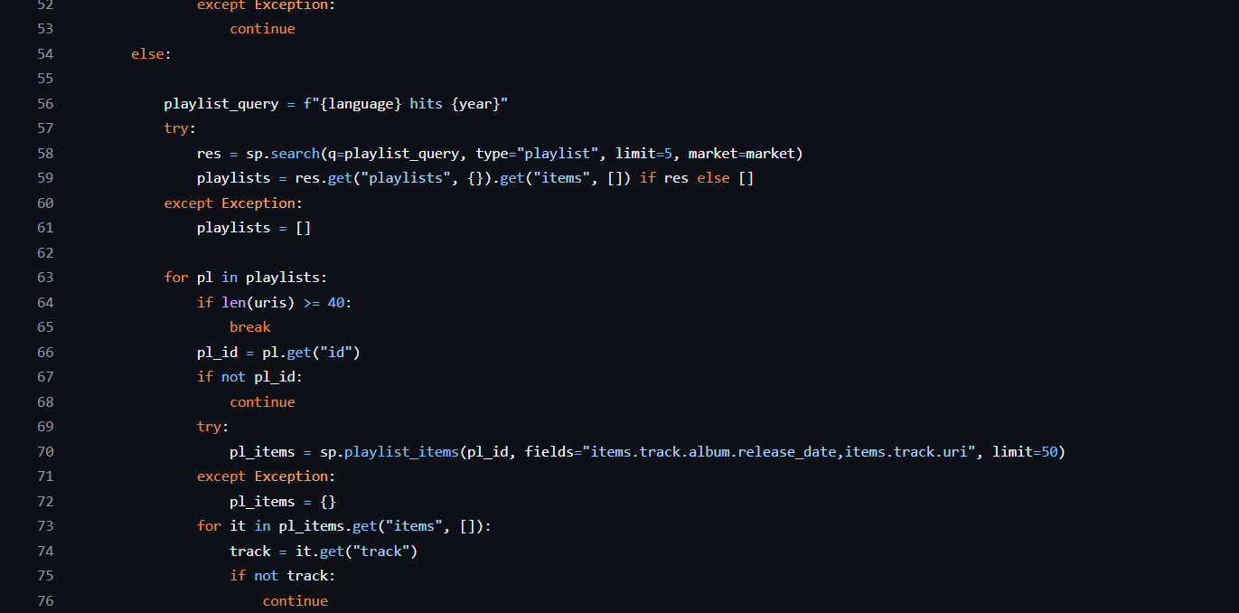
Time_travel.py

Slide 37
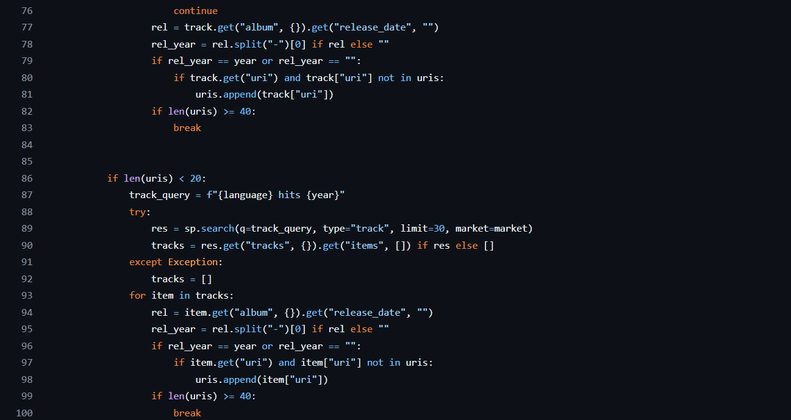
Time_travel.py

Slide 38
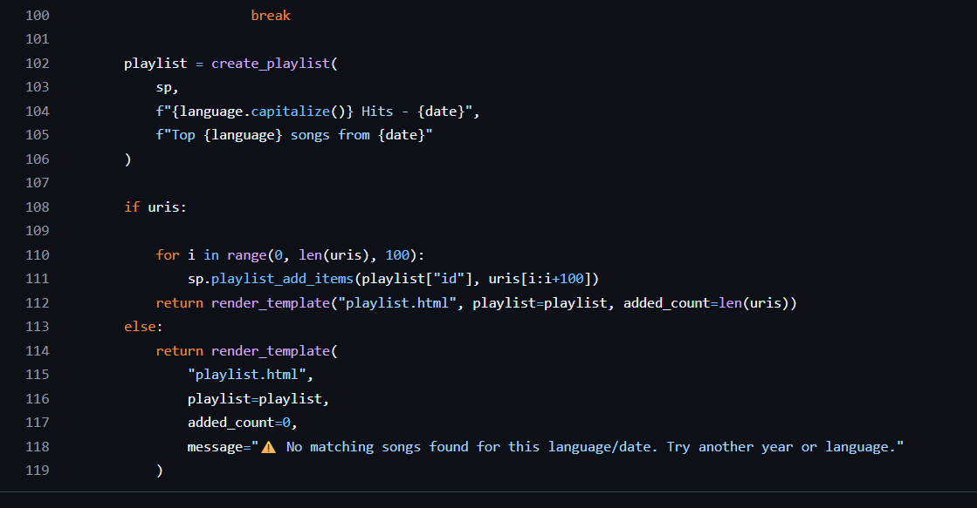
Time_travel.py

Slide 39
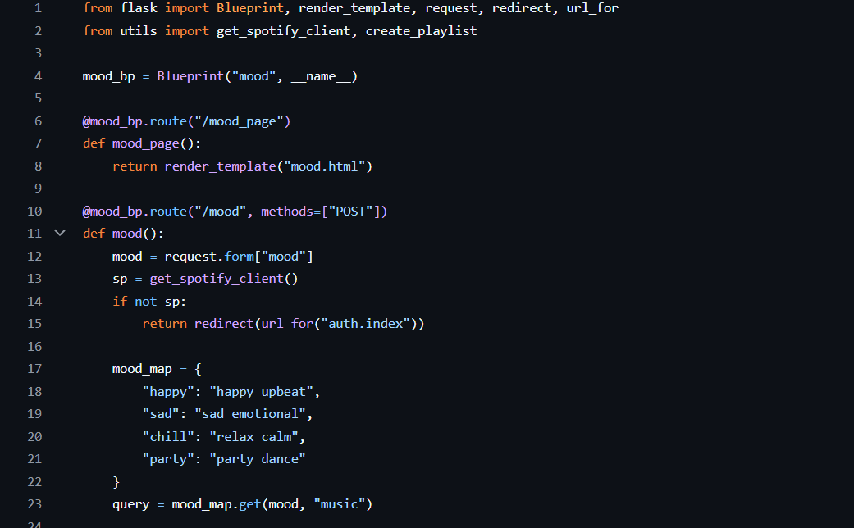
Mood.py

Slide 40
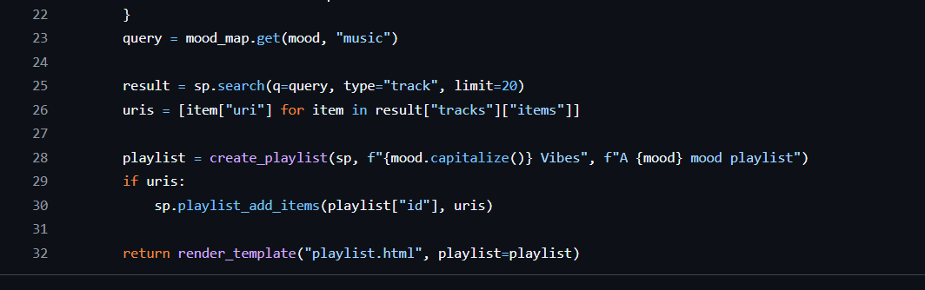
Mood.py

Slide 41
THANK YOU

