Slide 1
Use Case Diagram
AI-Powered Personalized Learning
Web Platform for Class 5 Students
Student
Program
Roshail Zeeshan
BS Computer Science
Semester
University
Fall 2026
Pakistan Global Institute

Slide 2
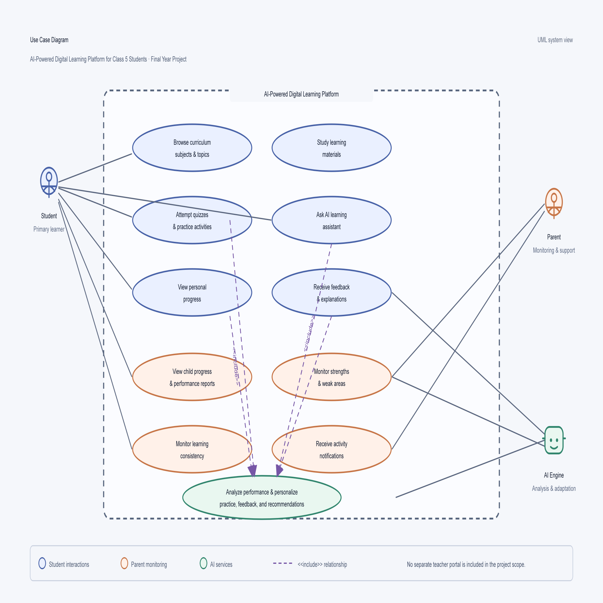

Slide 3
THANK YOU
Questions & Discussion
AI-Powered Personalized Learning Web Platform
for Class 5 Students
Roshail Zeeshan · BS Computer Science · Pakistan Global Institute

