Slide 1
Owl-M_ A_Material study app
Presented by
S.Roshan kumar
L.Sanjay
T.Sakthivel
S.Sangavi

Slide 2
A project that demonstrates the use of Android Jetpack Compose to build a UI for a Owl-M: a material design study app. Owl-M app is a sample project built using the Android Compose UI toolkit. A Compose implementation of the Owl Material study.
Learning Outcomes :
By end of this project:
You’ll be able to work on Android studio and build an app.
You’ll be able to integrate the database accordingly.
Project Workflow:
Users register into the application.
After registration , user logins into the application.
User enters into the main page
User can view the subject themes on selecting theme he can read about it.

Slide 3
To complete the project you need to finish up the tasks listed below:
Tasks:
1.Required initial steps
2.Creating a new project.
3.Adding required dependencies.
4.Creating the database classes.
5.Building application UI and connecting to database.
6.Using AndroidManifest.xml
7.Running the application.

Slide 4
package com.example.owlapplication
import androidx.room.ColumnInfo
import androidx.room.Entity
import androidx.room.PrimaryKey
@Entity(tableName = "user_table")
data class User(
@PrimaryKey(autoGenerate = true) val id: Int?,
@ColumnInfo(name = "first_name") val firstName: String?,
@ColumnInfo(name = "last_name") val lastName: String?,
@ColumnInfo(name = "email") val email: String?,
@ColumnInfo(name = "password") val password: String?,
)

Slide 5
package com.example.owlapplication
import androidx.room.*
@Dao
interface UserDao {
@Query("SELECT * FROM user_table WHERE email = :email")
suspend fun getUserByEmail(email: String): User?
@Insert(onConflict = OnConflictStrategy.REPLACE)
suspend fun insertUser(user: User)
@Update
suspend fun updateUser(user: User)
@Delete
suspend fun deleteUser(user: User)
}

Slide 6
package com.example.owlapplication
import android.content.Context
import androidx.room.Database
import androidx.room.Room
import androidx.room.RoomDatabase
@Database(entities = [User::class], version = 1)
abstract class UserDatabase : RoomDatabase() {
abstract fun userDao(): UserDao
companion object {
@Volatile
private var instance: UserDatabase? = null
fun getDatabase(context: Context): UserDatabase {
return instance ?: synchronized(this) {
val newInstance = Room.databaseBuilder(
context.applicationContext,
UserDatabase::class.java,
"user_database"
).build()
instance = newInstance
newInstance
}
}
}
}

Slide 7
package com.example.owlapplication
import android.content.Context
import android.content.Intent
import android.os.Bundle
import androidx.activity.ComponentActivity
import androidx.activity.compose.setContent
import androidx.compose.foundation.Image
import androidx.compose.foundation.background
import androidx.compose.foundation.layout.*
import androidx.compose.material.*
import androidx.compose.runtime.*
import androidx.compose.ui.Alignment
import androidx.compose.ui.Modifier
import androidx.compose.ui.graphics.Color
import androidx.compose.ui.layout.ContentScale
import androidx.compose.ui.res.painterResource
import androidx.compose.ui.text.font.FontFamily
import androidx.compose.ui.text.font.FontWeight
import androidx.compose.ui.text.input.PasswordVisualTransformation
import androidx.compose.ui.tooling.preview.Preview
import androidx.compose.ui.unit.dp
import androidx.compose.ui.unit.sp
import androidx.core.content.ContextCompat
import com.example.owlapplication.ui.theme.OwlApplicationTheme

Slide 8
class LoginActivity : ComponentActivity() {
private lateinit var databaseHelper: UserDatabaseHelper
override fun onCreate(savedInstanceState: Bundle?) {
super.onCreate(savedInstanceState)
databaseHelper = UserDatabaseHelper(this)
setContent {
LoginScreen(this, databaseHelper)
}
}
}
@Composable
fun LoginScreen(context: Context, databaseHelper: UserDatabaseHelper) {
var username by remember { mutableStateOf("") }
var password by remember { mutableStateOf("") }
var error by remember { mutableStateOf("") }
Column(
modifier = Modifier.fillMaxSize().background(Color.White),
horizontalAlignment = Alignment.CenterHorizontally,

Slide 9
Image(painterResource(id = R.drawable.study_login), contentDescription = "")
Text(
fontSize = 36.sp,
fontWeight = FontWeight.ExtraBold,
fontFamily = FontFamily.Cursive,
text = "Login"
)
Spacer(modifier = Modifier.height(10.dp))
TextField(
value = username,
onValueChange = { username = it },
label = { Text("Username") },
modifier = Modifier.padding(10.dp)
.width(280.dp)
)
TextField(
value = password,
onValueChange = { password = it },
label = { Text("Password") },
visualTransformation = PasswordVisualTransformation(),
modifier = Modifier.padding(10.dp)

Slide 10
if (error.isNotEmpty()) {
Text(
text = error,
color = MaterialTheme.colors.error,
modifier = Modifier.padding(vertical = 16.dp)
)
}
Button(
onClick = {
if (username.isNotEmpty() && password.isNotEmpty()) {
val user = databaseHelper.getUserByUsername(username)
if (user != null && user.password == password) {
error = "Successfully log in"
context.startActivity(
Intent(
context,
MainActivity::class.java
)
)
//onLoginSuccess()
}
else {
error = "Invalid username or password"
}

Slide 11
Row {
TextButton(onClick = {context.startActivity(
Intent(
context,
RegisterActivity::class.java
)
)}
)
{ Text(text = "Register") }
TextButton(onClick = {
})
{
Spacer(modifier = Modifier.width(60.dp))
Text(text = "Forget password?")
}
}
}
}
private fun startMainPage(context: Context) {
val intent = Intent(context, MainActivity::class.java)
ContextCompat.startActivity(context, intent, null)
}

Slide 12
import android.content.Context
import android.content.Intent
import android.os.Bundle
import androidx.activity.ComponentActivity
import androidx.activity.compose.setContent
import androidx.compose.foundation.Image
import androidx.compose.foundation.clickable
import androidx.compose.foundation.layout.*
import androidx.compose.foundation.rememberScrollState
import androidx.compose.foundation.verticalScroll
import androidx.compose.material.Card
import androidx.compose.material.Text
import androidx.compose.runtime.Composable
import androidx.compose.ui.Alignment
import androidx.compose.ui.Modifier
import androidx.compose.ui.draw.scale
import androidx.compose.ui.graphics.Color
import androidx.compose.ui.res.painterResource
import androidx.compose.ui.res.stringResource
import androidx.compose.ui.text.font.FontWeight
import androidx.compose.ui.text.style.TextAlign
import androidx.compose.ui.unit.dp
import androidx.compose.ui.unit.sp

Slide 13
modifier = Modifier
.fillMaxWidth()
.height(250.dp)
.clickable {
context.startActivity(
Intent(context, MainActivity2::class.java)
)
},
elevation = 8.dp
)
{
Column(
horizontalAlignment = Alignment.CenterHorizontally
) {
Image(
painterResource(id = R.drawable.img_1), contentDescription = "",
modifier = Modifier
.height(150.dp)
.scale(scaleX = 1.2F, scaleY = 1F)
)
Text(text = stringResource(id = R.string.course1),color = Color(0xFFFFA500),
fontSize = 16.sp)

Slide 14
Card(
modifier = Modifier
.fillMaxWidth()
.height(250.dp)
.clickable {
context.startActivity(
Intent(context, MainActivity5::class.ja
Image(
painterResource(id = R.drawable.img_4), contentDescription = "",
modifier = Modifier
.height(150.dp)
.scale(scaleX = 1.2F, scaleY = 1F)
)
Text(text = stringResource(id = R.string.course4),color = Color(0xFFFFA500),
fontSize = 16.sp)
Text(
text = stringResource(id = R.string.topic4),
fontWeight = FontWeight.Bold,
fontSize = 20.sp,
textAlign = TextAlign.Center,
)
}

Slide 15
class MainActivity2 : ComponentActivity() {
override fun onCreate(savedInstanceState: Bundle?) {
super.onCreate(savedInstanceState)
setContent {
Greeting()
}
}
}
@Composable
fun Greeting() {
Column(
modifier = Modifier.padding(start = 26.dp, end = 26.dp, bottom = 26.dp)
.verticalScroll(rememberScrollState())
.background(Color.White),
verticalArrangement = Arrangement.Top
) {
Image(
painterResource(id = R.drawable.img_1),
contentDescription = "",
modifier = Modifier.align(Alignment.CenterHorizontally)
.scale(scaleX = 1.5F, scaleY = 1.5F)
)

Slide 16
Spacer(modifier = Modifier.height(20.dp))
Text(
text = stringResource(id = R.string.text2_1),
modifier = Modifier.align(Alignment.Start),
textAlign = TextAlign.Justify,
fontSize = 16.sp
)
Spacer(modifier = Modifier.height(20.dp))
Text(
text = stringResource(id = R.string.subheading2_2),
modifier = Modifier.align(Alignment.Start),
fontSize = 20.sp
)
Spacer(modifier = Modifier.height(20.dp))
Text(
text = stringResource(id = R.string.text2_2),
modifier = Modifier.align(Alignment.Start),
textAlign = TextAlign.Justify,
fontSize = 16.sp

Slide 17
Spacer(modifier = Modifier.height(20.dp))
Text(
text = stringResource(id = R.string.subheading3_1),
modifier = Modifier.align(Alignment.Start),
fontSize = 20.sp
)
Spacer(modifier = Modifier.height(20.dp))
Text(
text = stringResource(id = R.string.text3_1),
modifier = Modifier.align(Alignment.Start),
textAlign = TextAlign.Justify,
fontSize = 16.sp
)
Spacer(modifier = Modifier.height(20.dp))
Text(
text = stringResource(id = R.string.subheading3_2),
modifier = Modifier.align(Alignment.Start),
fontSize = 20.sp
)
Spacer(modifier = Modifier.height(20.dp))

Slide 18
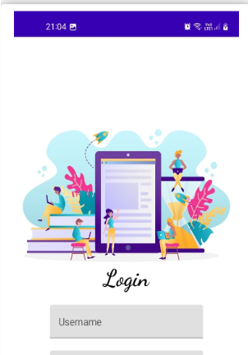
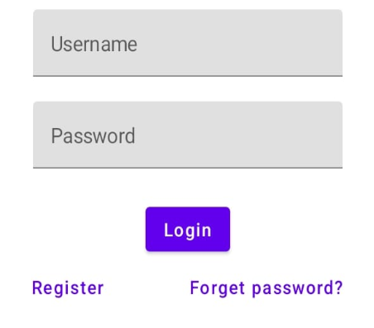

Slide 19

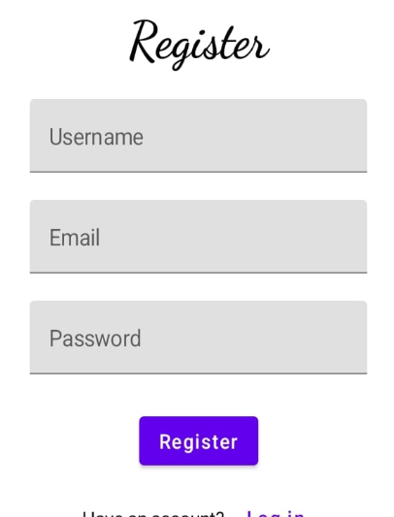

Slide 20
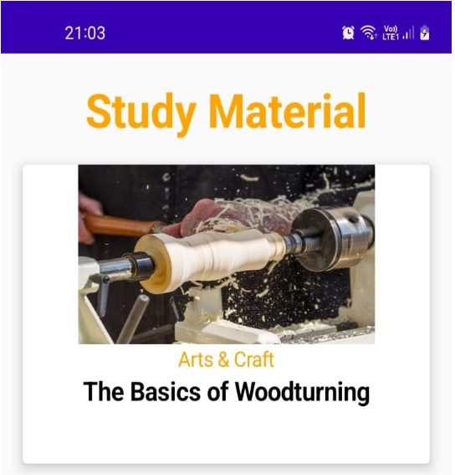
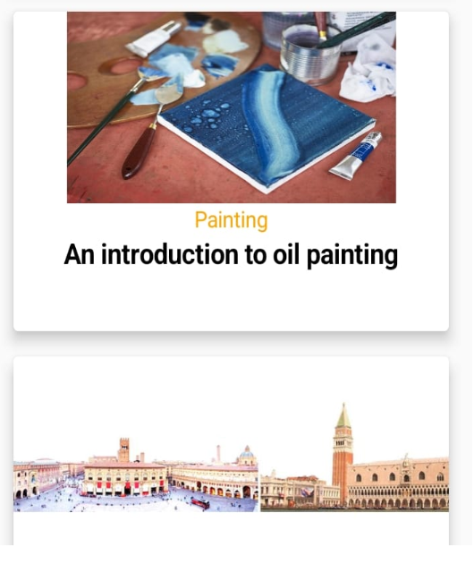

Slide 21

