Slide 1
THEME : DATA COLLECTION AND PROCESSING OF INFORMATION COLLECTED BY SENSORS TO IMPLEMENT A SUSTAINABLE SOLUTION FOR THE CHOSEN PROBLEM STATEMENT
TEAM NAME : Dapros
CHOSEN PROBLEM STATEMENT : Risk of exploring places which will be hazardous for human intervention.
TEAM LEADER'S NAME : MD SURAJ KUMAR
COLLEGE : BMSCE
EMAIL ID : suraj.cs20@bmsce.ac.in
CONTACT NUMBER : 9901445981

Slide 2
INTRODUCTION
For the increase in requirement and innovation of the design for the drones and rovers, we have come up with spherical alternative of the present
rovers.
To explore unexplored places and monitor them for long duration we are designing a small bot which detects radiation, obstacles, temperature and many other features.

Slide 3
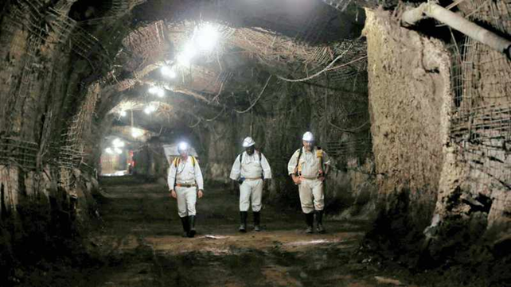
WHY??
Risk of exploring places which will be hazardous for human involvement.
Scavenging in nuclear fall out areas where the radiation can be harmful to humans.
Dangerous mining shafts and small tunnels.

Slide 4
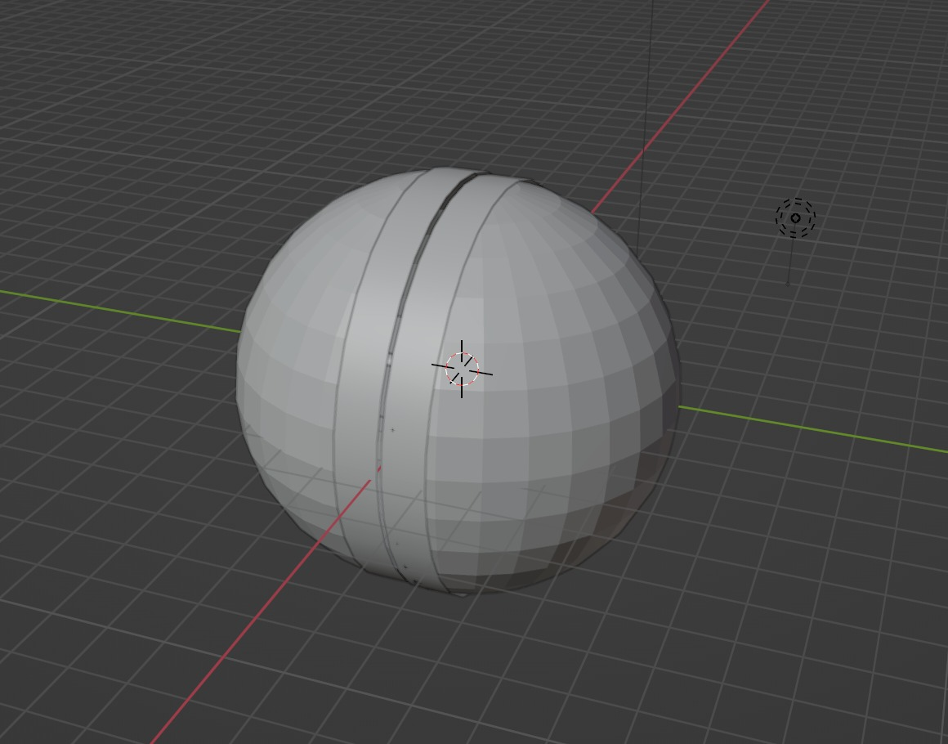
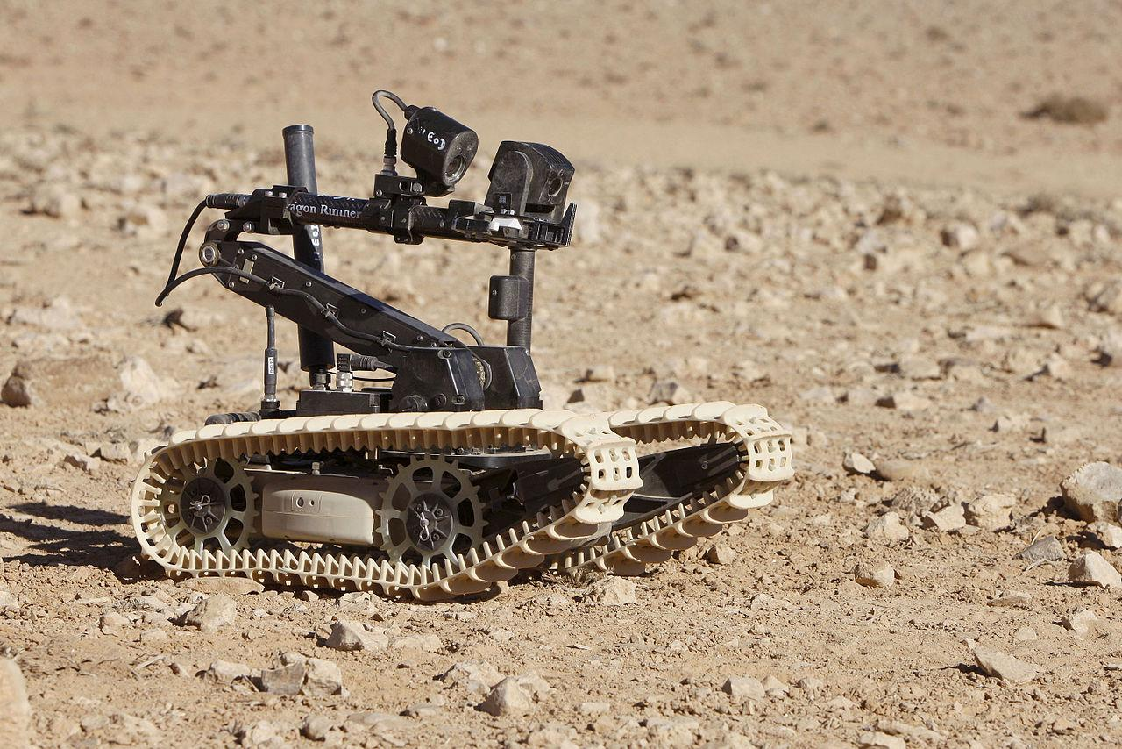
ADVANTAGES OVER PRESENT DESIGN:
VS
Compact
Self orientation due to modal shape
Protection of circuit and other components
Environmentally sustainable

Slide 5
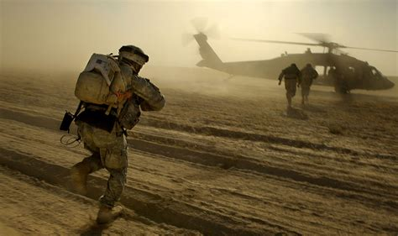
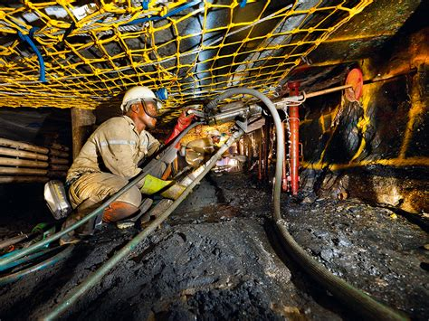
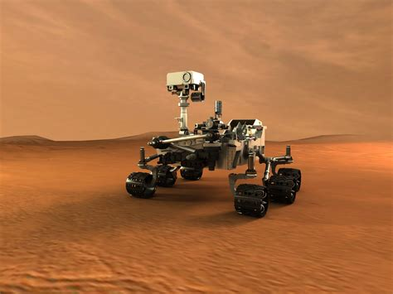
USE CASES
MINING
SPACE EXPLORATION
MILITARY

Slide 6
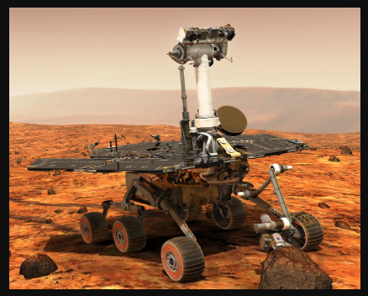
SELF ORIENTATION OF THE BALL
We have developed our model in spherical dimension which self orients (based on the physics) without using any gyroscope hence making it economical and robust.

Slide 7
SENSORS USED:
OV7670(CAMERA MODULE FOR LIVE STREAMING)
DHT11(TEMPERATURE AND HUMIDITY)
MQ3(METHANE DETECTION)
OTHER PARTS:
NodeMCU
MOTOR DRIVER

Slide 8
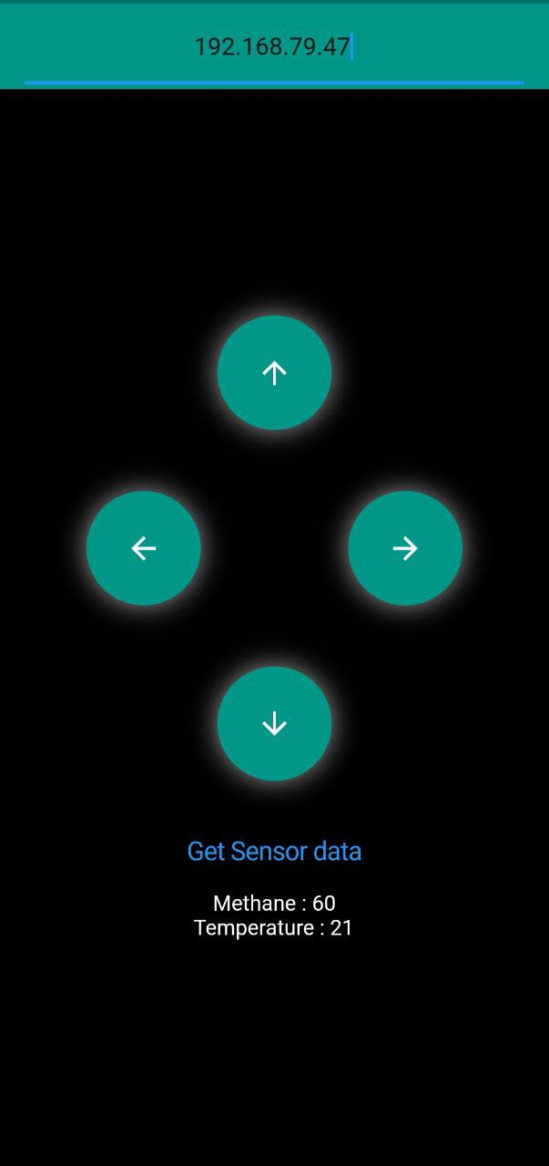
HOW DO WE CONTROL:
Easy to use, cross platform mobile application built using Flutter framework(BY GOOGLE).
Simple UI for users to control the directions of the spherical bot.
This application reads and displays thedata fetched from the sensor, which is passed by NodeMCU through HTTP Server.

Slide 9
FUTURE IMPLEMENTATIONS:
GEIGER COUNTER(DETECTION OF IONIZING RADIATION)
NAVIGATION USING COMPUTER VISION
STRONG ENVIRONMENTALLY FRIENDLY MATERIAL FOR THE SPHERICAL MODEL

Slide 10
THANK YOU

