Slide 1
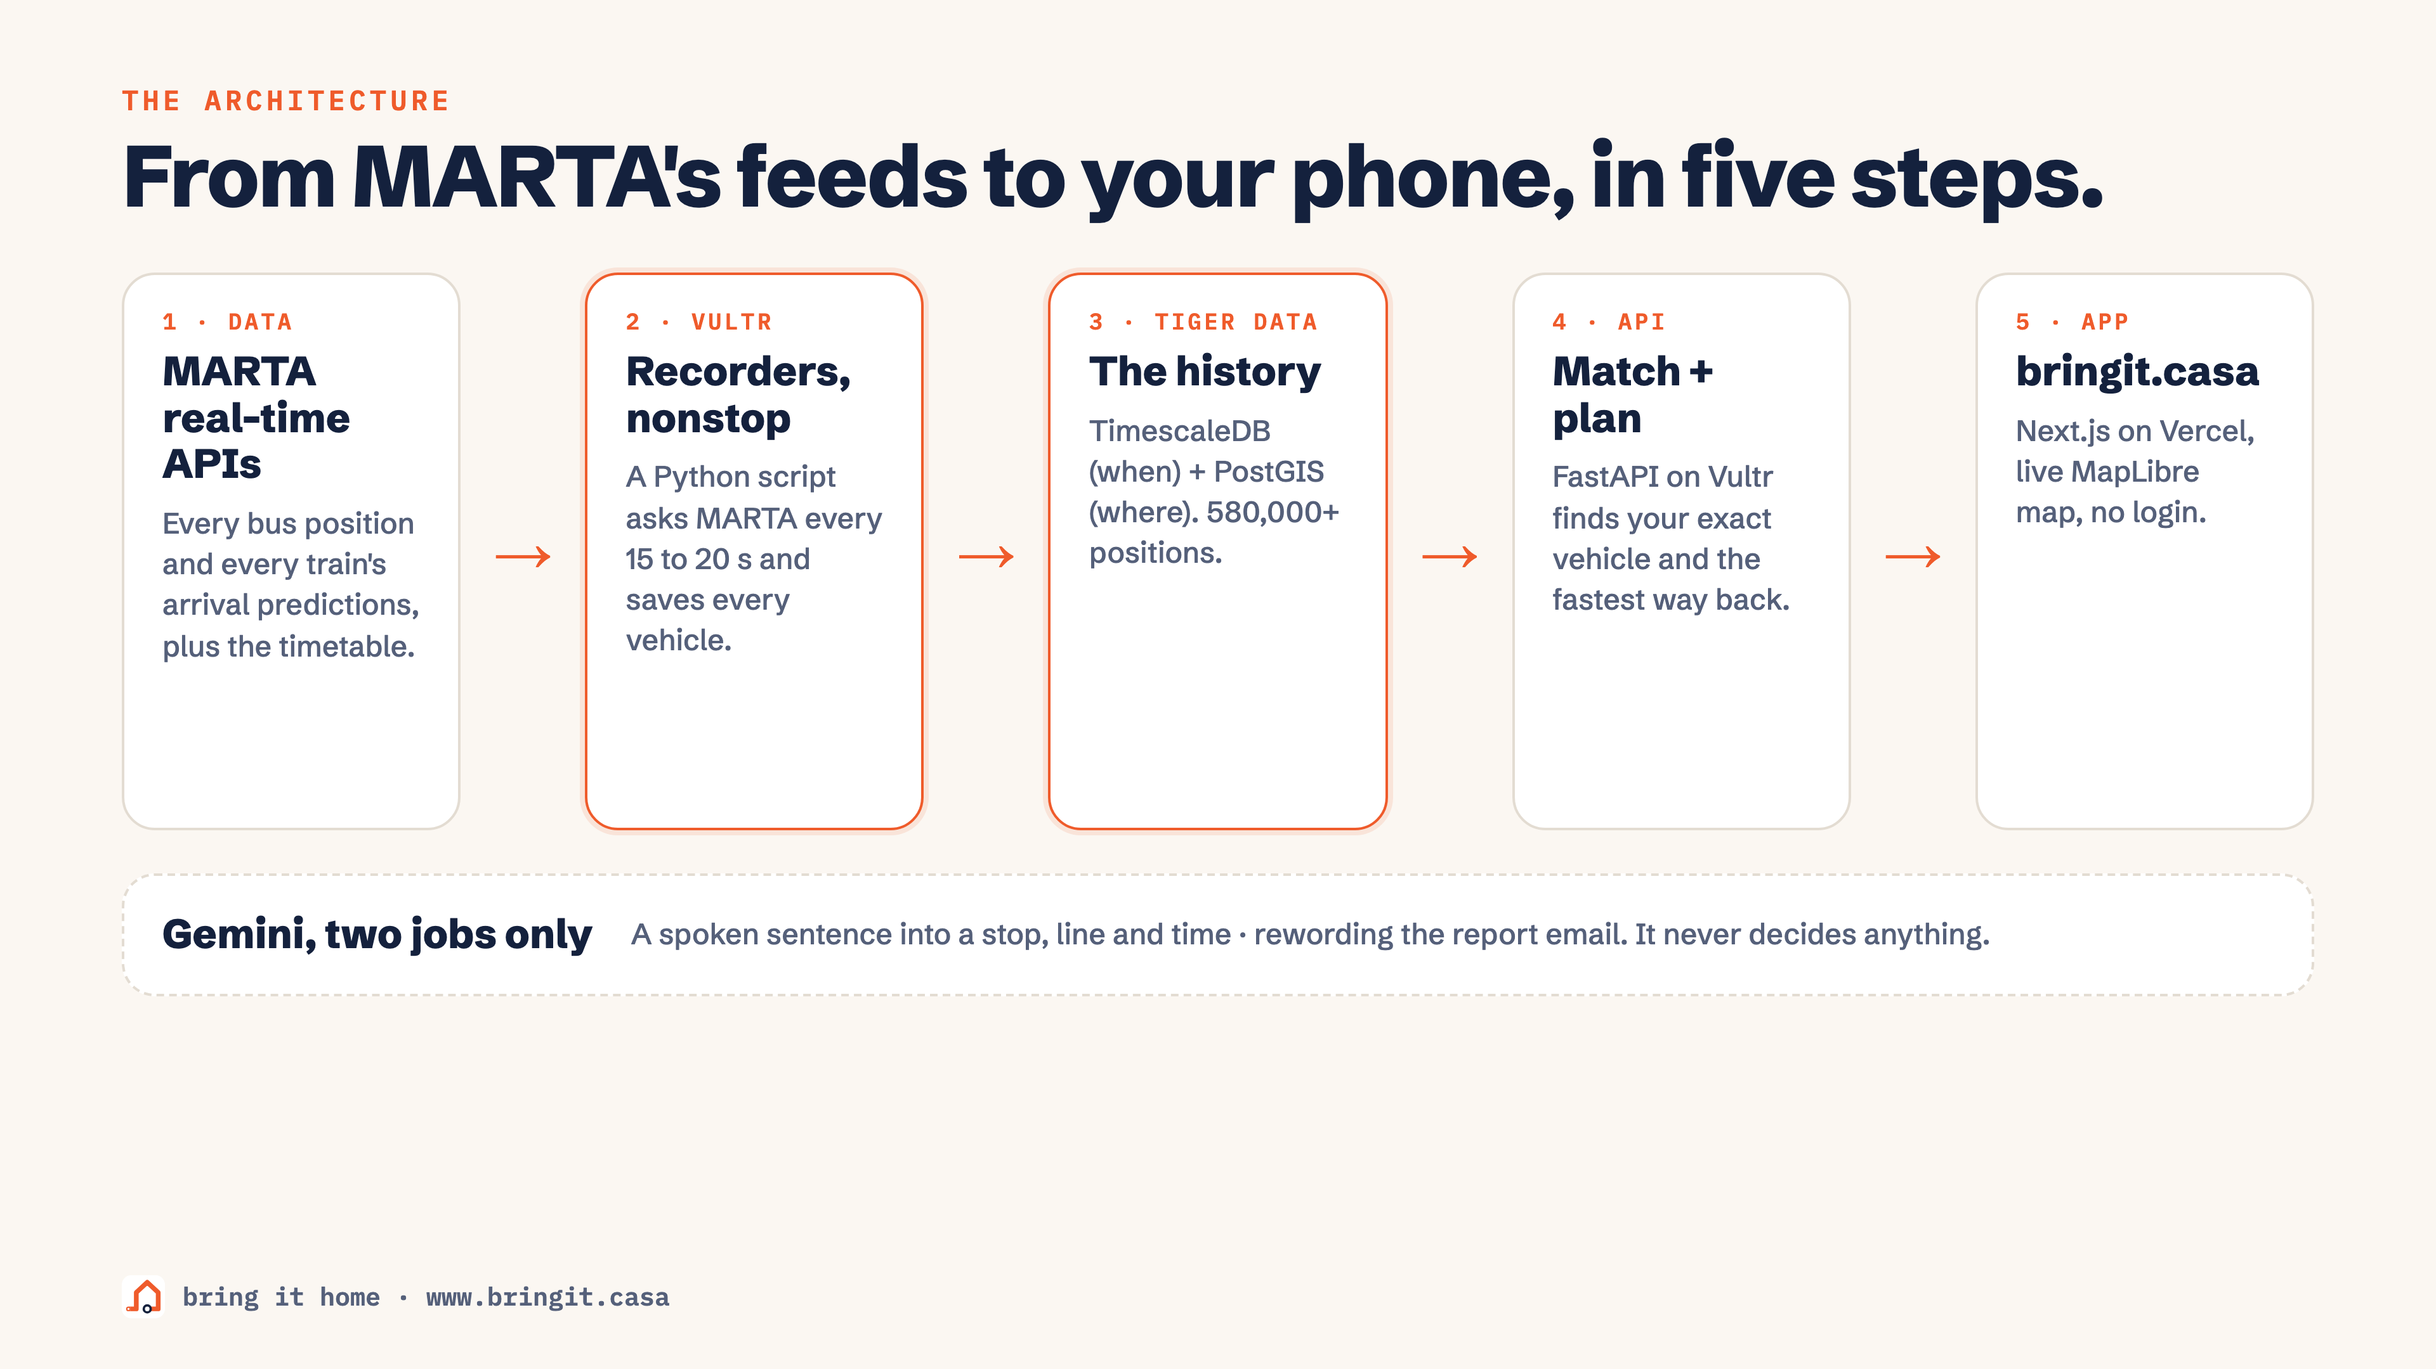
Notes:
From MARTA's feeds to your phone: MARTA real-time APIs, recorders on Vultr, Tiger Data, our API, the app. Gemini only translates.

Slide 2
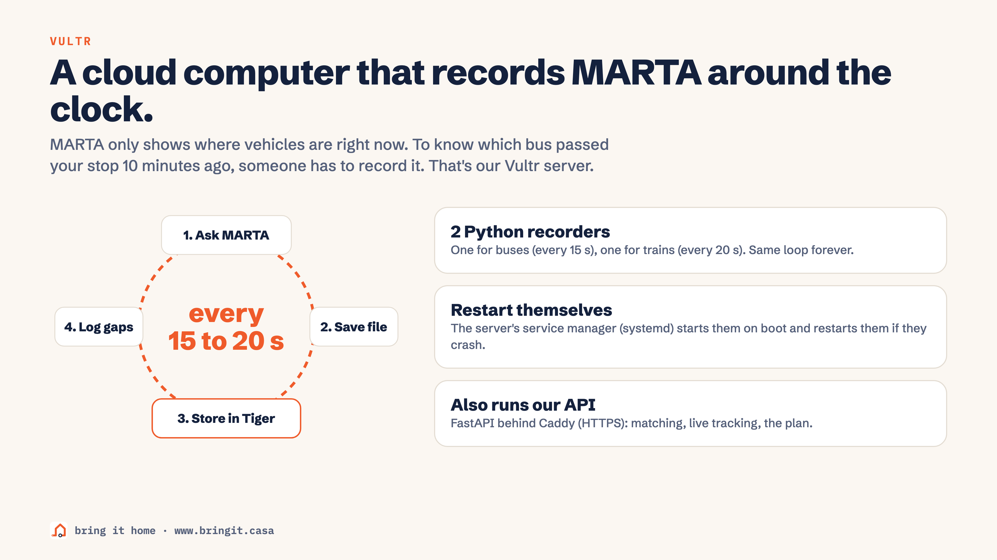
Notes:
Vultr is an always-on cloud computer. Two Python recorders ask MARTA every 15 to 20 seconds, save the file, store it in Tiger Data and log any gap. It also runs our API.

Slide 3
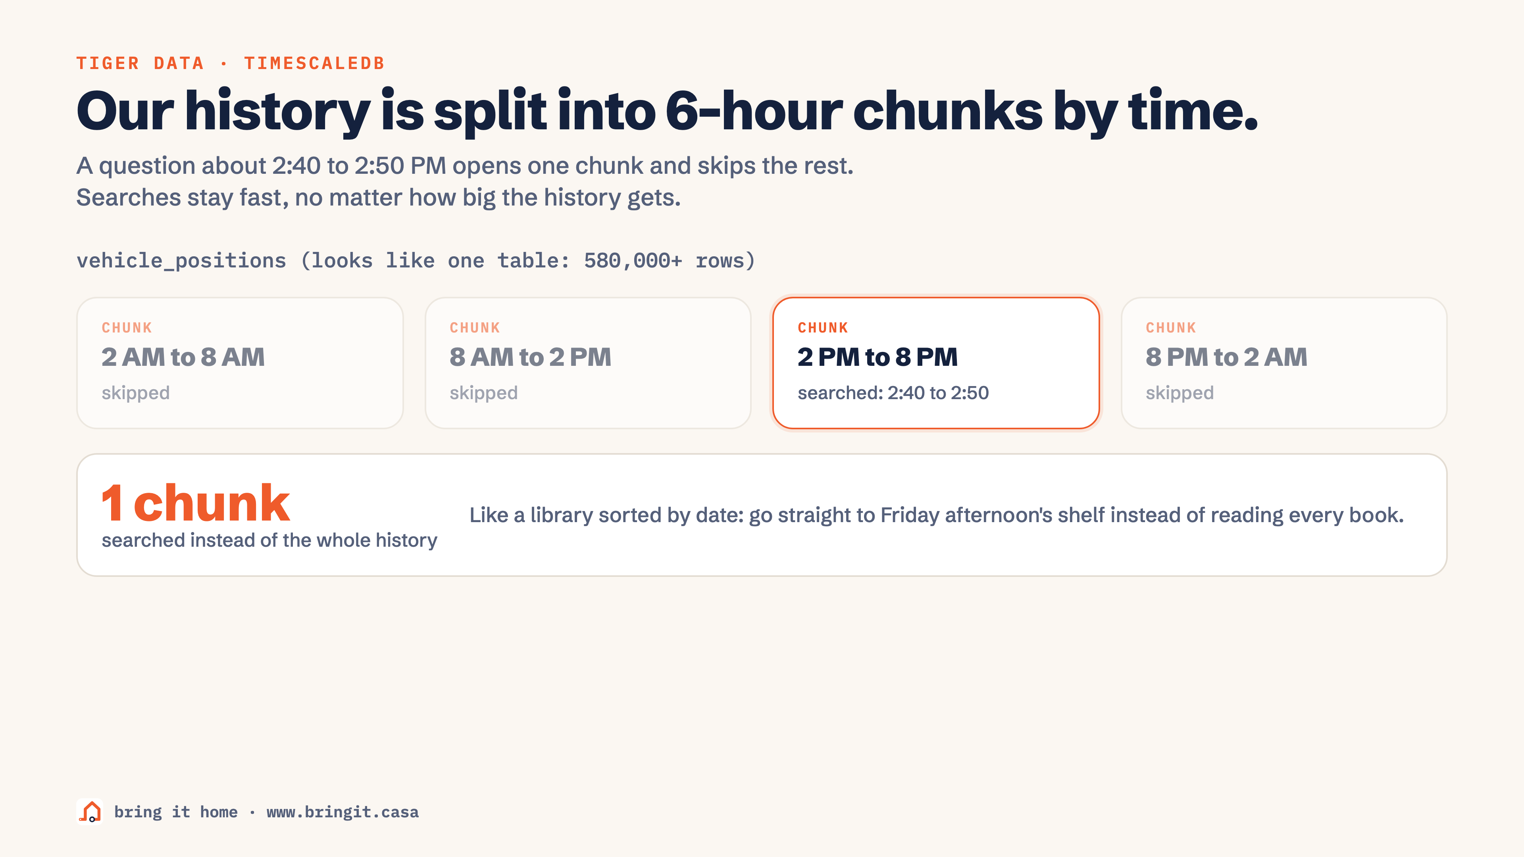
Notes:
TimescaleDB splits the history into 6-hour chunks. A question about 2:40 to 2:50 PM opens one chunk and skips the rest.

Slide 4
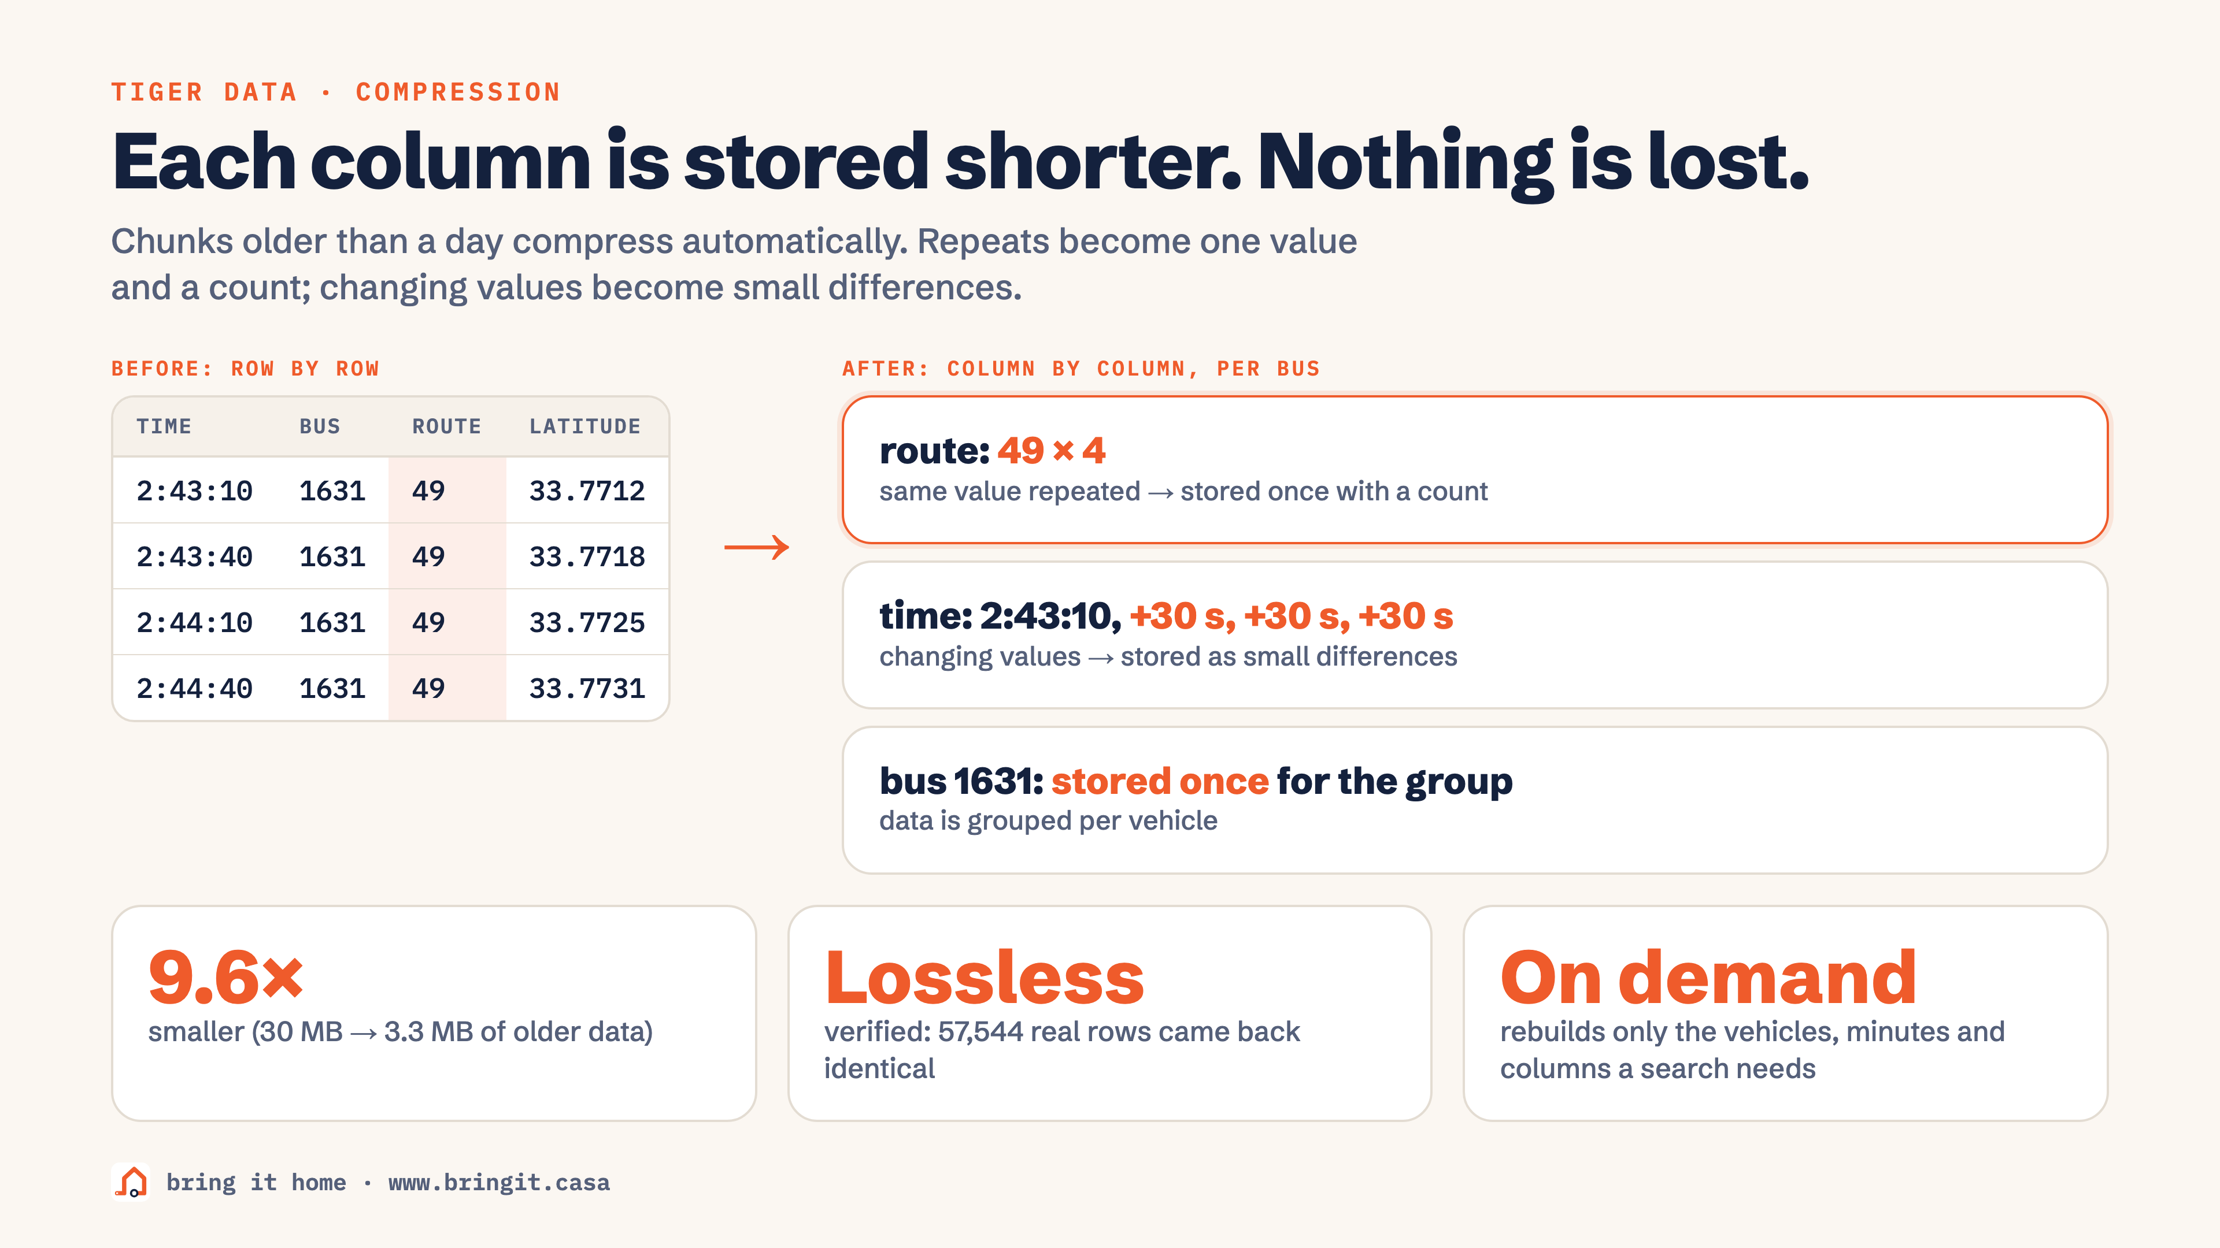
Notes:
Compression stores each column shorter: route 49 four times becomes 49 x 4, times become +30 s differences. 9.6 times smaller, lossless.

Slide 5
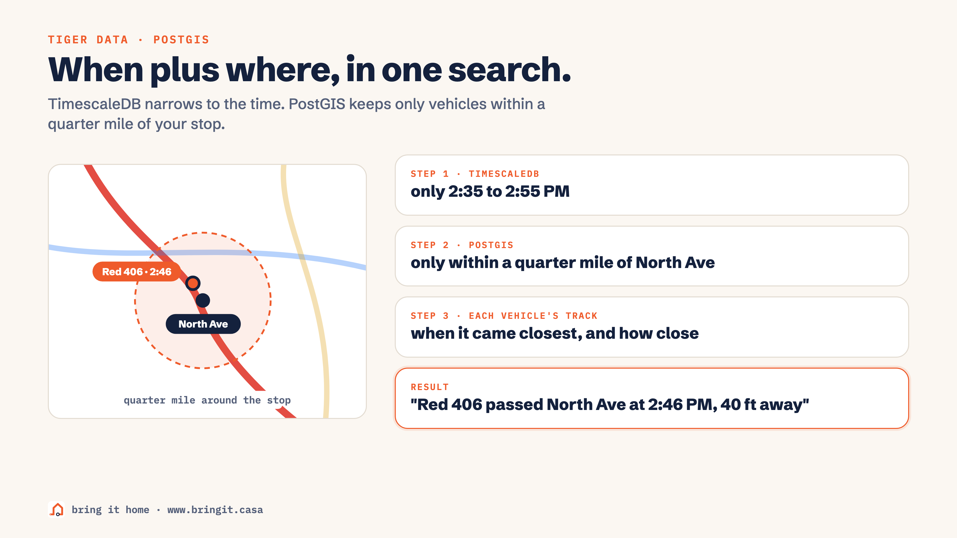
Notes:
PostGIS does the map math: keep only vehicles within a quarter mile of North Ave, then find when each came closest. Red 406 passed at 2:46, 40 ft away.

Slide 6
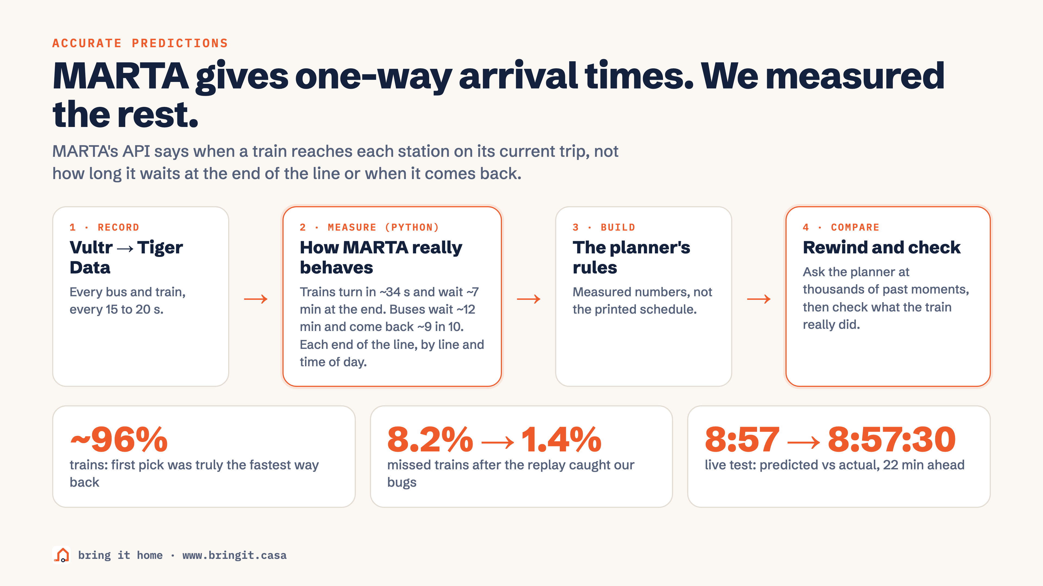
Notes:
MARTA only gives one-way arrival times. We recorded, measured how trains and buses really behave, built the planner on it, then rewound and compared: about 96 percent.

Slide 7
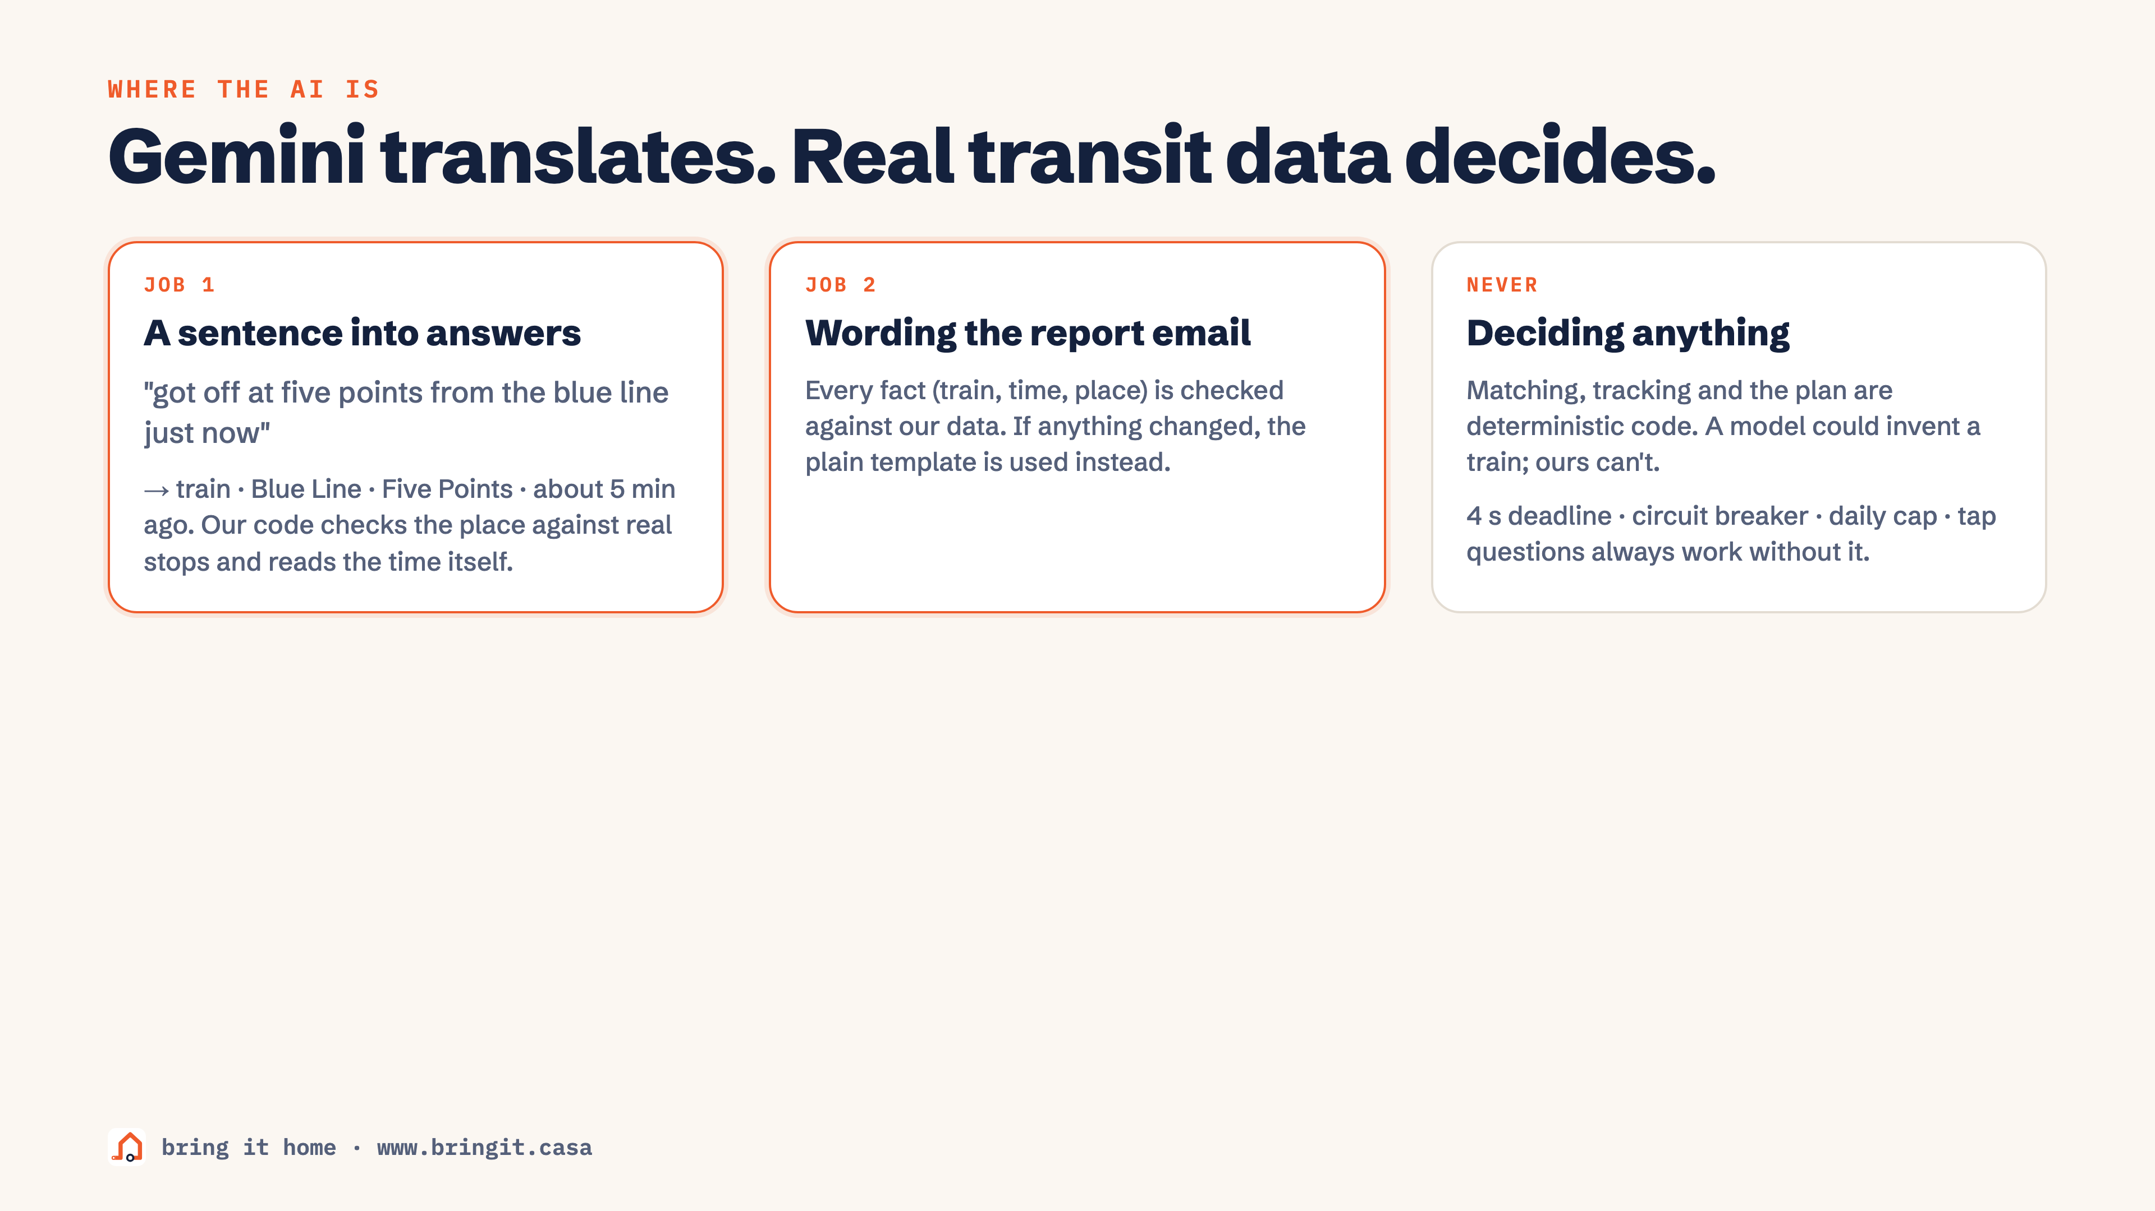
Notes:
Gemini has two jobs: a sentence into answers, and wording the report email. It never decides anything.

