Slide 1
Data Warehousing Final ETL Project
Customer, Item, and Order Tables Transformation
Shohruz Junaidov, Christian Keener, Marzook mansoor, roshan rai

Slide 2
Agenda
Project Overview
ETL Plan and Workflows
Transformations
Delta Load
Test Results
Things We Learned
Conclusion

Slide 3
Project Overview
The project focuses on managing and transforming data using both PgAdmin4 and Pentaho Spoon in a structured ETL (Extract, Transform, Load) process. The aim was to facilitate seamless data migration from raw datasets into the core layer of a PostgreSQL database, ensuring that the data is appropriately cleaned, transformed, and stored for downstream analysis or reporting.
The task was divided into distinct phases:
Initial Data Acquisition and Schema Setup: Using PgAdmin4 to create tables in the public schema and migrate raw data into the database.
Transformation and Data Loading: Utilizing Pentaho Spoon to transform the data and load it into the core schema, ensuring that the data structure aligns with business requirements.

Slide 4
ETL Plan
Data extracted from CSV files into the public schema.
Data temporarily stored in the staging schema.
Transformed data then loaded into the core schema.
Extract
Transform
Load

Slide 5
Transformation Plan
Customer, item, and order

Slide 6
CUSTOMER TABLE
Workflow steps
Import Customer
Transform Customer
Staging Customer
SetLastLoadCustomer
GetLastLoadCustomer
Check Core for data load

Slide 7
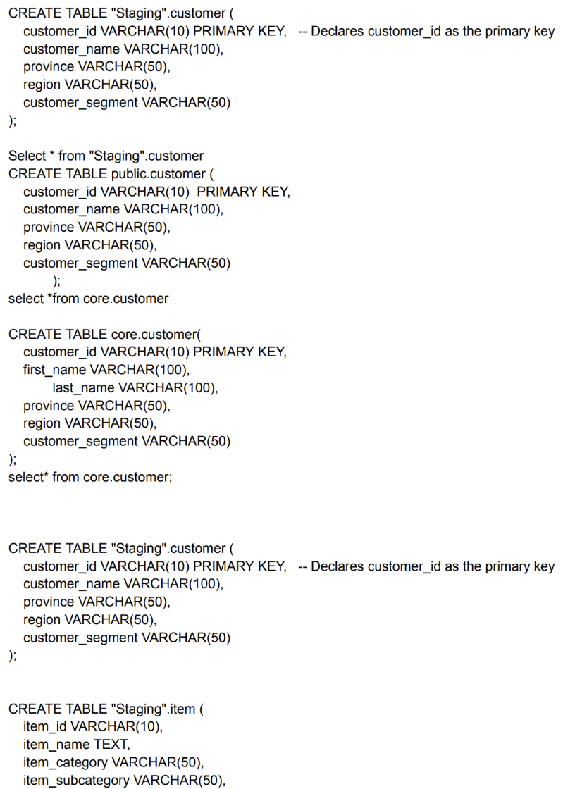
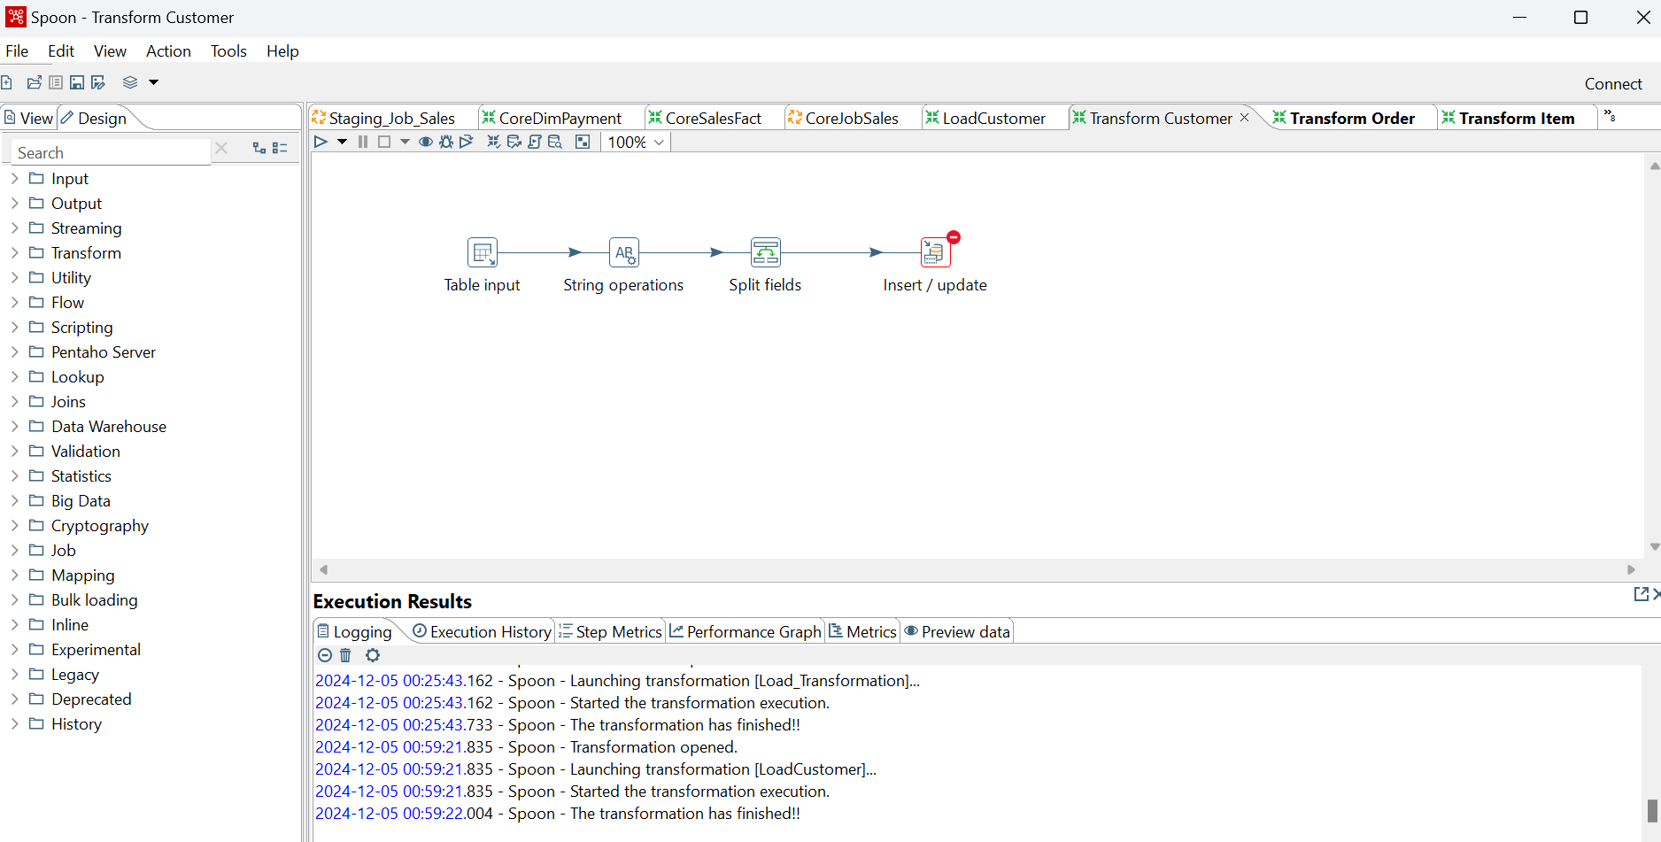
CUSTOMER TABLE
Public Schema
Workflow

Slide 8
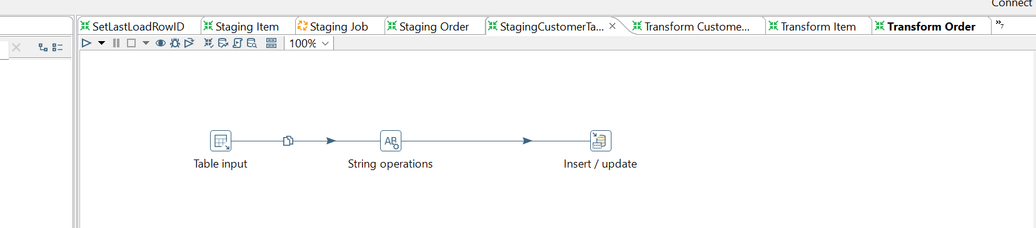
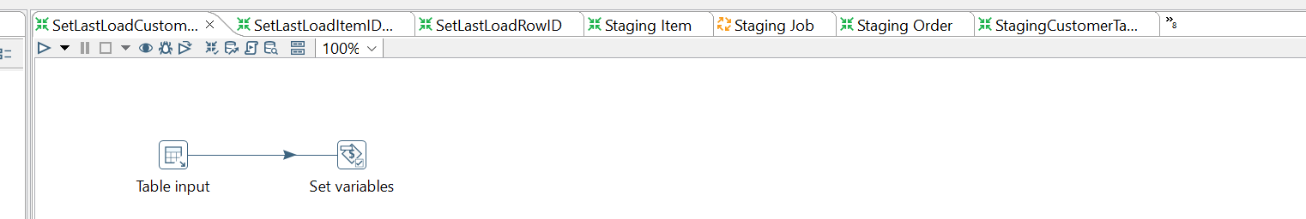
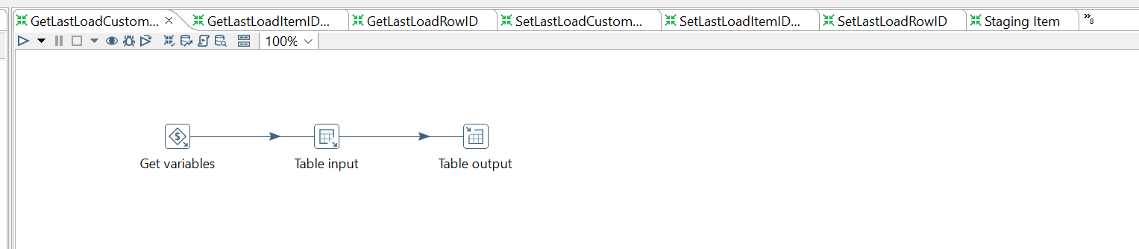
WORKFLOW

Slide 9
TEST RESULTS & OBSERVATIONS
Item names must be unique, as they serve as a key identifier during the order transformation process.
Data must be clean and free of duplicates.
The correct insertion order is: customer, followed by order, then item.

Slide 10
What We Learned Throughout the Course:
ETL and ELT
ETL Tools
Data modeling
Data warehousing principles
Fact Tables

Slide 11
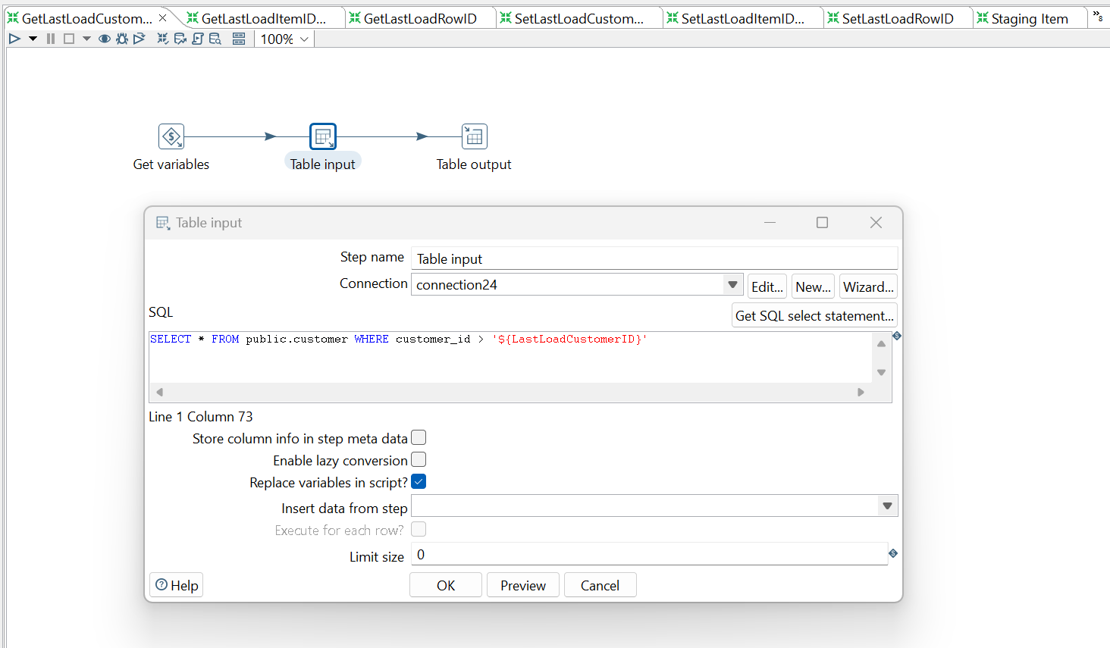
DELTA LOAD

Slide 12
LIVE DEMONSTRATION

Slide 13
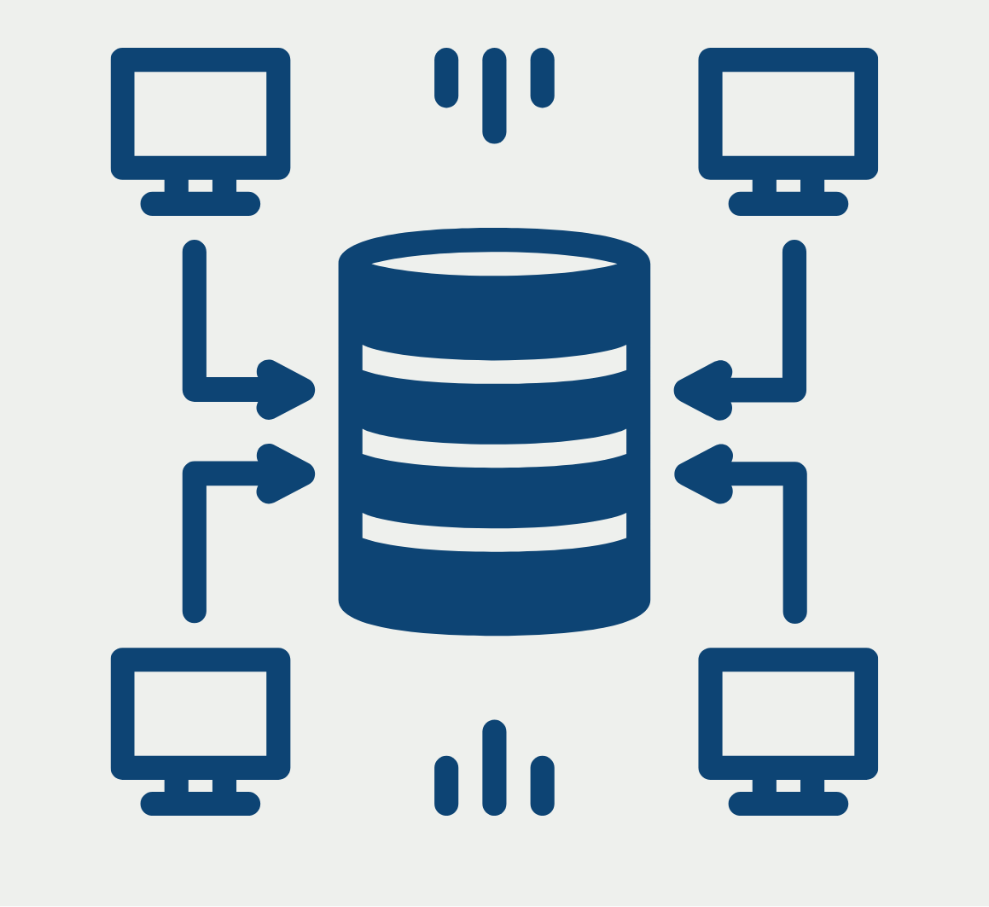
CONCLUSION
Thank you so much! Any questions?

