Slide 1
Autograding of C programming Assignments
Roshan Vasu Muddaluru
Sharvaani Ravikumar Thoguluva
Shruti P
Yogeshwar Nitin Kulkarni

Slide 2
Initial Dataset vs New Dataset
Columns taken into consideration for initial dataset:
Code_with_Errors - Feature
Marks_awarded - Target
Columns taken into consideration for new dataset:
Question - Feature
Code_with_Errors - Feature
Marks_awarded - Target

Slide 3
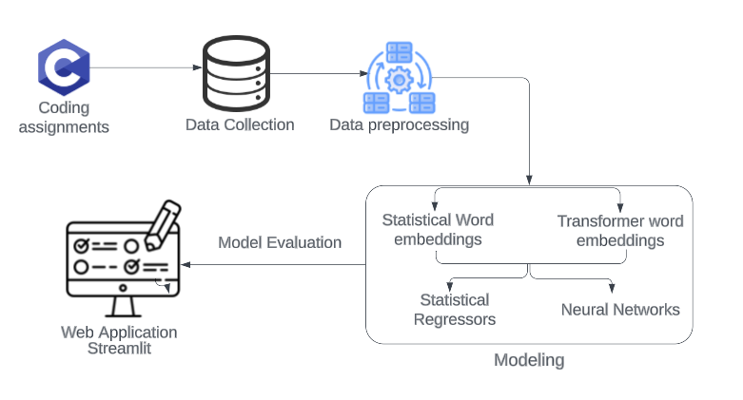
System Architecture

Slide 4
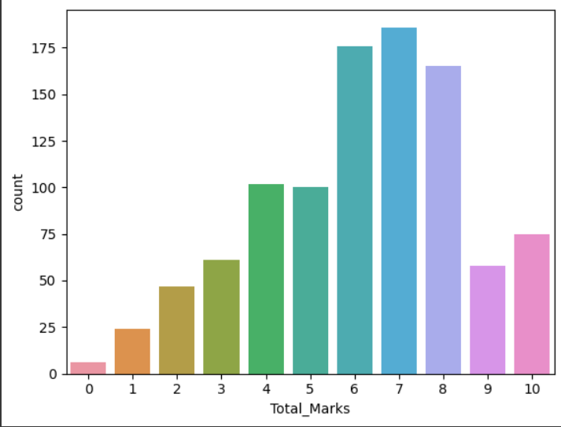
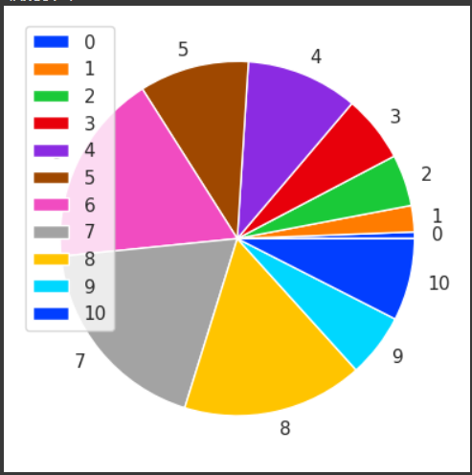
Data Visualization

Slide 5
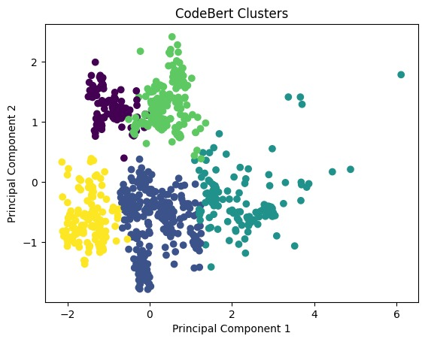
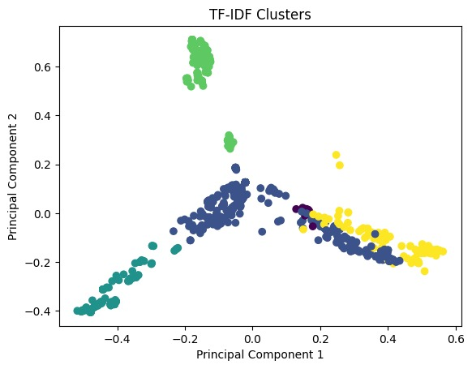
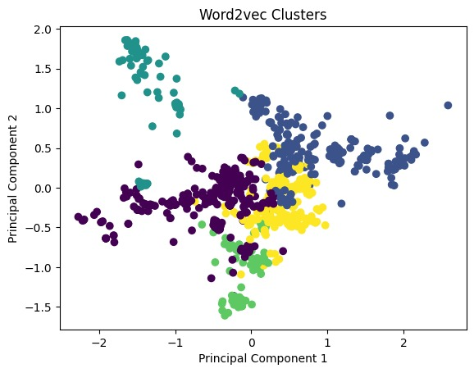
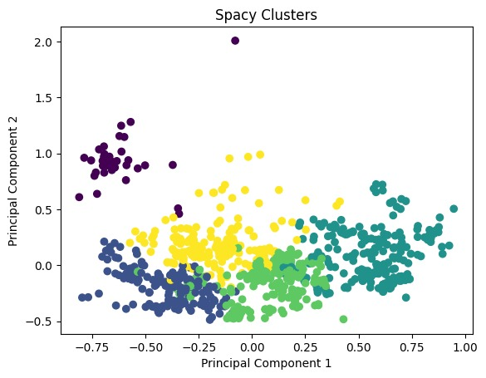
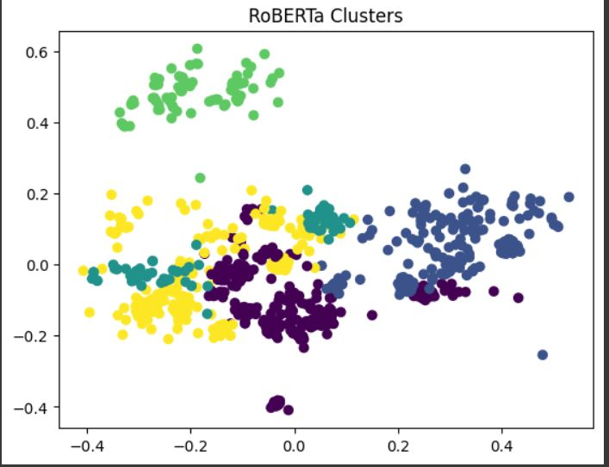
Clusters formed by the vectors of text embedding models

Slide 6
Spacy
Name | Train RMSE | Train MAE | Train R2 | Test RMSE | Test MAE | Test R2
CatBoost | 0.52 | 0.11 | 0.94 | 1.96 | 1.45 | 0.26
RidgeCV | 1.85 | 1.43 | 0.29 | 2.13 | 1.59 | 0.14
HistGradBoost | 0.59 | 0.28 | 0.92 | 1.90 | 1.40 | 0.32
ExtraTreesRegressor | 0.52 | 0.09 | 0.94 | 1.91 | 1.41 | 0.31
RandomForestRegressor | 0.85 | 0.57 | 0.85 | 1.94 | 1.45 | 0.29
LSTM | 2.04 | 1.62 | 0.13 | 2.29 | 1.76 | 0.009

Slide 7
CodeBERT
Name | Train RMSE | Train MAE | Train R2 | Test RMSE | Test MAE | Test R2
LSTM + RidgeCV | 1.79 | 1.37 | 0.336 | 1.87 | 1.44 | 0.33
LSTM + LGBM | 0.65 | 0.34 | 0.91 | 2.03 | 1.47 | 0.22
LSTM + CatBoost | 0.33 | 0.39 | 0.91 | 1.96 | 1.43 | 0.26
Gradient Boost | 0.886 | 0.65 | 0.83 | 1.93 | 1.45 | 0.29
LGBM | 0.55 | 0.19 | 0.93 | 1.95 | 1.39 | 0.27
Catboost | 0.56 | 0.26 | 0.93 | 1.92 | 1.39 | 0.30
RidgeCV | 1.61 | 1.23 | 0.45 | 1.89 | 1.45 | 0.31

Slide 8
RoBERTa
Name | Train RMSE | Train MAE | Train R2 | Test RMSE | Test MAE | Test R2
CatBoost | 0.56 | 0.26 | 0.93 | 1.85 | 1.39 | 0.35
RidgeCV | 1.62 | 1.25 | 0.45 | 1.93 | 1.47 | 0.29
XGBoost | 0.55 | 0.19 | 0.93 | 1.89 | 1.41 | 0.32
ExtraTreesRegressor | 0.52 | 0.09 | 0.94 | 1.88 | 1.39 | 0.33
RandomForestRegressor | 0.83 | 0.55 | 0.85 | 1.90 | 1.41 | 0.31
LSTM | 2.08 | 1.65 | 0.10 | 2.19 | 1.73 | 0.09
LSTM + Cat | 0.70 | 0.46 | 0.89 | 2.04 | 1.54 | 0.21
LSTM + LGBM | 0.73 | 0.40 | 0.88 | 2.0 | 1.58 | 0.16
LSTM + Ridge | 1.84 | 1.4 | 0.29 | 2.01 | 1.55 | 0.23

Slide 9
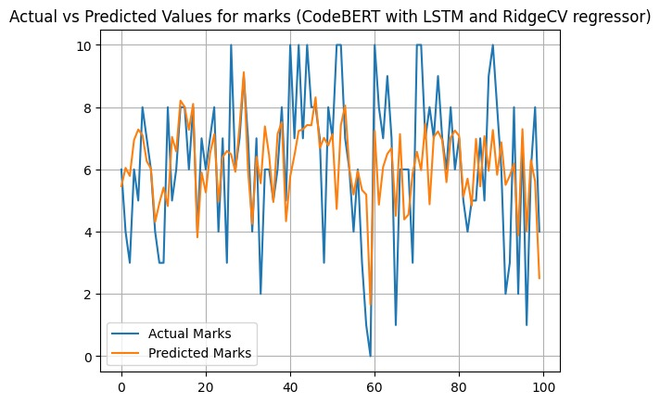
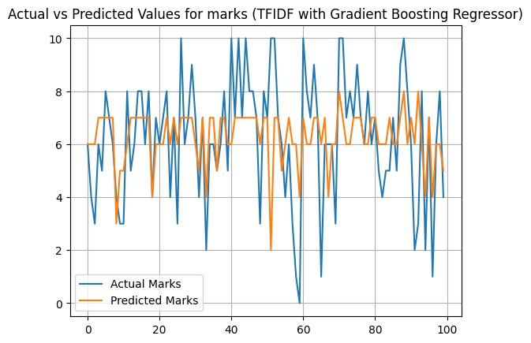
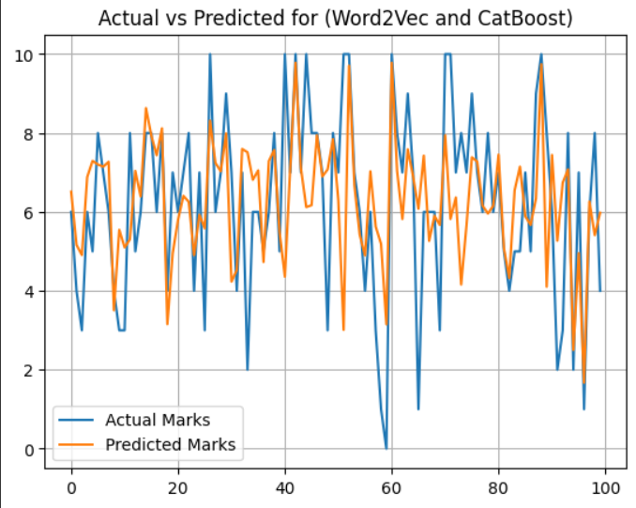
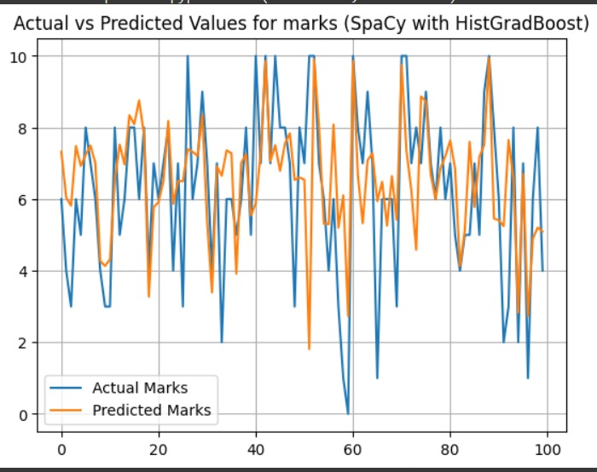
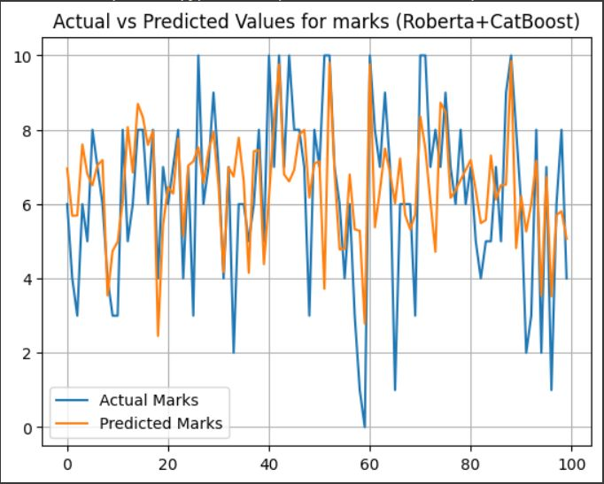
Actual vs Predicted for the best models

Slide 10
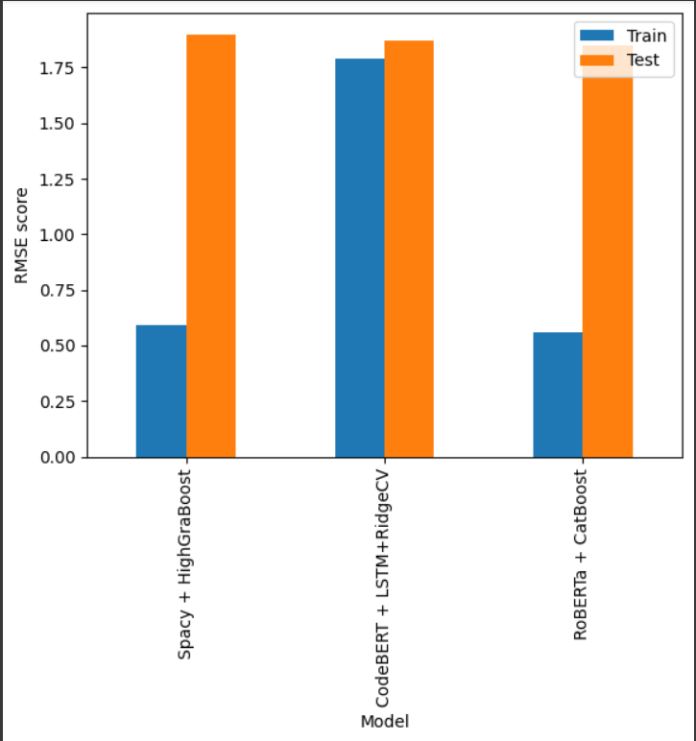
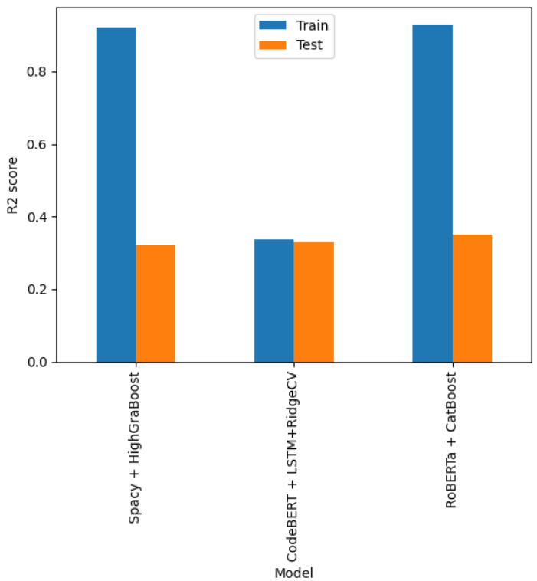
RMSE & R2 Plots for Top 3 Models
RMSE
R2

Slide 11
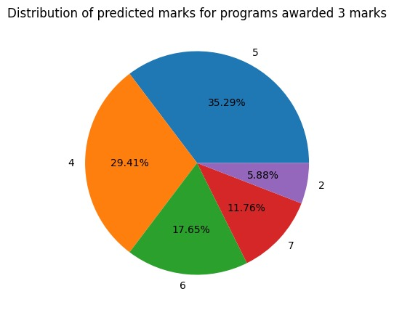
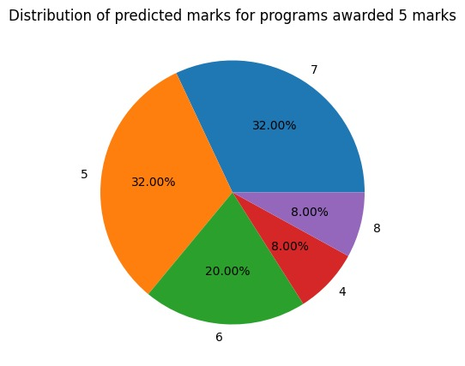
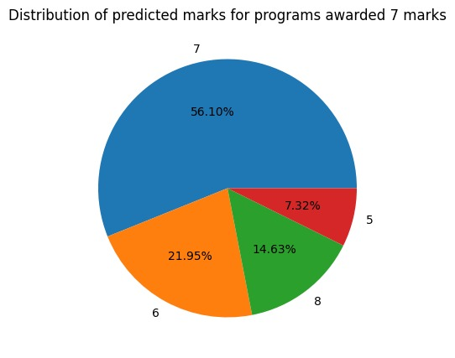
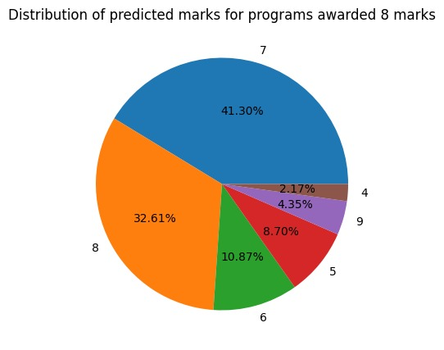
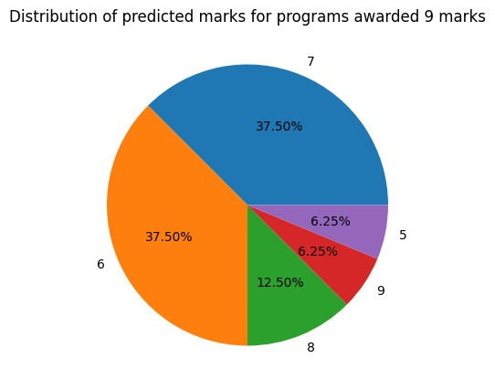
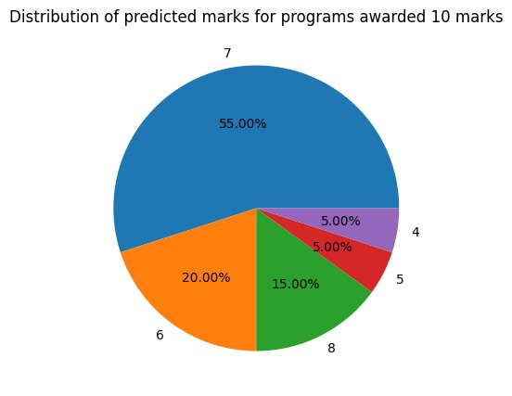
Predicted results

Slide 12
Thank You

