Slide 1
Qualtrics Competition (UT Dallas-Business School)
These results were presented to senior management and head of data governance of Qualtrics. It was awarded Second Place out of 125 participants.

Slide 2
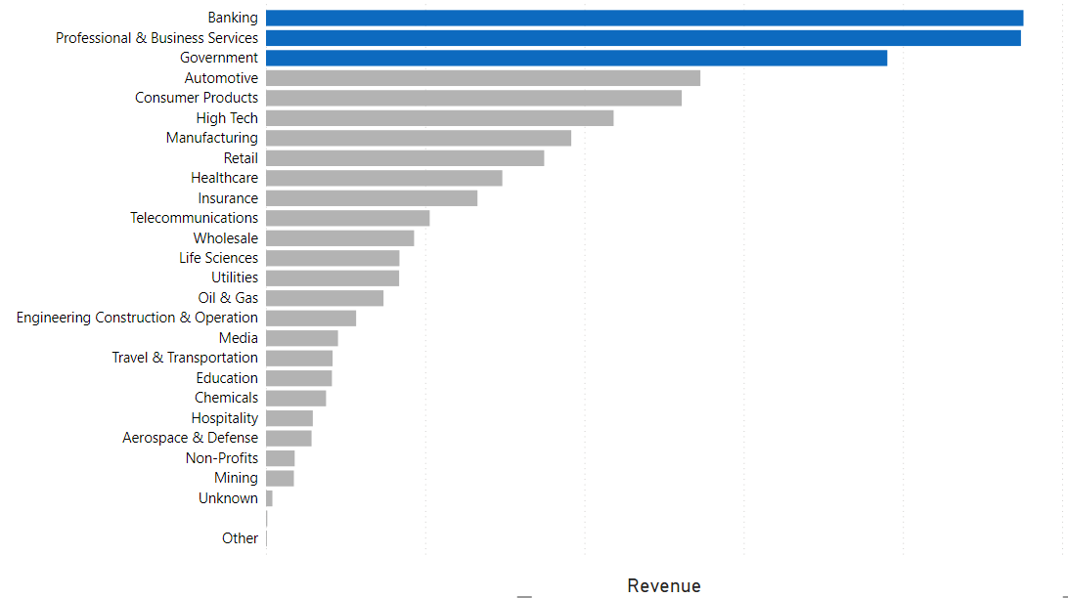
Top sectors that are contributing to revenue.
We can group industries by the revenue they are generating for Qualtrics.
Here we have identified Banking , Professional and Business Services and
Government as top 3 sectors to analyze their data over time.

Slide 3
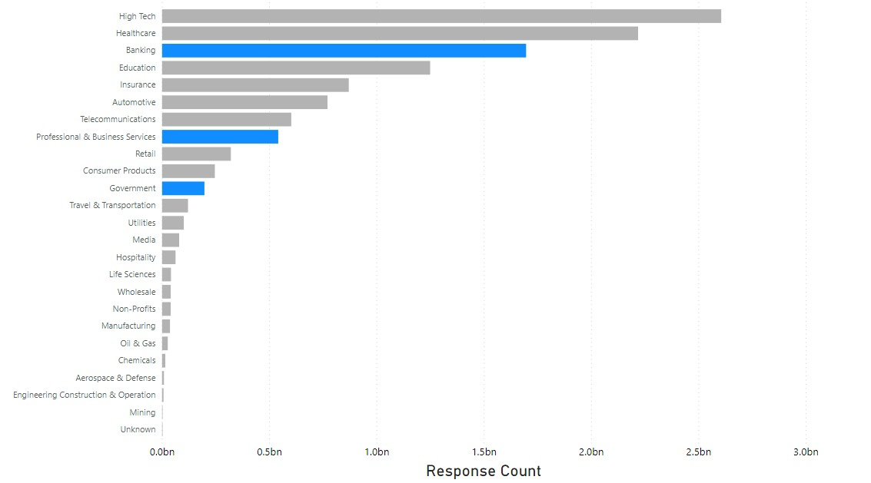
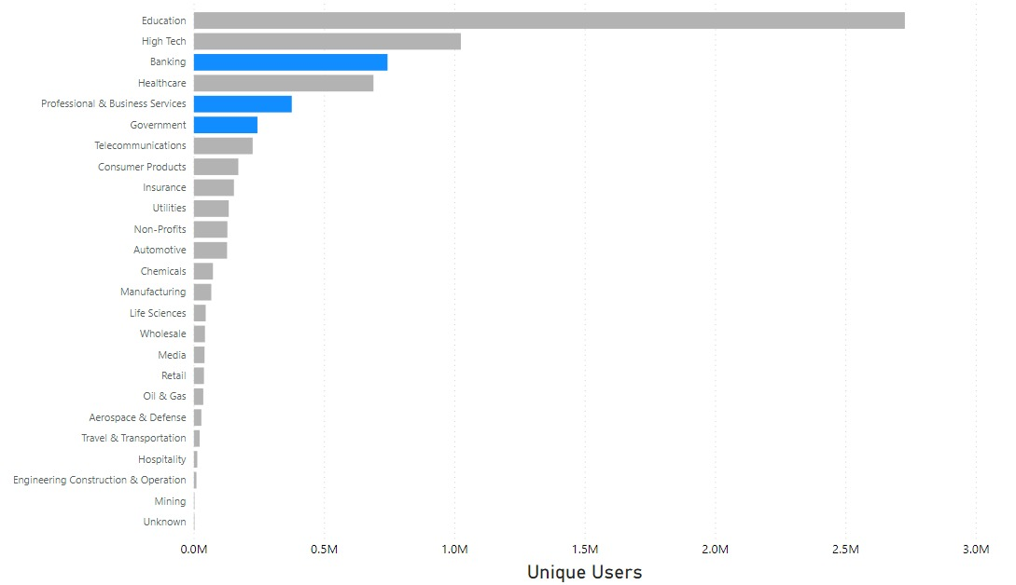
Unique Users and Response count by industry
Top Industries as per revenue are not the ones with most users logging in or ones with most number of responses to their surveys.

Slide 4
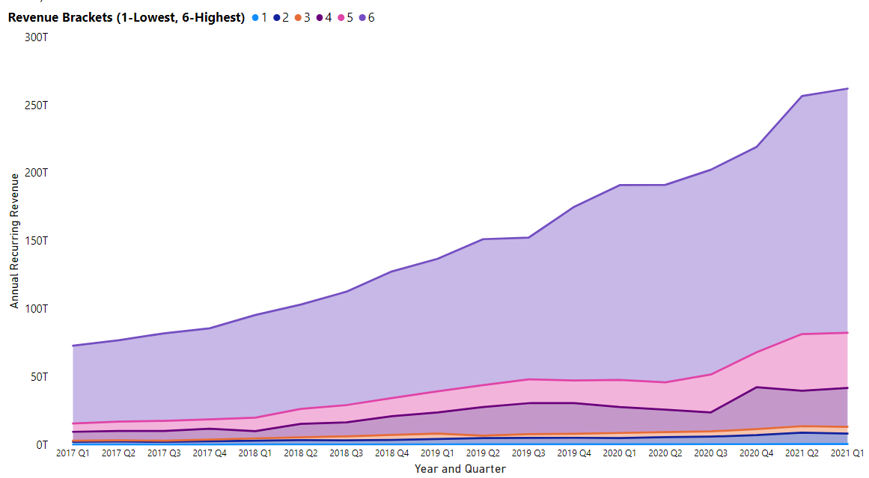
Identifying the Platinum Clients.
Platinum Clients : 80 % of total ARR belongs to companies in bracket 6.
Potential Platinum Clients : Brackets 4 and 5.

Slide 5
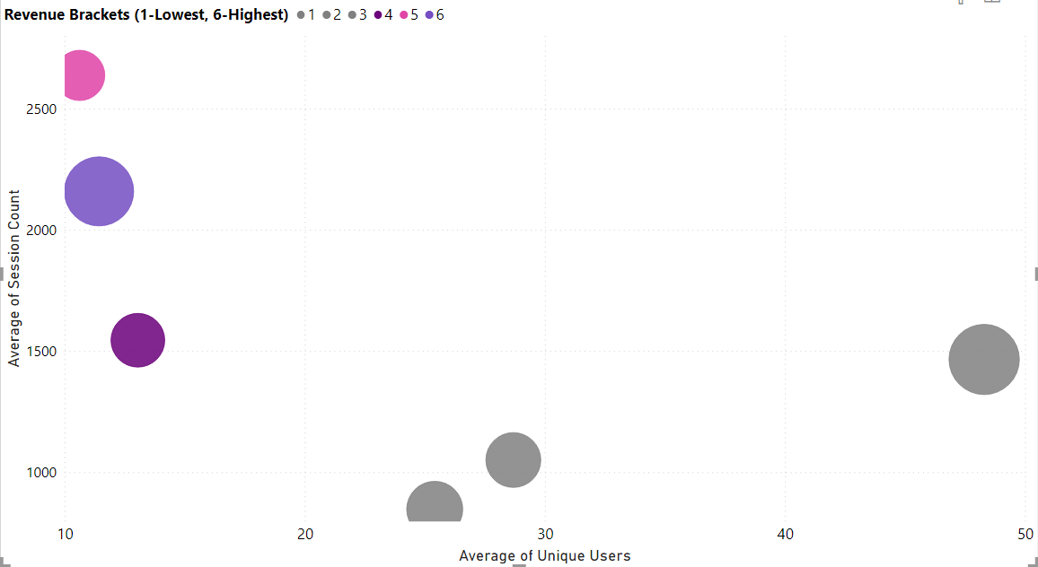
Behavior of Platinum and Potential Platinum clients.
1. Platinum and potential platinum clients have dedicated employees
to create and analyze projects on Qualtrics.
2. While other clients might have a lot of different employees
in various teams logging into Qualtrics data.
(Size of the bubble indicates number of accounts in that group)

Slide 6
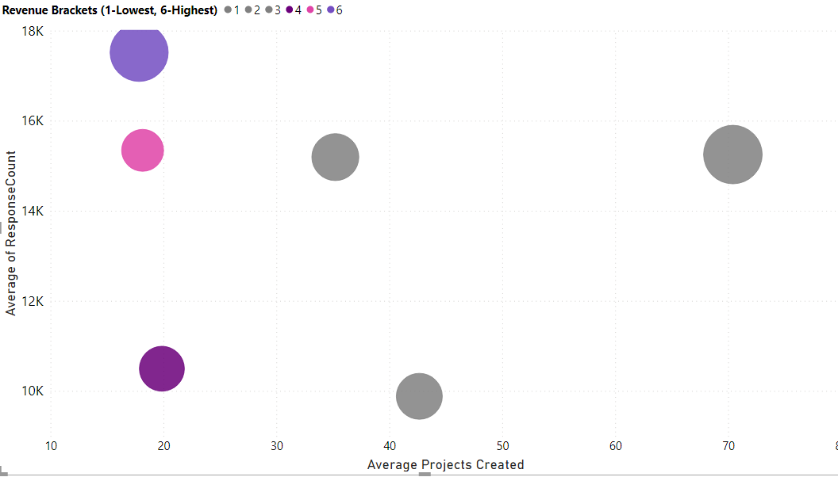
Behavior of Platinum and Potential Platinum clients.
Platinum clients create very few projects as compared to other brackets and have more responses than other brackets.

Slide 7
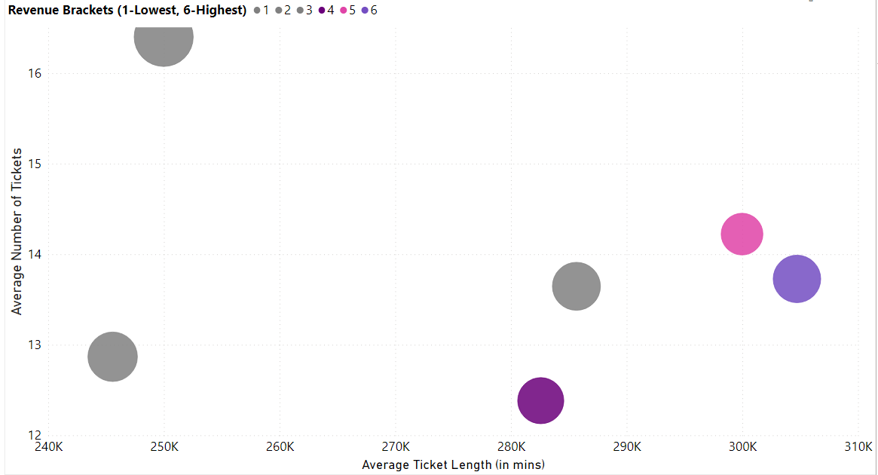
Prioritizing Support Requests of Platinum Clients
The average ticket length for support issues raised by platinum clients is very high.
In order to increase NPS score of most valuable clients we will have to prioritize support issues as per the revenue bracket of the company.

Slide 8
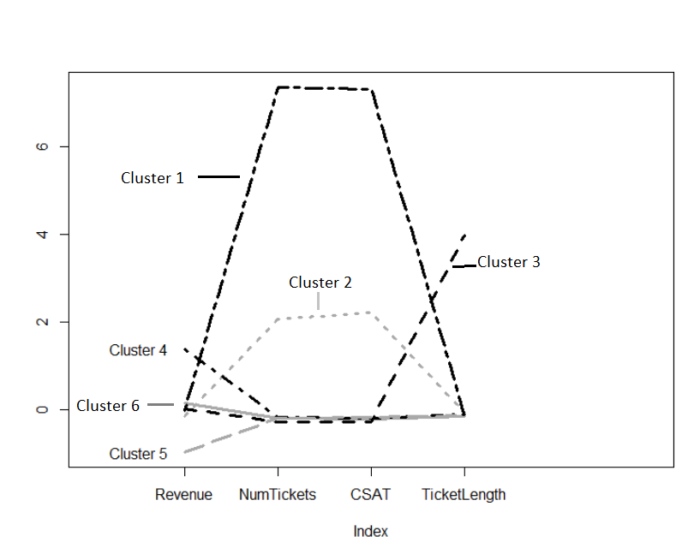
Clustering Analysis of the Support Data
Cluster 4 has high revenue accounts but it has same average ticket length as cluster 2,
in spite of having a fraction of support requests.
Cluster 3 which has similar ranking on revenue as cluster 1, encounters triple the ticket length time.
In spite of it having a fraction of support requests when compared to cluster 1.

Slide 9
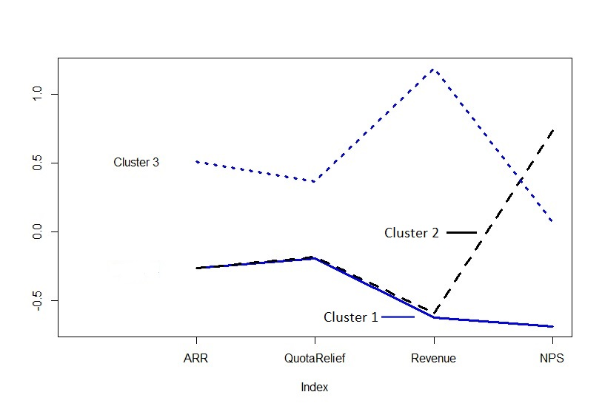
Understanding NPS and Revenue.
Cluster 1 and 2 have huge difference in NPS score in spite of having exact same ARR and Revenue bracket.
The company should focus on improving NPS of cluster 3 (Platinum clients).

Slide 10
Conclusion and Business Solutions.
By analyzing the needs of high revenue industries such as Government, Professional & Business Services, and Banking, we can increase customer retention.
We need to understand the behavior of platinum clients - low users, high session counts, low projects created, high response count
By understanding how these practices help them extract maximum benefit out of Qualtrics we can serve these most valuable clients in the best way possible.
We need to prioritize support requests for the platinum clients in order to reduce their ticket duration and increase their Net Promoter Score (NPS).

