Slide 1
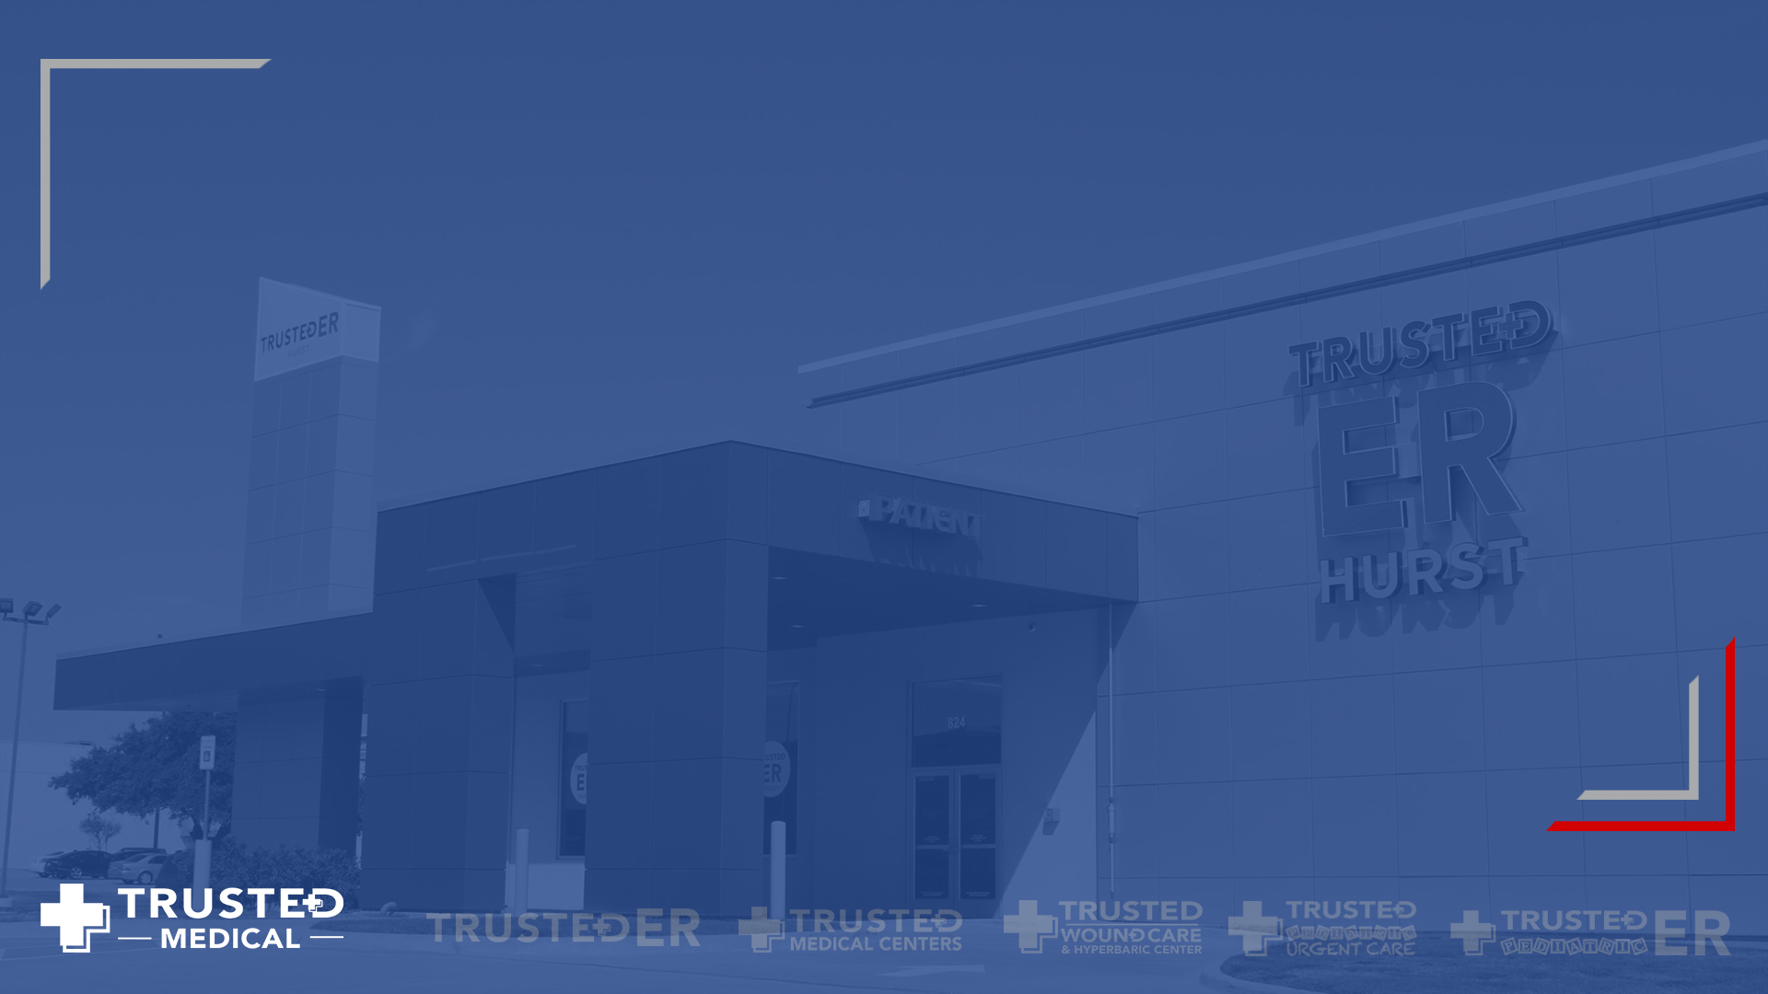
Chart Audit Tool
A tool to review patient charts and improve the process quality

Slide 2
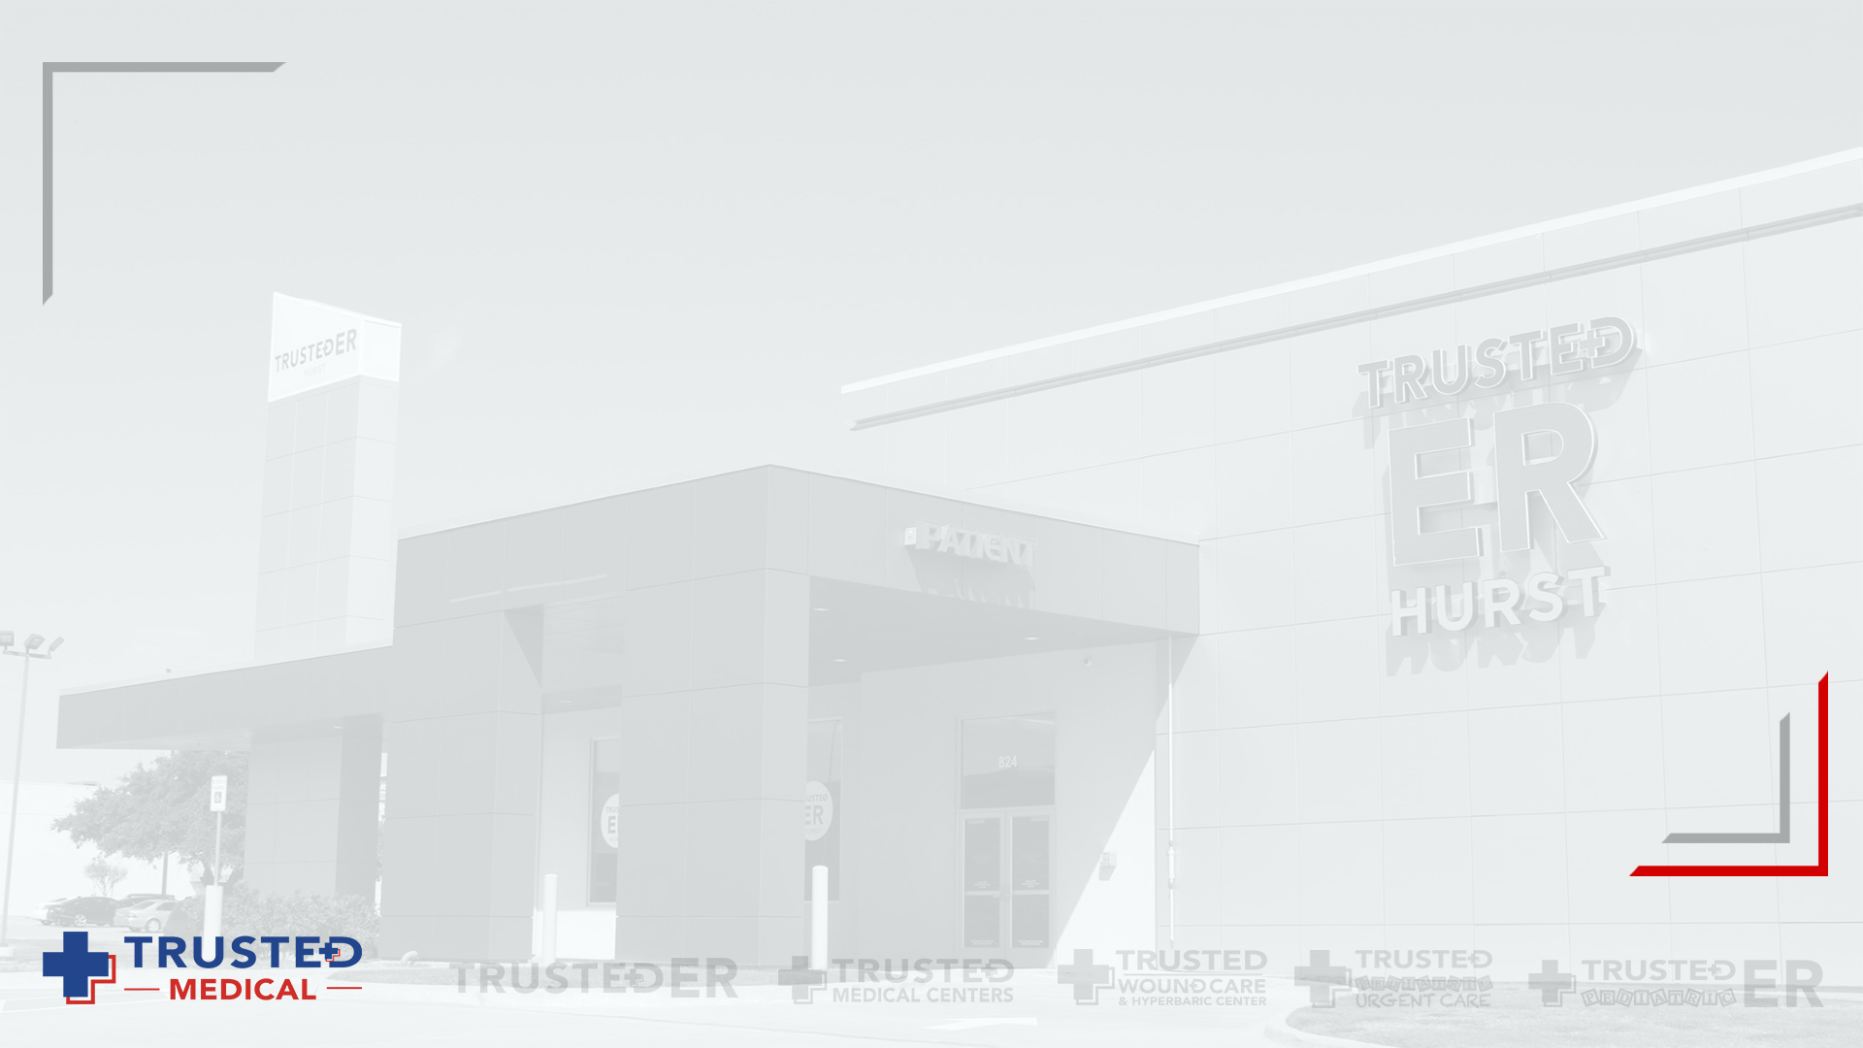
Purpose of Chart Auditing
To check performance of each department
To have a common data repository
To find areas of improvement

Slide 3
Problem Statement
Streamline the chart auditing process to make it consistent and efficient
Chart Auditing is done for the following departments:
Radiology
Nursing
Physician

Slide 4
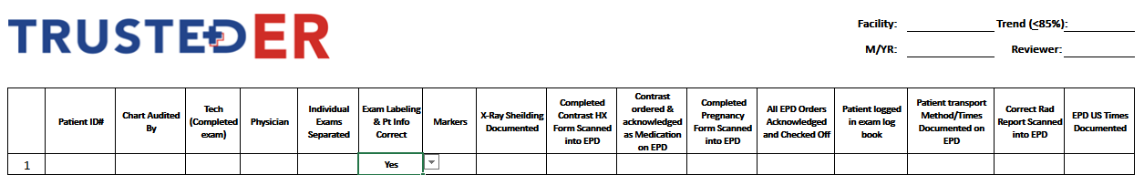
Radiology Operations
For Radiology chart audit, we are capturing the following data:
Patient ID#
Chart Audited By
Tech (Completed Exam)
Physician, etc

Slide 5
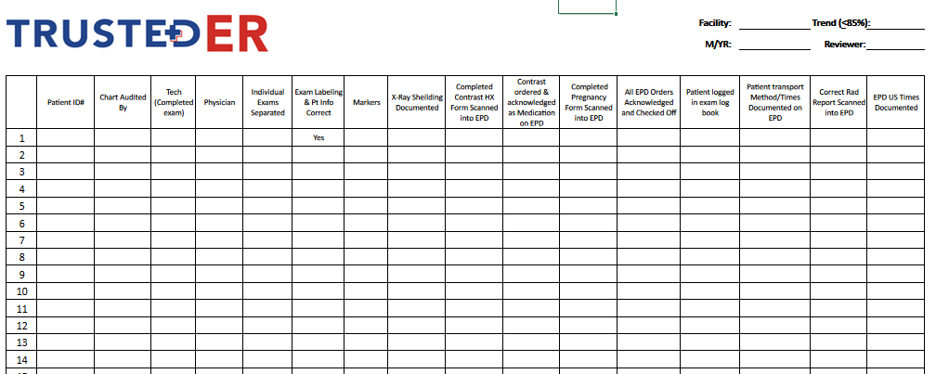
Current State - Radiology
Step 1: Fill out details in each row of the given excel sheet.

Slide 6
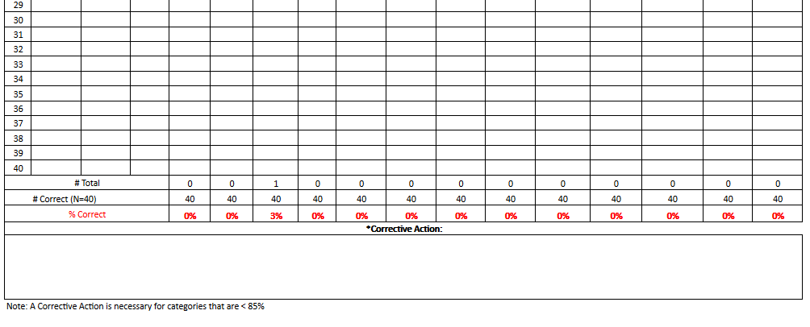
Current State - Radiology
Step 2: The number of yes/no are counted for a given column for a month and corrective action is performed based on that.

Slide 7
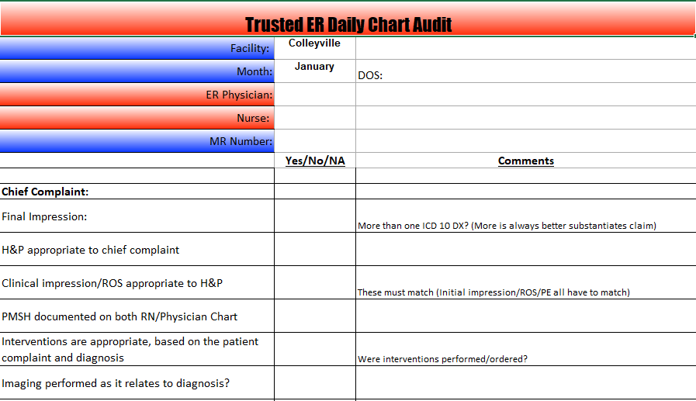
Nursing Operations – Form Fields

Slide 8
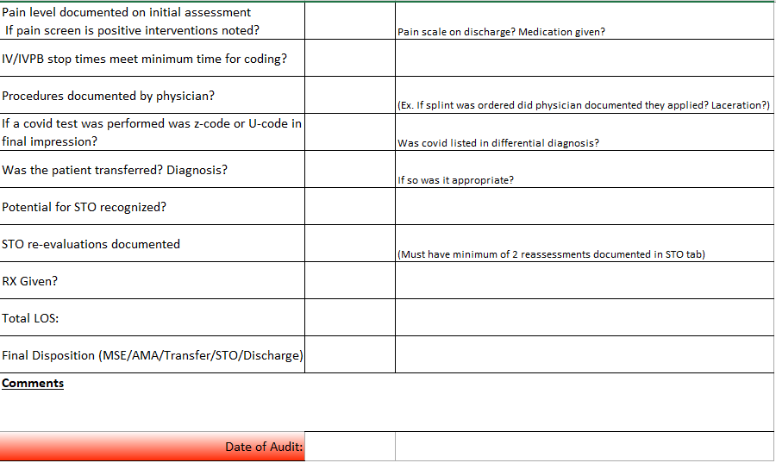
Nursing Operations – Form fields

Slide 9
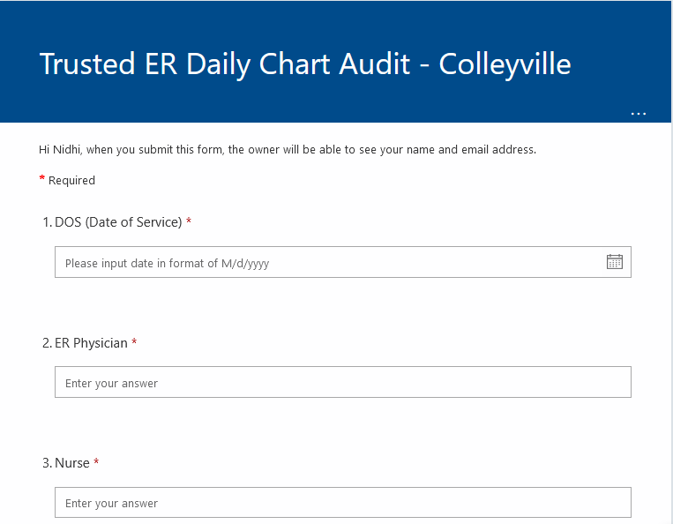
Current State – Nursing Operations
Step 1: Fill out the details in Microsoft Forms.

Slide 10
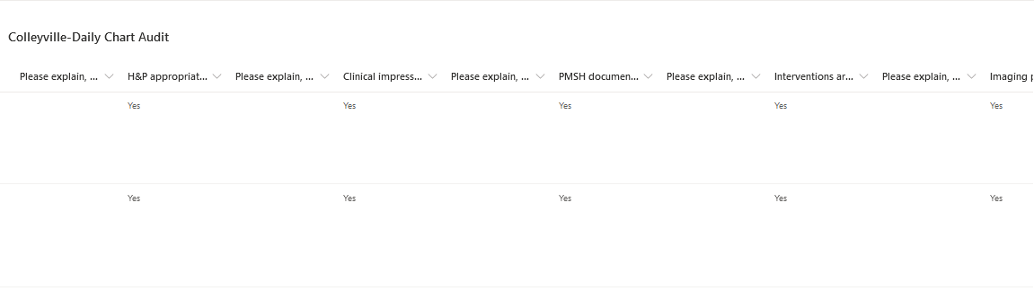
Current State – Nursing Operations
Step 2: Once the form is submitted, the data is stored in a SharePoint list (Power Automate).

Slide 11
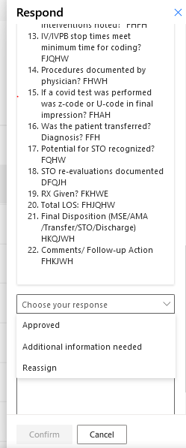
Current State – Nursing Operations
Step 3: The reviewer can review the information entered and mark it as- Approved or More Info Needed.

Slide 12
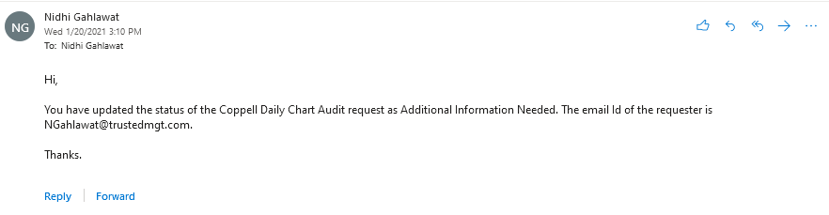
Current State – Nursing Operations
Step 4: The reviewer and the requester receives email notifications about the response of the reviewer.

Slide 13
Physician Operations
A third-party tool is currently being used by the physicians to enter operations data
The workflow is similar to the Nursing and Radiology operations; however, it has been created and maintained by an external party
Notes:
In order to manage the physician operations, a third-party tool is currently being used

Slide 14
Limitations – Current State
Low consistency due to the 3 different workflows
Difficult for the management to track and follow-up
Forms are not very user-friendly and intuitive
Existing data is not analyzed and needs visualizations/reports
Notes:
Each department has a different workflow and hence there is low consistency even though the end goal is pretty much similar

Slide 15
Future State
A single solution for all chart audits using AWS services
Improve user friendliness of the forms
Data visualization dashboard to gain valuable insights
Notes:
Each department has a different workflow and hence there is low consistency even though the end goal is pretty much similar

Slide 16
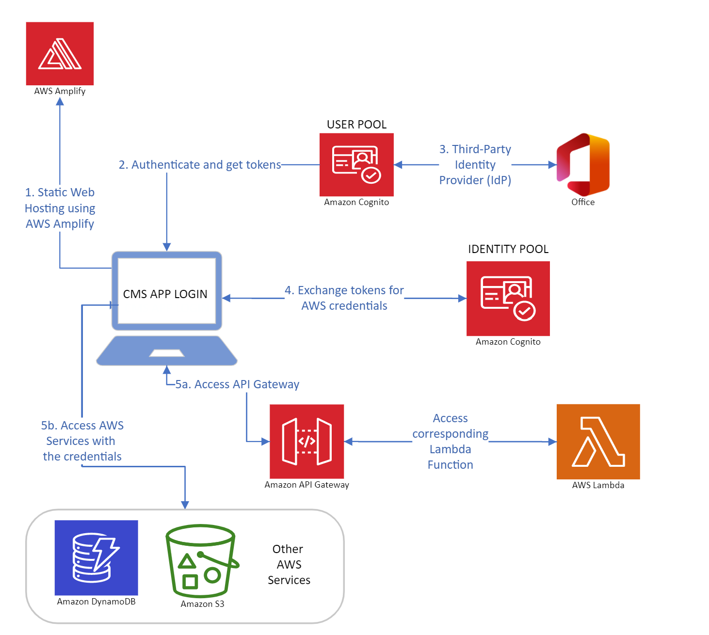
Complaints and Issue Management

Slide 17
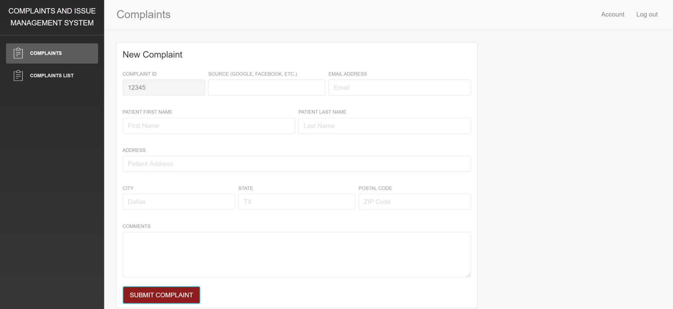
Future State

Slide 18
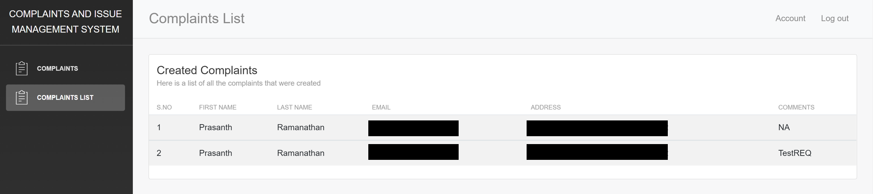
Future State

Slide 19
Summary
Trusted Medical’s Physician, Radiology and Nursing operations are currently being carried out as three different processes across varying platforms. An ideal solution would to be to provide a single application that includes all the processes hosted on AWS. This would satisfy Trusted Medical’s vision of gradually moving all their operations on cloud.

Slide 20
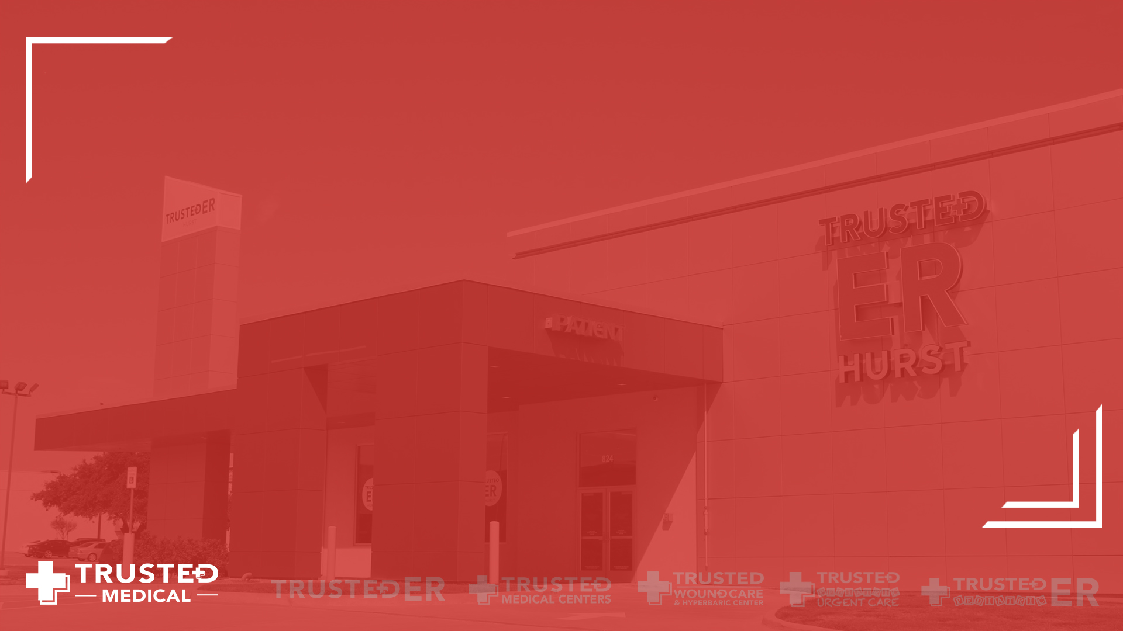
Thank You!

