Slide 1
Deep Reinforcement learning based Information Retrieval
Practice school presentation

Slide 2
Contents
Introduction
Objectives
Background Theory and Literature Review
Methodology
Results
Conclusion
Future Work
References

Slide 3
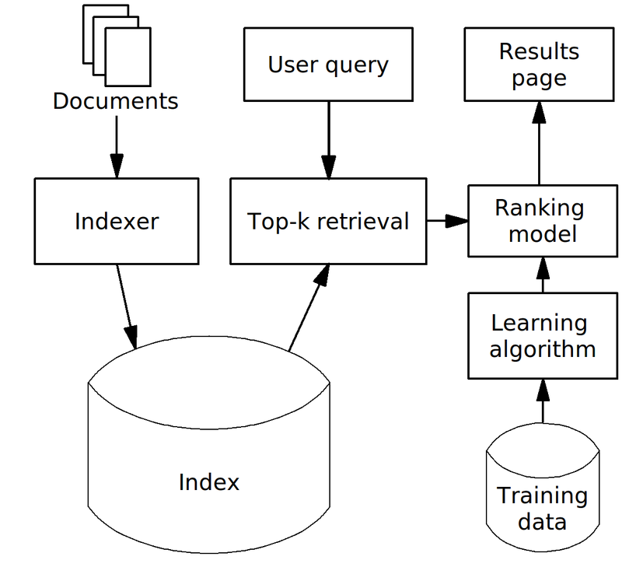
Introduction
Information Retrieval
Obtaining Relevant Information
Eg: Web Search Engines.
Learning To Rank
Application of Machine Learning.
Ranking models for IR systems.
Re-Ranking
Based on user feedback/activity.
Eg: modern search engines,shopping sites etc.
Fig 1.1. Search Engine [6]
Fig 1.1. Search Engine [6]

Slide 4
Introduction(cont.)
Reinforcement Learning
One of the 3 major types of machine learning that has recently gained a lot of traction.
Reinforcement learning aims to solve environments from experience (trial and error) similar to humans.
It learns from the interactions with the environment rather than a labelled or unlabelled dataset.
Deep Reinforcement Learning
Use of neural networks in reinforcement learning.
More powerful function approximators.
Certain issues arise, which are dealt with in various ways according to algorithm used.
We aim to design an Information Retrieval system based on Deep Reinforcement Learning.
Fig 1.1. Search Engine [6]

Slide 5
2. Objectives
Our primary objective is to build a RL based dynamic IR system which has the following features:
Concept of relevance scores which indicates how good a document is across queries.
Sliding window which systematically adds/removes documents to limit the scope of the IR system for efficiency.
Ability for users to give feedback which are transformed into rewards for the RL agent.
Use of semantic models to simulate the users to allow for experiments without being limited by the need for actual user(s) feedback.
Based on the query and documents available in the scope, give the most relevant ranking to the user.
Dynamically improve all components of the system with interactions between the users and system.
Our secondary objectives include improving the RL component in isolation, which is responsible for ranking and re-ranking ,by the application of multiple modern-RL algorithms and evaluating them on the standard datasets to provide for a fair comparison with previous methods.

Slide 6

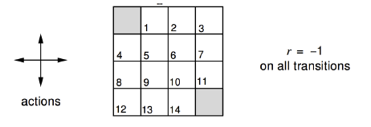
3. Background
Agent - Observes Environment and takes action
Environment – based on the action taken, updates the state and provides a reward
Reward – Tells the agent the effectiveness of action taken.
Fig. 3.1. Reinforcement Learning Diagram [7]
Markov Decision Process (MDP):
(S, A, P, R, γ)
Fig. 3.2. Small Gridworld [8]

Slide 7



3. Background
Any RL problem can be reduced to solving a tuple known as an MDP,
<S, A, R, P, ϒ>, Π where,
S = Finite number of markov states,
A = Set of Actions,
R = Reward function, which is given by:
P = State transition probability matrix, given by:
ϒ = Discount factor.
Along with a policy Π, given by:

Slide 8


3. Background
Goal of the agent is to maximise the expected cumulative rewards, i.e.
Policy: It fully defines the behaviour of an agent., i.e.

Slide 9


3. Background
We further define:
1. The state-value function that tells the agent how good a particular state is,
2. The action-value function which is the expected return of taking action a in state s and then following the policy π ,

Slide 10
3. Background
An RL problem is solved when we find the optimal policy π*(a|s)
i.e, Following the optimal π*(a|s) makes sure we maximize our rewards.
Hence to find the optimal policy we can:
Find the optimal action-value function q*(s,a) and construct the policy:
π*(a|s)=1 if a= argmax q*(s,a) else 0
These give rise to the value based methods which are discussed next.
Directly optimize the policy π(a|s) to arrive at the optimal policy π*(a|s)
These give rise to policy based methods which are discussed next.

Slide 11
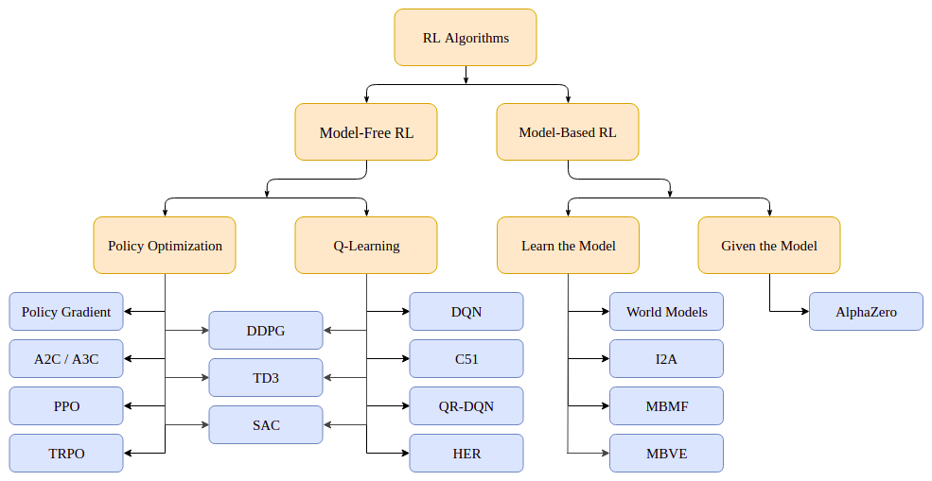
3. Background
Figure 3.1. Taxonomy of algorithms in Modern RL [3]

Slide 12
3. Background
The scope of our study and this project is limited to Model-Free Reinforcement Learning.
Modern Reinforcement Learning gives us:
Pure value based methods such as DQN [4] and its variants.
These methods directly optimize the action-value function q(s,a).
Pure policy based methods such as Policy Gradient.
These methods directly optimize the policy (s,a)
Actor Critic methods such as A2C/A3C[5],PPO[6] and its derivatives.
These methods optimize both policy (s,a) and value function V(s).
An interesting set of algorithms arise from the combination of Q-Learning with policy based methods such as DDPG[7] and its derivatives.
These methods optimize both policy (s,a) and action value function q(s,a).
These algorithms and the application of them to our problem statement are explored in detail.

Slide 13
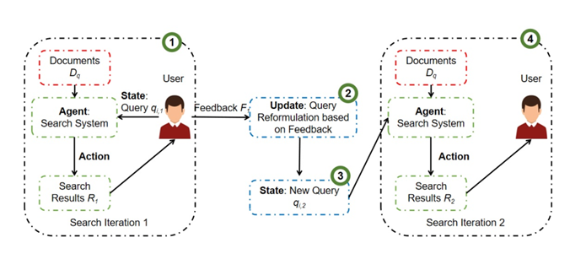
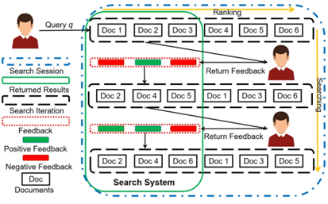
3. Literature Survey
RLI Rank: Learning to Rank with Reinforcement Learning for Dynamic Search[12]
Authors propose an effective dynamic ranking paradigm in which the search results of the IR system incorporates both the user feedback received and information displayed so far.
For each search iteration they apply a stepwise training method to tune a stacked recurrent neural network which is a deep value network model.
Apply a embedding Rocchio algorithm[14] to take into account user feedback.

Slide 14
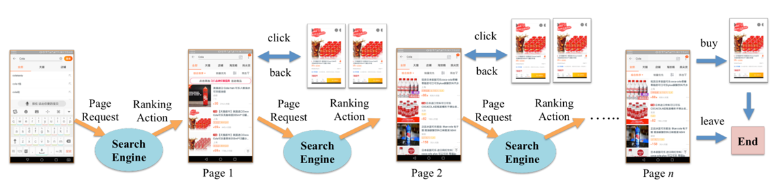
3. Literature Survey
2. Reinforcement Learning to Rank in E-Commerce Search Engine [15]
Learns a ranking policy in a multi-step ranking setting which contains multiple rounds of interactions and typically occurs in E-commerce settings.
Defines the concept of a search session Markov decision process (SSMDP) to formulate the problem and prove its theoretical soundness.
Proposes a modified DPG algorithm called deterministic policy gradient with full backup estimation (DPG-FBE) to deal with the issues of the setting and find the optimal policy.

Slide 15
3. Literature Survey
3. MDPRank[10]
Propose a novel listwise approach to LTR using an MDP. Define the ranking task as an MDP wherein, each state consists of the set of unranked, remaining documents while actions involve selecting a single document to add to a ranked list.
Using the set of labeled training data, policy gradient[2] is used to learn the MDP parameters.
Demonstrated to be the new state-of-the-art on MQ2007 and MQ2008 benchmarks[13].
4. PPGRank[11]
Same authors came up with a novel pairwise approach to the ranking task called Pairwise Policy Gradient. It solves some of the issues faced by MDPRank by taking into account the relative ordering nature of IR ranking and it also estimates gradients with low variance while sustaining low bias.
It can be considered as a variation of REINFORCE with a baseline.
Experimental results show that PPG outperforms the existing state-of-the-art baselines and converges fast to a better optimum with reduced estimated variances.

Slide 16
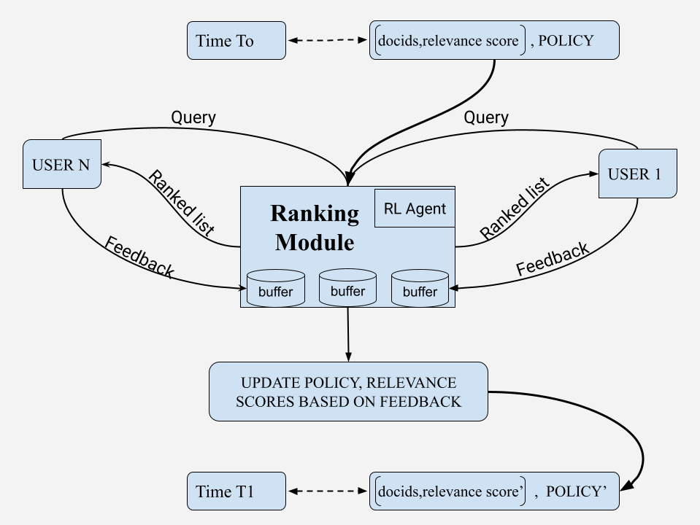
4. Methodology
Figure 4.1. High level Design Diagram of the Information Retrieval System

Slide 17
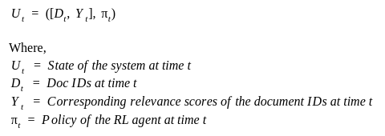
4. Methodology
We first present a high level overview of the system and then dive deeper into each module to explore the workings of the reinforcement learning based information retrieval system.
Formally the state of the system (Ut ) can be defined as:
The system’s state is provided to the ranking module.
Multiple users fire queries.
The ranking module then shows a list of ranked list of documents to the user.
Based on the ranked list shown to the user, the user would give feedback which would be stored into one of the buffers of the ranking module.
The system then updates its system state by updating the relevance score and the parameters of the policy associated with the RL agent based on the feedbacks.
The update can be triggered either by the user, or by a set time period. Once the update happens the system moves to the next state with the updated relevance scores and the updated policy.

Slide 18
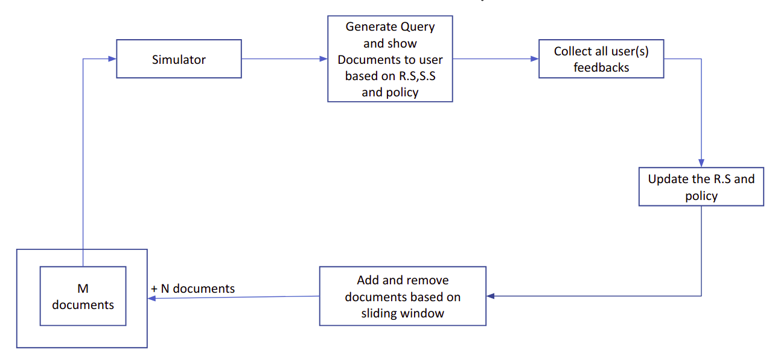
4. Methodology
Figure 4.2. High level Flowchart of the Information Retrieval System

Slide 19
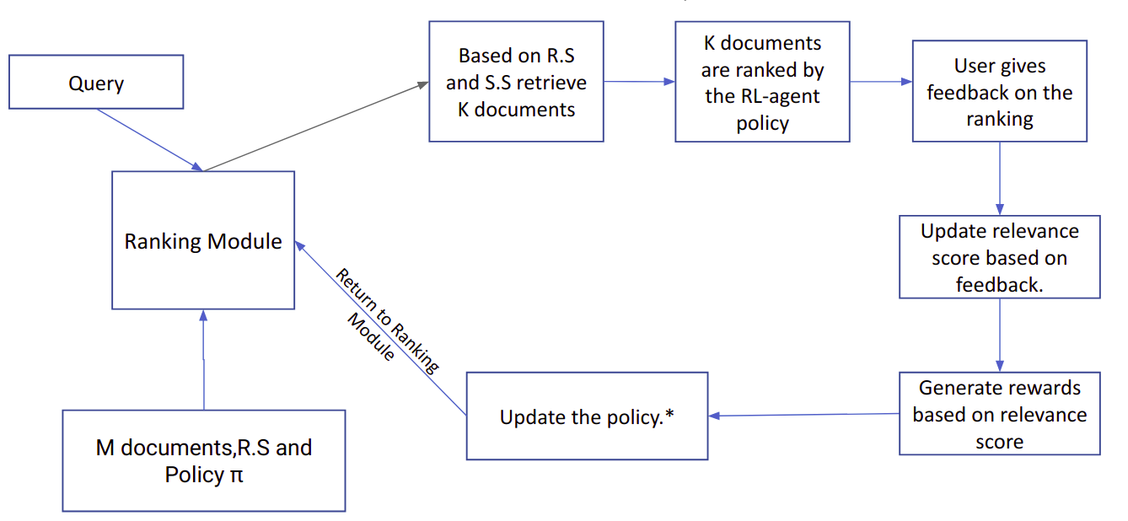
4. Methodology
Figure 4.3. Flowchart of the Ranking Module

Slide 20

4. Methodology
The system starts with initial M documents and the GUI interface (or the simulator) is called.
The very first query is fetched or generated and based on the query, similarity scores are calculated for the M documents.
Using a linear combination of the similarity and the relevance scores, K documents are retrieved and given to the RL agent.
Based on the initialized policy, the RL agent ranks the K documents and this is then shown to the user. The user either generates or provides user feedback
During the phase of updation, the user feedbacks are used to update the relevance score of the documents.
These relevance scores are then used to generate rewards for the agent
With the help of sliding window concept documents are added and the documents which have lost relevance due to linear decay and lack of frequent positive feedback from the user(s), are evaluated and removed if the relevance score of the document is less than or equal to 0. This is not done until the window’s capacity is reached
This new list of documents along with the updated corresponding relevance scores and policy is considered as a new state of the system ( Ut+1 ).
Hence the system would have transitioned to the next state

Slide 21
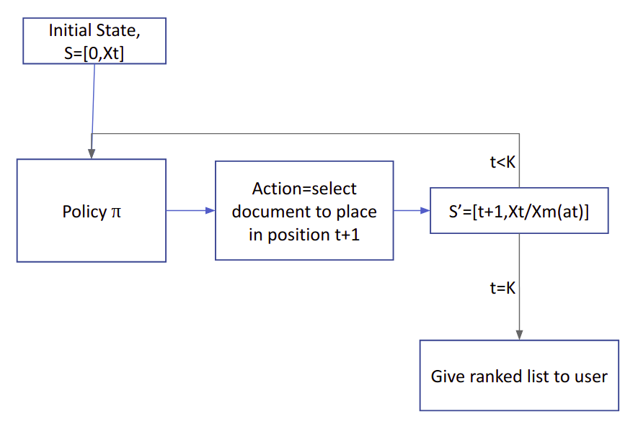
4. Methodology
Figure 4.4. Flowchart of the RL Agent

Slide 22

4. Methodology
The RL module is an extension of the formulation of the MDPRank paper.
Here, instead of using the relevance labels, we make use of the relevance scores.
The agent can be divided into 2 parts:
The entire episode is sampled with the help of the current policy and the actions denote the ranking of the documents.
The ranking is shown to the users, who provide a feedback. These feedbacks are updated into the relevance scores. With the help of DCG metric, the reward is generated and the policy of the agent is updated.

Slide 23
4. Methodology
We now look into the various experiments done to improve the LTR component. We shall be discussing the following algorithms:
REINFORCE (Policy Gradient - Original implementation of the paper)
Deep Q Learning
Actor Critic based methods:
Q - Actor Critic
Incremental Actor Critic
Advantage Actor Critic
Proximal Policy Optimization

Slide 24
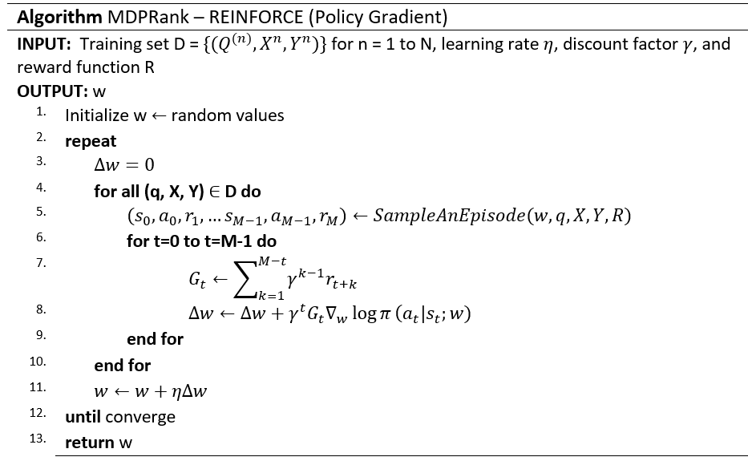
REINFORCE - Policy Gradient

Slide 25
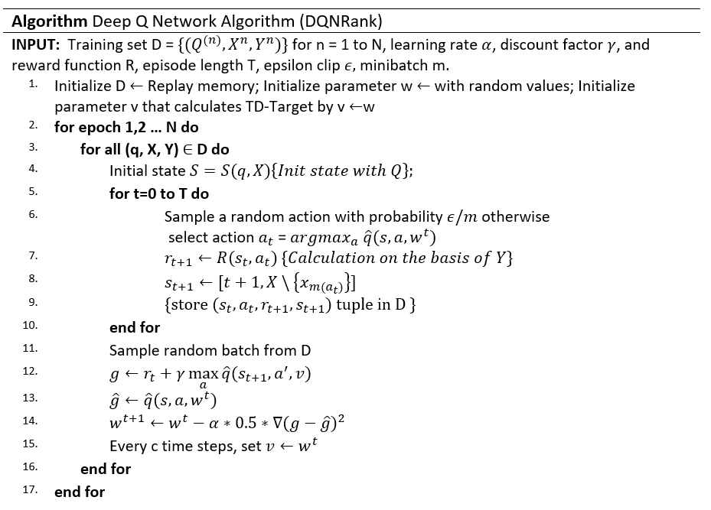
Deep Q Learning

Slide 26
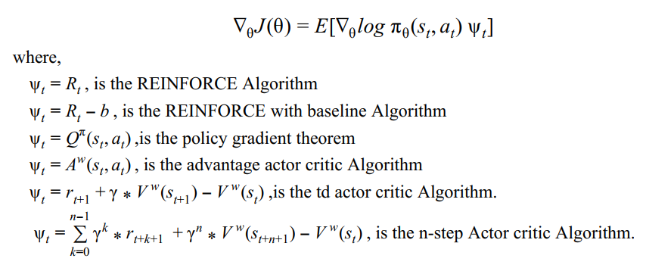
Actor Critic Based Methods
Consider the objective function as J, then,

Slide 27


Q- Actor Critic
As per the policy gradient theorem,
To reduce the variance we use a critic to estimate the action value function:
Note that this holds if the approximator with parameter w is compatible with the policy π, therefore,

Slide 28
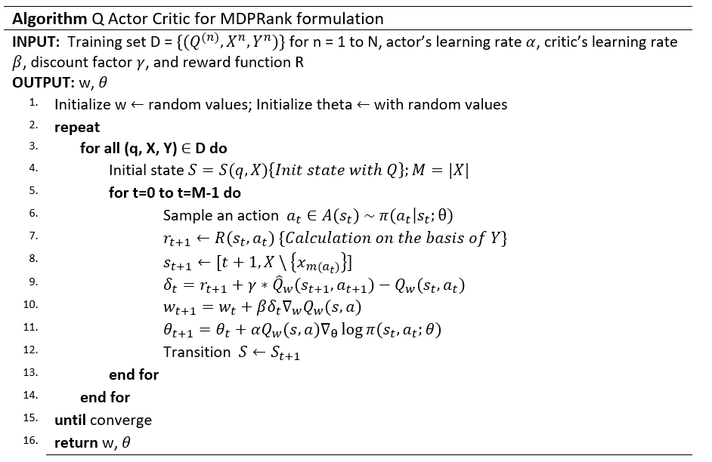
Q - Actor Critic

Slide 29
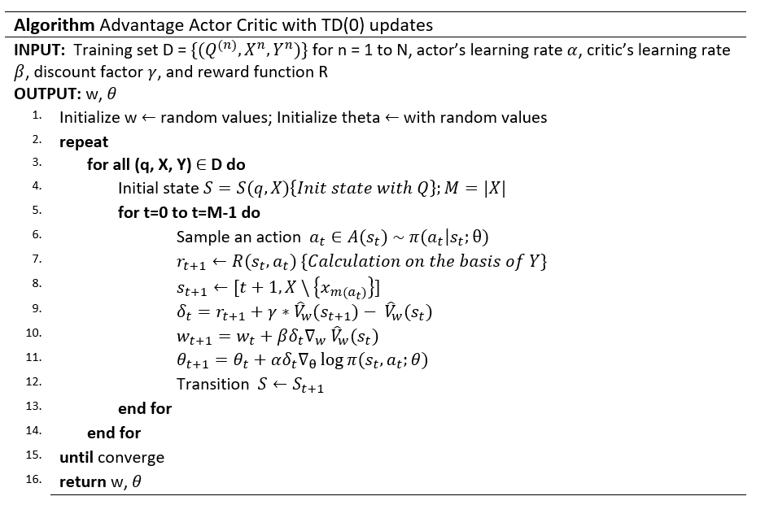
Advantage Actor Critic with TD(0) updates (or)
td actor critic (or)
Incremental
Actor critic

Slide 30
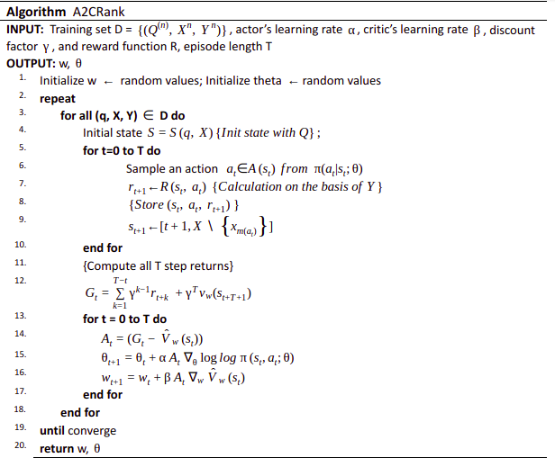
Advantage Actor Critic
(A2C)

Slide 31
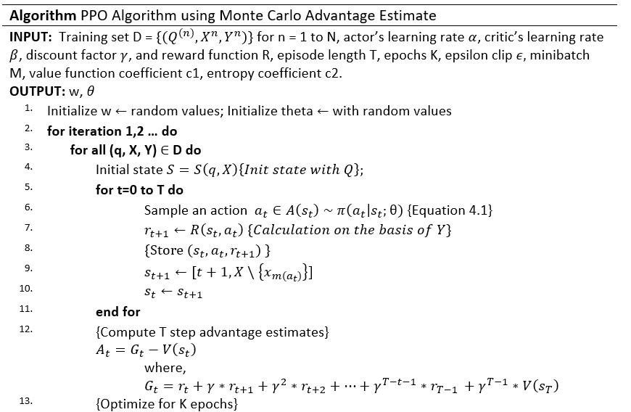
Proximal Policy Optimization Algorithm

Slide 32
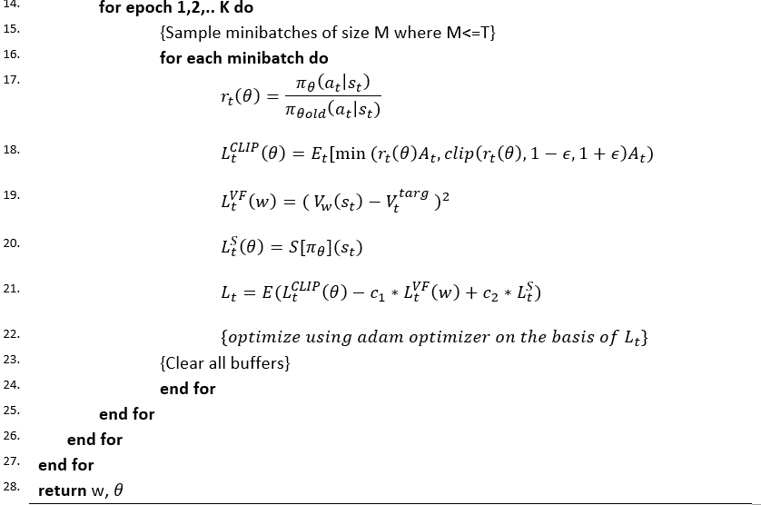
Proximal Policy Optimization Algorithm contd.

Slide 33
5. Results
Dynamic Information Retrieval System
Dataset used for the system: MSMARCO dataset [8]
Tools Used:
Python Tkinter library for the construction of the simulator
Gensim library based Doc2Vec
Pandas, Numpy and Pytorch
Reinforcement Learning Component Experiments and Analysis (RL based LTR)
Dataset used for the system: MQ2007, MQ2008
Tools Used:
Pandas
Numpy
Pytorch
Matplotlib

Slide 34
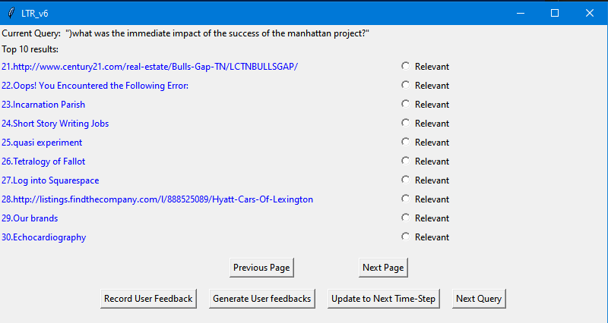
5. Results - Dynamic Information Retrieval System
Fig. 5.1. MSMARCO Dataset [8]

Slide 35
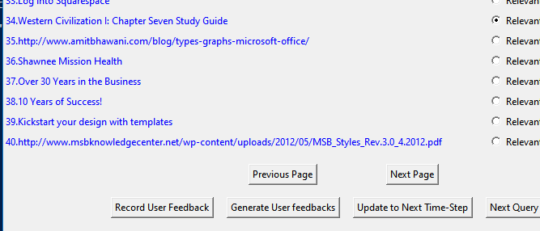
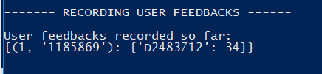
Record User Feedback
Denotes Manual
User Feedback
Position of Document
Query ID
Document ID

Slide 36
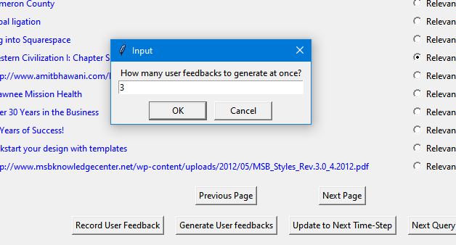

Generate User Feedback
Denotes Automatic
User Feedback
Query ID
Document ID
Position of Document

Slide 37
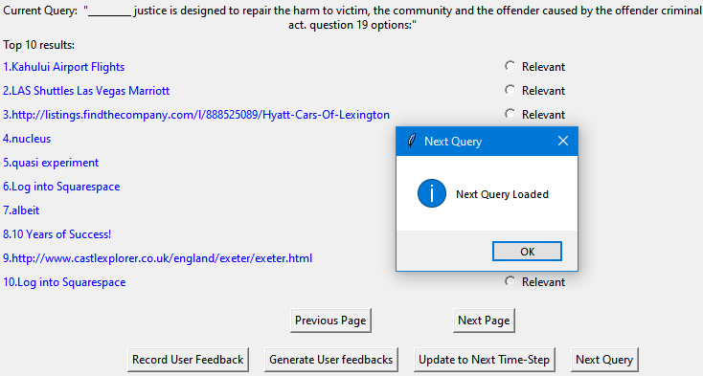
Next Query

Slide 38
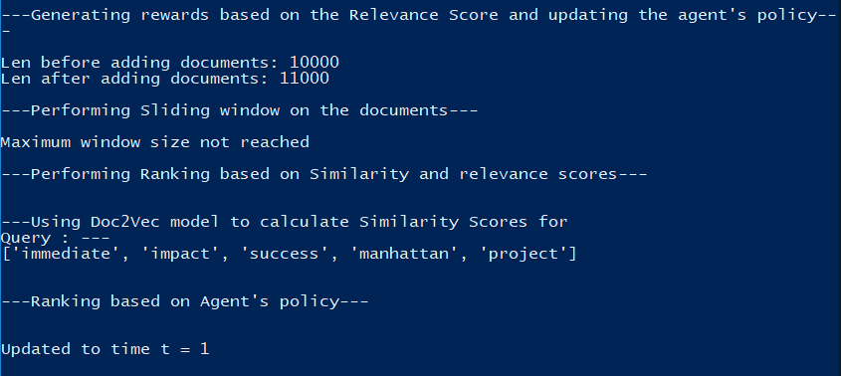
Update to the next time step

Slide 39
5. Results - Application of RL to LTR
To evaluate the results and to form a fair comparison, the NDCG (normalized discounted cumulative gain) scores are considered for each model.
The NDCG score at the Kth position indicates the number of documents ranked correctly upto the Kth position with respect to the perfect ranking of the documents upto the Kth position.
The results generated for the dataset are with respect to a 70-30 split. 70% of the dataset is considered as the training set and 30% of the dataset is considered as the testing set.
These results indicated a similarity to those generated with 5 Fold cross validation. Only the results of the MDPRank and PPGRank paper were produced across the 5 folds; the rest was produced on the entire dataset with 70-30 split.All LTR experiments are done on MQ2007 and MQ2008 datasets[13].
The results obtained help us understand how well the reinforcement learning agent performs in learning to rank tasks. This is more apparent when comparing the results with other machine learning models.

Slide 40
Result Comparison of RL algorithms - MQ2007 dataset
Algorithm | NDCG@1 | NDCG@3 | NDCG@5 | NDCG@10
MDPRank | 0.3954 | 0.3983 | 0.4069 | 0.4350
PPGRank | 0.3947 | 0.3993 | 0.4089 | 0.4382
QACRank | 0.3694 | 0.3759 | 0.3827 | 0.4120
DQNRank | 0.4022 | 0.4041 | 0.4069 | 0.4254
IncrRank | 0.3786 | 0.3871 | 0.3953 | 0.4189
A2CRank (MC) | 0.4042 | 0.3953 | 0.4016 | 0.4272
PPORank (MCAE) | 0.3779 | 0.3950 | 0.3951 | 0.4218
MDPRank Paper Results | 0.4061 | 0.4101 | 0.4171 | 0.4416

Slide 41
Result Comparison of RL algorithms - MQ2008 dataset
Algorithm | NDCG@1 | NDCG@3 | NDCG@5 | NDCG@10
MDPRank | 0.3741 | 0.4099 | 0.4569 | 0.2230
PPGRank | 0.3741 | 0.4226 | 0.4627 | 0.2290
QACRank | 0.3658 | 0.3920 | 0.4292 | 0.2053
DQNRank | 0.3376 | 0.3887 | 0.4313 | 0.2320
IncrRank | 0.3969 | 0.4148 | 0.4744 | 0.2533
A2CRank (MC) | 0.3715 | 0.4100 | 0.4625 | 0.2457
PPORank (MCAE) | 0.3785 | 0.4080 | 0.4537 | 0.2344
MDPRank Paper Results | 0.3827 | 0.4420 | 0.4881 | 0.2327
PPGRank Paper Results | 0.3877 | 0.4511 | 0.4910 | 0.2455

Slide 42
6. Conclusion
We would like to conclude by stating the promise of reinforcement learning and its applications in the information retrieval domain. The work we have done provides a overview of the current state of the domain. The simulator we have built can be easily modified due to its modular nature and be extended for any future use case. Each Reinforcement algorithm applied in this setting provides a strong foundation to the understanding of the theoretical and practical concepts of Reinforcement Learning and may also serve as a base for beginners willing to get started with reinforcement learning.

Slide 43
7. Future Work
Possible extensions include but are not limited to:
The GUI interface can be made better with the help of UI / UX concepts or may also be implemented in Java which is more design friendly than GUI implementations in python.
The RL algorithms implemented can further be tried with different hyperparameters and variation in the neural network architecture which might enable better scores than those discussed in the report.
More advanced RL algorithms can be applied to analyze and improve the results on the standard Learning to rank datasets.
The RL algorithms can be tested on larger datasets like the MSLR datasets [29] to observe the learning for a more complex ranking environment since the size of the dataset is huge which is beneficial for a neural network.
A new retrieval paradigm using indexing,metadata concepts can be built to support more efficient working.

Slide 44
8. References(cont.)
Journal / Conference Papers
[2] Crammer, Koby, and Yoram Singer. "Pranking with ranking." In Nips, vol. 1, pp. 641-647. 2001.
[3] Nallapati, Ramesh. "Discriminative models for information retrieval." In Proceedings of the 27th annual international ACM SIGIR conference on Research and development in information retrieval, pp. 64-71. 2004.
[4] Burges, Chris, Tal Shaked, Erin Renshaw, Ari Lazier, Matt Deeds, Nicole Hamilton, and Greg Hullender. "Learning to rank using gradient descent." In Proceedings of the 22nd international conference on Machine learning, pp. 89-96. 2005.
[5] Cao, Yunbo, Jun Xu, Tie-Yan Liu, Hang Li, Yalou Huang, and Hsiao-Wuen Hon. "Adapting ranking SVM to document retrieval." In Proceedings of the 29th annual international ACM SIGIR conference on Research and development in information retrieval, pp. 186-193. 2006.

Slide 45
8. References(cont.)
[6] Joachims, Thorsten. "Optimizing search engines using clickthrough data." In Proceedings of the eighth ACM SIGKDD international conference on Knowledge discovery and data mining, pp. 133-142. 2002.
[7] Burges, Christopher JC. "From ranknet to lambdarank to lambdamart: An overview." Learning 11.23-581 (2010): 81.
[8] Cao, Zhe, Tao Qin, Tie-Yan Liu, Ming-Feng Tsai, and Hang Li. "Learning to rank: from pairwise approach to listwise approach." In Proceedings of the 24th international conference on Machine learning, pp. 129-136. 2007.
[9] Xu, Jun, and Hang Li. "Adarank: a boosting algorithm for information retrieval." In Proceedings of the 30th annual international ACM SIGIR conference on Research and development in information retrieval, pp. 391-398. 2007.

Slide 46
8. References(cont.)
[15] Sutton, Richard S., and Andrew G. Barto. Reinforcement learning: An introduction. MIT press, 2018.
[11] Zhou, Jianghong, and Eugene Agichtein. "RLIRank: Learning to Rank with Reinforcement Learning for Dynamic Search." In Proceedings of The Web Conference 2020, pp. 2842-2848. 2020.
[12] Hu, Yujing, Qing Da, Anxiang Zeng, Yang Yu, and Yinghui Xu. "Reinforcement learning to rank in e-commerce search engine: Formalization, analysis, and application." In Proceedings of the 24th ACM SIGKDD International Conference on Knowledge Discovery & Data Mining, pp. 368-377. 2018.
[13] Silver, David, Guy Lever, Nicolas Heess, Thomas Degris, Daan Wierstra, and Martin Riedmiller. "Deterministic policy gradient algorithms." In International conference on machine learning, pp. 387-395. PMLR, 2014.

Slide 47
8. References(cont.)
[14] Wei, Zeng, Jun Xu, Yanyan Lan, Jiafeng Guo, and Xueqi Cheng. "Reinforcement learning to rank with Markov decision process." In Proceedings of the 40th International ACM SIGIR Conference on Research and Development in Information Retrieval, pp. 945-948. 2017.
[17] Mnih, Volodymyr, Koray Kavukcuoglu, David Silver, Alex Graves, Ioannis Antonoglou, Daan Wierstra, and Martin Riedmiller. "Playing atari with deep reinforcement learning." arXiv preprint arXiv:1312.5602 (2013).
[18] Konda, Vijay R., and John N. Tsitsiklis. "Actor-critic algorithms." In Advances in neural information processing systems, pp. 1008-1014. 2000.
[19] Mnih, Volodymyr, Adria Puigdomenech Badia, Mehdi Mirza, Alex Graves, Timothy Lillicrap, Tim Harley, David Silver, and Koray Kavukcuoglu. "Asynchronous methods for deep reinforcement learning." In International conference on machine learning, pp. 1928-1937. PMLR, 2016.

Slide 48
8. References(cont.)
Books
[10] Manning, Christopher D.; Raghavan, Prabhakar; Schütze, Hinrich. “Introduction to Information Retrieval”. Cambridge University Press.2018.
[34] S. Grace and P. Gravestock, “Inclusion and diversity: Meeting the needs of all students. Routledge”, 2008.
[35] R. A. of Engineering, “Engineering ethics in practice: a guide for engineers”. Royal Academy of Engineering London (UK), 2011.
[36] I. Van de Poel and L. Royakkers, “Ethics, technology, and engineering: An introduction”. John Wiley & Sons, 2011.
[38] M. R. Spiegel, J. J. Schiller, and R. A. Srinivasan, Schaum's outlines probability and statistics. McGraw-Hill, 2013.

Slide 49
8. References(cont.)
Web
[25] Part 2: Kinds of RL Algorithms — Spinning Up documentation. (2021). [Online]. Available: https://spinningup.openai.com/
[30] MSMARCO dataset. [Online]. Available: https://microsoft.github.io/msmarco/
[31] Microsoft Learning to Rank Datasets. [Online]. Available:
https://www.microsoft.com/en-us/research/project/mslr/
[32] LETOR: Learning to Rank for Information Retrieval. [Online]. Available: https://www.microsoft.com/en-us/research/project/letor-learning-rank-information-retrieval/
[33] ElasticSearch Documentation [Online]. Available: https://www.elastic.co/

Slide 50
Thank you.

