Slide 1
Next Utterance Prediction For Mental Health Counselling
Ashish Bargoti (2022114)
Wasif Ali (2022583)
Roshan Kumar Mahto (2022418) Group no: 53

Slide 2
Introduction
Motivation:
Effective mental health counseling requires understanding and responding empathetically. Automating this with NLP can support mental health professionals by generating context-aware and emotionally intelligent replies, making virtual mental health tools more responsive and supportive.
Relevant Example:
Virtual Mental Health Assistant: An AI chatbot that supports users dealing with anxiety or depression by engaging in supportive conversations, understanding their context, and responding with comforting and helpful messages when a human counselor isn't immediately available.
Crisis support Chatbot: An AI-powered chatbot designed to assist users in crisis situations (e.g., suicidal ideation or panic attacks). It predicts the next supportive utterance based on the user’s input to de-escalate emotional distress. For example, if a user expresses hopelessness, the model generates empathetic and safety-oriented responses, and can escalate to human support if needed.

Slide 3
Related Work
2. Evaluating GPT-4 for Psychological Counseling
Key Contributions:
Examines the capabilities of GPT-4 in generating mental health counseling responses.
Evaluates language fluency, empathy, appropriateness, and therapeutic value.
Uses real-world counseling dialogues to simulate therapist-patient interactions.
Method:
GPT-4 is given patient inputs from actual therapy sessions.
Responses are rated by licensed therapists based on empathy, relevance, and clinical safety.
Findings:
GPT-4 responses were judged to be:
Fluent and coherent in 90% of cases
Emotionally supportive and therapeutically aligned in 70–80% of scenarios
Highlights GPT-4's potential for support roles but warns against replacing human therapists. Link: https://arxiv.org/abs/2402.12738

Slide 4
Related Work
1. READER: Response-act Guided Reinforced Dialogue Generation for Mental Health Counseling Key Contributions:
Proposes READER, a novel transformer-based model that:
Predicts the next dialogue-act (response-act)
Generates an appropriate therapist response
Combines GPT-2 with three heads:
LM-Head (for response generation)
RAC-Head (for act prediction)
V-Head (for reward evaluation using PPO)
Uses reinforcement learning (PPO) with a reward function based on ROUGE, BERTScore, and relative entropy..
Performance:
Outperforms GPT-2, DialoGPT, and other baselines on ROUGE, METEOR, and BERTScore
Demonstrates strong semantic alignment, relevance, and fluency
Link: https://arxiv.org/abs/2301.12729

Slide 5
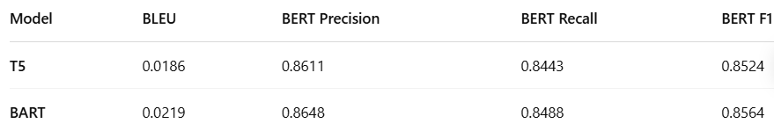
Baseline and Their Results
T5-small Model
Text-to-Text Approach: T5 treats every NLP task as a text-to-text problem, making it ideal for next utterance generation.
Custom Input Format: We framed our input as "predict next utterance: <context>" to match T5’s expected structure.
Advanced Decoding & Evaluation: Used beam search for output generation and evaluated using BLEU and BERTScore for quality.
BART-base Model
Robust Pretraining: BART is pre-trained as a denoising autoencoder, helping it handle noisy or incomplete conversations better.
Sequence-to-Sequence Fine-Tuning: We fine-tuned it with the same dialogue format using BartTokenizer and customized data preprocessing.
Performance Optimization: Used AdamW optimizer and selected the best model based on validation loss, with evaluation via BLEU and BERTScore.

Slide 6
Methodology
1 : Sentiment Infused Bart Model ▶
Title: Sentiment Infused Bart Model │ │
┌─────────────────────┐ │
│ Utterances │ ──▶ Tokenized (w/ speaker & emotion tags)│
└─────────────────────┘ │
│ │
▼ │
┌─────────────────────┐ │
│ Token Embeddings │ │
├─────────────────────┤ │
│ Speaker Embeddings │ (with utmost next 6 utterance) │
├─────────────────────┤ │
│ Emotion Embeddings │ │
└─────────────────────┘ │
│ │
– – – – – – – – – – – – – – – – – – – – – – – – – – – –
[Multi-head attention + Linear Projection] ⟶ `fused_embeds`
│
▼
┌─────────────────────┐
│ BART Encoder │
└─────────────────────┘
│
▼
┌─────────────────────┐
│ BART Decoder │
└─────────────────────┘
│
▼
Next Utterance

Slide 7
Methodology
T-GenSim Model
Step 1: Initial Response Generation
The model takes previous dialogue H (everything that has been said so far) and produces a response Ut​.
This is the model’s first attempt at replying in the current turn.
Step 2: User Simulation
The model tries to predict how a typical user would react to its response Ut​.
It generates a simulated next user utterance Ut+1​, assuming the user sees Ut and replies naturally.
Step 3: Feedback Evaluation & Regeneration
The system evaluates how good or helpful the simulated Ut+1​ is.
If it determines that the user reaction is negative, unhelpful, or unsatisfactory, it goes back and modifies/regenerates Ut.
The goal is to improve Ut such that it leads to a more constructive or desired Ut+1.

Slide 8
Dataset
About the Dataset
The dataset consists of mental health counseling dialogues, structured for next utterance prediction.
It contains:
4008 training samples
576 validation samples
968 test samples
Each sample includes:
Input: A sequence of prior utterances in a therapy session, separated by [SEP].
Target: The next expected utterance in the conversation.
Example
Input: T: Hi you how to do it today? [SEP] P: Great. How are you? [SEP] T: I'm doing well. Thanks for asking. Target: "So you're doing great."

Slide 9
Experimental Setup
Experiment Setup
Dataset: Therapist-patient dialogues split into train, validation, and test sets using HuggingFace format.
Models Used:
Generator : T5-base — generates therapist response UtU_tUt​
Simulator : T5-base — predicts patient’s next utterance Ut+1U_{t+1}Ut+1​
Preprocessing:
Built dialogue triples: (History, UtU_tUt​, Ut+1U_{t+1}Ut+1​)
Tokenization using T5 tokenizer
max_input_len = 256, max_output_len = 128
Training M2 (Simulator):
Cross-Entropy loss with batch size 8
Optimizer: AdamW (lr = 5e-5)
Trained for 3 epochs
Training M1 (Generator) with Feedback:
Combined loss: CE loss + λ × Feedback Loss
Feedback simulated using frozen M2
BERTScore used to guide reward signal
Batch size = 4, λ = 1.0
Evaluation:
Early stopping based on val loss
Metrics: BERTScore, SacreBLEU
Evaluation limited to 100 samples for efficiency

Slide 10
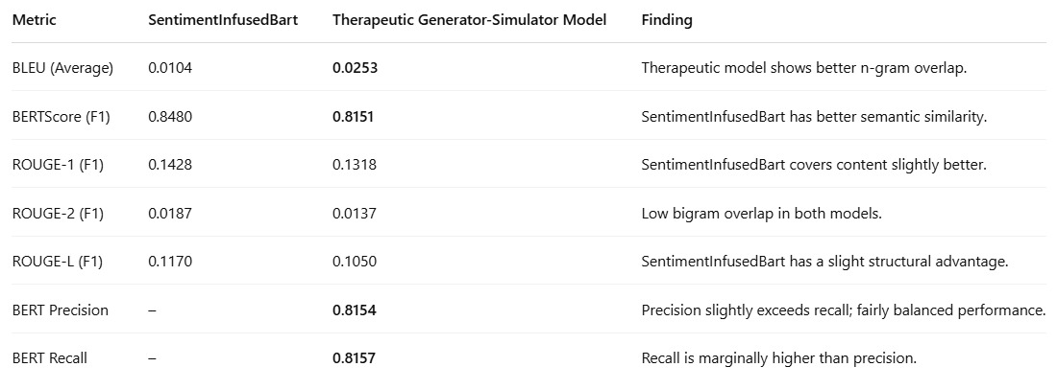
Results/Findings
SentimentInfusedBart demonstrates superior semantic similarity (BERTScore F1: 0.8480 vs. 0.8151).
The Therapeutic model shows better n-gram overlap (BLEU: 0.0253 vs. 0.0104), though both have low bigram overlap.
ROUGE-1 and ROUGE-L scores suggest SentimentInfusedBart provides slightly better content and structural coverage.

Slide 11
Discussion/Analysis/Observation
SentimentInfusedBart Model
Achieved highest BERTScore (0.8480), indicating strong semantic similarity.
Higher ROUGE-1 (0.1428), ROUGE-2 (0.0187), and ROUGE-L (0.1170) scores, reflecting better content and structure alignment.
Demonstrates effective sentiment integration and improved lexical-structural coherence.
Therapeutic Generator-Simulator Model
Lower BERTScore (0.8151), showing slightly reduced semantic alignment.
Higher BLEU score (0.0253 vs. 0.0104), suggesting better n-gram overlap.
Maintains emotional relevance, valuable for therapeutic or empathetic applications.

Slide 12
Conclusion And Future Work
Conclusion
SentimentInfusedBart outperforms the Therapeutic Generator-Simulator on semantic and structural metrics (BERTScore, ROUGE).
The Therapeutic Generator-Simulator shows better n-gram overlap (higher BLEU), but overall lags in semantic depth.
Results highlight that sentiment integration enhances response coherence, relevance, and emotional alignment.
Future Work
Explore reinforcement learning with human feedback (RLHF) for personalized generation.
Incorporate multimodal learning (text + voice tone or facial cues) for better empathy modeling.
Develop dynamic context tracking for longer, emotionally coherent conversations.
Evaluate with clinical experts or psychologists for real-world validation and feedback.
Mode Trained link: https://drive.google.com/drive/folders/1DOu99Y8G4x4Nt8uJDVjMEHzyle5Ujm1s?role=writer

Slide 13
Thank you

