Slide 1
Plant disease detection
By- Roshan Kumar Mahto(2022418)
-Tarandeep Singh (2022536)

Slide 2
Problem Statement:
This project on plant disease detection using a leaf dataset with 38 classes and CNN model training is immensely useful due to its potential to revolutionize agricultural practices. By leveraging advanced machine learning techniques, the project enables early and accurate identification of plant diseases, thereby promoting enhanced crop health monitoring, precision agriculture, and economic sustainability. It not only empowers farmers and agricultural experts with actionable insights for proactive disease management but also contributes to global food security efforts by ensuring sustainable crop production. Additionally, the integration of cutting-edge technologies like Convolutional Neural Networks showcases the ongoing digital transformation in agriculture, highlighting the project's role in fostering innovation and resilience within the agricultural sector.

Slide 3
Relevant literature
Several key studies in the literature showcase the effectiveness of Convolutional Neural Networks (CNNs) for plant disease detection. For instance,
Maruthi et al. (2017) demonstrated the application of CNNs in accurately identifying plant diseases from leaf images, highlighting their superior performance compared to traditional methods.
Kumar et al. (2020) emphasized the importance of large-scale datasets and preprocessing techniques in improving CNN-based disease identification systems. Additionally, review articles like Kumar et al. (2021) provide a comprehensive overview of deep learning algorithms, including CNNs, used in plant disease detection tasks, discussing their advantages and challenges.
Abhay and Mohan (2018) and Akshaya et al. (2020) also contributed significantly by evaluating different CNN architectures and image processing techniques for robust plant disease classification. These studies collectively underscore the growing prominence of CNNs in revolutionizing automated plant disease diagnosis and management

Slide 4
Literature Review
S. S. Sannakki and V. S. Rajpurohit proposed a method called "Classification of Pomegranate Diseases Based on Back Propagation Neural Network." They focused on segmenting the affected area and used color and texture as features for classification. Their approach involved converting images to Lab format to extract chromaticity layers, enhancing classification accuracy to 97.30%. However, a drawback is that this method is limited to specific crops.

Slide 5
Methodology
Data Preparation : In the data preparation phase using Keras ,a batch size of 32 is set to efficiently process training and validation samples. The images are resized to a standardized 128 x 120 pixel size, maintaining aspect ratio for image quality. Conversion to RGB format ensures consistent color representation across the dataset, crucial for accurate model training.
Data count: Total train data set is 70295 belong to 38 classes that help to deep leaning network to enough data and model give good accuracy for validation data set as well as test data set and total validation data set is 17572 files belonging to 38 classes.
Model Architecture Design (CNN): .
Construct convolutional layers with appropriate filter sizes and activation functions to extract meaningful features from the input images.
Apply max-pooling layers to downsample feature maps and reduce computational complexity.
Incorporate dropout layers to prevent overfitting by randomly deactivating neurons during training.

Slide 6
Methodology
Model Architecture Design (CNN): .
Design a fully connected neural network with an initial layer of 1400 neurons, gradually reducing the number of neurons towards the output layer with 38 neurons corresponding to the 38 disease classes.
Training Configuration:
Set the learning rate to 0.0001, which is considered suitable for stable and gradual model convergence without large fluctuations
Utilize a categorical cross-entropy loss function for multi-class classification, optimizing the model using the Adam optimizer or a similar algorithm.
Divide the dataset into training, validation, and test sets, allocating a significant portion for training to ensure model generalization.
Train the model for 10 epochs, monitoring training and validation metrics such as accuracy, loss, precision, recall, and F1-score.

Slide 7
Experimental settings
First, we convert RGB images into digits using Keras with a batch size of 32. If we need faster preprocessing, we would use a batch size of 64, but our system cannot handle that, so we stick to a batch size of 32.
CNN Architecture Design:
Layer 1 (Convolutional):
Convolutional layer with 2, 32 filters of size 3x3.
Padding set to "same" to preserve spatial dimensions.
Activation function (e.g., ReLU) applied after convolution.
Polling that is max polling and size 2*2 and stride is 2
Layer 2 (Convolutional):
Convolutional layer with 2, 64 filters of size 3x3.
Padding set to “valid " if keep same then dimension is increase means feature will be increase
Activation function (e.g., ReLU) applied after convolution.
Polling that is max polling and size 2*2 and stride is 2

Slide 8
Experimental settings
CNN Architecture Design:
Layer 3 (Convolutional):
Convolutional layer with 2, 128 filters of size 3x3.
Padding set to “valid " if keep same then dimension is increase means feature will be increase
Activation function (e.g., ReLU) applied after convolution.
Polling that is max polling and size 2*2 and stride is 2
Layer 4 (Convolutional):
Convolutional layer with 2, 256 filters of size 3x3.
Padding set to “valid " if keep same then dimension is increase means feature will be increase
Activation function (e.g., ReLU) applied after convolution.
Polling that is max polling and size 2*2 and stride is 2

Slide 9
Experimental settings
CNN Architecture Design:
Layer 5 (Convolutional):
Convolutional layer with 2, 512 filters of size 3x3.
Padding set to “valid " if keep same then dimension is increase means feature will be increase
Activation function (e.g., ReLU) applied after convolution.
Polling that is max polling and size 2*2 and stride is 2
Final Layers:
Flatten layer to convert 2D feature maps into a 1D vector.
Fully connected (Dense) layer with appropriate neurons for classification tasks (e.g., 38 output neurons for 38 disease classes).
Output layer with softmax activation for multi-class classification.

Slide 10
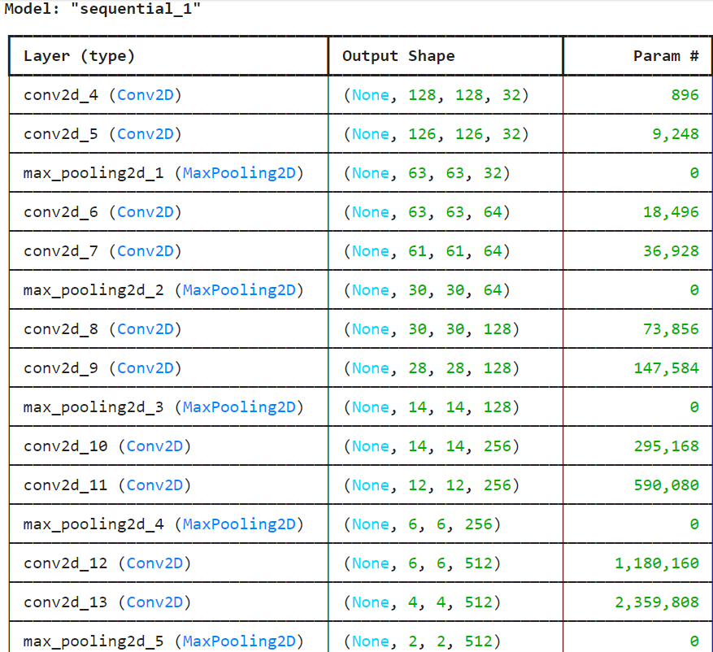
This is the summary layer by layer :

Slide 11
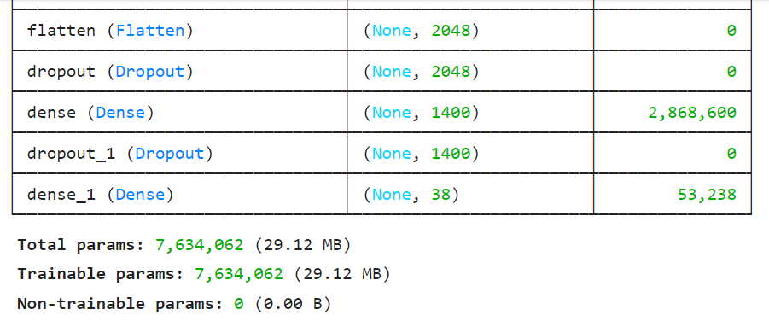

Slide 12
Experimental settings
Evaluation and Validation:
Evaluate the trained model using validation metrics such as accuracy, precision, recall, and F1-score to assess its performance in disease classification.
Conduct hyperparameter tuning experiments if needed to optimize model performance further.
Results Analysis and Reporting:
Analyze and interpret model results, including confusion matrices and visualizations, to understand classification performance across different disease classes.
Document findings, insights, and any limitations encountered during the experimentation process.
Prepare a comprehensive report or presentation summarizing the methodology, experimental outcomes, and implications for plant disease detection research and applications.
These experimental settings account for the batch size limitation and ensure efficient preprocessing while maintaining the quality and accuracy of the CNN-based plant disease detection model.

Slide 13
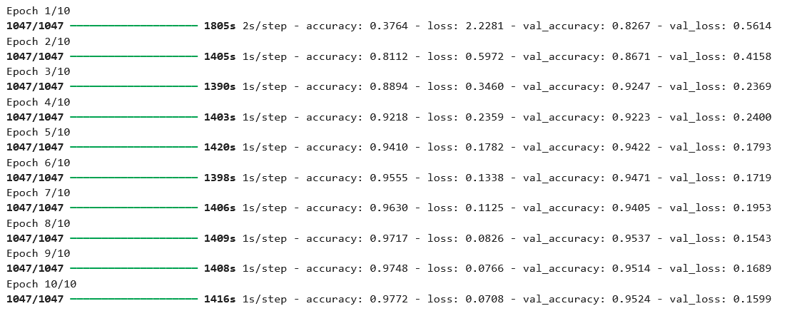
Results

Slide 14
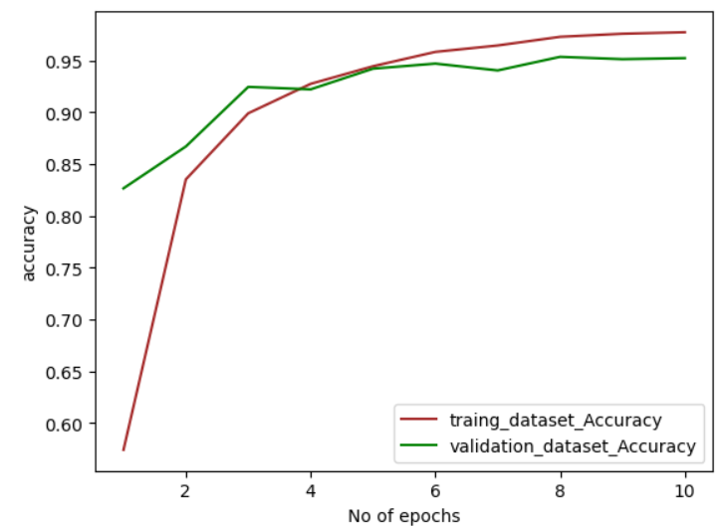
Results

Slide 15
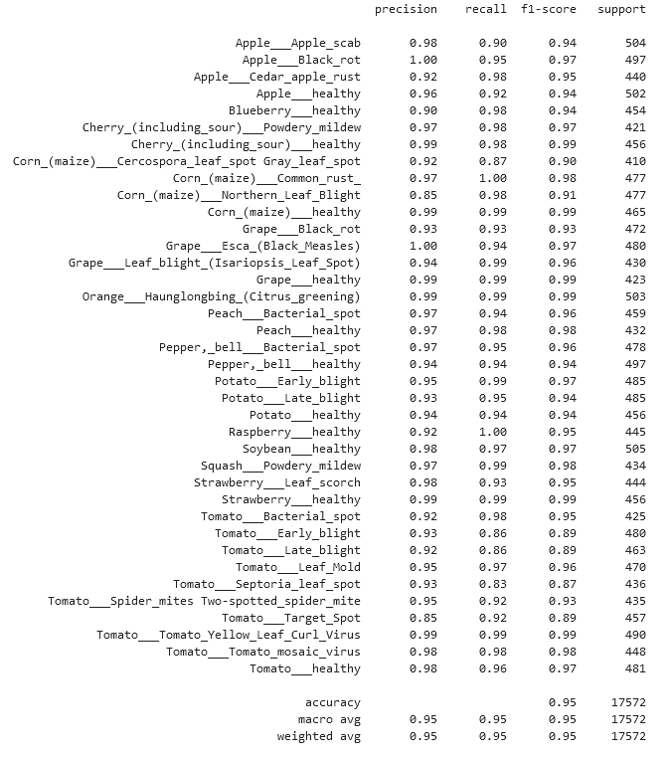
Results

Slide 16
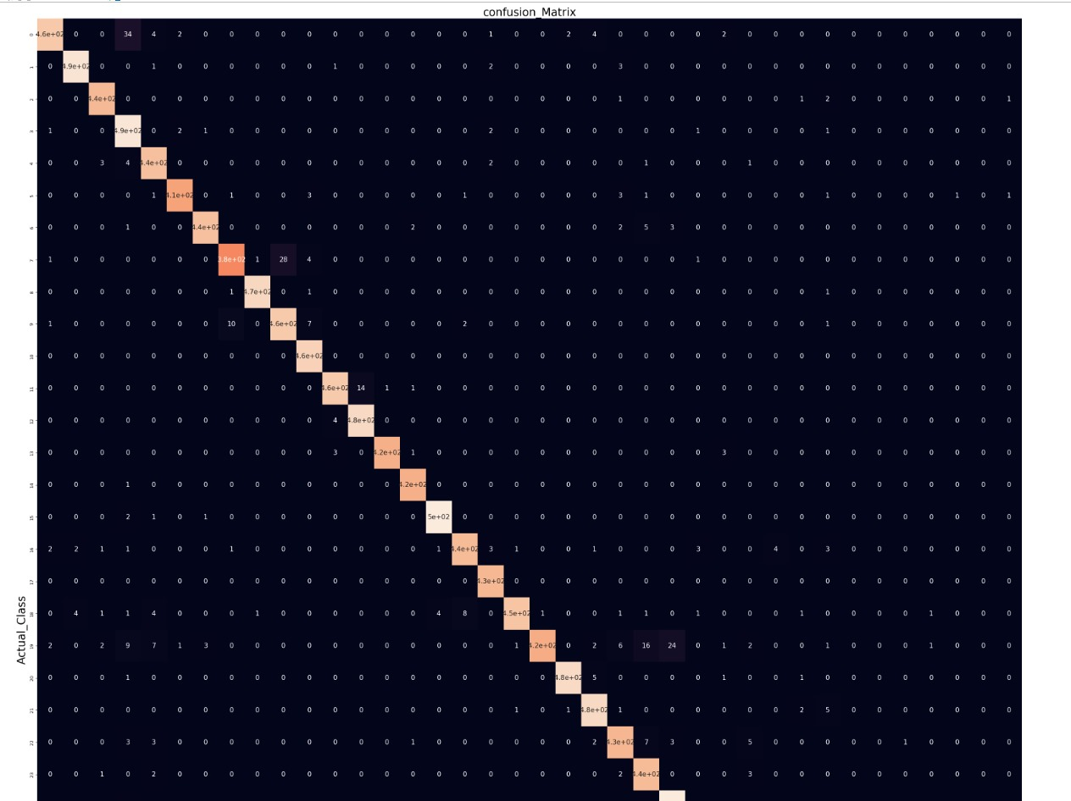

Slide 17
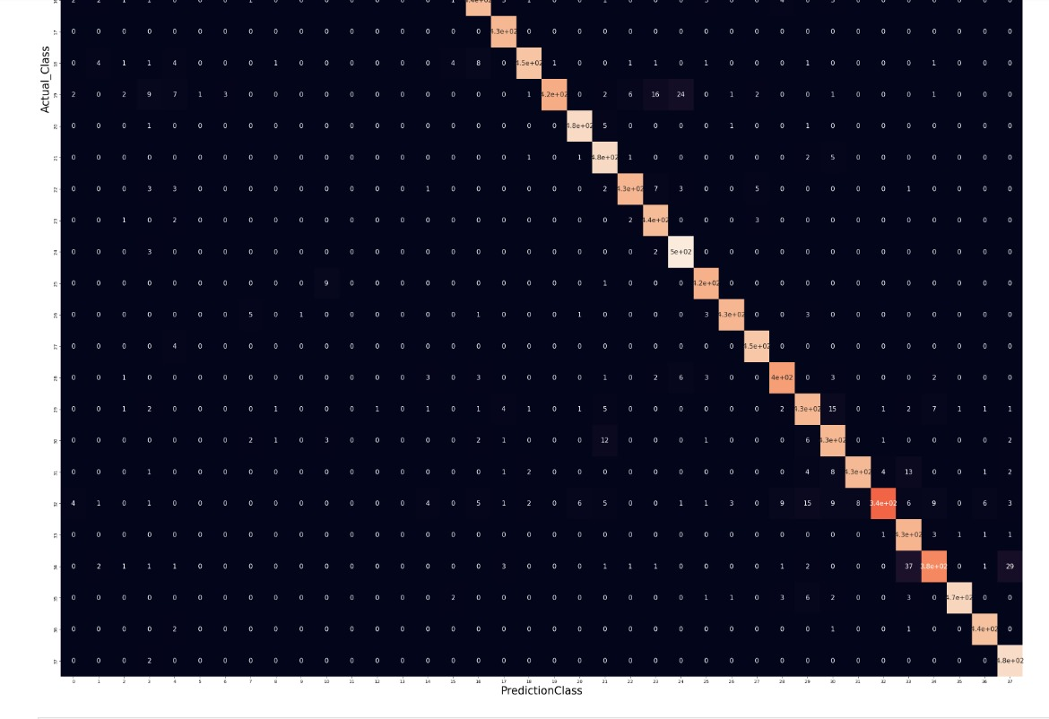

Slide 18
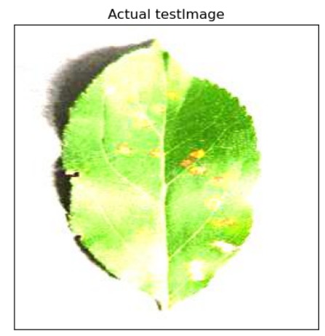
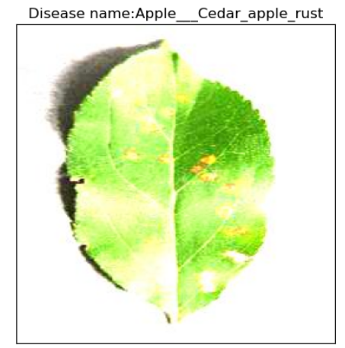
Results: prediction of the model on one of the test images

