Slide 1
K.RAMAKRISHNAN COLLEGE OF TECHNOLOGY
(An Autonomous Institution, affiliated to Anna University Chennai and Approved by AICTE, New Delhi)
SAMAYAPURAM – 621112
DEPARTMENT OF ARTIFICIAL INTELLIGENCE
AI MOCK INTERVIEW SIMULATOR
PRESENTED BY
BALAJI S (811722001004)
GOKULRAJ A (811722001010)
RAGHISH S (811722001039)
ROSHAN ABOORVA RAJ J (811722001043)
GUIDED BY
Mrs. GANGA NAIDU, M.E .,
AP/AI

Slide 2
OBJECTIVE
To create an intelligent, interactive system that simulates job interviews using AI-based natural language processing, speech recognition, and machine learning techniques. The simulator helps users practice and improve their responses, communication, and confidence.

Slide 3
EXISTING SYSTEM
In traditional interview preparation methods, students and job seekers typically rely on manual resources such as question banks, peer-to-peer mock interviews, or generalized online tutorials.
These approaches often lack interactivity, personalization, and real-time evaluation, resulting in limited feedback and an inconsistent preparation experience.
Demerits:
Lack of Realistic Simulation
Limited Personalization
No Speech Analysis or Scoring

Slide 4
PROPOSED SYSTEM
The proposed system, AI Mock Interview Simulator, offers a voice-based, AI-driven platform that transforms how students and job seekers prepare for interviews.
The simulator is built to provide a realistic, interactive mock interview environment powered by speech recognition, natural language understanding, and intelligent feedback mechanisms.
Merits:
Progress Tracking and Feedback
Automated Evaluation and Scoring
Role-Specific Questioning

Slide 5
LITERATURE SURVEY
S.No. | Title | Author/Year | Technique Used | Merits | Demerits
1. | An AI Mock-interview Platform for Interview Performance Analysis | Yi-Chi Chou, Felicia R. Wongso, Chun-Yen Chao, Han-Yen Yu, 2022 | Interview performance analysis | Efficient interview preparation | May not cover all real-world interview nuances
2. | Smart Interview Using AI | Aditi S. More, Samiksha S. Mobarkar, Siddhita S. Salunkhe, 2022 | AI-driven smart interview system | Reduces human bias, automated feedback on performance | May not accurately judge soft skills or adaptability to unexpected scenarios

Slide 6
S.No. | Title | Author/Year | Technique Used | Merits | Demerits
3. | An Affective Service Based on Multi-Modal Emotion Recognition | Danai Styliani Moschona, 2022 | Emotion recognition using EEG and speech emotion tracking | Focuses on emotional intelligence | Dependent on accurate emotion detection
4. | AI-Based Mock Interview Evaluator: An Emotion and Confidence Classifier | Rubi Mandal, Pranav Lohar, Dhiraj Patil, Apurva Patil, 2023 | AI classifier for emotion and confidence in mock interviews | Provides insights into emotional state and confidence levels | May not cover technical assessment or skills beyond emotion and confidence
5. | Speech and Sentiment Analysis in AI Interviews | Wang & Patel, 2023 | MFCC for Speech Processing & VADER for Sentiment Analysis | Evaluates voice confidence and sentiment | Speech recognition errors affect accuracy.

Slide 7
ARCHITECTURE
GUI(Tkinter)
Evaluation Module(GPT4All)
Display Response in Chat Interface
Text-to-Speech(pyttsx3 TTS engine)
Speech-to-Text(Vosk)
Interview Controller
Collected Answer
Voice Input(sounddevice) /Text Input
LLM Response Generation(GPT4All - Mistral)

Slide 8
SYSTEM & SOFTWARE SPECIFICATIONS
HARDWARE SPECIFICATIONS:
CPU: Dual-core processor or better.
RAM: 4 GB minimum.
Storage: At least 1 GB free space.
Microphone and speakers/headphones.
SOFTWARE SPECIFICATIONS:
Operating System: Windows 10/11
Python Version: 3.10 or higher

Slide 9
SYSTEM & SOFTWARE SPECIFICATIONS
FUNCTIONAL SPECIFICATIONS :
Libraries: tkinter, sounddevice, pyttsx3, vosk, gpt4all, numpy, threading.
Vosk Speech Model: vosk-model-en-us-0.22.
LLM Model: mistral-7b-instruct-v0.1.Q4_0.gguf.

Slide 10
MODULES
User Interface
Speech-to-text(STT)
Text-to-speech(TTS)
AI Interview Engine
Interview Controller

Slide 11
.
MODULE EXPLANATION
1.USER INTERFACE
Role Selector:
Dropdown menu for users to pick interview roles like Data Analyst, Software Developer, etc.
Role selection customizes AI interviewer’s questions to fit specific job profiles.
Updates internal state for consistent context throughout the interview.
Chat Display:
Scrollable text area showing real-time conversation flow between AI and user.
Differentiates messages by labels and colors to improve readability.
Automatically scrolls to latest message, preserving context for evaluation and review.

Slide 12
USER INTERFACE
Function Highlights from Code:
__init__ method builds UI elements and binds events to buttons.
say_and_display() shows messages in chat box and triggers text-to-speech.
toggle_interview() manages interview state, starts/stops session, and triggers evaluation.
Button states dynamically update to prevent conflicting actions, improving user experience.

Slide 13
USER INTERFACE
Purpose: Acts as the front-end where users interact with the AI Mock Interview Simulator.
Features:
Clean and intuitive layout supporting users of all skill levels.
Main components include Role Selection, Chat Display, Control Panel (Start/Stop Interview, Recording, Submit).
Supports both voice and manual text inputs for user answers.

Slide 14
2.SPEECH-TO-TEXT MODULE:
Purpose:
Converts user’s spoken answers into text for AI processing.
Key Features:
Fully offline operation for reliability in low-resource settings.
Continuous real-time audio capture and transcription.
Supports natural verbal communication for realistic mock interviews.
Noise filtering and silence detection for clear, accurate transcription.

Slide 15
SPEECH-TO-TEXT MODULE:
Audio Capture:
Uses sounddevice to stream microphone audio at consistent sampling rates (16/44.1 kHz).
Buffers audio asynchronously for smooth, uninterrupted data flow.
Applies noise reduction and volume thresholding for cleaner input.
Real-Time Transcription:
Vosk engine processes audio stream into text with partial (interim) and final results.
Role-specific language models improve accuracy for technical, HR, or behavioral terms.
Includes punctuation restoration and confidence scoring to ensure reliability.

Slide 16
SPEECH-TO-TEXT MODULE:
Key Functions Explained:
speak(text)
Converts any text string to speech output using pyttsx3. This function is called to vocalize questions, prompts, and feedback during the interview.
User Feedback:
Visual/audio alerts like “Please speak clearly” or “Moving to next question” keep users informed.
Ensures smooth interview flow by preventing system hangs or confusion.

Slide 17
3.TEXT-TO-SPEECH (TTS) MODULE:
Purpose:
Converts AI-generated text into clear, audible speech for an immersive interview experience.
Advantages:
Works offline, ideal for low-bandwidth environments.Mimics professional interviewer tone, improving realism.Enhances accessibility for visually impaired users.Helps candidates practice auditory comprehension and verbal response timing

Slide 18
TEXT-TO-SPEECH (TTS) MODULE:
Core Function: Converts text strings into natural spoken audio using pyttsx3.
Features:
Real-time, asynchronous speech generation for smooth interaction.
Vocalizes dynamic content like user names, customized questions, and performance feedback.
Integrated error handling to manage audio device issues without disrupting sessions.
Example Use:
Announces interview start, reads questions, prompts answers, and provides spoken feedback.

Slide 19
TEXT-TO-SPEECH (TTS) MODULE:
Key Functions Explained:
say_and_display()
This function takes a speaker and message as input, displays the formatted message in the chat window by enabling and disabling the text box appropriately to allow insertion, scrolls to the latest message for visibility, and simultaneously uses the Text-to-Speech (TTS) engine to vocalize the message, ensuring both visual and auditory delivery for an immersive interview experience.

Slide 20
4.AI Interview Engine
Role:
Central intelligence driving realistic, adaptive mock interviews
Features:
Emulates human interviewer with context-aware dialogue
Tailors questions and tone based on user’s selected role (Technical, HR, Managerial)
Maintains structured conversation history for logical flow
Provides detailed evaluation and feedback on candidate performance

Slide 21
AI Interview Engine
Question Generation:
Generates role-specific, context-relevant questions dynamically
Uses prior answers to probe deeper or explore related topics
Avoids repetition and maintains natural interviewer tone
Answer Evaluation:
Analyzes responses on clarity, relevance, confidence, and depth
Produces qualitative feedback and quantitative scores
Generates comprehensive performance reports to guide improvement
Context Management:
Tracks full conversation history for multi-turn coherence
Prevents redundant questions and ensures smooth transitions
Keeps interviewer persona consistent with user-selected role

Slide 22
AI Interview Engine
Benefits:
Simulates realistic interview conversations for effective practice
Provides adaptive, personalized feedback to improve skills
Works fully offline for privacy and accessibility
Future Enhancements:
Session summarization and keyword tagging
Integration with user profiles for tracking progress over time
Expansion of domain-specific question banks

Slide 23
5. INTERVIEW LOGIC:
PURPOSE
Acts as the central coordinator managing all modules (UI, TTS, STT, AI Interview Engine)
Orchestrates the full interview session lifecycle:
Starts the interview on user command
Triggers question generation and vocalization
Listens for user responses via voice or text
Routes inputs to relevant modules
Ends session and triggers evaluation and feedback delivery

Slide 24
INTERVIEW LOGIC:
State Management:
Tracks and controls interview states (Idle, In Progress, Recording, Paused, Completed)
Ensures correct sequencing and prevents invalid actions
Maintains flags like interview_active and recording_enabled
Input Aggregator:
Collects and unifies typed and transcribed speech inputs
Cleans inputs (trimming, filtering fillers)
Optionally timestamps responses and parses role-specific content
Ensures only valid, complete answers are forwarded

Slide 25
INTERVIEW LOGIC:
Evaluation Trigger:
Detects session completion (auto or manual)
Calls AI Interview Engine to evaluate all user responses
Formats and presents feedback visually and via speech
Provides closure with performance report and restart options
Benefits:
Seamless integration of all modules for smooth user experience
Modular design for easy future expansion
Enables fully responsive, real-time interview simulation

Slide 26
ADVANTAGES
Real-Time Processing
Feedback Driven
Modular Architecture
User-Friendly Interface

Slide 27
APPLICATIONS
Campus Placement Preparation
Job Interview Training
Soft Skills Development
HR and Recruiter Training
Language Learning

Slide 28
CONCLUSION
The AI Mock Interview Simulator represents a significant step forward in preparing job seekers and students for real-world interviews by leveraging artificial intelligence. The system offers an interactive and realistic interview experience through voice-based AI agents, simulating diverse roles and interview scenarios.This immersive environment helps users build confidence, enhance communication skills, and identify areas for improvement before facing actual interviews.

Slide 29
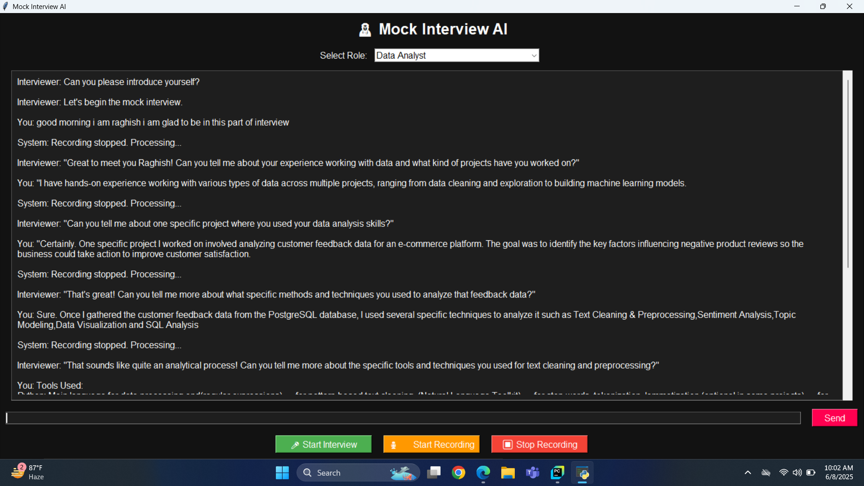
SCREENSHOTS

Slide 30
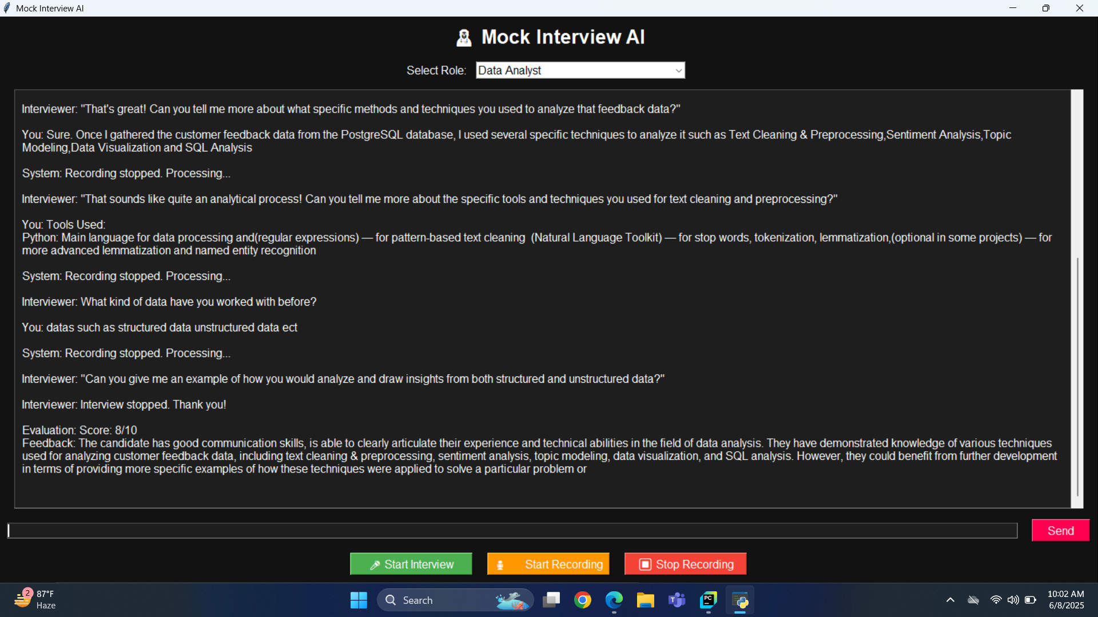
SCREENSHOTS

Slide 31
REFERENCES
S. Barari, J. Angbazo, N. Wang, L. M. Christian, E. Dean, Z. Slowinski, and B. Sepulvado, "AI-Assisted Conversational Interviewing: Effects on Data Quality and User Experience," arXiv preprint arXiv:2504.13908, 2025.
Z. Liu, "Interview AI-ssistant: Designing for Real-Time Human-AI Collaboration in Interview Preparation and Execution," arXiv preprint arXiv:2504.13847, 2025.
N. S. Rai, A. K. R., A. P., and H. N. R., "AI Based Interview Evaluator: An Emotion and Confidence Classifier," International Journal of Advanced Research in Computer and Communication Engineering, vol. 13, no. 4, pp. 1–5, 2025.
Wang. R, Patel. S. “Speech and Sentiment Analysis in AI Interviews”,2023.
S. Dharmatti, A. S. Patil, and R. R. Patil, "Interview Practice-Voice-Based Chatbot," International Journal of Advances in Engineering Research, vol. 23, pp. 45–50, 2022.

Slide 32
THANK YOU

