Slide 1
FairShare AI
Final Review
Stock allocation and shortage decision platform
Team HyperHex | November 2026
Notes:
Welcome. We are Team HyperHex, six members. FairShare AI helps Wrenfield Hygiene divide scarce stock fairly: code calculates, agents explain, a manager decides.

Slide 2
Team HyperHex
Six members, six modules
RA
Roshan Aboorva Raj J
RU
Rajesh U
AC
Abhishek Choudhary
Module owned:
Module owned:
Module owned:
add module here
add module here
add module here
KS
Konala Suhan Jayakar
MB
Mokshitha Busi
AT
Ankita Tiwari
Module owned:
Module owned:
Module owned:
add module here
add module here
add module here
Notes:
Introduce the team. Each member owns one of the six modules shown later; add the module under each name.

Slide 3
Agenda
Problem and objectives
Solution and architecture
The six modules
Live demo flow
Governance, results and requirements
Challenges, next steps and Q&A
Notes:
Twenty minutes: two minutes on the problem, three on architecture, about eleven on the six modules, then demo flow, governance and close.

Slide 4
The business problem
Wrenfield Hygiene: one distribution centre, 180 business customers
Why allocation by hand does not work
2,960 vs 1,200
3 routes
Orders exceed stock. 2,960 cases ordered of HS-0500 when only 1,200 exist.
One order, three notations. C0021 / CUS-0021 / Acct 21; units, cases or pallets.
Orders arrive twice. The same purchase order can come through two routes.
Rules differ by category. Five policies, four rules each: history weeks, cap, protected customers, reserve.
Too many shortages. 40 products are on allocation at once; the desk cannot work them in arrival order.
Decisions need an owner. Nothing may be confirmed or sent until a manager decides.
cases ordered vs in stock (HS-0500)
EDI, Portal and Email, each with its own notation
40
180
products on allocation in the live queue
business customers across 8 channel types
Notes:
When a product runs short, orders add up to far more than the cases available. The supply desk must decide who gets how many cases. That is hard to do by hand.

Slide 5
What the platform must deliver
Eight requirements from the problem statement
1
Clean the data
2
Three models
3
Knowledge base
4
Policy-driven rules
Five raw extracts with defects, and a report of what cleaning did to each.
Inflated-order classifier, next-week demand regressor, email request classifier.
Sixteen documents; every statement traceable to its document.
History weeks, cap, protected channels and reserve read from each policy.
5
Exact allocation
6
Agents and a human gate
7
Service and dashboard
8
Grounded chat
Notation read per route, duplicate POs kept once, every case accounted for.
Seven agents, one LLM call each, no case decided; pause for a different manager.
REST API, sign-in, three roles, access refused in the service, full audit.
One LLM call per question; refuse if uncovered; adviser needs account and postcode.
Notes:
These are the requirements we built against. Every one maps to a module and is traced in the requirements table later.

Slide 6
Our approach: five responsibilities, kept apart
Each part does one job, so every result can be explained and audited
M2 Models
M3 Knowledge
M4 Allocation
M5 Workflow
M5 gate + M6
ML predicts
RAG retrieves
Code calculates
Agents explain
Human decides
Scores, forecasts, request types
The exact policy rules and guidance
Every customer's cases, exact fractions
Seven agents, one LLM call each
A different Supply Planning Manager
An agent can explain a number. It can never create or change one.
Notes:
This is the key design idea. Machine learning predicts, retrieval finds the rules, code calculates cases, agents explain, and a human decides. An agent can never create or change a number.

Slide 7
System architecture
Build time prepares the artefacts; run time serves them through one API
BUILD TIME (run once, in order)
run_database_setup
6 tables, 14 accounts
run_data_pipeline
5 clean CSVs + report
run_model_training
3 models + metrics
run_knowledge_indexing
16 PDFs to Chroma
run_api_service
FastAPI :8081
run_dashboard
Streamlit :8080
RUN TIME
LangGraph workflow
10 nodes, 7 agents
Human gate
a different manager decides
Users
Planner
Manager
Adviser
Streamlit dashboard
5 pages, no rules, reads no files
FastAPI service
authorize_request: token, role, area
11 endpoints, locks
Chat
1 LLM call per question
workflow and chat read and write the stores
DATA AND STORES
Input CSVs
5 live files + 5 training extracts
Models
3 .pkl + 2 feature schemas
Chroma index
16 documents, 145 sections
fairshare.db
6 tables: the audit record
checkpoint.db
paused workflow state
Coral = service and decisions | Purple = AI agents | Steel = data and models | Grey = people and scripts
Notes:
Top row: six scripts run once in order. Below: the dashboard talks only to the API. The API guards every request, starts the workflow, which pauses at the human gate. Data lives in models, Chroma, fairshare.db and checkpoint.db.

Slide 8
Technology stack
Chosen for exactness, auditability and a single local deployment
Layer | Technology | Why
Data cleaning | pandas; config-driven patterns | Read as text, repair by named rules, refuse the unreadable
Machine learning | scikit-learn 1.9.1: HistGradientBoosting, TF-IDF + LogisticRegression | Native missing-value handling, monotonic constraints, fast text model
Knowledge base | pypdf, all-MiniLM-L6-v2, ChromaDB (cosine) | Persistent, traceable passages with document names
Agents | LangGraph with SqliteSaver; Google Gemini | Pause and resume, checkpointing; one text call per agent
API | FastAPI, Pydantic, uvicorn | Strict request and reply shapes; auto docs at /docs
Database | SQLAlchemy over SQLite | Six tables, one repository, transactions
Dashboard | Streamlit | Fast role-based pages that only call the API
Security | PBKDF2-HMAC-SHA256, secrets tokens | Salted hashes, constant-time compare, one session per user
Notes:
Standard, well-supported Python libraries throughout. Gemini is used only for text, one call per agent or chat question.

Slide 9
The six modules
M1 to M6, from data to dashboard
Notes:
Now the six modules, three to four slides each: what goes in, what happens, what comes out.

Slide 10
M1 Three routes, one order
M1 Data pipeline
The same purchase order arrives in three notations
Route | account_code | quantity | How it becomes cases
EDI | C0021 | 12000 units | 12 units per case: 12000 / 12 = 1,000
Portal | CUS-0021 | 1000 cs | cases are used as they are: 1,000
Email | Acct 21 | 20 plt | 50 cases per pallet: 20 x 50 = 1,000
One clean row
CUS-0021
1,000 cases
The route decides
Refused, never guessed
What counts as a duplicate
EDI C + 4 digits; Portal CUS- + 4 digits; Email Acct + number
Quantities: units, cs or plt, by route
Pack size and pallet size come from the data
CUS-0021 on an EDI line
Units that are not a whole number of cases
Units or pallets with no pack size
A PO under two accounts
Same PO and same product: first arrival kept
Different PO numbers: both kept and added
Converted first, then compared
Notes:
The same order can arrive by EDI, Portal and Email, each written differently. The route decides which notation is valid; the cleaner converts all three to the same account and the same number of cases. Anything unreadable is refused, never guessed.

Slide 11
M1 The cleaning pipeline
M1 Data pipeline
run_data_pipeline.py: load, clean, save, profile for each of five extracts
Load as text
Remove duplicates
Normalise names and categories
Convert numbers, packs, accounts, cases
Impossible values to missing
Drop rows with no target
Profile and report
Repairs (named functions)
What is dropped or blanked
Why the order matters
normalize_category_values: 'e-mail' to Email
convert_whole_numbers: '3 weeks' to 3
convert_decimal_numbers: '45%' to 45.0
convert_pack_descriptions: '500ml x12' to 12x500ml
convert_account_code, convert_quantity_to_cases
keep_first_arrival_of_each_order
Exact duplicate rows
Rows with no target (the answer to learn)
Emails with no label or too few words
Impossible values (below minimum, count above total) become missing and the row is kept
Accounts and quantities are converted before duplicates are compared
Every value is read before any row is dropped, so a bad value is caught
The same functions clean live open orders and emails, so training and live data match
Notes:
Each extract goes through the same four stages. dataset_loader reads everything as text; common_cleaning holds the repair functions; three cleaners define the recipe; quality_profiler counts what changed.

Slide 12
M1 Results: five extracts cleaned and audited
M1 Data pipeline
Every removed row is explained exactly once
Extract | Received | Kept | Removed
order_history_train | 34,338 | 31,663 | 2,675
order_history_eval | 8,870 | 8,218 | 652
weekly_demand_train | 32,005 | 30,855 | 1,150
weekly_demand_eval | 10,579 | 10,214 | 365
customer_emails | 36,712 | 35,223 | 1,489
Total | 122,504 | 116,173 | 6,331
122,504
116,173
6,331
The audit identity
rows received
rows kept
removed (5.2%)
rows_removed = duplicate_rows + rows_missing_target + dataset-specific removals
Saved to output/data_quality_report.json
Also reused at run time: fetch_open_orders and fetch_open_emails apply the same cleaners to the live files.
Notes:
122,504 rows received, 116,173 kept, 6,331 removed. The quality report breaks every removal into duplicates, missing targets and dataset-specific defects, so nothing disappears without a reason.

Slide 13
M2 Three models, three jobs
M2 Models
Each model produces evidence for the review; none of them decides a case
Model | Question | Type | Target | Algorithm | Main metric (minimum)
Inflated order | Will this customer cut or cancel this order once supply recovers? | Binary classifier | cut_after_shortage | HistGradientBoostingClassifier | ROC AUC (0.72)
Demand | How many cases will this customer need next week? | Regressor | next_week_cases | HistGradientBoostingRegressor, Poisson loss | R-squared (0.84)
Request type | What is this email asking for? | Text classifier, 8 classes | request_type | TF-IDF + LogisticRegression | Macro F1 (0.85)
Tree models
Poisson loss
Balanced weights
Handle missing numbers natively and give probabilities; monotonic rules keep scores sensible.
Demand is a count of cases, so the forecast can never be negative.
The text model weights rare request types up so urgent ones are not ignored.
Notes:
Two tabular models and one text model. The inflated-order score warns the planner, the demand forecast ranks the queue, and the request type tells the agent what each customer is asking for.

Slide 14
M2 One preparation step, saved with each model
M2 Models
feature_builder.py and model_registry.py: identical preparation in training and live scoring
Training
(once)
Clean CSVs from M1
build_feature_frame
Prepare: fill, one-hot
Fit on TRAIN rows
Score held-out, save
Live scoring
Live rows (cleaned)
Same build_feature_frame
SAME saved pipeline
predict / predict_proba
Score, forecast, type
Preparation rules
Split and scoring
Business sense built in
Numbers pass through; a gap stays NaN
Blank category becomes 'missing', then one-hot
Unseen category becomes all zeros, never a crash
No new features invented
Orders: 31,663 train, 8,218 held-out
Demand: 30,855 train, 10,214 held-out
Emails: 28,178 train, 7,045 held-out (80/20, stratified, seed 42)
Scores on rows never used to fit
Monotonic: score never falls as the order rises above usual
Forecast never falls with a higher 4-week average or a promotion
No class weight on the order model, so score bands stay honest
Notes:
The preparation step and the estimator are saved as one pipeline. Live rows go through exactly the same step, which prevents train-serving skew. The feature builder selects and types columns; it does not invent new features.

Slide 15
M2 Results: every model beats its minimum
M2 Models
Held-out scores from output/model_metrics.json
0.7799
0.9156
ROC AUC, inflated order (min 0.72)
R-squared, demand (min 0.84)
0.9352
25.9
macro F1, request type (min 0.85)
demand MAE in cases (baseline 104.9)
All three models meet their minimum
Generalisation gaps are small: 0.046, 0.024 and 0.040
Notes:
All three models meet the configured minimum on held-out data. Demand R-squared is 0.9156 against 0.84; the order model ROC AUC is 0.7799 against 0.72; the request model macro F1 is 0.9352 against 0.85. Demand MAE is 25.9 cases versus 104.9 for always guessing the average.

Slide 16
M2 Reading the numbers
M2 Models
Request model per-class F1 and inflated-order detail
Inflated-order metric | Held-out | Train
ROC AUC (main) | 0.7799 | 0.8256
Accuracy | 0.7821
Precision | 0.6344
Recall | 0.3597
F1 | 0.4591
Mean predicted probability | 0.2509
Positive share (actual) | 0.2571
Calibration check
Mean predicted 0.2509 vs actual 0.2571: the probabilities are honest, so the HIGH 0.60 and MEDIUM 0.30 bands mean what they say.
Evidence only: a high score escalates nothing and moves no case. The policy cap already limits over-ordering.
Notes:
The request model is strong on all eight classes; the weakest is Forecast update at 0.915. The order model is deliberately a warning signal: its mean predicted probability of 0.251 matches the real positive share of 0.257, so the HIGH, MEDIUM and LOW bands are honest.

Slide 17
M3 From 16 PDFs to a searchable index
M3 Knowledge
run_knowledge_indexing.py builds a persistent Chroma collection
16 PDFs
pypdf, file-name order; empty page refused
Sections
exactly one header; numbering 1, 2, 3 with no gap
Chunks
sentence-safe, up to 700 characters
Embeddings
all-MiniLM-L6-v2 on CPU
Chroma
collection allocation_documents; document_name kept
Setting (config) | Value
Chunk size | 700 characters
Overlap | up to 120 characters, whole sentences only
Embedding model | all-MiniLM-L6-v2
Vector store | Chroma, persistent, cosine distance
Chat results per question | 4, accepted if distance is 0.65 or less
Excluded from chat | Past-Shortages-Casebook.pdf
16
145
documents
numbered sections
Why sentence-safe chunks
A rule like 'no more than 1.0 times usual demand' is one sentence. It is never cut in half, so the pattern matcher always finds it.
Notes:
Sixteen PDFs are split at their numbered sections, then into sentence-safe chunks of up to 700 characters with a small whole-sentence overlap, embedded with MiniLM and stored in Chroma. Each chunk keeps its document name for traceability.

Slide 18
M3 Policy rules: read exactly, never guessed
M3 Knowledge
read_allocation_policy('Hand hygiene'): every chunk of that category's own policy
Policy sentences (Hand hygiene)
policy_rules (structured)
Refused when
usual demand over the last 8 weeks
an order counts for no more than 1.0 times usual demand
Healthcare customers are protected
up to 10 percent may be held in reserve
{
"history_weeks": 8,
"cap": Fraction(1, 1),
"protected_channels":
["Healthcare"],
"reserve_percent": 10,
"rule_sentences": {...}
}
A rule is missing
A rule is stated twice differently
Protected is both 'these' and 'none'
A protected channel is unknown
The category has no policy
Exact and complete, not 'closest in meaning'
The cap is kept as an exact Fraction. The same sentence found in two overlapping chunks counts once.
Notes:
The four rules are not found by similarity search. The code takes every chunk of the category's own policy, matches each rule's sentence pattern, and refuses a policy where a rule is missing, repeated or contradictory. No rule value lives in code or config; change the PDF, re-index, and allocation follows.

Slide 19
M3 Retrieval: guidance and grounded chat
M3 Knowledge
Three ways to read the same index, each chosen for what it must guarantee
 | Policy rules | Guidance passages | Chat
Reads | every chunk of ONE policy | 1 nearest passage in ONE document | 4 nearest passages, all permitted documents
Method | sentence patterns (regex) | semantic search, filtered | semantic search + distance limit
Refuses when | a rule is missing or contradicted | none | closest distance above 0.65
LLM calls | 0 | 0 (the agent using it makes its own) | exactly 1
Answered
Refused
Status is not a document
Distance 0.31 (illustrative) is under 0.65, so the model may answer, citing Allocation-Policy-Hand-Hygiene.pdf.
Distance 0.92 (illustrative) is over 0.65: type OUT OF SCOPE, was_refused = true, and the refusal message.
ALLOCATION STATUS is answered from the database. The adviser needs the account code and the matching postcode.
Notes:
Policy rules need certainty, so they are read exactly. Guidance and chat need relevance, so they use meaning-based search, either filtered to one document or limited by a distance threshold. Allocation status comes from the database, never from documents.

Slide 20
M4 From orders and shipments to eligible cases
M4 Allocation
tools/allocation_tools.py: the only place a case is calculated
Input | Source | Example
Cases available | shortage_products.csv | DW-0900: 2,105
Open orders | open_orders.csv (cleaned) | Greenacre ordered 1,234
Shipments | shipment_history.csv | cases shipped per week
Channel | customer_master.csv | protected or not
Four rules | category policy PDF (M3) | weeks, cap, protected, reserve
Usual demand
cases shipped in the last N weeks / N (a silent week counts as 0; exact Fraction)
Eligible ('may have')
min( ordered , floor( cap x usual demand ) )
DW-0900, real figures
Ordered 6,713 -> may have 5,521 -> cover 2,105 x 100 / 5,521 = 38.13%
Cover
cases available x 100 / total eligible
Greenacre Foodstores: ordered 1,234, may have 674. The policy cap, not the order size, sets each customer's ceiling.
Notes:
Three inputs combine with the four policy rules. Usual demand is shipments in the last N weeks divided by N, held as an exact fraction. Eligible cases are the smaller of ordered and the capped usual demand. Cover is available divided by eligible. DW-0900: Greenacre ordered 1,234 and may have 674.

Slide 21
M4 Dividing 1,200 cases: HS-0500
M4 Allocation
Protected customers first, then reserve, then a share by usual demand
1
Serve protected customers in full (400)
2
Reserve = floor(10% x 800) = 80 (reserve option only)
3
Share the rest by usual demand
4
Anyone at their ceiling takes it and leaves; share again
Customer | May have | RELEASE | WITH RESERVE
Northgate (Healthcare) | 250 | 250 | 250
Saverly Discount | 20 | 20 | 20
Greenacre Foodstores | 400 | 293 | 262
Brightline Cleaning | 90 | 66 | 59
5
Floor to whole cases; leftovers by largest remainder, larger demand, lower code
Check: 400 + 800 = 1,200 placed; 400 + 720 + 80 reserve = 1,200.
Notes:
Healthcare is protected, so Northgate 250 and Oakhaven 150 are served in full: 400. That leaves 800. Under RELEASE all 800 is shared. Under RELEASE WITH RESERVE, 10 percent of 800 is held back, so 720 is shared. Customers already at their ceiling do not change; the others give up a little, exactly the 80 reserve.

Slide 22
M4 Open decisions: why DW-0900 escalates
M4 Allocation
summarise_allocation decides what the manager may choose
A decision is closed when... | RELEASE | WITH RESERVE | ESCALATE
Nothing is eligible | closed | closed | open
A protected customer would be short | closed | closed | open
Cover is below the minimum | closed | closed | open
The policy holds no reserve | open | closed | open
Guarantees in code
Cases available = placed + reserve + in stock
Never more than eligible, never more than available
Exact Fraction arithmetic; whole cases only
Fixed tie-break: largest remainder, larger demand, lower code
Same input always gives the same answer
No model or LLM output is an input to allocate_cases
DW-0900 Dishwash Liquid 900 ml
2,105 available, 5,521 may have
Cover 38.13%: below the minimum release cover
Only ESCALATE is open
Tom Hadley escalated it: 'The cover is less than 50%'
Result: 0 cases confirmed, all 2,105 stay in stock
Notes:
ESCALATE is always open. A release closes if nothing is eligible, a protected customer would be short, or cover is below the minimum; the reserve option also closes if the policy holds no reserve. DW-0900 has 38.13 percent cover, so only ESCALATE is open. The guarantees on the right are why the numbers can be trusted.

Slide 23
M5 The agent workflow: ten nodes, one pause
M5 Agents + HIL
LangGraph StateGraph with a SQLite checkpoint after every node
1 Load facts
code
2 Planner
agent
3 Demand
agent
4 Requests
agent
5 Allocate
code + Advisor
6 Writer
agent
7 PAUSE
waits for a different manager
Router
which decision?
8 Notice
agent, releases only
9 Briefing
agent, every path
10 Record
code, one commit
ESCALATE: no notice
LLM calls per review
The case file (state)
Restart-safe
5 before the pause
7 after RELEASE or WITH RESERVE
6 after ESCALATE
AllocationReviewState, 21 keys. Each node writes only its own keys; llm_call_count is summed.
SqliteSaver writes checkpoint.db after every node; the paused review is still waiting after a restart.
Notes:
Opening a review runs nodes 1 to 6, which is five agent calls and the allocation engine, then node 7 pauses. When a different manager decides, the same thread resumes: releases go through the notice and briefing, an escalation goes straight to the briefing.

Slide 24
M5 What each node reads and writes
M5 Agents + HIL
Every node returns only the keys it adds to the state
Node | Reads | Writes to the state | LLM
1 load_shortage_context | product_code, planner_id, planner_request, thread_id | run_id, review_id, shortage_profile, open_orders, customer_accounts, demand_facts, request_facts | 0
2 plan_allocation_review | profile, orders, customers, request | review_plan {PRIORITY, CHECKS, RATIONALE} | 1
3 analyse_demand | demand_facts, orders, plan CHECKS | demand_analysis {INFLATED ORDERS, ORDERS AGAINST FORECASTS, DEMAND SUMMARY} | 1
4 review_customer_requests | request_facts, plan CHECKS (+ guides) | request_review {CUSTOMER REQUESTS, CHECKS TO MAKE, REQUEST SUMMARY} | 1
5 compute_allocation | profile, orders, customers (+ policy, shipments) | allocation_facts, allocation_advice {4 labels} | 1
6 compose_allocation_recommendation | everything above + forecast shortfall | review saved PENDING_DECISION, run AWAITING_DECISION | 1
7 request_allocation_decision | review_id (+ decision on resume) | allocation_decision, allocation_outcome, allocation_notice = {} | 0
8 draft_allocation_notice | outcome, policy rules (+ customer advice) | allocation_notice {HEADLINE, WHY, HOW, WHAT CUSTOMERS CAN DO} | 1*
9 draft_sales_briefing | outcome, notice headline (+ guidance) | sales_briefing {DECISION TAKEN, WHAT CUSTOMERS WERE TOLD, WHAT TO SAY} | 1
10 record_allocation_outcome | decision, outcome, notice, briefing | decision row, review closed, run COMPLETE | 0
* releases only
Notes:
This is the contract between nodes. Agents write labelled text; code nodes write facts. The Writer's output is stored as the pending review. Node 7 receives the manager's decision when the thread resumes.

Slide 25
M5 Seven agents, one LLM call each, checked in code
M5 Agents + HIL
agents.py: facts in, labelled text out; a bad reply stops the run
1
Build the prompt from facts only: invent no figure, rule or customer
Agent | Labelled fields | Extra check
Planner | PRIORITY, CHECKS, RATIONALE | labels present
Demand | INFLATED ORDERS, ORDERS AGAINST FORECASTS, DEMAND SUMMARY | labels present
Requests | CUSTOMER REQUESTS, CHECKS TO MAKE, REQUEST SUMMARY | labels present
Advisor | PROTECTED CUSTOMERS, LIMITS REACHED, CUSTOMERS SHORT, ALLOCATION SUMMARY | quotes figures exactly
Writer | RECOMMENDATION, RECOMMENDED DECISION | one line, an OPEN decision
Notice | HEADLINE, WHY IT IS SHORT, HOW ALLOCATIONS WERE WORKED OUT, WHAT CUSTOMERS CAN DO | one-line headline, no customer named
Briefing | DECISION TAKEN, WHAT CUSTOMERS WERE TOLD, WHAT TO SAY | no customer named, quotes headline
2
ONE Gemini call (call_language_model); key and model from .env
3
Reject an empty reply or one that did not finish
4
Parse the labelled fields; a missing label is rejected
5
Agent-specific checks (below)
6
Save the call to llm_calls: agent, model, sizes, latency
No agent calculates or changes a case: quantities come only from allocate_cases.
Notes:
Every agent follows the same routine through one shared function. The prompt contains only established facts. The reply must contain every label or it is refused. Extra checks stop the Writer recommending a closed decision and stop notices naming any customer.

Slide 26
M5 The human gate: pause, decide, resume
M5 Agents + HIL
Real review: DW-0900, REV-2DB2EE4803CF
ben opens the review
5 agent calls
Review PENDING_DECISION
saved in fairshare.db
PAUSE
state in checkpoint.db
Tom Hadley decides
ESCALATE + reason
Thread resumes
briefing written
Review ESCALATED
6 calls, 0 cases confirmed
Decision | Cases confirmed | Reserve | Notice | LLM calls
RELEASE | all available | 0 | yes | 7
RELEASE WITH RESERVE | placed, minus reserve | policy % | yes | 7
ESCALATE | 0 | 0 | no | 6
Maker-checker, enforced in the service
ben decides his own review: 403
A planner calls the decision URL: 403
Tom decides: 200, status ESCALATED
Tom again: 409 already decided
RELEASE when only ESCALATE is open: 409
A half-finished decision can be retried
If the notice or briefing call fails after the gate, sending the same decision again finishes the run. A different decision is refused.
Notes:
ben opened the DW-0900 review: five agent calls, then the workflow paused. Tom Hadley, a different manager, escalated it with the reason 'The cover is less than 50%'. The same thread resumed; the briefing was written, the outcome recorded, and the review closed with six calls. Nothing was confirmed and no customer was told.

Slide 27
M6 Eleven endpoints, five areas, three roles
M6 Serve + secure
api/routes.py: the only door into the system
# | Endpoint | Area | Manager | Planner | Adviser
1 | POST /auth/signin | public | yes | yes | yes
2 | POST /auth/signout | public | yes | yes | yes
3 | GET /queue | intake | yes | yes | 403
4 | GET /queue/{product_code} | intake | yes | yes | 403
5 | POST /reviews | review | yes | yes | 403
6 | GET /reviews | audit | yes | yes | 403
7 | POST /reviews/{id}/decision | decision | not own | 403 | 403
8 | GET /reviews/{id}/calls | audit | yes | yes | 403
9 | POST /chat/ask | chat | yes | yes | yes
10 | GET /chat/turns | chat | own | own | own
11 | GET /audit/chat-turns | audit | all | all | 403
Areas by role
Manager: intake, review, decision, audit, chat
Planner: intake, review, audit, chat
Adviser: chat
Status codes
401 not signed in
403 role or own review
404 unknown product or review
409 already reviewed / decided / not open
422 bad shape or value
502 failure inside the work
Notes:
Eleven endpoints. Sign-in and sign-out are public; the other nine sit behind authorize_request. Each route belongs to one area, and each role reaches certain areas. The Manager has five pages, the Planner four and the Adviser one.

Slide 28
M6 Access control in three questions
M6 Serve + secure
access/permissions.py and access/password_security.py
1
Header X-Session-Token present? No: 401
Passwords and sessions
PBKDF2-HMAC-SHA256, 200,000 rounds, a random salt per account
Compared with hmac.compare_digest (constant time)
Token = secrets.token_bytes(24).hex(), one per user
A new sign-in replaces the old token; sign-out clears it
2
Find the account with this session_token. None: 401
3
Route template matched, e.g. (POST, /reviews/{review_id}/decision)
4
area = AREA_BY_ROUTE[(method, template)]; no area means refused
Level | Question | Refusal | Example
Authentication | Who are you? | 401 | no token
Authorisation | May your role reach this area? | 403 | adviser asks /queue
Business rules | Own review? Open? Postcode? | 403 / 409 | ben decides his review
5
Is the area in the role's list? No: 403
6
Yes: the endpoint receives the account
Hiding a page is convenience; this check is the security.
Notes:
authorize_request runs before every guarded endpoint. It turns the token into an account, looks up the area of the route template, and refuses unless the role reaches that area. Passwords are salted PBKDF2 hashes; sessions are random tokens, one per user.

Slide 29
M6 Persistence: six tables, one repository
M6 Serve + secure
persistence/: the permanent record behind audit and restart
Table | Key | One row is...
user_accounts | username | a person who can sign in: role, password hash, session token
agent_runs | run_id | one workflow run: thread, product, planner, status, call count
allocation_reviews | review_id | one review: figures, lines, decisions open, recommendation, outcome
allocation_decisions | decision_id | who decided, their role, what and why
llm_calls | call_id | one LLM call: agent, model, sizes, latency
chat_turns | turn_id | one chat question and answer, postcode withheld
Repository rules
Takes the caller's session
Flushes, never commits
Returns plain dicts
Node 6: one transaction
insert_llm_call (Writer)
+ insert_allocation_review (PENDING)
+ update_agent_run (AWAITING)
= one commit: all three or none
run_id links everything
run, review, decision and every LLM call, so 'why did this customer get these cases?' can be rebuilt from the database alone.
Two SQLite files
fairshare.db is the business record; checkpoint.db holds the paused workflow.
Notes:
database.py builds one shared engine, models.py defines the six tables, repository.py is the only code that reads or writes them. The repository flushes but never commits, so node 6 can save the Writer's call, the pending review and the run status in one transaction.

Slide 30
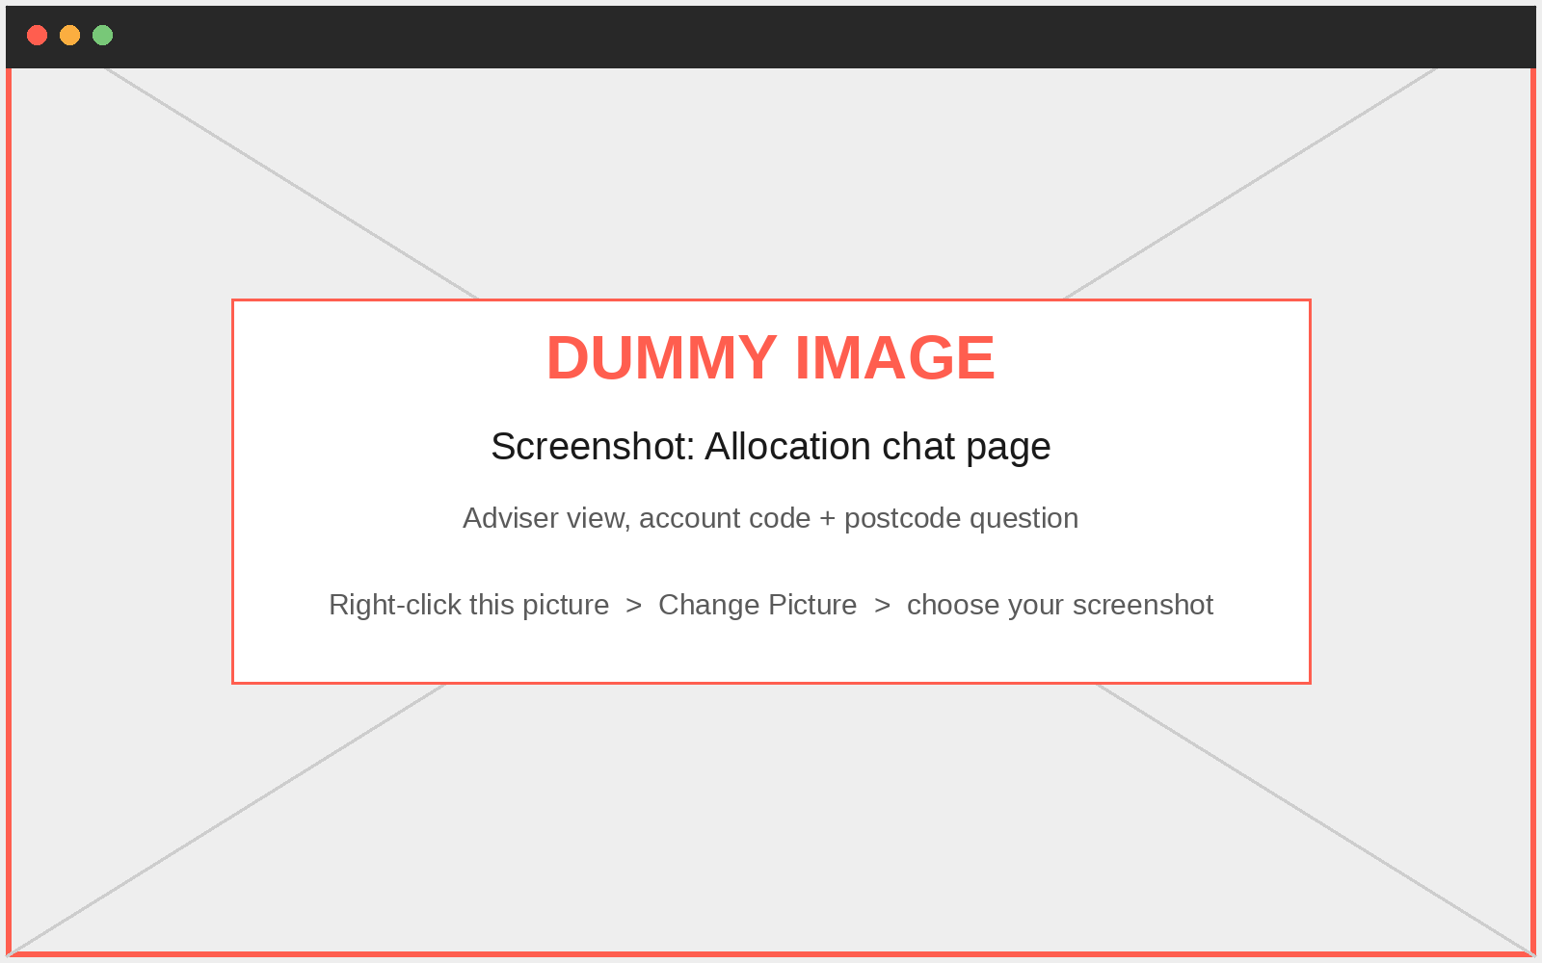
M6 Dashboard and grounded chat
M6 Serve + secure
Streamlit shows what the API returns; it holds no business rule and reads no file
Page | Who sees it | Calls
Shortage queue | Manager, Planner | GET /queue
Allocation detail | Manager, Planner | GET /queue/{code}, POST /reviews
Decision queue | Manager | GET /reviews, POST decision
Audit trail | Manager, Planner | GET /reviews, /calls, /audit
Allocation chat | all three roles | POST /chat/ask, GET /chat/turns
Chat rules
One LLM call per question; refuse if the documents do not cover it
Postcodes removed before the model, memory and storage
Adviser: account code AND matching postcode, else the same refusal
Allocation status comes from the database, not documents
Allocation chat (dummy image: replace with your screenshot)
Same checks twice
The page checks friendly things (own review, open decisions, text length). The service checks them all again.
Notes:
Five role-based pages, all through api_client.call_service. The page list comes from the server at sign-in. Chat makes one LLM call, withholds postcodes before the model sees them, and an adviser only gets an allocation answer when the account code and delivery postcode match the customer master.

Slide 31
Demo and results
How it runs and why it is trusted
Notes:
Now the live flow, the controls that keep AI in its lane, and how every requirement maps to the code.

Slide 32
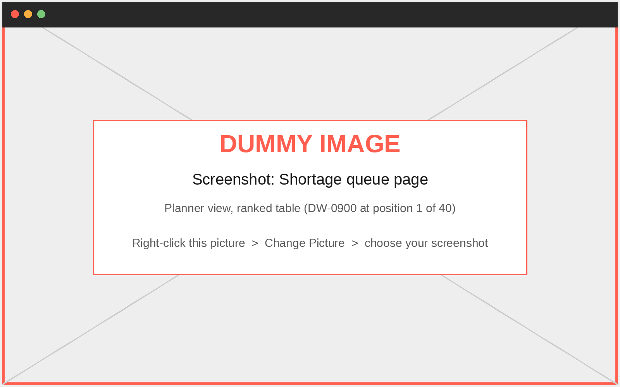
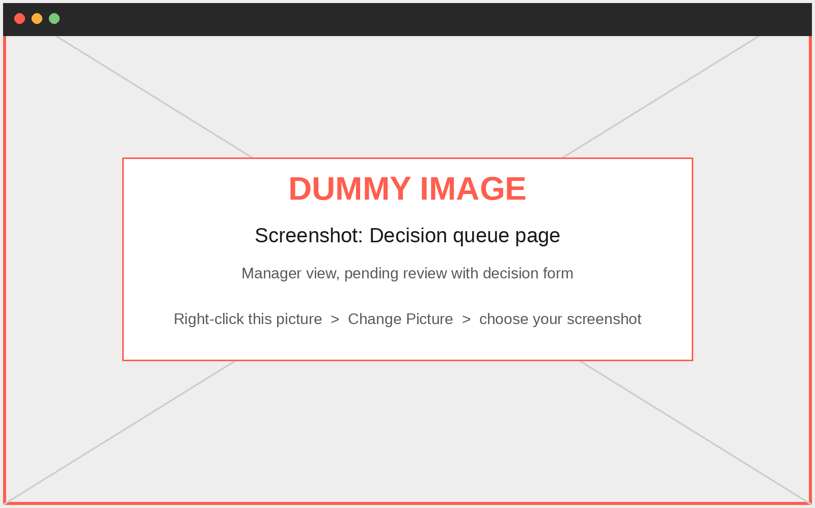
Live demo flow
One real review, three roles, end to end
ben signs in, opens DW-0900
5 agents work; workflow pauses
Tom (not ben) escalates
Audit: 6 calls made, 6 expected
dev asks with account + postcode
Wrong postcode: same refusal
1 Shortage queue (planner)
2 Decision queue (manager)
3 Allocation chat (adviser)
Real review: REV-2DB2EE4803CF
DW-0900 | opened by ben | escalated by Tom Hadley: 'The cover is less than 50%' | 0 cases confirmed, 2,105 stay in stock | 6 LLM calls
Notes:
Walk the demo in this order: ben opens DW-0900, five agents work and the workflow pauses; Tom, not ben, decides; the audit trail shows six of six calls; dev asks with account code and postcode, and a wrong postcode gets the same refusal. Replace the three dummy images with your screenshots.

Slide 33
Governance: how AI stays in its lane
Six controls built into the code, not just into the prompts
1
Numbers only from code
2
One agent, one call
3
Replies checked in code
allocate_cases divides the cases in exact fractions. No AI output is an input to it.
Every call is logged. The audit shows 5, 6 or 7 calls against the expected count.
Missing labels, a closed decision or a named customer: the reply is rejected and the run stops.
4
Independent decision
5
Survives a restart
6
Full audit trail
Only a Supply Planning Manager who did not open the review can decide: 403 otherwise.
The paused review is saved in checkpoint.db and resumes on the same thread.
Run, review, decision and every LLM call are linked by run_id in the database.
Notes:
These are the six controls that let us trust the result: numbers only from code; one call per agent that is logged and counted; replies checked in code; an independent decision; a restart-safe pause; and a complete audit trail.

Slide 34
Requirements mapped to implementation
Each requirement, where it lives, and the evidence
Requirement | Implemented in | Evidence
Clean five extracts and report | data_pipeline/, run_data_pipeline.py | 122,504 rows in, 116,173 kept; quality report JSON
Two tabular models and one NLP model | modeling/, run_model_training.py | ROC AUC 0.780, R-squared 0.916, macro F1 0.935
Searchable knowledge base, traceable | knowledge/, run_knowledge_indexing.py | 16 documents, 145 sections, document_name on every chunk
Four rules read from each policy | knowledge/policy_reading.py | Read from the PDF; refused if missing or contradictory
Route notation, dedupe, exact division | data_pipeline/, tools/allocation_tools.py | Fraction arithmetic; every case accounted for
Multi-agent workflow, one call each | agentic/ | 5, 6 or 7 LLM calls per review, logged
Stop, different manager, survive restart | agentic/graph.py, api/routes.py | 403 on own review; checkpoint.db
Record every run, review, decision, call, chat | persistence/ | Six tables linked by run_id
REST service and dashboard without rules | api/, dashboard/ | 11 endpoints, 5 pages, one API client
Sign-in, role pages, refusal in the service | access/ | 401 and 403 in authorize_request
Grounded chat, one call, postcode rule | chat/ | 0.65 distance limit; same refusal for every failure
Notes:
This is the traceability table. Every requirement from the problem statement maps to a module and to something we can show.

Slide 35
Challenges and how we solved them
Design problems and one real environment problem
Challenge | What we did | Outcome
One order in three notations | Route-specific parsers; refuse what cannot be read | One canonical account and quantity in cases
Rules must not be hard-coded | Read exact sentences from each category's own policy | Change the PDF, re-index, allocation follows
Keep AI away from the numbers | Code-only allocation; agents get facts; checks in code | Agents explain, never decide a case
Pause must survive a restart | LangGraph SqliteSaver; resume on the same thread_id | Review still waiting after an API restart
Inflated orders: score or cap? | The policy cap limits over-ordering; the score is evidence | A HIGH score moves no case
Office network blocked Hugging Face | Cached the embedding model once; HF_HUB_OFFLINE=1 | Indexing and the API run offline
Notes:
Five design challenges and one practical one: the office network blocked the Hugging Face download, so we cached the embedding model once and ran offline.

Slide 36
Next steps
Proposed extensions that keep the same safety rules
1
2
3
4
What-if simulator
Number fact-checker
Fairness scorecard
Hardening
Slide stock, cap or reserve and see the division change. Reuses allocate_cases; never saves or confirms.
Reject any agent reply containing a figure that is not in the facts it was given.
Jain's index and per-channel fill rate beside RELEASE and RELEASE WITH RESERVE.
Hash session tokens and add expiry; PostgreSQL for several instances; scheduled retraining and drift checks.
Proposals only: none of these is built yet.
Notes:
These are proposals, not done work. Each keeps the rule that nothing but code decides a case. The what-if simulator and fairness scorecard make the manager's choice easier; the fact-checker turns the 'invent no figure' instruction into a code check.

Slide 37
Thank you
Team HyperHex | FairShare AI
Notes:
Thank you. We are happy to take questions.

