Slide 1
PSK Personalised Lobby
The lobby should know who is looking at it.
A game recommender that rebuilds the casino lobby around what each player actually plays.
23,673 players
3,202 games
741,679 rows
a trained ranker
Team Q'Makers · Bandlapalli Roshan Babu · C. Kavya Sri · M. Yashwanth
FEG Innovation Challenge 2026 · Croatian brand (PSK) track

Slide 2
Problem Statement
psk.hr's casino lobby is static. Every player sees the same rows. The biggest one is Najigranije — "most played" — an identical global list for all 27,000 players.
The behavioural evidence says that matters. In the FEG event export, the single most common way a player reaches a game is typing its name into search (3,580 launches, ahead of every browsable surface). If you have to search, the lobby did not surface it.
And players are not narrow. In the given datasets, 74% of interactions are with games the player has never played before. They explore constantly — they just explore badly, through a search box and one global row.

Slide 3
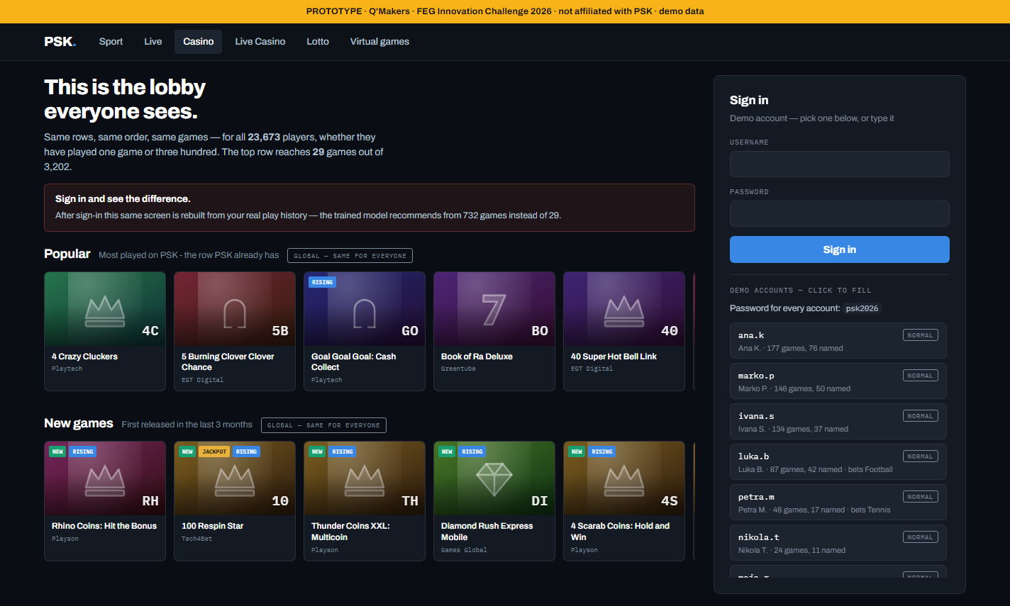
01 / TODAY
One lobby. 23,673 players.
Two rows. Identical for everyone — whether they have played one game or three hundred. The most common route to a game here is typing its name into search. If you have to search, the lobby didn't surface it.
32 of 3,202
games the top row can ever reach — about 1% of the library
01 / 11
Q'Makers · FEG Innovation Challenge 2026

Slide 4
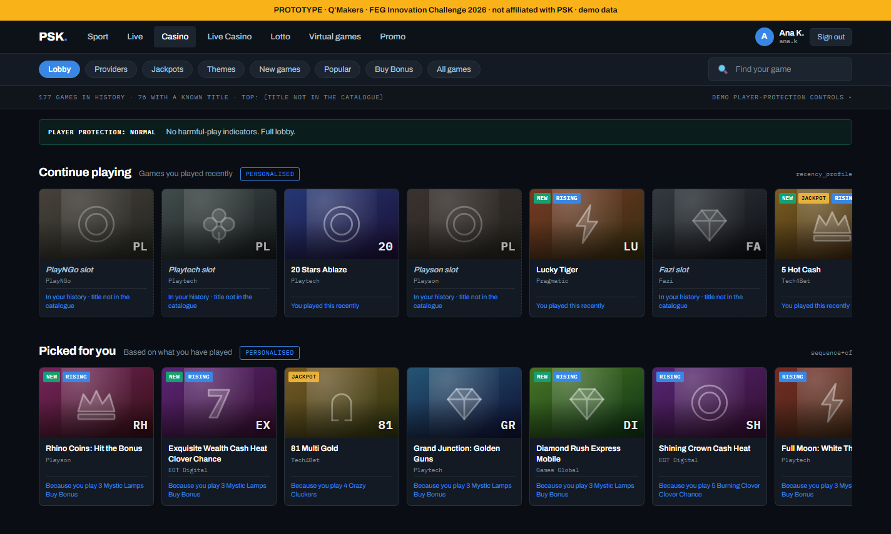
02 / THE PRODUCT
Sign in. Same page.
Two rows become six, built from that player's own history by the trained ranker. Nothing was removed. Popular is still there, unchanged — and that turns out to matter.
Every tile says why. The reason is the model's own largest term — not a generated sentence.
02 / 11
Q'Makers · FEG Innovation Challenge 2026

Slide 5
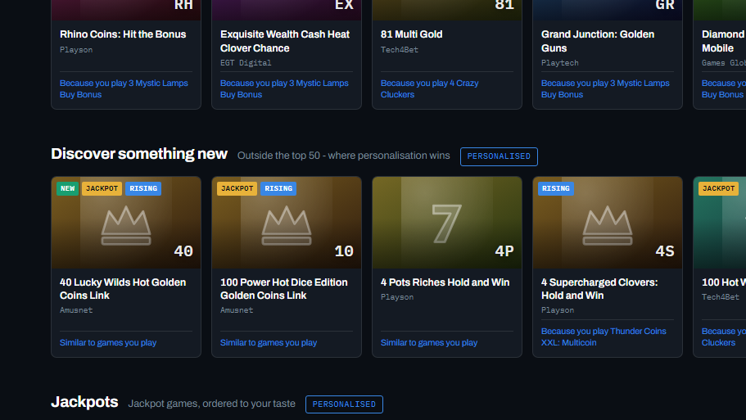
03 / EXPLAINABILITY
Every tile carries the reason it is there.
Not a generated rationale — the single feature with the largest weight × value in the model's own score. A test proves the attribution reconstructs the probability exactly, so /explain can be trusted in an audit.
EU AI Act 2024/1689. Explainability met by construction, not by a report written afterwards.
Dimmed, dashed tiles are games whose title is not in the data. They appear only in your own history — never as a recommendation.
No stake suggestion exists anywhere in the codebase. The system recommends games, never amounts.
No dark patterns. No countdowns, no scarcity, no “others are playing”, no near-miss framing.
03 / 11
Q'Makers · FEG Innovation Challenge 2026

Slide 6
LIVE DEMO
Watch two rows become six.
01
The anonymous lobby — what all 23,673 players see today
02
Sign in as ana.k — the same page rebuilds into six rows
03
Read a tile out loud — that is the model's own top feature
04
davor.z — sign-in REFUSED. Age unverified; the check precedes play
05
lucija.h — signs in, zero rows. Self-exclusion blocks inducements, not account access
12 demo accounts, generated from real player histories in the model. ~25 ms per lobby, and no network on the request path.

Slide 7

Formulation of NDCG
u | one player; U = the cohort (5,921 for your tail task)
i | position in the row, 1-indexed — 1 is the leftmost tile
k | how many tiles you score, 10 here
rel(u, i) | relevance of the item at position i: 1 if player u played it in the test week, else 0
Rᵤ | that player's set of truths; |Rᵤ| ≈ 7.1 on average
k
DCG@k(u) = $Σrel\left(u,i\right)/log₂\left(i+1\right)$
i=1
min(|Rᵤ|, k)
IDCG@k(u) = $Σ1/log₂\left(i+1\right)$
i=1
NDCG@k(u) = DCG@k(u) / IDCG@k(u)
NDCG@k = $\left(1/\left|U\right|\right)·ΣN DCG@k\left(u\right)$
u∈U
DCG = 1/log₂2 + 1/log₂5 + 1/log₂10
= 1.0000 + 0.4307 + 0.3010 = 1.7317
IDCG = 1/log₂2 + 1/log₂3 + 1/log₂4
= 1.0000 + 0.6309 + 0.5000 = 2.1309
NDCG = 1.7317 / 2.1309
= 0.8127

Slide 8
04 / THE FINDING WE DIDN'T WANT
Our recommender lost.
On predicting the next game a player tries, collaborative filtering was beaten outright by the popularity row PSK already ships.
most_played
0.2110
What players try next is overwhelmingly what is already popular. Correlation between a game's popularity and its next-week discovery count is 0.79, and one title takes 13% of all discovery plays on its own. We swept popularity correction, shrinkage, neighbourhood size and eight blend weights before accepting it.
provider_popular
0.1350
item-item CF (ours)
0.0489
NDCG@10 · discovery task · 9,102 players
So we kept the popularity row. Replacing it would have made the lobby worse — which is why Popular is still on the screen you just saw.
04 / 11
Q'Makers · FEG Innovation Challenge 2026

Slide 9
05 / THE RESULT THAT JUSTIFIES THE BUILD
But popularity only knows 29 games.
Remove the global top-50 and it reverses. This is the tail — where 76.5% of all discovery already happens.
Trained ranker
0.0708
4.28×
25×
Blend (seq + CF)
0.0655
better than the row that ships today
the catalogue — 732 games, not 29
Sequence
0.0649
Item-item CF
0.0490
Popularity owns the head. We own the tail. The recommender is additive — nothing that already worked was removed, so the downside is bounded at screen space, and every row ships behind its own feature flag.
most_played
0.0165
NDCG@10 · tail discovery · 5,921 players
05 / 11
Q'Makers · FEG Innovation Challenge 2026

Slide 10
06 / HOW IT WORKS
Two stages: propose, then re-rank.
Cheap models generate candidates; a trained model orders them. The second stage is what beats the blend — and it is also what makes every tile explainable.
Item-item CF
Day-to-day sequence
~200 candidates
Trained re-ranker
Score → reason
Cosine over 23,673 × 3,202, shrinkage, and a popularity correction applied to the similarity
Row-normalised transitions over 1.4M ordered pairs, with recency-decayed profiles
The union per player, with everything already played removed
LogisticRegression · 14 features · ~200k labelled rows
Each score decomposes into weight × value; the largest term is the sentence on the tile
The features. CF score, sequence score, popularity, provider affinity and recency, type affinity, stake momentum, release age, is-new, jackpot, payout ratio, and three player-level terms. Payout ratio is a similarity feature only — never ranked on, never shown, because advertising “this game pays more” is the inducement the AI Act prohibits.
The name bridge. 2,723 game codes carried no title at all. Co-occurrence on (player, day), constrained to matching providers, recovered 180 of them — 37% of all stake. It independently derived that gpas_3chken_pop is “4 Crazy Cluckers”, from a slug it cannot read.
Measured honestly. Three-way temporal split — hyperparameters chosen on a validation week, never the test week. Gradient boosting won a player-split validation and then lost the temporal test: exactly the overfitting you cannot see if you only split by user.
06 / 11
Q'Makers · FEG Innovation Challenge 2026

Slide 11
07 / ARCHITECTURE
Additive middleware on FEG's own stack.
One stateless service reading precomputed artifacts. No GPU, no model API, and no new instrumentation — it reads the warehouse table CA_Player is already exported from.
CA_Player
Pipeline
artifacts/
Service
Vue 3 row
The export FEG already produces. Daily batch, no new tracking required
Clean, name-bridge, features, three-way split. Seconds on one core
18 MB — similarity, sequence, catalogue, ranker. Object storage or the image
Python or Java, stateless, horizontally scaled. ~25 ms, no I/O on the request path
One component, one JSON contract. Render the rows you recognise, ignore the rest
The responsible-play gate sits inside the service, before scoring — not in the client, and not behind a flag anyone can switch off.
What FEG actually builds: a Vue row component (3–4 days), a daily batch job (1 day), and a service deployment (2–3 days). Redis and Kafka are only needed below a daily cadence, so neither is on the critical path. Everything else in the repository is done.
07 / 11
Q'Makers · FEG Innovation Challenge 2026

Slide 12
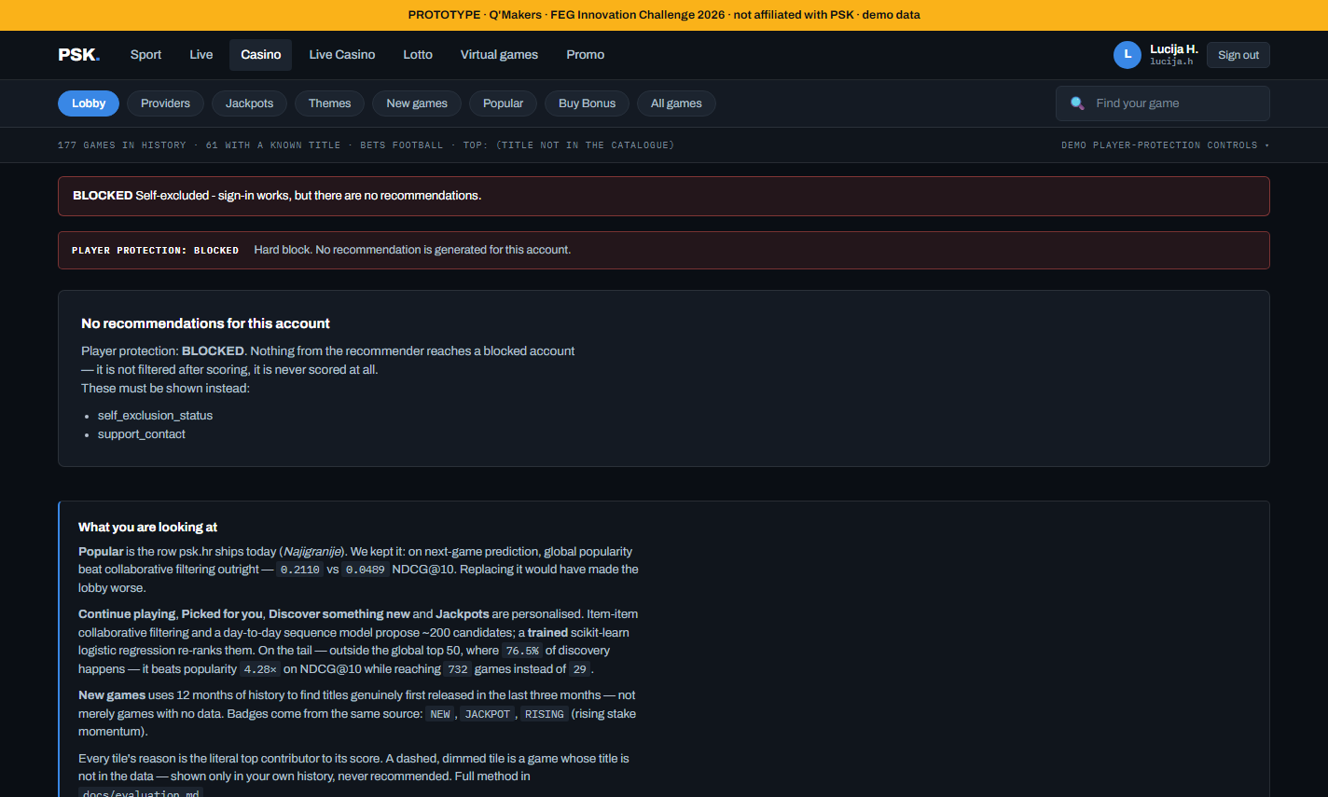
08 / COMPLIANCE BY DESIGN
The gate runs before the model.
Two gates, firing at different points, because the law treats them differently. Both directions are asserted in tests — getting either backwards would be a real compliance failure.
Gate | Where it fires
Age / ID unverified | At sign-in — refused, no session issued at all
Self-excluded | After sign-in — the account opens, the lobby returns zero rows
Self-exclusion blocks inducements, not account access. The person must still reach their account and support — so they sign in, and get zero recommendations plus the required surfaces. Not filtered afterwards. Never scored.
the self-excluded account, signed in — zero rows
08 / 11
Q'Makers · FEG Innovation Challenge 2026

Slide 13
09 / BUSINESS IMPACT
€19.6M a fortnight rides on discovery.
13.7% of all stake sits on games a player was trying for the first time — 138,041 first-time adoptions, median €16.16. That entire flow is served today by a search box.
€17.00
0
€19.6M
median stake on a newly-adopted tail game, against €10.50 on a top-50 game. The tail is not the cheap end
revenue-uplift numbers we are willing to claim. We tested it three ways and it did not survive
on first-time game plays every fortnight — a seventh of all stake
Matched on activity, adopters retain no better and stake less the next week. So we make no revenue claim. What we argue instead: exploration correlates with lower value because exploration currently fails — players hunt and don't find. The job is not more exploration; it is making the exploration they already do succeed.
The experiment that settles it: A/B on the lobby, primary metric = first-time adoptions replayed within 7 days. That separates “found something good” from “tried and bounced”.
09 / 11
Q'Makers · FEG Innovation Challenge 2026

Slide 14
10 / THE ONE ASK
58% of stake is on games we cannot name.
Opaque codes like pop_9f571b7a_egtfeg. They train the model — their co-occurrence is real signal — but they can never be recommended, because a player cannot know what they are being offered.
180
~9×
58%
codes our name bridge already recovered from behaviour alone — 37% of stake, catalogue up to 479 games
of all stake, still on games with no title we can show a player
the addressable inventory, if FEG shares a game catalogue
A game catalogue — code → title, category, thumbnail. It costs FEG a database export. It is the single highest-value thing we could be given, and the only limit here we cannot engineer around.
If the data extraction is proper and clear,the same model and approach can be developed for all the games w.r.t users
10 / 11
Q'Makers · FEG Innovation Challenge 2026

Slide 15
11 / WHERE IT STANDS
The lobby should know who is looking at it.
Today it doesn't. We measured what personalisation can and cannot do here, kept the row that already worked, and added the 732 games it could never reach.
Shipped
Pipeline → model → API → lobby, end to end
A real login journey, 12 accounts from real histories
~25 ms per lobby. No GPU, no model fit at request time
54 tests, green on a clean clone
Eight documents — including the evaluation with the loss in it
Not built — and we say so
No Vue SDK yet — the dashboard is plain HTML
No Kafka/Redis — the pipeline is a daily batch
Prototype auth: hashed and signed, but no rate limiting or MFA
No session-level sequence model
No online experiment — every number here is offline
Team Q'Makers · feg-hackathon-2026-QMakers · FEG Innovation Challenge 2026
11 / 11
Q'Makers · FEG Innovation Challenge 2026

