Slide 1
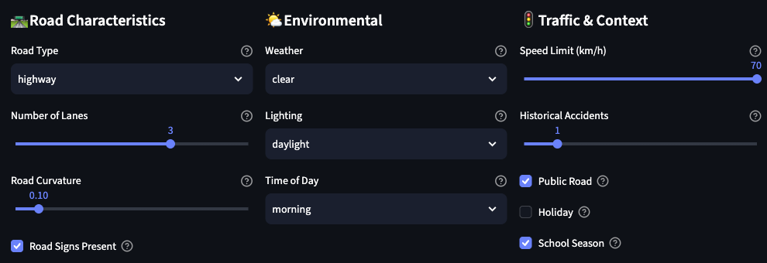
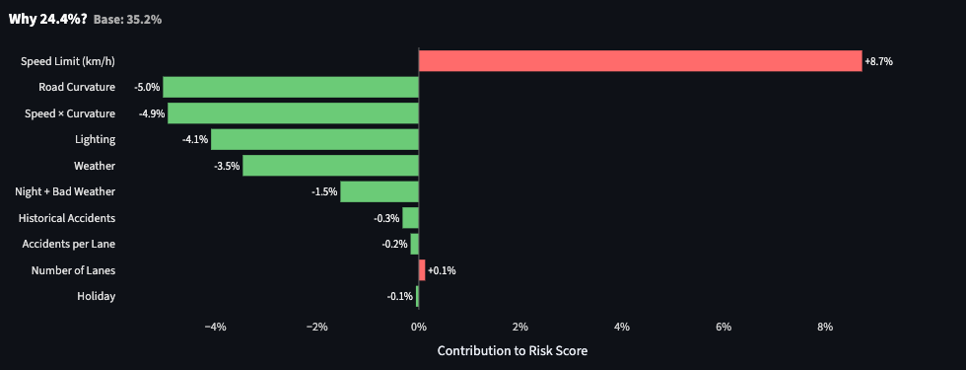
Safe-Route
SSD 2026 · PROJECT P21
An explainable shortlist for road safety checks
Roshan Aryal
Independent Researcher, Auckland, New Zealand
Working prototype: Streamlit app
Notes:
About 30 seconds.
Kia ora, I'm Roshan Aryal. My project is Safe-Route. In one sentence: it helps road engineers decide which road conditions to check first, and it shows the reason behind every suggestion. On the right is the working app. You don't need any machine-learning background for this talk; I'll explain each term as it comes up.
Official project title: Safe-Route: Explainable Risk Scoring for Infrastructure Safety Prioritization.

Slide 2


Which roads should engineers inspect first?
Time and budgets are limited. Safe-Route suggests where to look first.
12 sites · time for 3 visits
Notes:
About 1 minute.
Road safety teams can't visit every site at once. Each inspection takes an engineer's time, so they have to choose. Imagine these twelve sites, but only time for three visits this month. Which three?
A simple way to picture Safe-Route is a hospital triage desk. Triage doesn't treat anyone; it decides who is seen first. Safe-Route does the same for road conditions: it suggests an order for inspections, and the engineer still decides what to do on site.
If asked 'Does it map real roads?': not yet. Today it scores combinations of conditions, like 'rural road, sharp curve, night, rain', rather than a specific stretch of road.

Slide 3
Three terms used in this talk
Each one is explained again when it comes up.
01
02
03
Risk score
Explanation
Practice data
A number from 0 to 1. Higher means the model rates the conditions as riskier.
Which conditions pushed the score up or down, so a person can check it.
Synthetic examples, not real New Zealand crash records.
Notes:
About 1 minute.
Three terms. The risk score is a number between 0 and 1; higher means the model thinks these conditions are riskier. It is not a probability of a crash.
The explanation shows, for every score, which conditions pushed it up and which pulled it down, so an engineer can ask 'does that make sense?'
Practice data: the model learned from computer-generated examples published on Kaggle, a data-science competition site, about 518,000 of them. They are realistic but not real New Zealand crashes. I'll come back to why that matters.
If asked 'Why not real data?': the prototype was built on a public practice dataset so the method could be developed openly. Testing on real New Zealand data is the proposed pilot.

Slide 4
From road conditions to an explained score
The tool suggests. An engineer still decides.
1
2
3
Describe the road
Get a score
See why
Road type, curve, speed limit, lighting, weather and more.
A Random Forest model rates the conditions from 0 to 1.
SHAP shows which conditions raised or lowered the score.
Dataset: about 518,000 synthetic examples (Kaggle Playground Series S5E10). Model: 200 decision trees, 15 inputs.
Notes:
About 1 minute.
The whole tool is three steps. One: describe the road conditions, for example a rural road with a sharp curve, 100 kilometres an hour, at night in the rain. Two: the model gives a score from 0 to 1. The model is a Random Forest: think of 200 simple decision trees that each give an answer, and the tool averages them. Three: it shows why, using a method called SHAP. That last step is the part I care about most.
The key message is the line under the title: the tool suggests, an engineer decides.
If asked 'Why this model?': it is accurate on this data, fast, and works well with SHAP explanations.

Slide 5

What raised and lowered this score?
Example: highway, 70 km/h, daylight, clear weather, gentle curve.
35.2 → 24.4
Average score, then this road once the bars are added. Low: below 75% of practice examples.
Raises the score
70 km/h speed limit
Lowers the score
gentle curve, daylight, clear weather
Contribution to the score in points (app's 0 to 100 display), from TreeSHAP.
The app shows 24.4%. That is a score, not a one-in-four chance of a crash.
Notes:
About 1 minute 30.
These numbers come straight from the working app. The example is a highway at 70 kilometres an hour, in daylight and clear weather, with a gentle curve.
Read the chart like a tug of war. Red bars push the score up; here the speed limit is the biggest push. Teal bars pull it down: the gentle curve, daylight and clear weather. Start from the average score of 35.2, add the bars, and you get 24.4 on the app's 0 to 100 display, or 0.244, which is low: lower than three quarters of the practice examples.
One caution: the app displays this as 24.4 percent. Please don't read that as a one-in-four chance of a crash. It is a score on the practice data's scale.
If asked 'Does lowering the speed limit make the road safer?': the chart explains the model's arithmetic, not cause and effect. That needs a separate real-world study.
If you show the live demo here, open it before the talk; it can take about a minute and a half to wake up.

Slide 6
The model explains 88% of the score's variation
Measured on practice examples it had never seen. Real roads still need testing.
88%
of the variation in the practice score, on one in five examples held back from training.
R² 0.8835
Average error 0.044 on a 0 to 1 scale
Slightly weaker at night: 85.7% in daylight, 84.6% at night.
Notes:
About 1 minute.
How do we know the model learned anything? We hid one in five examples while it was learning, then asked it to score those. It explained about 88 percent of the variation in the practice score. Technically that's an R-squared of 0.88; I reproduced it independently at 0.8835.
It is slightly weaker at night: about 85.7 percent in daylight down to 84.6 percent at night. A small gap, but I report it because night is when risk matters most. The backup slide has every subgroup.
The honest message is the line under the title: doing well on practice data doesn't prove it works on real roads.
If asked 'Is 88 percent the share of crashes it predicts?': no. It is how much of the variation in the practice score it reproduces.

Slide 7
The top 10% hold 18.2% of the predicted score
Sort every practice example by its score, then look at the highest tenth.
1.82×
their fair share of the predicted score
Measured on the model's own scores. Whether it finds real problem sites is the next test.
Notes:
About 1 minute.
Is a shortlist worth anything? A simple check: I sorted all the practice examples from highest to lowest score and looked at the top ten percent. Those examples hold 18.2 percent of the total predicted score, so 1.82 times a fair share. Focusing on the top of the list does concentrate attention where the model scores highest.
Be clear about what this is: it describes the model's own scores on practice data. It is not a count of real crashes or injuries prevented.
If asked for more: the backup slide shows the top 1, 5, 10 and 25 percent. The top 1 percent is 2.23 times.

Slide 8
Three limits before real-world use
Built for planning roads, not judging drivers. No personal data is used.
1
Not a real crash probability
The model learned from synthetic practice data.
2
Not tested in other places or years
The data has no locations or dates.
3
Not proof that a fix works
Explaining a score does not show that changing the road helps.
Notes:
About 1 minute.
Three limits, upfront. One: the scores are not real crash probabilities, because the model learned from practice data. Two: we can't yet say how it would work in another region or a later year, because the data has no locations or dates. Three: the explanation tells you why the model scored something high. It does not prove that changing that thing would make the road safer.
And one boundary that is a design choice, stated under the title: it only looks at road and weather conditions. No driver names, ages or personal data. It's for planning road work, not for blaming drivers, policing or insurance.

Slide 9
Next: test it on real New Zealand roads
A retrospective pilot with a council or road authority.
1
2
3
Gather council data
Compare fairly
Engineer review
Crash records, road details and traffic volumes.
Does the shortlist beat how sites are chosen today?
Record where engineers agree or disagree with the list.
SDG 3.6 Fewer road deaths and injuries SDG 11.2 Safe transport for everyone
Notes:
About 1 minute 15.
What would prove it useful? A pilot with a council or road authority, in three steps. One: gather real data: crash records, road details and traffic volumes. Two: compare fairly. Run the shortlist on past years and check whether it points to the right places better than how sites are chosen today. Three: work with engineers and record when they agree or disagree with the list, because their judgement is part of the system.
This connects to two United Nations Sustainable Development Goal targets: 3.6, reducing road deaths and injuries, and 11.2, safe transport for everyone. Today the contribution is at the planning stage. Any claim of fewer injuries would need real outcome data.

Slide 10


An explainable shortlist for road safety checks
Next: test it on real New Zealand roads.
Live demo
Source code
Demo roadaccident-roshanar-aryal.streamlit.app
Code github.com/roshanaryal1/SafeRoute
Roshan Aryal
Thank you. Questions welcome.
Notes:
About 30 seconds.
If you remember one thing: Safe-Route gives engineers a shortlist of road conditions to check first, with the reason for each one, so people stay in charge. The next step is testing it on real New Zealand roads. You can try the demo or read the code with these QR codes. Thank you, I'm happy to take questions.

Slide 11
Predicted-score concentration by shortlist size
Ranked by predicted practice score. Each shortlist includes the rows above it.
Shortlist | Examples | Score share | Concentration
Top 1% | 5,177 | 2.2% | 2.23×
Top 5% | 25,887 | 9.9% | 1.98×
Top 10% | 51,775 | 18.2% | 1.82×
Top 25% | 129,438 | 39.3% | 1.57×
All examples | 517,754 | 100% | 1.00×
Notes:
Backup, only if asked.
Say: The smaller the shortlist, the more it concentrates the predicted score. The top 1 percent holds 2.23 times its fair share, the top 10 percent 1.82 times, and the top quarter 1.57 times. These are the model's own scores on practice data, not real crashes.
Source note: from compute_concentration.py and CONCENTRATION.md. An earlier draft quoted 19.3 percent; that figure ranked on the true labels by mistake and was corrected to 18.2 percent.

Slide 12
Performance by road type, lighting and weather
Held-out 20%: about 104,000 examples. Overall R² 0.8835, average error 0.044.
Split | Groups | Score variation explained (R²)
Road type | Highway / Rural / Urban | 88.4% / 88.5% / 88.1%
Lighting | Daylight / Dim / Night | 85.7% / 85.1% / 84.6%
Weather | Clear / Foggy / Rainy | 87.7% / 88.4% / 87.5%
Regional and demographic fairness could not be tested: the data has no such fields.
Notes:
Backup, only if asked.
Say: Performance is very similar across road types and weather, around 88 percent. The one visible gap is lighting: it drops from 85.7 percent in daylight to 84.6 percent at night. I could not test fairness across regions or groups of people, because the data has no such fields.
Source note: from ssd2026/MODEL_VALIDATION.md. Group sizes are about 31,000 to 37,000 each. Mean absolute error rounds to 0.044 for all three road types.

