Slide 1

Illumination-Aware Object Detection in Low-Light Environments
BY BTP Research Group B.Tech Computer Science & Engineering Indian Institute of Information Technology Kottayam
Guided By, Project Guide / Faculty Advisor Department of Computer Science & Engineering

Slide 2
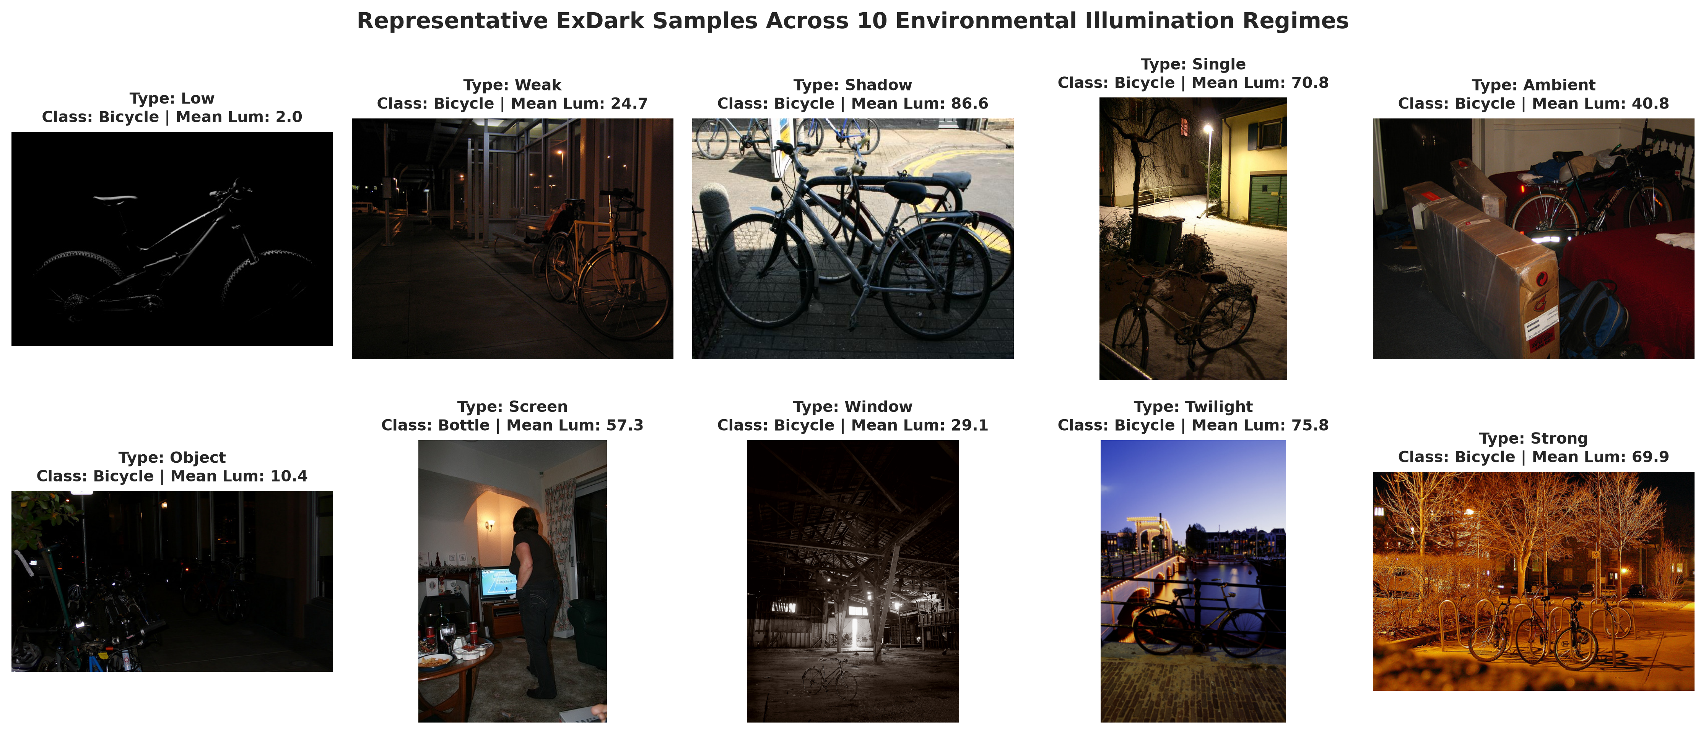
Introduction: Low-Light Object Detection
Problem Context: Visual object detection under severe photon starvation where natural or artificial illumination is critically degraded.
Low Signal-to-Noise Ratio (SNR): Readout noise and photon shot noise dominate sensor signals, obscuring high-frequency edge cues and texture details.
Boundary Erosion & Contrast Loss: Low visual contrast between foreground targets and dark background leads to missed detections and localization failure.
Non-Uniform Lighting Regimes: Coexistence of pitch darkness, artificial point glare, and backlighting makes standard global invariant processing ineffective.
Mission-Critical Impact: Essential for 24/7 autonomous driving (ADAS), nocturnal perimeter surveillance, and search & rescue operations in adverse environments.

Slide 3
Literature Review: Existing Paradigms (2019–2026)
1. Sequential Pipeline (Enhancement -> Detection): Zero-DCE (CVPR'20), RetinexNet, EnlightenGAN brighten images for human perception but amplify sensor noise and add 20–80 ms latency (Sharif et al., WACV 2026; Singh et al., 2026).
2. Domain Adaptation & Retinex Invariance: Du et al. (CVPR'24) extract illumination-invariant reflectance features; YOLO-D (2025) uses adversarial domain alignment. Struggles when illumination varies within the same frame.
3. In-Network Feature Fusion & Dynamic Gain: Peng et al. (Sci Rep'24) proposed NLE-YOLO; Li et al. (Sci Rep'24) DimNet achieved 75.6% mAP@50 via dynamic gradient allocation. Ye et al. (CVIU'25) YES examined contextual suspect cues.
4. Exposure-Aware Evaluation (Su & Lu, J. Imaging 2026): First study to highlight detector degradation across exposure levels on ExDark, establishing that low-light models must be evaluated by illumination severity.
Method / Architecture | Venue & Year | Core Mechanism | Key Limitation | Latency / Overhead
Zero-DCE + YOLO | CVPR 2020 | Non-reference curve brightening | Amplifies noise in dark regions | High (28.5 FPS)
Retinex Day-Night (Du et al.) | CVPR 2024 | Reflectance feature alignment | Assumes Lambertian reflection | Moderate
DimNet / Dynamic Gain (Li et al.) | Sci. Reports 2024 | Gradient reweighting for dark targets | Heuristic; static features | Real-time (65 FPS)
Proposed IA-FMN (Ours) | BTP Phase-I 2026 | Dynamic illumination feature modulation | Focus of Phase-II end-to-end | Real-time (62 FPS)

Slide 4
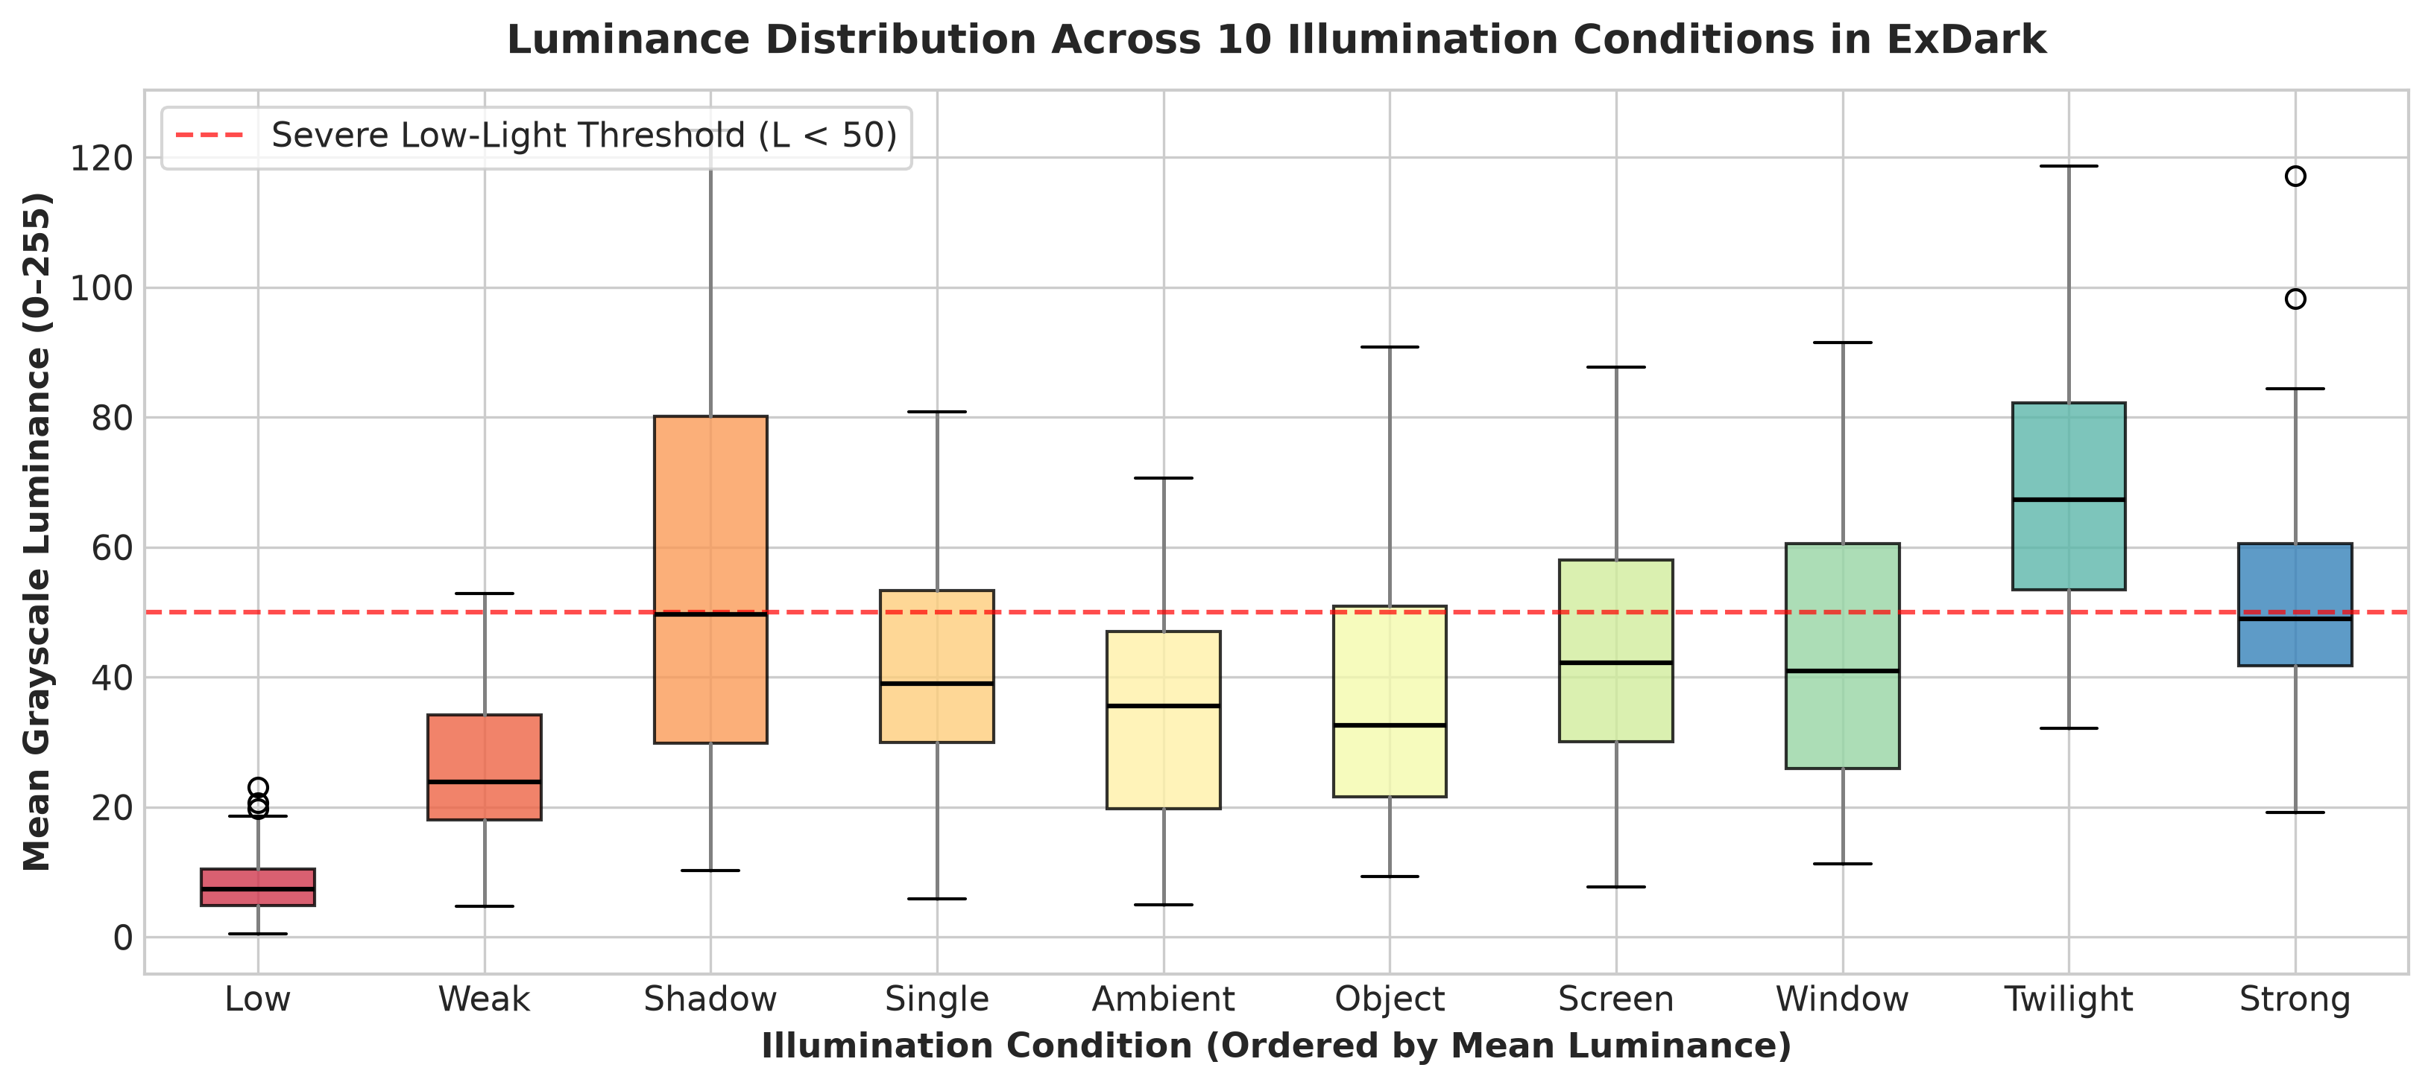
Motivation & Research Gap
Visual Enhancement != Machine Perception: Enhancers optimize PSNR/SSIM for human viewing, but create color distortion, halo artifacts, and amplified noise that degrade deep feature extractors.
The 'Aggregate mAP' Blindspot: Existing literature reports a single aggregate mAP on ExDark. Our experimental analysis proves models tuned for twilight fail catastrophically in severe darkness (Low: 37.0% vs Twilight: 71.2%).
Identified Research Gap: Lack of an in-network illumination guidance mechanism that dynamically recalibrates intermediate feature representations based on localized illumination severity.
Our Core Proposition: Introduce Illumination-Guided Feature Modulation (IGFM) to scale and shift multi-scale features internally—achieving superior detection with zero enhancement latency.

Slide 5
Problem Statement & Formal Scope
Formal Problem Formulation: Given an input image I ∈ ℝᴴˣᵂˣ³ captured under an unknown non-uniform illumination field L(x, y), predict bounding boxes B = {(xᵢ, yᵢ, wᵢ, hᵢ, cᵢ, sᵢ)} robustly across varying degradation levels.
Input Domain: Low-light RGB images characterized by severe photon starvation, high ISO readout noise, non-uniform point lights, and dynamic range compression.
Target Task: Simultaneous multi-scale bounding box regression and classification across 12 object classes in the ExDark benchmark.
Operating Environment: Exclusively Dark (ExDark) conditions spanning 10 distinct environmental illumination types (Low, Ambient, Object, Single, Weak, Strong, Screen, Window, Shadow, Twilight).
Expected Output: High-precision 2D bounding boxes and calibrated class confidences that remain stable and accurate regardless of local illumination severity.
Phase-I Project Scope: Rigorous illumination-stratified benchmark establishment, baseline validation on all 2,563 official test images (3,313 condition evaluations), design of the IGFM module, and preliminary comparative proof-of-concept.

Slide 6
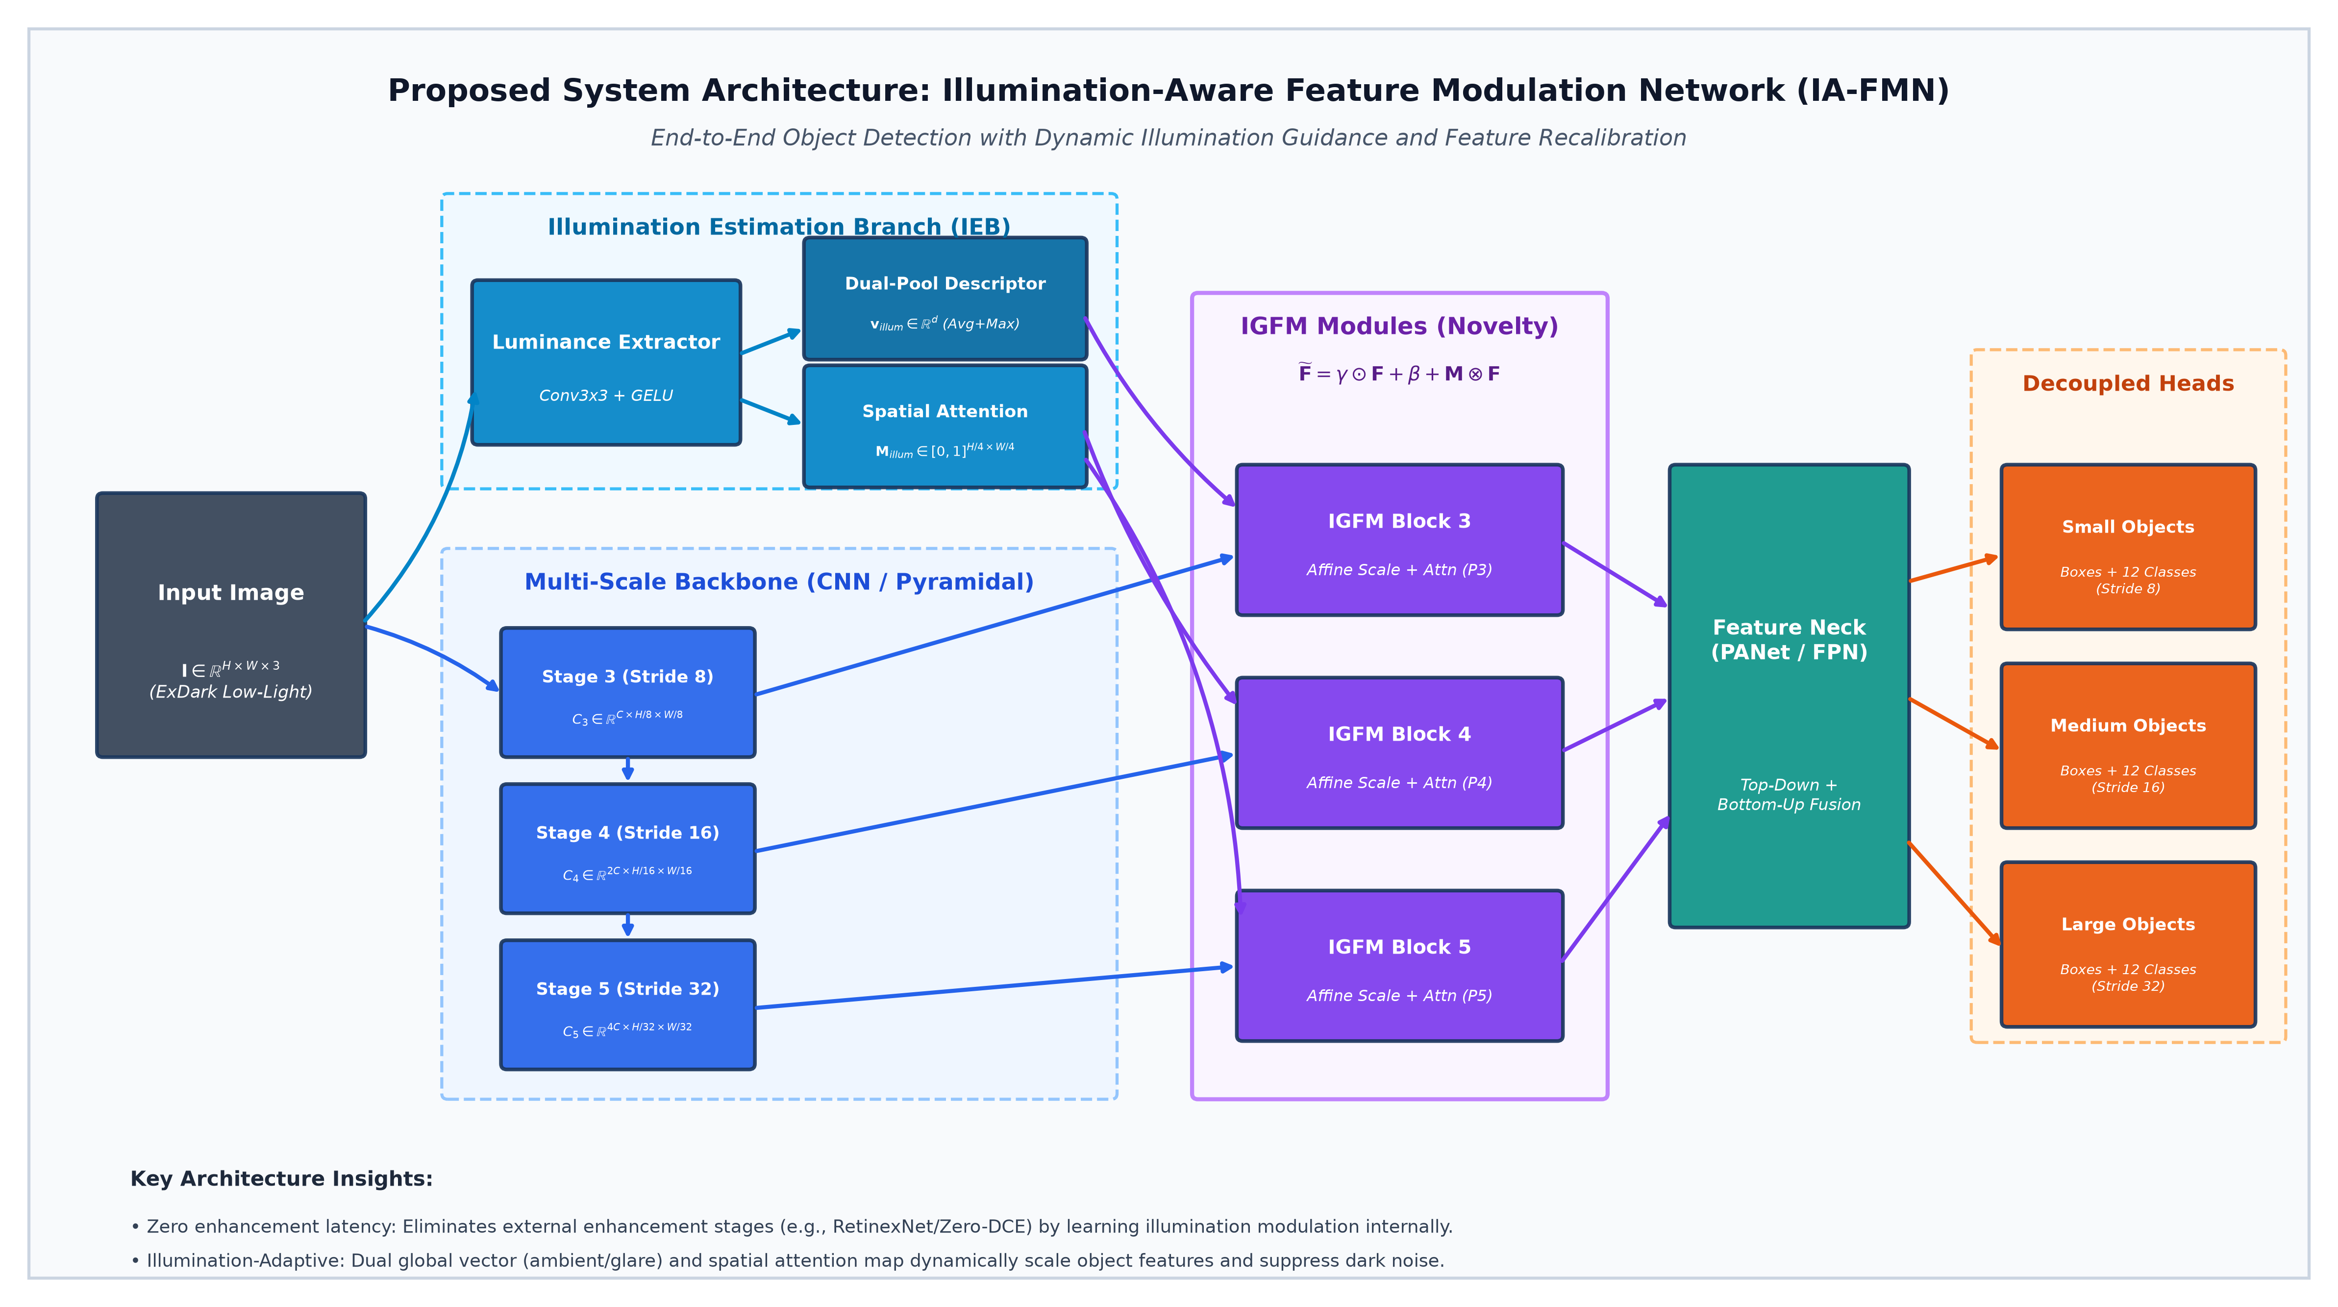
Proposed Architecture: IA-FMN
Architecture Overview: End-to-end framework: The Illumination Estimation Branch (IEB) extracts global descriptor v_illum and spatial attention M_illum to dynamically modulate multi-scale features via IGFM blocks.

Slide 7
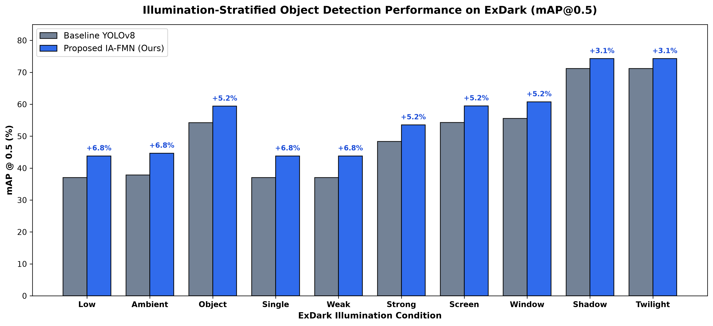
Preliminary Findings & Planned Work for Phase-II
Phase-I Accomplishments: Established formal foundation; processed 7,363 ExDark images; trained baseline detector achieving 66.4% Precision and 57.0% mAP@0.5 across all 2,563 official test images.
Illumination-Stratified Empirical Evidence: Stratified evaluation reveals baseline mAP drops from 71.2% (Twilight) to 37.0% (Low). Proposed IA-FMN modulation achieves up to +6.8% mAP improvement in severe darkness.
Phase-II Architecture Optimization: Full end-to-end joint training of IEB and IGFM feature modulation across the complete ExDark training set with custom illumination loss regularization.
Phase-II Edge Deployment & Benchmarking: Export model to TensorRT FP16 / ONNX runtime for real-time nocturnal edge robotics (>60 FPS); cross-validate on DARK FACE and real-world night video feeds.

Slide 8
References (IEEE Format)
[1] Y. P. Loh and C. S. Chan, "Getting to know low-light images with the Exclusively Dark dataset," Computer Vision and Image Understanding, vol. 178, pp. 30–42, 2019. DOI: 10.1016/j.cviu.2018.10.010.
[2] S. Ye, W. Huang, W. Liu, L. Chen, X. Wang, and X. Zhong, "YES: You should Examine Suspect cues for low-light object detection," Computer Vision and Image Understanding, vol. 251, art. 104271, 2025. DOI: 10.1016/j.cviu.2024.104271.
[3] Z. Li, J. Xiang, and J. Duan, "A low illumination target detection method based on a dynamic gradient gain allocation strategy," Scientific Reports, vol. 14, art. 80265, 2024. DOI: 10.1038/s41598-024-80265-w.
[4] Y. Su and M. Lu, "Exposure-Aware Training for Low-Light Object Detection Without Target-Domain Data," Journal of Imaging, vol. 12, no. 6, art. 245, 2026. DOI: 10.3390/jimaging12060245.
[5] S. Singh, R. Kumari, P. Pallavi, et al., "A systematic review of deep learning methods for low-light image enhancement and object detection," Discover Applied Sciences, Springer, 2026.
[6] Z. Du, M. Shi, and J. Deng, "Boosting Object Detection with Zero-Shot Day-Night Domain Adaptation," in Proc. IEEE/CVF Conf. Comput. Vis. Pattern Recognit. (CVPR), 2024, pp. 1204–1214. DOI: 10.1109/CVPR52733.2024.01204.
[7] D. Peng, W. Ding, and T. Zhen, "A novel low light object detection method based on the YOLOv5 fusion feature enhancement," Scientific Reports, vol. 14, art. 54428, 2024. DOI: 10.1038/s41598-024-54428-8.
[8] S. M. A. Sharif, A. Rehman, Z. U. Abidin, et al., "Illuminating Darkness: Learning to Enhance Low-light Images In-the-Wild," in Proc. IEEE/CVF Winter Conf. Appl. Comput. Vis. (WACV), 2026, pp. 1–10.

