Slide 1
GearVR Framework Tutorial
Lesson 1: Installing GearVRF

Slide 2
GearVRf Installation Steps
Run GearVRf installer
Click on GearVRFInstaller.msi
Select directory to get GearVRF sources and demos
Android Studio Installer is run by GearVRF
JDK Installer is run by GearVRF
Open Android Studio
Set JDK install directory
Set Android SDK install directory
Open and build a GearVRF demo
Select a subdirectory in GearVRf-Demos
Open it as a project in Android Studio
Build and run

Slide 3
JDK Installation
GearVRF Installer Will Install Java Development Kit 8
Default location is C:/Program Files/Java/jdk1.8_073
The installer does not prompt you to change the location
Android Studio may need this path

Slide 4
Android Studio Installation
GearVRF Installer Will Install Android Studio 2.1
Default location is C:/Program Files/Android/Android Studio
Android Studio installs the Android SDK in C:\Users\your.name\AppData\Local\Android\sdk
You can change the Android SDK location
If you have a previous version of Android Studio, the installer will uninstall it for you. The GearVRF installation has been tested with Android Studio 2.1. It will probably work with 2.0 too.

Slide 5
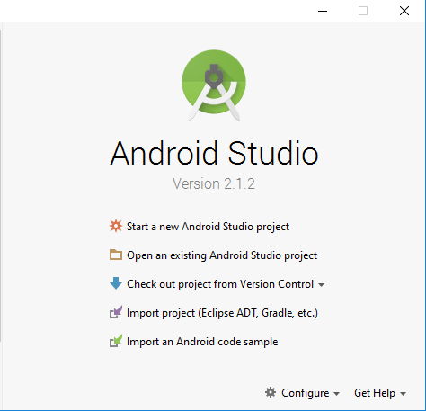
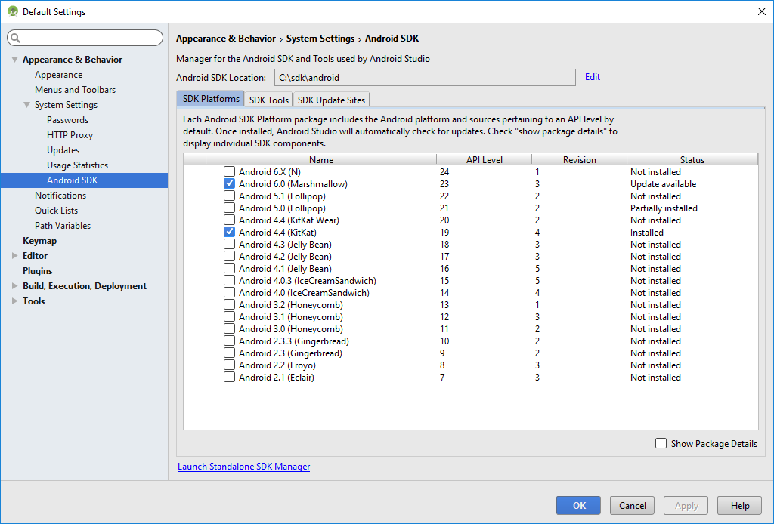
Android Studio Setup
Set Android SDK path
C:\Users\your.name\AppData\Local\Android\sdk
Click on Configure and select SDK Manager
You will get this window
Install Android SDK 19

Slide 6
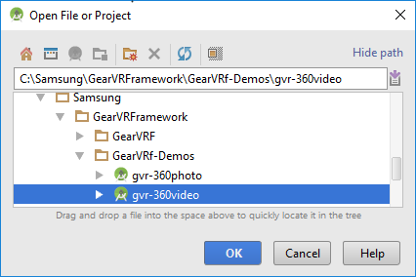

Building a GearVRF Demo
Select one of the demos
You will see this for a long time…
Open an existing Android Studio project

Slide 7
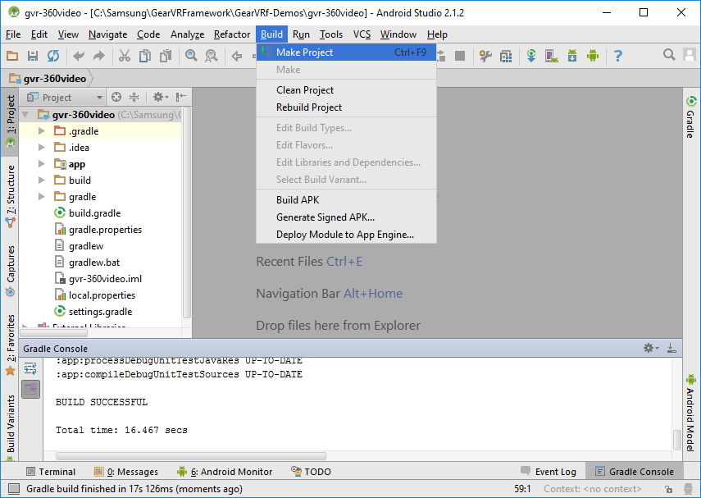
Building a GearVRF Demo
Click on Build / Make Project to build the application
You should eventually see “BUILD SUCCESSFUL” in the Gradle Console

Slide 8
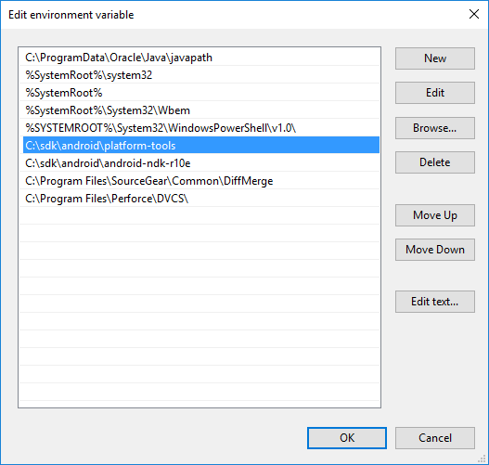
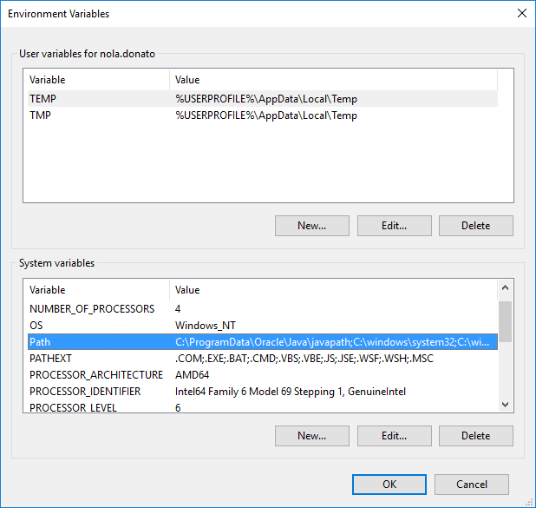
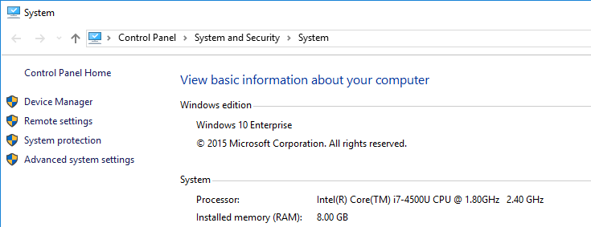
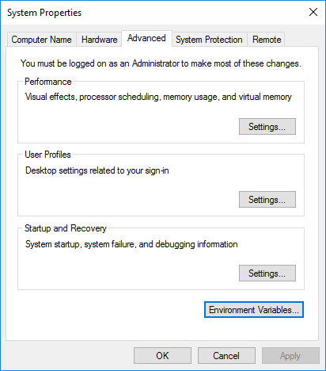

What About ADB?
Android Studio cannot find ADB unless you add the Android SDK platform tools to the PATH environment variable
Add Android SDK platform tools path:
C:\Users\your.name\AppData\Local\Android\sdk\platform-tools
Select advanced settings from control panel
Select environment variables
Select Path environment variable

Slide 9
Homework
Open the lesson 2 tutorial application and run it
GearVRf-Demos/gvr-tutorial-lesson2
Now you are ready for lesson 2

