Slide 1
GearVR Framework Tutorial
Lesson 3: Events and Picking

Slide 2
GearVRf Event Handling
Event Receivers IEventReceiver
Receives events and dispatches to listeners
Contains a list of event listeners
Dispatches events based on event class
Event Listeners IEventListener
Listens for a specific class of event
Implements a handler for the event
Events are used for
Input devices
Control flow
Picking and collisions
Asset loading

Slide 3
Application Events IScriptEvents
GVRActivity
onInit application startup
onTouch touch events
GVRMain
onInit scene startup
onStep every frame
GVRSceneObject
onInit scene startup
onStep every frame
JavaScript or Lua scripts can handle events too
MYMain
GVRScene
MYActivity
onCreate
onTouchEvent
IScriptEvents
onInit
onStep
IScriptEvents
onInit
onStep
Script
onInit
onStep
GVRSceneObject
GVRScriptBehavior
IScriptEvents
onInit
onStep
Script
onInit
onStep

Slide 4
Application Startup
public class MYActivity extends GVRActivity { MYMain main = new MYMain(); @Override protected void onCreate(Bundle icicle) { super.onCreate(icicle); setMain(main, "gvr.xml"); } @Override public boolean onTouchEvent(MotionEvent event) { main.onTouchEvent(event); return super.onTouchEvent(event); } }

Slide 5

Colliders
GVRCollider component provides simplified collision mesh
Sphere or bounding box collider optimizes collision detection
Mesh collider slower but more precise
Colliders are used for picking and cursors
Picking: collision with a ray
Cursor: collision with a sphere
Collider Types
GVRMeshCollider – mesh or mesh bounding box
GVRSphereCollider - sphere
Scene Object
Transform
Collider calculates center from scene object transform
RenderData
SphereCollider
radius
Mesh
Collider calculates radius from mesh bounding box if none provided

Slide 6
Attaching a Collider
Here we update the makeBalloon function from lesson 2 to attach a collider. The collider will automatically calculate the radius from the bounding box but it will not be the real radius of the sphere mesh which is 1.0
GRSceneObject makeBalloon(GVRContext context) { GVRSceneObject sphere = new GVRSphereSceneObject(context, true); GVRRenderData rdata = sphere.getRenderData(); GVRMaterial mtl = new GVRMaterial(context); GVRSphereCollider collider = new GVRSphereCollider(context); collider.setRadius(1.0f); sphere.attachComponent(collider); mtl.setDiffuseColor(1.0f, 0.0f, 1.0f, 0.5f); sphere.setName("balloon"); rdata.setShaderTemplate(GVRPhongShader.class); rdata.setAlphaBlend(true); rdata.setMaterial(mtl); rdata.setRenderingOrder(GVRRenderingOrder.TRANSPARENT); sphere.getTransform().setPositionZ(-3.0f); return sphere; }

Slide 7
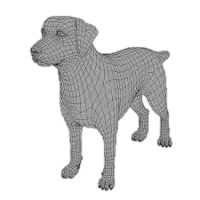
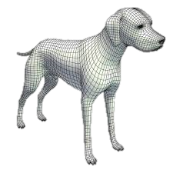

Picking
Calculates positions where a ray hits each collider and sorts based on distance from the ray origin
If the ray originates at the camera and follows its orientation you will pick what the viewer sees
Hit point will be with respect to the collider in local coordinates
It will not be a point on the mesh unless it is a GVRMeshCollider

Slide 8
GVRPicker
Picking component GVRPicker
Computes picking ray from scene object transform
Origin is the position of the scene object (0, 0, 0)
Direction is forward axis of camera (0, 0, -1)
Generates picking events each frame
onEnter – ray enters collider
onExit – ray exits collider
onInside – ray inside collider
onPick – sorted list of picked objects
onNoPick – nothing was picked this frame
Picking events are sent to the scene
IPickEvents is the event listener class
GVRScriptBehavior routes pick events to the attached script

Slide 9
Picking Event Handler Example
This example remembers the object closest to the camera and sets its diffuse color to pink when it is picked and red when it is not.
public class PickHandler implements IPickEvents { public GVRSceneObject PickedObject = null; public void onEnter(GVRSceneObject sceneObj, GVRPicker.GVRPickedObject pickInfo) { } public void onExit(GVRSceneObject sceneObj) { } public void onNoPick(GVRPicker picker) { if (PickedObject != null) { PickedObject.getRenderData().getMaterial().setDiffuseColor(1, 0, 0, 0.5f); } PickedObject = null; } public void onPick(GVRPicker picker) { GVRPickedObject picked = picker.getPicked()[0]; PickedObject = picked.hitObject; PickedObject.getRenderData().getMaterial().setDiffuseColor(1, 0, 1, 0.5f); } public void onInside(GVRSceneObject sceneObj, GVRPicker.GVRPickedObject pickInfo) { } }

Slide 10
Listening to Pick Events
private PickHandler mPickHandler;
public void onInit(GVRContext context)
{ mScene = context.getNextMainScene(); mScene.getMainCameraRig().getLeftCamera().setBackgroundColor(1.0f, 1.0f, 1.0f, 1.0f); mScene.getMainCameraRig().getRightCamera().setBackgroundColor(1.0f, 1.0f, 1.0f, 1.0f); mScene.getMainCameraRig().getOwnerObject().attachComponent(new GVRPicker(context, mScene)); mPickHandler = new PickHandler(); mScene.getEventReceiver().addListener(mPickHandler); }
Attach a GVRPicker to the camera scene object and add a listener to the GVRScene for pick events
public void onTouchEvent(MotionEvent event) { switch (event.getAction() & MotionEvent.ACTION_MASK) { case MotionEvent.ACTION_DOWN: if (mPickHandler.PickedObject != null) { mPickHandler.PickedObject.getRenderData().getMaterial().setDiffuseColor(0, 0, 1, 1); } break; default: break; } }
Listen for application touch events and change the color of the picked object to blue on a touch event

Slide 11
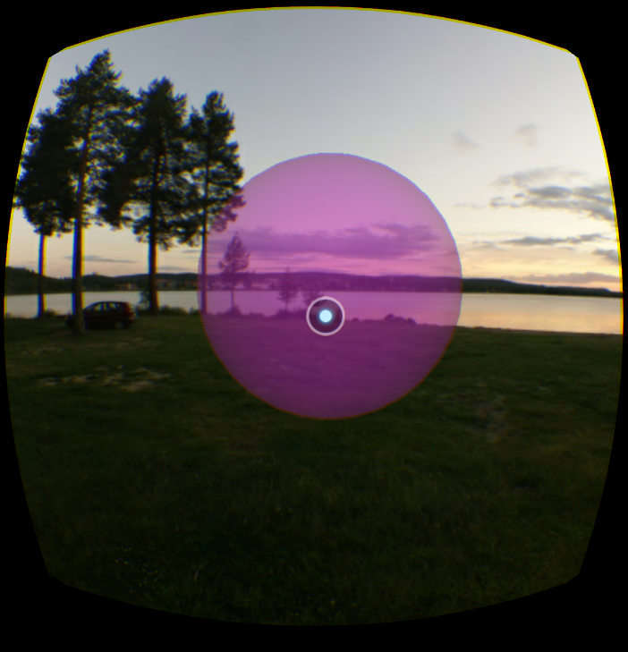



Lesson 3 Scene Graph
Transform
root
camera
rig
Transform
CameraRig
Picker
Mesh
headtracker
Transform
RenderData
Material
environment
Transform
RenderData
DirectLight
balloon
Transform
RenderData
Mesh
Material
SphereCollider
Mesh
Material

