Slide 1
GearVR Framework Tutorial
Lesson 5: Sound and Text

Slide 2
Sound Effects
GearVRF uses Android for sound
SoundPool sound effects
MediaPlayer music
CardboardAudioEngine 3D spatial sound
Lesson Example: balloon popping sound
Play the balloon pop when the user touches the pad while the cursor is inside one of the balloons
Implement as a Sound component
Preload the balloon pop sound
Play on a touch event

Slide 3
SoundEffect Component (setup)
SoundEffect component preloads a sound effect from the Android sound pool when it is constructed.
public class SoundEffect extends GVRBehavior
{
private SoundPool mPlayer;
private int mSoundID;
private boolean mLoop;
private float mVolume = 1.0f;
static private long TYPE_SOUND_EFFECT = newComponentType(SoundEffect.class);
public SoundEffect(GVRContext ctx, final SoundPool soundPool, String soundFile, boolean loop) throws IOException
{
super(ctx);
mType = TYPE_SOUND_EFFECT;
mLoop = loop;
mPlayer = soundPool;
AssetFileDescriptor descriptor = ctx.getContext().getAssets().openFd(soundFile);
mSoundID = mPlayer.load(descriptor, 1);
descriptor.close();
}
static public long getComponentType() { return TYPE_SOUND_EFFECT; }

Slide 4
SoundEffect Component (play)
public void setVolume(float v)
{
mVolume = v;
}
public float getVolume() { return mVolume; }
public void setLooping(boolean loop) { mLoop = loop; }
public boolean isLooping() { return mLoop; }
public void play()
{
if ((mPlayer != null) && (mSoundID != 0))
{
int loop = mLoop ? 1 : 0;
mPlayer.play(mSoundID, mVolume, mVolume, 1, loop, 1);
}
}
public void stop()
{
if ((mPlayer != null) && (mSoundID != 0))
{
mPlayer.stop(mSoundID);
}
}
Add functions for playing and stopping the sound, setting the volume and controlling looping

Slide 5
Using the SoundEffect Component
public void onInit(GVRContext gvrContext) {
mAudioEngine = new SoundPool(4, AudioManager.STREAM_MUSIC, 0);
try
{
mPopSound = new SoundEffect(gvrContext, mAudioEngine, "pop.wav", false);
mPopSound.setVolume(0.6f);
}
catch (IOException ex)
{
Log.e("Audio", "Cannot load pop.wav");
}
Create a SoundEffect component and preload the pop sound file
public void onHit(GVRSceneObject sceneObj)
{
Particle particle = (Particle) sceneObj.getComponent(Particle.getComponentType());
if (particle != null)
{
mPopSound.play();
mParticleSystem.stop(particle);
}
}
Play the sound effect when a particle is hit

Slide 6
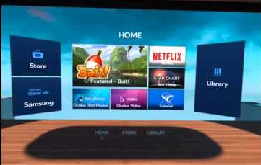
View Scene Objects
GVRViewSceneObject
Scene object maps external texture onto mesh
Android canvas drawn onto external texture
Maps Android canvas as a texture onto any 3D object
GVRTextViewSceneObject displays 2D text in the scene
Subclass of GVRViewSceneObject
2D text is drawn on the canvas
Rendered on a flat quad in the scene
Display Android GUI in GearVRF scene

Slide 7
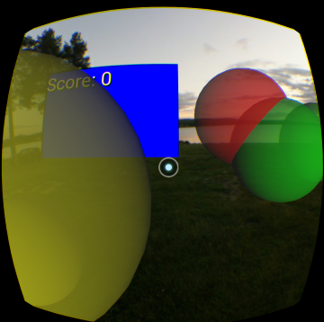
Adding a Scoreboard
GVRTextViewSceneObject makeScoreboard(GVRContext ctx)
{
GVRTextViewSceneObject scoreBoard = new GVRTextViewSceneObject(ctx, 3, 2, "Score: 0");
GVRRenderData rdata = scoreBoard.getRenderData();
scoreBoard.getTransform().setPosition(-1.2f, 1.2f, -3.0f);
scoreBoard.setTextColor(Color.YELLOW);
scoreBoard.setBackgroundColor(Color.BLUE);
return scoreBoard;
}
Add a scoreboard using GVRTextViewSceneObject to display the current score in the upper left corner of the scene
Attach it to the head tracker scene object under the camera.
public void onInit(GVRContext gvrContext) {
. . . .
GVRSceneObject headTracker = new GVRSceneObject(gvrContext, . . .
mScene.getMainCameraRig().addChildObject(headTracker);
mScene.addSceneObject(makeBackground(mGVRContext));
mScoreBoard = makeScoreboard(mGVRContext);
headTracker.addChildObject(mScoreBoard);

Slide 8
Game Logic
public void onTouchEvent(MotionEvent event)
{
if (mGameOver)
{
gameStart();
return;
}
. . .
private boolean mGameOver = false;
private Timer mTimer;
private Integer mScore;
public void onInit(GVRContext context) {
. . . .
mTimer = new Timer();
TimerTask gameOver = new TimerTask()
{
public void run() { gameOver(); }
};
long oneMinute = 60 * 1000;
mTimer.schedule(gameOver, oneMinute);
}
If the user taps when the game is finished, the scoreboard is reset and another game starts.
The game runs for one minute. When the game timer elapses, gameOver is called to change the scoreboard to red and ask to play again.
public void gameStart()
{
mScoreBoard.getTransform().setPosition(-1.2f, 1.2f, -3.0f);
mScoreBoard.setBackgroundColor(Color.BLUE);
mScore = 0;
mScoreBoard.setText("Score: 0");
mGameOver = false;
mParticleSystem.setEnable(true);
}
public void gameOver()
{
mParticleSystem.setEnable(false);
mScoreBoard.getTransform().setPosition(0, 0, -2);
mScoreBoard.setBackgroundColor(Color.RED);
mScoreBoard.setText(mScoreBoard.getTextString() + "\nTap to play again");
mGameOver = true;
}

Slide 9
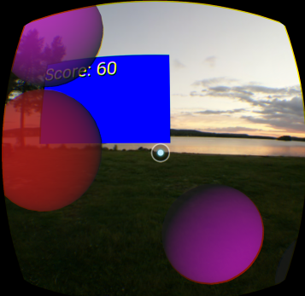
Scoring
Update the score based on the balloon velocity. It is harder to hit the faster ones so they count more. Don’t score points if the game is over.
public void onHit(GVRSceneObject sceneObj)
{
Particle particle = (Particle) sceneObj.getComponent(Particle.getComponentType());
if (!mGameOver && (particle != null))
{
mPopSound.play();
mParticleSystem.stop(particle);
mScore += Math.round(particle.Velocity);
mScoreBoard.setText("Score: " + mScore.toString());
}
}

Slide 10




Lesson 5 Scene Graph
Transform
root
camera
rig
Transform
CameraRig
Picker
Mesh
headtracker
Transform
RenderData
Material
scoreboard
Transform
RenderData
environment
Mesh
particleRoot
Transform
RenderData
DirectLight
Transform
Material
Score: 10
balloon0
Mesh
Material
ParticleEmitter
Transform
Particle
balloon1
Transform
RenderData
Particle
SphereCollider
RenderData
Mesh
Mesh
Material1
Material0
SphereCollider

