Slide 1
GearVR Framework Tutorial
Lesson 6: Working with Assets

Slide 2
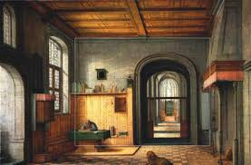
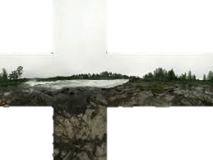
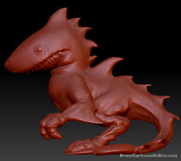
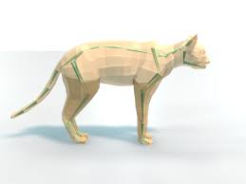
Art Assets
Art assets are created by artists
Produced with digital content creation tools (Max, Photoshop, Maya)
Usually binary data – meshes and textures
Can describe an entire scene with animations (X3D, FBX)
Examples of assets
cubemap texture
3D model
Skinned character
Complex scene

Slide 3
Loading Assets in GearVRF
GVRAssetLoader loads 3D models and their textures
loadModel() functions load 3D a model and return the scene graph
The textures used by the model are also loaded
Callers can observe asset load events
File formats: fbx, obj, 3ds, x3d, dae
GVRPhongShader template is used on imported assets to allow multiple lights
GVRContext loads independent textures
Can load asynchronously or synchronously
Supports cube maps and compressed textures
File formats: png, jpg (not tiff, tga)

Slide 4


Loading a 3D Model
Original model is too large and oriented wrong
GVRSceneObject boardFrame = null;
try
{
boardFrame = ctx.loadModel("mirror.3ds");
GVRSceneObject.BoundingVolume bv = boardFrame.getBoundingVolume();
GVRTransform trans = boardFrame.getTransform();
float sf = 1.5f / bv.radius;
trans.setScale(sf, sf, sf);
trans.rotateByAxis(-90.0f, 0, 1, 0);
trans.rotateByAxis(90.0f, 0, 0, 1);
bv = boardFrame.getBoundingVolume();
trans.setPosition(-bv.center.x, -bv.center.y, -bv.center.z + 0.1f);
scoreBoard.addChildObject(boardFrame);
}
catch (IOException ex)
{
Log.e("Balloons", "Cannot load scoreboard frame " + ex.getMessage());
}
Scale to fit desired area and rotate to orient properly

Slide 5
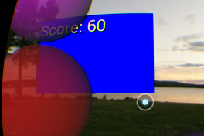
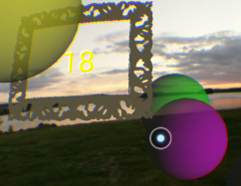
Improving the Scoreboard
Put a nice frame around the scoreboard, center the score and make the background transparent
GVRTextViewSceneObject makeScoreboard(GVRContext ctx, GVRSceneObject parent)
{
GVRTextViewSceneObject scoreBoard = new GVRTextViewSceneObject(ctx, 2.0f, 1.5f, "000");
GVRRenderData rdata = scoreBoard.getRenderData();
GVRCollider collider = new GVRMeshCollider(ctx, true);
collider.setEnable(false);
scoreBoard.attachComponent(collider);
scoreBoard.setTextColor(Color.YELLOW);
scoreBoard.setBackgroundColor(Color.argb(0, 0, 0, 0));
scoreBoard.setGravity(Gravity.CENTER_VERTICAL | Gravity.CENTER_HORIZONTAL);
rdata.setDepthTest(false);
rdata.setAlphaBlend(true);
rdata.setRenderingOrder(GVRRenderingOrder.OVERLAY);
GVRSceneObject boardFrame = . . . .
parent.addChildObject(scoreBoard);
return scoreBoard;
}

Slide 6
Game Logic
Position the scoreboard in the upper left corner and enlarge the text when the game starts. Disable picking on the scoreboard.
public void gameStart()
{
mScoreBoard.getTransform().setPosition(-1.2f, 1.2f, -2.2f);
mScore = 0;
mScoreBoard.setTextSize(15.0f);
mScoreBoard.setText("000");
mScoreBoard.getCollider().setEnable(false);
mParticleSystem.setEnable(true);
Timer timer = new Timer();
TimerTask gameOver = new TimerTask()
{
public void run() { gameOver(); }
};
timer.schedule(gameOver, 60 * 1000);
}
Position the scoreboard in the center and shrink the text when the game ends. Enable picking on the scoreboard and start the game over when it is picked.
public void gameOver()
{
mParticleSystem.setEnable(false);
mScoreBoard.getTransform().setPosition(0, 0, -1.0f);
mScoreBoard.getCollider().setEnable(true);
mScoreBoard.setTextSize(10.0f);
mScoreBoard.setText(mScoreBoard.getTextString() + "\nTap to play again");
}

Slide 7
Conclusion
We hope this tutorial has been helpful in learning how to use the GearVR Framework.
Visit www.gearvrf.org for more information about GearVRF

